Slide 1
Barcelona, 14 January 2016
EARTH SYSTEM SERVICES
Earth Sciences Department at BSC
Raül Marcos – Nube González-Riviriego

Slide 2
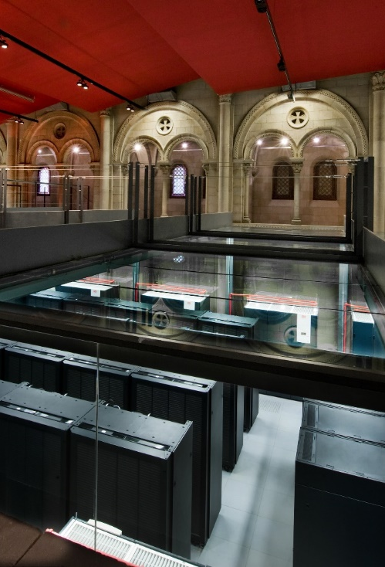
Barcelona Supercomputing Center
Created in 2005; more than 450 employees
BSC-CNS hosts MareNostrum, the most powerful supercomputer in Spain.
part of the PRACE Resarch Infrastructure, a pan-European supercomputing infrastructure currently available for European scientists.
Research, develop and manage information technology
Facilitate scientific progress and its application in society
Notes:
For the wind energy sector they have been working on seasonal wind speed and capacity factor predictions. Based in the European center predictions they have been doing research on methods to improve these predictions and better adjust them to the sector needs [this is related to Research added value box]. On top of that they have an active and constant contact with stakeholders and users to ensure that this applied research is truly user-driven and tailored to the sector needs. [related to Climate service added value box]

Slide 3
Earth Sciences Department structure
EARTH SCIENCES DEPARTMENT (BSC-ES)
Computational Earth Sciences (CES)
HPC, software development and IT support
Climate Predictions (CP)
Research line on climate modelling
at sub-seasonal to decadal scales
Atmospheric Composition (AC)
Research line on air quality and mineral dust modelling
Management
Earth System Services (ESS)
Knowledge and technology transfer
Notes:
For the wind energy sector they have been working on seasonal wind speed and capacity factor predictions. Based in the European center predictions they have been doing research on methods to improve these predictions and better adjust them to the sector needs [this is related to Research added value box]. On top of that they have an active and constant contact with stakeholders and users to ensure that this applied research is truly user-driven and tailored to the sector needs. [related to Climate service added value box]

Slide 4
Research lines: - Climate services - Atmospheric Composition

Slide 5
Added value of the Earth System Services group to the seasonal forecasting approach for the Energ
CLIMATE SERVICES ADDED VALUE
RESEARCH ADDED VALUE
User-defined information: timescales, domain, var…
User interface Platform:
E.g. Resilience prototype
Knowledge transfer: Technical reports and factsheets
Performance assessment: demonstrating value for decision making
SEASONAL
PREDICTIONS
Forecast quality assessment: comparison to observations
Bias adjustment: model correction
Seasonal predictability: teleconnections
Data management
NMME, EUROSIP
Global domain
Aggregated output in terciles
Forecast of extremes
Notes:
For the wind energy sector they have been working on seasonal wind speed and capacity factor predictions. Based in the European center predictions they have been doing research on methods to improve these predictions and better adjust them to the sector needs [this is related to Research added value box]. On top of that they have an active and constant contact with stakeholders and users to ensure that this applied research is truly user-driven and tailored to the sector needs. [related to Climate service added value box]

Slide 6
BSC partnership in EU Projects in climate services
SPECS: Seasonal-to-decadal climate Prediction for the improvement of European Climate Services
EUPORIAS: EUropean Provision Of Regional Impact Assessment on a Seasonal-to-decadal timescale
NEWA: New European Wind Atlas
PRIMAVERA: Process-based climate simulation: advances in high-resolution modelling and European climate risk assessment
IMPREX: Improving predictions and management of hydrological Extremes
VISCA: Climate Service (CS) and Decision Support System (DSS) that integrates climate, agricultural and end-users´ specifications for wine sector.
CLIM4ENERGY: Climate for Energy
Notes:
The Services group carries out research related to atmospheric and Climate services in a number of sectors like Renewable energies, Agriculture, Water management or sustainable urban development. These are some of the European projects where the Services group participates in applied research for economic sectors and user-engagement

Slide 7
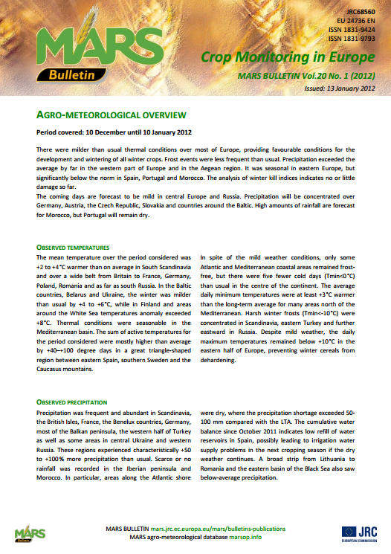
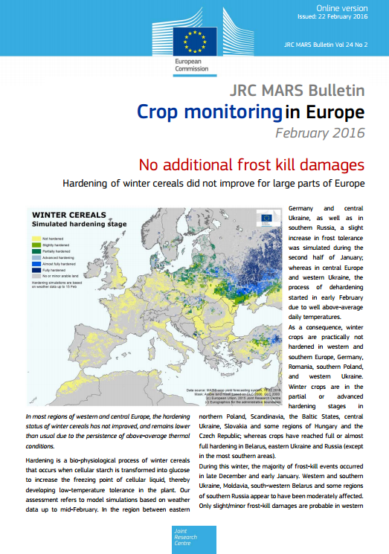
Seasonal forecasts for food security
Agreement with the Joint Research Center for exploring how the MARS Crop Yield Forecasting System (MCYFS) could ingest the seasonal forecast after bias adjustment and downscaling (when required) for a future operational use
Notes:
Renewable energies are a key sector for services but they are also involved in projects related to Agriculture. They have a contract with the Joint Research Centre to study how to implement seasonal predictions of agriculture relevant variables into the Monitoring Agriculture Resources system (MARS) of the JRC. [Agriculture can benefit from seasonal predictions as it can inform on specific aspects of crop planning (i.e. budburst, ripening, harvesting, pruning, defoliation, etc.)]

Slide 8
Thank you!
For further information please contact
info-services-es@bsc.es

