Slide 1
Boulder, September 20th, 2018
How skilful are the multi-annual forecast of Atlantic hurricanes?
L-P Caron, L Hermanson, A Dobbin, J Imbers, L Lledó, G.A. Vecchi

Slide 2
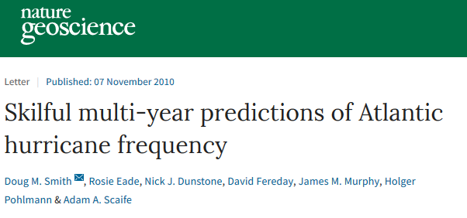
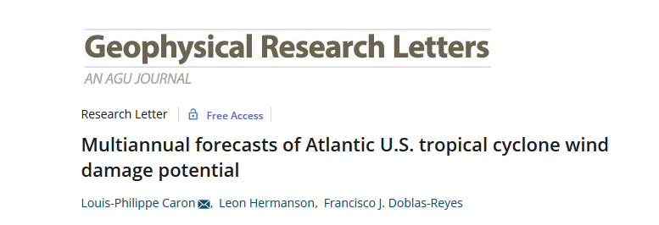
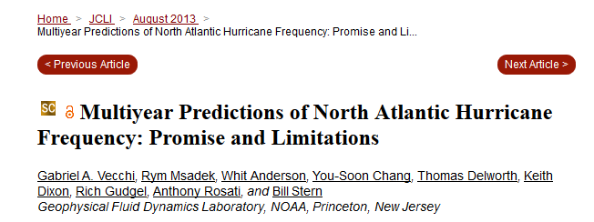
A success story!

Slide 3
A success story!
But difficult to compare due to variations in the methodology

Slide 4
3 different techniques
Technique | Type | Summary
Cyclone tracking | Dynamical | Hurricane numbers are obtained directly by tracking local minima in surface pressure over the tropical Atlantic
Relative SST (Vecchi et al., 2011) | Hybrid | Hurricane numbers are estimated through a statistical model with 2 predictors: mean June-Nov SST over 1) tropical Atlantic and 2) the entire tropics
AMO index (Klotzbach and Gray, 2008) | Hybrid | Hurricane numbers are estimated using a climate index (AMO) correlated with low-frequency hurricane variability. (Atlantic SST and MSLP)

Slide 5
3 different techniques
Technique | Type | Summary
Cyclone tracking | Dynamical | Hurricane numbers are obtained directly by tracking local minima in surface pressure over the tropical Atlantic
Relative SST (Vecchi et al., 2011) | Hybrid | Hurricane numbers are estimated through a statistical model with 2 predictors: mean June-Nov SST over 1) tropical Atlantic and 2) the entire tropics
AMO index (Klotzbach and Gray, 2008) | Hybrid | Hurricane numbers are estimated using a climate index (AMO) correlated with low-frequency hurricane variability. (Atlantic SST and MSLP)
Compare average year 1-5

Slide 6
Dynamical Forecast
Hybrid Forecast (x2)
GCMs
GCMs
Dynamical
Forecast
Cyclone tracking
Future SSTs
or MSLP
Statistical
Downscaling
Future TCs
Future TCs

Slide 7
Dynamical Forecast
Hybrid Forecast
GCMs
GCMs
46 members from 4 CGCMs:
HadCM3
MIROC5
MPI-ESM
GFDL-CM2.1
33 members from 3 versions of the Met Office model
Dynamical
Forecast
Cyclone tracking
Future SSTs
or MSLP
Statistical
Downscaling
Future TCs
Future TCs

Slide 8
Dynamical Forecast
Hybrid Forecast
RMS
GCMs
GCMs
Past SSTs
Past climate
(SST, TCs)
Dynamical
Forecast
Statistical
Forecast
Cyclone tracking
Future SSTs
or MSLP
Future SSTs
Statistical
Downscaling
Statistical
Model
Future TCs
Future TCs
Future TCs

Slide 9
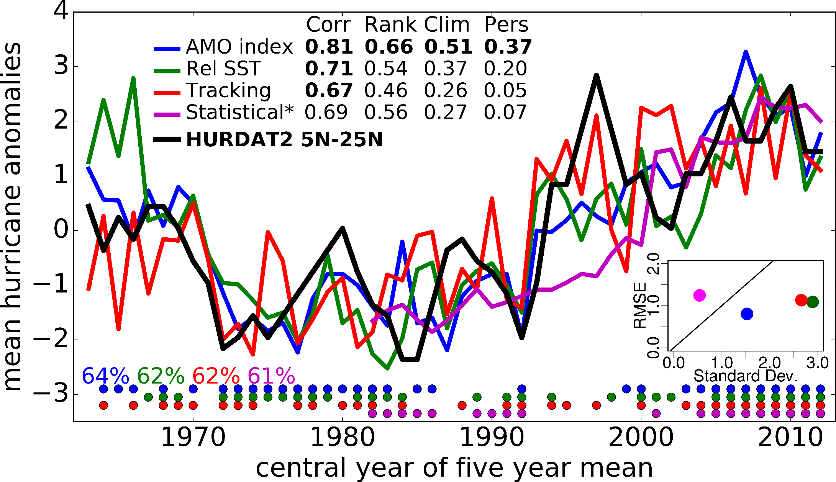
Skill, average year 1-5
RMSS

Slide 10
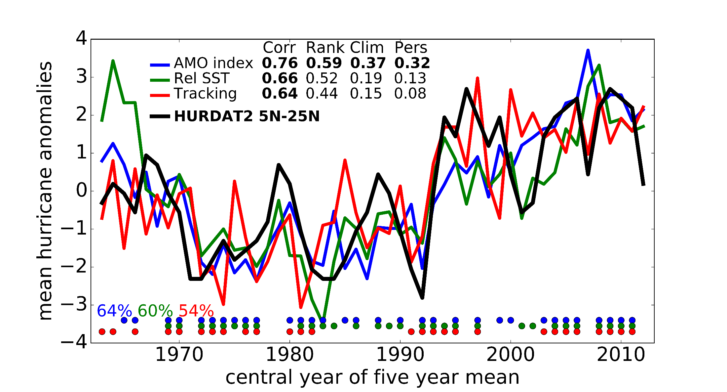
Skill, average year 2-5
RMSS

Slide 12
Weather roulette
Hagedorn and Smith (2009)
Competition between 2 forecasts:
Player (your forecast system)
The house (reference forecast)
Both compete in providing the best forecast

Slide 13
Weather roulette
Player starts with an initial amount of (e.g. 10€)

Slide 14
Weather roulette
Player starts with an initial amount of (e.g. 10€)
The player bets according to the odds given by his/her forecast, for each category:
Above average
How active will the next 5 hurricane seasons be?
Average
Below average

Slide 15
Weather roulette
Player starts with an initial amount of (e.g. 10€)
The player bets according to the odds given by his/her forecast, for each category:
For example:
Above average
Average
Below average
29%
52,7%
For our hurricane forecast system, the odds are given by the number of ensemble members.
18,3%

Slide 16
Weather roulette
Player starts with an initial amount of (e.g. 10€)
The player bets according to the odds given by his/her forecast, for each category:
For example:
Above average
Average
Below average
29%
52,7%
5,27€
1,83€
18,3%
2,9€

Slide 17
Weather roulette
After the first round, the money bet on the wrong terciles is lost.
The player’s return is given by
$\frac{\text{1}}{p_{baseline}(ν)}$
$p_{baseline}\left(ν\right)$: probability of verifying tercile
All the player’s money is invested in the next round
33,3%
33,3%
(e.g. clim 1/0.33 -> x3)
33,3%

Slide 18
10€
2,9€
1,83€
5,27€
2,9€ x 3= 8,7€
0,17€
0,87€
7,65€
7,65€ x 3= 22,97€
…
1 round per start date: 50 rounds.

Slide 19
Weather roulette
For each round, the return ratio r is given by
$$r=\frac{p(ν)}{p_{baseline}(ν)}$$
Where $p(ν)$: probability verifying tercile for each round
The skill R of the forecast system is given by the geometric average of the return ratios r:
$$R=\sqrt[n]{\prod_{i=1}^{n}{r_{i}}}$$
A forecast more skillful than a baseline will return R>1
Effective yearly interest rate is given by R-1

Slide 20
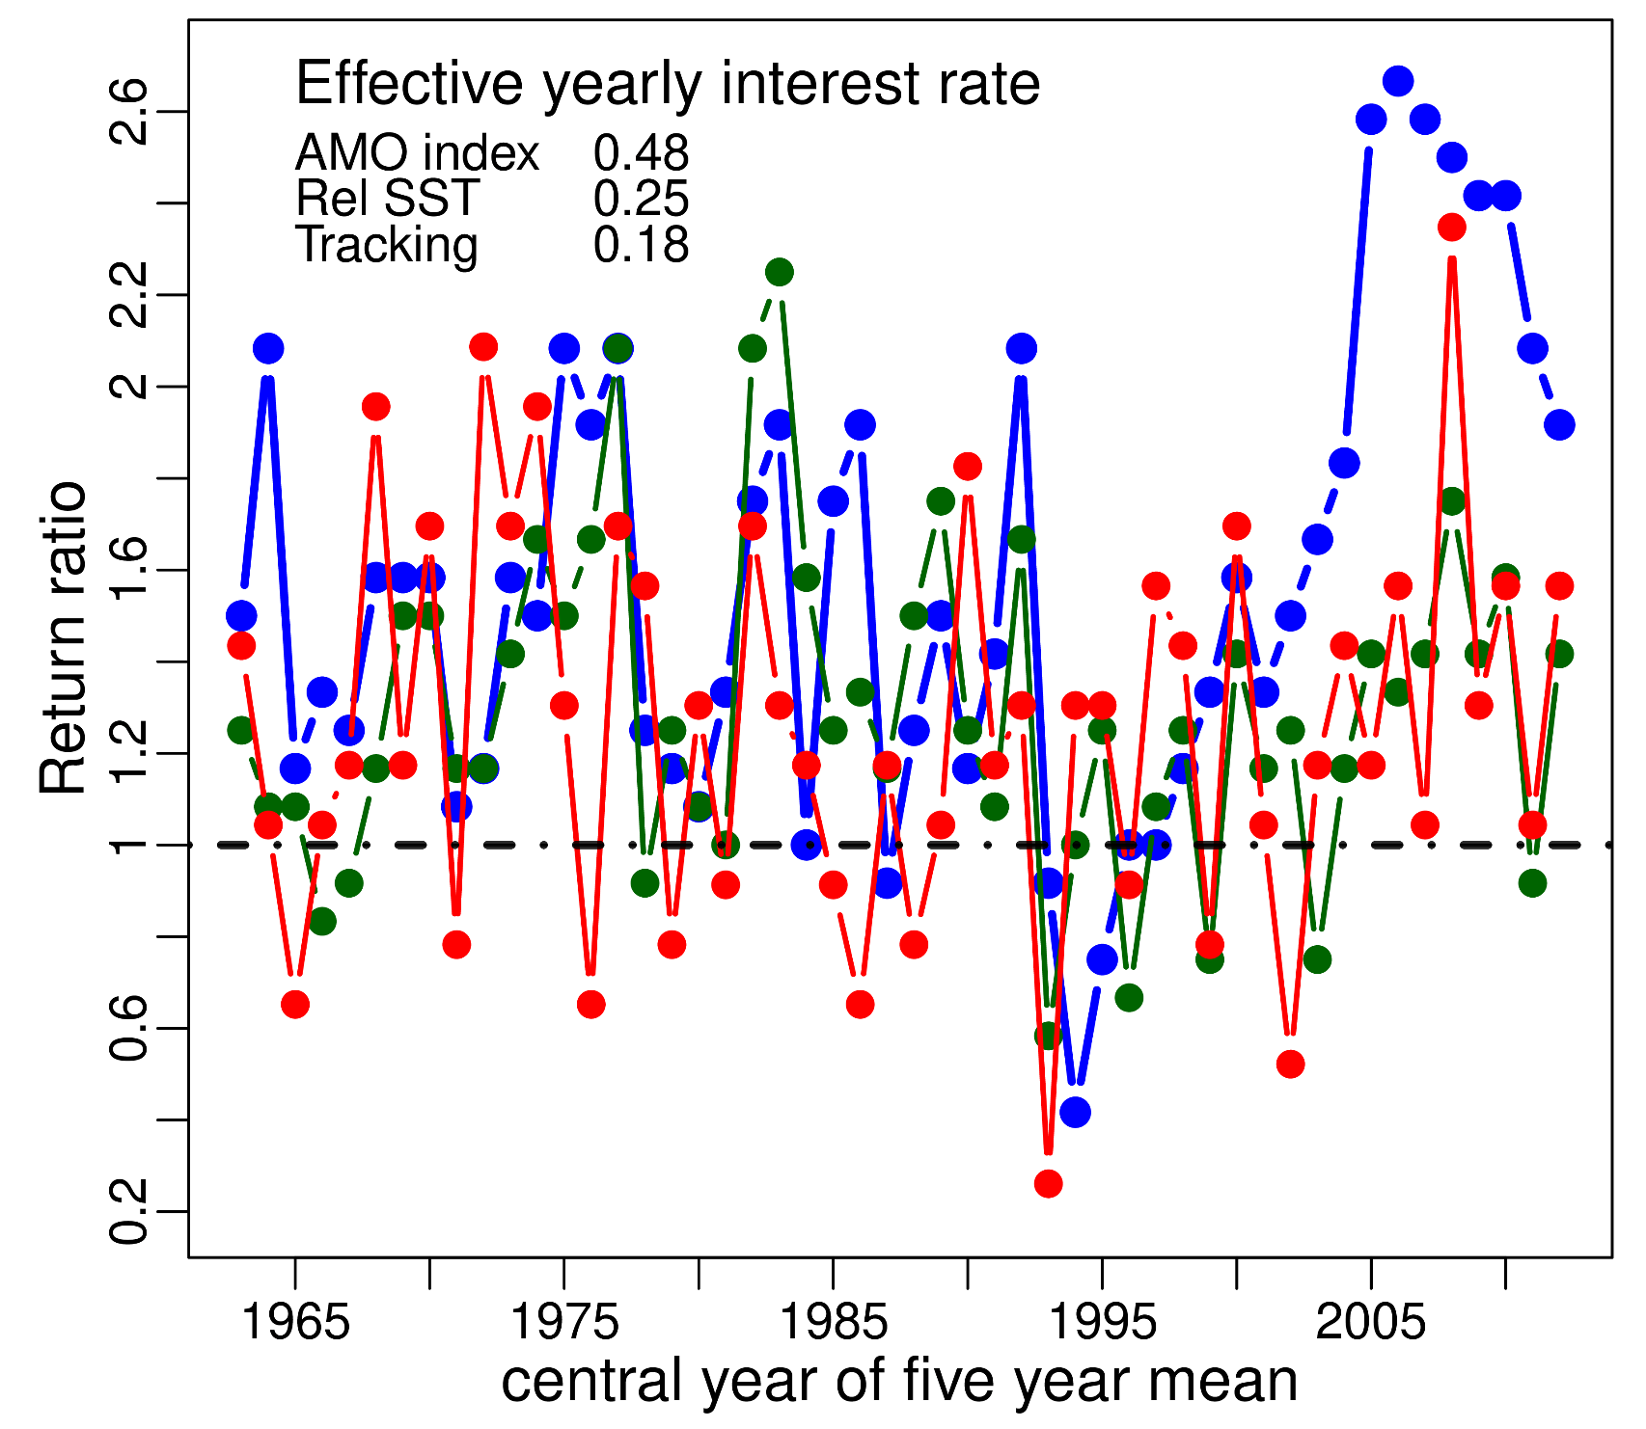
Performance against climatology

Slide 21
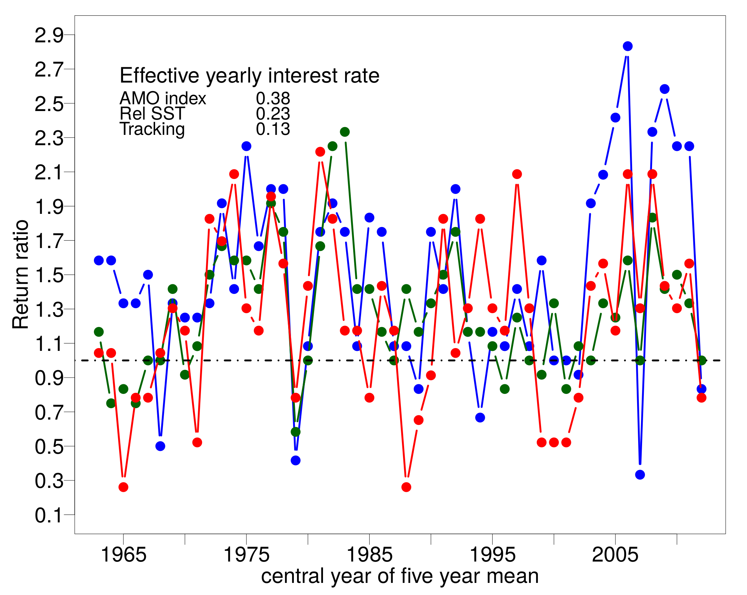
Performance against climatology (2-5)

Slide 22
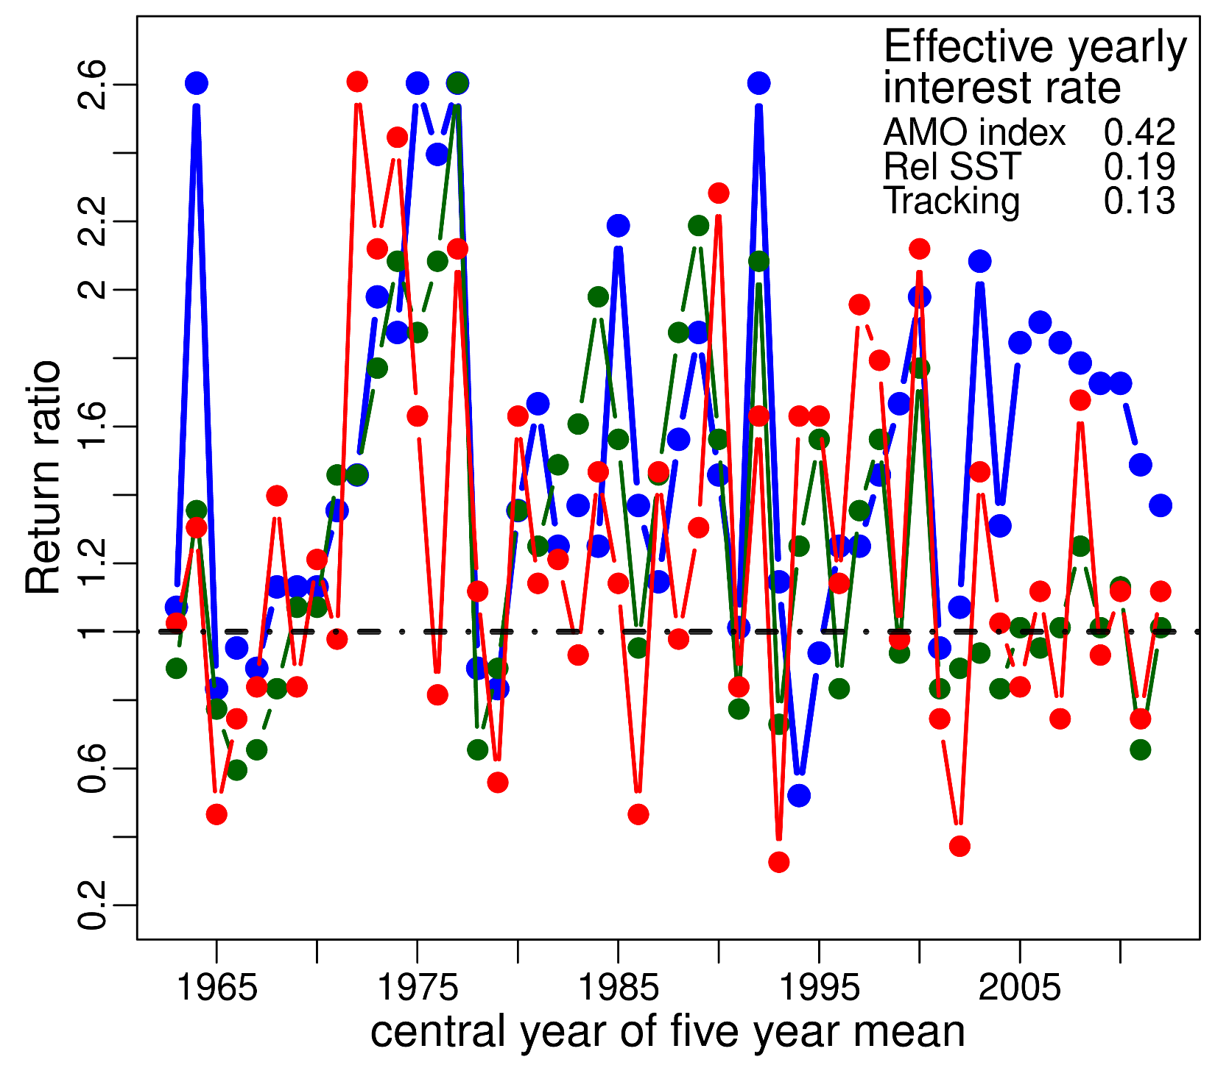
Performance against persistence

Slide 23
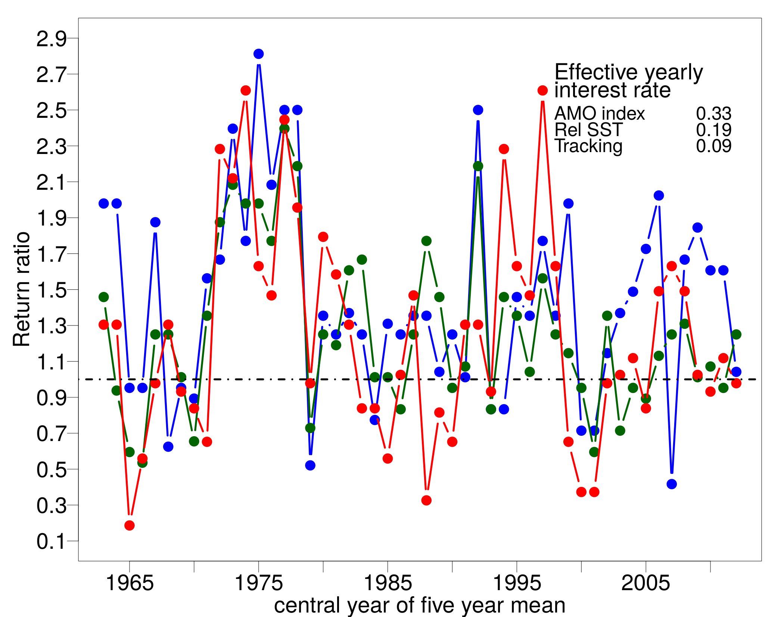
Performance against persistence (2-5)

Slide 24
How skilful are the multi-annual forecast of Atlantic hurricanes? Better than climatological forecasts Probably better, or at least equivalent to, 10-year persistence forecasts
Caron et al. (2018) Bull. Amer. Meteor. Soc., 99 (2), 403-413.

Slide 25
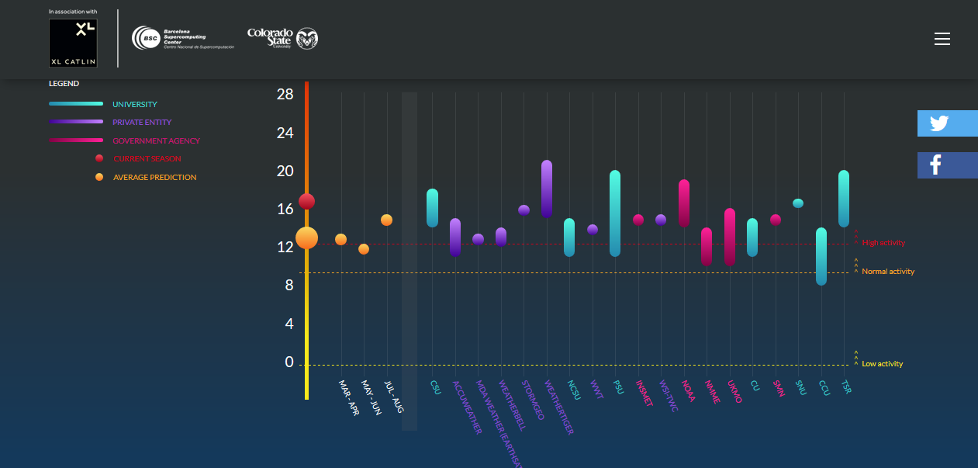
www.seasonalhurricanepredictions.org
Number of tropical cyclones
Number of hurricanes
Number of major hurricanes (cat 3-5)
Accumulated Cyclone Energy
Forecasts are issued from late March to early August

Slide 26
http://www.seasonalhurricanepredictions.org
Contributing Forecast Groups
Mix of
Private vendors
Universities
Government Agencies
21 groups in 2017
26 groups in 2018

Slide 27
We’re hiring https://www.bsc.es/join-us/job-opportunities Deadline: October 1st

Slide 28
Thank you!
You get to play with it
Won’t be finished for another 10 years (at least)
Never so empty
(Disclosure)
Salary not comparable

Slide 29
Thank you!
For further information please contact
louis-philippe.caron@bsc.es

