Slide 1
WGSIP
Francisco Doblas-Reyes (Barcelona Supercomputing Center BSC-CNS, Spain)
William Merryfield (Canadian Centre for Climate Modelling and Analysis, Environment and Climate Change, Canada)
JSC37, 25-27 April 2016

Slide 2
New co-chair
Adam Scaife stood down to lead the GC on Near-Term Climate Prediction
Bill Merryfield new co-chair proposed for approval by the JSC

Slide 3
Climate-system Historical Forecasting Project (CHFP)
http://chfps.cima.fcen.uba.ar
enable assessments of the seasonal prediction capabilities of many historical forecast systems by the global research community
provide a record of the evolution of dynamical seasonal forecasting capabilities over time

Slide 4
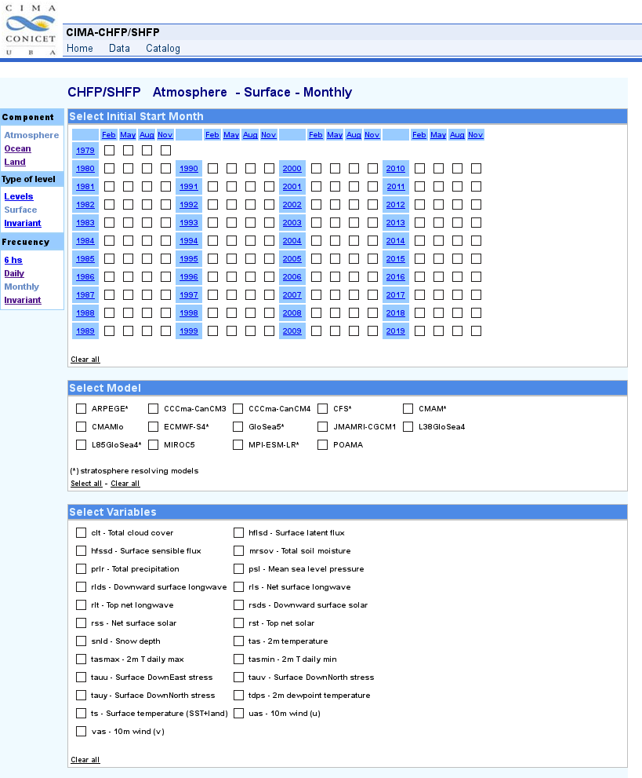
Climate-system Historical Forecasting Project (CHFP)
14 models
Hindcast data covering 1960-2014
Typically 4 start dates Feb/May/Aug/Nov
Many atmosphere and ocean variables
Includes Strat-HFP high-top/low-top experiments
NetCDF (SPECS convention) served via OPeNDAP
ENSEMBLES database containing seasonal and decadal hindcasts from six European models transferred to CIMA from ECMWF
Aim to transfer everything to an ESGF node at CIMA

Slide 5
Climate-system Historical Forecasting Project (CHFP)
JJA from 1 May anomaly correlation
all years
ENSO years
200 hPa
500 hPa
850 hPa

Slide 6
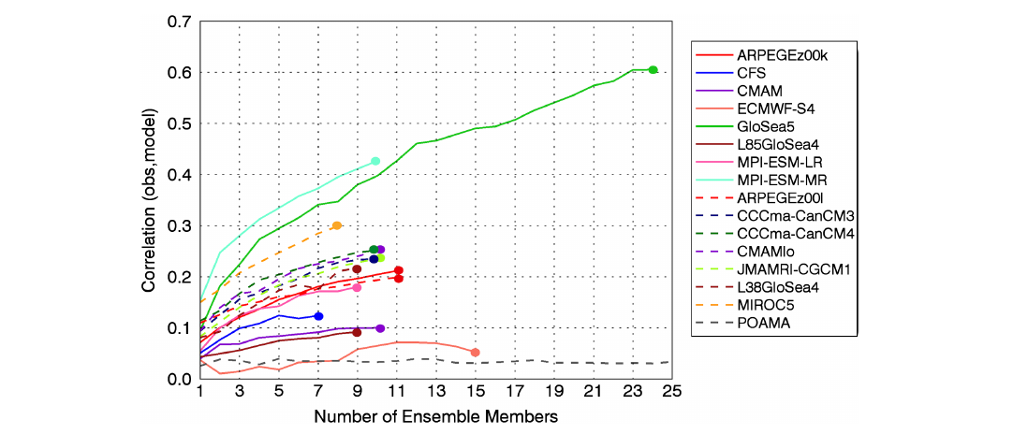
Climate-system Historical Forecasting Project (CHFP)
DJF NAO skill vs model & ensemble size
Hi top
Lo top

Slide 7
New projects: initial shock and drift
Long-Range Forecast Transient Intercomparison Project (LRFTIP)
Steered by William Merryfield (lead S2D component, Canadian Centre for Climate Modelling and Analysis, Environment and Climate Change, Canada ) and Mikhail Tolstykh (lead S2S component, Institute of Numerical Mathematics, Russian Academy of Sciences and Hydrometcentre of Russia)
Objectives
Develop an online archive of hindcast climatologies and related diagnostics, including for other active research efforts like S2S, DCPP
Address science questions, including influence of different initialization methods on transient , behavior of climate system components, and identification of any impacts (likely negative) on climate forecast quality
Possibly at a later stage: perform hindcast initialization experiments (same model, different initialization methods) that will contribute to (1) and inform (2)

Slide 8
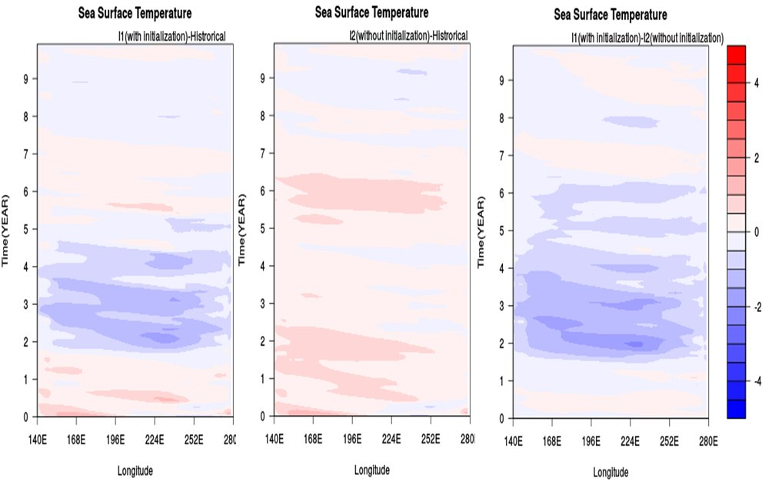
New projects: initial shock and drift
Hovmoeller plots of equatorial Pacific SST (initialized-historical)
Decadal forecasts initialized in January 1961,1966…2006
CanCM4 model using two different initialization methods
Init method 1
Init method 2
difference 1 - 2
Forecast time (years)
Transient Rossby wave

Slide 9
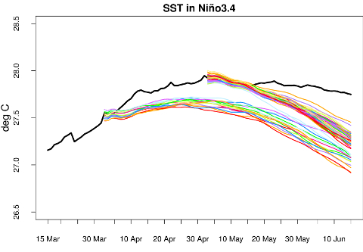
New projects: initial shock and drift

Slide 10
New projects: SnowGLACE
Impact of snow initialisation on subseasonal-to-seasonal forecasts
Steered by Yvan Orsolini (NILU and Bjerknes Centre for Climate Research, Norway) and Jee-Hoon Jeong (Faculty of Earth Systems & Env. Sciences, Chonnam National Univ., South Korea)
Links to SnowMIP, PPP and future PolarRCC
Objectives
Quantify snow initialization impacts on subseasonal-to-seasonal forecasts by evaluating how individual state-of-the-art dynamical forecast systems vary in their ability to extract forecast skill from snow initialization e.g. through stratospheric coupling and influence on the NAO.
Compare twin forecast ensembles with realistic or else some sort of unrealistic snow initialisation (e.g. climatological or “scrambled”); analogous to GLACE 1 and 2 initiatives aimed at assessing the impact of soil moisture on seasonal forecasts; experiments relevant both for the assessment of forecasting skill and attribution of climate variability and extreme events to snow forcing.

Slide 11
New projects: Teleconnections
Analyse tropical-extratropical interactions at seasonal and sub-seasonal time scales in different forecast systems and observational data sets using a common framework for a straightforward intercomparison
Steered by Laura Ferranti (ECMWF) and Adam Scaife (Met Office, UK)
Links to similar S2S project
Objectives
Base the work on the fact that tropical rainfall which is highly predictable drives Rossby waves through upper level divergence; the resulting influence on circulation responsible for substantial portion of extratropical seasonal predictability
Focus on the variability of the NAO and PNA and how they are associated with precipitation, 2m temperature and SST anomalies on a global scale; assess their dependence on the mean climate, seasonal cycle and different phases of ENSO, tropical Atlantic variability, MJO and QBO
Ultimately, assess the ability of forecast systems to skillfully predict tropical precipitation

Slide 12
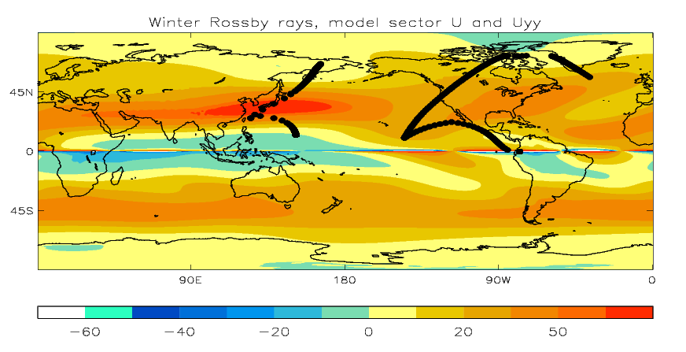
New projects: Teleconnections
Analyse tropical-extratropical interactions at seasonal and sub-seasonal time scales in different forecast systems and observational data sets using a common framework for a straightforward intercomparison
Rossby Wave Ray Paths
k = 2
k = 2
k = 3
k = 4

Slide 13
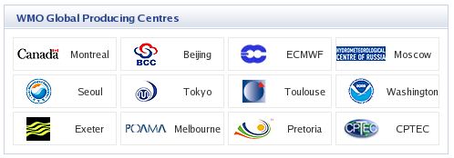
Lead Centre for Long-Range Forecast Multi-Model Ensembles (WMO LC-LRFMME)
http://www.wmolc.org
Global Producing Centres contribute their data to the LC-LRFMME
Collaboration with WGSIP has been requested for many years through ET-OPSLS
However, no access for research outside the GPCs is given to the hindcasts or past forecasts, not even in graphical form to non-met service users

Slide 14
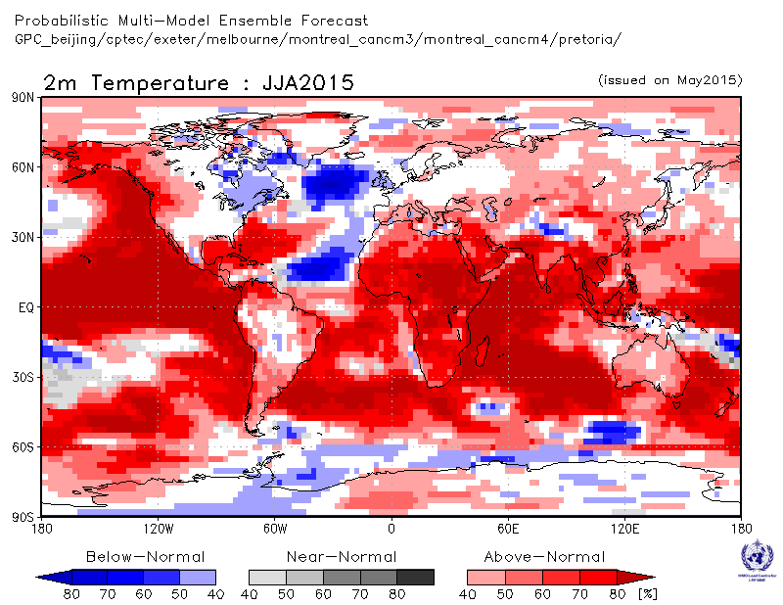
Global Seasonal Climate Update (GSCU)
http://www.wmo.int/pages/prog/wcp/wcasp/GSCU.html
The GSCU is produced by a small group lead by the CCl and CBS
WGSIP feedback has been requested
No access to the GSCU is granted to non-met service institutions, although the GSCU web site says otherwise

Slide 15
Proposed WGSIP/ET-OPSLS subgroup
Periodically reports to ET-OPSLS (timing to be determined) about potential new societally useful forecast products identified by research community
ET-OPSLS may submit requests for a brief assessment of the current state of knowledge regarding a product of interest
Assessments to include
brief descriptions of the product itself, its potential societal usefulness (e.g. target regions/sectors), data variables and frequency required
summary of existing evidence including references that the product can be predicted skillfully
Assessments will be revisited and possibly updated with each reporting cycle until product is adopted or indicated not to be of interest by ET-OPSLS
Alternative: instead of subgroup, WGSIP-wide activity identified in Terms of Reference

Slide 16
Decadal prediction
Organised by the Decadal Climate Prediction Project (DCPP) panel
Designed the CMIP6 contribution in 3 components with WGCM and CLIVAR
Fundamental transfer data dissemination technology of component B -> CCl/CBS
Meetings in Aspen last summer (component C) and in Barcelona in May (final design and coordination)

Slide 17
Decadal prediction
Component B focuses on decadal forecasts (not hindcasts), which are currently being made by a number of groups. It proposes a decadal prediction protocol with the aim of the collection, calibration and combination of forecasts
Component C focuses on the mechanisms responsible for decadal predictability and permitting (or making difficult) decadal forecast quality
Specific modes (North Atlantic, Pacific) driven by DCVP
Specification and impact of volcanic aerosol (link to VolMIP)
Important data issues: reduced variable list, double time axis -> problems to link to the WIP
Note that many contributors to component B are not Global Producing Centres

Slide 18
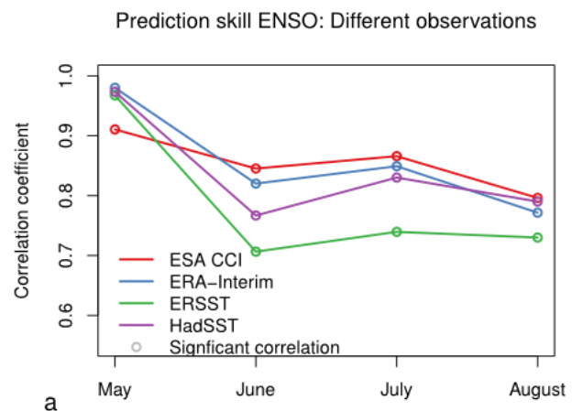
Observational uncertainty
Predictions with EC-Earth3 started every May over 1993-2009 with ERAInt and GLORYS2v1 initial conditions, and internal sea-ice reconstruction.

Slide 19
Increased resolution
Lots of work going to global forecast systems with resolutions of around 25-50 km.
Build on what is being done in other communities (WGNE, HiResMIP). Weather forecast systems (high resolution) moving towards coupling from day 1.
Huge amount of work to be done in the initialisation part. Ensembles should also be large enough as forecast quality depends heavily on ensemble size. Lots of computing time and technical ability required. However, good for flagship computational projects.
Increased resolution does not automatically improve forecast skill (even if the mean climate looks nicer).

Slide 20
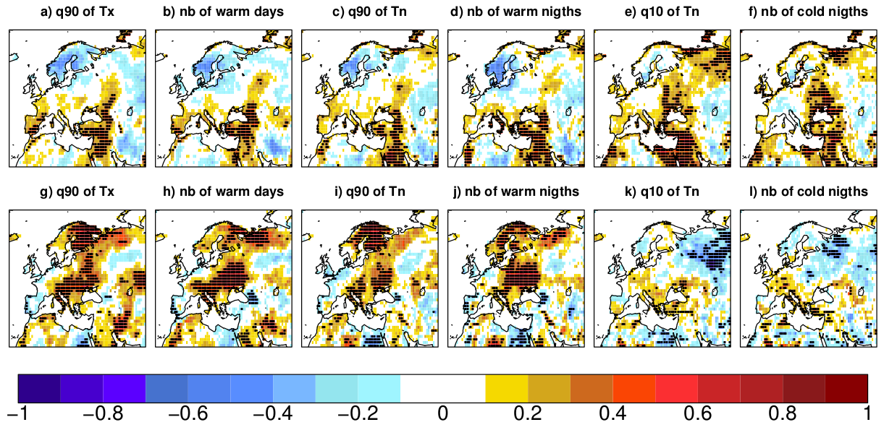
Other links
Polar Prediction Project: polar-lower latitudes linkages (after the hosting of the PPP-WCRP workshop in December 2014)
GC on Extremes: participation in workshops, training and the WCE special issue
Climate services: GFCS, CSP, RCOFs (attended the November meeting on operational climate prediction in Pune)
Event attribution
Prodhomme et al. (2015, Clim. Dyn.)
C3S Climate Projections Workshop: Near-term predictions and projections, 21 April 2015

