Slide 1
NEMO Users Meeting
22th June 2016
Which sea ice models does the climate community need?
François Massonnet

Slide 2
Which sea ice models does the climate community need?
A few remarks!
This presentation is oriented towards climate aspects
Less emphasis on process aspects
Complementary to A. Barthélemy’s, C. Rousset’s and D. Salas’s presentations
This presentation is certainly not exhaustive
I have tried to be unbiased but may have missed important aspects
I’m happy to receive feedback and hear others opinions
I’m highlighting several articles that I recommend reading if you haven’t already done so
francois.massonnet@bsc.es

Slide 3
Which sea ice models does the climate community need?
Year −30
Year 0
Year 1
Year 10
Year 50
1. Reanalyses
2. Operational
forecasts
3. Seasonal-to-decadal forecasts
4. Projections

Slide 4
Which sea ice models does the climate community need?
Year −30
Year 0
Year 1
Year 10
Year 50
1. Reanalyses
2. Operational
forecasts
3. Seasonal-to-decadal forecasts
SYMPTOM?
STRONG NEED FOR?
4. Projections
SCIENTIFIC GOAL?
Notes:
A convenient way to think
As opposed to process-level
Reflect my own views

Slide 5
Which sea ice models does the climate community need?
Year −30
Year 0
Year 1
Year 10
Year 50
1. Reanalyses
2. Operational
forecasts
3. Seasonal-to-decadal forecasts
4. Projections
Notes:
A convenient way to think
As opposed to process-level
Reflect my own views

Slide 6
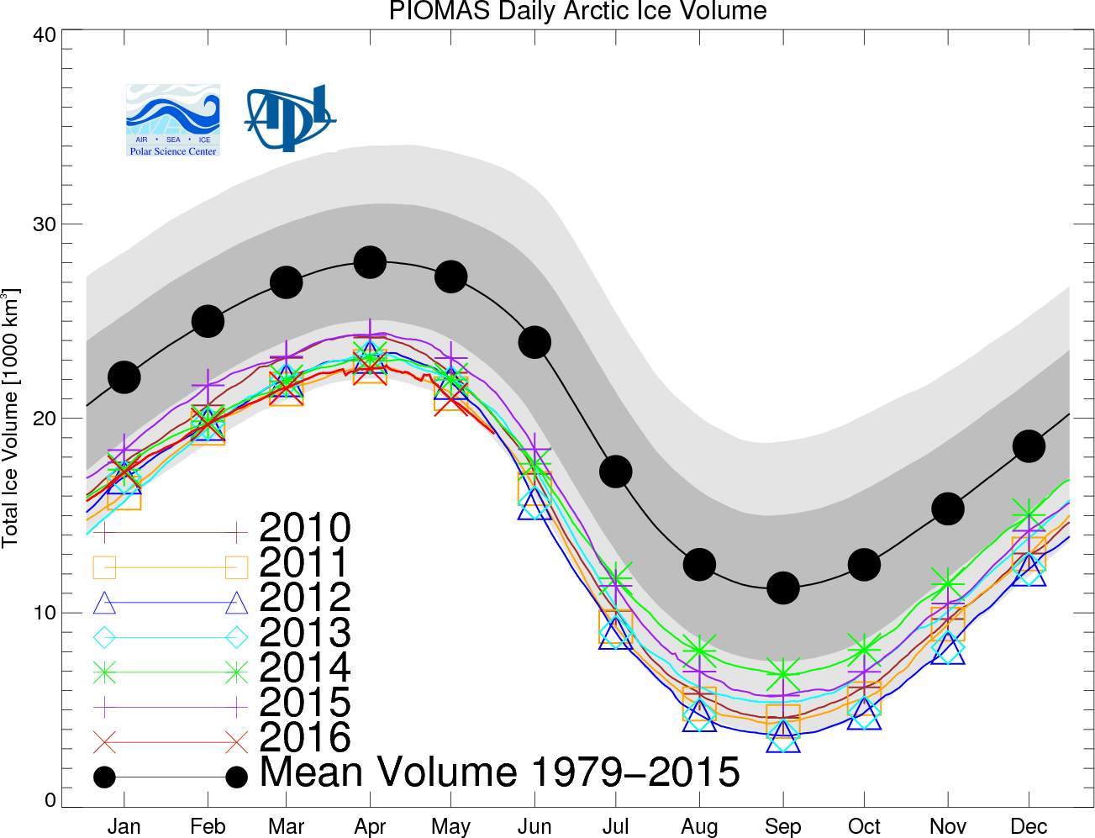
1. Reanalyses
SYMPTOM
The sea ice climate community is largely PIOMAS-dependent
http://psc.apl.uw.edu/research/projects/arctic-sea-ice-volume-anomaly/
Notes:
Not blaming piomas (they are very careful), but how people use it.

Slide 7
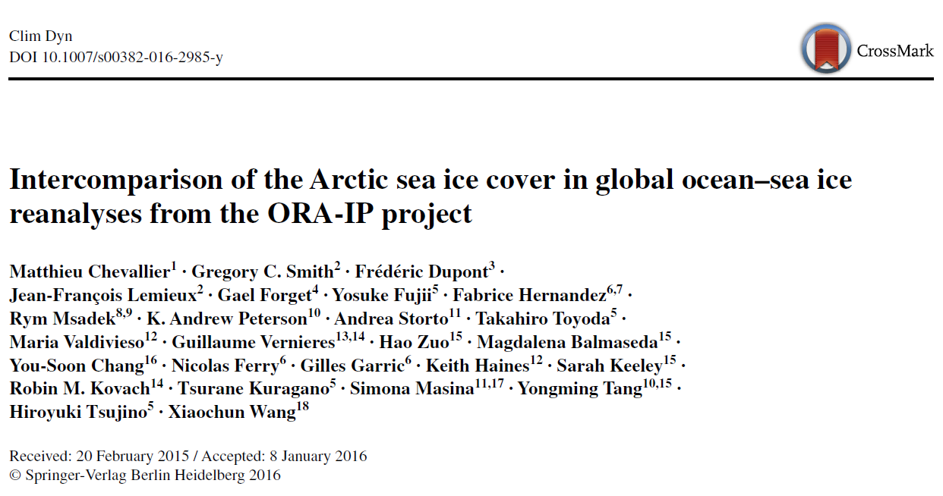
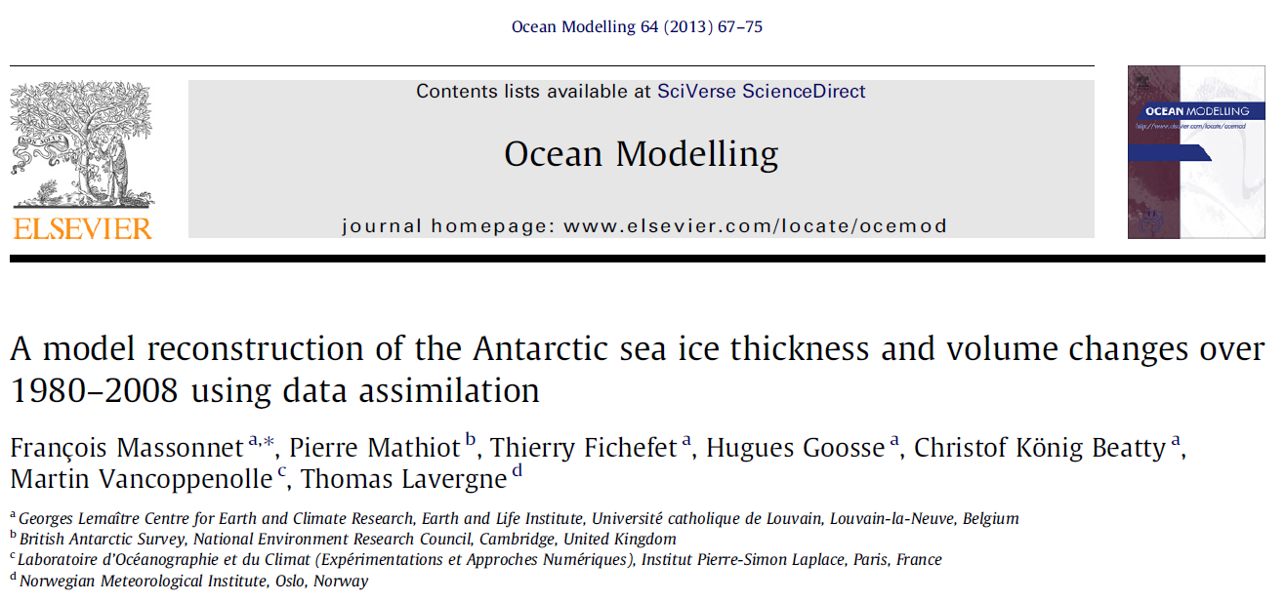
1. Reanalyses
SYMPTOM
The sea ice climate community is largely PIOMAS-dependent
Coupled and physically consistent polar reanalyses (ocean + ice + atmosphere; balanced)
Assimilation of recent products (e.g., ESA-SICCI; SMOS)
Quantification of uncertainty
STRONG NEED FOR
SCIENTIFIC GOAL
Quantification of recent Arctic and Antarctic sea ice mass & energy balances with their uncertainties
Chevallier et al., Clim. Dyn., 2016
Massonnet et al., Oc. Modell., 2013
Xie et al., The Cryosph. Discuss., 2016
Notes:
Lack of antarctic reconstructions

Slide 8
Which sea ice models does the climate community need?
Year −30
Year 0
Year 1
Year 10
Year 50
1. Reanalyses
2. Operational
forecasts
3. Seasonal-to-decadal forecasts
4. Projections
Notes:
As opposed to process-level

Slide 9
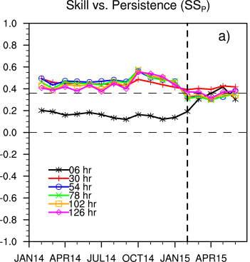
2. Operational forecasts
SYMPTOM
The community is using verification metrics that are useful to track performance, but often meaningless to end-users.
Hebert et al., JGR, 2015

Slide 10
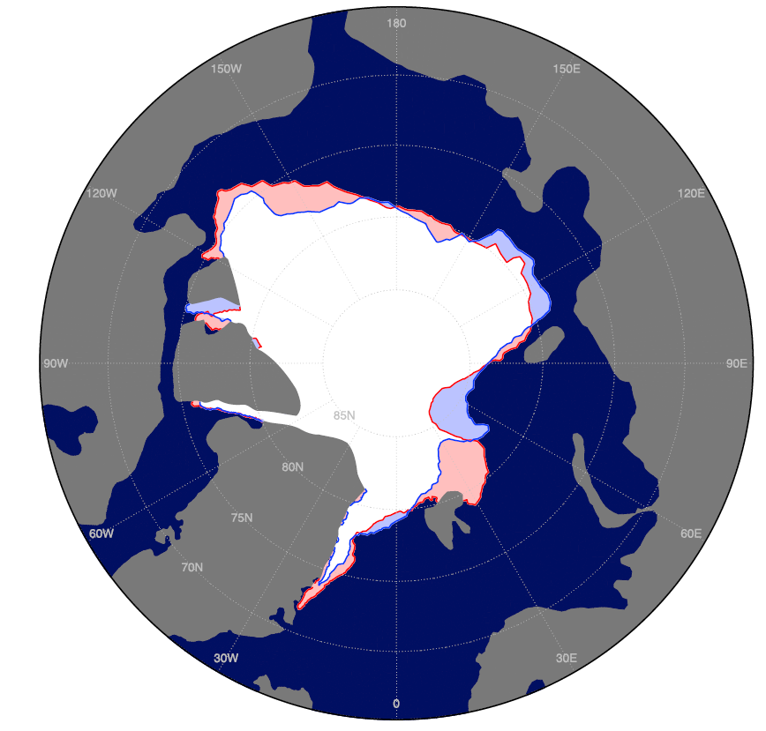
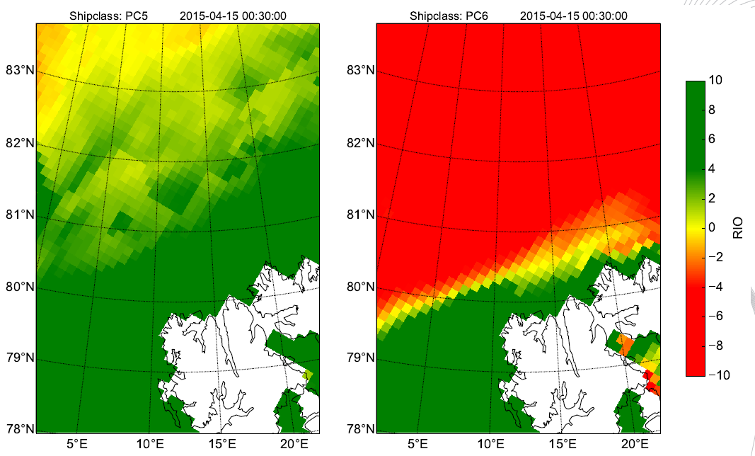
2. Operational forecasts
SYMPTOM
The community is using verification metrics that are useful to track performance, but often meaningless to end-users.
STRONG NEED FOR
Simple verification metrics for ice edge mismatch
User-oriented diagnostics
Probabilistic and risk information (incl. ice-thickness distribution)
Maps of risk index outcome
Shipping not permitted
Error = OVERESIMATION + UNDERESTIMATION
Shipping
Permitted
Goessling et al., GRL, 2016
Courtesy Andrea Gierisch + see her poster

Slide 11
2. Operational forecasts
SYMPTOM
The community is using verification metrics that are useful to track performance, but often meaningless to end-users.
STRONG NEED FOR
Simple verification metrics for ice edge mismatch
User-oriented diagnostics
Probabilistic and risk information (incl. ice-thickness distribution)
SCIENTIFIC GOALS
Achievement of skillful forecasts beyond the academic beauty
Usefulnes for upcoming campaigns (e.g., Year of Polar Prediction)
Southern Ocean

Slide 12
Which sea ice models does the climate community need?
Year −30
Year 0
Year 1
Year 10
Year 50
1. Reanalyses
2. Operational
forecasts
3. Seasonal-to-decadal forecasts
4. Projections
Notes:
As opposed to process-level

Slide 13
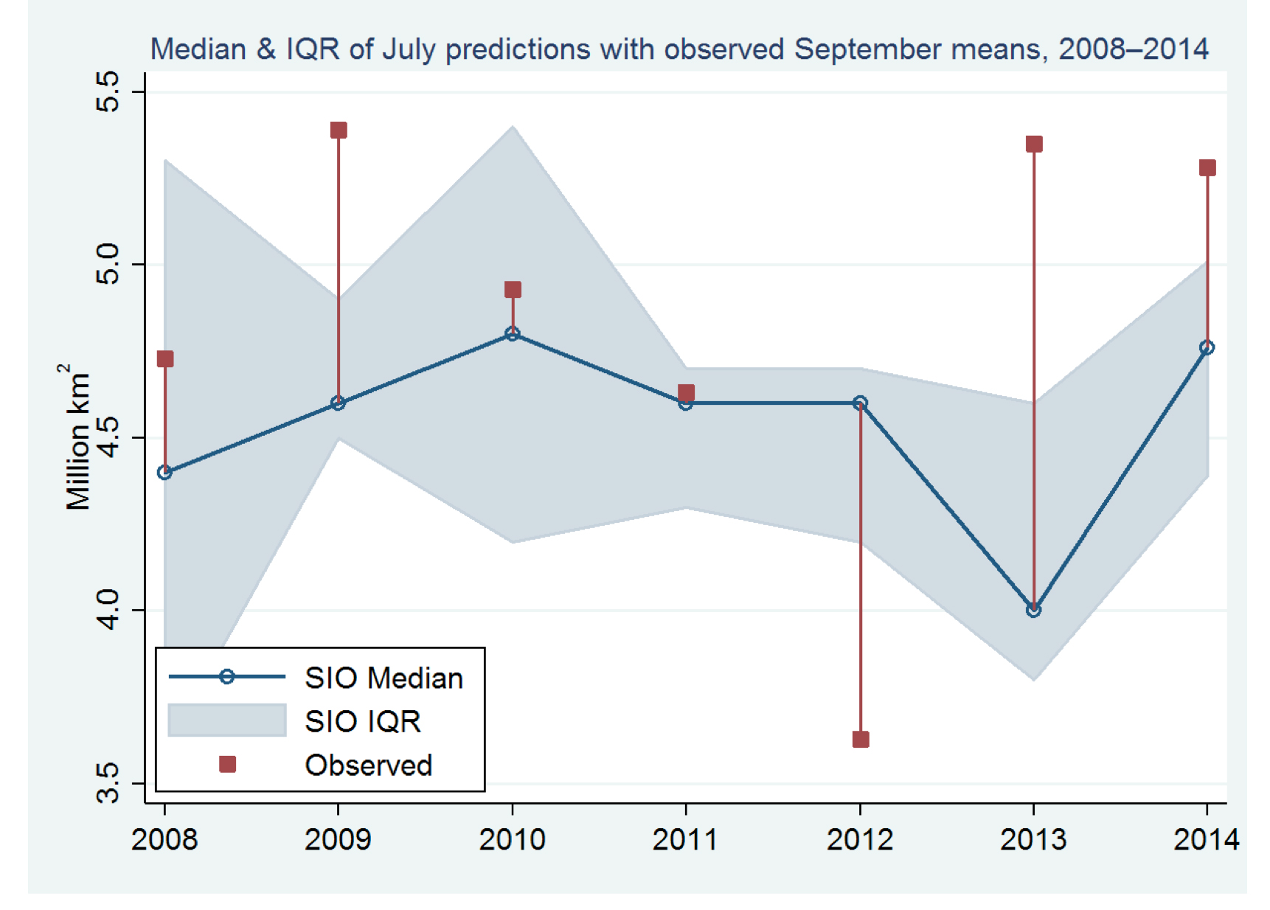
3. Seasonal-to-decadal forecasts
SYMPTOM
Model and initial-condition uncertainty is not (enough) accounted for in current sea ice predictions
Stroeve et al., EOS, 2015

Slide 14
3. Seasonal-to-decadal forecasts
SYMPTOM
Model and initial-condition uncertainty is not (enough) accounted for in current sea ice predictions
Stroeve et al., EOS, 2015
https://www.arcus.org/sipn/sea-ice-outlook/2015/post-season
Notes:
We are only exploring a subspace

Slide 15
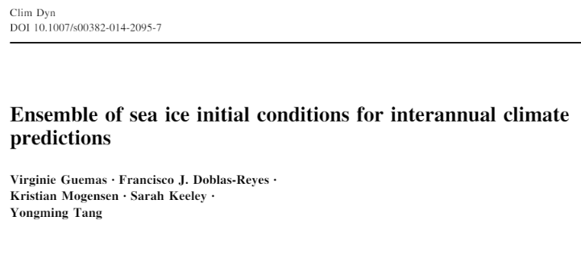
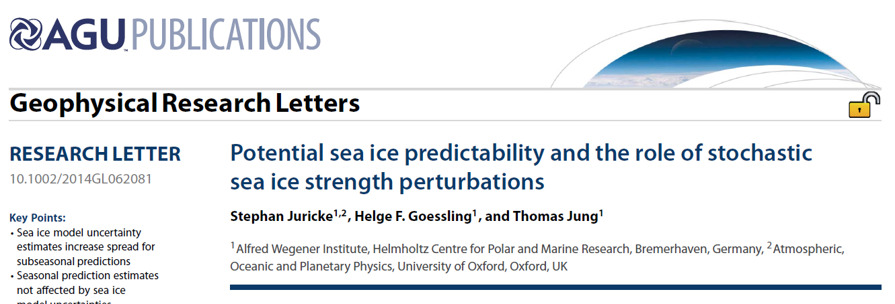
3. Seasonal-to-decadal forecasts
SYMPTOM
Model and initial-condition uncertainty is not (enough) accounted for in current sea ice predictions
Modular sea ice models with « switchable » features to test the impact of individual physical formulations on skill
Stochastic formulations to reflect uncertainty in parameterizations
Ensembles of sea ice initial conditions
STRONG NEED FOR
Juricke et al., GRL, 2014
Guemas et al., Clim. Dyn., 2014
Notes:
There is a lack of variety in the experimental setup

Slide 16
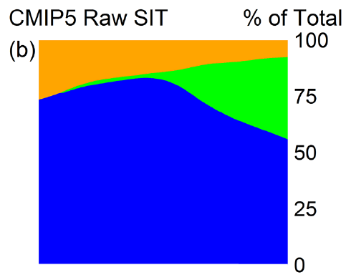
3. Seasonal-to-decadal forecasts
SYMPTOM
Model and initial-condition uncertainty is not (enough) accounted for in current sea ice predictions
Modular sea ice models with « switchable » features to test the impact of individual physical formulations on skill
Stochastic formulations to reflect uncertainty in parameterizations
Ensembles of sea ice initial conditions
STRONG NEED FOR
SCIENTIFIC GOALS
Link between potential and actual skill
Budget analysis of uncertainty
Nat. variability
Forcing
Model
0
40
60
80
20
Years
Melia et al., The Cryosph., 2016
Notes:
There is a lack of variety in the experimental setup

Slide 17
Which sea ice models does the climate community need?
Year −30
Year 0
Year 1
Year 10
Year 50
1. Reanalyses
2. Operational
forecasts
3. Seasonal-to-decadal forecasts
4. Projections
Notes:
As opposed to process-level

Slide 18
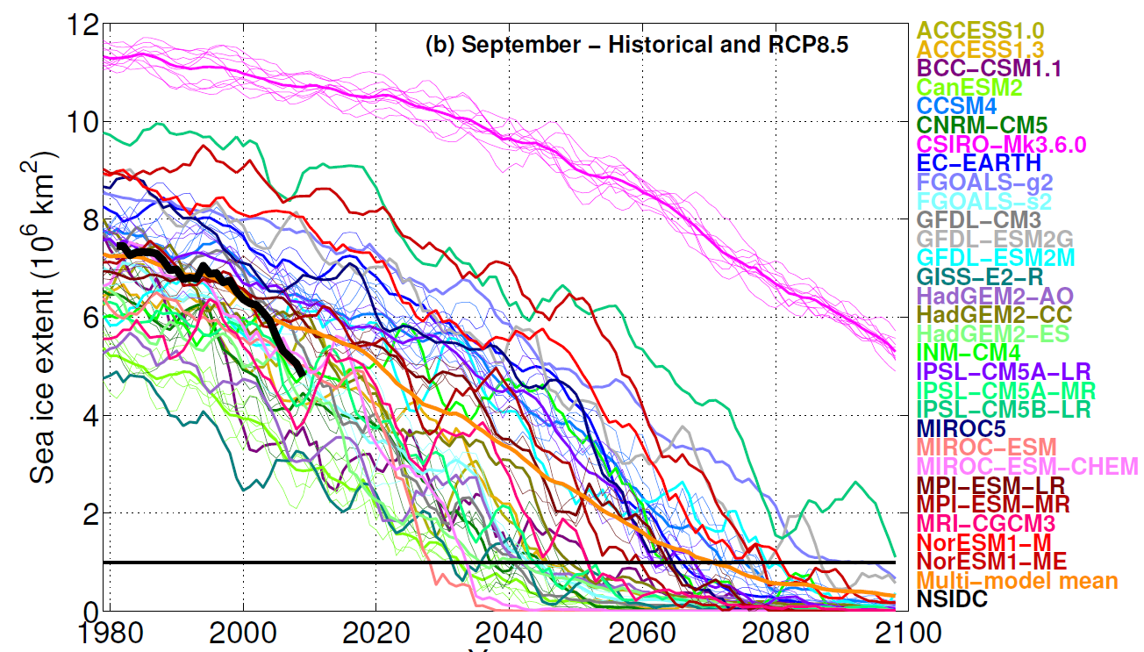
4. Projections
SYMPTOM
Sea ice model response to external forcing is poorly understood in terms of baseline mean state
Massonnet et al., The Cryosph., 2012

Slide 19
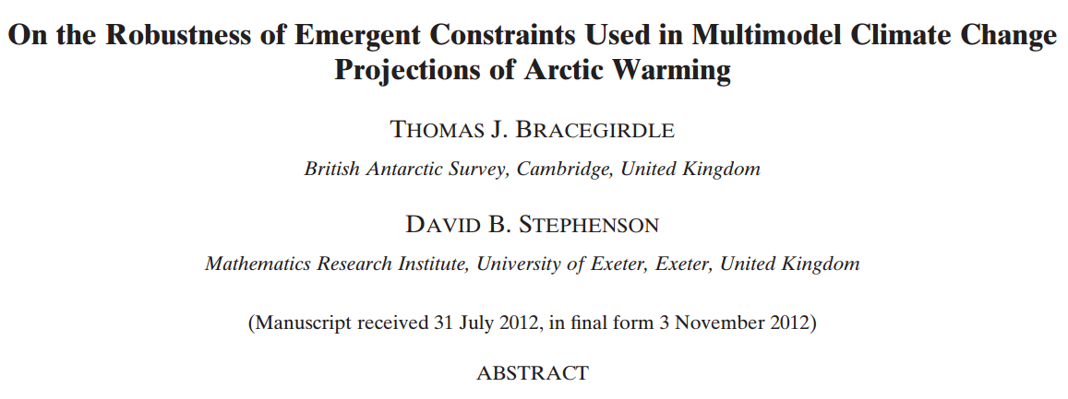
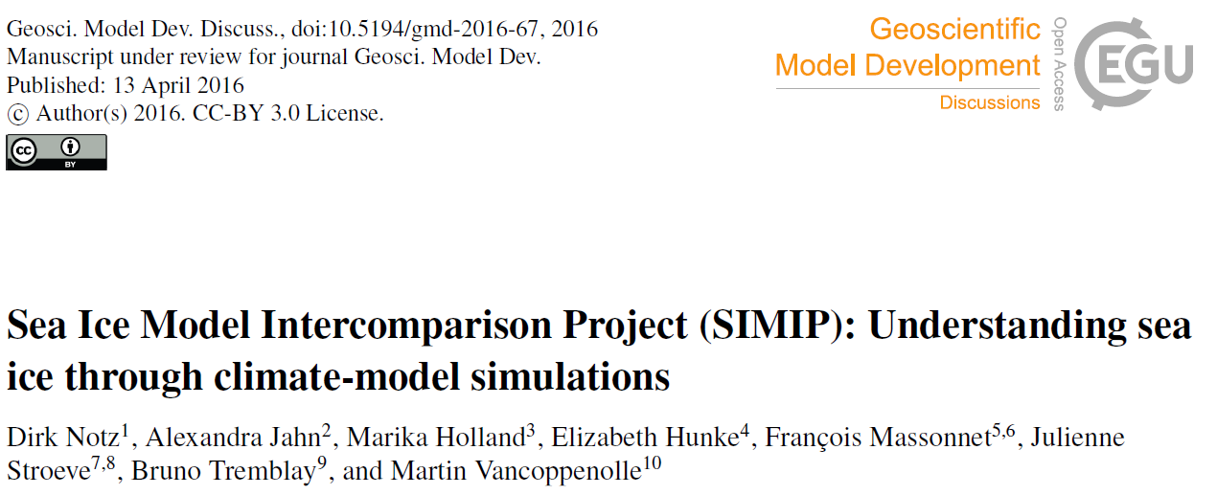
4. Projections
SYMPTOM
Sea ice model response to external forcing is poorly understood in terms of baseline mean state
STRONG NEED FOR
Emergent constraints: link between present-day simulation of processes and long-term response
Bracegirdle and Stephenson, J. Clim., 2012
Notz et al., GMD Discuss., 2016

Slide 20
4. Projections
SYMPTOM
Sea ice model response to external forcing is poorly understood in terms of baseline mean state
STRONG NEED FOR
Emergent constraints: link between present-day simulation of processes and long-term response
SCIENTIFIC GOALS
Better characterization of uncertainty and its sources
Understanding the role of model physics on response to external forcing

Slide 21
Take home messages
WHICH SEA ICE MODELS DOES THE CLIMATE COMMUNITY NEED?
Fancy rheology
ITD
MODULAR MODELS
Even if they look different, sea ice models are often very similar
We need advanced, but modular sea ice models: a (European?) kernel + plug-and-play routines
UNCERTAIN MODELS
Reconstructions/predictions/projections are generally over-confident (under-dispersive)
Formulations must be inherently probabilistic to reflect what we truly ignore (forcing, initial conditions, physics)
INFORMATIVE MODELS
Current sea ice models have plenty of information that is under-used!
Packaging the information appropriately for the right user is a task whose difficulty is often underestimated
Snow
Air/oce interactions

Slide 22
Thank you!
For further information please contact
francois.massonnet@bsc.es

