Slide 1
Barcelona, 13 November 2015
RESILIENCE: A semi-operational prototype to predict wind speed at seasonal time scales
Isadora Jiménez
Earth System Services – Earth Sciences Department

Slide 2
Earth System Services
ESS OBJECTIVE:
Facilitate technology transfer of state-of-the-art research from local, national to international levels in five areas:
Air quality assessments
Mineral Dust modelling
Weather forecasting
Climate predictions
Climate predictions
Computational Earth Services
Notes:
Earth system Services objective is….
And we try to do this for all the research advances of our department. But one of the areas of services most developed in the part of climate predictions for wind energy

Slide 3
Past
Seasons
Years
Today
Hours
Days
Weeks
Months
Decades
Century
DIAGNOSTIC
FORECAST
PREDICTION
PROJECTION
Notes:
Wind energy sector is a consumer of weather and climate data but most of the developments have been focused in the short-term forecast, from hours to days ahead which is key for the energy balance between power generatiion and demand.
From weeks to Decades, however they use retrospective climatology. Assume that what has happened in the last 20 or 30 years is going to be a constant for the next 10 or 15 years is quite a bold assumption.

Slide 4
Climate predictions for wind power
Pre-Construction Decisions: Annual to Decadal Timescales
Wind farm planners: Site selection
Wind farm investors: Evaluate return on investments
Policy makers: Understand changes to energy mix
Post-Construction Decisions: Monthly to Seasonal Timescales
Energy producers: Resource management strategies
Energy traders: Resource effects on markets
Wind farm operators: Planning for maintenance works
Wind farm investors: Optimize return on investments
Notes:
In fact the sector is used to take that assumption and make decisions in many aspects of the energy business both in pre-construction and post-construction of wind farms.

Slide 5
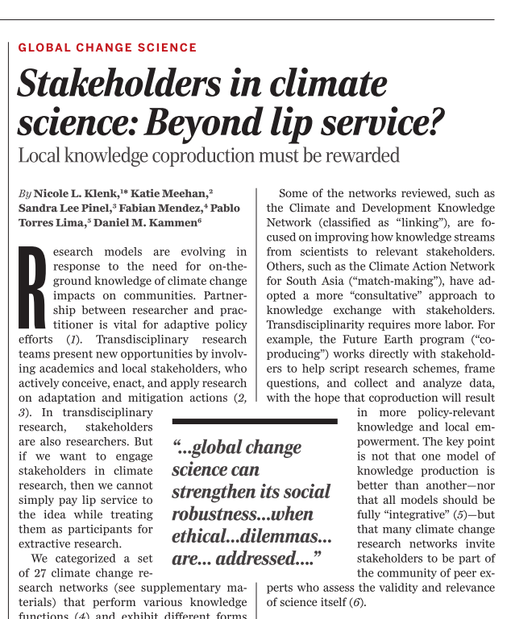
User engagement with stakeholders
Klenk et al.
13 Nov 2015 Science
Notes:
The role of services is to engage with users, hear their needs and find the common place between the actual state-of-the-art in climate predictions and their real needs.

Slide 6
Climate services for energy
ESS partnership in EU Projects in climate services for the energy sector
SPECS: Seasonal-to-decadal climate Prediction for the improvement of European Climate Services
EUPORIAS: EUropean Provision Of Regional Impact Assessment on a Seasonal-to-decadal timescale
NEWA: New European Wind Atlas
PRIMAVERA: Process-based climate simulation: advances in high-resolution modelling and european climate risk assessment
IMPREX: Improving predictions and management of hydrological Extremes
CLIM4ENERGY: Climate for Energy
Notes:
And that’s what we do in most of the EU projects con climate services where we participate.

Slide 7
EUPORIAS – Energy prototype
One of the specific objectives of EUPORIAS is:
To develop a few fully working prototypes of climate services
addressing the need of specific users,
show how climate predictions could impact their decision-making processes
and ultimately encourage them to use the prototypes.

Slide 8
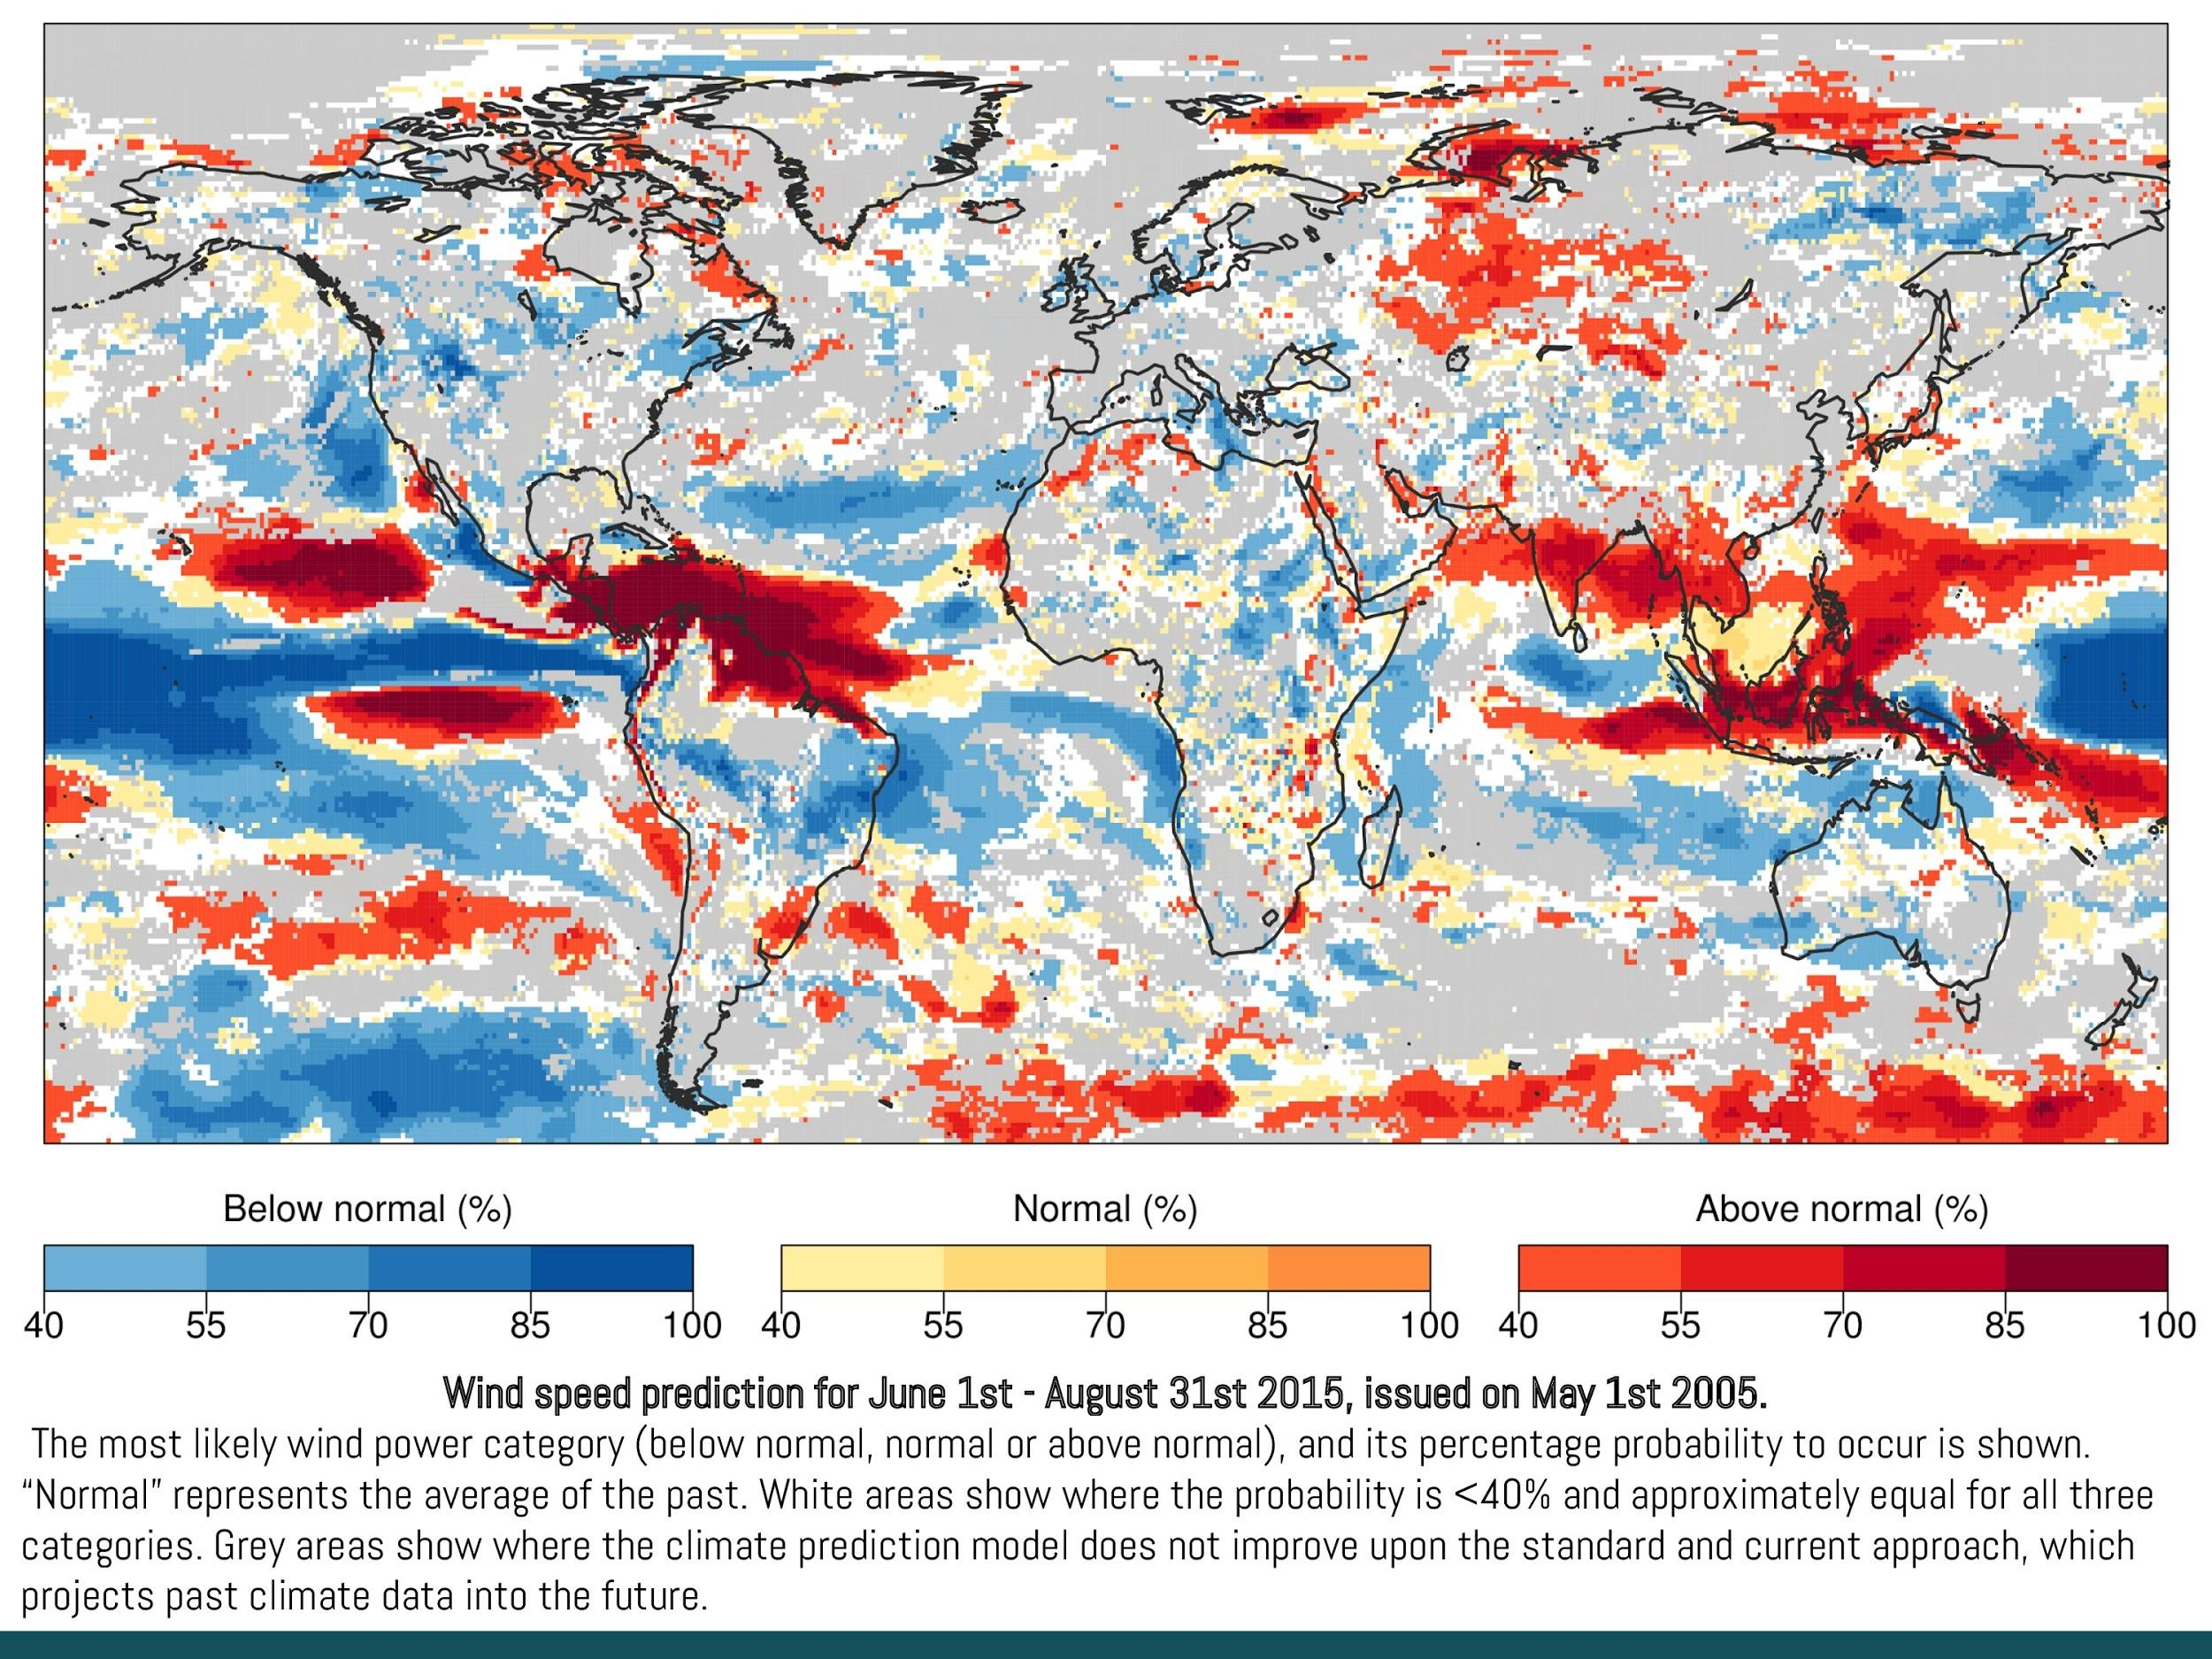
RESILIENCE
RESILIENCE: Seasonal wind speed predictions for the Energy sector
Semi-operational prototype that aims to provide information on
seasonal wind speed variability based on probabilistic climate predictions.
Data from ECMWF, prediction system: System 4
Global domain
Probabilistic predictions
Aggregated output in terciles:
Above normal
Normal
Below normal
Operational prediction for Winter 2015/2016
All the added value of the research we have done (validation, post-processing, skill assessments, calibration,)
This all requires supercomputing and a lot of processing time and expert advise in the data downloading adaptation, etc.
Notes:
Aquest és un exemple concret però aquesta informació la podem donar en forma espaial en mapa amb informació detallada per diferents zones. Per tant a un inversor energètic li interessarà muntar un parc en les zones que tinguin una probabilitat major que les altres d’incrementar el vent en el futur. El que aportem és una eina per valorar el risc.
____
NOTES en cas de pregunta per les zones grises:
Ensenyem els valors per aquelles zones en les que les dades del Centre Europeu son prou bones per aportar valor afegit a un model que només tingui climatologia. En les zones on no podem donar aquest tipus d’anàlisi fen un anàlisi detallat des del punt de vista meteorològic analitzant patrons meteorologics ben descrits. P.e. si s’espera una fase anticiclònica de la NAO aleshores si que podem donar una resposta de com evolucionarà el vent. No és un valor sino una descripció per als propers mesos.

Slide 9
Covering all the slide with different types of graphics, capacity factor, impact surfaces, reliability diagrams, histograms, etc.
Notes:
Aquest és un exemple concret però aquesta informació la podem donar en forma espaial en mapa amb informació detallada per diferents zones. Per tant a un inversor energètic li interessarà muntar un parc en les zones que tinguin una probabilitat major que les altres d’incrementar el vent en el futur. El que aportem és una eina per valorar el risc.
____
NOTES en cas de pregunta per les zones grises:
Ensenyem els valors per aquelles zones en les que les dades del Centre Europeu son prou bones per aportar valor afegit a un model que només tingui climatologia. En les zones on no podem donar aquest tipus d’anàlisi fen un anàlisi detallat des del punt de vista meteorològic analitzant patrons meteorologics ben descrits. P.e. si s’espera una fase anticiclònica de la NAO aleshores si que podem donar una resposta de com evolucionarà el vent. No és un valor sino una descripció per als propers mesos.

Slide 10
RESILIENCE
From the 6 prototypes developed within EUPORIAS, our prototype was selected to make a visualisation exercise
On-line visualisation tool of RESILIENCE
Joint development between scientists and designers
Renowned data visualiser, Mortiz Stefaner
User Interface Platform (UIP)
Notes:
Project Ukko is the online visualisation tool of RESILIENCE. Is the joint effort between scientists and a designer specialised in data visualisation to have a user-friendly tool that bridges the psicological gap between numerical outputs and decision-making

Slide 11
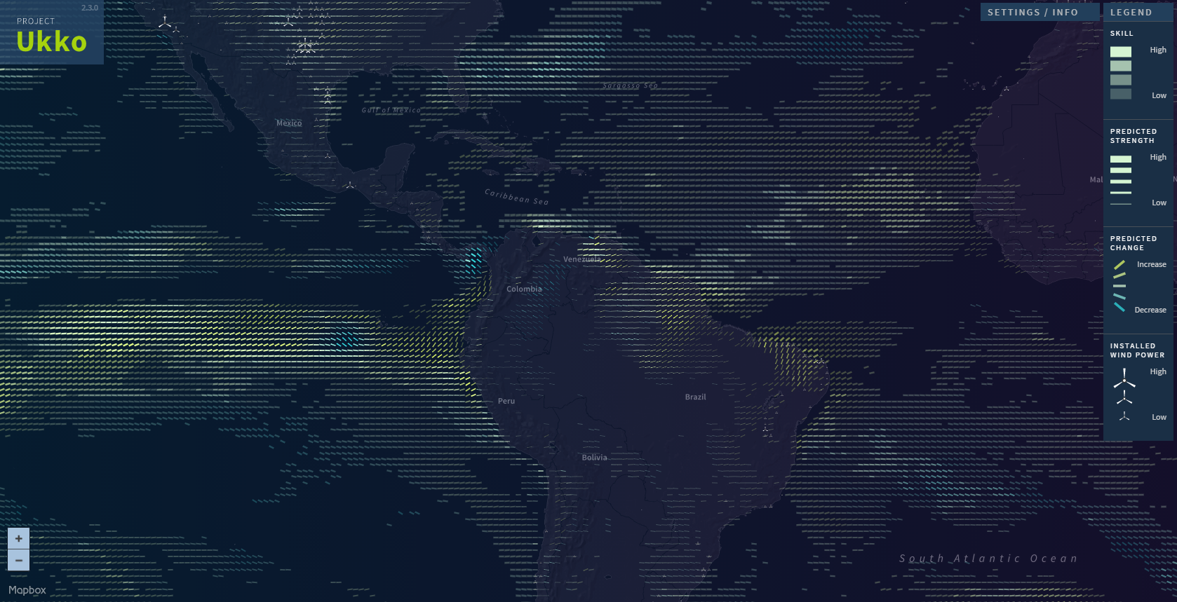

Slide 12
Transparency:
PREDICTION SKILL
Only areas with a positive skill (RPSS) have a visible line

Slide 13
Line width:
PREDICTED WIND SPEED
mean wind speed predicted for the coming season.
Notes:
The actual value is not provided and not easy to get. This is a general indicator of how much wind is predicted but, since it is a deterministic value one of the objectives was that users couldn’t focus too much on it.

Slide 14
Color and slope:
PREDICTED SEASONAL VARIABILITY
the most probable category and its probability.
Notes:
The actual value is not provided and not easy to get. This is a general indicator of how much wind is predicted but, since it is a deterministic value one of the objectives was that users couldn’t focus too much on it.

Slide 15
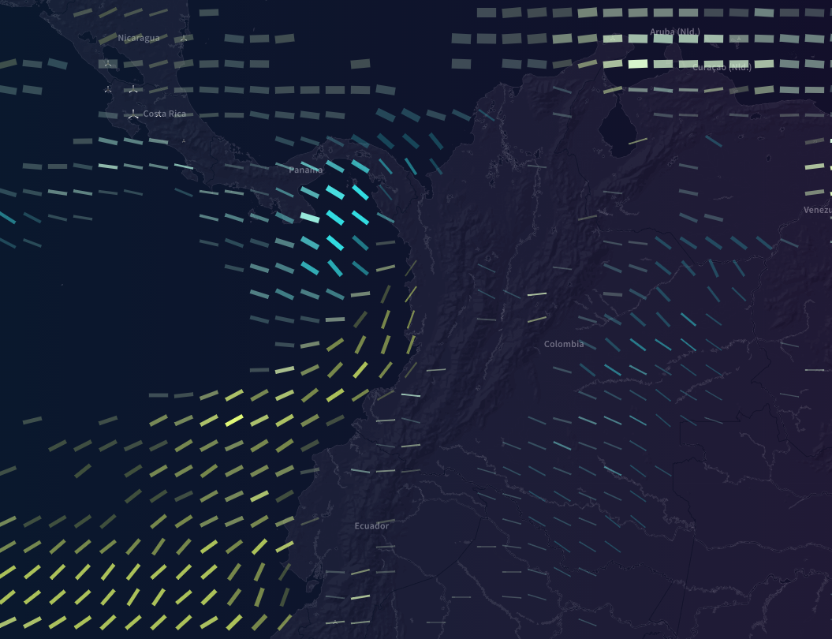
Color and slope:
PREDICTED SEASONAL VARIABILITY
the most probable category and its probability.
Notes:
The actual value is not provided and not easy to get. This is a general indicator of how much wind is predicted but, since it is a deterministic value one of the objectives was that users couldn’t focus too much on it.

Slide 16
Notes:
The actual value is not provided and not easy to get. This is a general indicator of how much wind is predicted but, since it is a deterministic value one of the objectives was that users couldn’t focus too much on it.

Slide 17
OBSERVATIONS
ERA-Interim 10-m wind speed reanalysis
PREDICTIONS
the most probable category and its probability.
SKILL
RPSS skill score
Notes:
The actual value is not provided and not easy to get. This is a general indicator of how much wind is predicted but, since it is a deterministic value one of the objectives was that users couldn’t focus too much on it.

Slide 18
LESSONS LEARNT
Our main lesson learnt from the process of developing the visualisation tool:
Designers and Scientists have different perspectives on how information should be displayed.
To have a good visualisation it is key to have the end user closely involved in all the steps of the visualisation development.
Klenk et al.
13 Nov 2015 Science
Notes:
The role of services is to engage with users, hear their needs and find the common place between the actual state-of-the-art in climate predictions and their real needs.

Slide 19
Thank you!

Slide 20
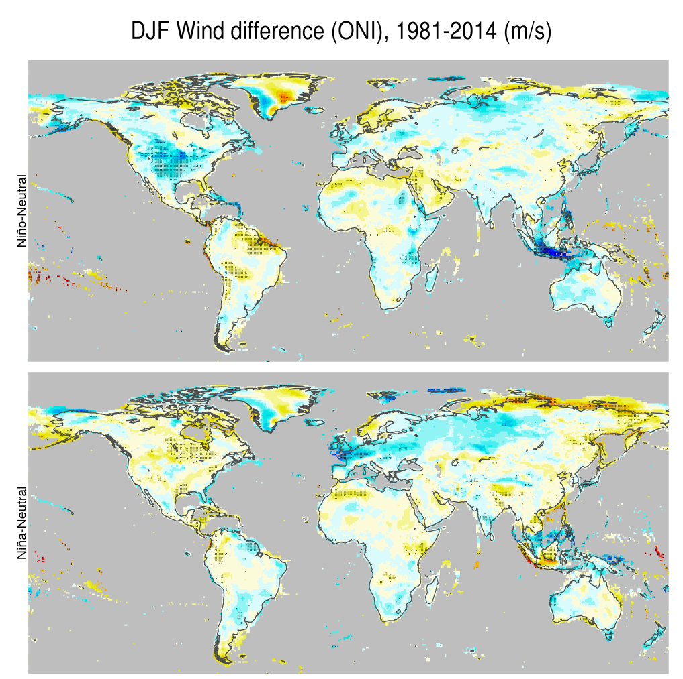
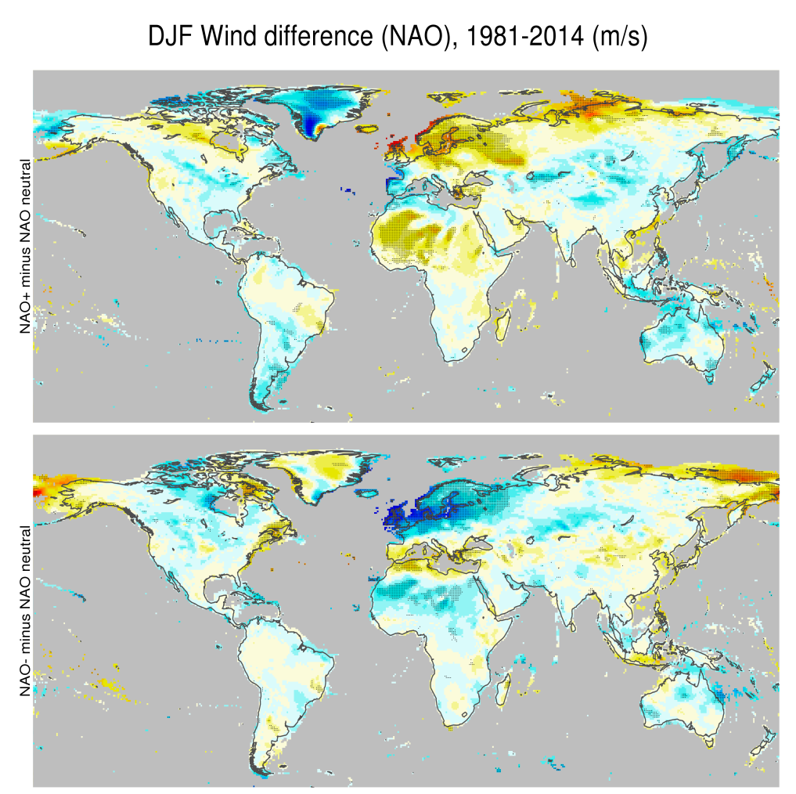
e.g. Climate drivers of seasonal variability
Niño
NAO +
Niña
NAO -

Slide 21
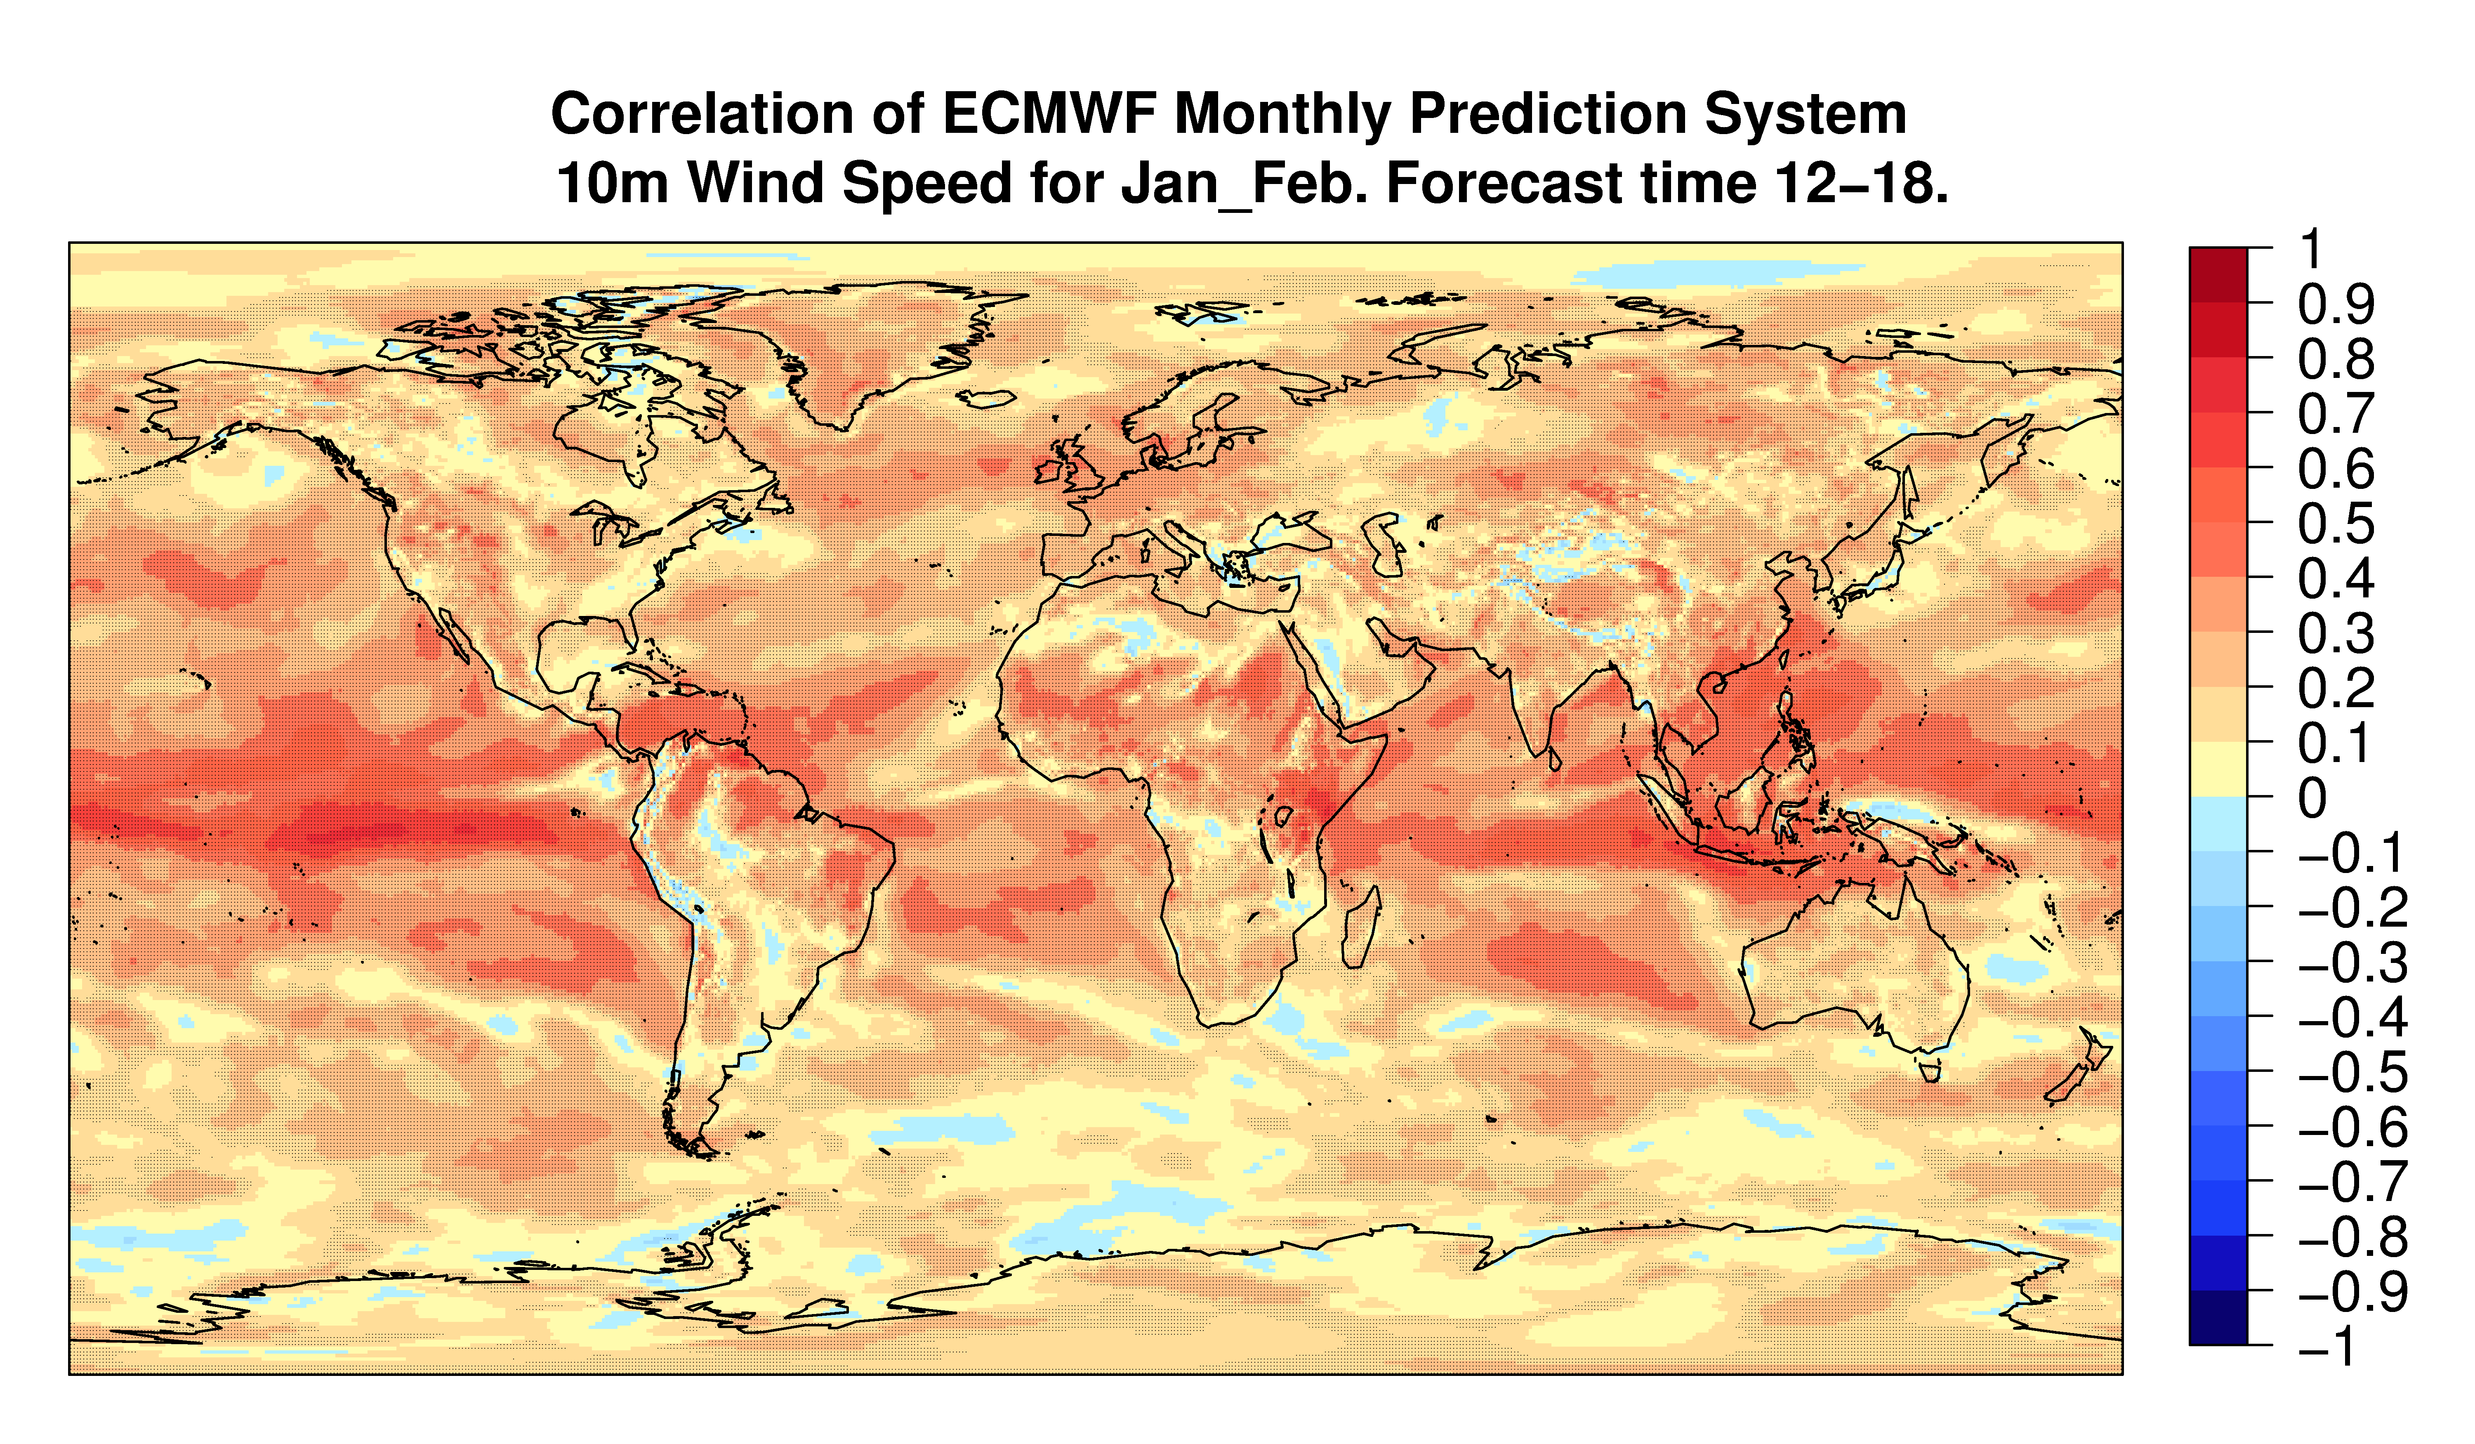
Skill map for sub-seasonal

