Slide 1
IHPCSS16, June 2016
Performance tools for climate models optimization
Miguel Castrillo, Oriol Tintó-Prims, Harald Servat, Germán Llort, Kim Serradell, Oriol Mula-Valls, Francisco Doblas-Reyes

Slide 2
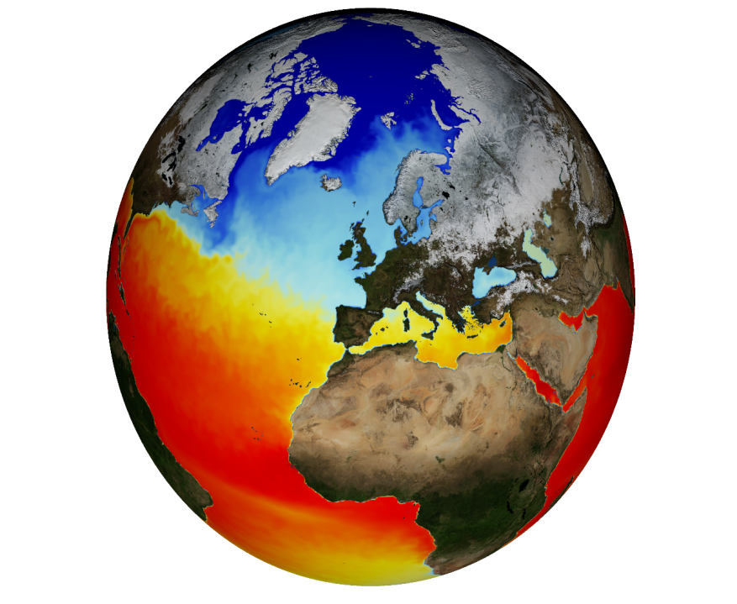
Efficiency in Earth Science models
Especially critical in Earth science models.
Simulations use a huge amount of computational resources.
Future simulations will need much more resources.
NEMO: Nucleus for European Modeling of the Ocean (NEMO) is a state-of-the-art global ocean model.
It is used in oceanographic research, operational oceanography, seasonal forecast and climate studies.
Almost 170.000 lines of FORTRAN 90 code
Parallelization based on spatial domain decomposition through MPI.
Mostly small stencil element calculations
0,84M points
67,72M points
991M points
~2000M points

Slide 3
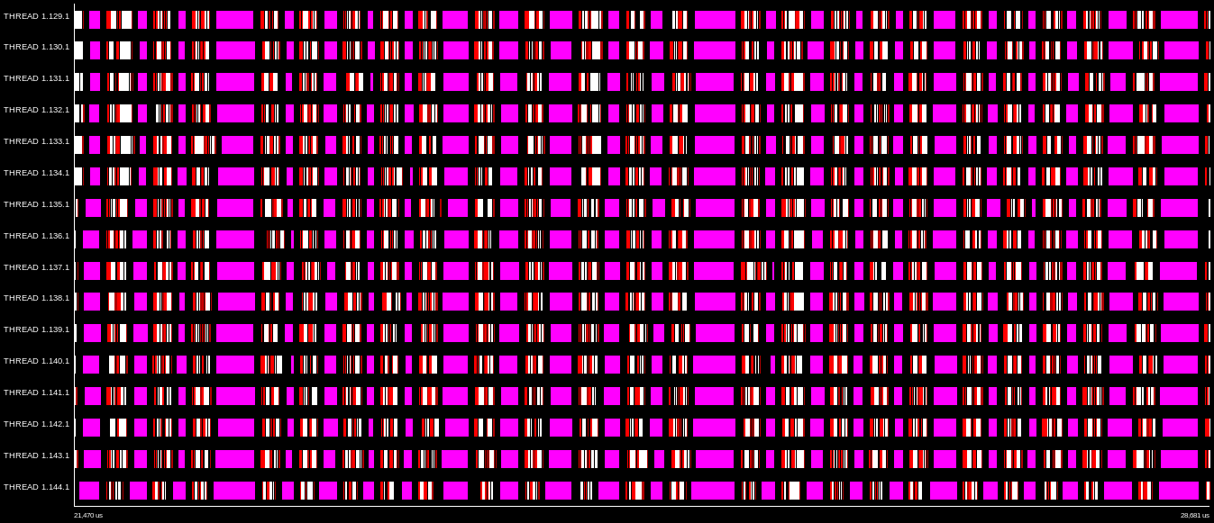
Methodology: PARAVER trace analysis
Model scalability overview: Routines analysis → Each color represents one different routine
time
16
32
64
128
256
LIMHDF (Sea-ice horizontal diffusion) → Bad scalability & big portion of time spent
Global Communication every loop iteration
60% of time
LIMHDF communications
Only 20% time invested in computation.
Outside MPI
MPI Isend
MPI Recv
MPI Wait
MPI Allgather

Slide 4
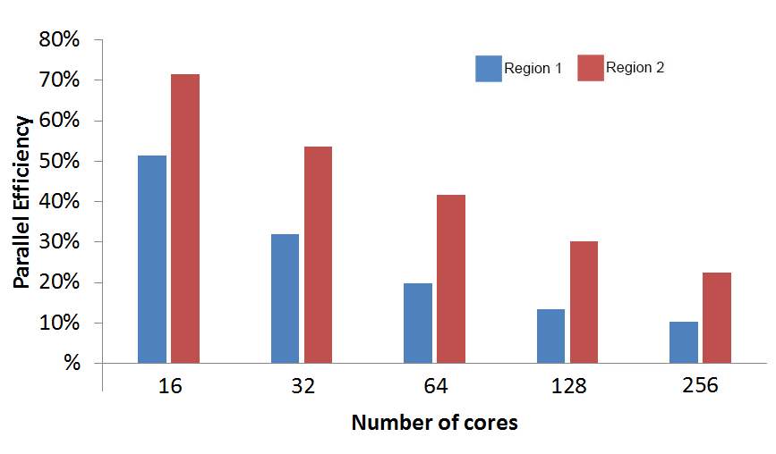
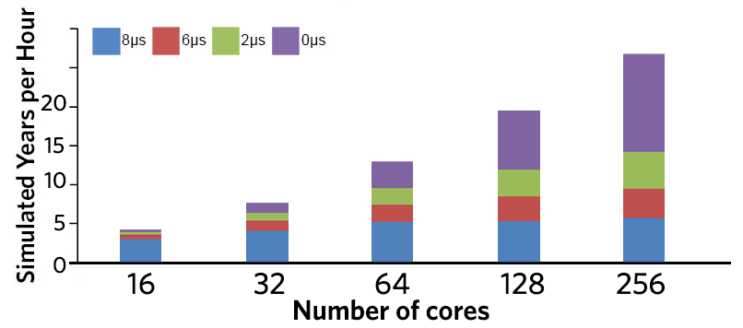
Cause of efficiency loss
Cluster techniques used to identify different computational trends in the regions of interest → Decrease of computational efficiency due to code duplication.
However, communications are the main performance problem. Even in the 16-core case parallel efficiency is really bad.
The figure at the right shows how sensitive the model is to network latency.
Communications efficiency drops much more faster than computational.

Slide 5
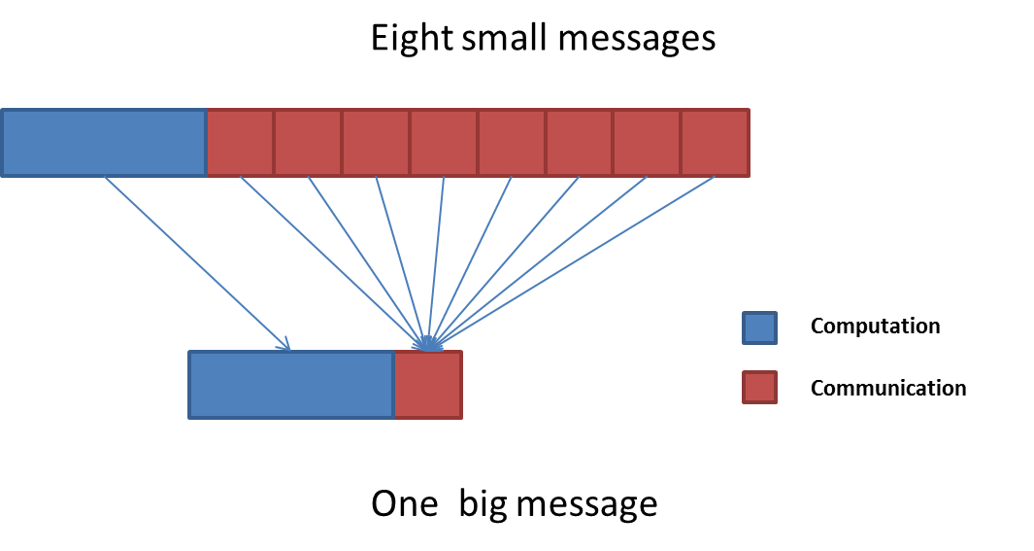
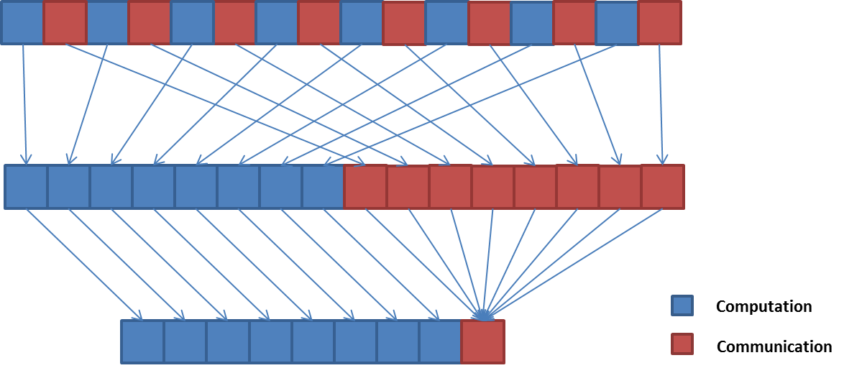
Optimizations
MPI message packing
Convergence check reduction
Taking in account that NEMO is really sensitive to latency, messages aggregation is the best way to reduce the time invested in communications. Therefore, consecutive messages have been packed wherever the computational dependencies allow to do so.
Some routines use collective communications to perform a convergence check in iterative solvers. The cost of this verifications is really high, reaching a 66% of the time. Wherever the model allowed it, we reduced the frequency of this verifications in order to increase parallel efficiency.
Reordering
In order to apply the message packing optimization to as many routines as it was possible, it was necessary to rearrange some computation and communication regions, taking into account the dependencies between them , to reduce the number of messages. This way it was possible to compute (and communicate) up to 41 variables at the same time, resulting in a dramatic reduction of the granularity.

Slide 6
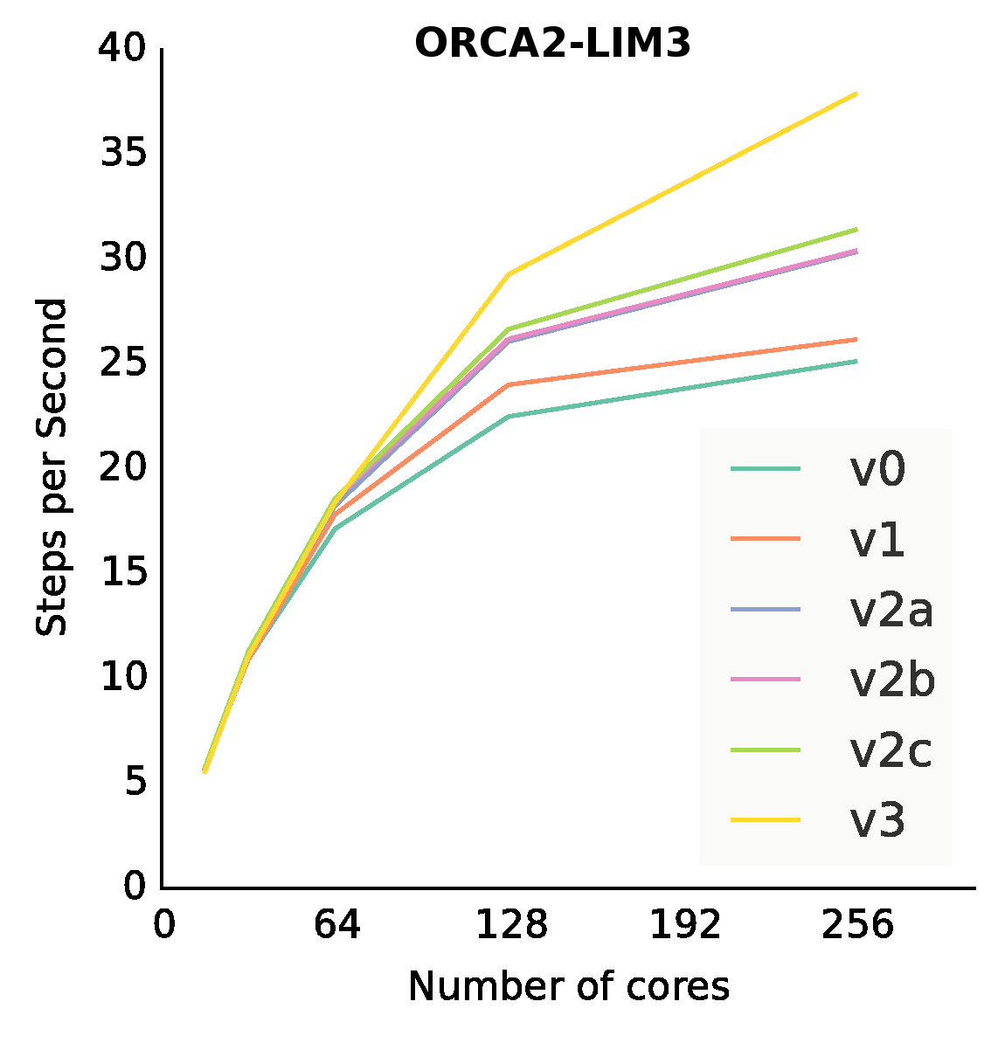
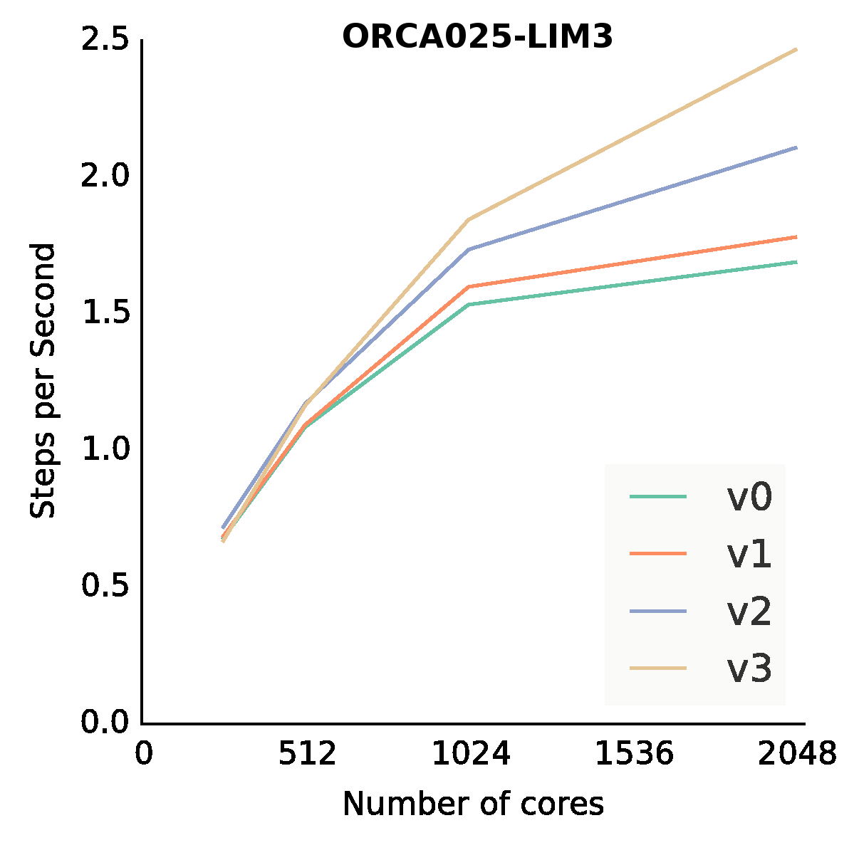
Results
Original code
16
32
64
128
256
Optimized code
16
32
64
128
256
V0 → Original
V1 → Message packing
V2 → Conv. Check reduction
V3 → Reordering

Slide 7
Work done & future plans
What has already been done? 2014-2015 (Highlights)
Collaboration with the NEMO dev. team, now NEMO HPC Group
2 optimization branches created, both already merged to 3.6 stable and trunk (June 2015, Apr 2016)
Technical memorandum (Autumn 2015) and poster at SC15
Collaboration @ NEMO merging party ‘16
Ongoing work
Paper: “Finding, analyzing and optimizing MPI communication bottlenecks in Earth System models”
Create benchmark configs. → ORCA025-LIM3 (BSC) ready
Testing OPA-SAS to decouple ocean and sea-ice.
Testing removing land-only subdomains
ORCA025 (HiRes) tests
Future plans
New algorithmic approaches (higher order equations)
Overlap communication and computation (tasks? Would need OpenMP)

Slide 8
Thank you!
For further information please contact
name@bsc.es

