Slide 1
Preparing NEMO and EC-Earth models for very high-resolution production experiments
Miguel Castrillo (BSC), Dorotea Iovino (CMCC), Clement Bricaud (Mercator Ocean)
27/05/2021
Summer School on Effective HPC for Climate and Weather

Slide 2
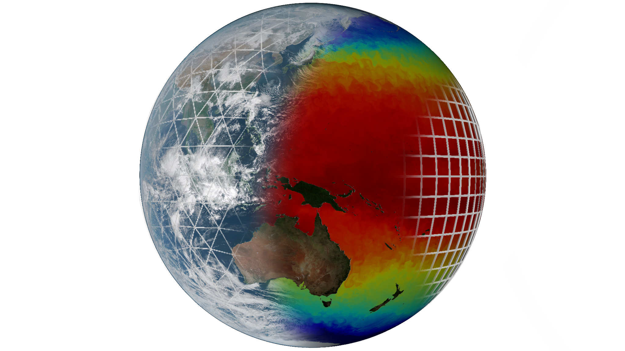
The EC-Earth model
Ocean - ICE: NEMO - LIM
Atmosphere:
IFS
Coupler:

Slide 3
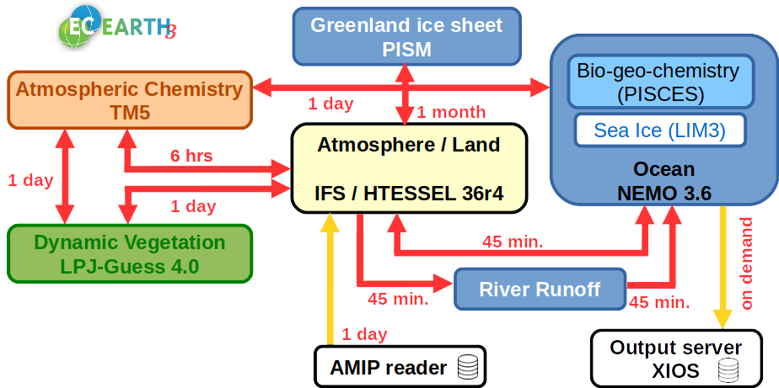
EC-Earth structure
~30 partner institutes
8 core partners
KNMI, AEMET, DMI, Met Éireann, FMI, IPMA, CNR-DTA, SMHI
Workgroups
Technical
Tuning and CMIP
Atmospheric Composition
Climate Prediction
Land Vegetation
Ocean
Paleoclimate
EC-Earth 4

Slide 4
Efficiency in Earth Science models
Especially critical in Earth science models
Simulations use a huge amount of computational resources
Data handling becoming an increasing bottleneck.
Future simulations will need much more resources
0.84M points
67.72M points
991M points
8,917M points

Slide 5
EC-Earth 3 coupled ~10 km
ESiWACE: EC-Earth ~10km coupled demonstrator
IFS cycle 36r4 for atmosphere
T1279L91: ~16 km grid point distance, 2.1 M grid points
NEMO-LIM3 v3.6 for ocean & sea-ice
ORCA12L75: ~9 km grid point distance, 13.2 M grid points*
Total 3D space points: 1,181kM vertices
* Including land points (up to 1/3 of the total)

Slide 6
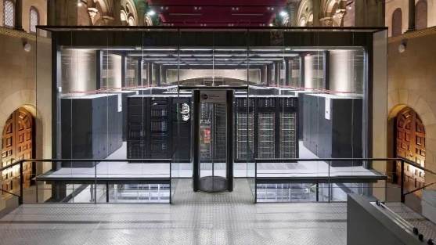
EC-Earth 3 - T1279-ORCA12 in MareNostrum 3
First global, coupled ~10km simulations
EC-Earth 3.2 (IFS36r4 + NEMO 3.6 + OASIS3-MCT)
2,035 MPI tasks - 60 SDPD
1,170 NEMO
848 IFS
16 XIOS (I/O server)
1 runoff mapper
MareNostrum3 @ BSC

Slide 7
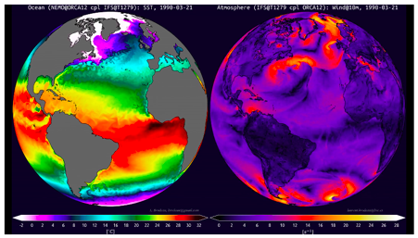
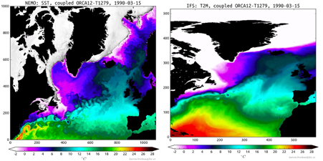
First EC-Earth T1279-ORCA12 results
First global, coupled ~10km simulations
Left, Global Sea Surface Temperature of the ocean component NEMO. Right, Global Speed Wind at 10m of atmosphere component IFS.
Left, regional crop Sea Surface Temperature of the ocean component NEMO. Right, regional crop Temperature at 2m of the atmosphere component IFS.

Slide 8
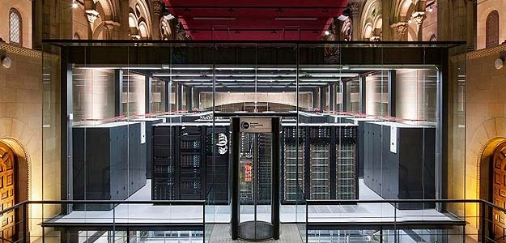
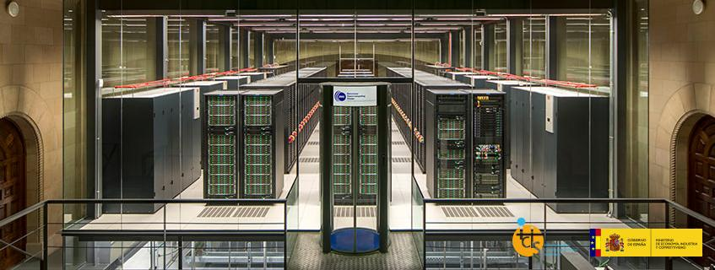
MareNostrum evolution
 | MareNostrum III (2012) | MareNostrum IV (2017)
Processor | Intel Xeon E5-2670 2.6 GHz | Intel Xeon Platinum 8160 2.1 GHz
#Cores per socket / #Sockets | 8 / 2 | 24 / 2
Memory | 32Gb DDR3-1600 | 96Gb DDR4-2667
Interconnection | Infiniband FDR10 10Gb | Intel Omni-Path 100Gb
MareNostrum IV – 11.15 petaFLOPS
MareNostrum III – 1.1 petaFLOPS

Slide 9
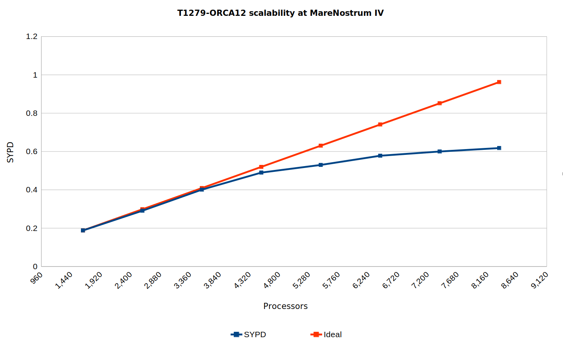
EC-Earth 3 - T1279-ORCA12 in MareNostrum 4

Slide 10
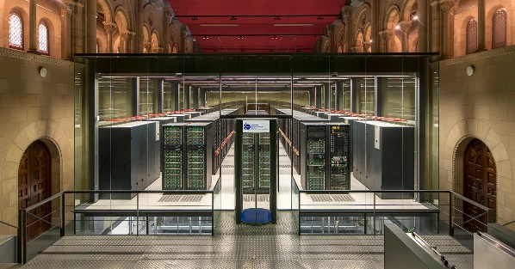
EC-Earth 3 - T1279-ORCA12 in MareNostrum4
Operational global, coupled ~10 km simulations:
EC-Earth 3.2 (IFS36r4 + NEMO 3.6 + OASIS3-MCT)
5,040 MPI tasks - 0.44 SYPD, 160 SDPD
3,209 NEMO
1,584 IFS
69 XIOS (I/O)
1 runoff mapper
MareNostrum4 @ BSC
100 year exp ~27M computing hours!!!

Slide 11
EC-Earth 3 - T1279-ORCA12: production runs
PRIMAVERA is a Horizon 2020 project which aims to develop a new generation of advanced and well-evaluated high-resolution global climate models, capable of simulating and predicting regional climate with unprecedented fidelity, for the benefit of governments, business and society in general.
The High Resolution Model Intercomparison Project (HighResMIP) is a CMIP6 endorsed MIP that applies, for the first time, a multi-model approach to the systematic investigation of the impact of horizontal resolution.

Slide 12
H2020: European HPC & science integration case
Research infrastructure
Climate science and HPC
HPC applications (CoEs)
Community

Slide 13
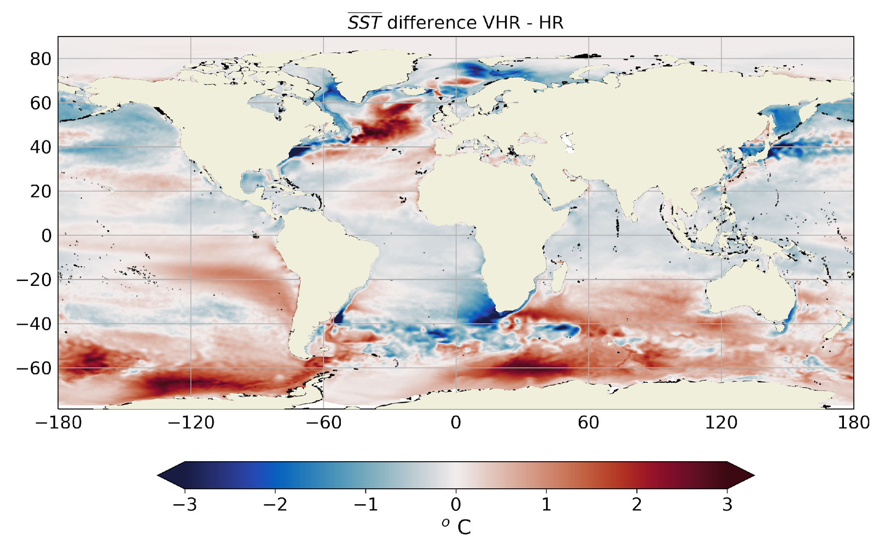
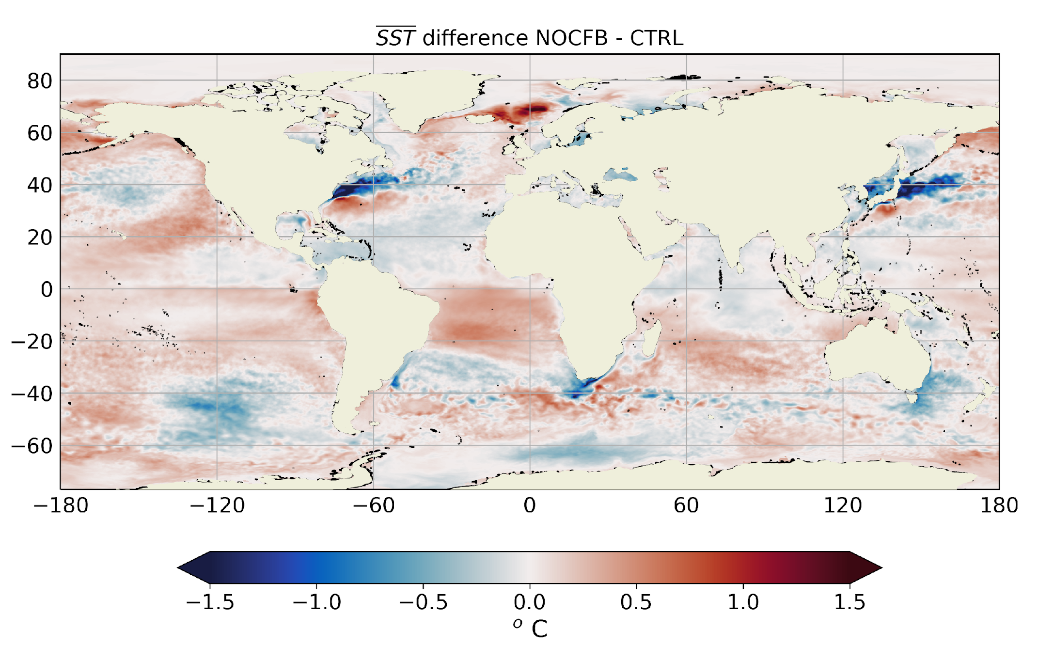
Scientific objectives
Develop and prepare a new generation of global high-resolution climate models
Evaluating global high-resolution climate models at a process level
Focus on air-sea interactions at oceanic mesoscale:
Thermal feedback
Evaluate the role of the mechanical interactions between oceanic surface currents and atmospheric winds (“current-feedback”)
Courtesy of: Thomas Arsouze

Slide 14
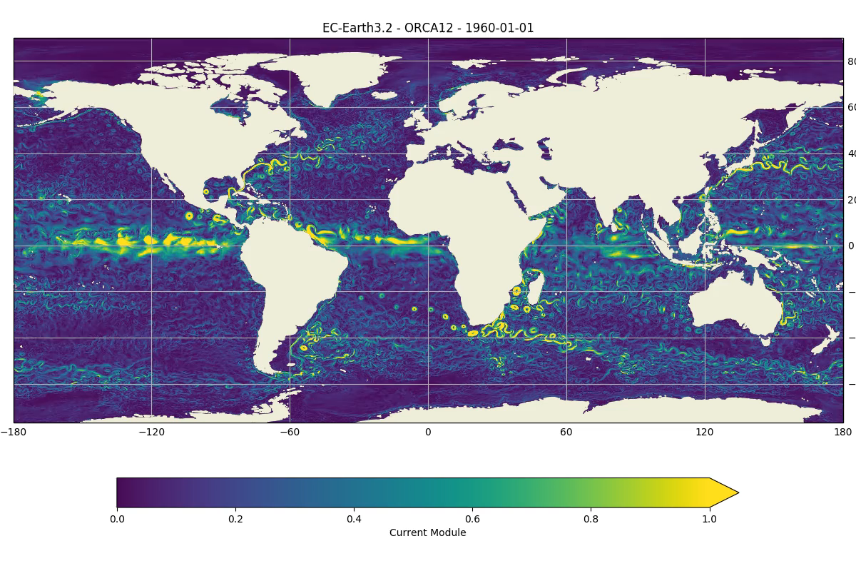
EC-Earth 3 - T1279-ORCA12: production runs
Courtesy of: Thomas Arsouze

Slide 15
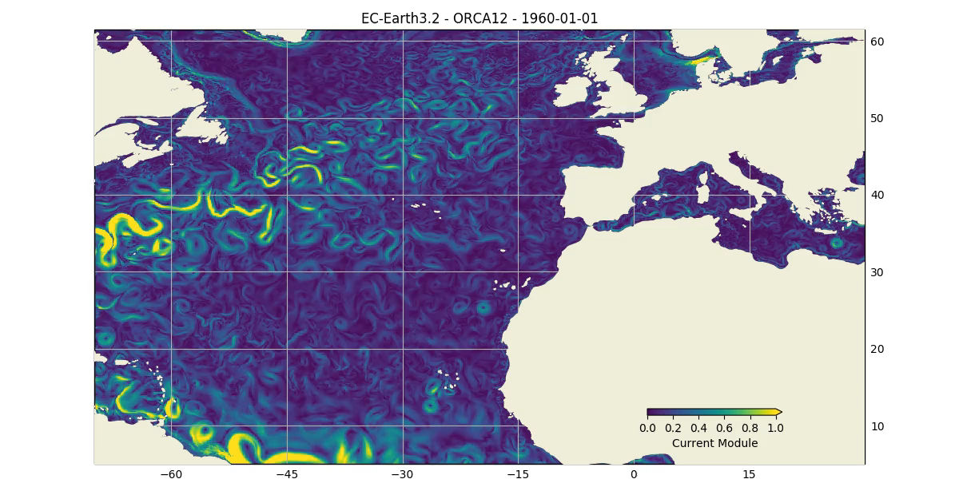
EC-Earth 3 - T1279-ORCA12: production runs
Courtesy of: Thomas Arsouze

Slide 16
EC-Earth 3 - T1279-ORCA12: Main bottlenecks
I/O overhead → Interface IFS with XIOS
Sea-ice scalability → Reduce global communications, couple through OASIS
Legacy atmospheric model (2010) → Update IFS to newest cycle, using octahedral grid

Slide 17
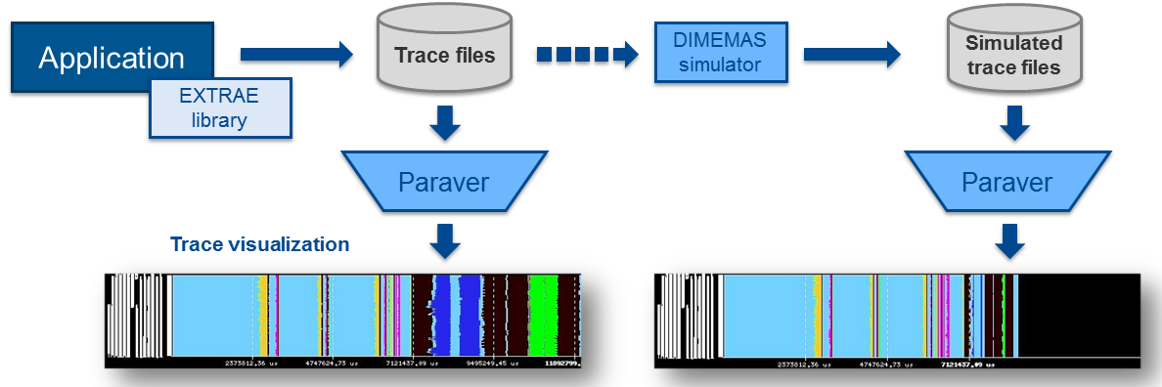
Performance analysis
From 1991
Based on traces
Open Source: https://tools.bsc.es
Extrae: Package that generates Paraver trace-files for a post-mortem analysis
Paraver: Trace visualization and analysis browser
Dimemas: Message passing simulator

Slide 18
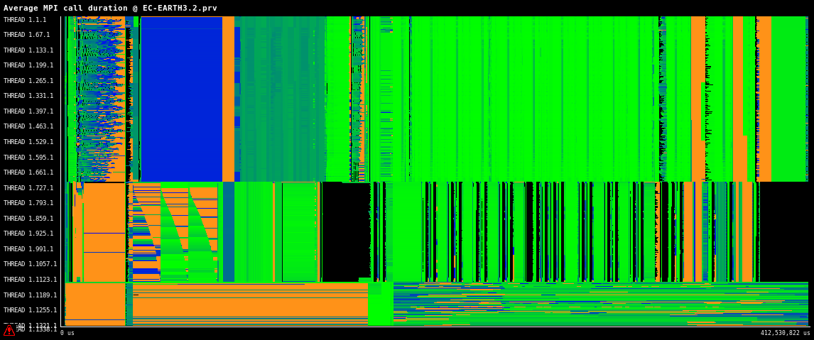
EC-Earth - T1279-ORCA12: Performance analysis

Slide 19
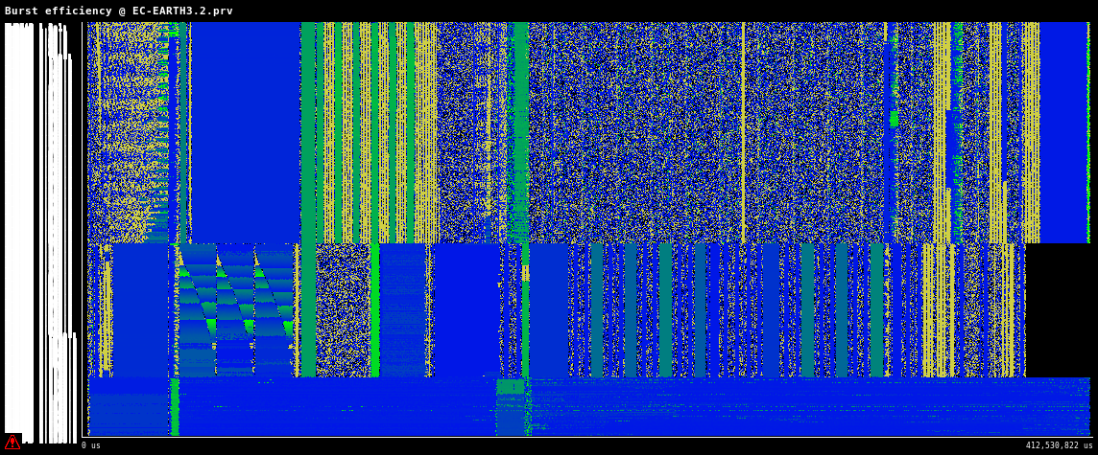
EC-Earth - T1279-ORCA12: Performance analysis

Slide 20
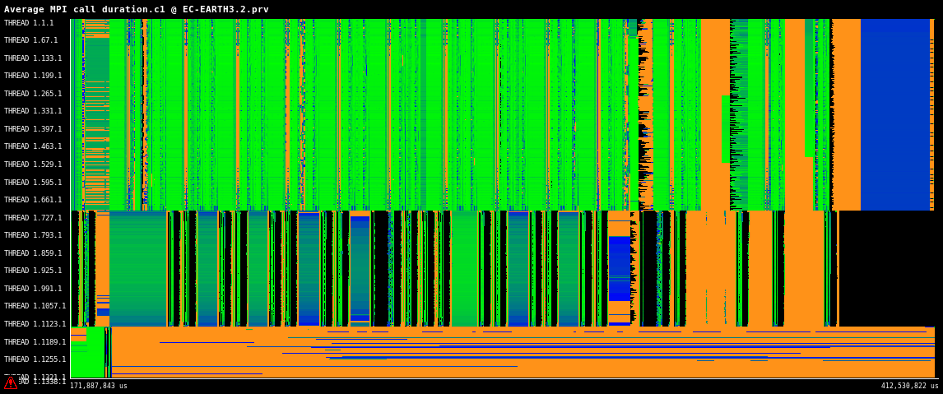
EC-Earth - T1279-ORCA12: Performance analysis

Slide 21
ESiWACE 2: EC-Earth coupled ~10 km production-mode
Develop infrastructure for production-mode configurations
Coupling infrastructure (OASIS)
Improvement of I/O (XIOS)
NEMO for high-resolution
Infrastructure for high-resolution data
Develop production-mode configurations
Port models to pre-exascale EuroHPC systems

Slide 22
ESiWACE 2: EC-Earth coupled ~10 km production-mode
Develop infrastructure for production-mode configurations
Develop production-mode configurations
Port models to pre-exascale EuroHPC systems

Slide 23
EC-Earth coupled ~10 km production-mode
ESiWACE2: EC-Earth 4 VHR coupled demonstrator
OpenIFS cycle 43r3 for atmosphere
Tco639L91: ~16 km grid point distance, 1.66 M grid points
NEMO-SI3 v4 for ocean & sea-ice
ORCA12L75: ~9 km grid point distance, 13.2 M grid points*
Total 3D space points: 1,141kM vertices
* Including land points (up to 1/3 of the total)

Slide 24
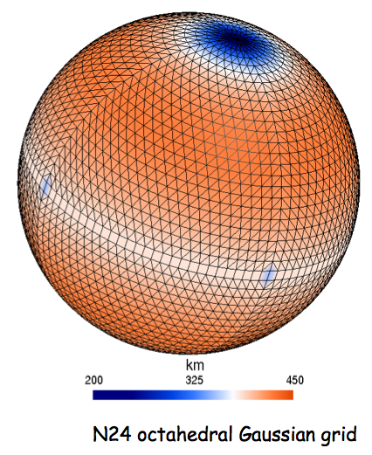
EC-Earth coupled ~10 km production-mode
Main assets
Brand new ESM: EC-Earth 4
OpenIFS cycle 43r3 (2020)
NEMO v4.0.2 (2019) (incl. SI3 sea-ice model)
OASIS3-MCT 4
Common asynchronous I/O server (XIOS v2.5)
Octahedral reduced gaussian grid for OpenIFS
Possibility to switch numeric precision

Slide 25
EC-Earth Tco639-ORCA12 production-mode
New VHR configuration development
Ocean
ORCA12 adapted from T1279-ORCA12 configuration in EC-Earth 3.
Atmosphere
Initial conditions for the Tco639 grid.
Coupler
OASIS coupler grids, masks and areas information using the OCP¹ tool.
OASIS remapping weights generated in parallel (OMP)².
¹ https://github.com/JanStreffing/ocp-tool
² OASIS3-MCT4 new feature

Slide 26
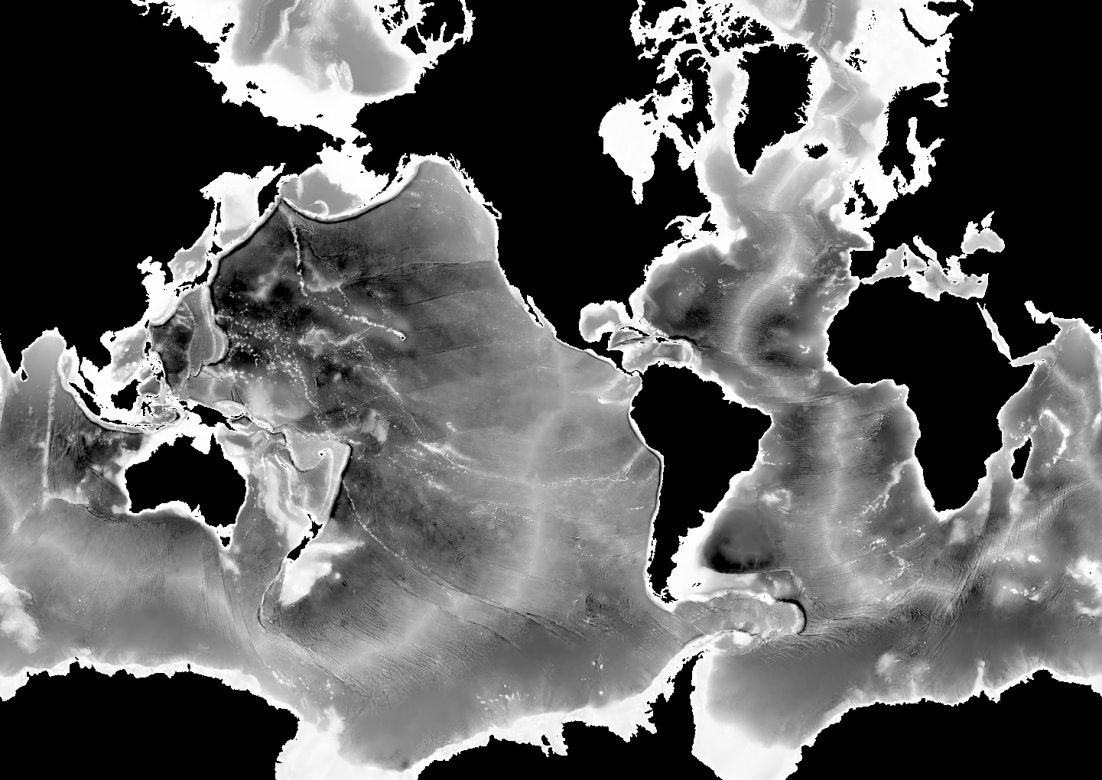
EC-Earth Tco639-ORCA12 production-mode
ORCA12 bathymetry

Slide 27
EC-Earth Tco639-ORCA12 production-mode
Objective: >1 SYPD
EC-Earth 3 T1279-ORCA12
0.44 SYPD
EC-Earth 4 Tco639-ORCA12
1 SYPD

Slide 28
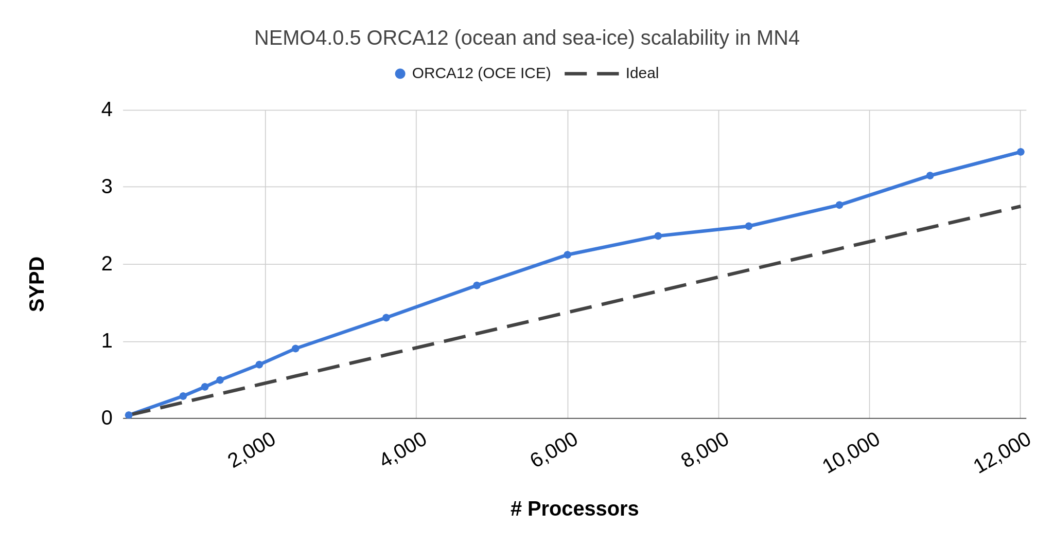
NEMO 4 - ORCA12 in MareNostrum 4
Objective for the coupled version

Slide 29
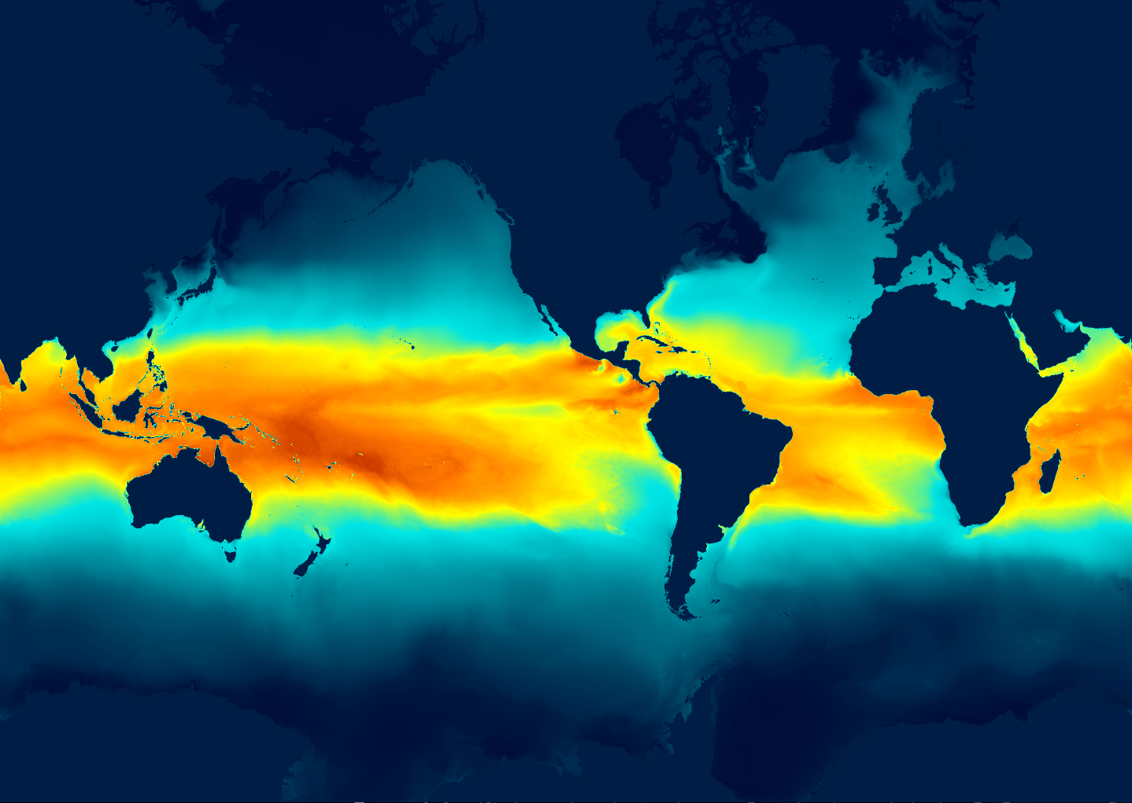
EC-Earth coupled ~10 km in production mode
Progress status
Deployment of EC-Earth 4 at MareNostrum 4.
NEMO (ORCA12) and OpenIFS (Tco639) configuration data and initial parametrizations.
Generation and testing of remapping weights.
Test runs. Test and tune output generation.
Fine tuning of the model’s parameters.
Spinup and generation of initial conditions.
Load balance and scalability analysis.
Performance study.
Mixed-precision?
Sea-surface temperature after 1 month

Slide 30
An operational EC-Earth workflow in BSC-ES
Model setup
Deployment on remote HPC
Initial data pre-processing
Configure experiment
Set up platform-specifics
Prepare run scripts
Synchronize model files
Deploy configuration files
Compile the model
Select and deploy initial data
Pre-process initial conditions
Simulation
Output post-processing
Verification & diagnostics
Run simulation
Assimilation / adaptive ensembles
Post-process output data
Archive restarts / output files
Transfer results
Calculate diagnostics
Generate visualization plots

Slide 31
Conclusions
First coupled ~10km configuration developed within ESiWACE:
Developed and shared among EC-Earth consortium partners
Deployed and tested in the BSC HPC systems
Used in production for different projects
Used to investigate very-high resolution scalability for coupled systems
~10 km production-mode configuration developed within ESiWACE2:
Solves the most important bottlenecks. Uses updated model components
Will be deployed and tested in the pre-Exascale EuroHPC systems
Will allow running efficient VHR simulations with a production throughput

Slide 32
Preparing NEMO and EC-Earth models for very high-resolution production experiments
Miguel Castrillo (BSC), Dorotea Iovino (CMCC), Clement Bricaud (Mercator Ocean)

Slide 33
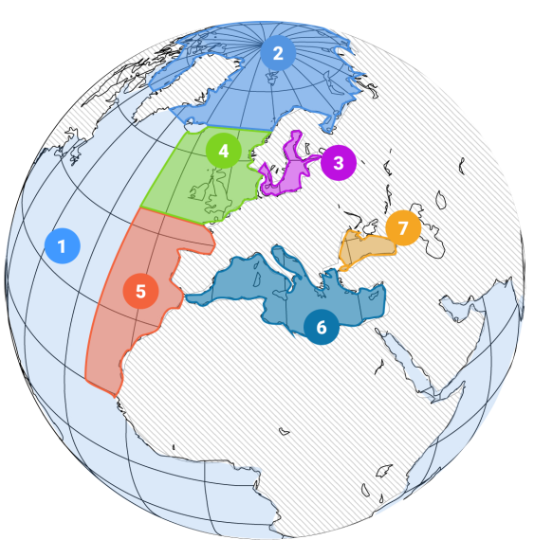
EU Copernicus Marine Service (CMEMS): Improve Ocean forecasting systems
ocean dynamic: HYCOM
sea-ice : EVP model
BGC: ECOSMO
ocean dynamic:
BGC: ERSEM
ocean dynamic: HBM
sea-ice : HBM
BGC: ERGOM
OGCM for: ocean dynamic
sea-ice
BGC
ocean dynamic:
BGC: BAMHBI
OGCM for: ocean dynamic
BGC
ocean dynamic :
BGC: BFM

Slide 34
Ocean forecasting: improve Ocean numerical representation
Improve data assimilation systems with new observing platforms
increase in the amount of collected observations
enhancement of their accuracy
the time and space resolution of observations improved
Description of finer scales improved
SST/microwaves sensors: resolution of about 25 km, whereas
SST/infrared sensors: resolution down to the kilometric scale.
SSH/SWOT scales until 15 to 30 km whereas actual altimeters are limited to 150 km.

Slide 35
Ocean forecasting: improve Ocean numerical representation
Improve numerical model for a better
representation of the circulation in the open ocean
representation of energy transfers between finer and larger scales
understanding of scales contributions (geostrophic flows, tidal motions, waves, inertial currents)
=> Resolve scales below 100 kilometers, in particular sub mesoscale processes (1-50 km)

Slide 36
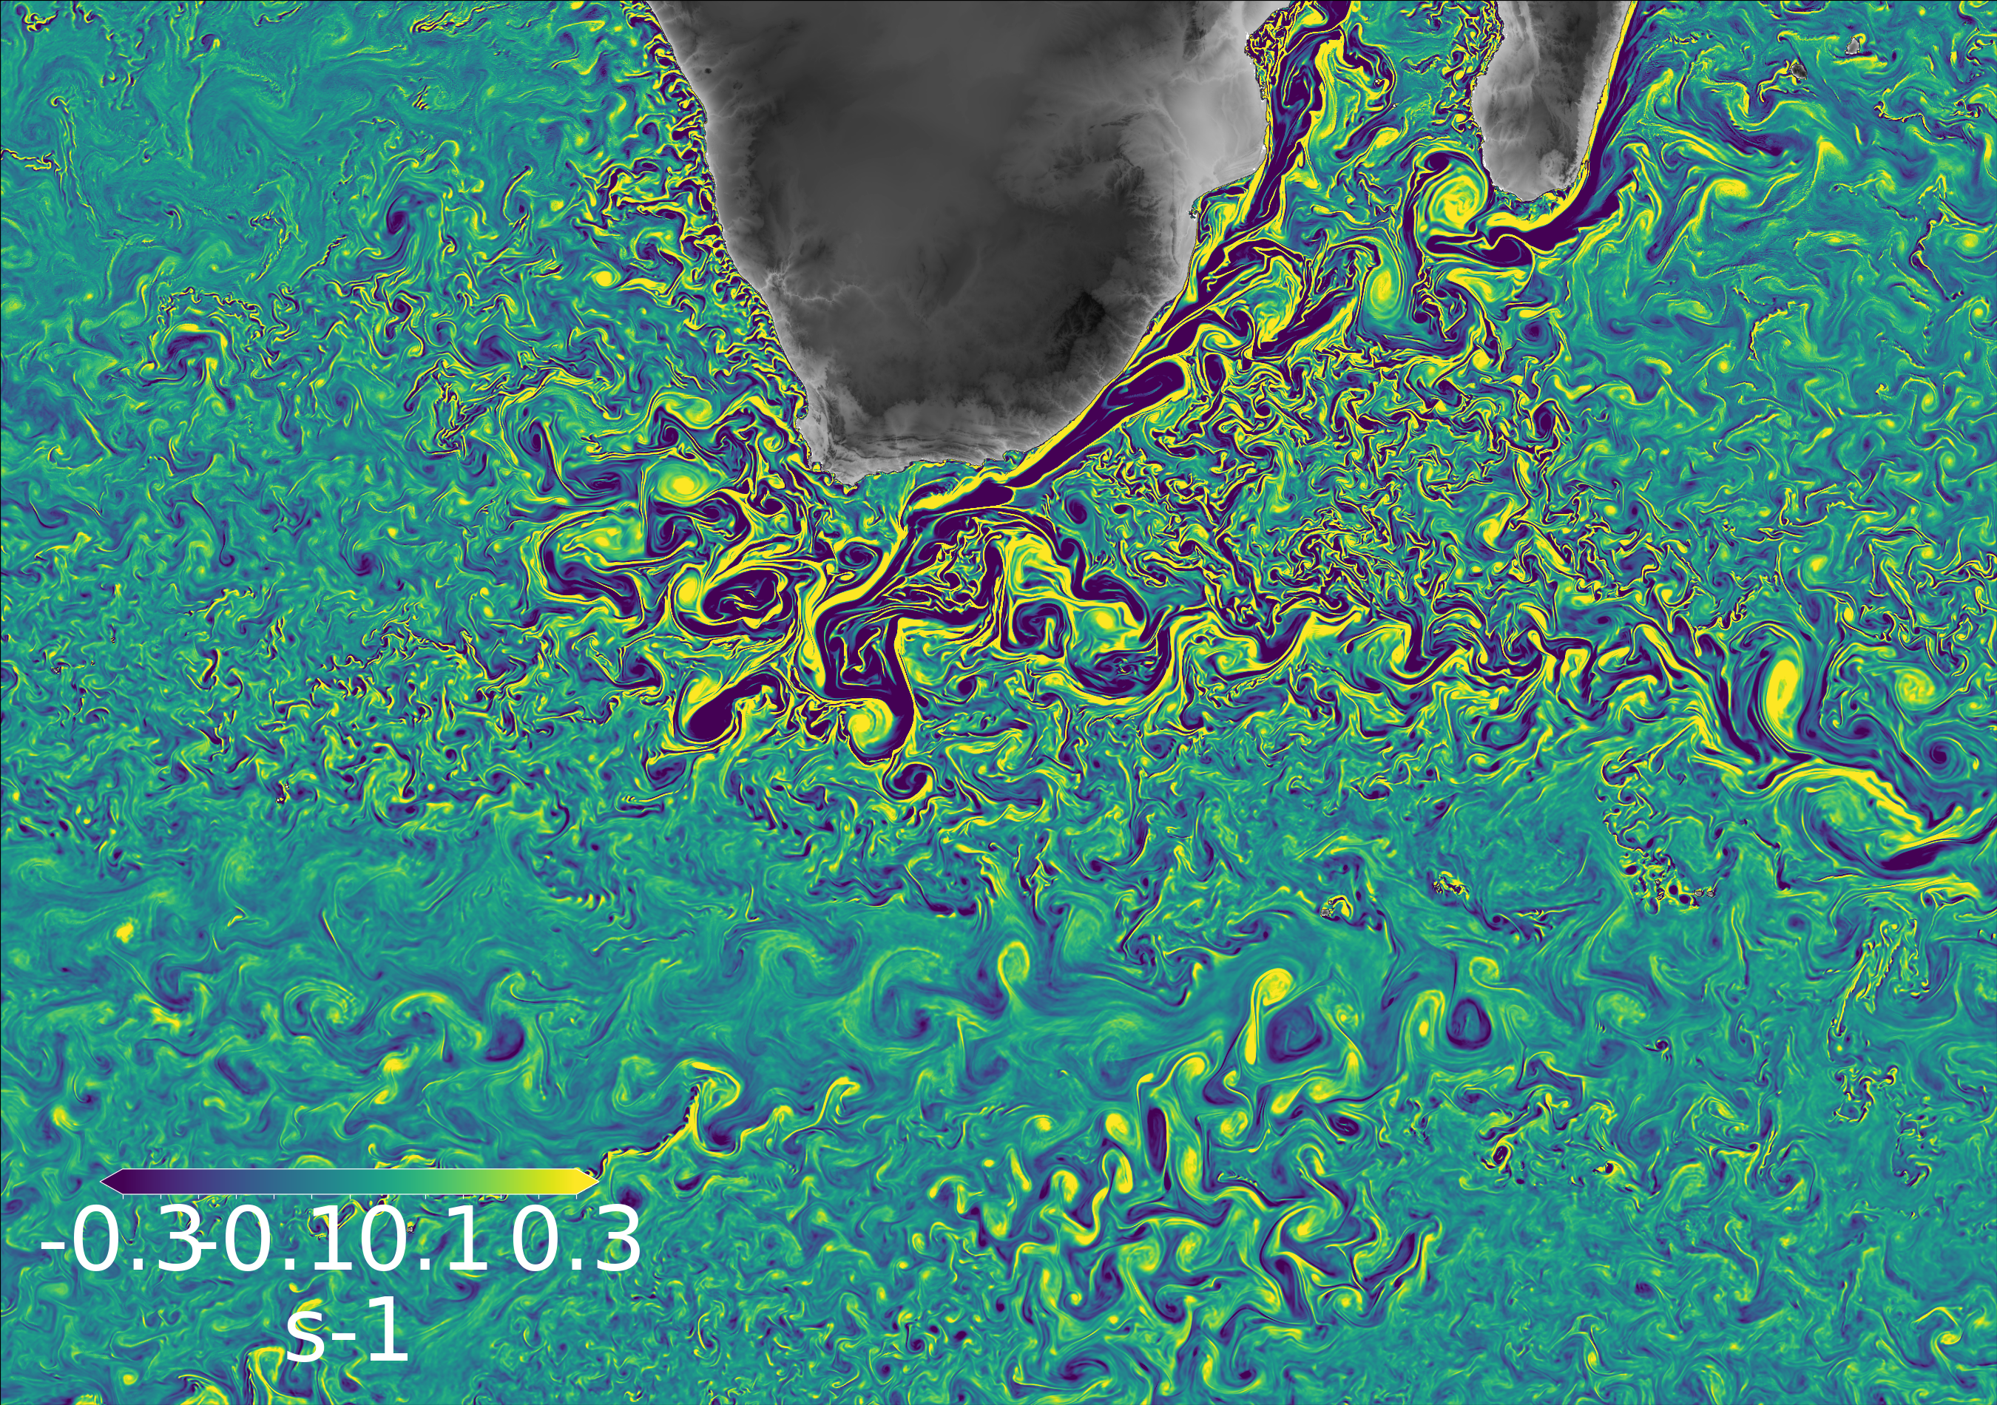
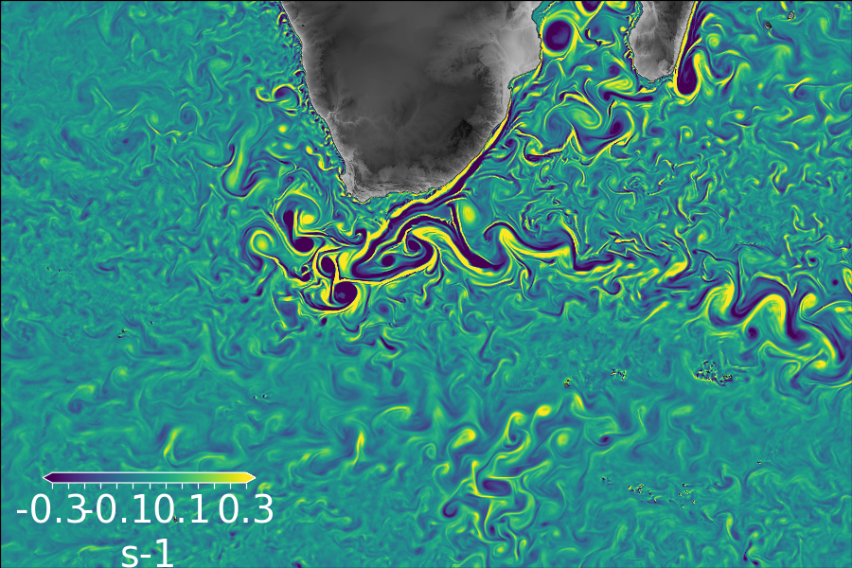
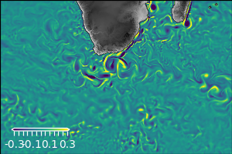
Improve Ocean numerical model
1/36°
Improve ocean regime: increase grid resolution
Improve model physic and parametrizations
Non-linear free surface (variable volume), multi-category sea ice model,…
Improve numerical representation
higher order numerical schemes for advection
Tracers: 4th order FCT scheme Momentum: 3rd order UBS scheme
Atmospheric forcing
increase space and time resolution: 16km to 9 km and 3 hours to 1 hour
regime | Resolution (°) | Resolution (km) | Operated (since)
Eddy-permitting | ¼° | 20-25 km | 2005
Eddy-resolving | 1/12° | 6-9 km | 2009
Submesoscale-permitting | 1/36° | 2-3 km | 2024?
1/12°
¼°

Slide 37
Improve Ocean numerical model
1/36°
Improve ocean regime : increase grid resolution
Advection: higher ordrer numerical schemes
Tracers: 4th order FCT scheme
Momentum: 3rd order UBS scheme
Improve model physic and parametrizations:
Non-linear free surface (variable volume), multi-category sea ice model,…
Atmospheric forcing: increase space and time resolution
16km to 9 km and 3 hours to 1 hour
regime | Resolution (°) | Resolution (km) | Operated (since)
Eddy-permitting | ¼° | 20-25 km | 2005
Eddy-resolving | 1/12° | 6-9 km | 2009
Submesoscale-permitting | 1/36° | 2-3 km | 2024?
1/12°
¼°
More operations
More memory access
More memory capacity
More I/0

Slide 38
Improve numerical models HPC performances
What running a high-resolution model imply ?
More operations
More memory access
More memory needed
More I/0
What we need to do ?
Adapt model to new architectures
Improve operations speed
Improve exploitation of memory hierarchies
Improve communications
Improve I/Os

Slide 39
Improve numerical models HPC performances
ESIWACE2 project (EU H2020)
improve efficiency and productivity of numerical weather and climate simulation and prepare them for future exascale systems
prepares the European weather and climate community to make use of future exascale systems in a co-design effort involving modelling groups, computer scientists and HPC industry
IMMERSE project (EU H2020)
Develop a new, efficient, stable and scalable NEMO reference code with improved performances adapted to exploit future HPC technologies in the context of CMEMS systems
Develop NEMO for the challenges of delivering ocean state estimates and forecasts describing ocean dynamics and biogeochemistry at kilometric scale with improved accuracy
ORCA36= high resolution configuration used as a bench
For developements « dedicated » to HPC

Slide 40
Improve numerical models HPC performances
Project: SWOP: the Submesoscale-permitting World Ocean Project
24M CPU hours obtained with the 22th PRACE call on the BSC MareNostrum IV
2 objectives:
Test HPC development on NEMO4 with ORCA36 configurations
Perform a multi year hindcast forced with the ECMWF high resolution / high frequency IFS dataset
Compare 2 hindcasts without/with tidal forcing
Transfer and dissemination on the EU WEKEO DIAS

Slide 41
The ”ORCA36” 1/36° global configuration
Based on NEMO 4
Horizontal grid : tripolar ORCA grid, (2-3km), 12960 * 10850 points
Vertical grid: 75 Z-levels, 1 meter at surface
Ocean dynamic and SI3 sea-ice models
Bathymetry based on GEBCO 2019
Forcing datased based on ECMWF IFS (HRES/1 hour) system

Slide 42
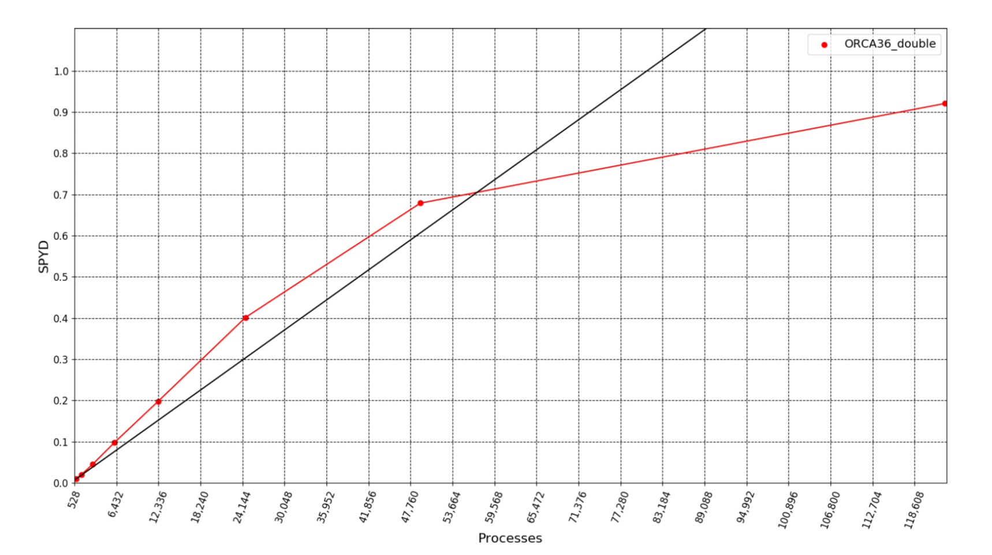
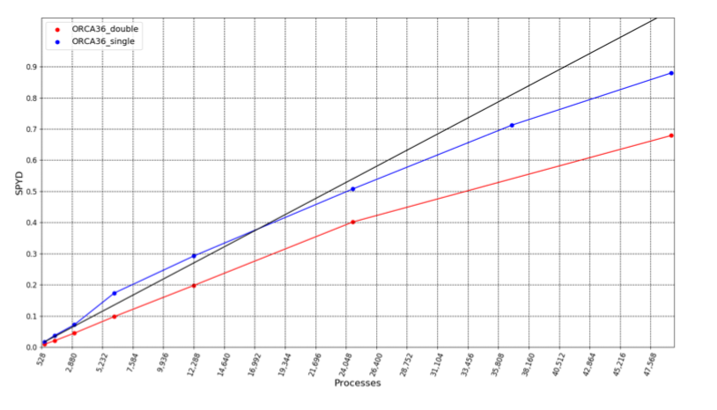
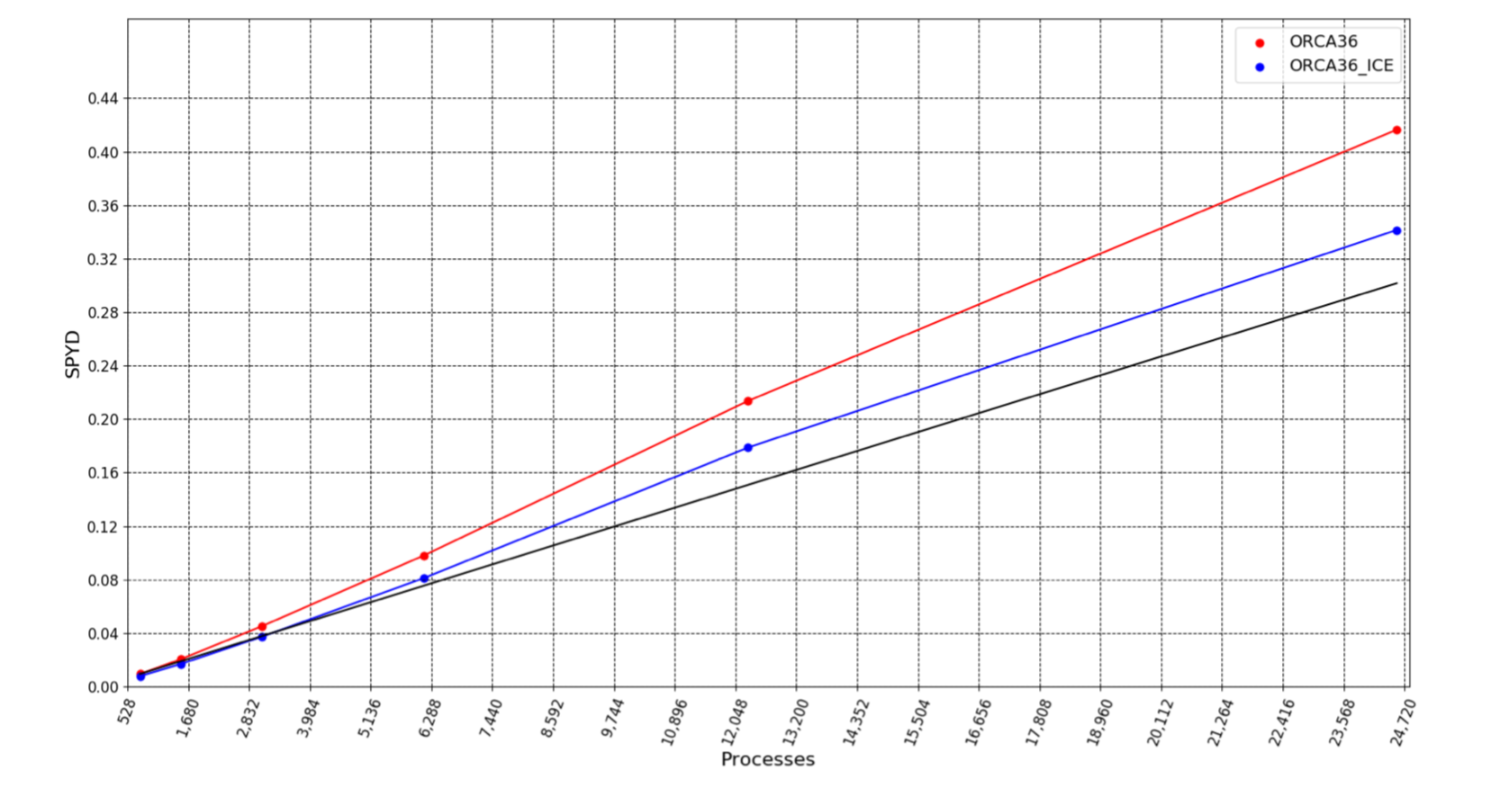
ORCA36: first tests of scalability
CMEMS contract with BSC:
« 87-GLOBAL-CMEMS-NEMO: EVOLUTION AND OPTIMISATION OF THE NEMO CODE USED FOR THE MFC-GLO IN CMEMS » :
Miguel Castrillo, Mario Acosta, Oriol Tintó Prims, Kim Serradell
ORCA36 scalability
(no forcing, no sea-ice, no outputs)
Simple vs double precision
ORCA36 scalability
(no outputs)
Sea-ice model impact
ORCA36 scalability
(no forcing, no sea-ice, no outputs)
Scalability tested up to 122 000 cores
Good scalability up to 50 000 cores
Single precision improves scalability of the double precision version

Slide 43
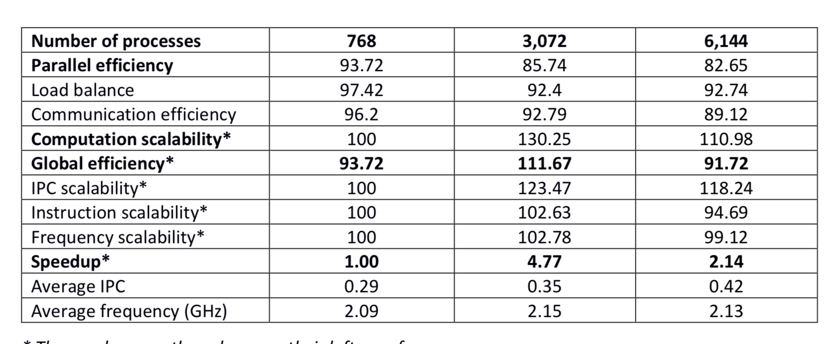
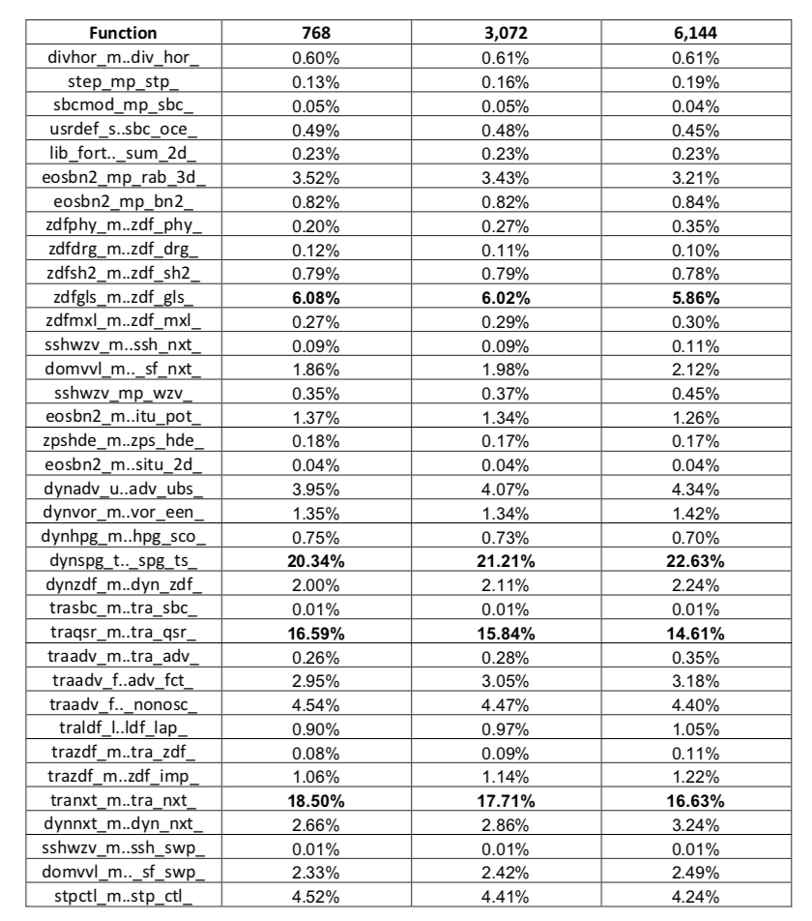
ORCA36: first tests of scalability
Proportion of useful instructions
(those not involved in MPI communication)
performance metrics
most of these instructions are Load and Stores and not floating point operations.
Impact of code writing or compiler optimization?
* These values use the column on their left as reference.
parallel efficiency decreases with the scale
gains in computational efficiency due to the increase in instructions per cycle (IPC).
better exploitation of the shared resources
faster memory operations

Slide 44
ORCA36: first tests of scalability
Time-to-solution for a 5 days run ( as for forecasting)
Performed on the new Météo France ATOS/BULL computer
10.000 cores | 3H40
20.000 cores | 1H55
30.000 cores | 1H15
40.000 cores | 1H20
Elapsed time for a 5 days run

Slide 45
HPC developments in NEMO 4
tilling method
loop fusion
better use the memory hierarchy and improve the memory access
increase halos (=local domain overlapping band)
Introduction of MPI3 and activation of collective neighbours communications
decrease the cost of communication between the different processes
Mixed precision
decrease the computational cost and the memory consumption

Slide 46
HPC developments in NEMO 4
compute diagnostics on GPUs
improve the scalability
XIOS I/O servers already used with NEMO OGCM only for model outputs
Activation of model restarts reading and writing with XIOS
Use 2 levels of servers in XIOS
=> Improve I/O performances

Slide 47
Thank you!
The ESiWACE project has received funding from the European Union’s Horizon 2020 research and innovation program under grant agreement No 675191
The IMMERSE project has received funding from the European Union’s Horizon 2020 research and innovation programme under grant agreement No 823988
This material reflects only the author's view and the Commission is not responsible for any use that may be made of the information it contains.
miguel.castrillo@bsc.es dorotea.iovino@cmcc.it cbricaud@mercator-ocean.fr

