Slide 1
Subseasonal to seasonal climate predictions for energy: the S2S4E project
International Conferences on Subseasonal to Decadal Prediction, Boulder 19 Sept 2018
Albert Soret⁽¹⁾, Llorenç Lledó⁽¹⁾, Andrea Manrique-Suñén⁽¹⁾, Verónica Torralba⁽¹⁾, Nicola Cortesi⁽¹⁾, Jaume Ramón Gamón⁽¹⁾, Nube González-Reviriego⁽¹⁾, Pierre-Antoine Bretonnière⁽¹⁾, Ilaria Vigo⁽¹⁾, Isadora Christel⁽¹⁾, Francisco J. Doblas-Reyes,^{(1,2)}
(1) Barcelona Supercomputing Center (BSC), Barcelona, Spain
(2) Institució Catalana de Recerca i Estudis Avançats (ICREA), Barcelona, Spain

Slide 2
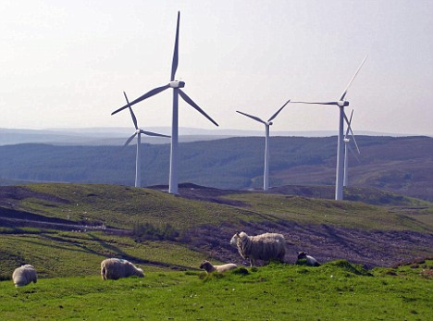
Context and motivation
Both energy supply and demand are strongly influenced by meteorological conditions and their evolution over time in terms of climate variability and climate change.
Notes:
Both energy supply and demand are strongly influenced by weather conditions and their evolution over time in terms of climate variability and climate change. The sensitivity of electricity demand to temperature is significant. While in northern Europe, cold spells during winter represent high-risk periods for the energy security of large areas (Ely et al., 2013), in southern Europe hot spells during summer are the source of high risk to the energy network stability (Pardo et al., 2002).
Despite cost competitive in many settings, renewable energy diffusion remains limited largely due to its variability. This works as a major barrier to renewable energies integration in electricity networks as knowledge of power output and demand forecasting beyond a few days remains poor.
The highest priority for the energy network operators is the balance between electricity demand and supply. Before the introduction of renewable energies, the demand was matched with base-load power plants (coal and nuclear) and generating plants that can be scheduled, usually hydroelectric and fossil-based power plants. This landscape has been changing rapidly with the integration of wind and solar energies into the energy mix over recent years. The increase has been particularly significant in wind energy which had rate of growth of 17% in 2014-2015 (GWEC, 2016), reaching near to 370 GW of installed capacity worldwide in 2014 (WWEA, 2015).This increase of renewable energy resources implies the introduction of new generation capacity that is dependent on a highly variable weather/climate (Spiecker and Weber, 2013).

Slide 3
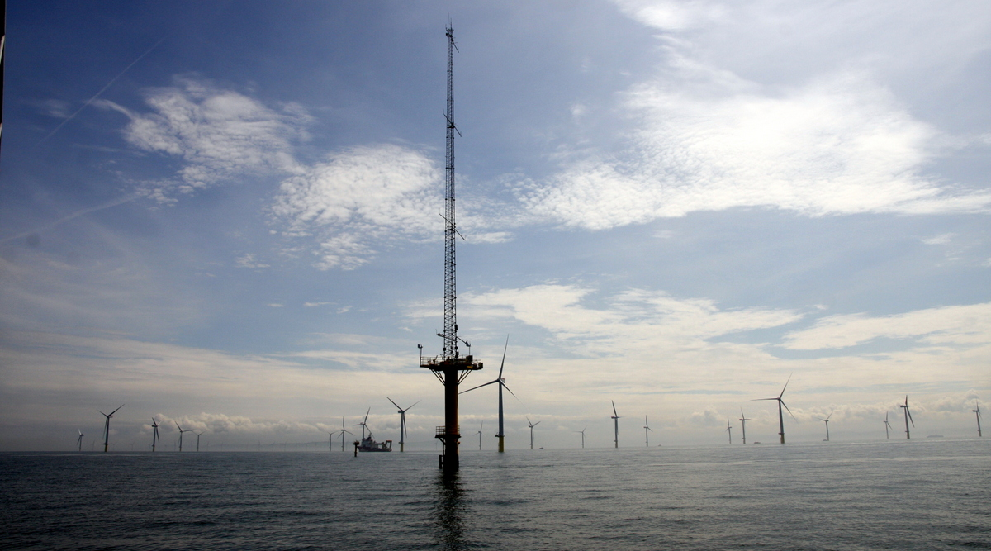
Context and motivation
Energy sector routinely uses weather forecast up to several days. Beyond this time horizon, climatological data are used.
Met mast on Gwynt y Môr offshore wind farm (source: solar wheel)
Days
Months
Seasons
Years
Decades
Hours
Weeks
MEDIUM RANGE FORECAST
SUBSEASONAL PREDICTION
SEASONAL PREDICTION
CLIMATE
PROJECTION
Notes:
While the energy sector has routinely been using weather forecasts of up to 15 days (Dubus, 2010), beyond this time horizon, climatological data (typically 30-year averages) are used. A common assumption in this method is that future conditions will be similar to past conditions. This assumption entails two inherent shortcomings. The first one is that past conditions can be highly variable, which can make them of limited use to forecast future ones. The second one is that climatology cannot predict events which have never happened before, e.g. extreme events, which can be particularly harmful and whose prediction is of special interest for stakeholders. Our knowledge of climatology is based on a finite sample of past events. This sample is limited in time, and doesn’t need to be fully representative of what can happen. Moreover, a climatological approach does not take into account changes in atmospheric dynamics, such as those caused by climate change. Climate change may render past conditions useless for predicting future events, as they may no longer be reproduced.

Slide 4
S2S4E objective

Slide 5
Objective
S2S4E will offer an innovative service to improve RE variability management by developing new research methods exploring the frontiers of weather conditions for future weeks and months.
The main output of S2S4E will be a user co-designed Decision Support Tool (DST) that for the first time integrates sub-seasonal to seasonal (S2S) climate predictions with RE production and electricity demand.

Slide 6
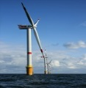
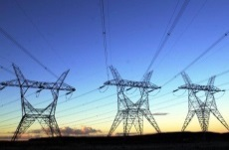
Applications
Weather forecast
Climate predictions
Climate projections or multidecadal
Sub-seasonal
Seasonal
Decadal
1-15 days
10 d-1 month
1-6 months
1-30 years
20-100 years
Applications for wind/solar/hydro generation
Post-construction decisions
Energy producers:
commit energy sales for next day
Grid operators: Market prices and grid balance
Energy traders: Anticipate energy prices
Plant operators: planning for cleaning and maintenance
Post-construction decisions
Energy producers: Resource management strategies
Energy traders: Resource effects on markets
Plant operators: Planning for maintenance works, especially offshore wind O&M
Plant investors: anticipate cash flow, optimize return on investments
Pre-construction decisions
Power plant developers: Site selection. Future risks assessment.
Investors: Evaluate return on investments
Policy-makers: Assess changes to energy mix
River-basin managers: understand changes to better manage the river flow
Applications for demand
Daily operation decisions
Grid operators:
Anticipate hot/cold days.
Schedule power plants to reinforce supply.
Energy traders: Anticipate energy prices.
Mid-term planning
Grid operators:
Anticipate hotter/colder seasons Schedule power plants to reinforce supply.
Energy traders:
Anticipate energy prices.
Long-term planning
Grid operators:
Anticipate addition of more capacity. Adaptation of transmission lines
Policy-makers:
Plan addition of more capacity.
Understand changes to energy mix
S2S4E project

Slide 7
Challenges and opportunities

Slide 8
S2S Forecast ranges and skill
Qualitative estimate of forecast skill based on forecast range from short-range weather forecasts to long-range seasonal predictions, including potential sources of predictability. Relative skill is based on differing forecast averaging periods. (Source: White et al., 2017 )

Slide 9
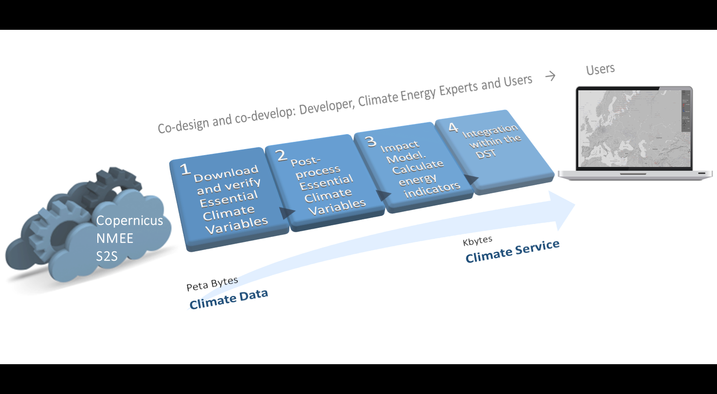
From data to service

Slide 10
Climate services
User: How much energy will I produce next month?
Scientist: Skill assessment, bias adjustment, probabilistic information, etc.
Notes:
Climate predictions (Figure 1) including both sub-seasonal (up to one month) and seasonal predictions (for the forthcoming months) have witnessed considerable improvements in the last decade demonstrating that probabilistic forecasting can inform better decision making at some temporal scales and regions (Alessandri et al., 2011, Doblas-Reyes et al., 2013). However, despite this improvement, climate predictions come with a new set of challenges for users: information is often un-tailored and hard to understand or apply in a decision-making context. Further research is needed to broaden our knowledge of the predictability and usability of S2S predictions and the requirements of energy companies and transmission system operators.

Slide 11
Methodology and first results

Slide 12
Methodology
Economic analysis
Assessment operational
real-time forecast
Operational real-time forecast
Improved operational real-time forecast
Define user needs
Model case studies
Data integration and processing
Improve model skill
DST
Development

Slide 13
First results
Reanalyses comparison: trends, interannual variability, etc.
ERA – Interim
MERRA-2
JRA – 55
NCEP - R2
ERA – 5
Case Studies:
Wind drought in the US, Jan-Mar 2015
Heat wave and wind drought in Spain, Sept 2016
Poster presentation: Analysing the uncertainty of reanalyses to assess the predictability at S2S time- scales of key climate and energy variables for the energy sector. Wed 19th Sep P-A4-02
Poster presentation: Wind drought episodes in the US and Europe: the power of case studies . Wed 19th Sep Foothills Lab P-B4-04
Lledó et al., 2018: Investigating the effects of Pacific sea surface temperatures on the wind drought of 2015 over the United States. Journal of Geophysical Research

Slide 14
Case study: wind drought in US

Slide 15
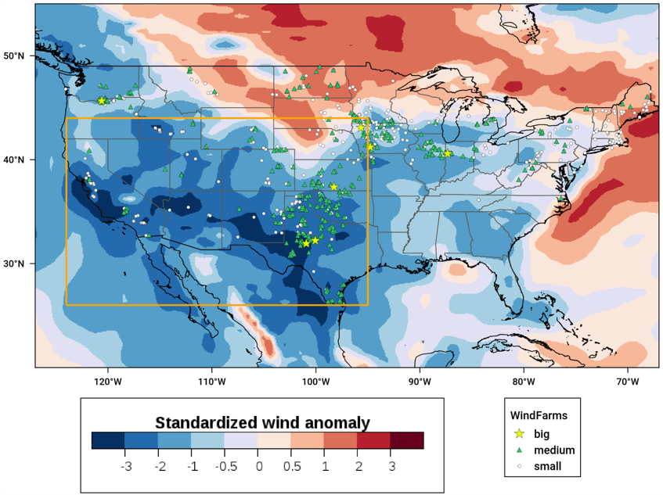
Wind drought in US
During the first quarter of 2015 the United States experienced a widespread and extended episode of low surface wind speeds. This episode had a strong impact on wind power generation. Some wind farms did not generate enough cash for their steady payments, and the value of wind farm assets decreased.
Wind speed anomalies reflecting the wind drought over the United States for the first trimester of 2015. The US wind farm fleet is also shown.

Slide 16
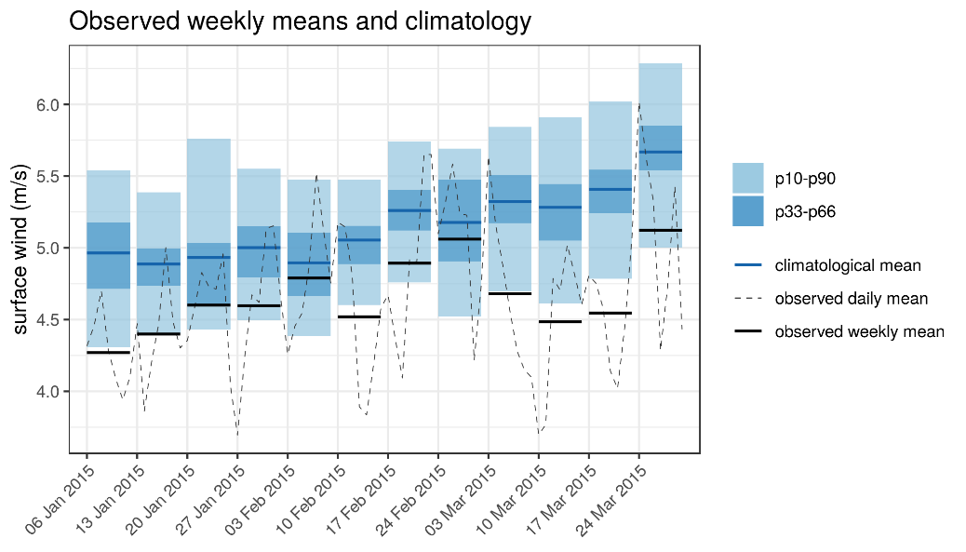
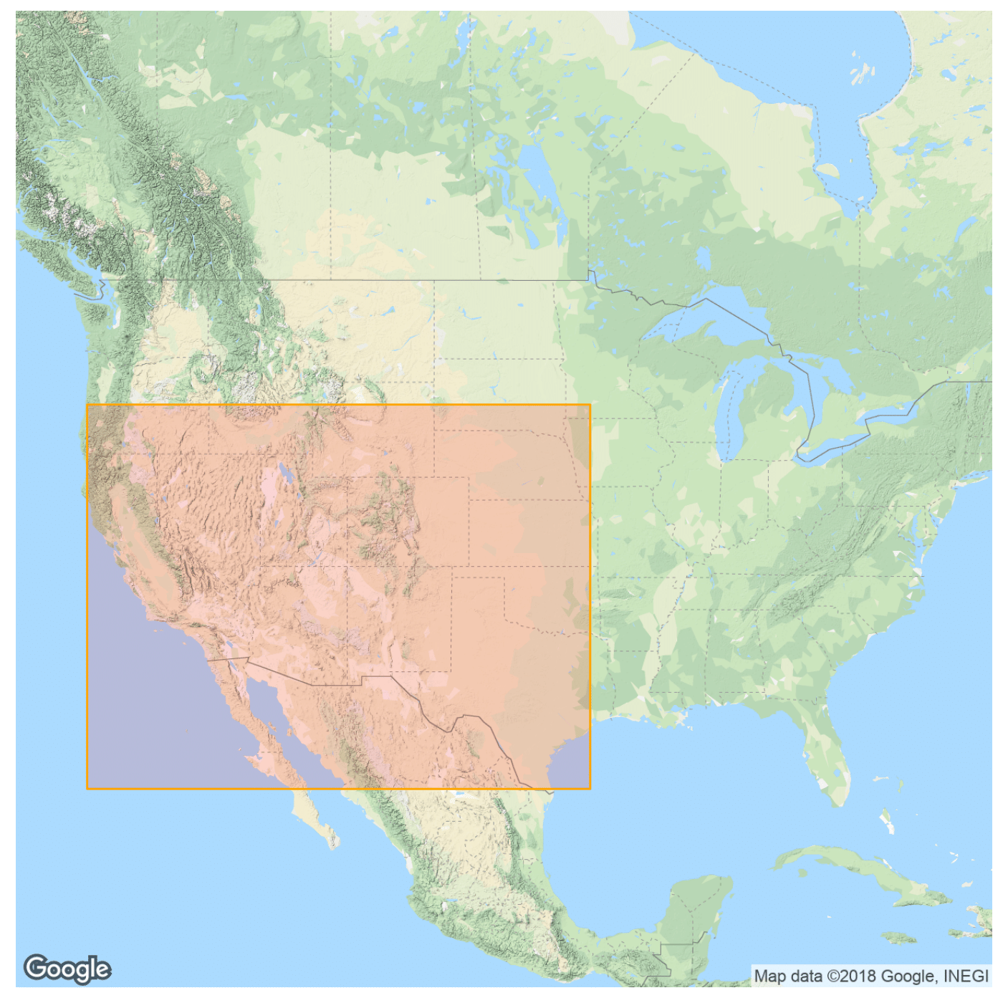
Wind drought in US
During the first quarter of 2015 the United States experienced a widespread and extended episode of low surface wind speeds. This episode had a strong impact on wind power generation. Some wind farms did not generate enough cash for their steady payments, and the value of wind farm assets decreased.

Slide 17
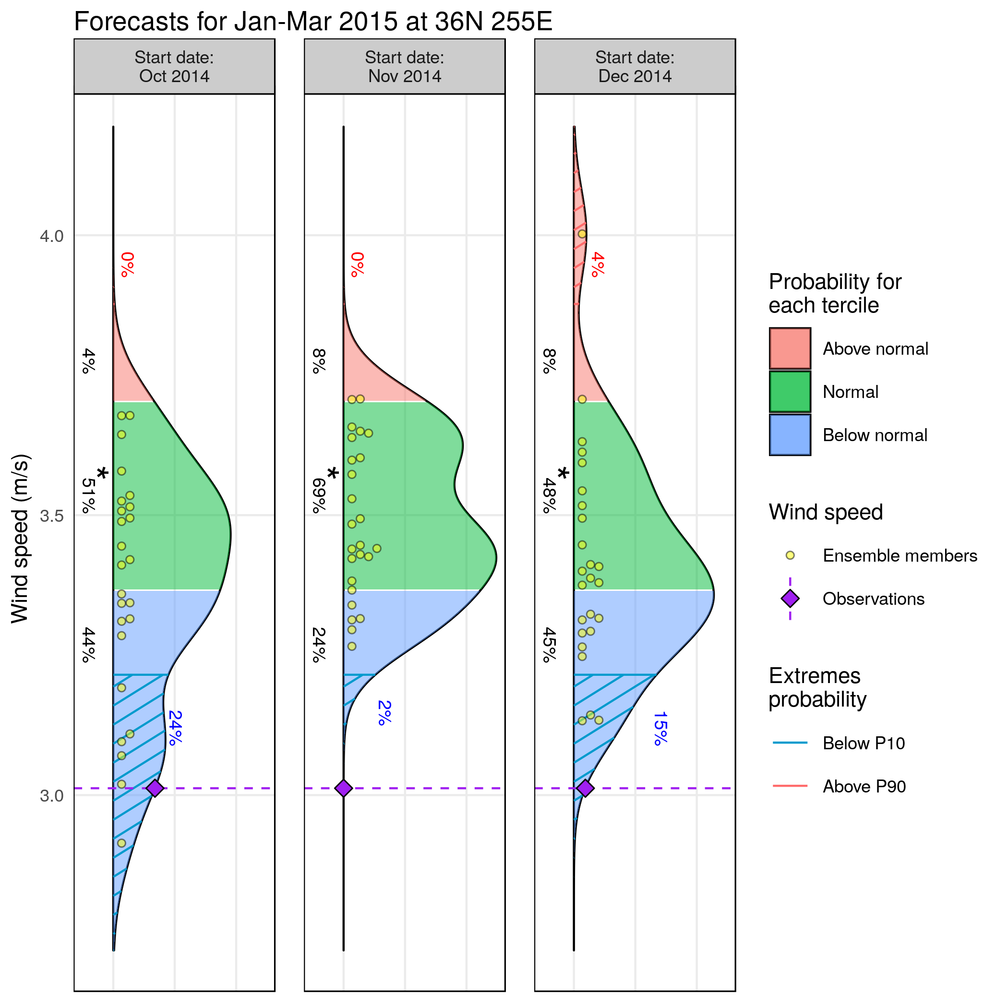
Available seasonal forecast
System: ECMWF SEAS5
Reanalysis: ERA-Interim
Bias adjusted –calibrated
Hindcast: 1993-2015
Lat= 36 N/Lon = 255 E
RPSS: 0.35
RPSS: 0.39
RPSS: 0.35
Which decisions would you take in view of those forecasts?

Slide 18
Case study: heat wave and wind drought in Spain. Sep 2016

Slide 19
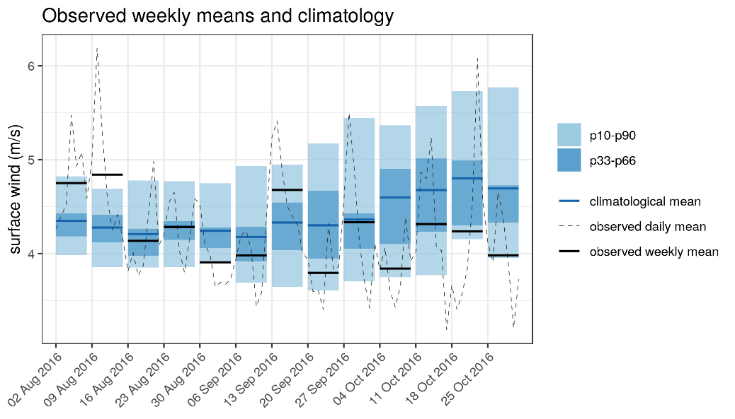
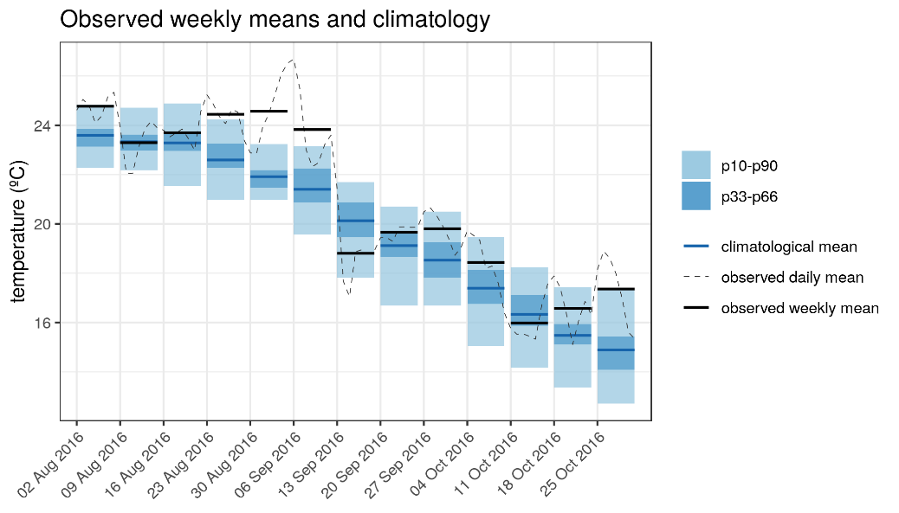
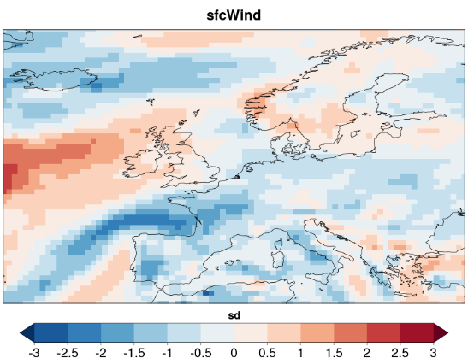
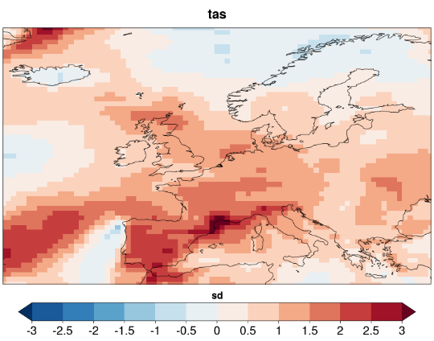
Heat wave and wind drought in Spain. Sep 2016
The hot spell over Europe created a combination of large increase in electricity demand and lower than usual hydro and wind power generation.
Surface wind and temperature standardized anomalies for the week 30/08/2016-5/09/2016.
ERA-Interim with respect to climatology (1981-2017)

Slide 20
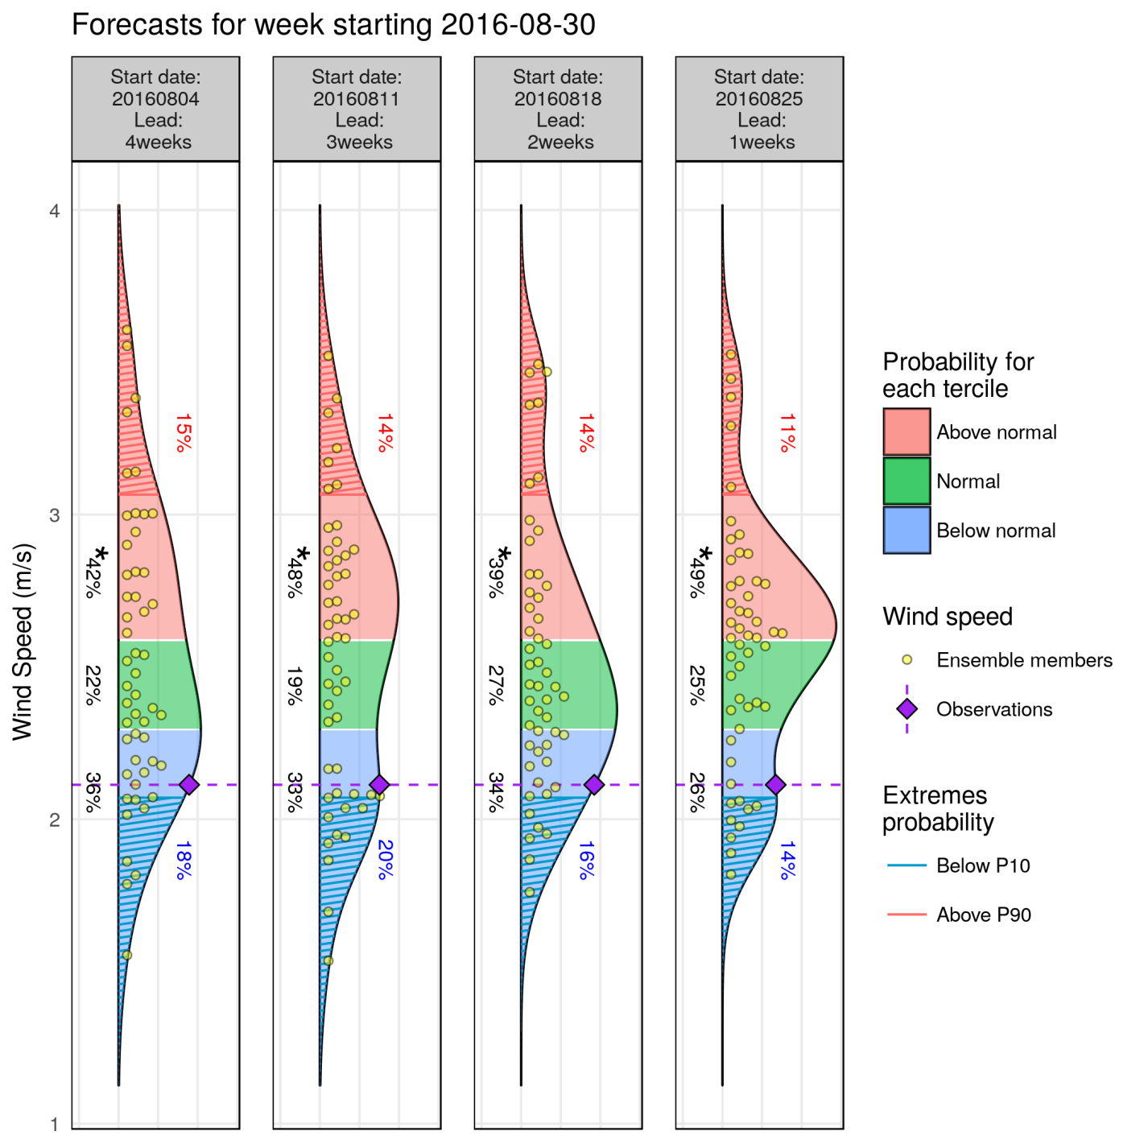
Forecast available: wind speed
System: ECMWF monthly prediction system
Reanalysis: ERA-Interim
Bias adjusted –calibrated
Hindcast: 1996-2015
Lat= 40.5 N/Lon = 358.5 E
fairRPSS: -0.01 -0.02 0.02 0.09

Slide 21
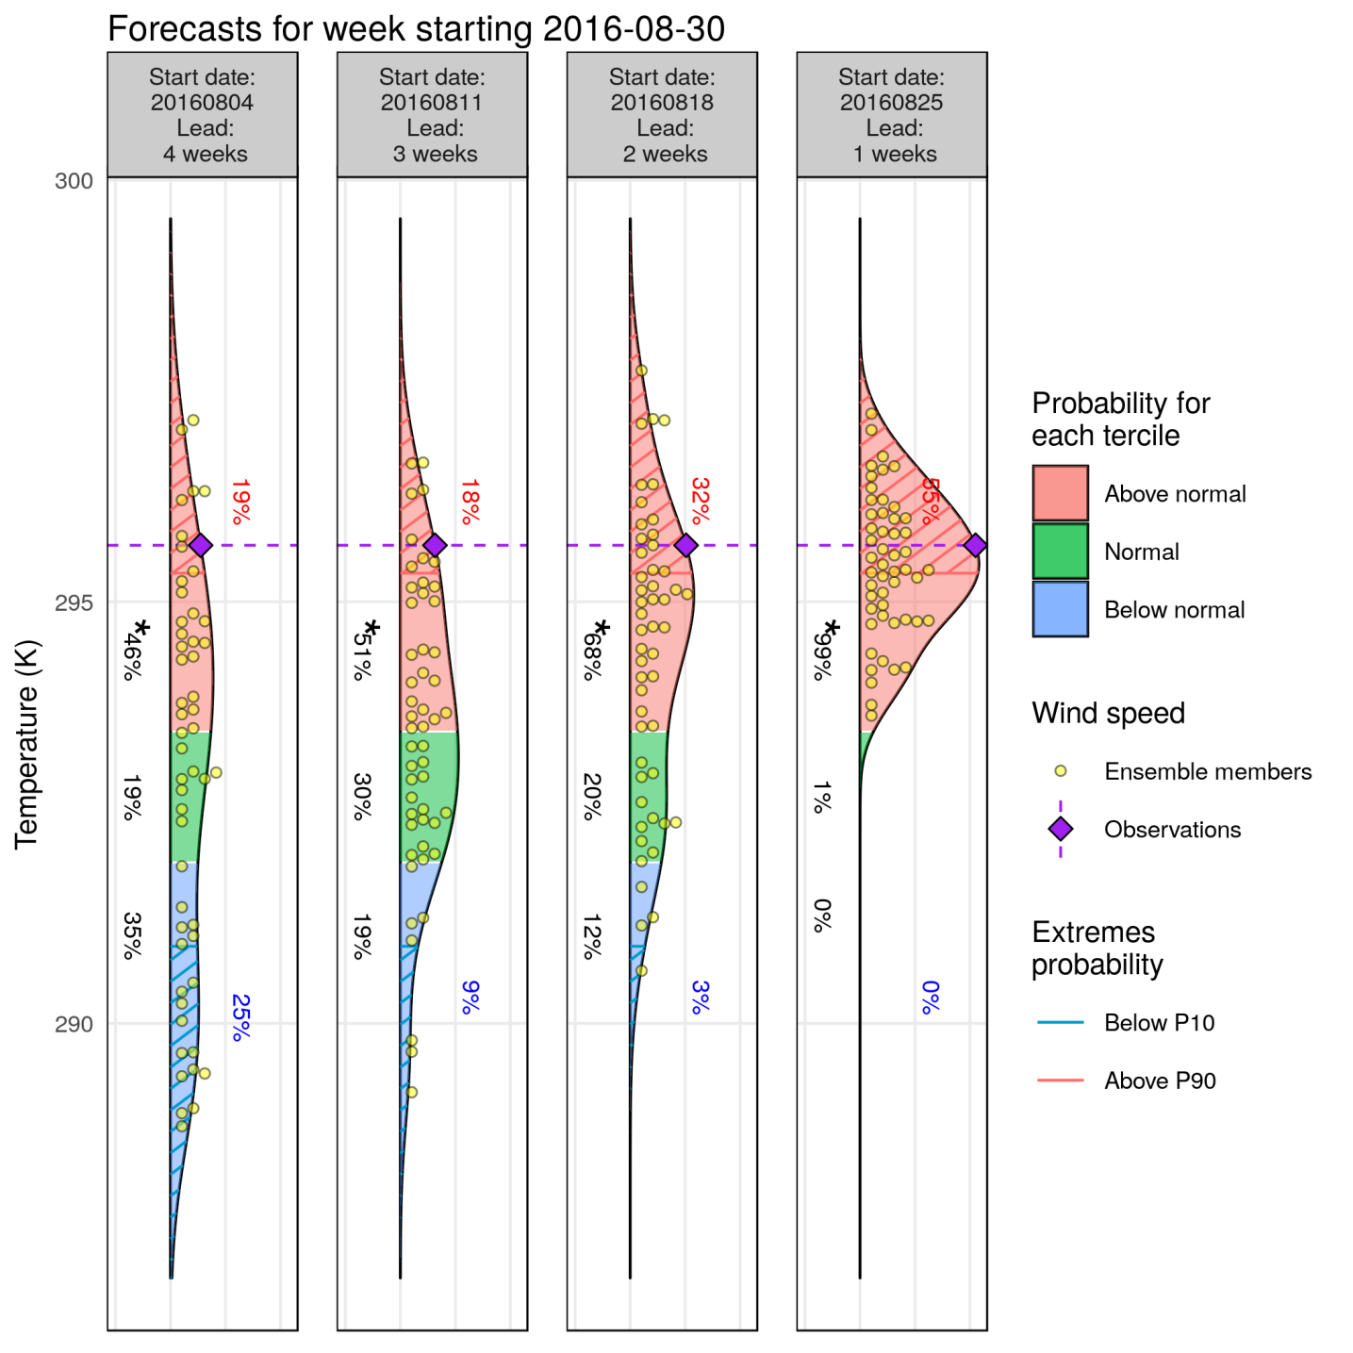
Forecast available: temperature
fairRPSS: 0.05 0.05 0.03 0.42
System: ECMWF monthly prediction system
Reanalysis: ERA-Interim
Bias adjusted –calibrated
Hindcast: 1996-2015
Lat= 40.5 N/Lon = 358.5 E

Slide 22
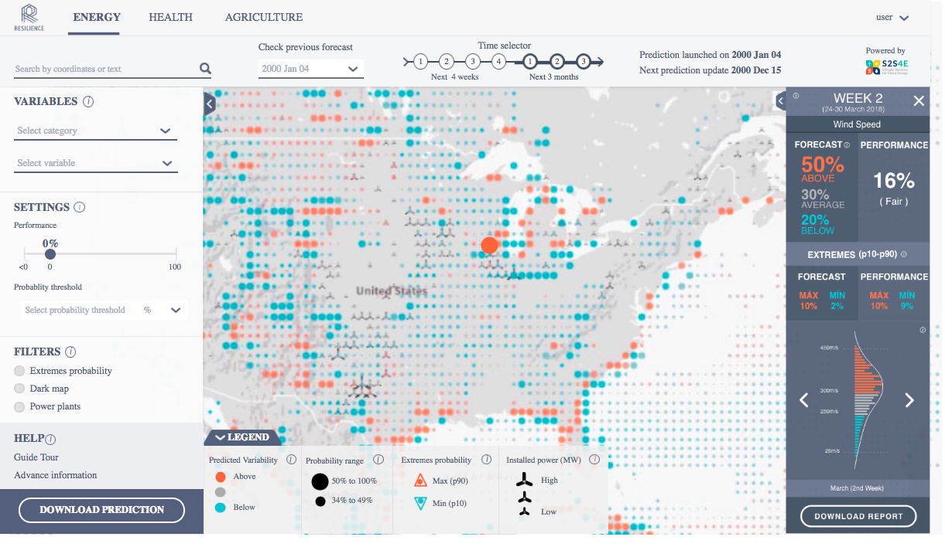
Decision Support Tool
http://www.bsc.es/ess/resilience/map.html

Slide 23
Final remarks
Climate prediction systems have improved in the last decade demonstrating that probabilistic forecasting can inform better decision making at some temporal scales and regions
Alongside the model development process, climate predictions need to be evaluated on past years to provide robust information before making decisions
Tailored service helpful for several applications
Interdisciplinary groups enhance the interaction with users to co-develop a service
Future work:
multi-model ensembles
to improve the utility of forecasts by incorporating skillful information of the large-scale teleconnection patterns at different time scales

Slide 24
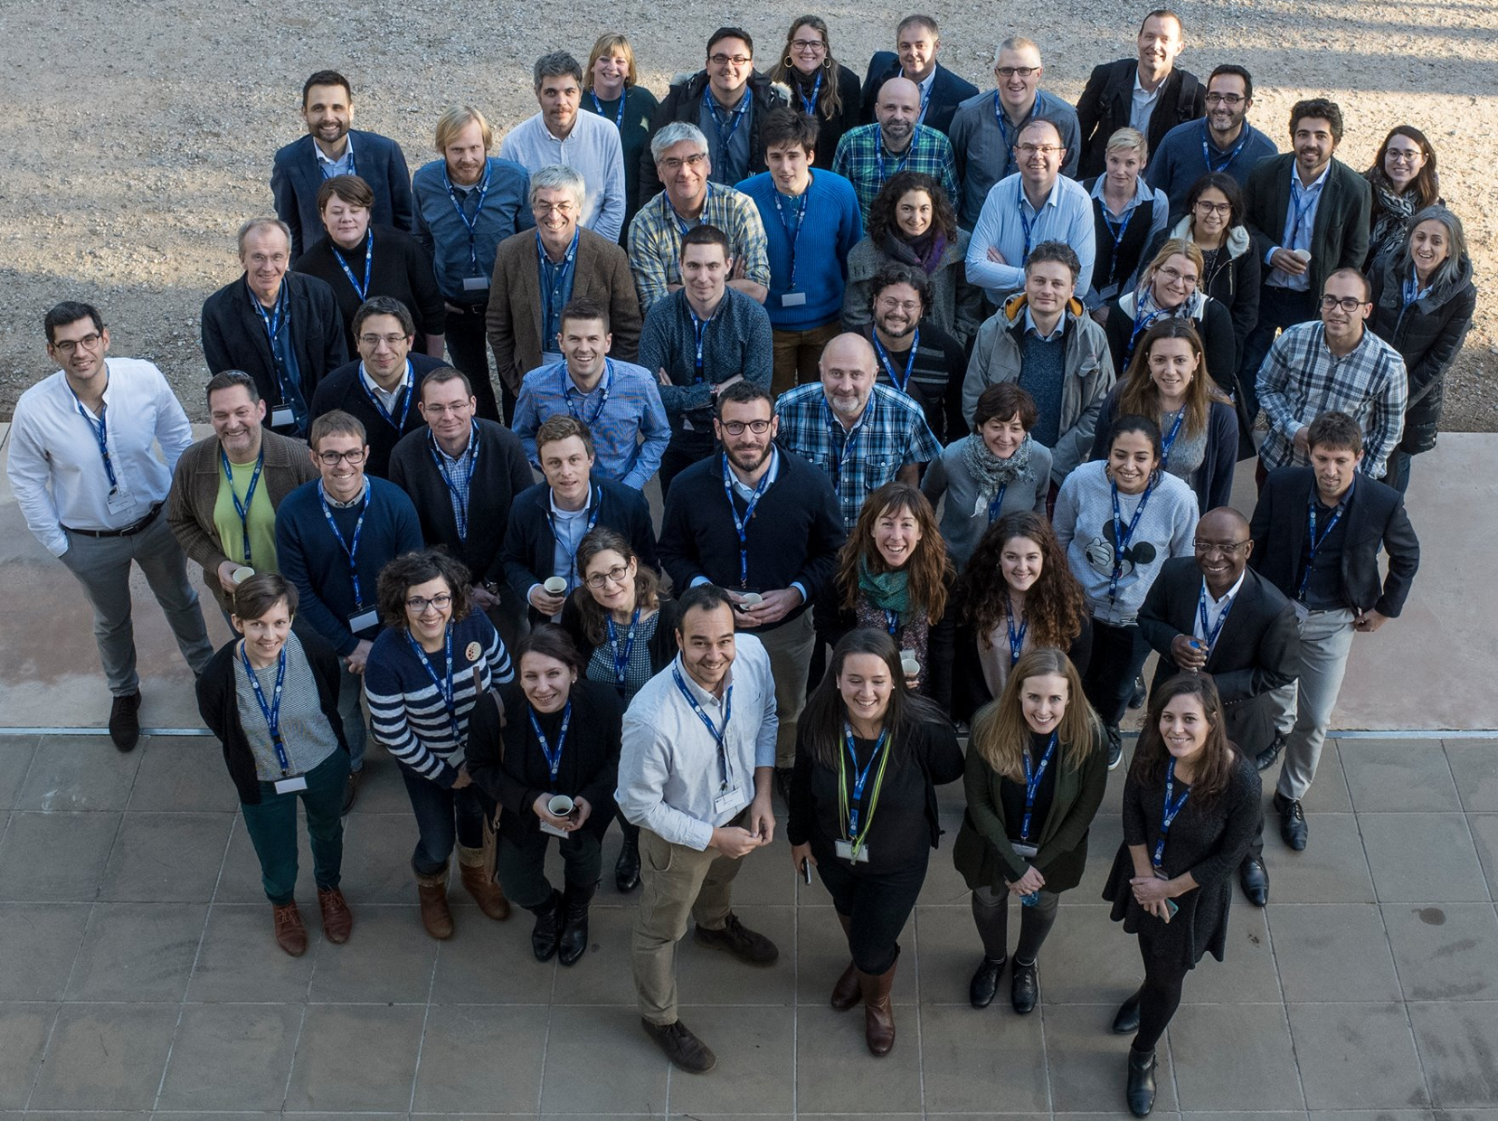
Albert Soret Miravet: albert.soret@bsc.es www.s2s4e.eu

