Slide 1
The challenges of probabilistic forecasts
Isadora Ch. Jiménez
Climateurope festival, 17-19 October, Belgrade, Serbia

Slide 2
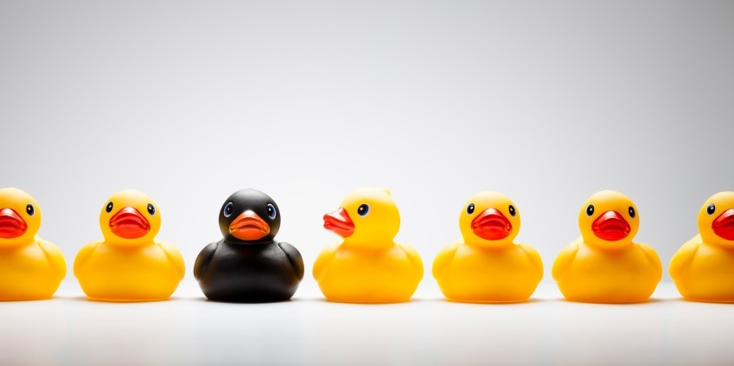
Perspectives from an outsider
Notes:
I used to consider myself as an outsider, but I must recognise that now, after 3 years working in the climate services topic I know many of the people here and I am more and more used to the climate science. But I love to think that I am still a bit of an outsider. And you may ask yourself why do I explain you my life… First because this is not a conference this is a festival and we can have a more relaxed talk (particularly this early in the morning in the last day of the conference). And also because personal stories reach further. It is all about storytelling, isn’t it?
(that’s why today we will be talking later about storytelling.

Slide 3
CLIMATE SERVICES
Notes:
That’s my job (or part of it). In the Knowledge transfer team in the climate services group of BSC we work with climate scientists but our job is to keep the focus always in the user,
(we are 20 people in the Climate servies group at BSC)
Watch with a bit of perspective as an outsider.
And after much networking, and seeing climate services in different projects I want to bring the topic of the challenges of probabilistic forecasts. Probably nothing new, but good to bring it back to the conversation every now an then.

Slide 4
UNCERTAINTY
Notes:
Hope you all agree with me, but the challenges can be summarised in just one word, uncertainty. But what each of us understands by uncertainty is very relative.

Slide 5
Uncertainty
means lack of precision or that the exact value for a given time is not predictable, but it does not usually imply lack of knowledge. Often, the future state of a process may not be predictable, such as a roll with dice, but the probability of finding it in a certain state may be well known (the probability of rolling a six is 1/6, and flipping tails with a coin is 1/2). In climate science, the dice may be loaded, and we may refer to uncertainties even with perfect knowledge of the odds. Uncertainties can be modelled statistically in terms of pdfs, extreme value theory and stochastic time series models.
CLIMATE SCIENTISTS
Notes:
EUPORIAS project did a nice glossary to explain different terms in climate services. This is the best definition they reach, and I am sure it was not easy to get everybody happy about it. But if it was really a glossary for externals, why so many explanations and justifications?
And there is plenty more about uncertainties, we can then move into RELIABILITY definition, different types of uncertainties of the model, on the initial conditions, of the…

Slide 6
Uncertainty
Uncertainty is a situation which involves imperfect or unknown information. It applies to predictions of future events, to physical measurements that are already made, or to the unknown. Uncertainty arises in partially observable and/or stochastic environments, as well as due to ignorance, indolence, or both.
USERS

Slide 7
Reliable
is a charactheristic of a forecast system for which the probabilities issued for a specific event vary a proportion of times equal to the climatological frequency of the event. A reliable system which predicts, for example 50% (or 20%, or 73%) probability of rain, should, on averge, be correct 50% (or 20%, or 73%) of the times, no more, no less.
CLIMATE SCIENTISTS
Notes:
EUPORIAS project did a nice glossary to explain different terms in climate services. This is the best definition they reach, and I am sure it was not easy to get everybody happy about it. But if it was really a glossary for externals, why so many explanations and justifications?
And there is plenty more about uncertainties, we can then move into RELIABILITY definition, different types of uncertainties of the model, on the initial conditions, of the…

Slide 8
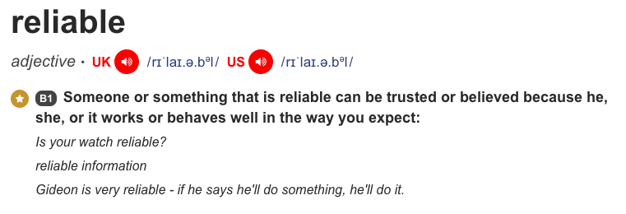
USERS
Notes:
If you analyse it with time and patience, both definitions convey similar message, one in the language of scientist and the other in the language of the rest of the people. Scientists’ definition is about exact, correct and numerical definition. But users are the rest. And they have this in their mental schemes.
And Reliable is about trust and uncertain is about imperfect or unknown information and therefore, not trusting.

Slide 9
Building TRUST
The challenge is…
Notes:
So to reword a bit the challenge. The problem is uncertainty and the solution is building trust.

Slide 10
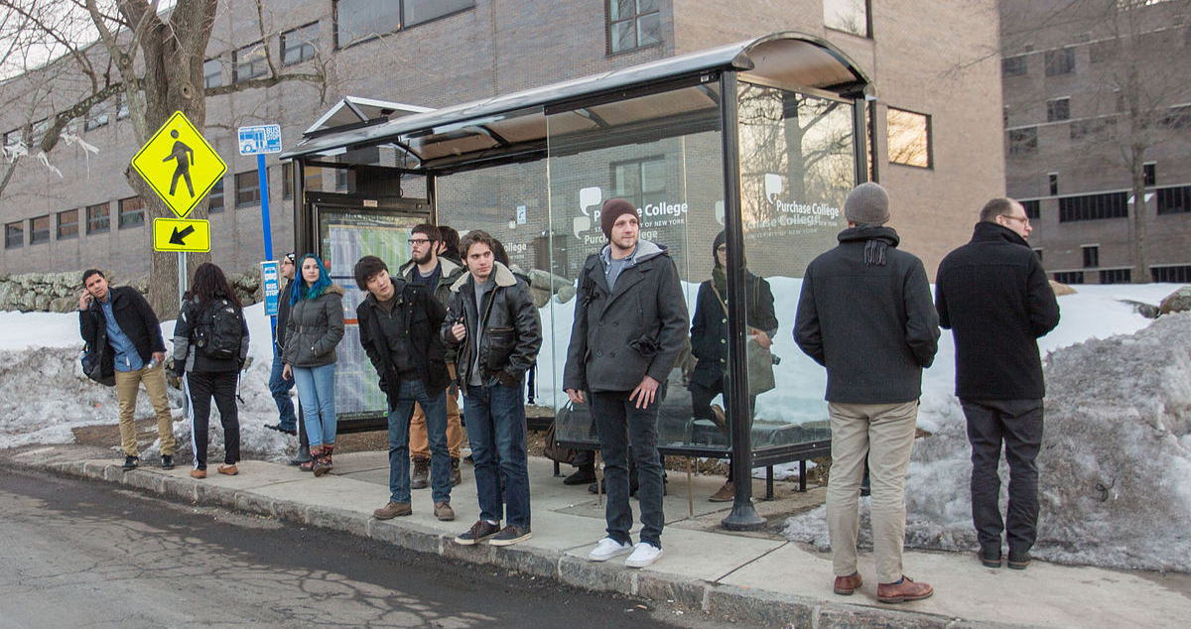
1
Users ≠ Decision makers
Notes:
Even more importantly. When we call them USERS there is an automatic idea in our minds. They are people expecting our results ready to use them. But they are not just users. They are decision makers. Which means thet they have to handle with many other sources of information that need to be taken into account. And some of those sources of concern are even
ISNOT OUR USER IS A DECISIONMAKER AND USES LOTS OF OTHER INFO.

Slide 11
2
Typologies of decision makers (WHO?)
Notes:
TYPOLOGY OF USER. HOW MUCH time they have to make a decision, which is their skills, time available for decision or typology of decision.

Slide 12
3
Understand motivations (WHY?)
Planning budget
Reduced losses/costs
Increased revenues
Notes:
MOTIVATION: from risk adversion to early adopters. Risk aversion vs. Business opportunities (Personal affinity)

Slide 13
4
Climatology vs. Predictions (WHICH?)
Translating and explaining skill
Notes:
WHE N USING CLIMATE PRED vs CLIMATOLOGY. Not to oversell what we can provide or inform in their decision making.

Slide 14
5
Action triggers (WHEN?)
Setting probability tresholds
Notes:
EVEN IF the system is good, depending on the predicted probability (40% vs. 85%)

Slide 15
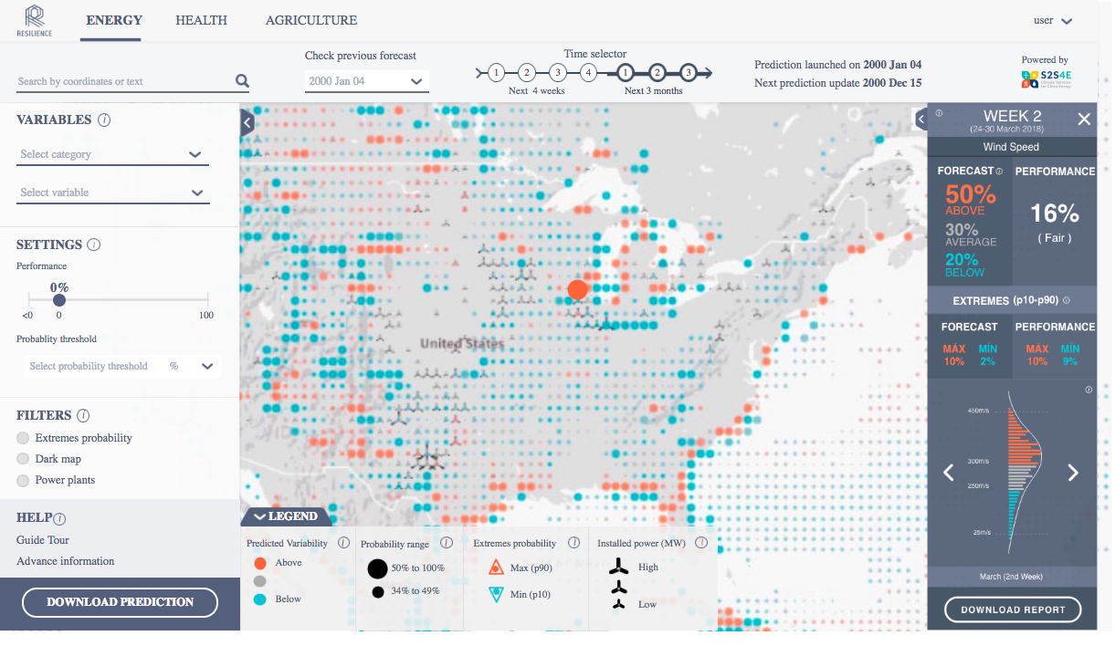
5
Action triggers (WHEN?)
Notes:
EVEN IF the system is good, depending on the predicted probability (40% vs. 85%)

Slide 16
and many more…
“certificate the quality of the data used for the service” Abdulla Sakalli
“Create capacity so users can understand probabilities” Svetlana Aniskevich, Natalja Ozernova
“Provide proper visibility to a service so it can just be found on google indicating a problem”
Rasmus Lauridsen
…
Notes:
certificate the quality of the data used for the service (Abdulla Sakalli)
Create capacity to better understand probabilities (???)
Provide proper visibility to a service so it can just be found on google (Rasmus Lauridsen)
Challenges that I have heard over these past days in this festival, which means that we can be proud to say that gradually we think and talk more and more from the user perspective.

Slide 17
Isadora.jimenez@bsc.es
@isadorachristel

