Slide 1
Chapter 5
Integration of climate modelling and climate services
Marta Terrado
Barcelona Supercomputing Center (BSC-CNS)

Slide 2
1. Joint design of simulations
Norwegian Meteorological Institute
Notes:
- Focus in interaction between climate and impact, which are different in each region (extreme events, changes in seasons, sea level rise)
- Feedback mechanisms from users to the climate modelling community lacking

Slide 3
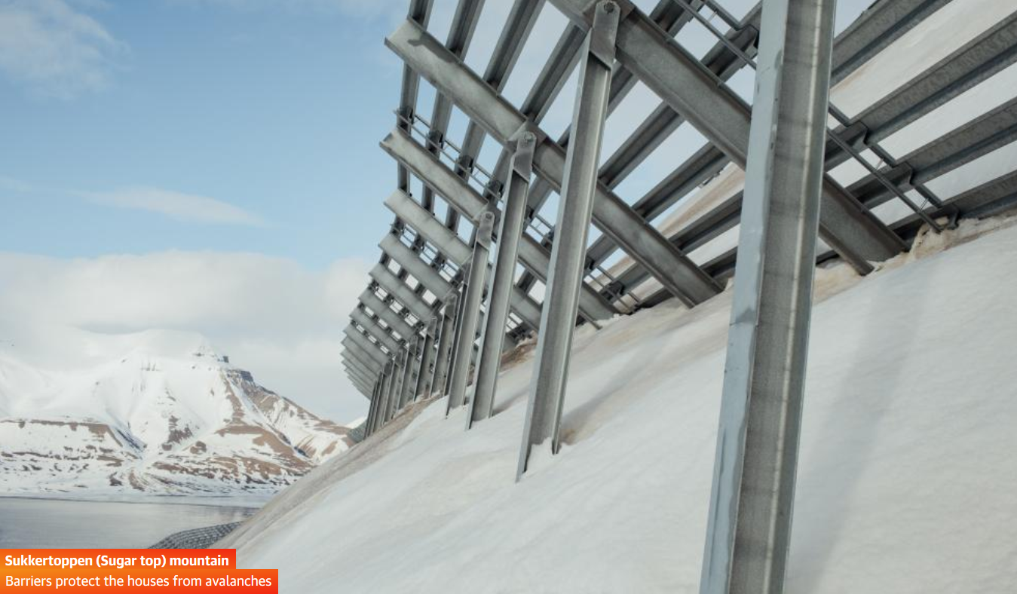
1. Joint design of simulations
Norwegian Meteorological Institute
The Guardian
Notes:
- Focus in interaction between climate and impact, which are different in each region (extreme events, changes in seasons, sea level rise)
- Feedback mechanisms from users to the climate modelling community lacking

Slide 4
2. Inter- and transdisciplinary approaches
Notes:
- Flexible co-production frameworks to be applied to different settings
- Visualisation and UCD to facilitate decision-making
- Operationalisation of collaboration research/policy/civil society

Slide 5
3. Artificial intelligence
A game changer for climate change
Notes:
- Big data
Artificial intelligence/ Machine learning for extreme events and observation gaps
Policy

Slide 6
4. Communicate
climate change differently
STORYLINES
NARRATIVES
CASE STUDIES
ONLINE PLATFORMS (DSTs)
GAMES
CITIZEN SCIENCE
ART
Notes:
Need to give meaning to facts and scientific calculations bringing them closer to user experiences. A lot has been heard about narratives.

