Slide 1
The Autosubmit workflow manager
Autosubmit Team

Slide 2
The Autosubmit Team

Slide 3
The Autosubmit Team
Daniel Beltrán
Main core developer, computational performance
Luiggi Tenorio
DDBBs, API/GUI main developer
Pablo Goitia
Final degree project on job aggregation policies
Bruno Kinoshita
Product analyst, interoperability and quality
Edgar Garriga
Interoperability, traceability & provenance
Naiara Alonso
Internship on API/GUI & visualization
Manuel Giménez de Castro
PhD on workflow efficiency
Enric Millán
Internship on job aggregation policies

Slide 4
Projects featuring Autosubmit

Slide 5
Digital Twins backend
Autosubmit is the backend for Europe’s major digital twins of the Earth
Destination Earth Climate Adaptation Digital Twin
European Digital Twin Ocean
EDITO Model Lab
https://digitaltwinocean.mercator-ocean.eu/
https://destination-earth.eu/
https://destine.ecmwf.int/digital-twins/
https://www.edito-modellab.eu/

Slide 6
A few other projects adding value to Autosubmit

Slide 7
Initiatives and centers powered by Autosubmit

Slide 8
Autosubmit

Slide 9
What is a workflow manager good for?
Wait… until data is ready
When?
Limited HPC storage
Data dependencies
The traditional way
On error: user intervention
On error: user intervention
Login to the remote cluster
Deploy the model
Execute run batch scripts
Execute post scripts
Move final results
× n_platforms
Using a workflow manager
As soon as dependencies are fulfilled
On error: possibility to automatic resubmit
On error: possibility to automatic resubmit
Shared configuration
Update Auto-model
Edit experiment configuration
Model deployment
Model run
Post-processing
Transfer
multiplatform
Automatic config checks
Remote interactive monitoring (unique endpoint, visual, web-based, embedded log files)
Manual steps
Automatic steps

Slide 10
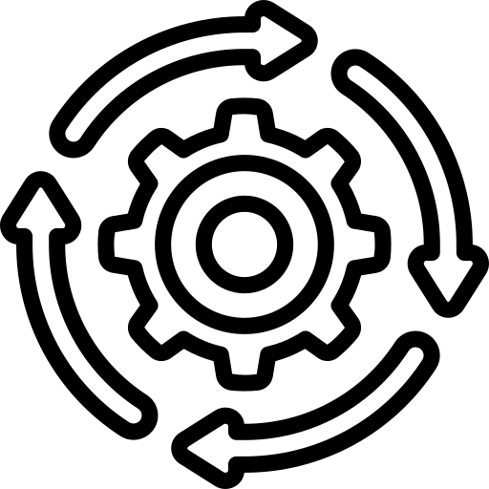
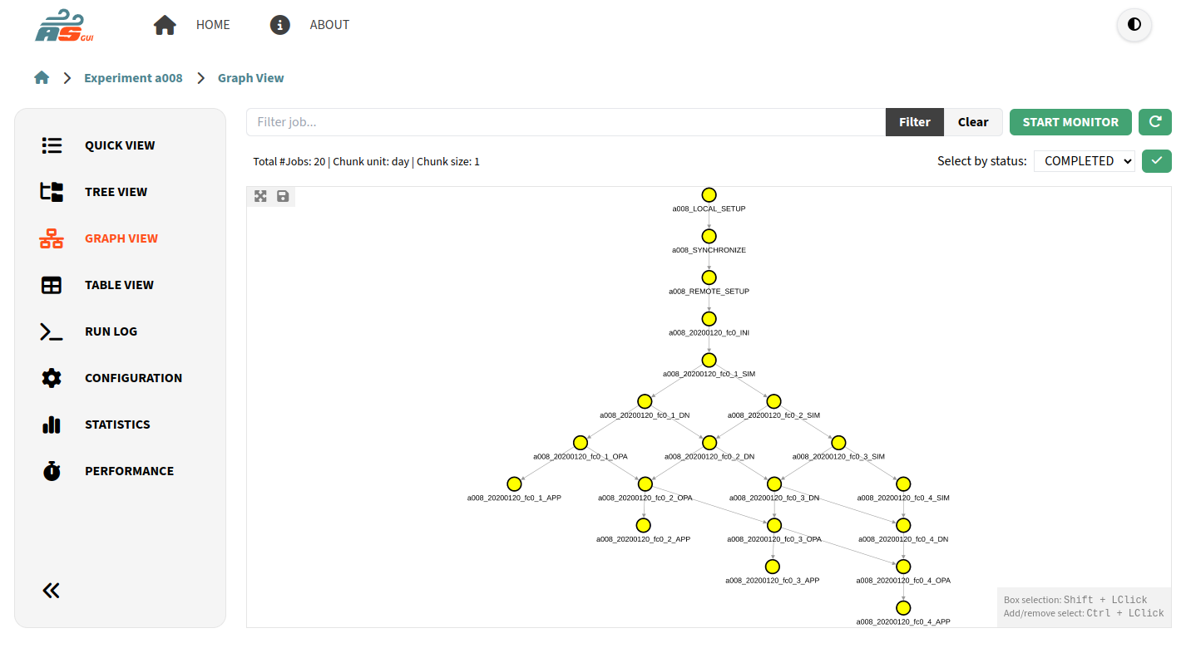
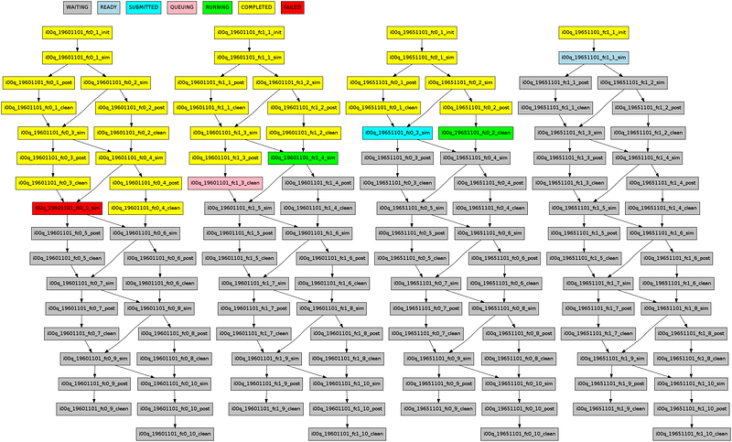
A workflow manager in action:
Autosubmit is a python-based workflow manager developed at the BSC to manage complex workflows for environmental problems in a user-friendly way and targeting especially complex environments with different access and submission rules. Autosubmit allows hiding a certain amount of architectural complexity to the user.
Platform 1
Users
Workflow monitoring
Job information
Job scheduler
Experiment configuration
… Platform n
Batch scripts
Templates
Model
Workflow graph (dependencies)
Job scheduler
Auto-Model
Developers
Archive
Notes:
The necessity for increasing the delivered computational performance makes necessary to build systems each time more heterogeneous in computing architectures, memory, etc. Workflow managers allow to hide all this complexity from users.
In order to start an experiment with Autosubmit, users should only need to fill in their experiments configuration. This information is used by Autosubmit to build the workflow dependency graph and to complete the templates (scripts) coded by the workflow developers. All this happens in the local environment.
These templates are submitted at the appropriate time to the scheduler, that at all time offers information that Autosubmit exploits and serves through the Graphical User Interface. Job’s logs are also retrieved from the filesystem and can be accessed from the GUI too.
The proposed workflow manager executes the workflow by deploying the local code in the remote platform, together with the initial data stored in the local archive, where it will store the results once transferred from the remote platform. Workflow information (performance metrics, monitoring plots) are delivered to the user to control the execution.

Slide 11
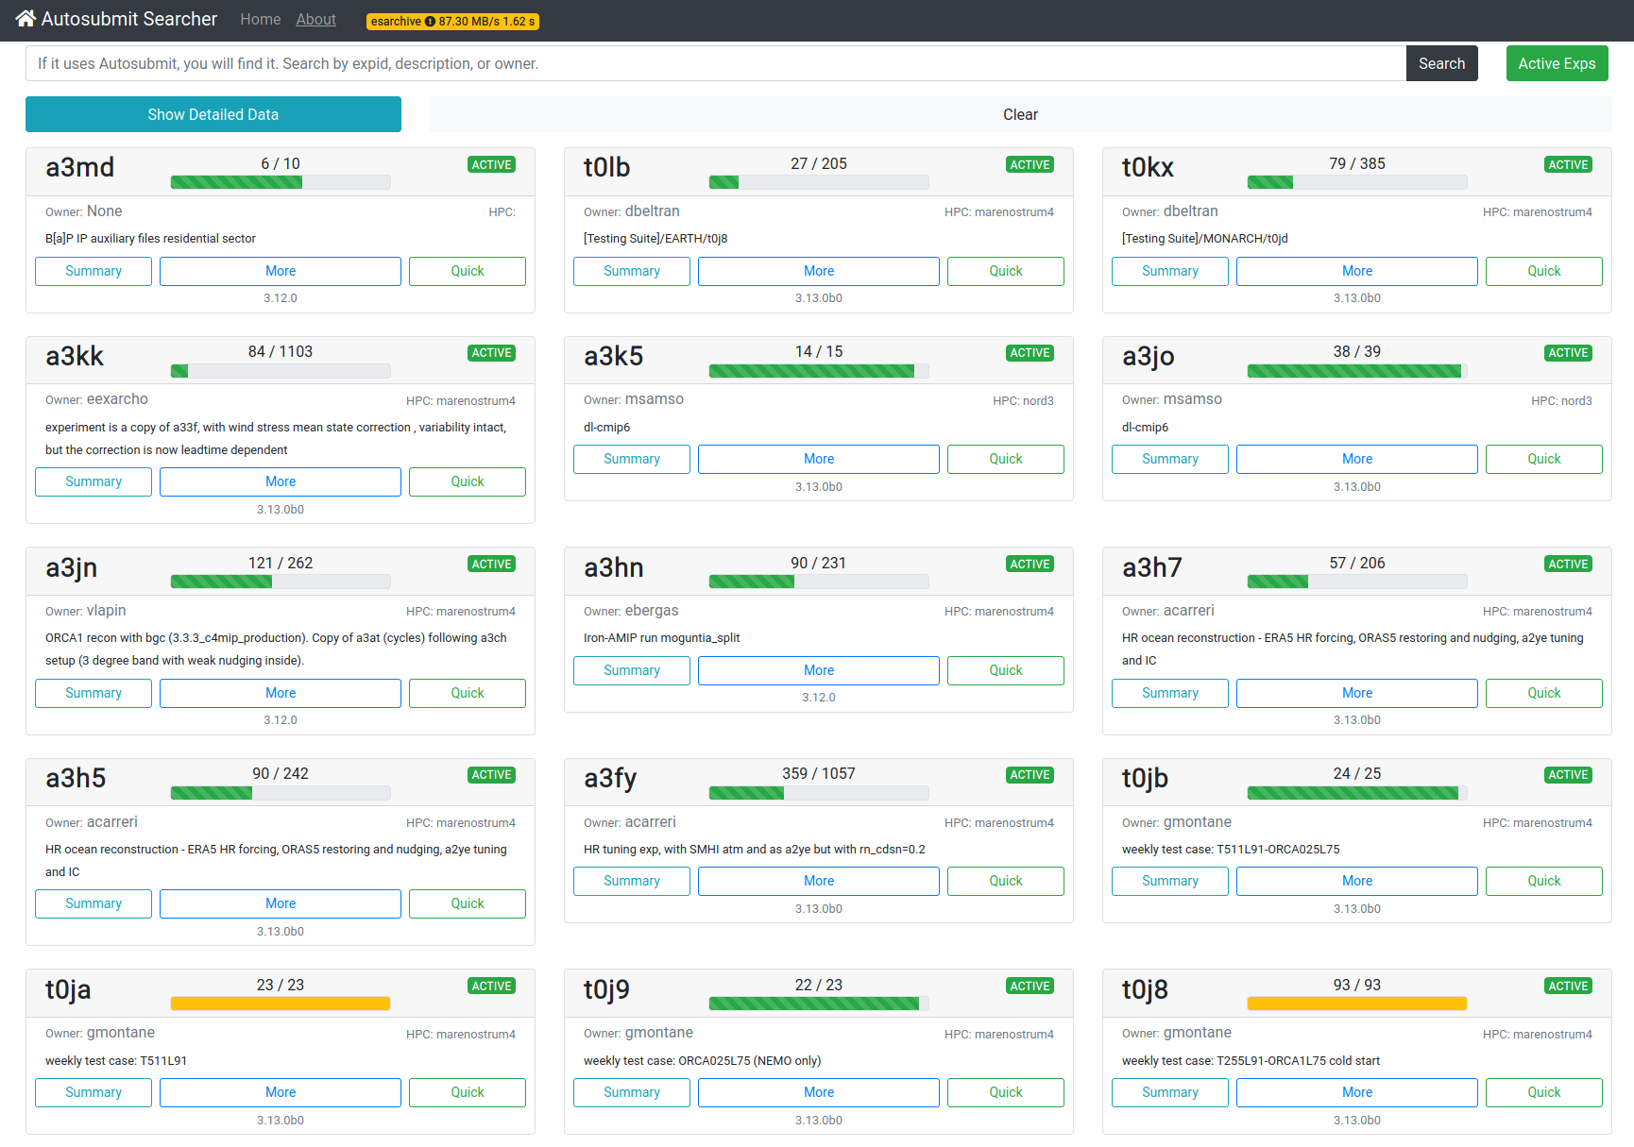
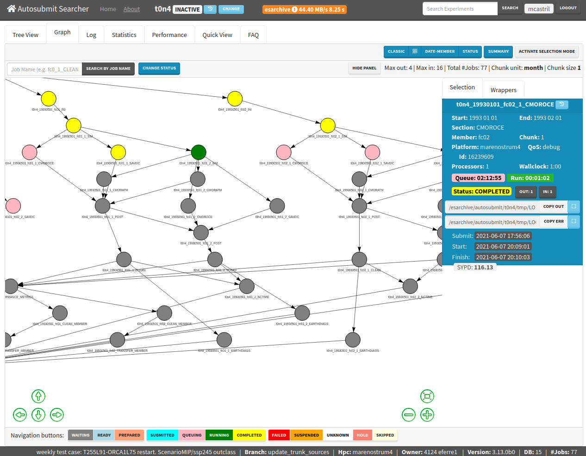
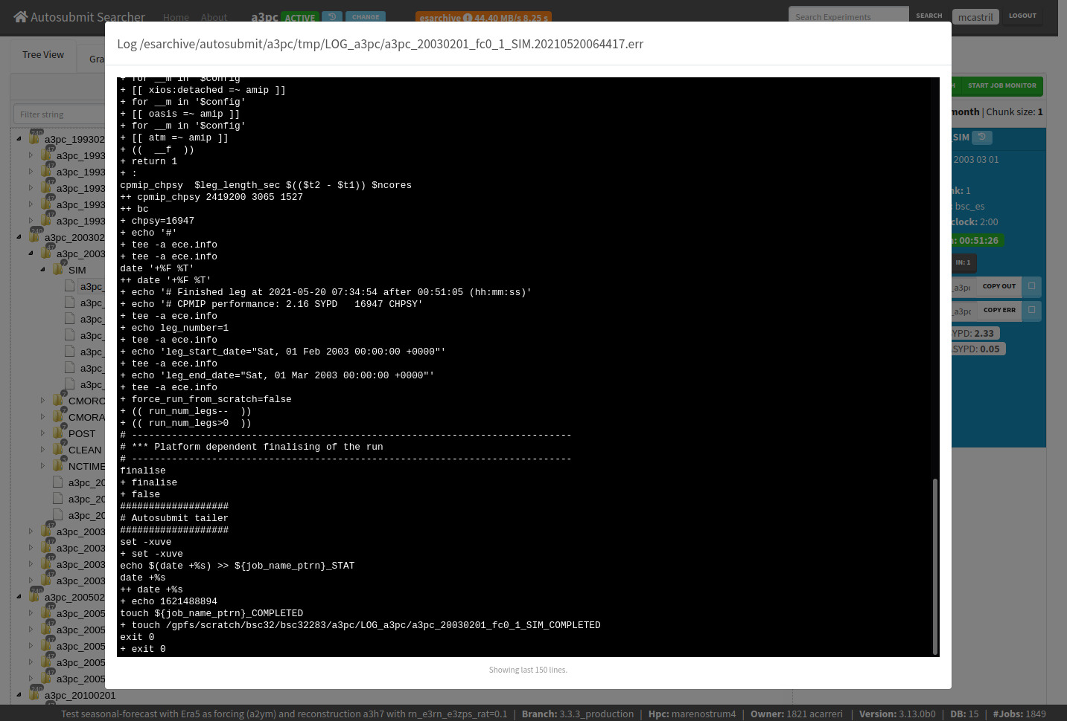
The workflow manager autosubmit
The Autosubmit workflow manager has been designed to meet climate research necessities. It supports workflows based on different hierarchical levels (once, startdate, member, chunk) and provides multiple features developed after years of operation on climate investigation.
Automatization
High-level workflow definition
Based on task dependencies
Seamless communication with remote job scheduler
Automatic retries in case of error
Multi-platform
Combines different platforms and partitions in the same workflow
Centralized user authentication
Efficiency
Possibility to refine granularity (chunks)
Wrap individual tasks in bigger allocations to better suit running rules
Robustness
Scalable database
Use multiple login nodes
Auto-recovery (after network or filesystem issues)
Mail notifications
Full traceability
Portability
Python tool (container available)
Shared database across platforms with option to copy experiments
Web-based GUI
Monitoring
Real time workflow status
Unique end point to all jobs with polling method
Access job log files from the GUI
Stats and performance metrics
D. Manubens-Gil, J. Vegas-Regidor, C. Prodhomme, O. Mula-Valls and F. J. Doblas-Reyes, (2016). “Seamless management of ensemble climate prediction experiments on HPC platforms”, 2016 International Conference on High Performance Computing & Simulation (HPCS), Innsbruck, pp. 895-900. https://doi.org/10.1109/HPCSim.2016.7568429
W. Uruchi, M. Castrillo and D. Beltrán, (2021). “Autosubmit GUI: A Javascript-based Graphical User Interface to Monitor Experiments Workflow Execution”, Journal of Open Source Software, 6(59), 3049. https://doi.org/10.21105/joss.03049

Slide 12
Autosubmit v4

Slide 13
Python version update
2022 (ops)

Slide 14
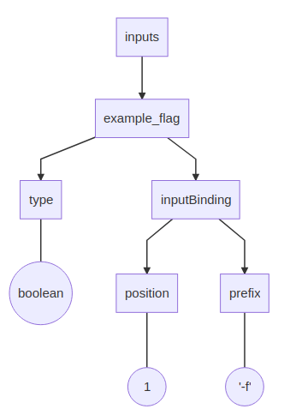
YAML Language
Key-Value Pairs
first_name: Bilbo
last_name: Baggins
age_years: 111
home: Bag End, Hobbiton
Maps
cwlVersion: v1.0
class: CommandLineTool
baseCommand: echo
inputs: # this key has an object value
example_flag: # so does this one
type: boolean
inputBinding: # and this one too
position: 1
prefix: -f
inputs.example_flag.type = boolean

Slide 15
Autosubmit YAML configuration
Main takeaways
No longer necessary!
autosubmit.conf
expdef.conf
proj.conf
platform..conf
jobs.conf
No variable is tied to a specific file.
Configuration files are free to be wherever they want
As long as you specify it in the Custom_config var
Allows creating a hierarchy of configurations (which overwrite each other)
Placeholders are case-insensitive
%PlacEhoLder% == %PLACEHOLDER%
Configuration files can include placeholders from ANY other file.
Map keys are always translated to UPPER case..
DEFAULT:
EXPID: "XXXX"
HPCARCH: "HPC-Platform"
CUSTOM_CONFIG: "%PROJDIR%/whererver/whatever"
versioned configurations
V
experiment configurations
V
User configurations
autosubmit upgrade $expid

Slide 16
Autosubmit YAML configuration
(Additional details)
New wrapper definition
“FOR” LOOPS
Minimal.yml example
wrappers:
wrapper_sim20:
TYPE: "vertical"
JOBS_IN_WRAPPER: "SIM_20"
wrapper_sim40:
TYPE: "vertical"
JOBS_IN_WRAPPER: "SIM_40"
POST:
FOR:
NAME: [ 20,40 ]
PROCESSORS: [ 20,40 ]
THREADS: [ 1,1 ]
DEPENDENCIES: [ SIM_20 POST_20-1,SIM_40 POST_40-1]]
FILE: POST.sh
RUNNING: chunk
WALLCLOCK: '00:05'
CONFIG:
AUTOSUBMIT_VERSION: "4.1.9"
TOTALJOBS: 20
MAXWAITINGJOBS: 20
DEFAULT:
EXPID: "a05j"
HPCARCH: "local"
CUSTOM_CONFIG: "%PROJDIR%/conf"
PROJECT:
PROJECT_TYPE: git
PROJECT_DESTINATION: git_project
GIT:
PROJECT_ORIGIN: “https…”
PROJECT_BRANCH: ""
PROJECT_COMMIT: ''
PROJECT_SUBMODULES: ''
FETCH_SINGLE_BRANCH: true
New jobs and platforms definition
Both confs are equivalent !
JOBS:
Job_A: Platforms: Marenostrum5: …
POST_20:
FILE: POST.sh
RUNNING: chunk
WALLCLOCK: '00:05'
PROCESSORS: 20
THREADS: 1
DEPENDENCIES: SIM_20 POST_20-1
POST_40:
FILE: POST.sh
RUNNING: chunk
WALLCLOCK: '00:05'
PROCESSORS: 40
THREADS: 1
DEPENDENCIES: SIM_40 POST_40-1

Slide 17
Autosubmit’s Hierarchy: PRE & POST
CURRENT FILE
Variables can and will be overwritten!
Load before
Load after
PRE: File Or Folder
POST: File Or Folder
When folder is specified, load order is abc.
Files in $expid/conf are always load.

Slide 18
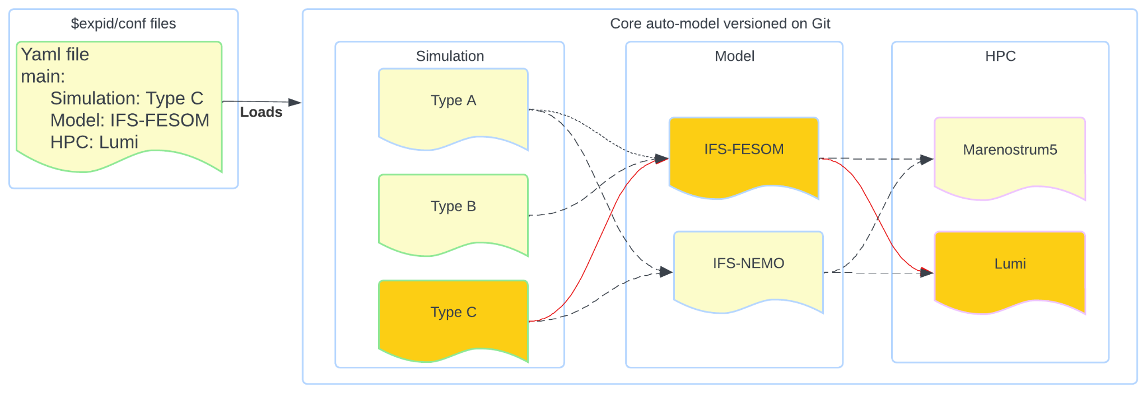
Autosubmit’s Hierarchy: Usage Example
autosubmit expid -min -repo https://earth.bsc.es/gitlab.. -b main -conf as_conf -d “example"
DEFAULT:
CUSTOM_CONFIG:
PRE:
- "%PROJDIR%/conf/simulation/%MAIN.SIMULATION%"
- "%PROJDIR%/conf/model/%MAIN.MODEL%”
- "%PROJDIR%/conf/hpc/%MAIN.MODEL%/%MAIN.HPC%
POST:
- "~/platforms.yml"

Slide 19
Autosubmit v4.1
Performance improvements

Slide 20
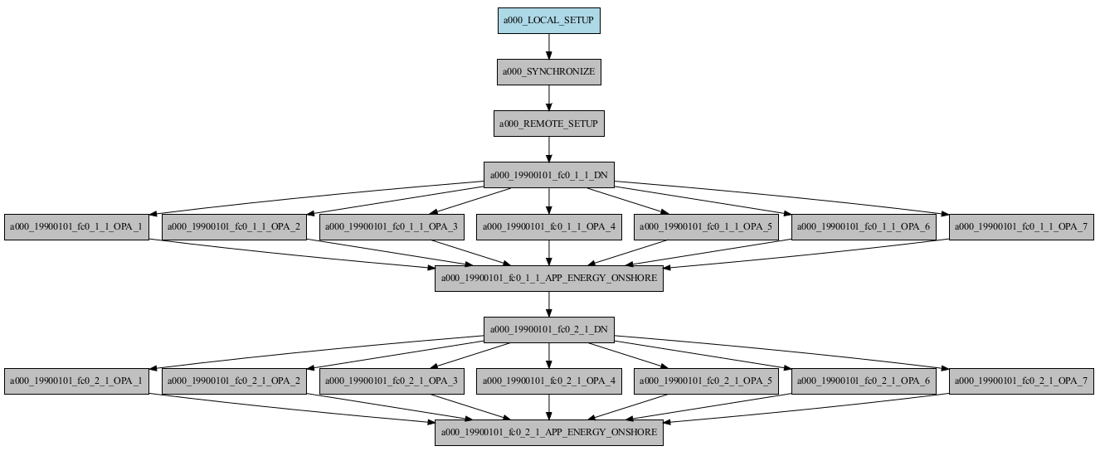
Autosubmit 4.1: Main motivation
Test suite workflow
We need to generate bigger workflows.
30+ min each autosubmit create.
Notes:
(wip)

Slide 21
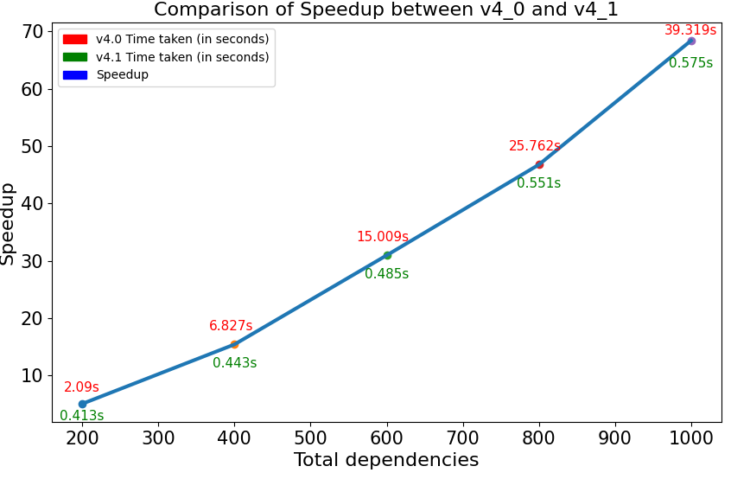
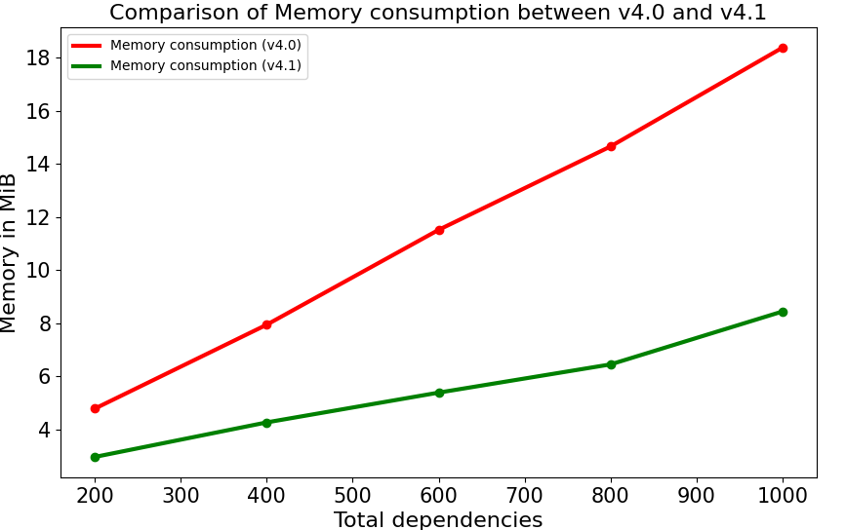
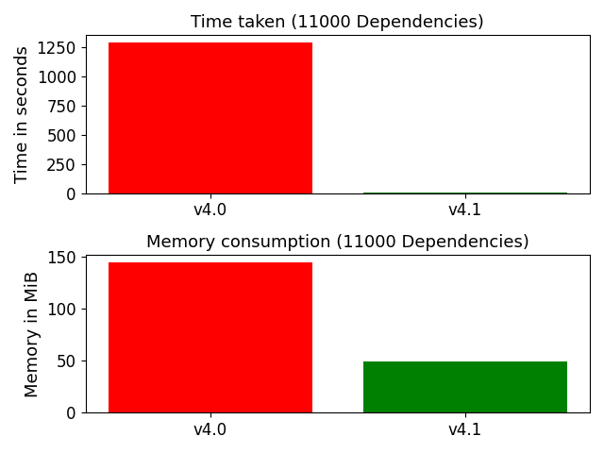
Autosubmit 4.1: Results
Autosubmit init run was also greatly improved.
Reuses the pkl generated with Autosubmit create.
Speedup x488!
Plot time is instant!
Extreme bigger workflows can’t be display without GUI.

Slide 22
Autosubmit v4.0 and v4.1
New features

Slide 23
Autosubmit 4.X: New features
(Template related)
%START_DATE%
Additional files
app.sh.tmpl
config.ini.tmpl
Parsed (converts placeholders) and transferred on submission with the name:
%date%_%member%_%chunk%_%spit%_%name%
app.sh
config.ini
20220101

Slide 24
Autosubmit 4.X: New features
(Template related)
Heterogeneous job
app_cpu+gpu.sh
Allows to combine GPU + CPU resources
Subtasks are determined by the length of the list in the %jobs.job% configuration
Slurm
Single job
000001#id
000002#id

Slide 25
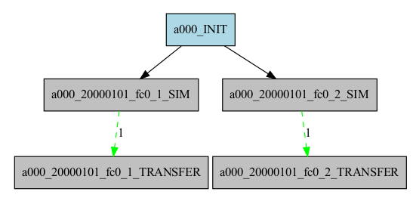
Autosubmit 4.X: New features
(Template related)
Why is needed?
Start conditions
New task dependencies different than COMPLETED.
Can be combined with an internal checkpoint feature that determines how much processing the task has completed
Workflow example: In this workflow, the transfer task can start to transfer data when some data is already present.
The green line indicates “RUNNING” status.
The “1” indicates progress within the job. %AS_CHECKPOINT%

Slide 26
Autosubmit 4.X: New features
(Template related)
Useful for adding code without touching the original template
app.sh.tmpl
header.sh.tmpl
tailer.sh.tmpl
Extended Header & Extended Tailer
Allows adding logic before and after the actual template code.
AS_header.sh
header.sh
app.sh
tailer.sh
AS_tailer.sh

Slide 27
Autosubmit 4.X New features
(Template related)
Jobs:
A:
…
SIM:
FILE: “sim.sh, namelist.sh”
NODES:
- 128
- 28
DEPENDENCIES:
A:
STATUS: RUNNING
FROM_STEP: 2
PLATFORM: lumi
RUNNING: chunk
EXTENDED_HEADER: …
EXTENDED_TAILER: ..
namelist.yml (won’t be executed)
sim.cmd executable
name_list:
EXPID: %DEFAULT.EXPID%
OTHER_INFO: …
#HET_GROUP:0 ...
#SBATCH --nodes=128
#SBATCH hetjob
#HET_GROUP:1 ...
#SBATCH --nodes=28
#SBATCH hetjob
Additional files
Heterogeneous job
Start conditions
#######HEADER######
%EXTENDED_HEADER%
###################
# Autosubmit job
###################
sleep 5
%AS_CHECKPOINT%
##### TAILER ####
%EXTENDED_TAILER%

Slide 28
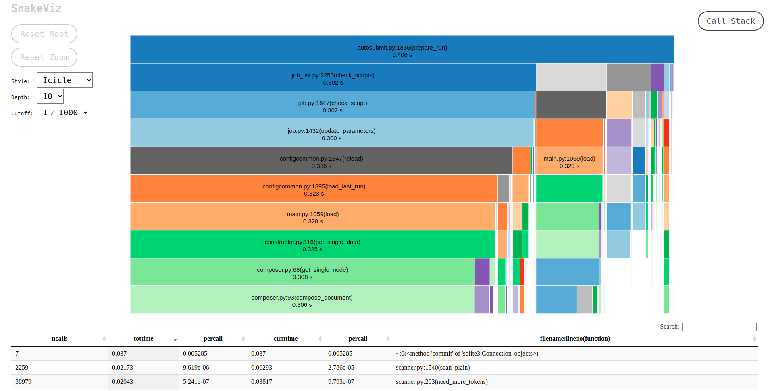
Autosubmit 4.X: New features
(commands related)
Autosubmit profiler
autosubmit run $EXPID --profile
Used to gather the performance and memory usage of Autosubmit
It can be appended to autosubmit run and autosubmit create
It can also profile only a section of the code
SnakeViz lib postprocess

Slide 29
Autosubmit 4.X: New features
(commands related)
Autosubmit Stop
This command can kill or safely finish all your autosubmit runs or those specified by id
Users can cancel remote jobs and specify a final status if they are submitted
Autosubmit stop -all -cancel
a001
a002
a002_job_A
Cancelable status
a002_job_A

Slide 30
Autosubmit 4.X: New features
(commands related)
Autosubmit cat-log
Autosubmit migrate
The cat-log command allows users to view Autosubmit logs using the command-line
You can visualize job logs and Autosubmit logs
After the YAML upgrade, autosubmit migrate has a new syntax.
Migrate command now shows progress and can be monitored

Slide 31
Autosubmit 4.X: new features
(takeaways)
Dependencies and Splits
General improvements
Autosubmit allows complex, non-standard workflows, allowing:
To define dependencies at task level with an extended syntax
Splits can now act as a new chunk level:
Added Split calendar.
Dependencies between splits are no longer deterministic.
MareNostrum5 support.
PJM support.
2FA auth*.
X11 jobs*.
Better logs.
Stats improvements.
Reworked log recovery.
New autosubmit config parser api.
*Some Autosubmit features could not work properly when using these options

Slide 32
Autosubmit API

Slide 33
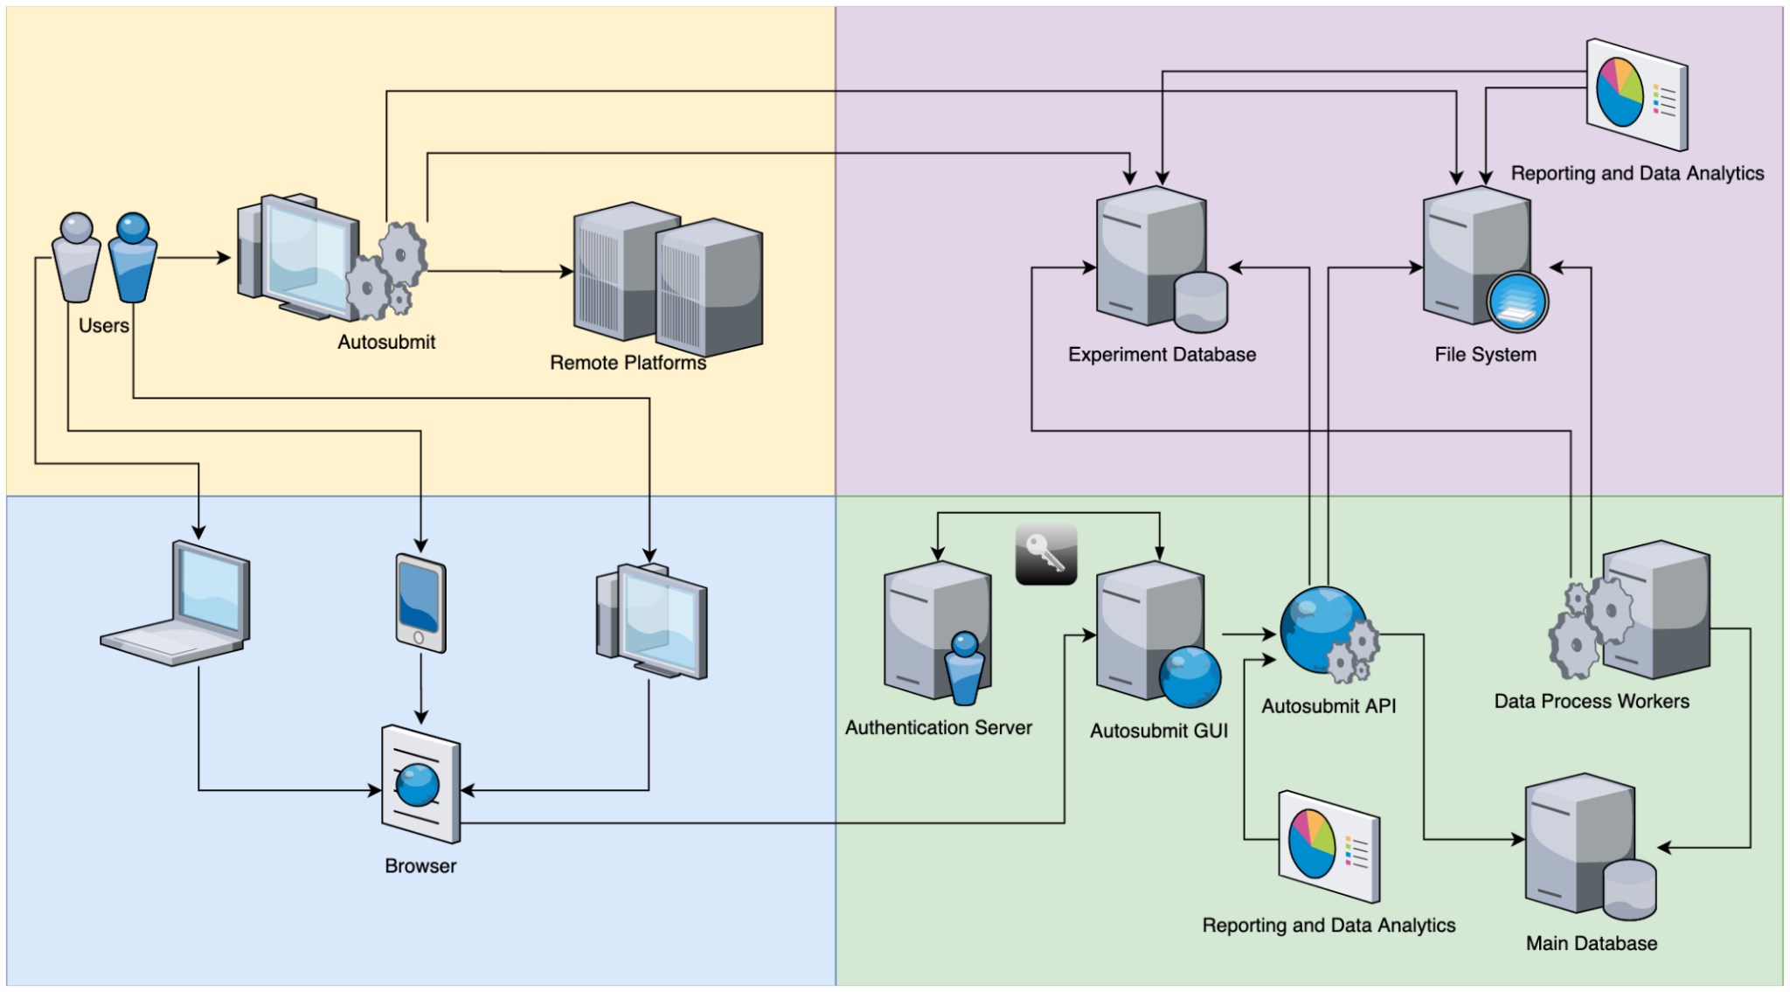
autosubmit v Architecture (System)
Notes:
( image to make people realize how complex autosubmit is)
At BSC we rely on additional Autosubmit components to make it easier to the users to understand what is Autosubmit doing underneath

Slide 34
Workflow operation
Experiment
Metadata
Configuration
Data
Workflow
Logs
Project
Experiment manager
Workflow orchestrator
Notes:
This is to show how the workflow manager can manage and run experiments and fulfil the FAIR requirements. But I could put it out

Slide 35
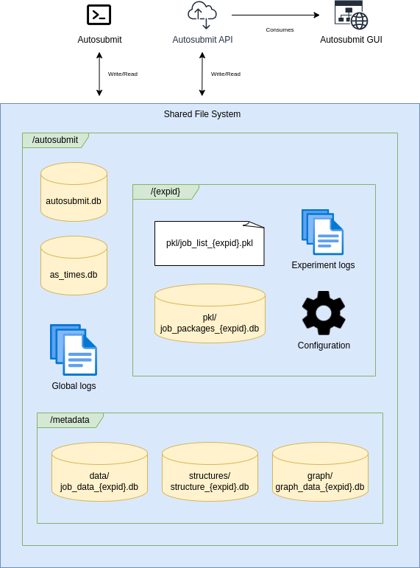
A comprehensive waypoint to the Autosubmit persistence layer
Notes:
Autosubmit persistance layer can be complicated, API facilitates it giving you the interface to get the information you need without going in deep on the raw data that Autosubmit generates

Slide 36
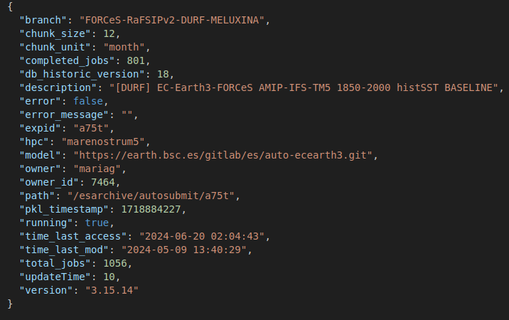
Integration
GET
/v3/expinfo/a75t
Response
Consumed by
Any other software via HTTP
Notes:
API have been made to be consumed by the AS GUI. But it can be integrated with any software via HTTP. With this, it is easy to access the data that autosubmit generates without having to go deep in what Autosubmit does.

Slide 37
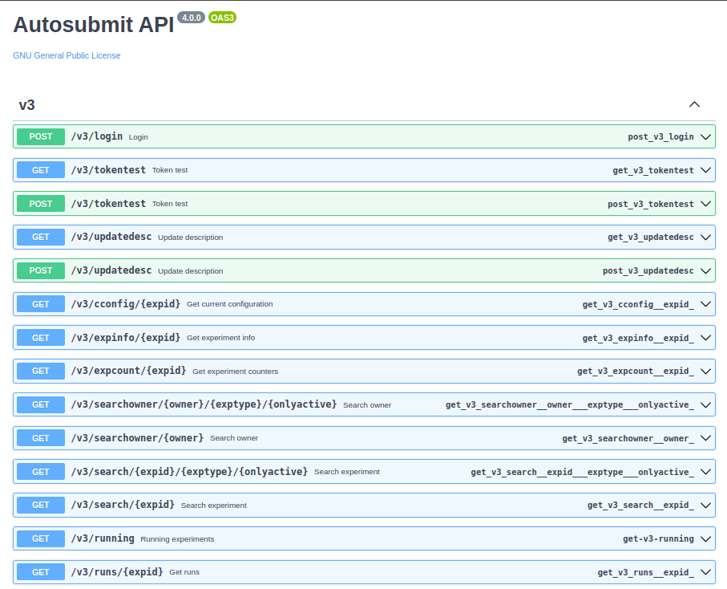
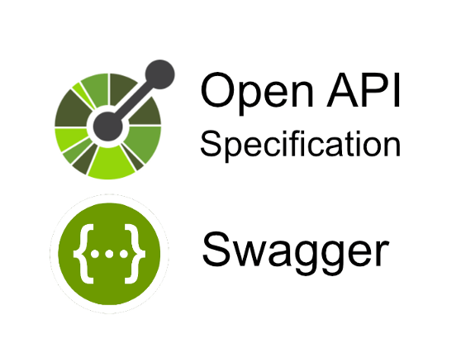
RESTful interface
Documented using:
Notes:
Better documentation that will help your integration process following global standards

Slide 38
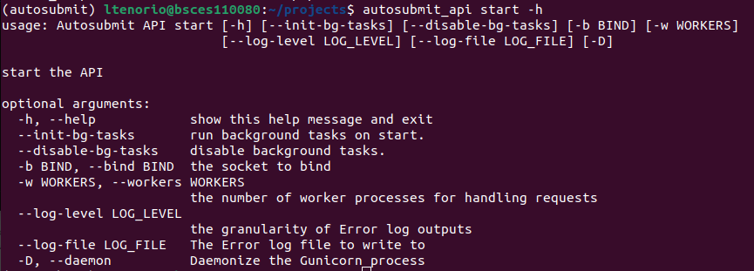
New! Installation and usage
pip install autosubmit-api==4.0.0b8
Notes:
Easier to install and use. With just two commands, you can start using the API

Slide 39
New! GitHub Oauth apps support
✓ Easy setup
✓ Authentication
✓ Authorization with Organizations/Teams
✓ Supported by Autosubmit GUI
Oauth Apps
Notes:
If needed, Authentication and Authorization can be set to protect your API and be only used by a closed set of users

Slide 40
Autosubmit GUI

Slide 41
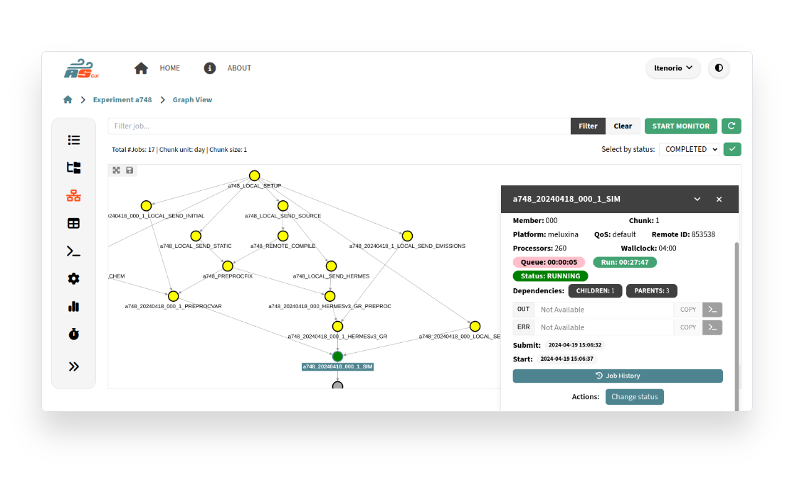
New! Updated GUI
Notes:
Aimed to improve usability having a cleaner and more modern style. Main features remains to keep the familiarity with the tool

Slide 42
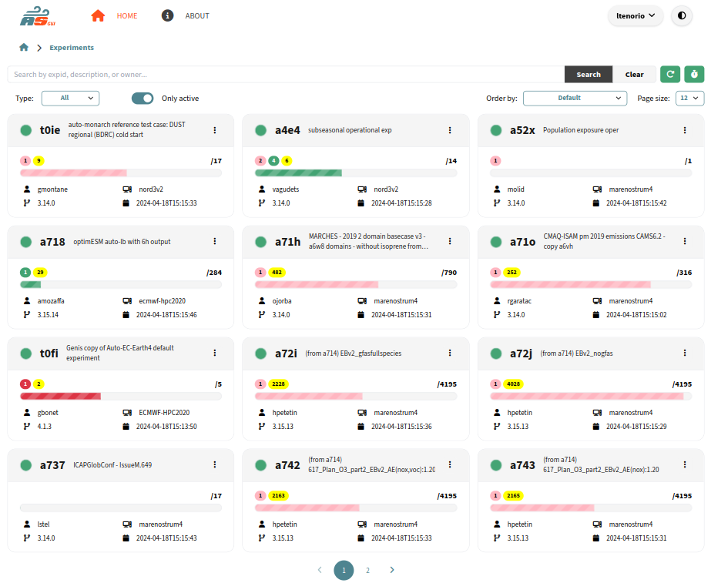
Search your Autosubmit experiments
🔍
Notes:
More search options
Cleaner view
Optimized pagination

Slide 43
Search your Autosubmit experiments 🔍
Experimental! Dark mode
New! Automatic
refresh
New! More specific filters
Types:
- Experiment
- Test
- Operational New!
New! Adjustable page size

Slide 44
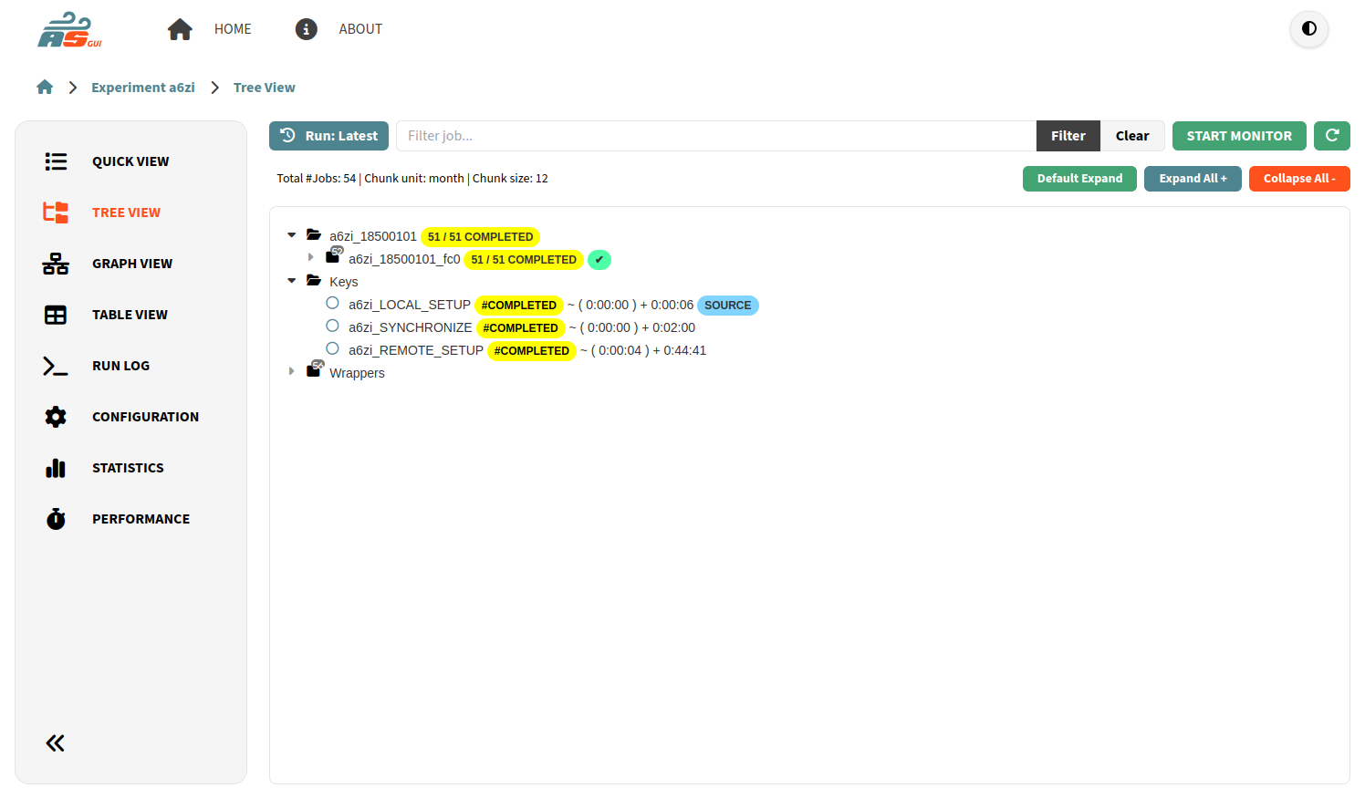
Visualize your experiment 👀
Notes:
Main ways to visualise your workflow: graph view (dependencies) and tree view (grouped). Cleaner view, Focus on what you need

Slide 45
Visualize your experiment 👀

Slide 46
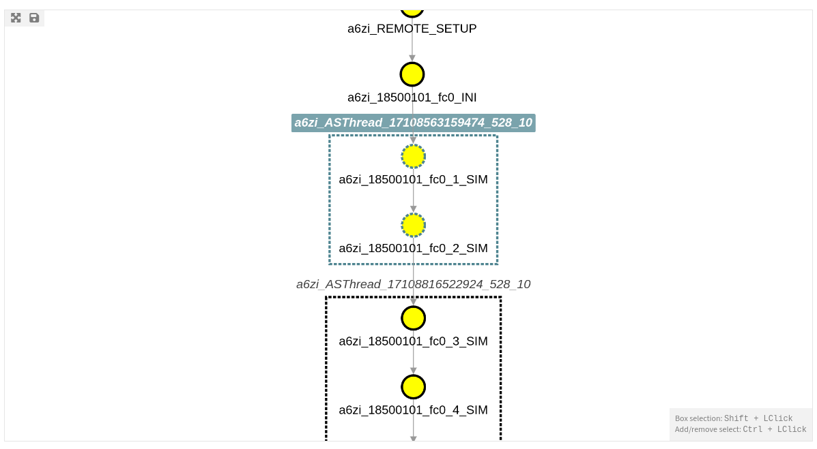
New! Visualize your wrappers 🎁
Notes:
Improved visualization of wrappers, similar than autosubmit monitor

Slide 47
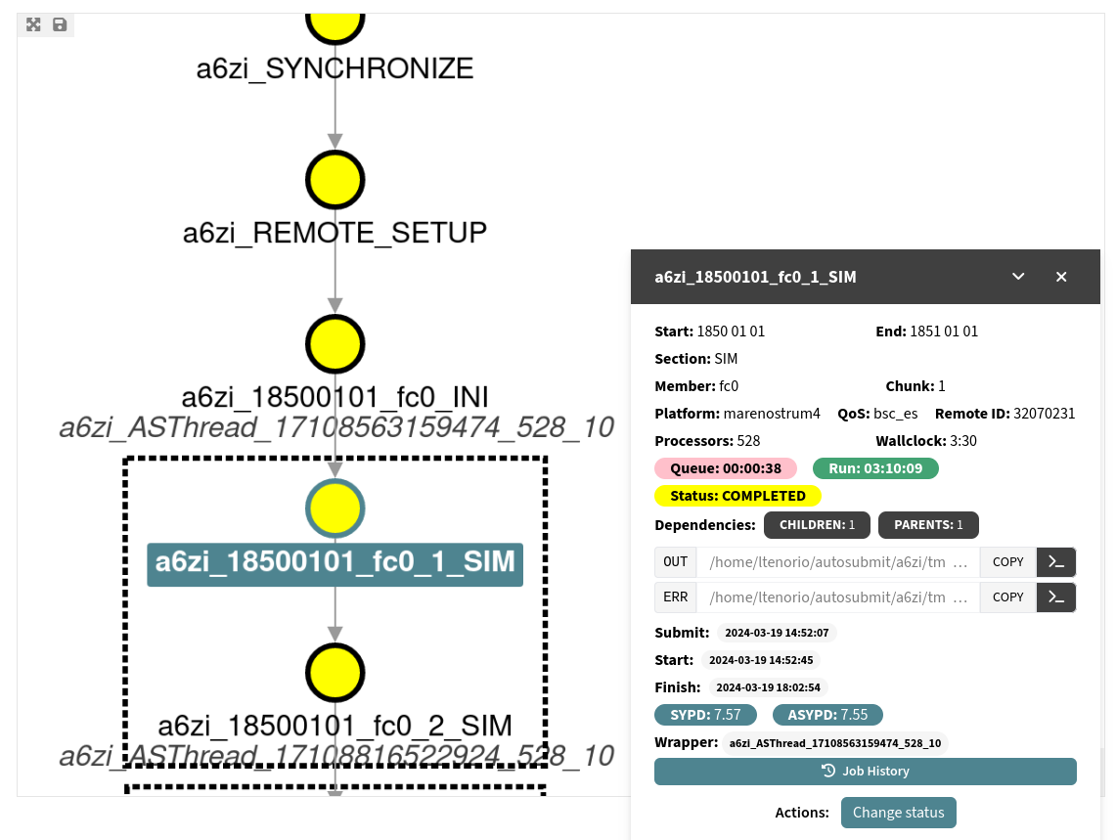
Get more details of your jobs 🤓
Notes:
Detailed panel, Collapsable. Allows multi selection

Slide 48
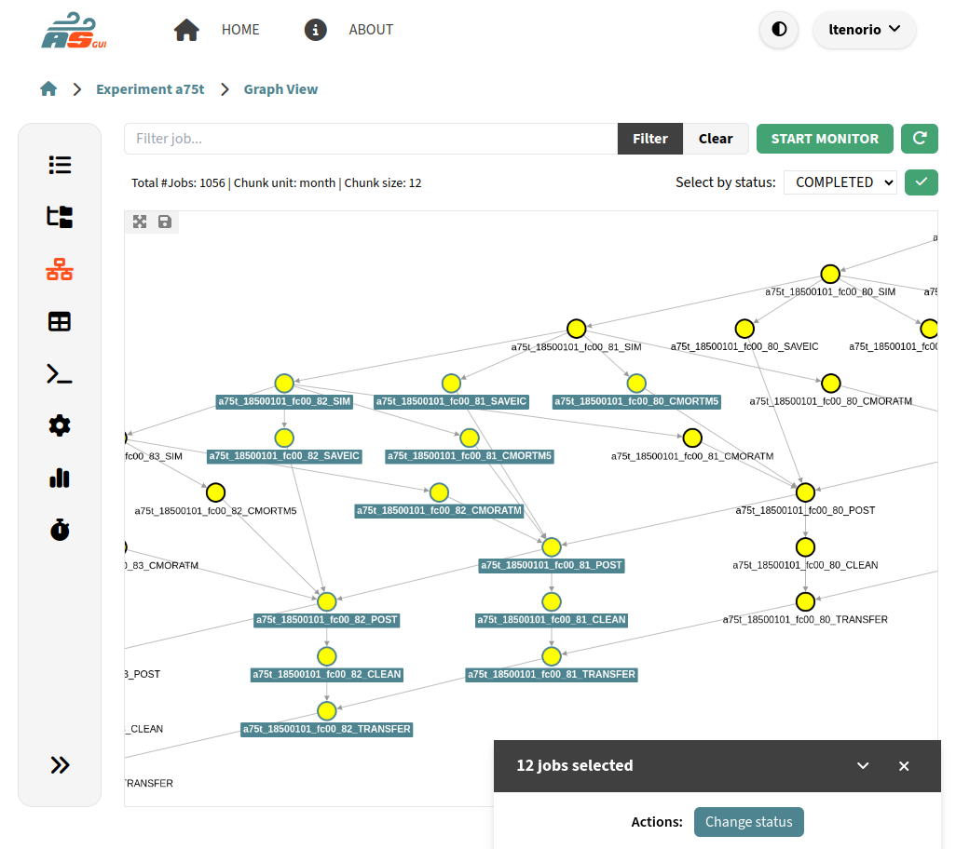
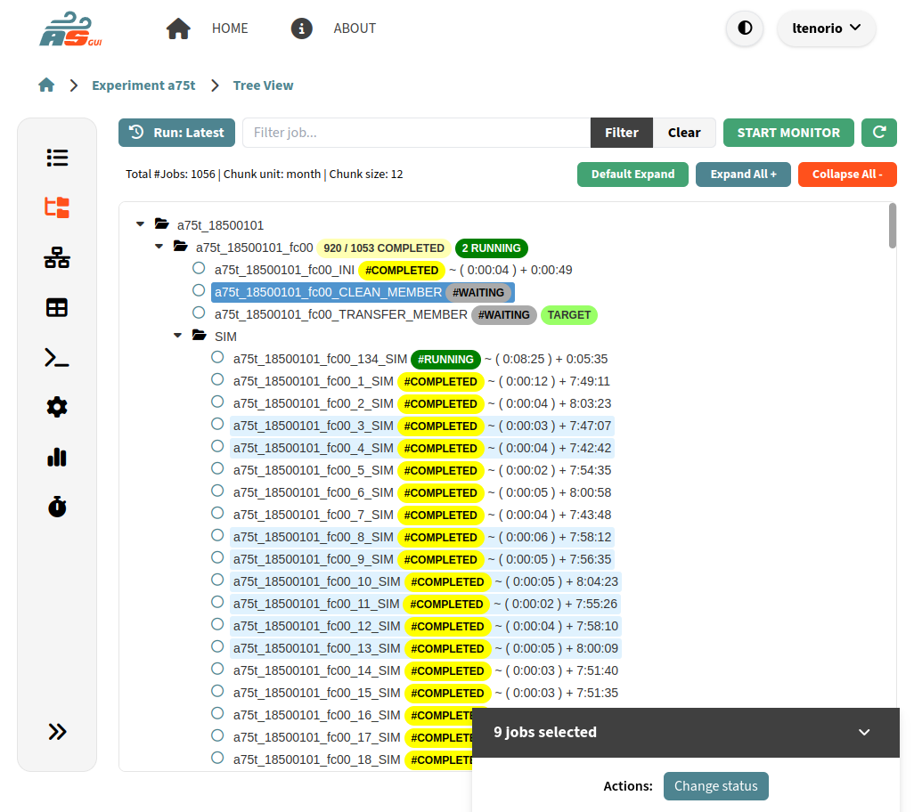
New! Multiple selection feedback ✅

Slide 49
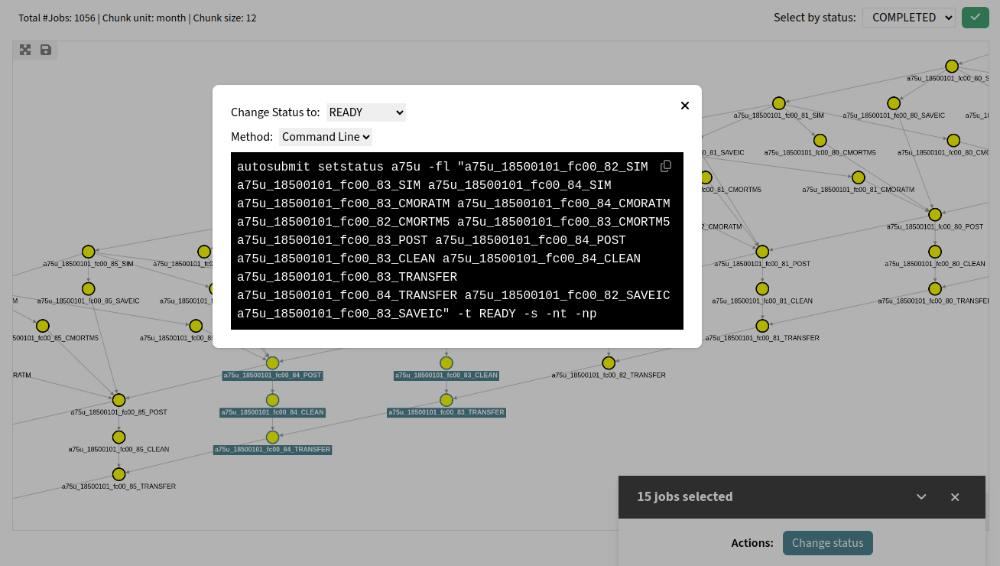
Generate Autosubmit commands 🧑‍💻
Notes:
Better feedback and visual

Slide 50
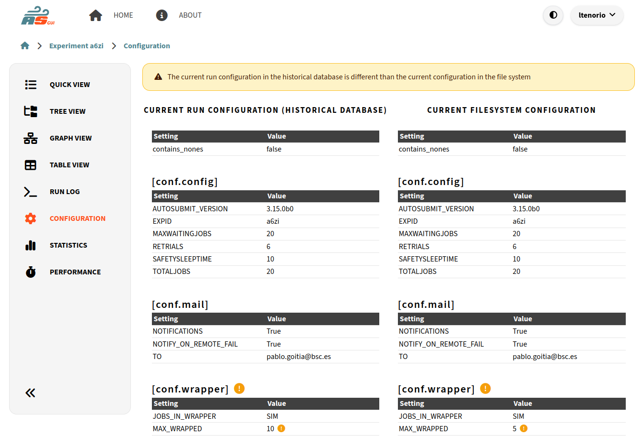
Watch your experiment configuration
⚙️
Autosubmit 3 and 4 supported!

Slide 51
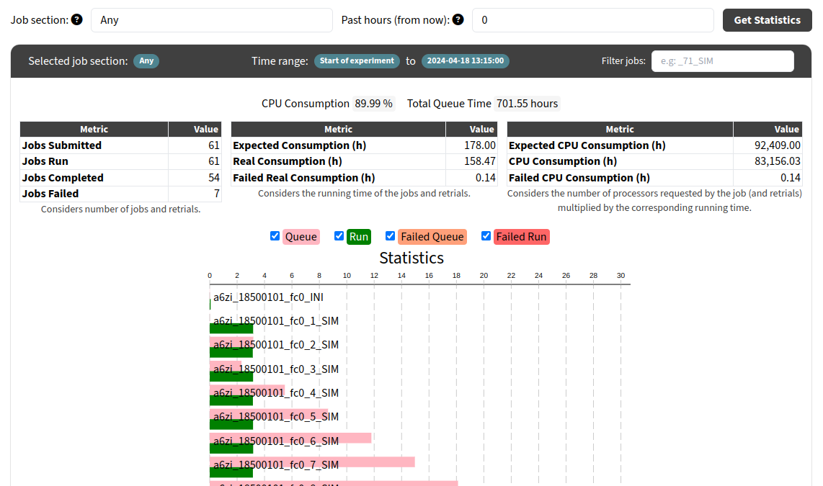
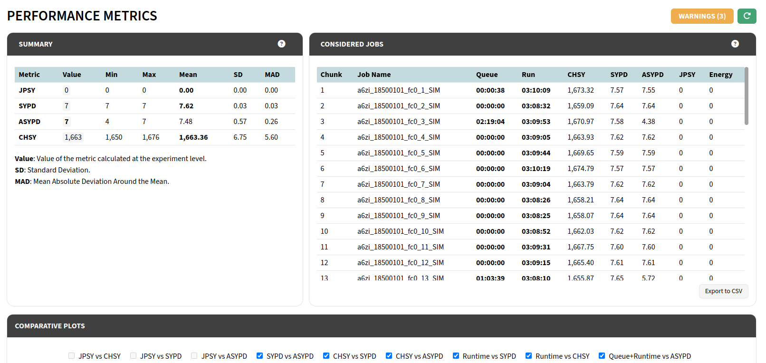
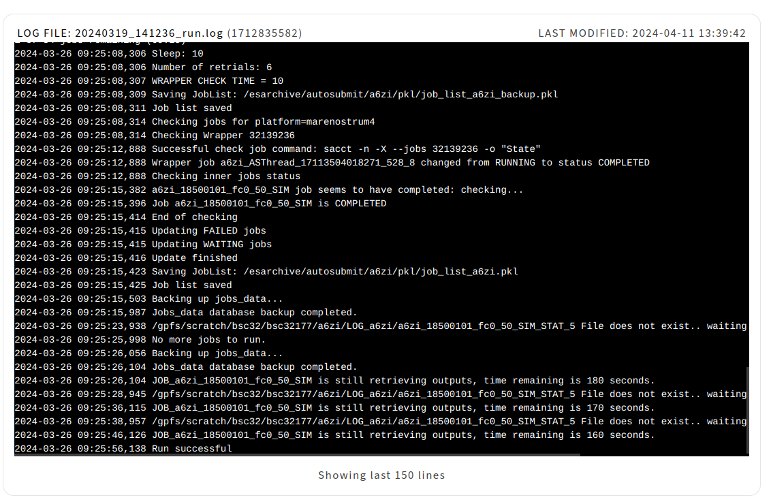
And much more… 😎
Notes:
Many other views stayed with the same layout but with cleaner visuals

Slide 52
Try the new GUI in BSC Earth Sciences
https://earth.bsc.es/autosubmittest

Slide 53
New Developments driven by the Digital Twins

Slide 54
Interoperability in Autosubmit
How can we get the best out of Autosubmit’s configuration management while using other workflow orchestrators?

Slide 55
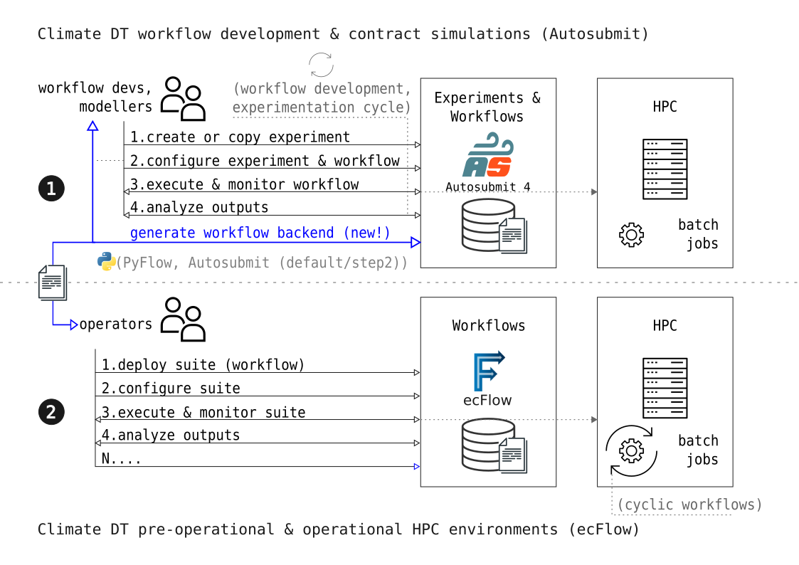
Autosubmit + PyFlow (ecFlow)
(in theory)
Cylc
Nextflow
PyCOMPSs
CWL
…

Slide 56
Provenance in Autosubmit
How can we achieve accountability (and reproducibility) in the research process?

Slide 57
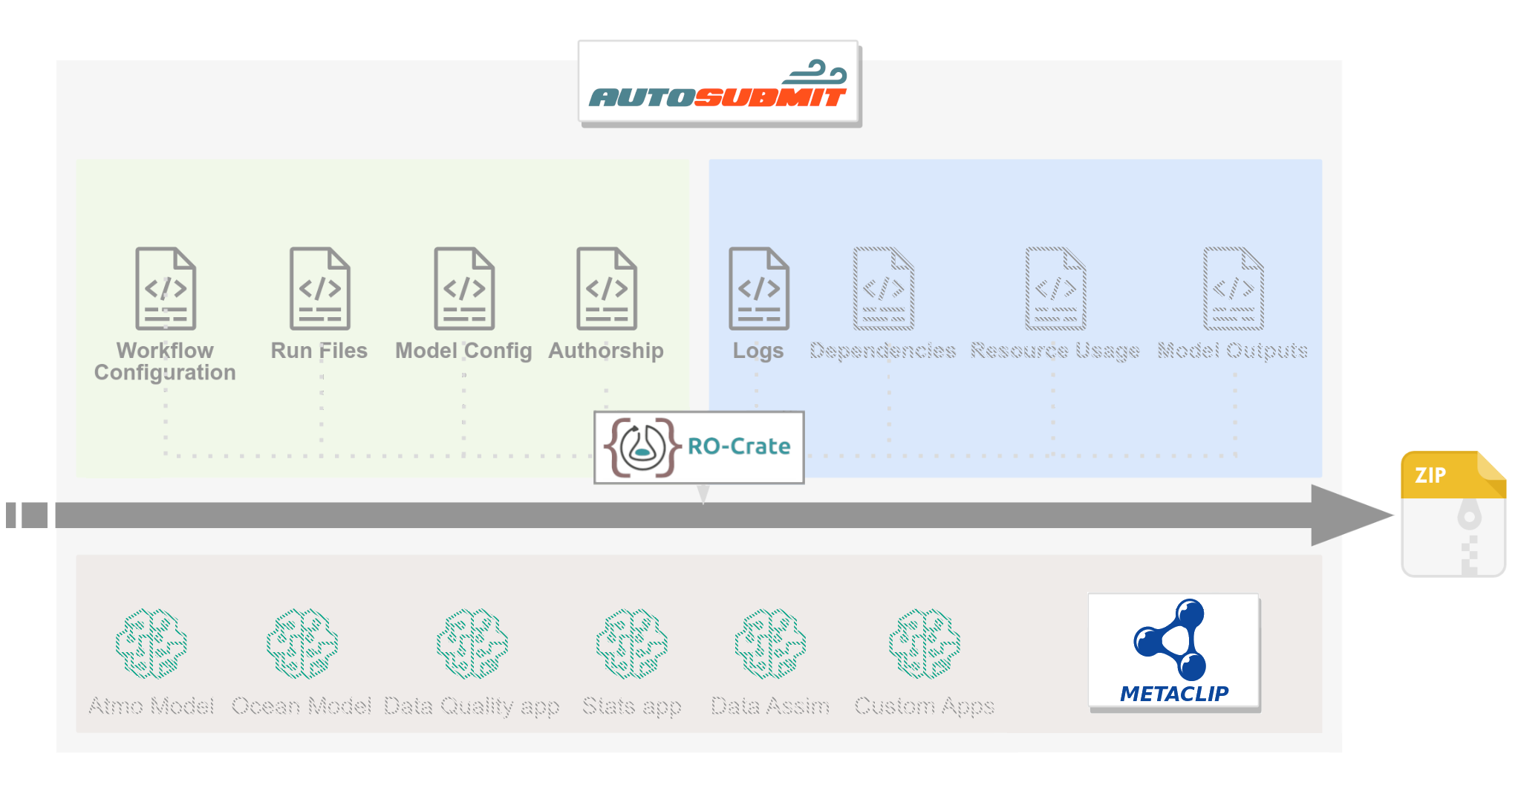
RO-Crate implementation in Autosubmit

Slide 58
EDITO-Infra Autosubmit service
How can we integrate Autosubmit in Virtual Development Labs / Cloud platforms?

Slide 59
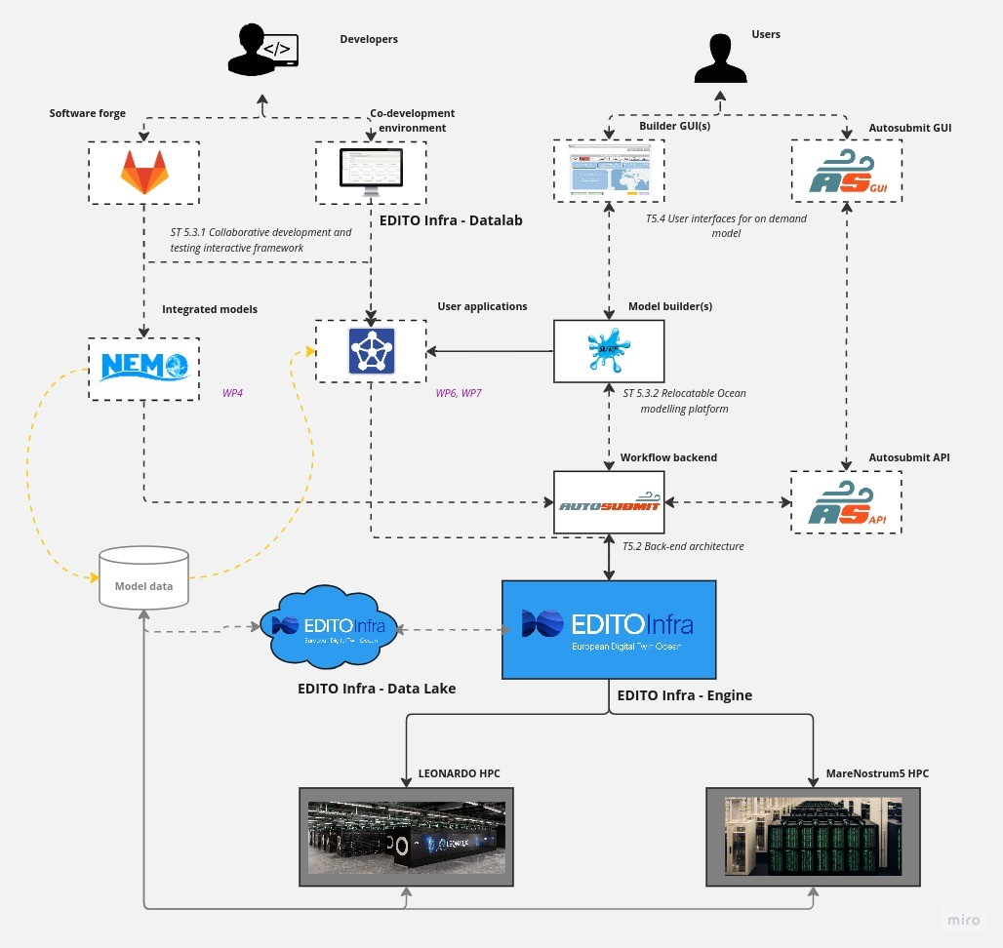
EDITO-Infra Autosubmit service
EDITO, European Digital Twin Ocean
“Virtual representation of marine and coastal environments around the globe.”
Autosubmit is used for its backend (in EDITO Infra), to connect to HPCs and cloud.

Slide 60
EDITO-Infra Autosubmit service

Slide 61
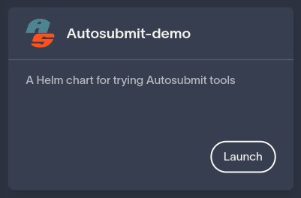
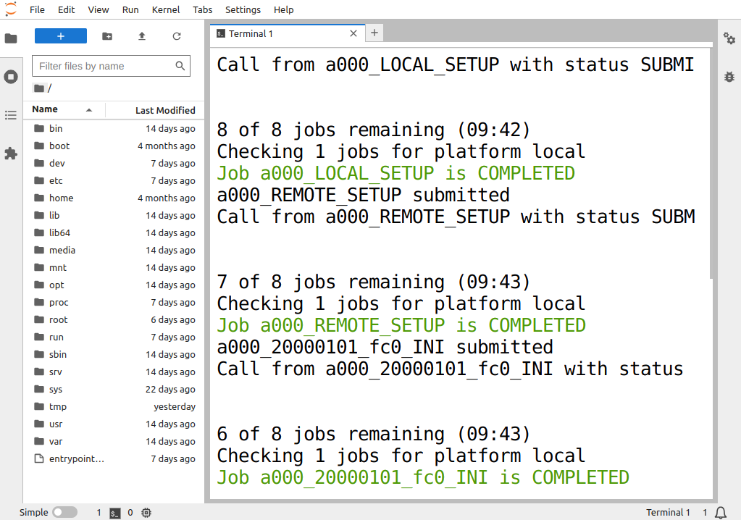
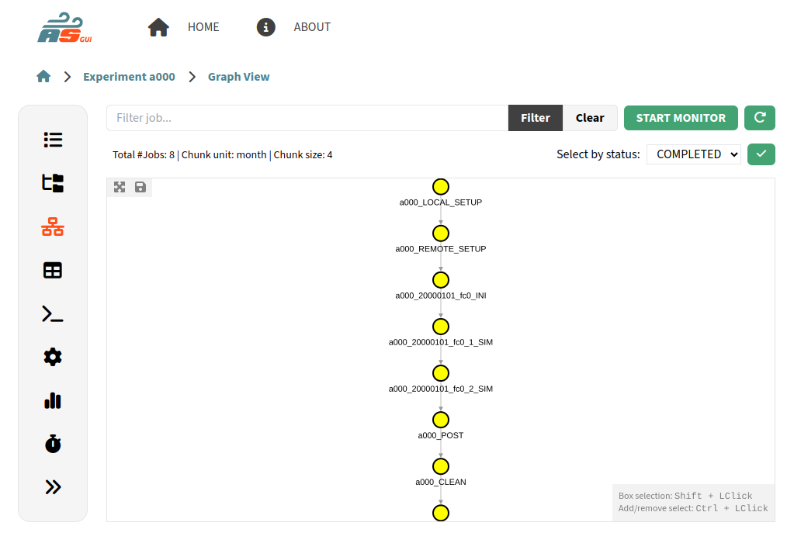
EDITO-Infra Autosubmit SaaS
Launches
Interacts
User
Creates

Slide 62
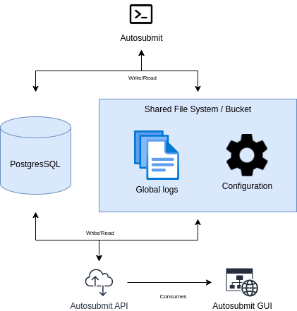
WIP: Postgres support

Slide 63
Wrapper impact analysis

Slide 64
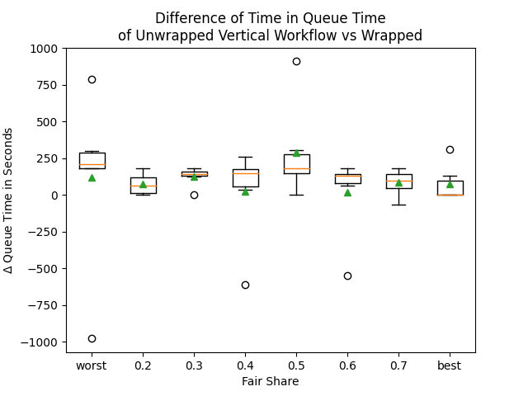
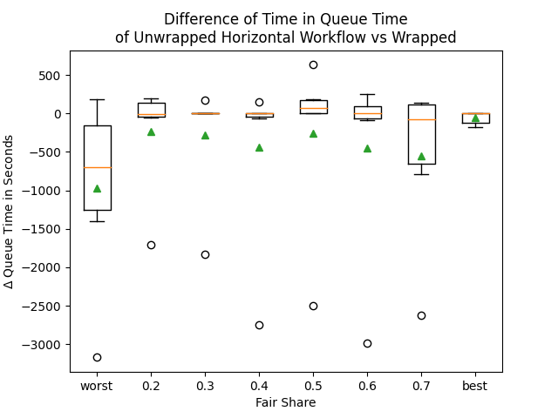
Simulated Wrappers
TL;DR vertical wrappers on average improve
horizontal not so
and we need more testing
(Enric is here!)

Slide 65
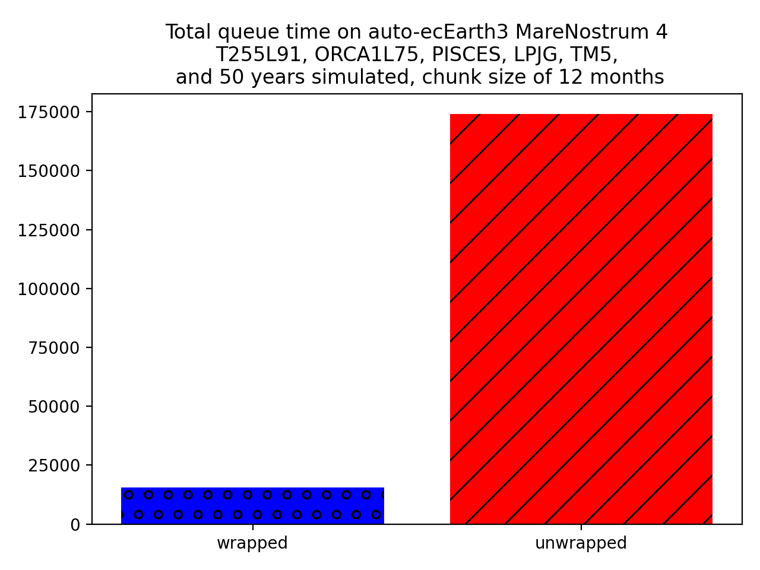
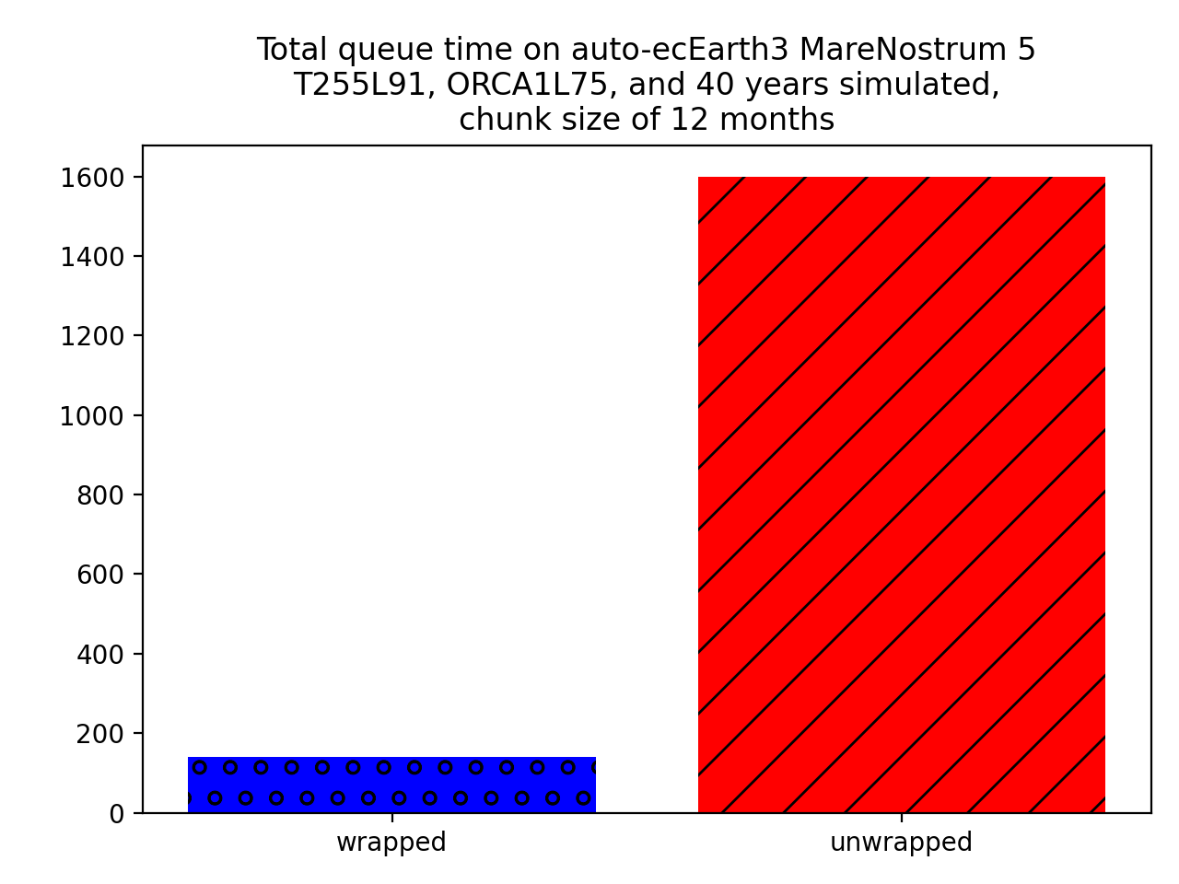
Real Life Testing
10x LESS QUEUE TIME IN BOTH PLATFORMS
queue time (s)
queue time (s)

Slide 66
Documentation, Testing

Slide 67
New documentation
How can we make our software documentation more friendly and usable?

Slide 68
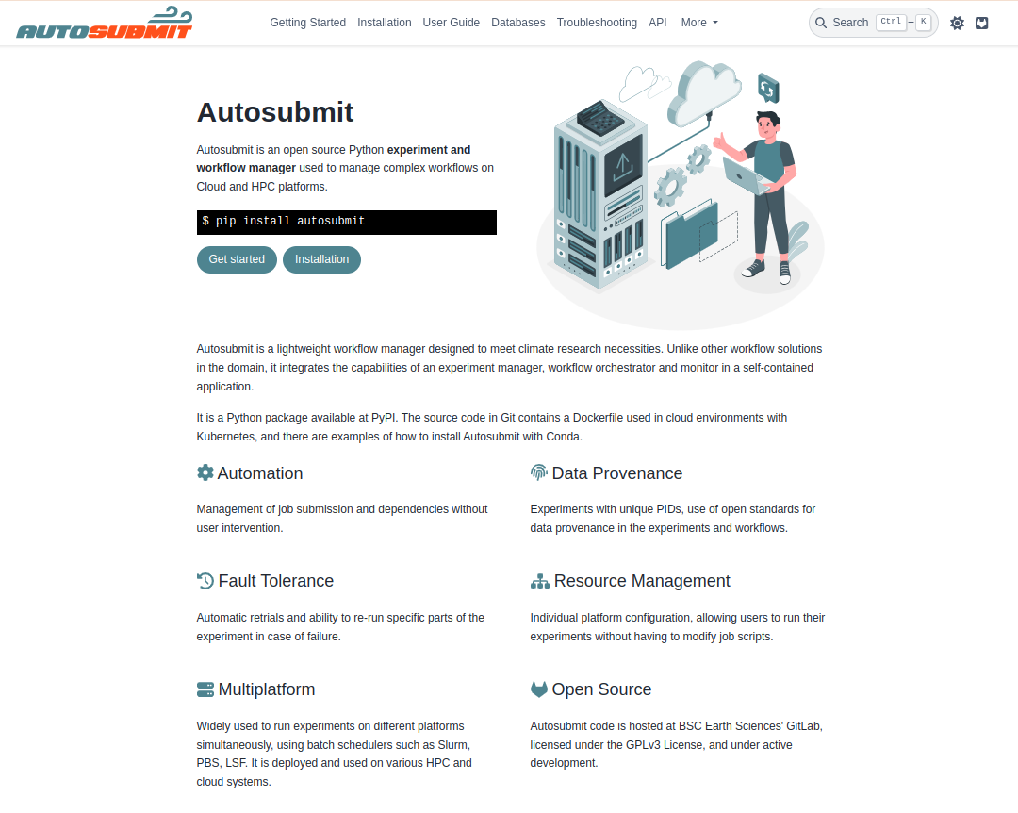
New documentation

Slide 69
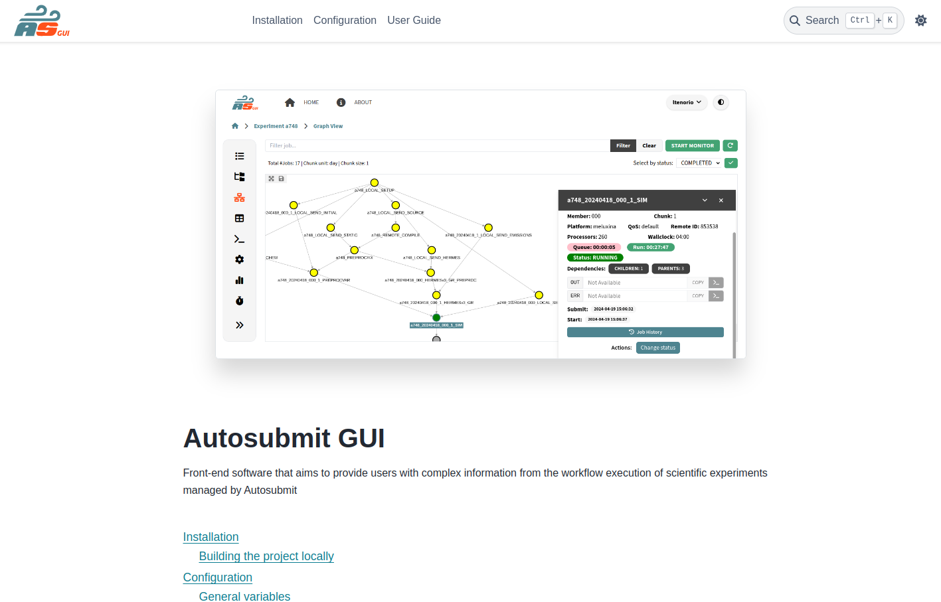
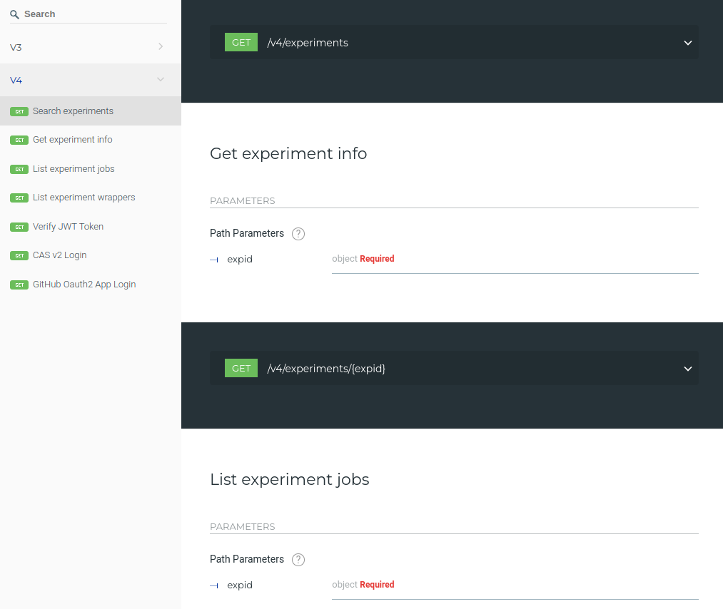
New documentation (GUI/API)

Slide 70
Testing
How can we make our software more stable, and avoid regressions?

Slide 71
Testing
Migrating from unittest to Pytest + fixtures
Measuring test coverage of changed code in CICD pipelines
Preparing for automation that will:
test more versions of Python
run more tests (unit, regression, …)
build Docker images
deploy automatically after tests to PyPI, DockerHub

Slide 72
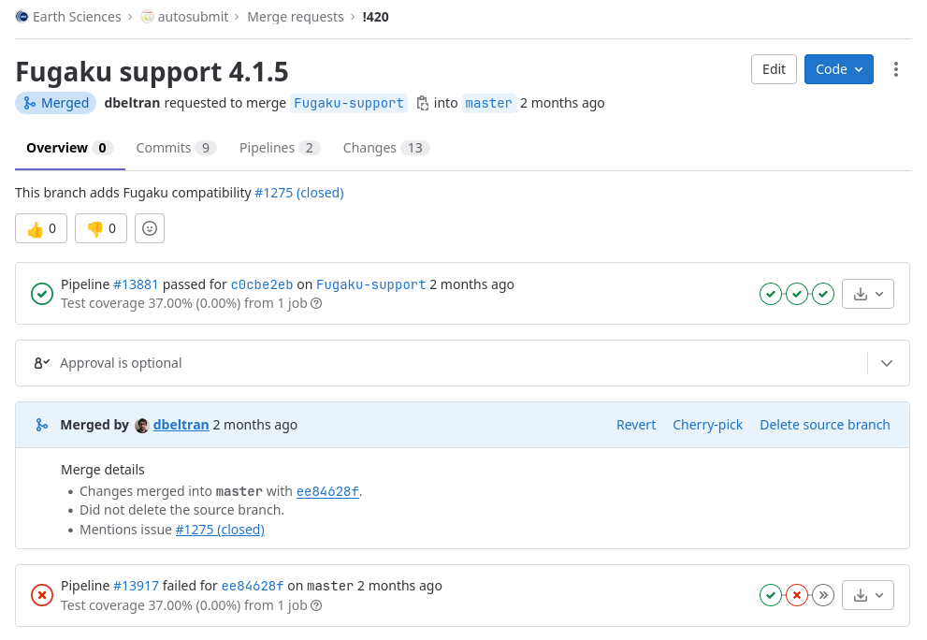
Testing

Slide 73
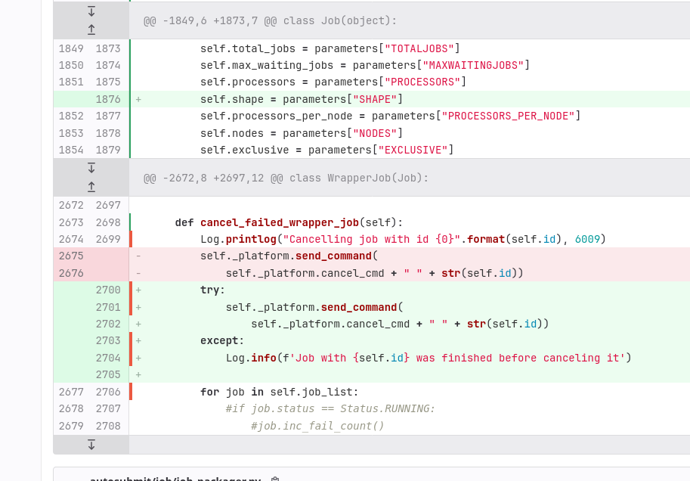
Testing

Slide 74
Testing Suite
Running tests using recent versions of Autosubmit
In the future this can be used to validate a .dev release, before an official PyPI/Docker/modules release
Approval of Testing Suite runners used to change the default module version of Autosubmit on VM’s, and to release to package management sites.
Launch TS periodically, automatically.

Slide 75
Autosubmit roadmap

Slide 76
Autosubmit 3: End of cycle
Current version
Current version features
Summer/Spring
Autosubmit 3
v3.15.18
May. 2024
- Stability improvements.
- Bug fixes.
- MN5, Fugaku support.
- Python3 wrappers.
Release of the last Autosubmit 3 version

Slide 77
Autosubmit
Autosubmit v3
Autosubmit v4
Autosubmit GUI
Autosubmit 5?
2025
END OF v3 LIFE CYCLE
v3.15.XX - Additional fixes
v4.3 - Additional testing, to be decided…
targeting mainly ECE-3, operational forecasts…
v4.2? - Workflow control capabilities
v4.2 - PostgreSQL, improved stats, additional testing
v3.15.XX - Additional fixes
v4.1? - PostgreSQL backend
2024
v3.15.18 - Stability, MN5, Fugaku, Python3 wrappers
v4.1 - Flexibility, efficiency
v4 - AS4 compatibility, new look, multiple fixes

Slide 78
Reference

Slide 79
Reference
Documentation
Autosubmit: https://autosubmit.readthedocs.io/en/master/
Autosubmit GUI: https://autosubmit-gui.readthedocs.io/en/latest/
Pip
Autosubmit: https://pypi.org/project/autosubmit/
Autosubmit API: https://pypi.org/project/autosubmit-api/
GitLab
Autosubmit: https://earth.bsc.es/gitlab/es/autosubmit
Autosubmit API: https://earth.bsc.es/gitlab/es/autosubmit-api
Autosubmit GUI: https://earth.bsc.es/gitlab/es/autosubmit-gui
Contact
General support: support-autosubmit@bsc.es

Slide 80
Autosubmit YAML configuration
(Other features)
Levels follows the standard hierarchy:
Dates -> Members -> Chunks.
Splits can also be selected under any of the other levels.
Jobs:
A:
…
running: date
B:
…
running: chunk
dependencies:
A:
dates_from:
“all”:
dates_to: “all”
Crossdate example
Filter types
{LEVEL}_FROM: Selects the current job {level} that you want to alter.
{LEVEL}_TO: Links current selected tasks to the dependency tasks of the dates specified.
“natural”: Will keep the default linkage. Will link if it would be normally. Example, SIM_FC00_CHUNK_1 -> DA_FC00_CHUNK_1.
“all”: Will link all selected tasks of the dependency with current selected tasks. Example, SIM_FC00_CHUNK_1 -> DA_FC00_CHUNK_1, DA_FC00_CHUNK_2, DA_FC00_CHUNK_3…
“none”: Will unlink selected tasks of the dependency with current selected tasks.
“previous”: Will link selected tasks of the dependency with previous selected tasks
Link Types

Slide 81
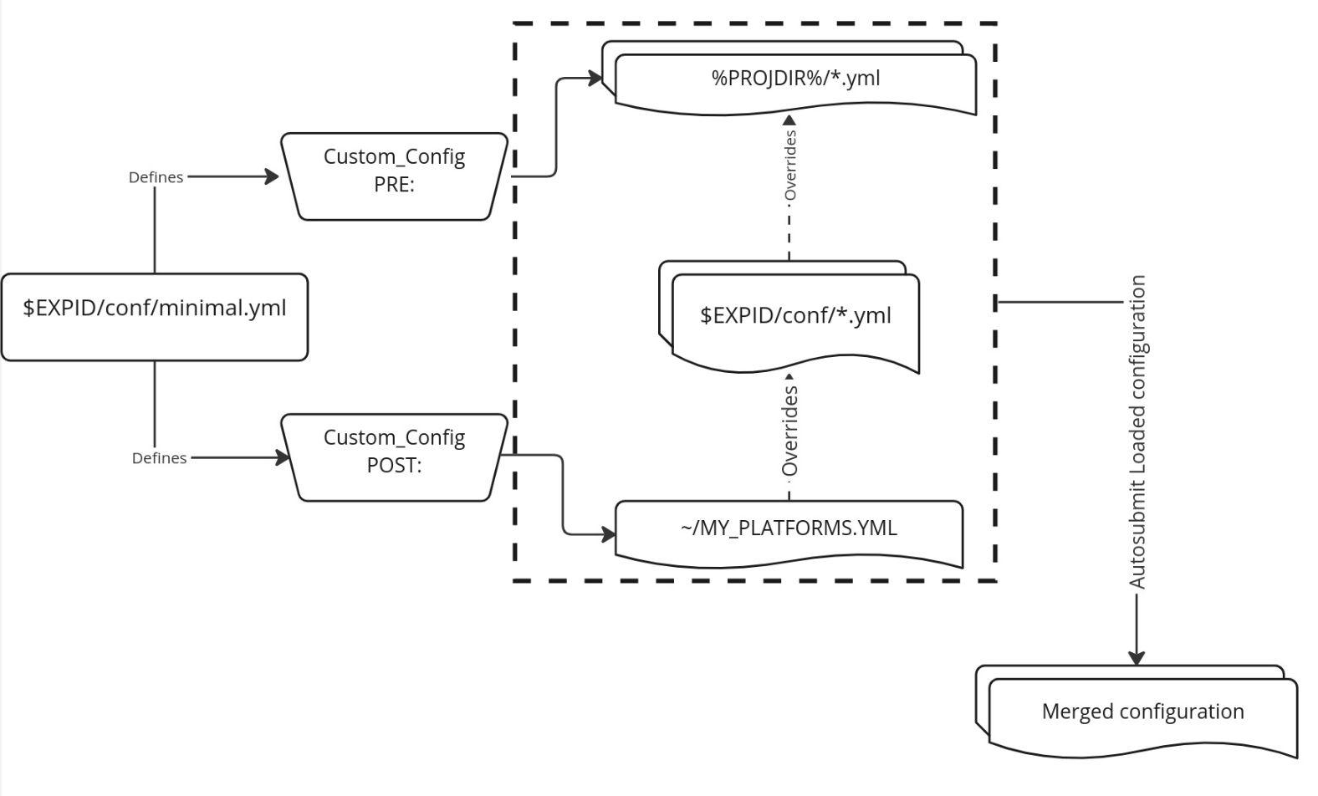
Autosubmit’s Hierarchy:
PRE & POST
Where developers store configuration files
The files that the user will edit to switch configurations
$EXPID/conf/minimal.yml
$EXPID/conf/bootstrap/include.yml
Personal user information
Notes:
Maybe too technical

Slide 82
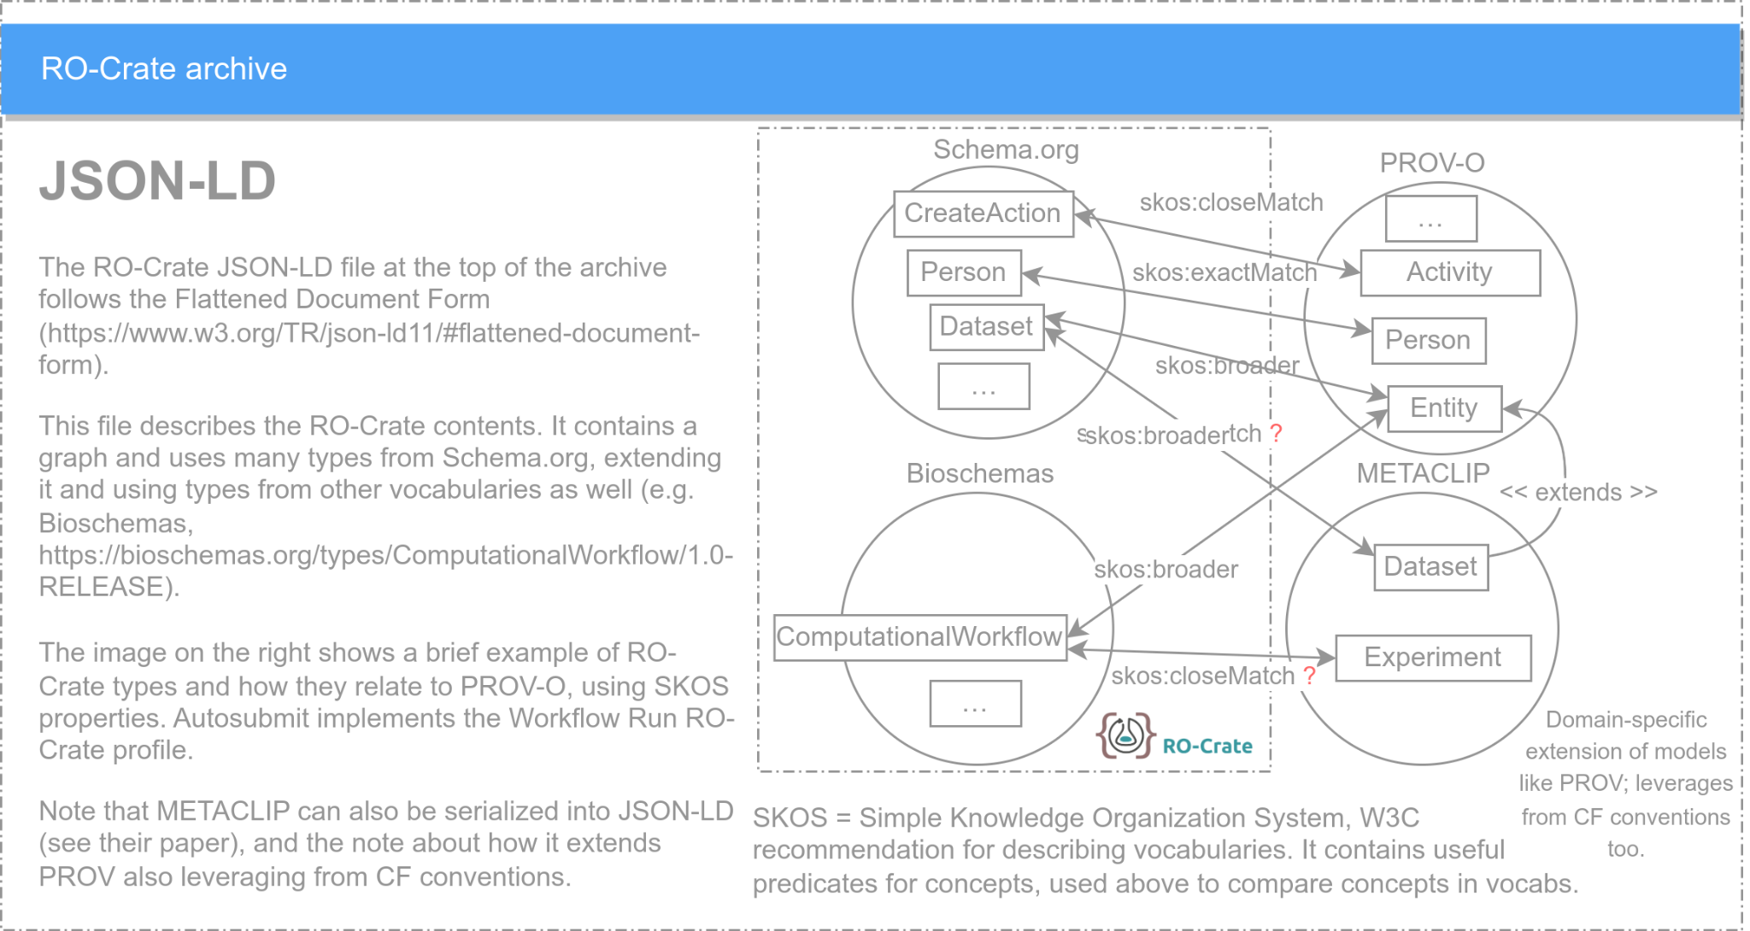
RO-Crate archive

Slide 83
RO-Crate implementation in Autosubmit

