Slide 1
O₃ sensitivity by reducing emissions of precursors in Barcelona
María Teresa Pay
BSC Team: C. Pérez-García Pando, O. Jorba, M. Guevara, A. Soret, M. Gonçalves
CSIC: X. Querol
U.S. EPA: S. Napelenok
Uni. Vasc Country: G. Gangoiti
Madrid, Nov 20-21, 2018
Workshop on air quality policy implementation related to ozone
Notes:
Collaboration between BSC, Spanish Research Council and US EPA

Slide 2
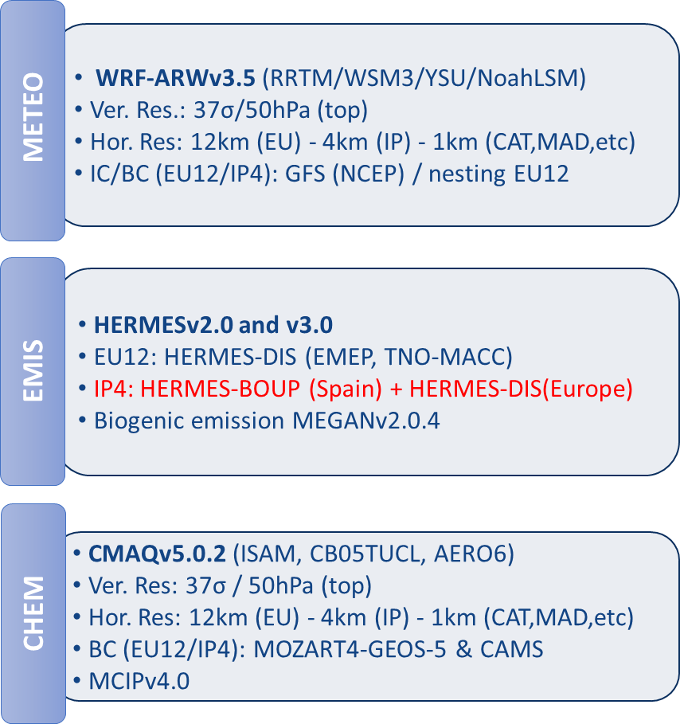
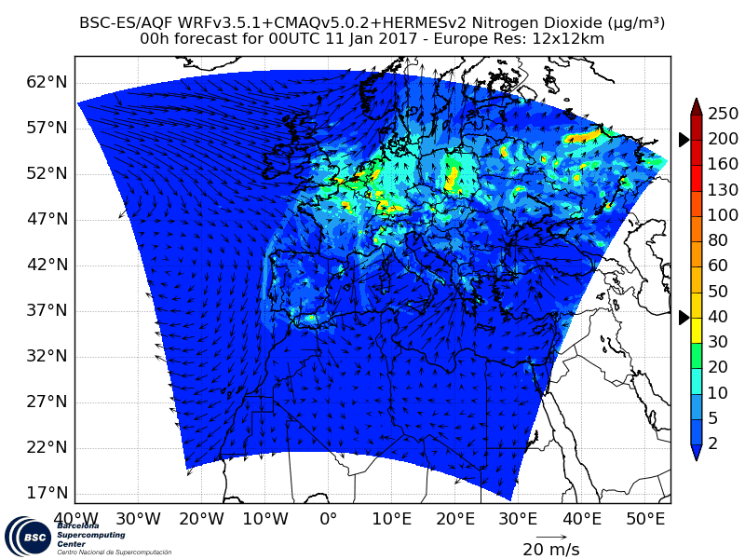
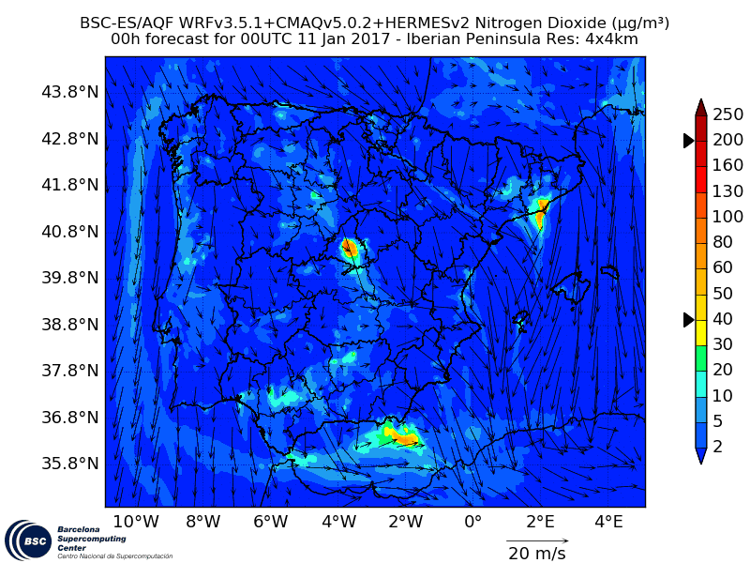
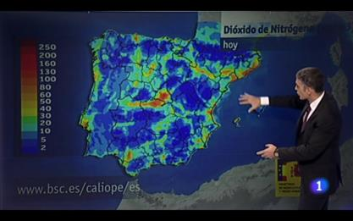
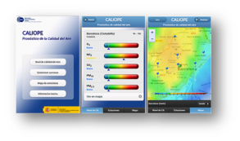
The CALIOPE air quality forecast system www.bsc.es/caliope
Air quality products
Smart city platform
Notes:
Provides air quality information for the coming days and for the application of short term action plans for air quality managers

Slide 3
CALIOPE for mitigation strategies Modelling approach – Earth Science Department @BSC
Targeting Barcelona & Madrid cities: different regimes (chemical, meteorological).
Focused on the road traffic sector (PM10, PM2.5 and NO₂).
Impact on NO₂ and PM: reduction in the conurbations (up to 30%).
Impact on O₃: slightly increase in the urban area (~1-4%) and low and negligible downwind.
Notes:
The air pollution control strategies adopted in the reviewed AQP, in particular the abatement measures of pollutant emissions, are mostly focused on the road traffic sector, which is identified as the main source of PM10 and NO2.
There is a large diversity of abatement measures associated to road traffic. speed reduction, street cleaning and others.

Slide 4
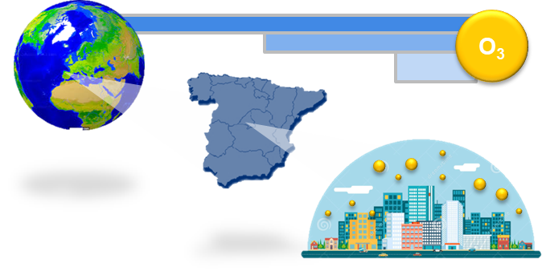
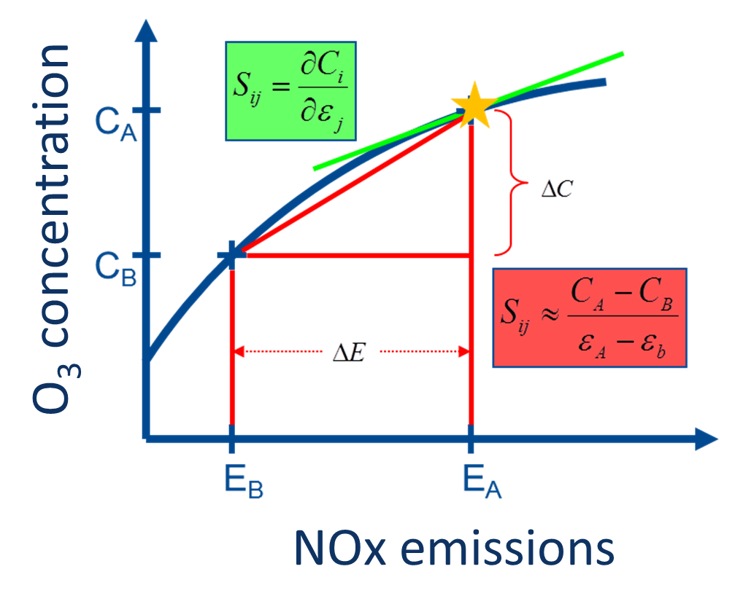
What remains? Diagnosis of O₃ problem
1
STATE
Which are the economic activities (sectors) responsible for high O₃?
Where do the precursors responsible for O₃ exceedances come from (regions)?
Source apportionment
2
Source sensitivity
RESPONSE
Which sources (sectors/regions) are more efficient to reduce?
Counterpart of NO_{x}/VOC reduction on O₃
Notes:
The definition of effective abatement measures to comply with the EU air quality limit values, within the prescribed period, is based on a previous characterization of sources to identify the geographic origin of pollutants and the contribution of sources responsible for the air pollution exceedances.

Slide 5
Source apportionment
Emission are critical
Brute Force
Tagging method
O₃
O₃
O₃_S1
O₃_S2
O₃_S1
O₃_S2
O₃*
O₃**
Exp 1
BaseCase
Exp 2
Zeroing S1
Exp 3
Zeroing S2
Exp 1
+ Straightforward for any model
- Mass inconsistency
- Not real atmospheric conditions
- High computational resources
+ Time saving (one simulation)
+ Mass consistency
+ Real atmospheric conditions
+ Appropriate secondary pollutant (O₃)
- Model coding required
CALIOPE system (CMAQ-ISAM)
Notes:
Why source apportionment for O3 is a challenge? The concentration of O3 depends:
non-linear fotochemical formation. It means there is not a necessary direct and proportional relation ship between the emission changes and O3 changes.
Different sources (natural and antropogenic) with different Ozone formation potential.
Different source regions: neighbouring area, but also regional, hemispheric and even stratospheric intrusion.

Slide 6
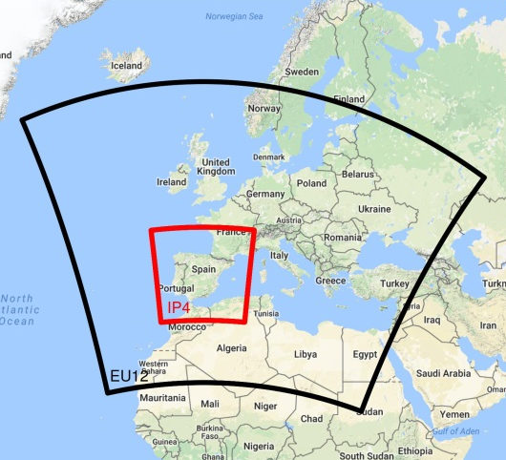
Exp: sector emissions + imported O₃ Pay et al., 2018. Atmos. Chem. Phys. Diss.
Experiment set-up
Which sources?
Sectors that account 92% of the total NO_{x}
Annual emissions HERMESv2.0 in Spain 2009
NO_{x}
NMVOC
Imported O₃ from where?
The episode
21-31 July 2012
Imported O₃
This presentation
#exceedances
Notes:
The tagged sectors in this study are those that account for the 92% of the total NOx emission in Spain, which correspond in order of importance to:
on-road transport (SNAP7, yellow)
Non-road transport (SNAP8, brown)
Power plants (SNAP1, purple) and combustion in energy (SNAP34, orange)
The other sectors accounting less than 8% are lumped in the tag “OTHER”
Note that OTHER is the biggest contributor to VOC emission, where a 70% come from biogenic sources.
ISAM will also tag: BCON and ICON
ICON after 6 days of spin-up is less than 1%.

Slide 7
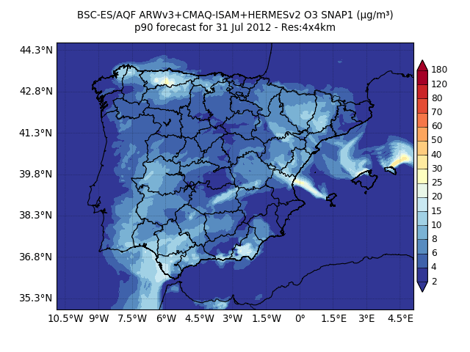
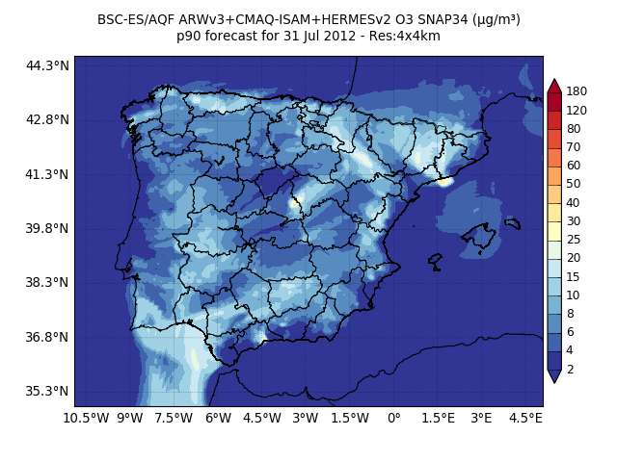
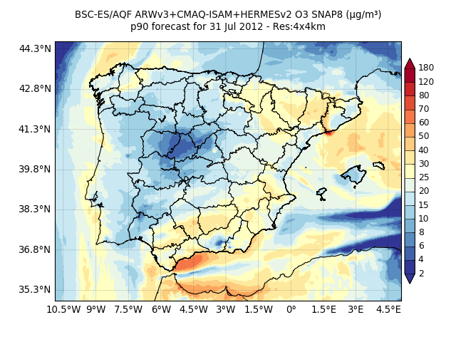
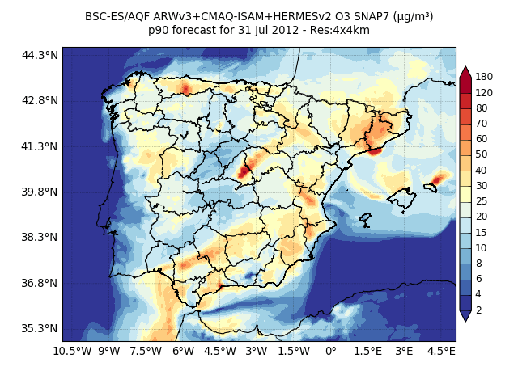
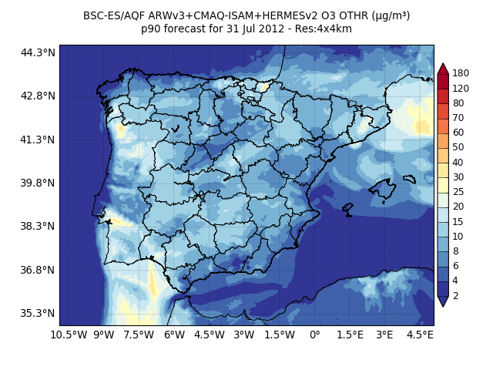
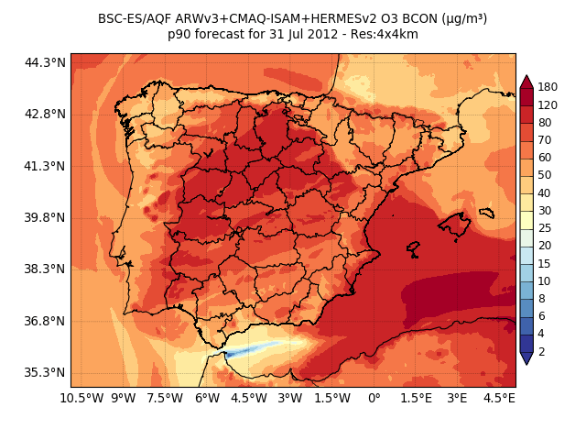
Exp: sector emissions + imported O₃ Pay et al., 2018. Atmos. Chem. Phys. Diss.
p90 O₃ for 31 Jul 2012
p90 O₃ contributions for 31 Jul 2012
Power Plants
Industry
Total
µg/m³
Tagging method
Non-road
On-road
Total O₃
µg/m³
Others
Imported
Notes:
Example of the SA O3 results for the p90 of the O3 concentration: 31 July – ITL
[LEFT]: net O3 concentration. Highlight: main ozone basin > 120ugm/3: Gualdaquivir Basin,
[RIGHT]: decomposition of O3 concentration by sources:
BCON: by far the largest contributor.
Elevated point sources (power plants and industry): similar contribution (15-25)
On-road traffic: second largest contributor after BCON. High concentration around main urban areas.
Non-road traffic: important contribution along main shipping routes or around main harbours.

Slide 8
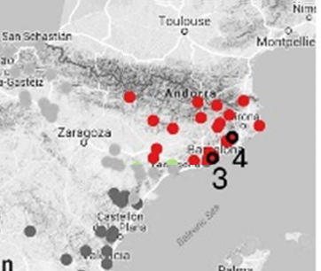
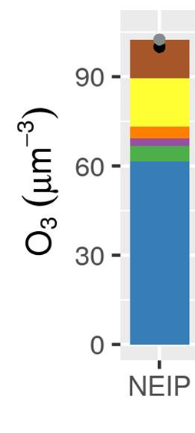
Exp: sector emissions + imported O₃ Pay et al., 2018. Atmos. Chem. Phys. Diss.
Daily mean contribution in exceedances (MDA8 > 120 µ/m³)
Episode (21-31 July 2012)
MDA8 = maximum daily 8-hour averaged
Notes:
E.g. O₃ non-road traffic (shipping, airplane, machinery in agriculture) and industrial processes can be as important as road traffic in Catalonia.

Slide 9
Exp: sector emissions + imported O₃ Pay et al., 2018. Atmos. Chem. Phys. Diss.
Receptor: urban station (3)

Slide 10
Exp: sector emissions + imported O₃ Pay et al., 2018. Atmos. Chem. Phys. Diss.
Receptor: rural station (4)
High model performance at rural background stations (bias = 4.5µg/m³ and r= 0.7)

Slide 11
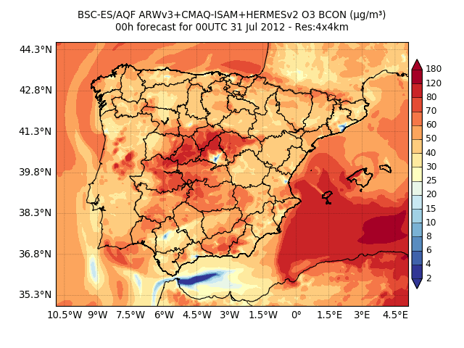
Exp: sector emissions + imported O₃ Pay et al., 2018. Atmos. Chem. Phys. Diss.
Imported O₃
W
E
Main contributor to concentration overall (background levels).
Processes: advection + vertical mixing.
W
E
Notes:
We note that the small biases at rural background stations obtained in the evaluation section indicate an overall high performance of the modelled background O₃ in the IP4 domain (Fig. S1).
Given its importance, this section is devoted to analyse the importance of the imported O₃ in southwestern Europe. In particular, we aim to understand its high contribution within the IP, far from the model domain boundaries.

Slide 12
Conclusions and next steps
Regional/local source contributions dominate O₃ during peaks
Next: Identify key emissions sectors.
Imported O₃ to the IP is a main contributor to ground-level O₃ concentration overall in summer in Spain (background levels).
Next: Quantify the relative importance of imported vs. regional/local O₃.
Next: Design mitigation strategies should be coordinated at different scales.
Modelled mitigation strategies have been designed mostly for targeting primary pollutants and the traffic sector.
Next: define air quality plan targeting O₃. Main elements:
1
2
Source apportionment (regions & sectors)
Source sensitivity
(regions & sectors)
3
Observations
(AQ & Meteorology)
Design mitigation strategies
(multiscale & climate)
+ More O₃ episodes or campaigns
+ Model evaluation
+ Comprehensive assessment
4
Test “potential mitigation strategies” (modelling)

Slide 13
Thank you!
Acknowledgments
Spanish Ministry of Economy and Competitiveness under the project PAISA (CGL2016-75725-R).
High Performance Computer resources of the “Red Española de Supercomputación” (AECT-2017-1-0008).
Computational Earth Science team - BSC
References:
Pay, M.T., Gangoiti, G., Guevara, M., Napelenok, S., Querol, X., Jorba, O., Pérez García-Pando, C. A source apportionment assessment of ozone concentrations in peak summer events over the Iberian Peninsula. Atmos. Chem. Phys., Diss.

