Slide 1
Lessons learned with EC-Earth on the predictability of the Earth system within the CMIP6 exercise and beyond
Pablo Ortega (BSC)
On behalf of the Climate Prediction Working Group
Virtual EC-Earth meeting, 16-18 November 2021

Slide 2
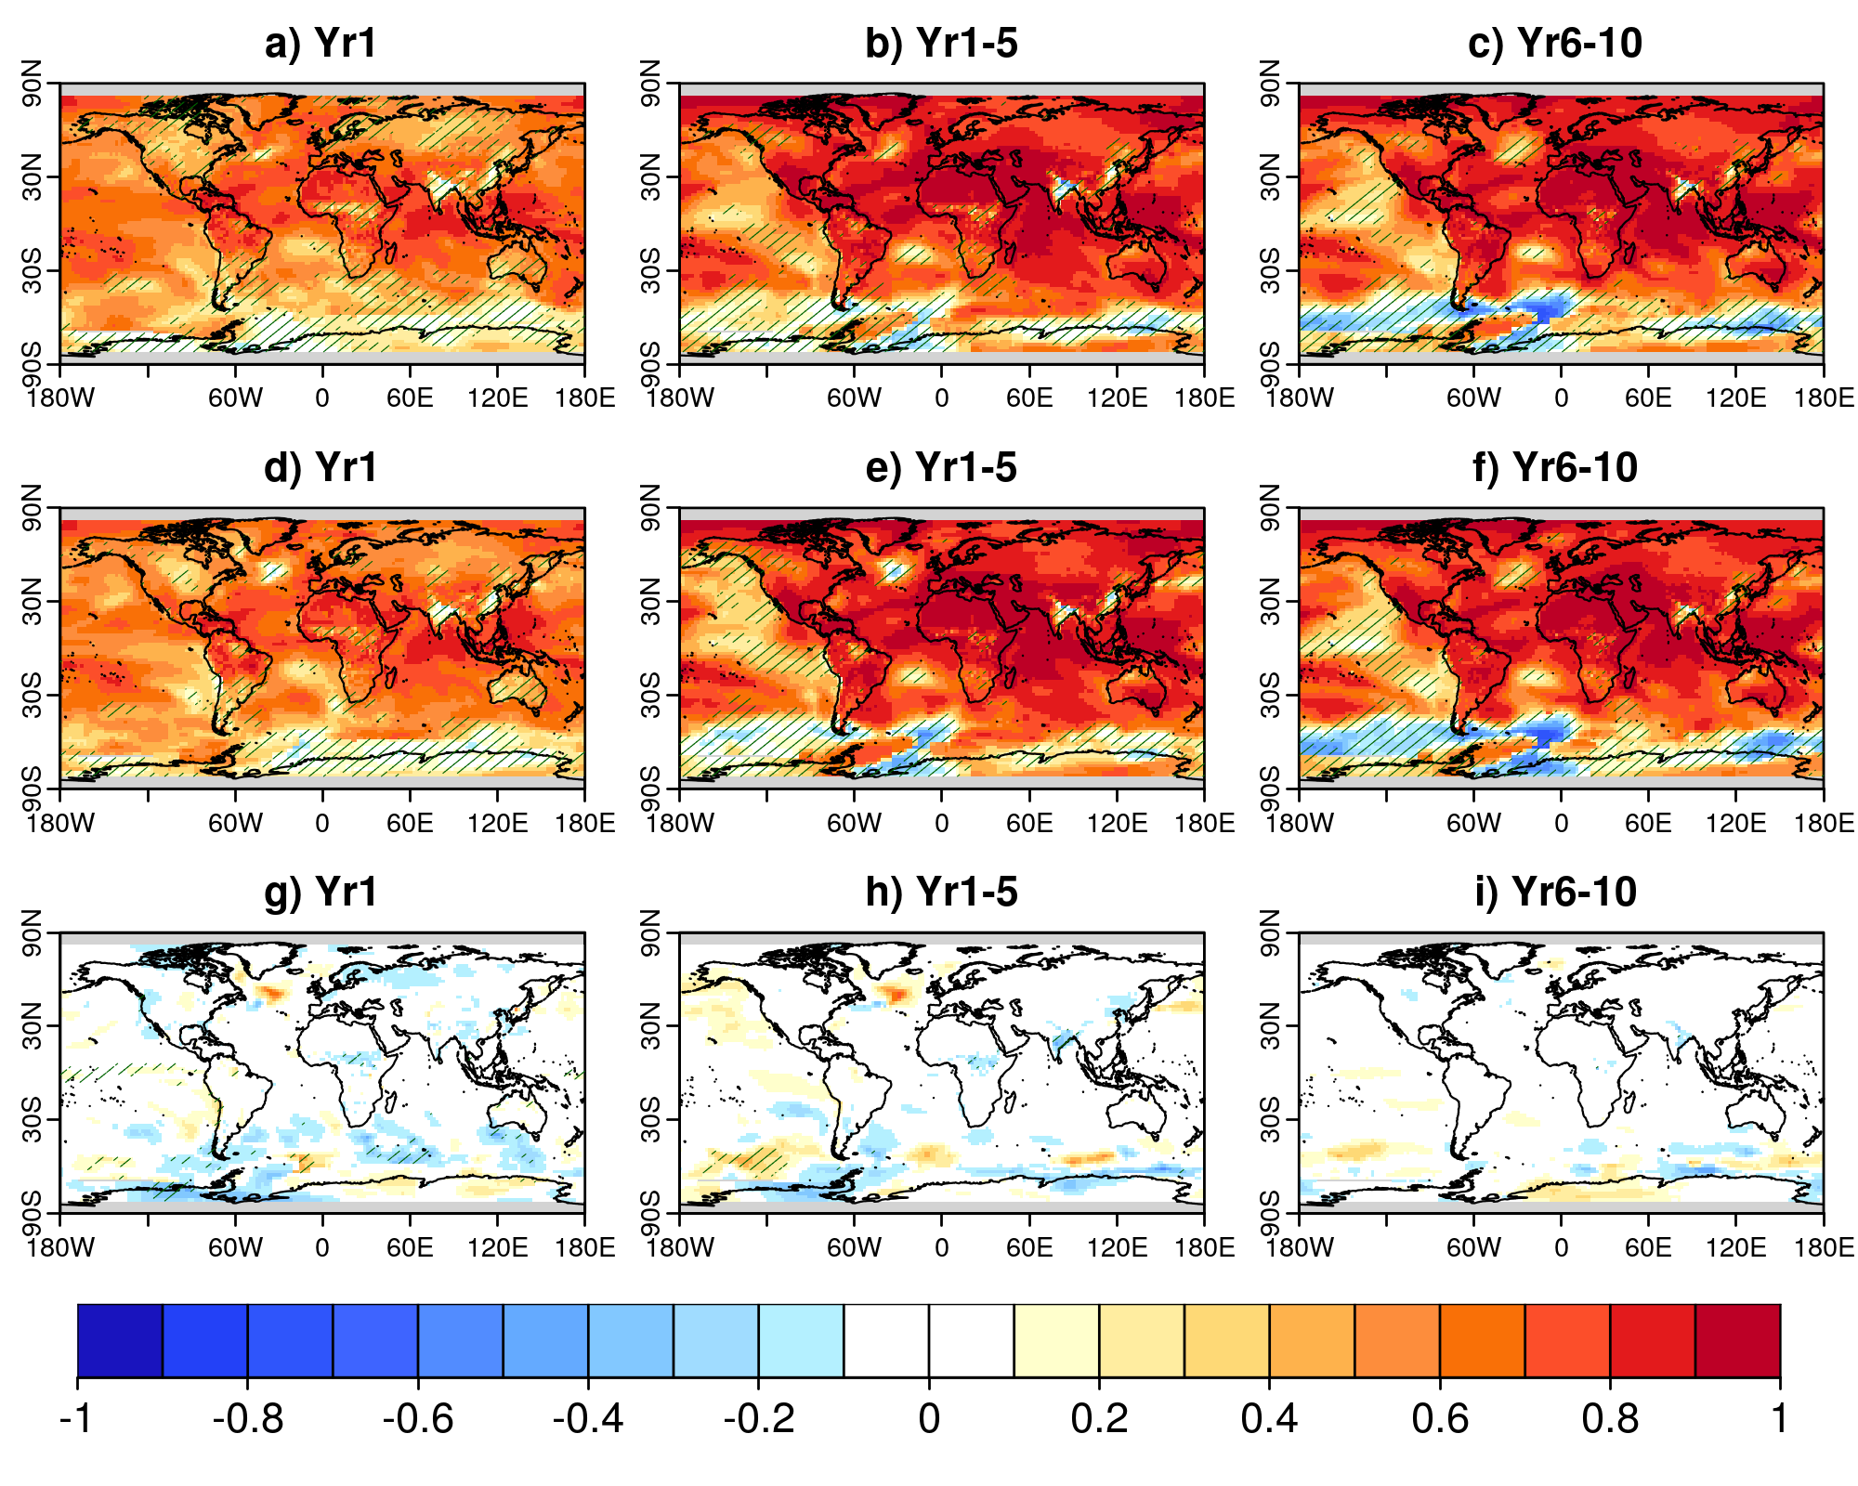
A new decadal prediction system based on EN4/ORAS5 (BSC)
Anomaly correlation for surface air temperature
Old full-field DCPP system based on ORAS4 cannot be used for new forecasts
New initialization method assimilates ORAS5 SST and SSS and EN4 T,S in the subsurface to circumvent the non-stationarity biases in ORAS5
The new method seems to partly correct the loss of skill in the Central North Atlantic
New
Old
New - Old
R. Bilbao, J. Acosta Navarro, I. Ayan, P. A. Bretonniere, V. Lapin, F. López Martí, P. Ortega, V. Sicardi, E. Tourigny

Slide 3
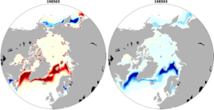
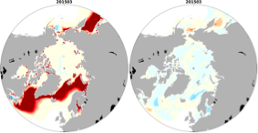
Reducing biases in Arctic sea ice (DMI)
by improving the representation of SSHF through leads
Leads in Central Arctic cover 1.2% of the ocean during winter, but account for more than 70% of the upward heat fluxes
GCMs generally have too coarse a resolution (~100 km) to simulate leads explicitly
DMI has introduced in EC-Earth a new parameterization (developed by NERSC*) to amplify the sensible heat flux through lead when SIC >70% .
Experiments: Two sets of 50-year simulations with both warm (2015) and cold (1985) fixed forcing, only differing in the activation of lead parameterization (Lead/Ctrl).
Large sea ice cover (1985)
Small sea ice cover (2015)
Future work:
Disentangle the added value of leads in a warm climate in pairs of seasonal and decadal forecasts
Use of satellite sea ice data in parameterization
Bias Bias reduction
Bias Bias reduction
T. Tian, R. Davy*, S. Yang and S.M. Olsen
Notes:
it is more effective to cold forcing: SIE/SIV reduced 11/27% all year round; to warm forcing SIE only improved in summer (JASO) along the ice edge in the CAO

Slide 4
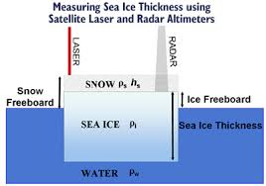
Testing sea ice freeboard assimilation in coupled mode (UCLouvain)
Assimilation Method
First results (September 2012)
Deterministic Ensemble Kalman Filter (DEnKF, Sakov et al. 2008)
NERSC implementation adapted to EC-Earth3 (Massonnet et al. 2015)
Assimilation reduces, but does not eliminate, the biases in the Chukchi- Beaufort-East Siberian Seas by prescribing thinner ice.
Constraining SIC/SIT/SIFB alone seem to be similarly efficient
DEnKF updates ocean/sea ice fields that are not observed, by exploiting covariances in the forecast ensemble. Atmospheric fields are not updated
Note: the observed 2012 September sea ice conditions were affected by the « great » cyclone of early August 2012, which is not predictable.
F. Massonnet, S. Fleury, F. Garnier, E. Blockley, P. Ortega, J. C. Acosta Navarro, L. Ponsoni and F. Klein

Slide 5
Added value of assimilating SIC on seasonal prediction (BSC)
Start month: May Reforecast period: 1992-2018 Ensemble size: 30 members
Improvements in summer prediction skill
Sea Ice Concentrations
Geopotential Height at 500 hPa
June (2nd month)
July-Sep (3rd-5th months)
June (2nd month)
July-Sep (3rd-5th months)
-0.5
-0.4
-0.3
-0.2
-0.1
0
0.1
0.2
0.3
0.4
0.5
Skill is worsened
Skill is improved
J. Acosta Navarro, J. García-Serrano, V. Lapin, P. Ortega (to be submitted)

Slide 6
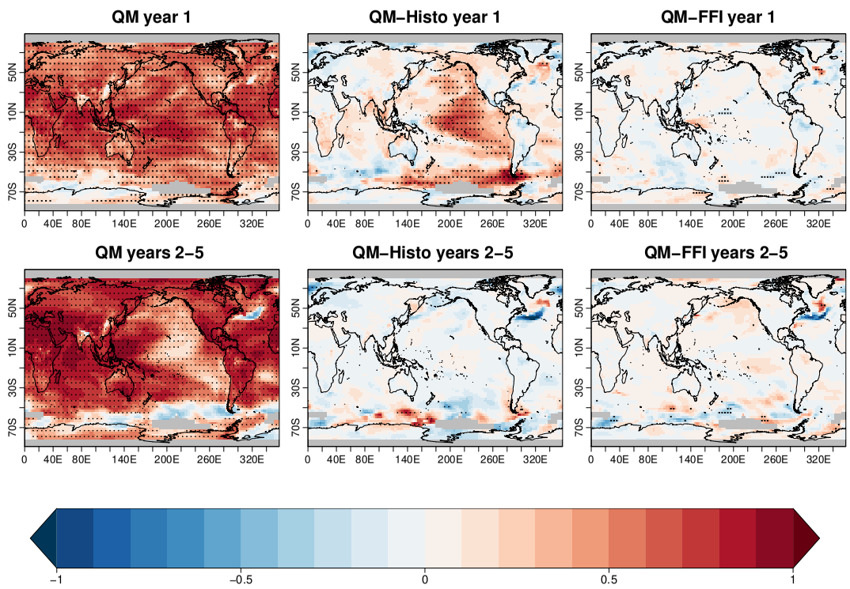
Quantile-matching method for initializing decadal hindcasts (CNR)
The quantile matching (QM) in a nutshell
The initial state is the model state that matches the observed distribution at initialisation time
QM allows the model to be on its attractor (reducing the initial shock and the drift)
Experimental set-up
10 ensemble members
5 forecast years
Start-dates: Nov 1960-2014
Near surface temperature anomaly correlation (AC)
AC in the Labrador Sea
Mixed layer depth
Barotropic streamfunction
QM
FFI
Histo_Conv
Histo_NoConv
Ref: GISTEMP
Comparison with a full field initialised (FFI) hindcasts
and 15 historical simulations
D. Volpi, V. Meccia, V. Guemas, P. Ortega, R. Bilbao, F. Doblas-Reyes, A. Amaral, P. Echevarria, R. Mahmood and S. Corti (2021, Front. Clim.)

Slide 7
Three different approaches for decadal prediction (SMHI)
Standard Resolution
(1° ocean, T255 atmos)
High Resolution
(1/4° ocean, T511 atmos)
Coupled Assimilation
(1° ocean, T255 atmos)
SMHI & DMI set up a quasi operational decadal prediction system with EC-Earth (v3.3.1.1)
15 members, initialized annually on 1 November throughout the period 1960-2020
Anomaly initialization for ocean + sea-ice concentration and thickness (new method was developed)
Full-field initialization for atmosphere
Tian et al., 2021
Karami et al., In prep
Same initialization approach as in SR
forecast period 1990-2004, 10-member; 5 years and 2 months
HR shows improved skill over SR
10 historical-SSP2-4.5 runs: 1850-2030
5 assimilation runs started from 5 historicals with SST restored to HadISST1 anomalies: 1900-1949
(2 runs continued until 2015)
5 assimilation runs started from previous ones, with SST restored to HadISST1-anomalies + atmospheric relaxation to 6h ERA5-anomalies (surface near winds, surface pressure): 1950-2020
Hindcasts to be run soon
Skill difference HR-SR
T. Kruschke, P. Karami, S. Wang, F. Schenk and T. Koenigk
(contributions to CMIP6-DCPP, EUCP and ArcPath)

Slide 8
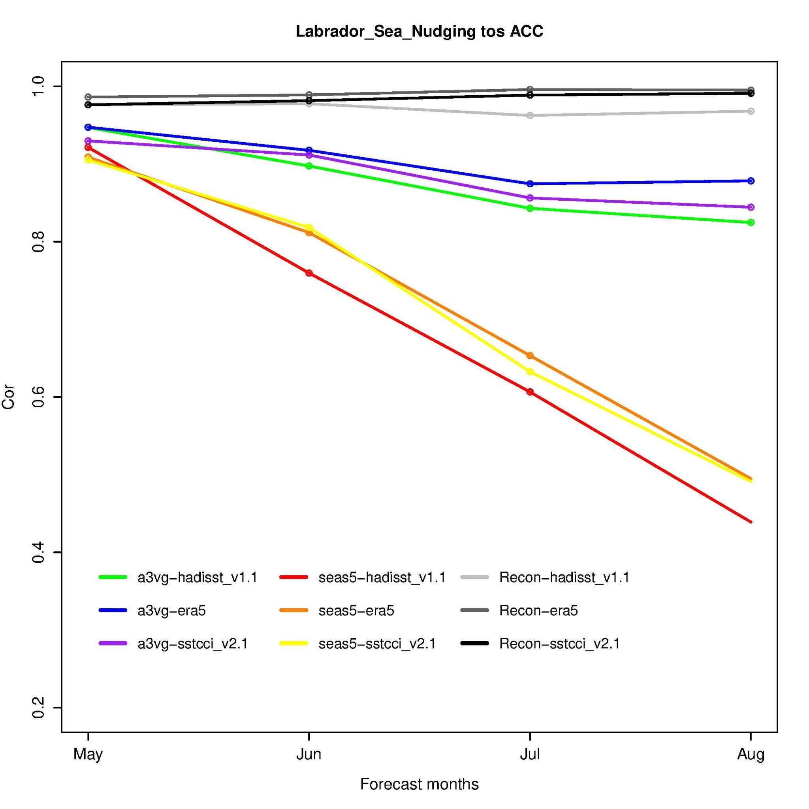
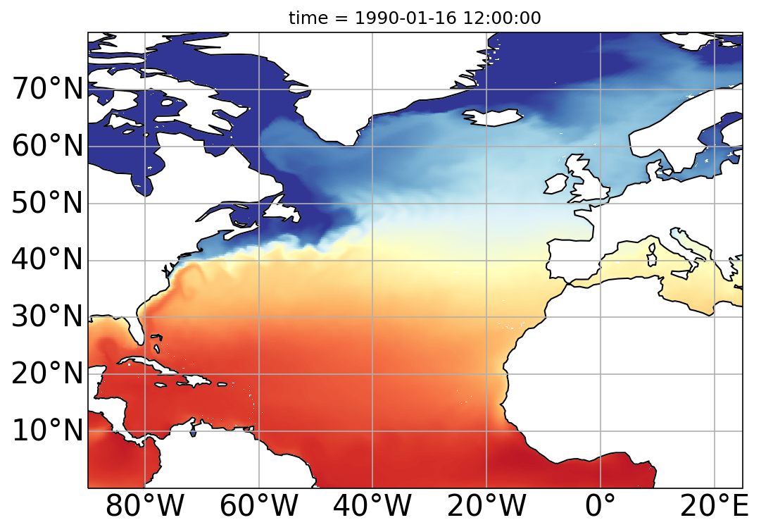
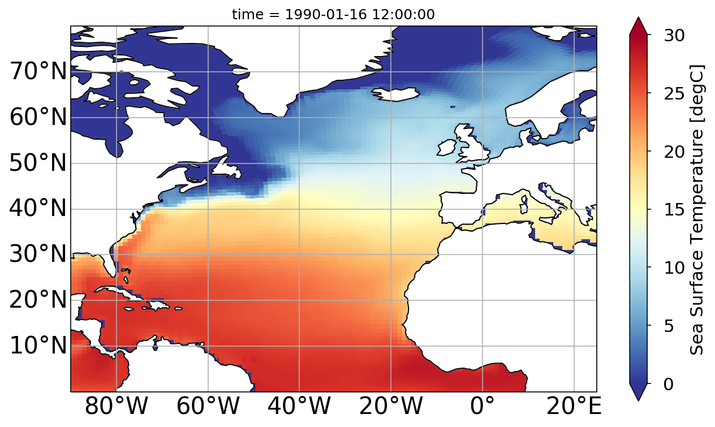
On the path towards a HR decadal prediction system (BSC)
1) Tuning of EC-Earth3.3-HR
3) Seasonal Hincasts
4) Reduced DCPP system
It has reduced strong Arctic sea ice biases in EC-Earth3P-HR
It does not show collapses of Labrador Sea convection as in EC-Earth3.3-LR
2) Producing HR reconstruction
Same approach as for the LR decadal predictions (with a small change in snow conductivity to compensate for a warm bias in ERA5)
Reforecast period: 1990-2015 (summer)
15 members (May to September)
10 members (May to December)
Skill levels higher than for SEAS5
Normal Reduced
1960-2020 1960-2020
(every yr) (every 2rd yr)
10 members 5 members
10 forecast yrs 3 forecast yrs
TOTAL (6100 yrs) TOTAL (465 yrs)
Skill for predicting Labrador Sea SST
Hindcasts to be run soon
Depending on the results we could later run more members/start dates/forecast years
A. Carreric, S. Palomas, M. Castrillo, M. Donat, P. Ortega and F. Doblas-Reyes

Slide 9
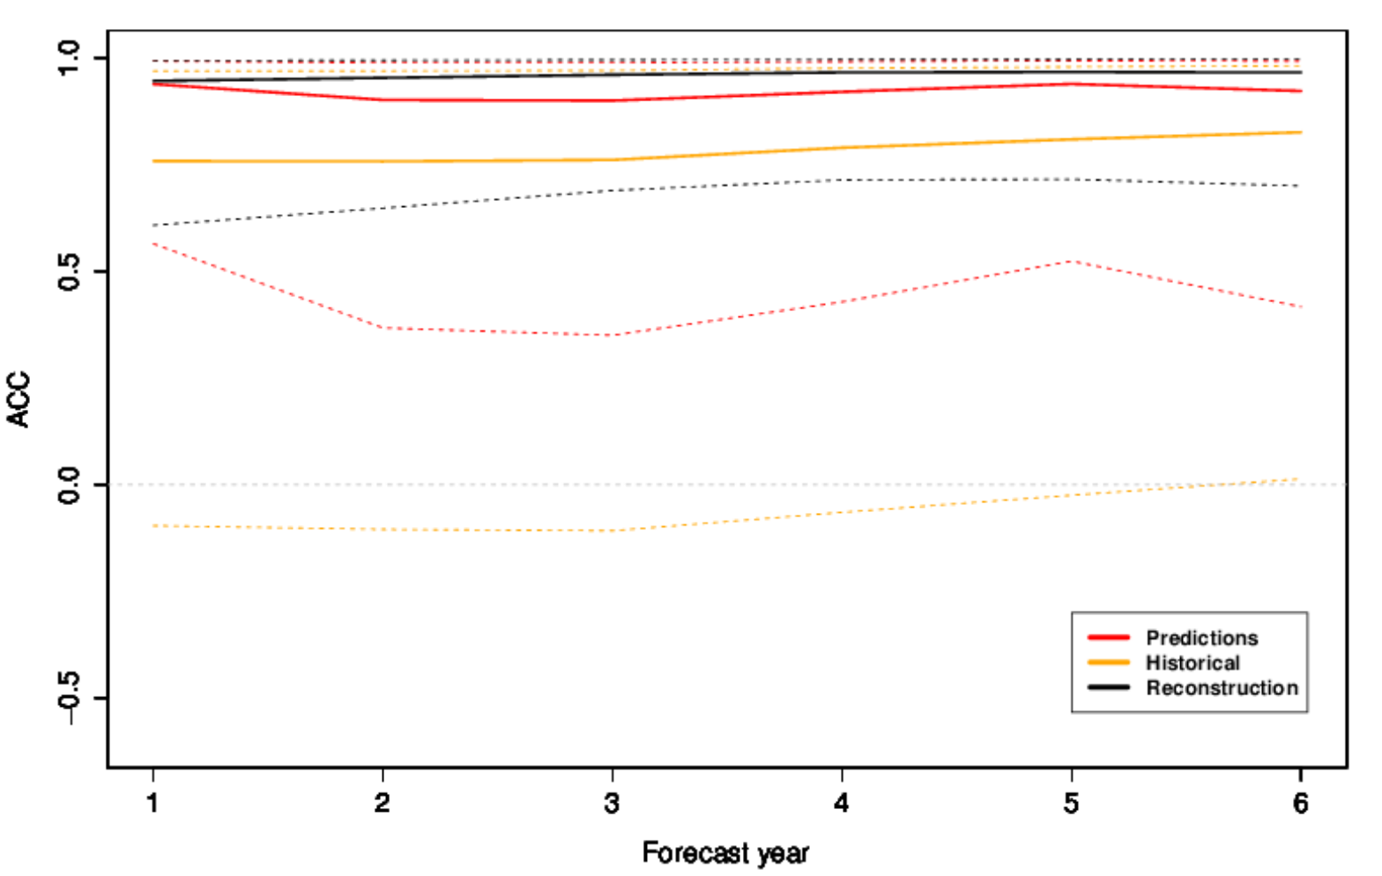
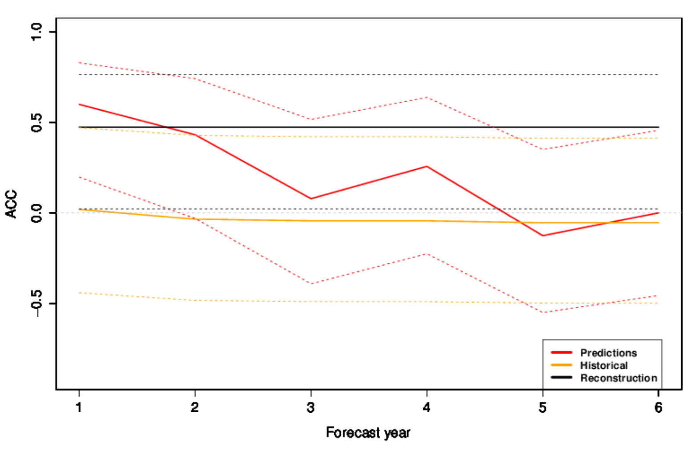
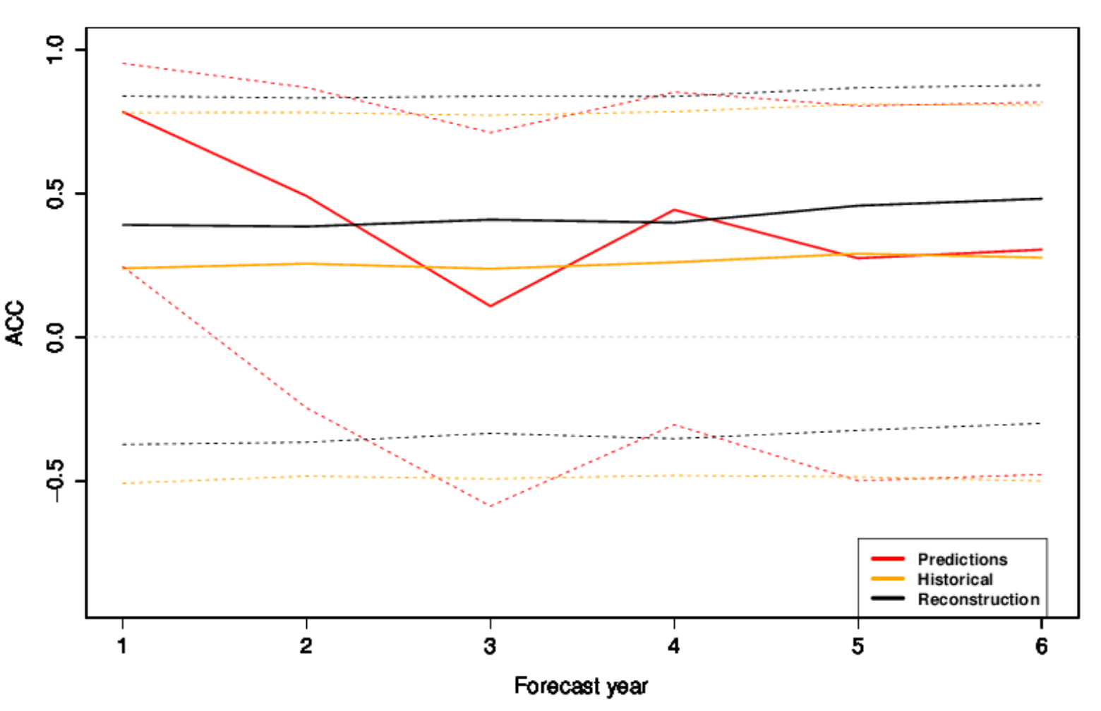
A first decadal hindcast of carbon cycle with EC-Earth-ESM (BSC)
EC-Earth-3.3-ESM (concentration driven) Ensemble size: 5 (+10 in production)
Reforecast period: 1980-2020 Forecast length: 7 years
3) Seasonal Hincasts
Ocean initialization: As in new EC-Earth3-GCM system (only physics assimilated) → 3 cycles to get present CO2 uptake
Land initialization: Offline land-surface reconstruction with LPJ-GUESS → forced with ERA20C/ERA5 (prior/after 1950)
Skill of global ocean CO2 flux anomalies
Skill of global land CO2 flux anomalies
Skill of global land+ocean CO2 fluxes
ref: GCB2020
Next steps: using emission driven configuration of EC-Earth3.3-ESM
J. Acosta-Navarro, E. Tourigny, R. Bernardello, V. Sicardi, E. Exarchou, V. Lapin
Notes:
Land BGC: cycled the first 20 years of era20c forcing with transient CO2 and other drivers
Ocean BGC: cycled 3 times over present period to get CO2 uptake levels expected at the current period.

