Slide 1
Co-production of multi-annual climate services to support food and wine production resilience
Carlos Delgado-Torres, Sara Octenjak, Raül Marcos, Francisco J. Doblas-Reyes, Markus G. Donat, Nadia Milders, Núria Pérez-Zanón, Albert Soret, Marta Terrado, Verónica Torralba, and Dragana Bojovic
EMS2024 September 2024, Barcelona
carlos.delgado@bsc.es

Slide 2
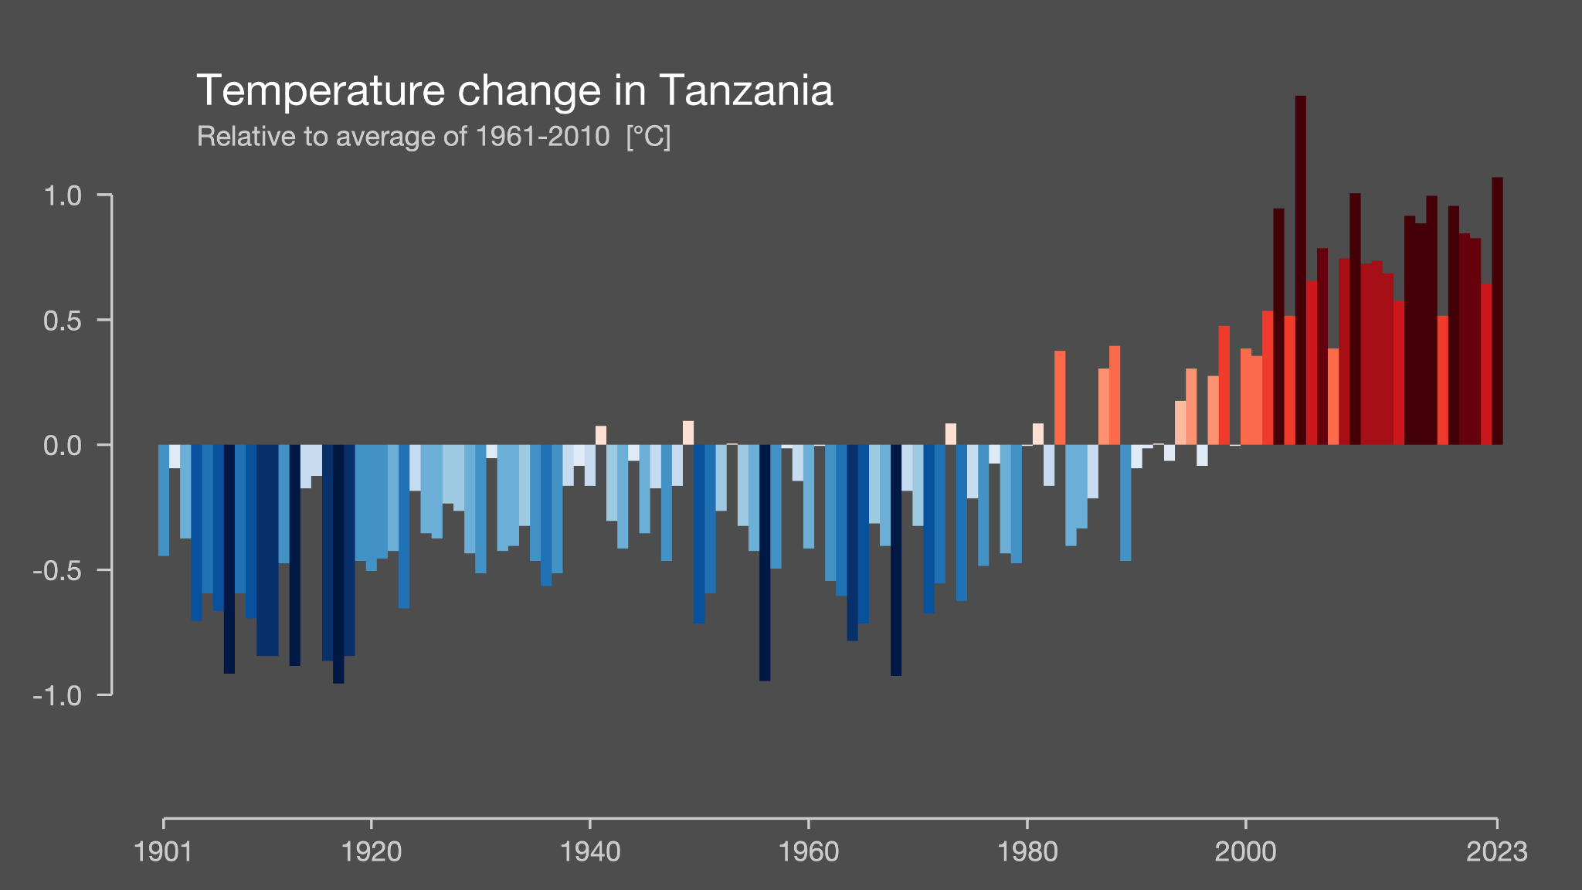
Climate variability and change
Source: University of Reading
In addition to the long-term trend due to climate change, there is also annual to decadal variability associated to internal variability.

Slide 3
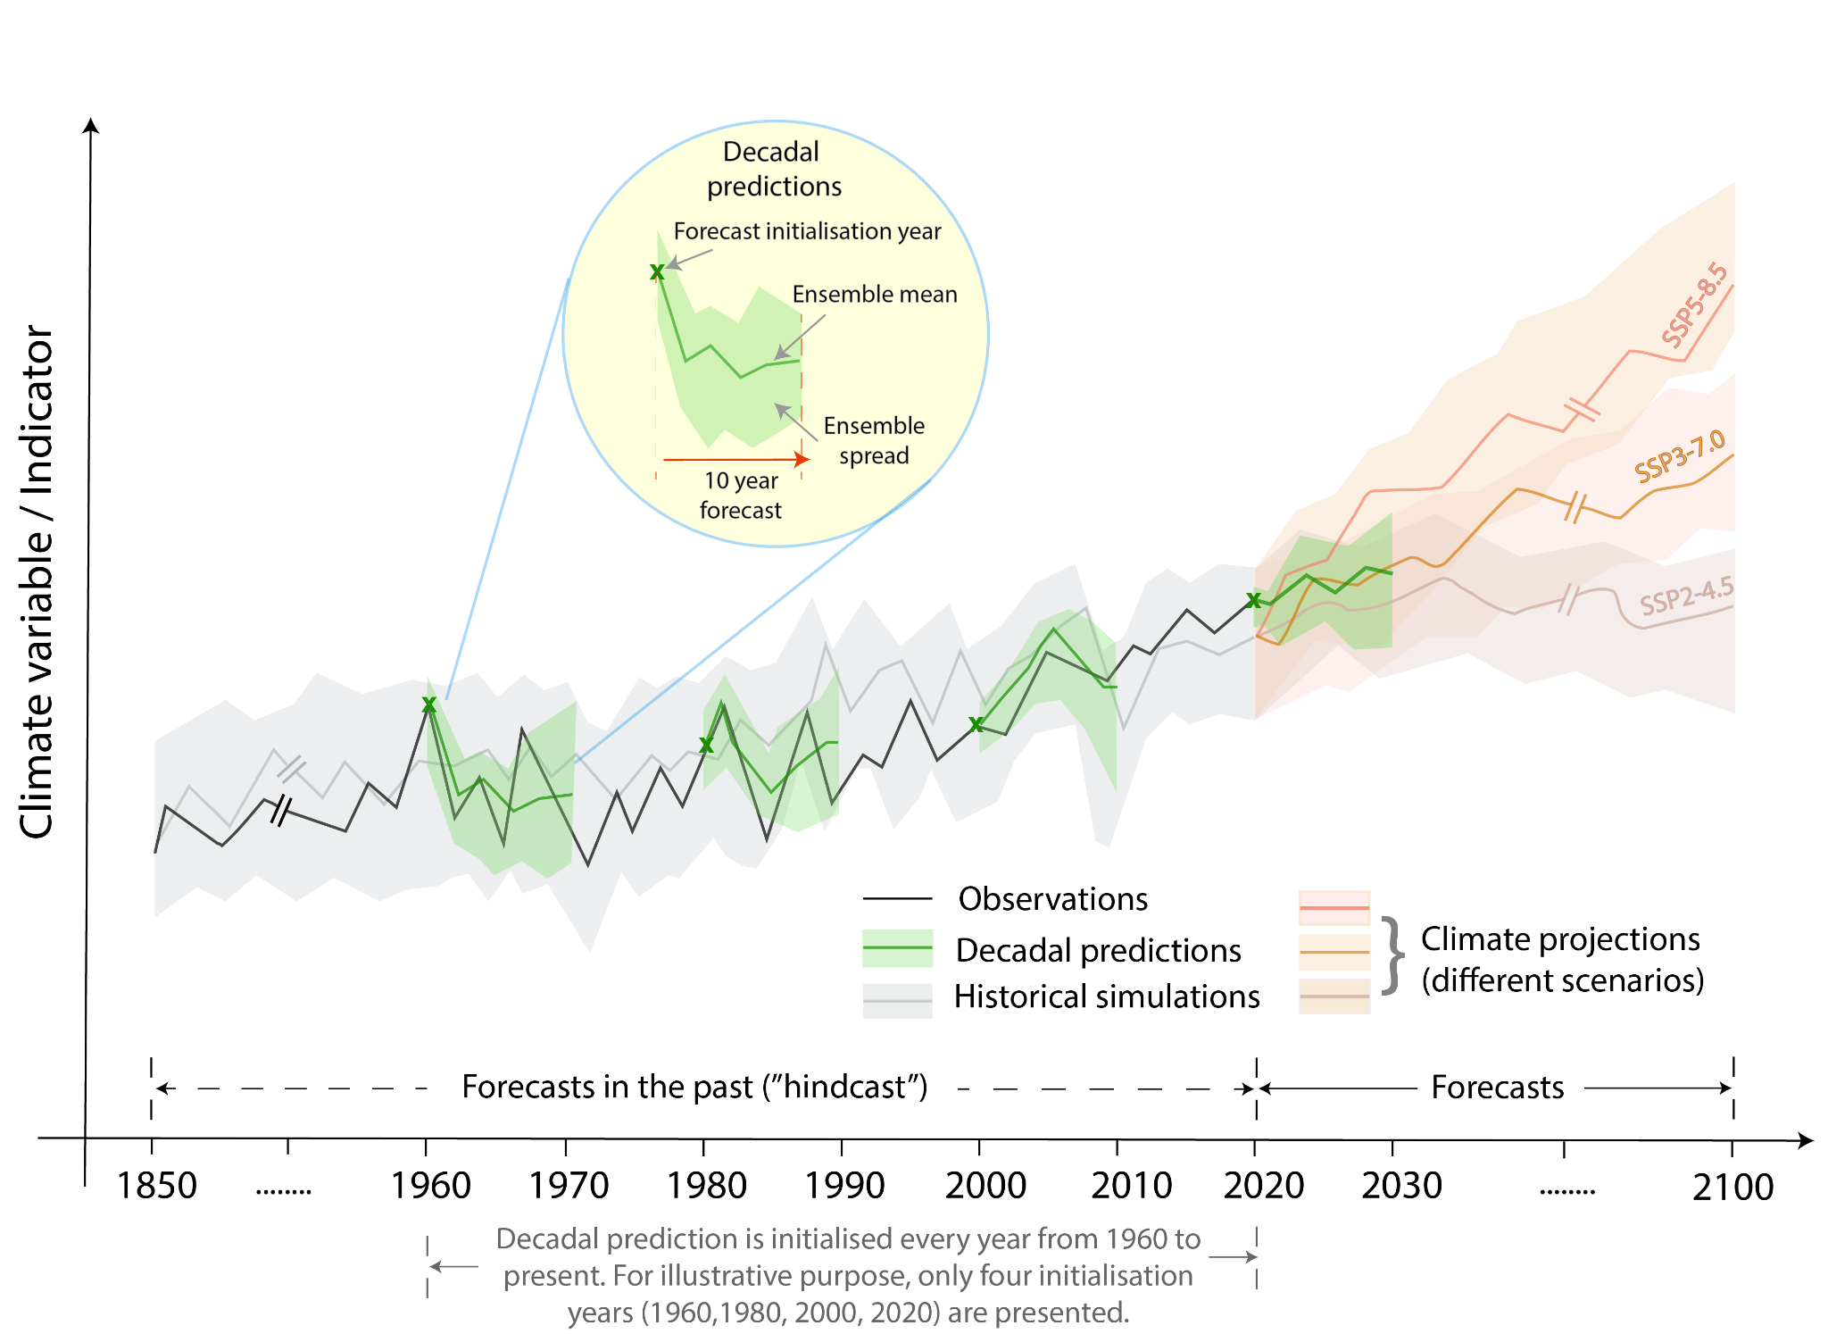
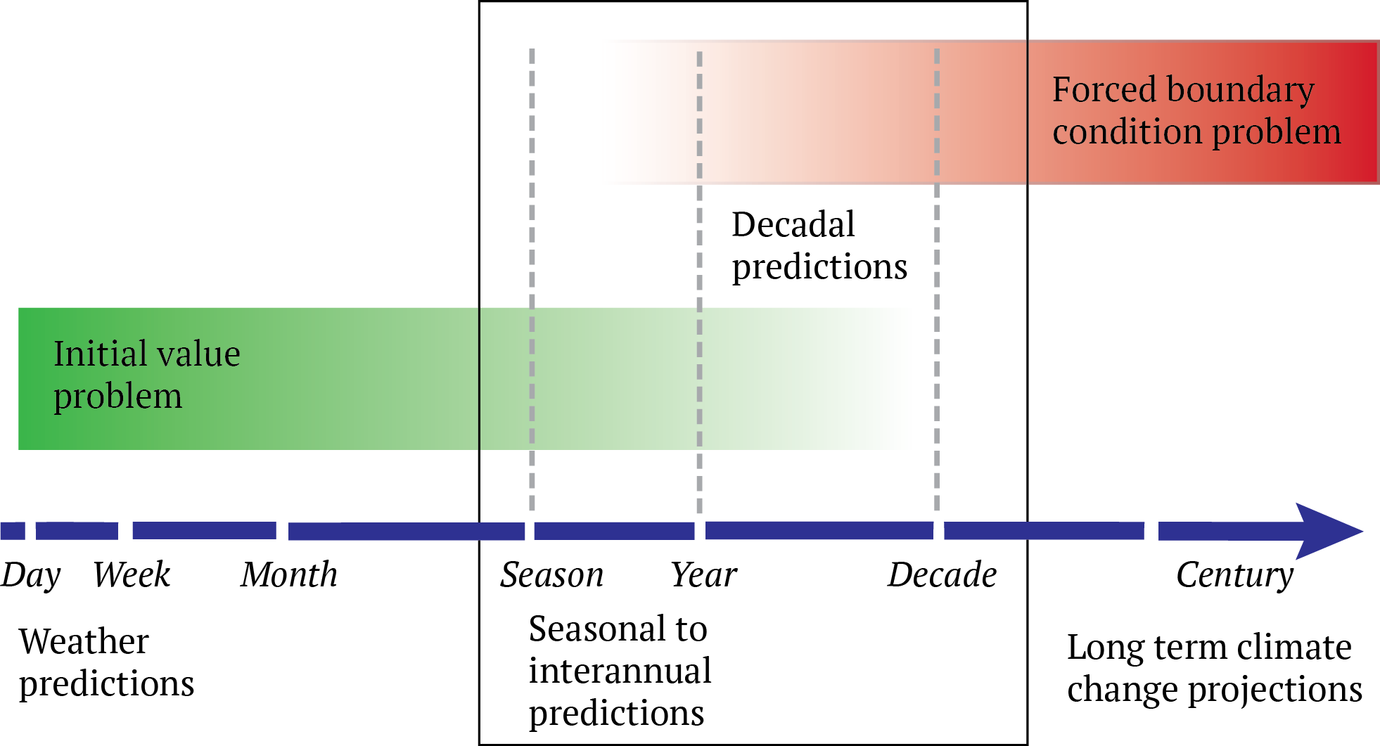
Multi-annual time scales
Kirtman et al. (2013)
Solaraju-Murali et al. (2022)

Slide 4
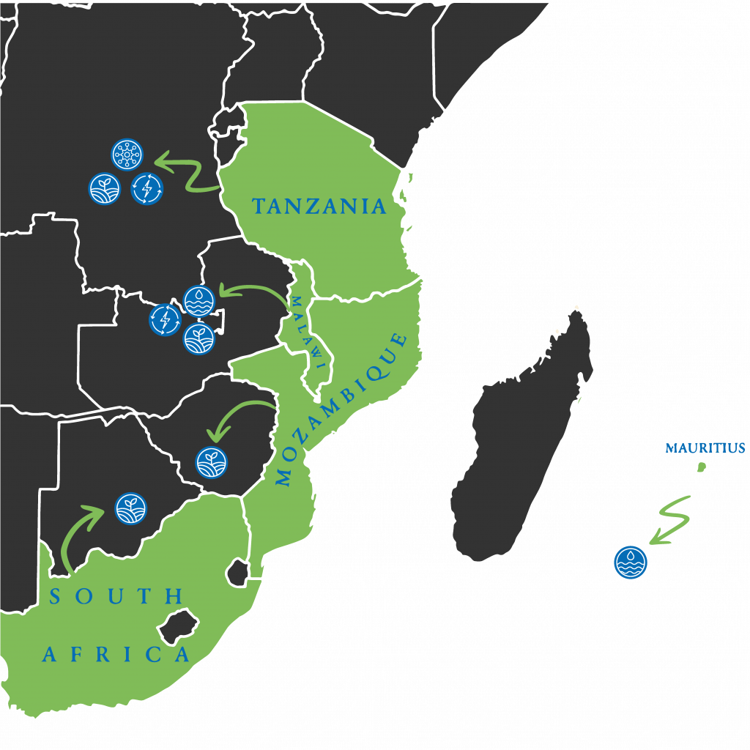
Climate information for food security
Climate events affecting agricultural productivity
Shifts in rainy season
Intensity and frequency of temperature extremes
Prolonged droughts
Floods
Adaptation policies to reduce risk and loses
Investment on new irrigation technologies
Water management
Multiplication of crop varieties
Agroforestry
Yield management

Slide 5
Co-production
October 2020
Literature review. Review of fellow-users’ challenges and needs in southern African context. Online interviews. Review of the availability and use of climate information. Confirm stakeholder mapping. Tanzania mission. Farmers’ requirements on a seasonal time scale. Malawi mission. Confirmed lack of climate information on longer time scales.
Prototype development. Printed bulletin and online platform, with regional information (sub-country level) for Malawi and Tanzania. Online demonstration. Confirmed multi-annual information can be useful for choosing the right seed varieties to buy, preparing against pests & diseases, investment in irrigation and management of perennial crops. Prototype refinement I. Addition of the SADC country level forecasts. Mozambique stakeholders workshop. Discussion on skillful and unskillful forecasts. Prototype refinement II. To include climatological and persistence forecasts.
Tanzania and Malawi missions. Tailor information to include all relevant seasons and forecast periods. Optimal use is pairing it with seasonal. Prototype refinement III. Addition of relevant seasons and update with most recent forecasts. Final project mission. Provision of updated multi-annual forecasts in the online app and new printed bulletin; capacity building.
May 2022
October 2022
Co-evaluation Co-design Co-exploration
Co-development
May 2023
November 2023
July 2024

Slide 6
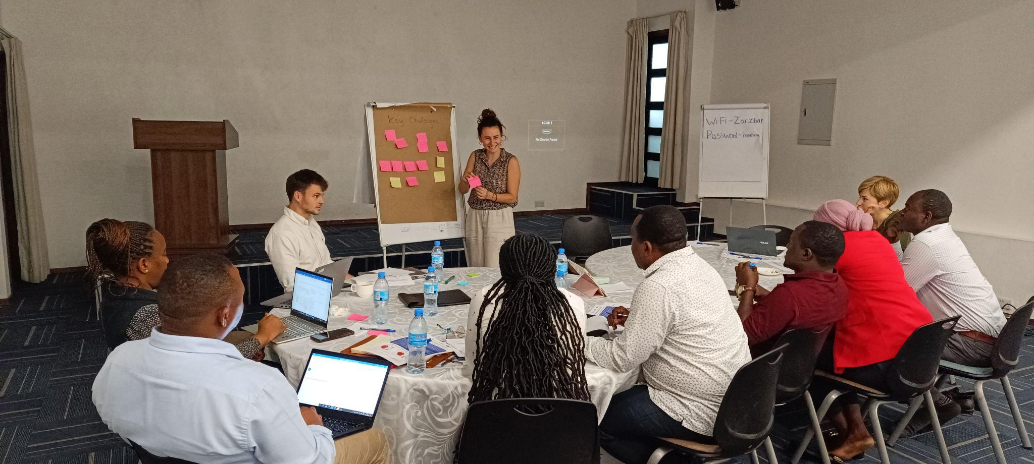
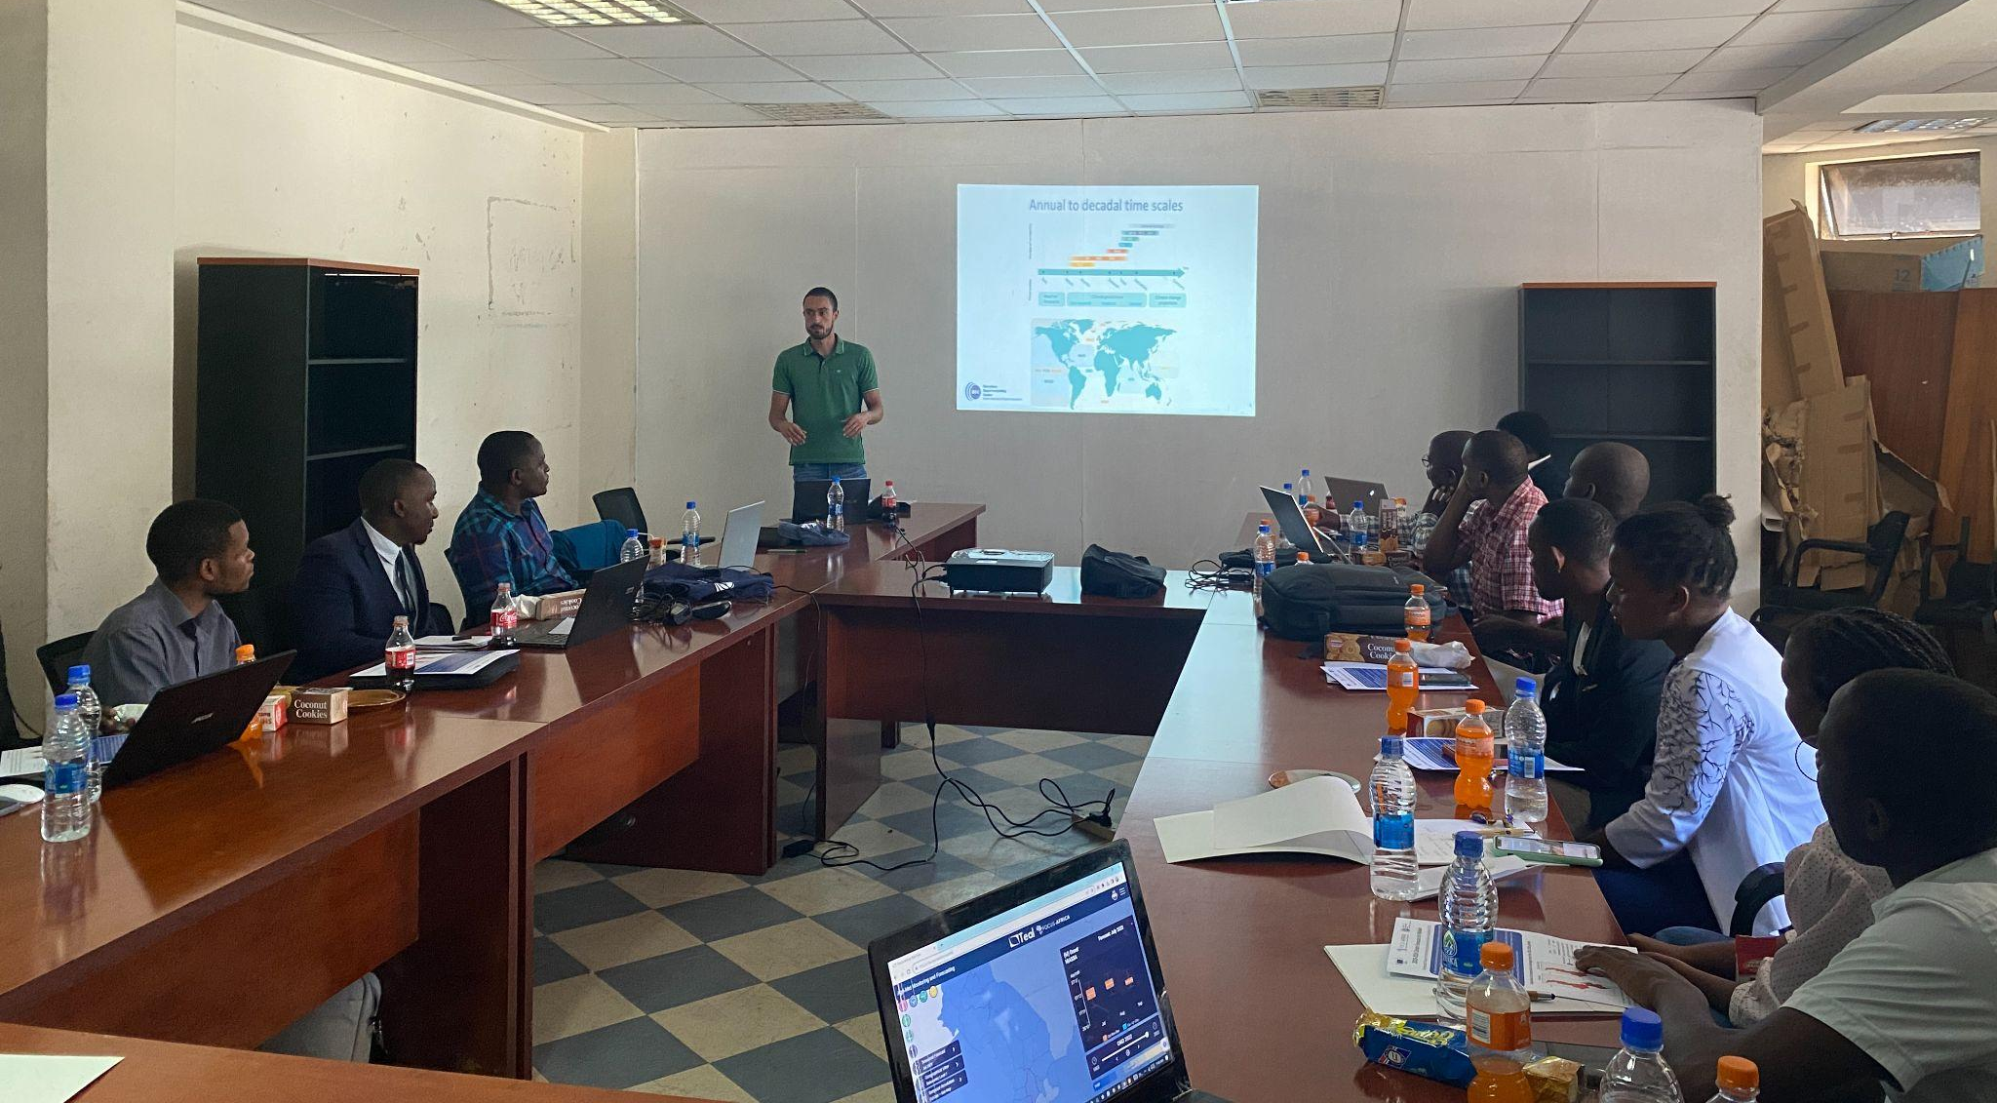
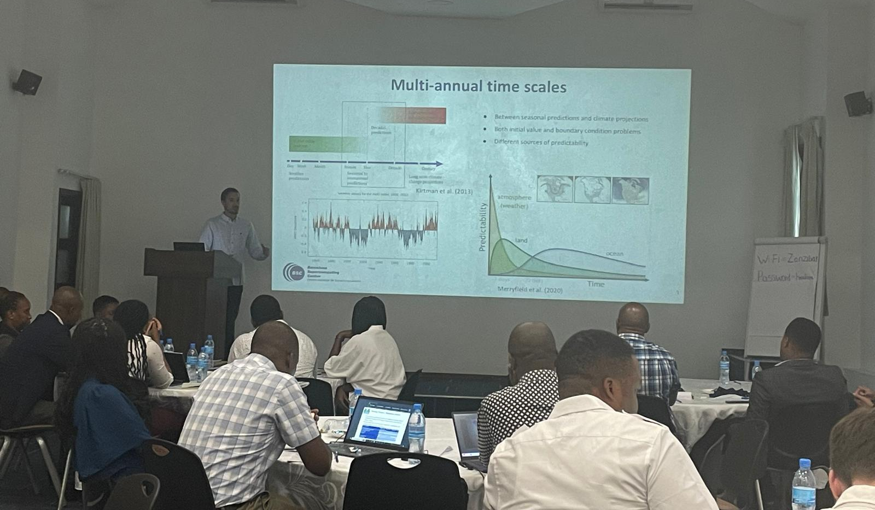
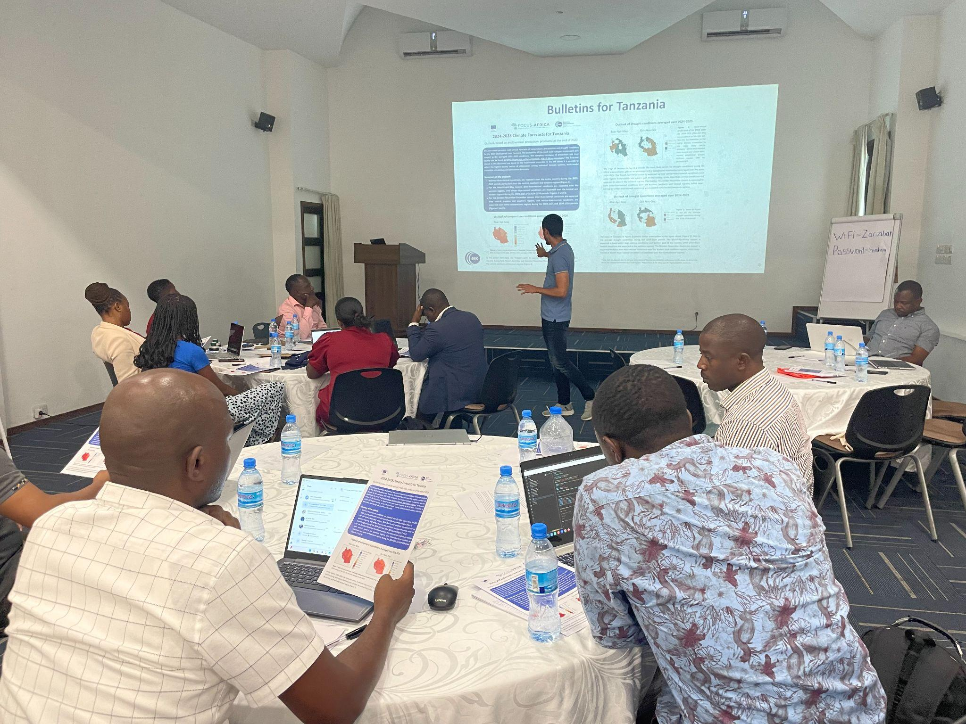
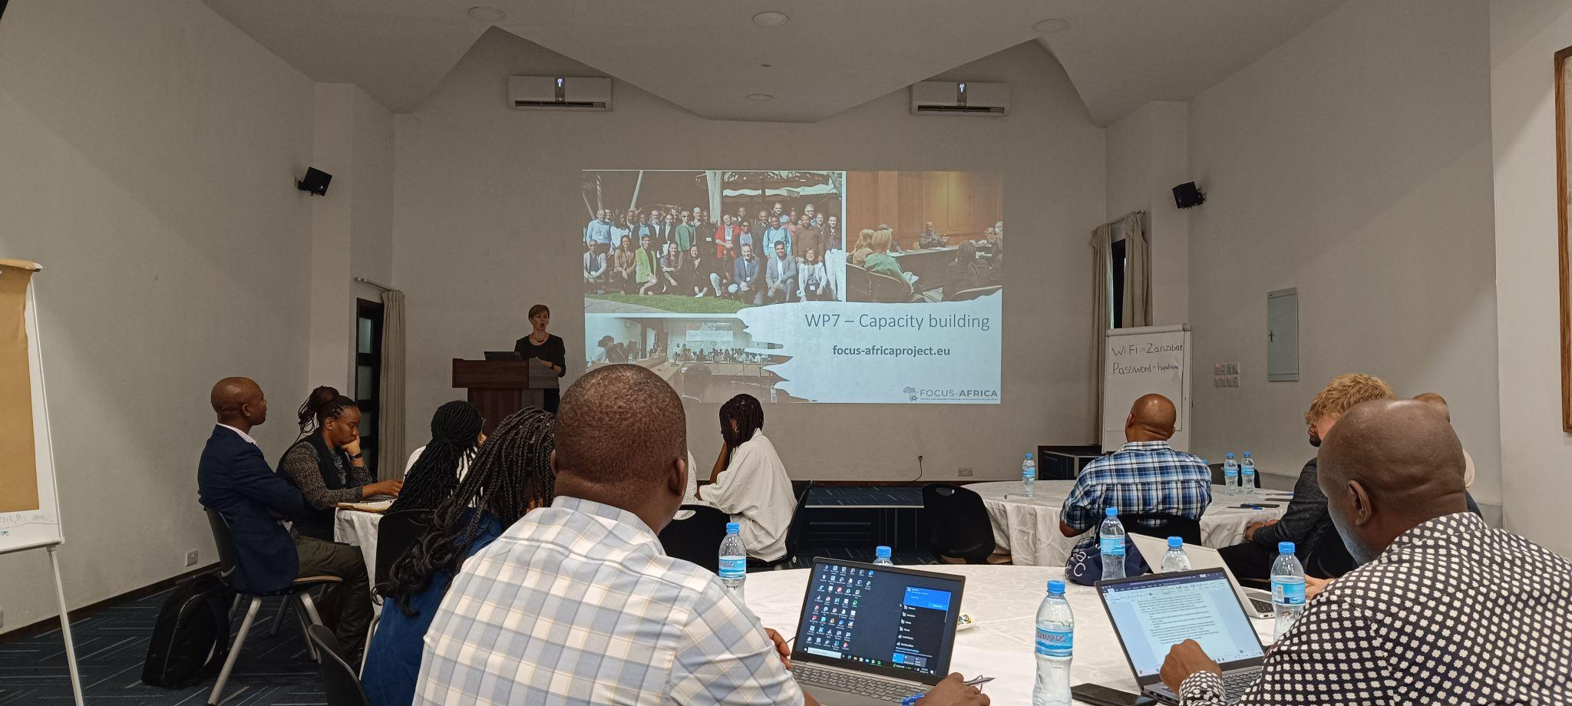
Co-production

Slide 7
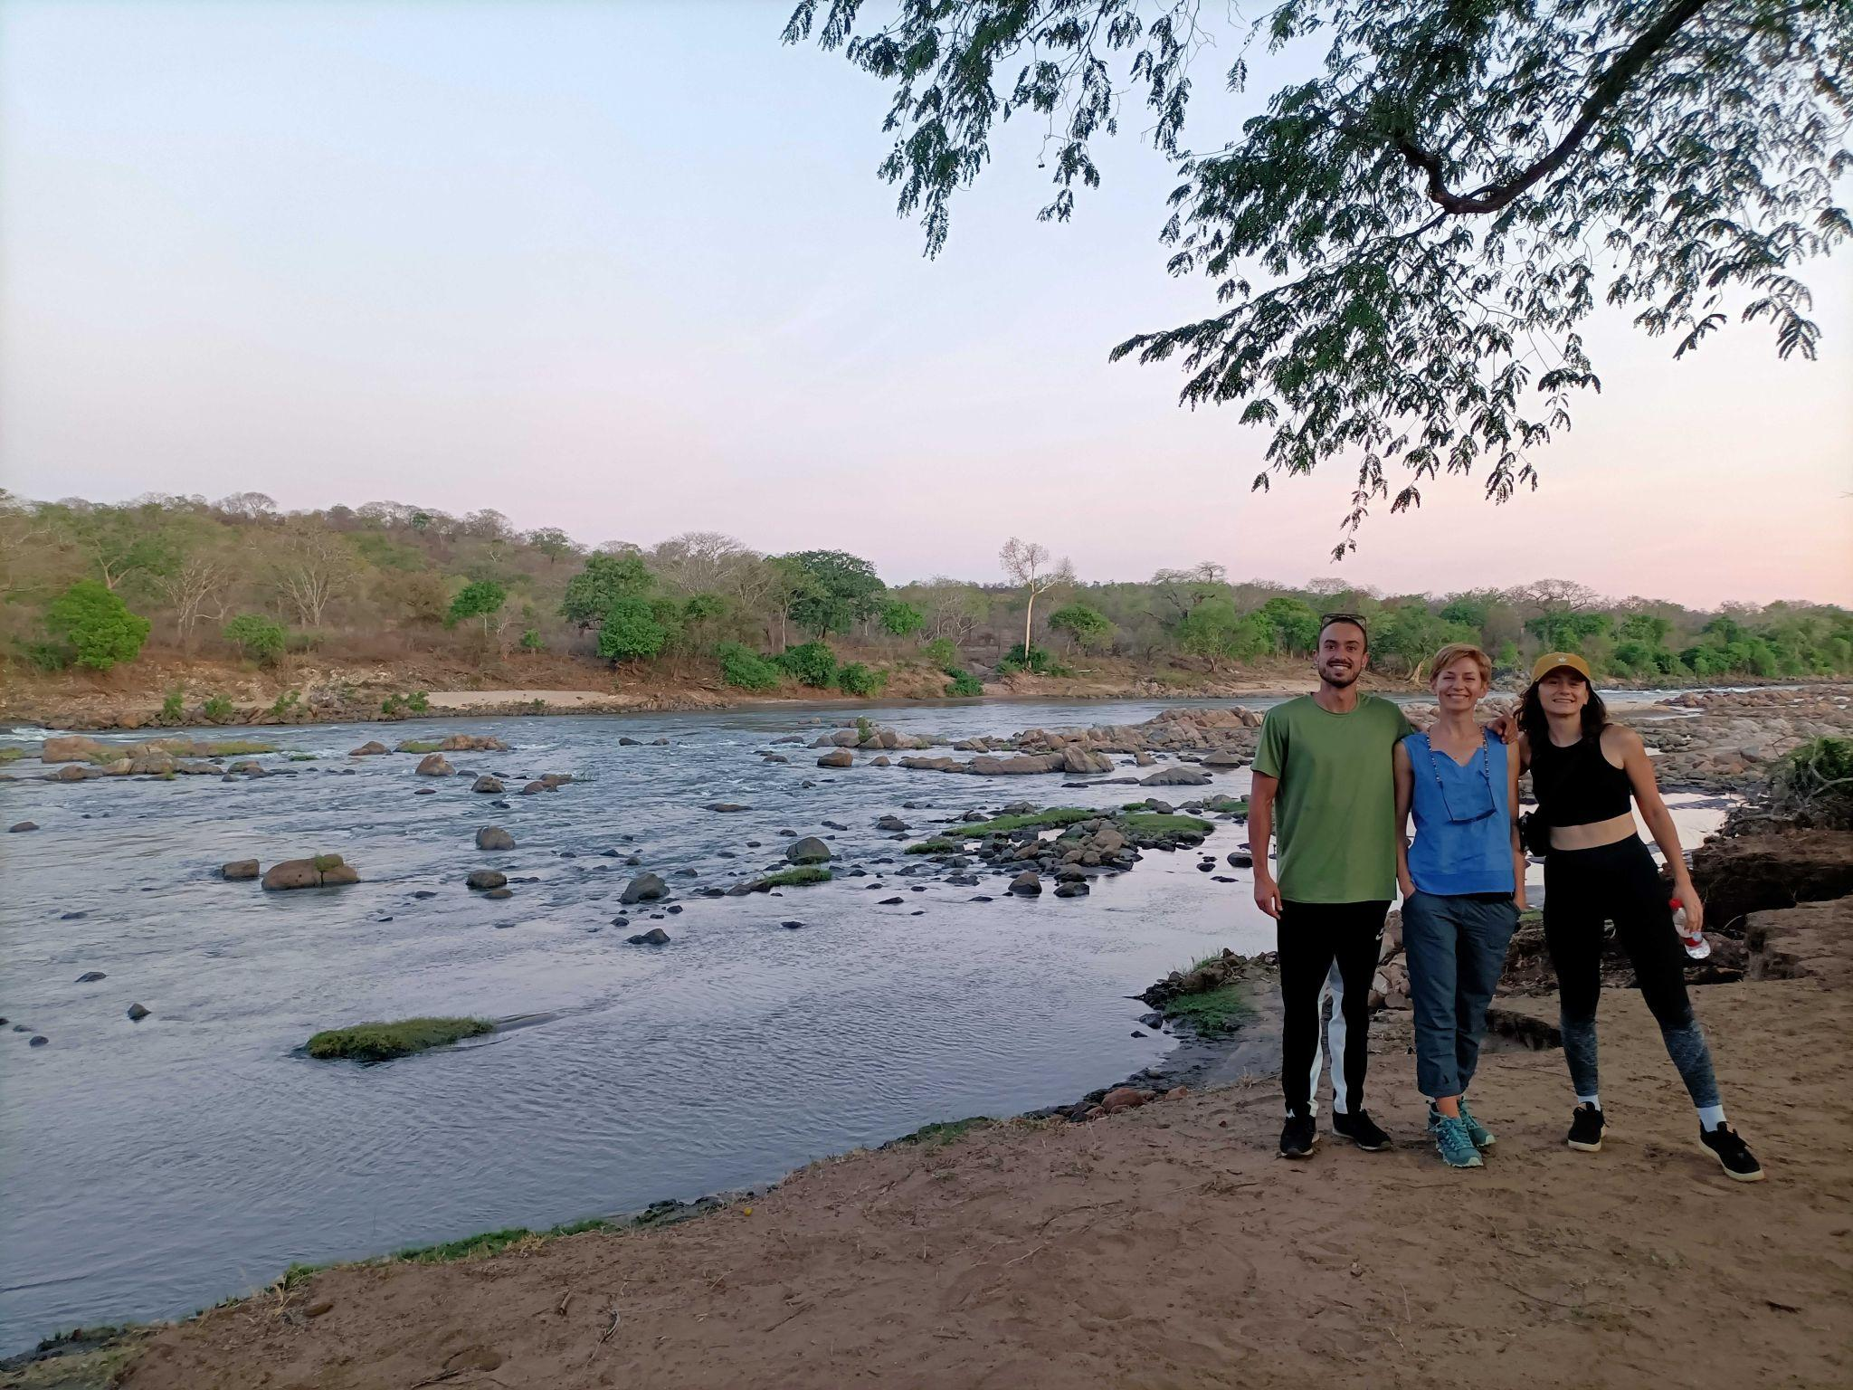
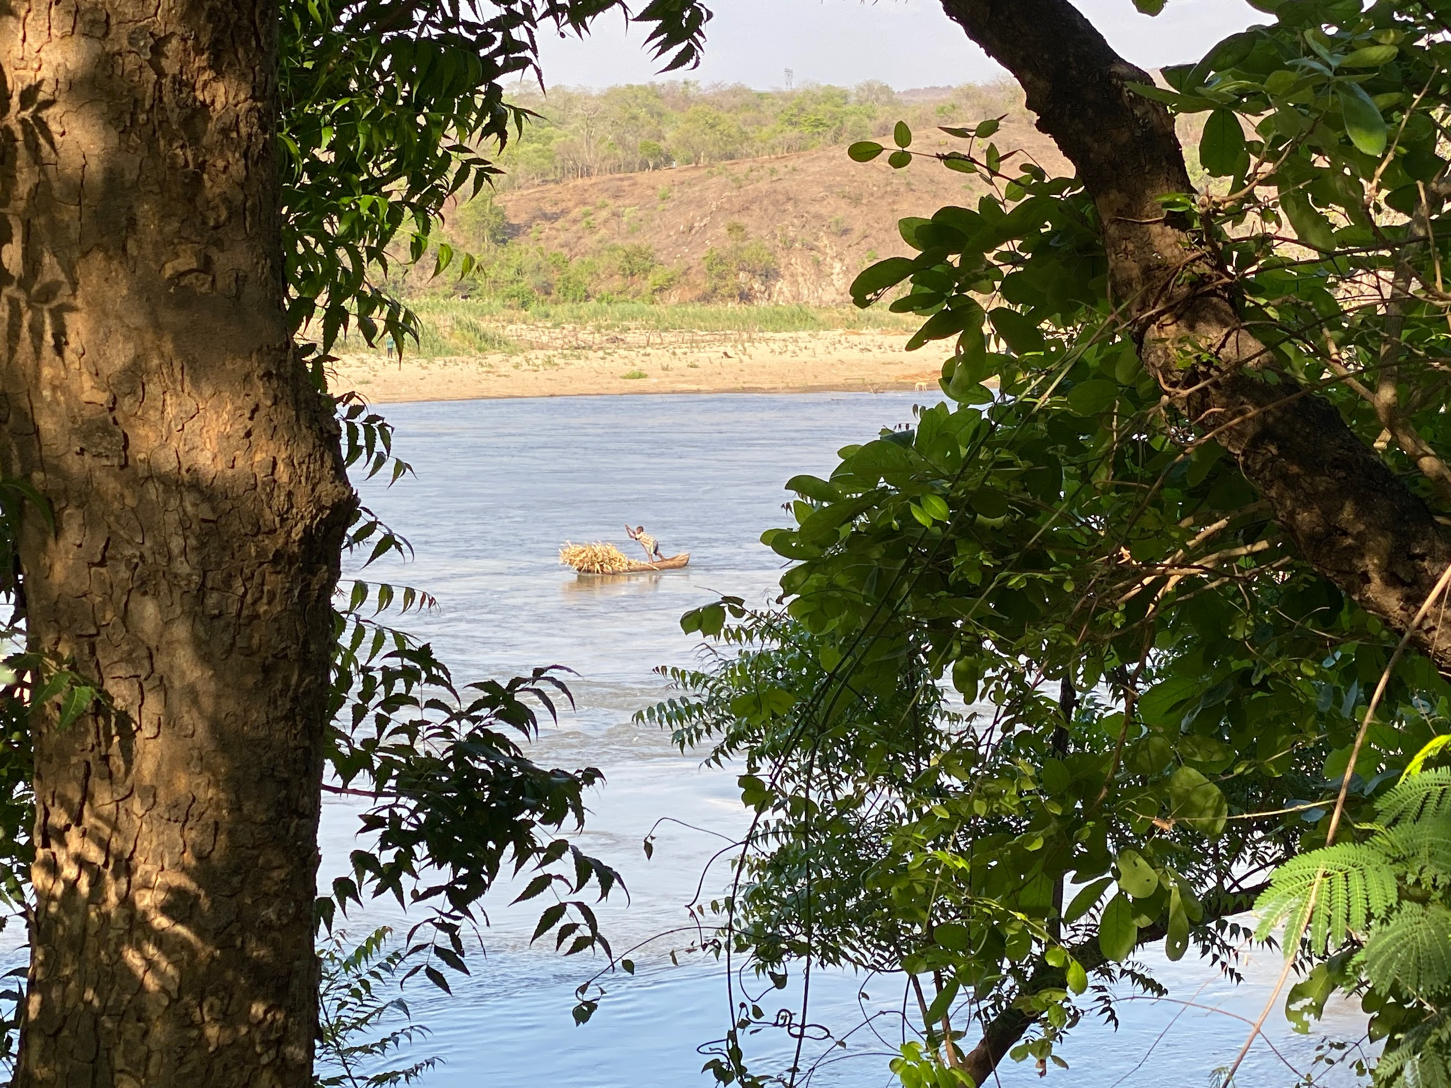
Co-production

Slide 8
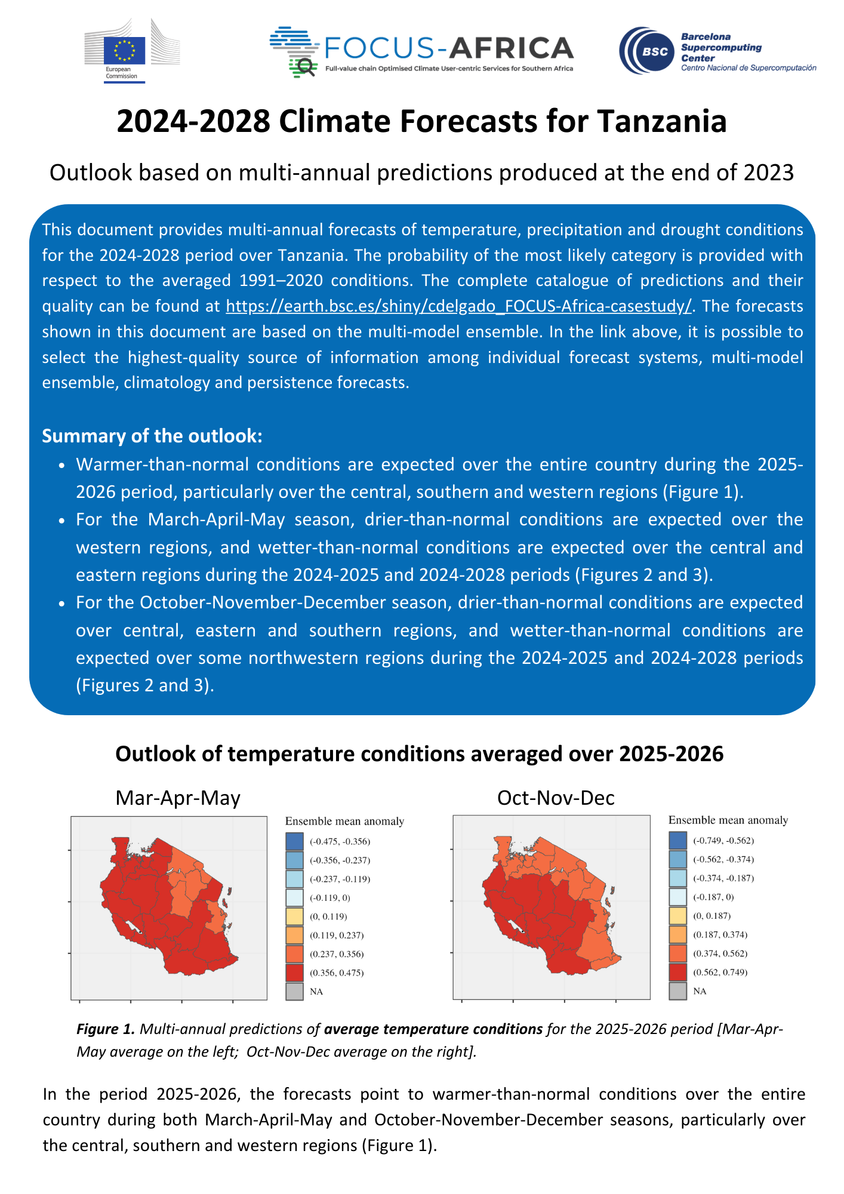
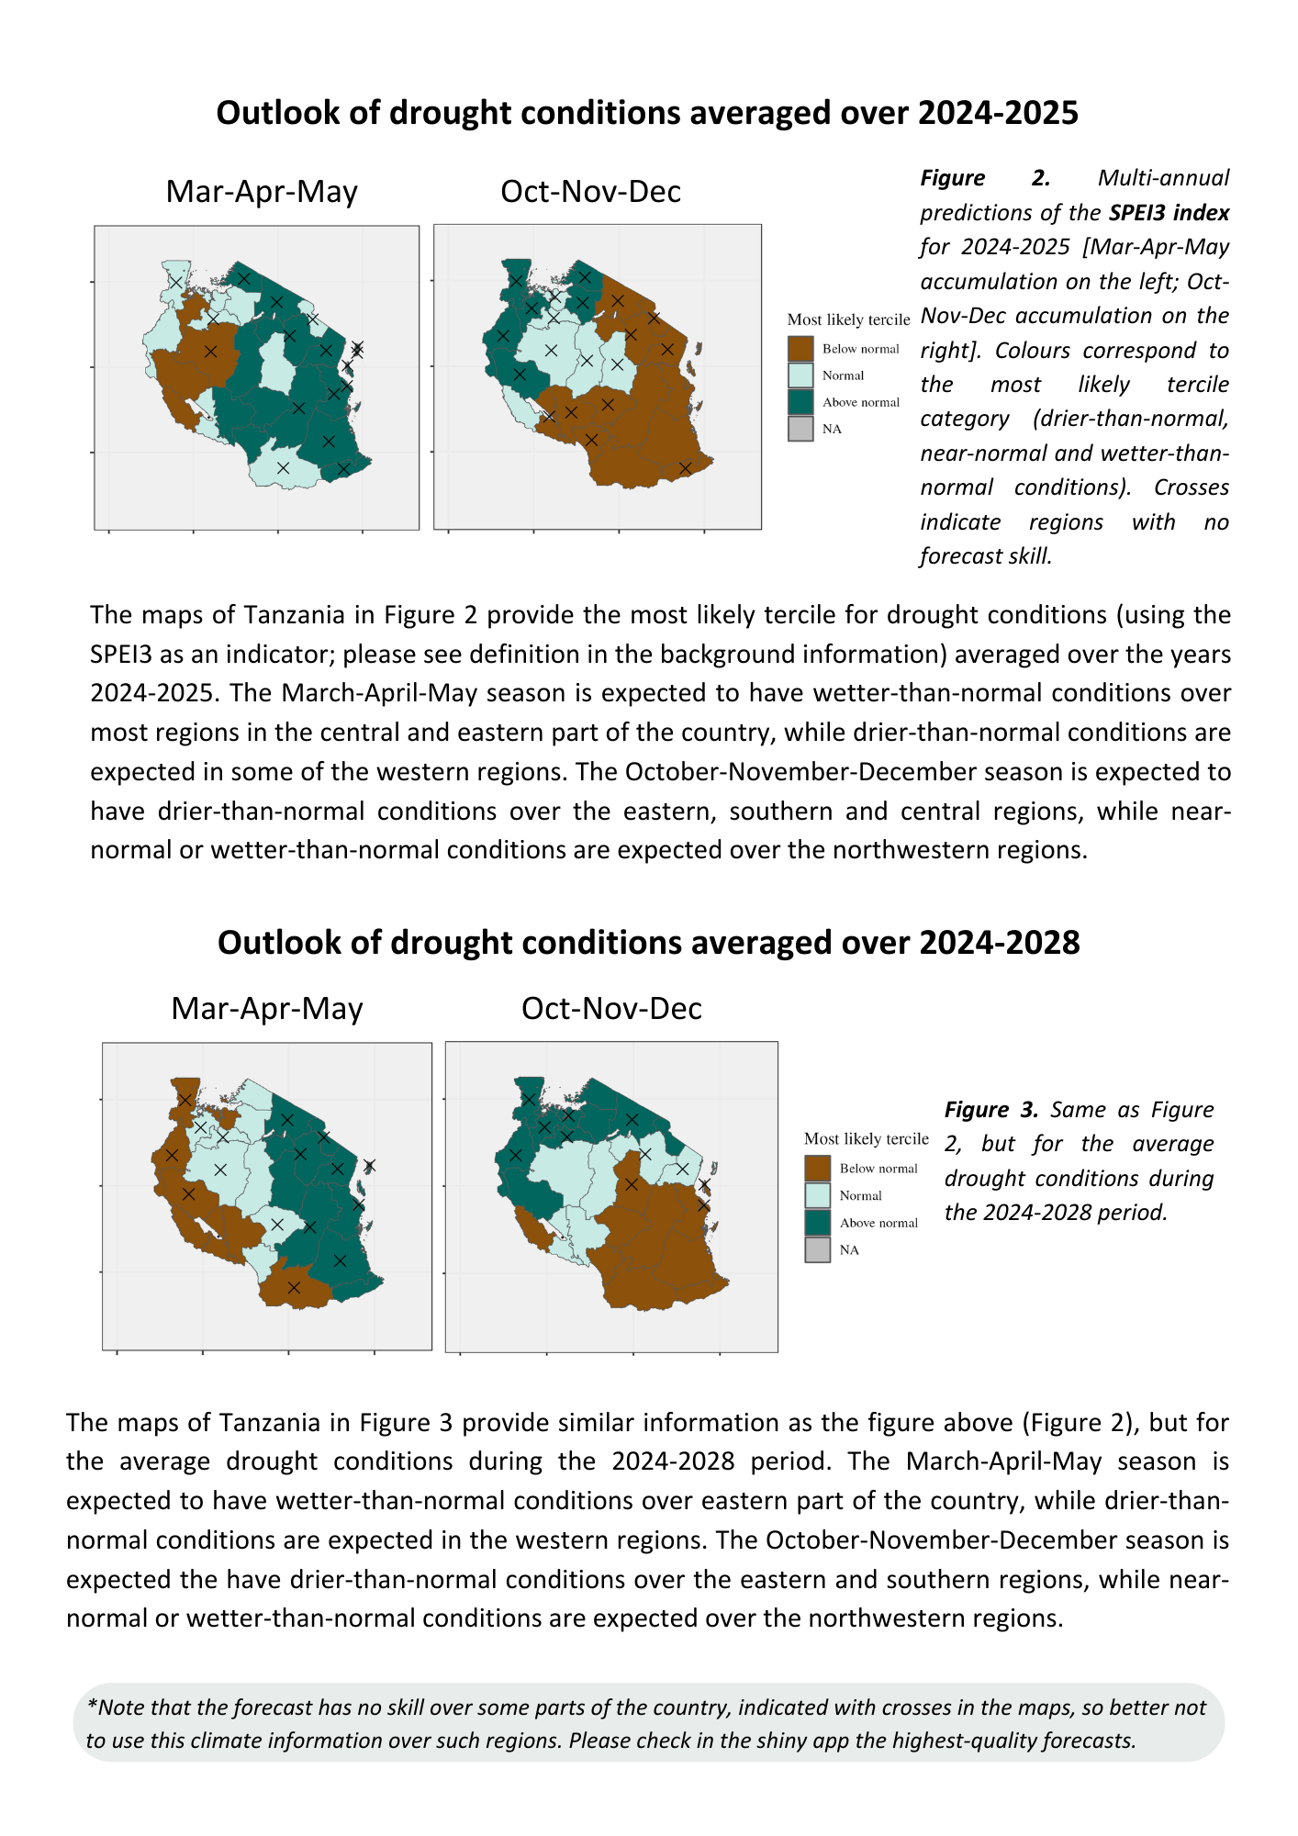
Bulletins for Tanzania

Slide 9
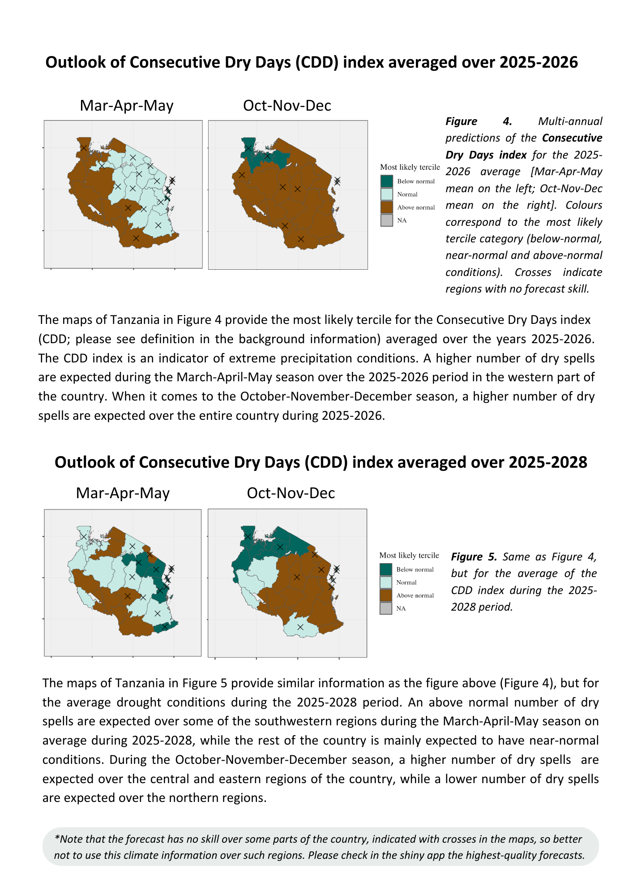
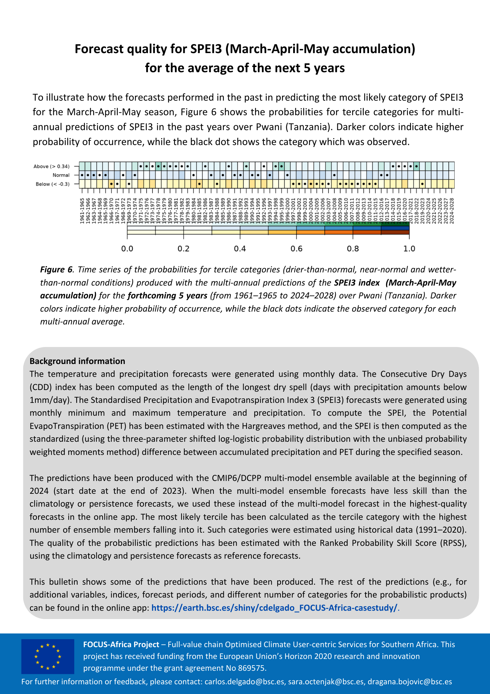
Bulletins for Tanzania

Slide 10
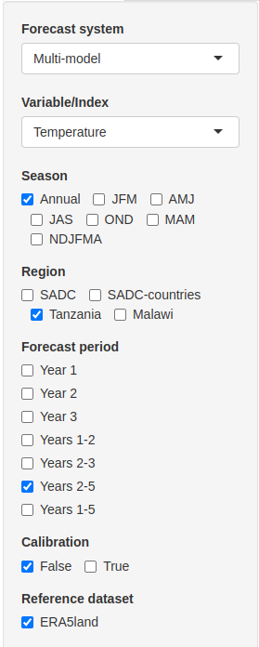
Multi-annual shiny app
https://earth.bsc.es/shiny/cdelgado_FOCUS-Africa-casestudy/
Forecast types: deterministic and probabilistic (3 and 5 categories)
Forecast systems: multi-model, models, climatology and persistence
Variables:
Mean temperature and precipitation
Extreme temperature and precipitation (ETCCDI)
Drought conditions (SPEI)
Seasons: including OND, MAM and NDJFMA
Regions: SADC, Tanzania and Malawi
Forecast periods: years 1, 2, 3, 1-2, 2-3, 2-5, and 1-5
Skill mask:
False: forecast is displayed everywhere
True: forecast is displayed only where skillful
Stippling: forecast is displayed everywhere but indicating where it is skillful

Slide 11
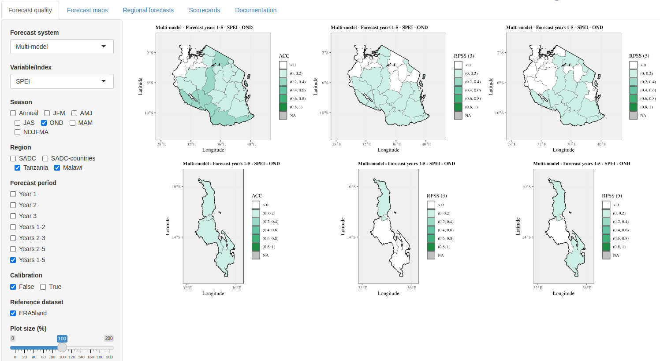
Forecast quality
https://earth.bsc.es/shiny/cdelgado_FOCUS-Africa-casestudy/

Slide 12
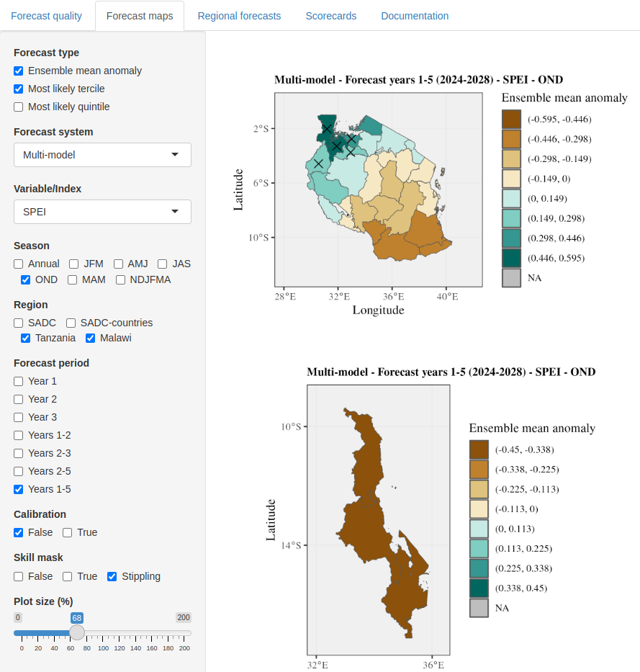
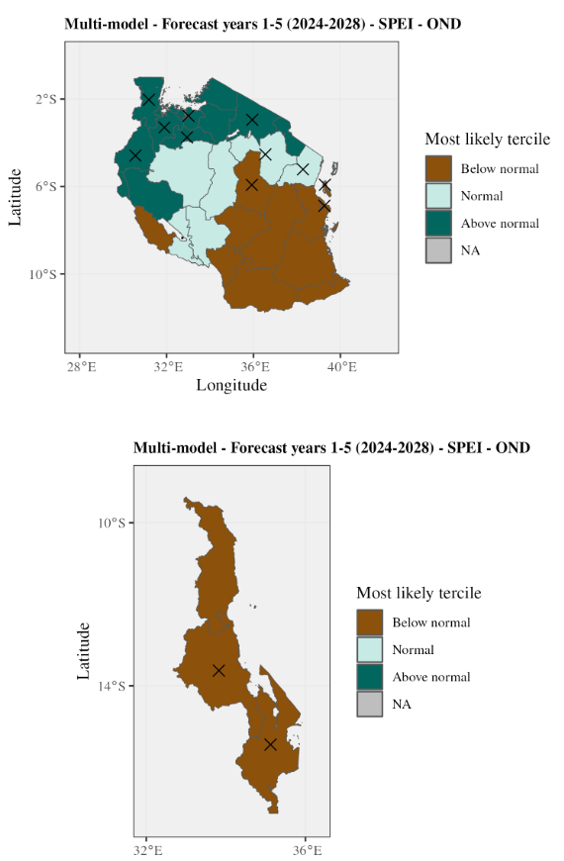
Multi-annual forecasts
https://earth.bsc.es/shiny/cdelgado_FOCUS-Africa-casestudy/

Slide 13
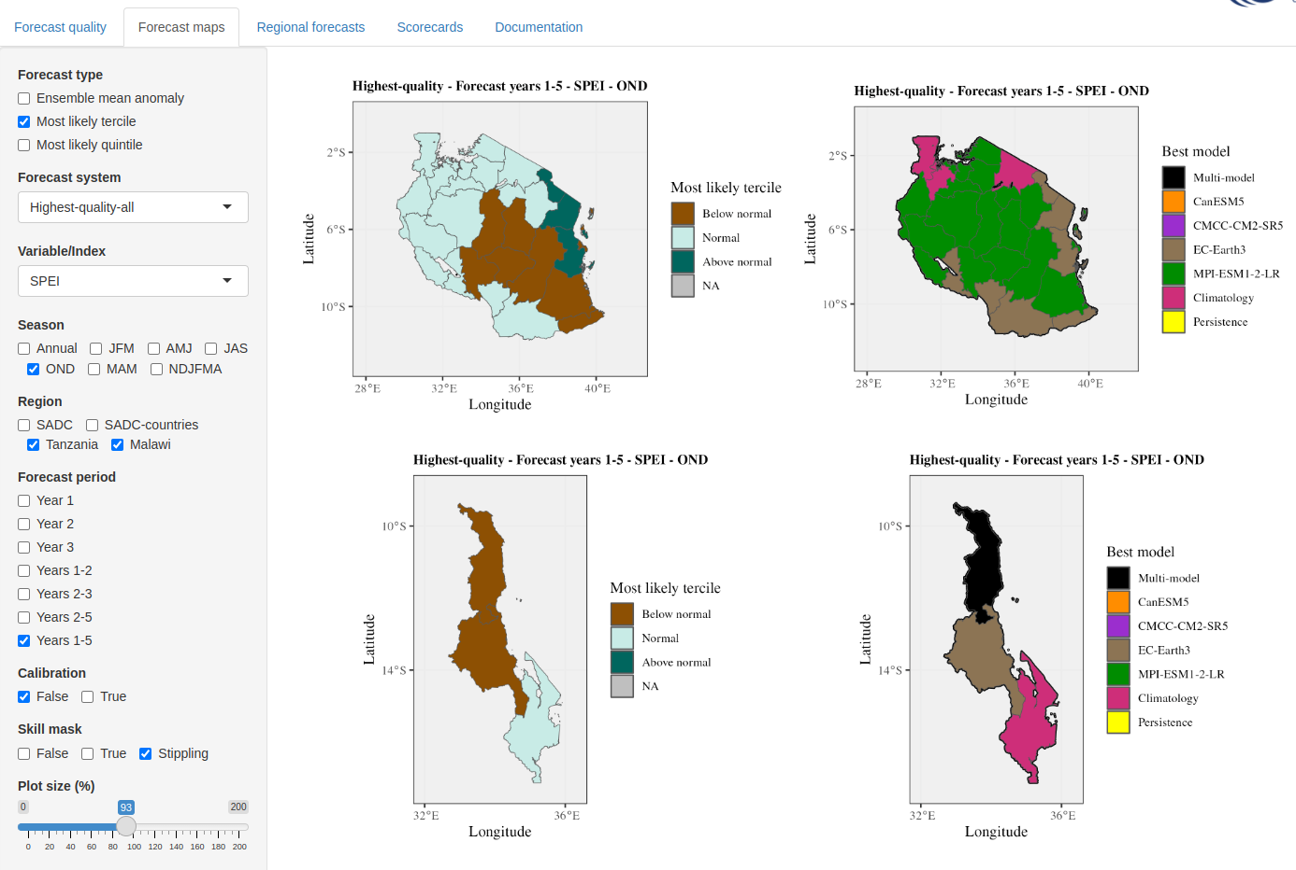
Multi-annual forecasts
The forecast from the best forecast system displayed for each region, variable, season, …
https://earth.bsc.es/shiny/cdelgado_FOCUS-Africa-casestudy/

Slide 14
Regional predictions
https://earth.bsc.es/shiny/cdelgado_FOCUS-Africa-casestudy/

Slide 15
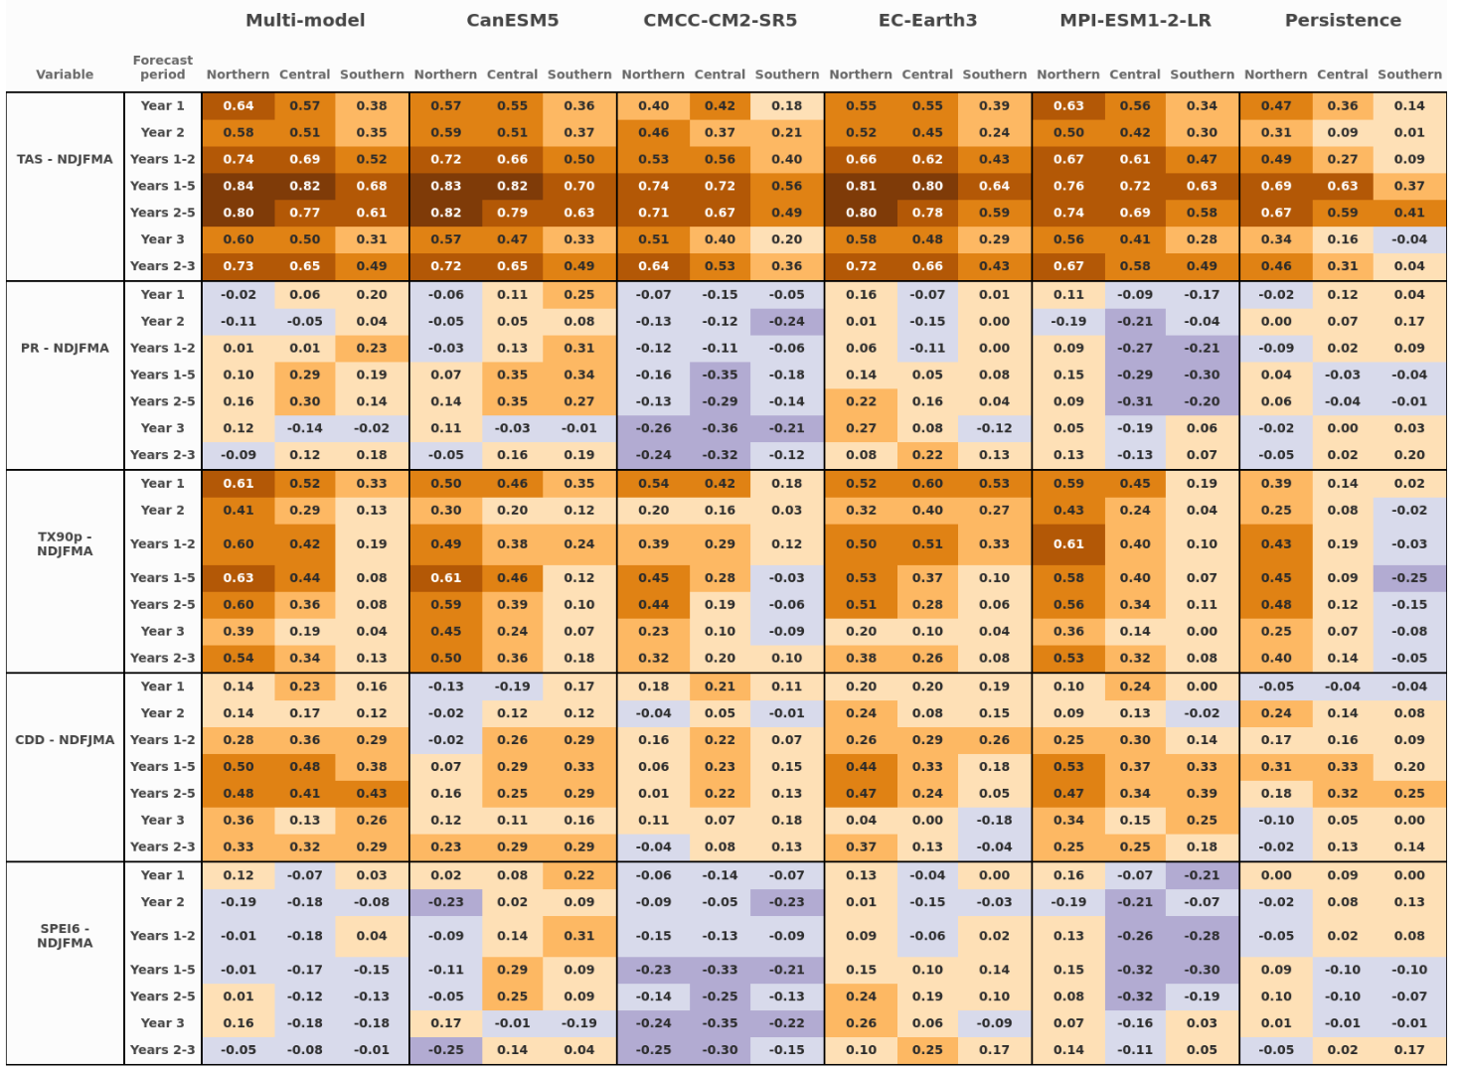
Scorecard

Slide 16
Thank you!
This project has received funding from the European Union’s Horizon 2020 Programme under grant agreement No 869575
EMS2024 September 2024, Barcelona
carlos.delgado@bsc.es

Slide 17
Case study on the wine sector
SEASONAL
DECADAL
CLIMATE PROJECTIONS
Spring frost protection
Water management

Slide 18
Case study on the humanitarian sector
SEASONAL
DECADAL
CLIMATE PROJECTIONS
Nutrition sensitive adaptation plan
Policy and advocacy for nutrition

