Slide 1
PRIMAVERA model evaluation aims and plan
Virginie Guemas (BSC), Malcolm Roberts (Reading), Pier Luigi Vidale (MetOffice), Torben Koenigk (SMHI), Martin Evaldsson (SMHI), Ramon Fuentes Franco (SMHI), Benoit Vanniere (Reading), Jeremy Grist (NERC), Adrian New (NERC), Simon Josey (NERC)

Slide 2
Model evaluation aims (1)
Model fidelity is central to PRIMAVERA
Focus on recent past to near future
Process understanding to identify the impacts of climate change and disentangle them from fingerprints of internal variability
Quantify uncertainties in projection
Focus on the North Atlantic Ocean, Arctic, Tropics and their impact on Europe

Slide 3
Model evaluation aims (2)
Assess the added-value of high-resolution
Explain how resolution impacts the representation of climate variability and change at the process level
Process-based model evaluation

Slide 4
Up to extreme high resolution
Example of Ec-Earth3 climate simulation spinup with the ORAC12-T1279 resolution (about 8km globally)
https://www.youtube.com/watch?v=JT4ZQAQf5yI

Slide 5
Examples of processes of interest
AMO variability -> African Easterly wave interactions -> Sahel rainfall + tropical cyclone activity -> mid-latitude storms
Gulf Stream variability -> mid-latitude jet variability / storm tracks -> heat and moisture transport toward Arctic & Europe
Interactions between ice and polar storms
Northward ocean heat transport (response to external forcing) -> sea ice

Slide 6
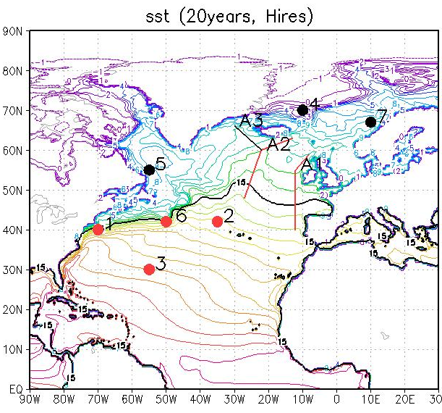
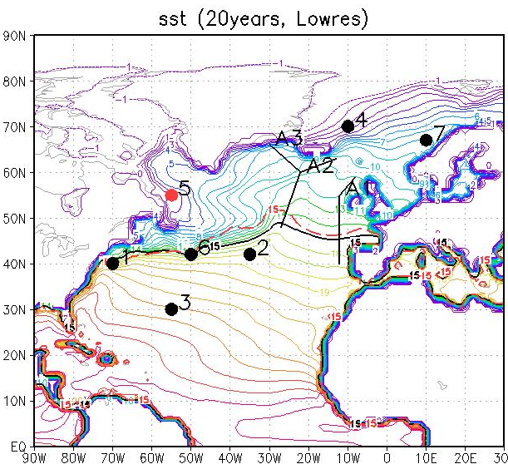
Gulf Stream variability (SMHI)
EC-Earth HR (T511-ORCA025) vs LR (T255-ORCA1) 1990-2009 : stronger SST gradient – wavier Gulf stream – higher frequency variability in HR
Higher SST frequency at higher resolution
High frequency (about 10 years)
Low frequency (about 5 years)

Slide 7
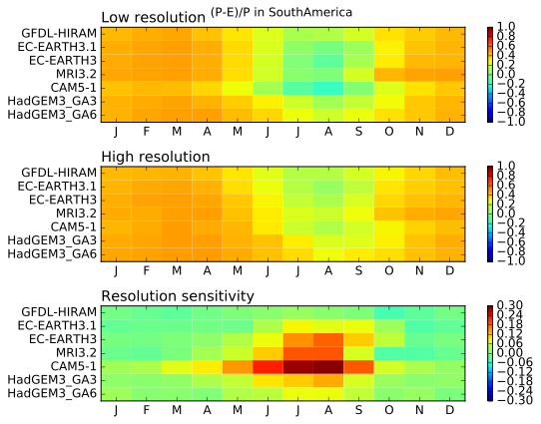
Moisture transport to lands (UREAD)
(P-E)/P over land represents the fraction of local precipitation due to moisture convergence
Larger moisture convergence over land at higher resolution

Slide 8
Ocean heat transport (NERC)

Slide 9
Model evaluation plans
Coordinated sets of experiments to be described in session 6
Development of process-based metrics to be incorporated in ESMValTool : for single model components and coupled processes ; covering North Atlantic ocean, Arctic, Tropics and impacts on Europe ; to be detailed in session 3

