Slide 1
Urbana, IL, 17th July 2017
Online diagnostics generation in high resolution climate simulations
JLESC 2017
Kim Serradell Maronda

Slide 2
Outline
Earth activities at BSC
EC-Earth climate model
More resolution, bigger outputs
Compute diagnostics
Adaptive ensemble workflow
Discussion
Earth sciences in JLESC

Slide 3
BSC Earth Department

Slide 4
BSC Earth Sciences Department
What
Environmental forecasting
Why
Our strength …
research
operations
services
more than 60 people working together
How
Develop a capability to model air quality processes from urban to global and the impacts on weather, health and ecosystems
Implement a climate prediction system for subseasonal-to-decadal climate prediction
Develop user-oriented services that favour both technology transfer and adaptation
Use cutting-edge HPC and Big Data technologies for the efficiency and user-friendliness of Earth system models
Earth system services
Climate prediction
Atmospheric composition
Computational Earth sciences

Slide 5
Computational Earth Sciences
Performance Team
Models and Workflows Team
Data and Diagnostics Team
Provide HPC Services
Apply new computational methods
Development of HPC user-friendly software framework
Provision of internal and external data services
Big Data in Earth Sciences
Support the development of climate and atmospheric research software
Visualization

Slide 6
Let’s talk about applications

Slide 7
EC-Earth
EC-Earth climate model
IFS for atmosphere (ECMWF)
NEMO (IPSL) for ocean
EC-Earth is developed as part of a Europe-wide consortium thus promoting international cooperation
Coupled online with OASIS y XIOS as I/O server
About JLESC collaboration:
EC-Earth deployed in MIRA (Argonne) with an INCITE call
Currently in K computer (in progress)

Slide 8
The Earth system model: EC-Earth
Atmospheric chemistry-TM5
Vegetation-LPJG
OASIS
Atmosphere-IFS
OASIS
OASIS
Ocean-NEMO
Sea ice-LIM
Biogeochemistry-PISCES

Slide 9
More resolution, bigger outputs
1° – 100km
0.25° – 25km
0.12° – 12km
EC-Earth | Horizontal resolution (atmosphere/ocean) | Output size per year (in NetCDF4, restarts not included)
standard resolution | T255/ORCA1 60km/100km | 26 Gb
high resolution | T511/ORCA025 40km/25km | 170 Gb
very high resolution | T1279/ORCA012 25km/12km | 1 Tb

Slide 10
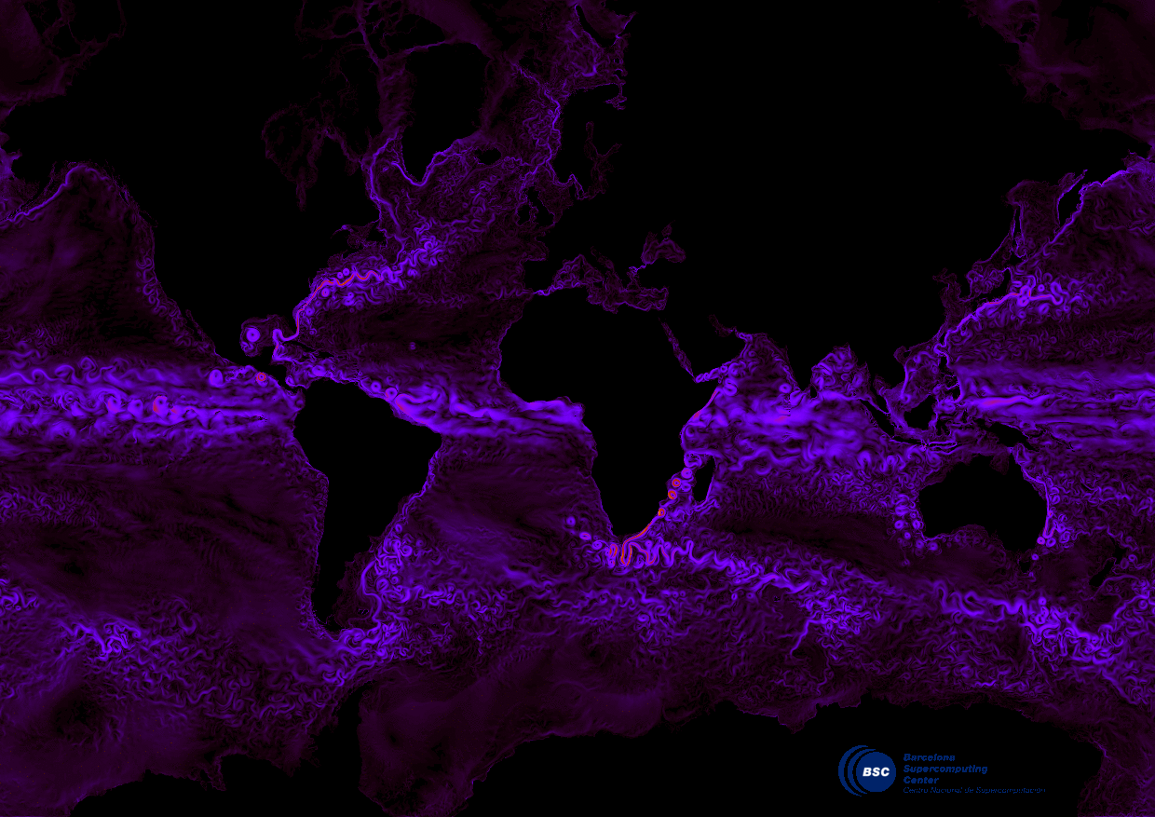
Ocean currents T1279-ORCA12 EC-Earth run (courtesy L. Brodeau)

Slide 11
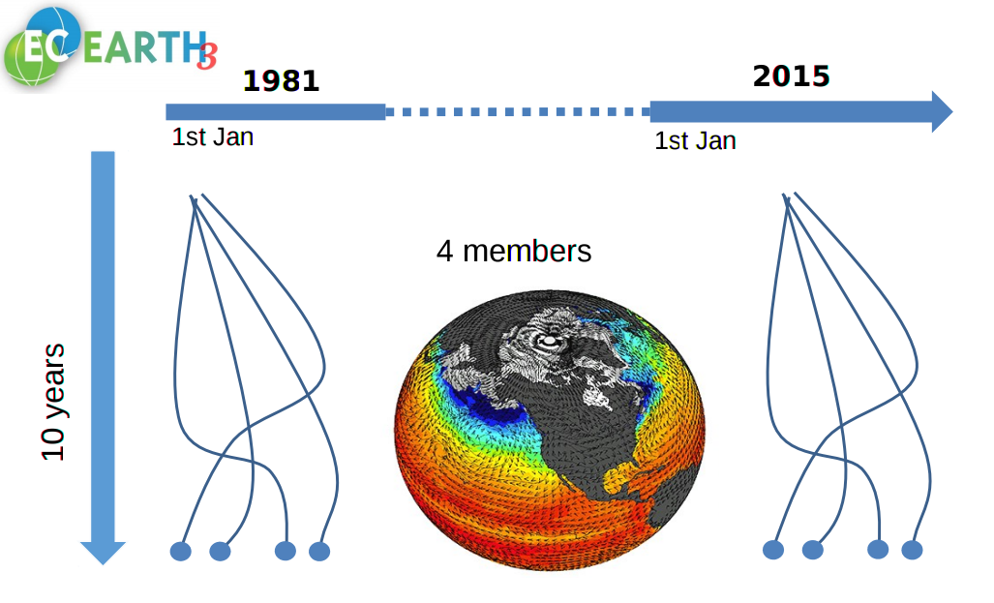
Running a decadal experiment

Slide 12
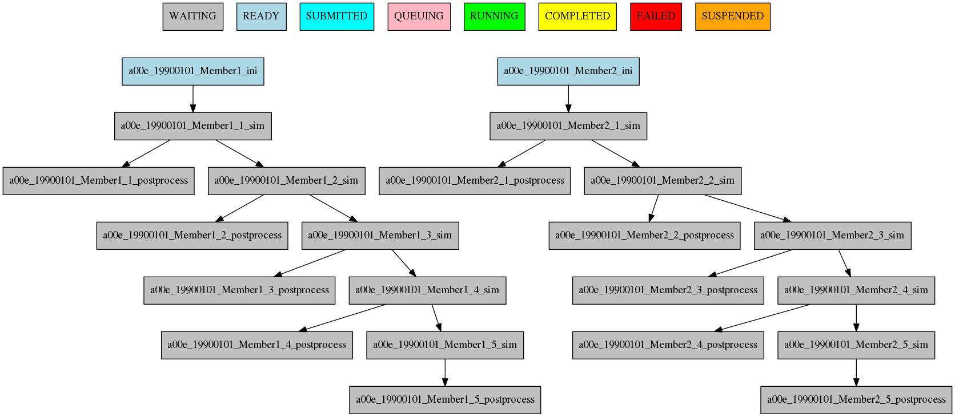
Autosubmit
Autosubmit
A versatile tool to manage Weather and Climate Experiments in diverse Supercomputing Environments
https://pypi.python.org/pypi/autosubmit
D. Manubens (BSC)

Slide 13
Computing diagnostics today
Diagnostics are computed after simulation
Only a subset of variables is saved
Diagnostics generation is mainly sequential
Different languages and technologies:
Fortran codes
Bash scripts using tools like CDO or NCO
Python scripts using modules like numpy, iris, pycdo…
We use fat nodes with a big amount of memory to compute these diagnostics.

Slide 14
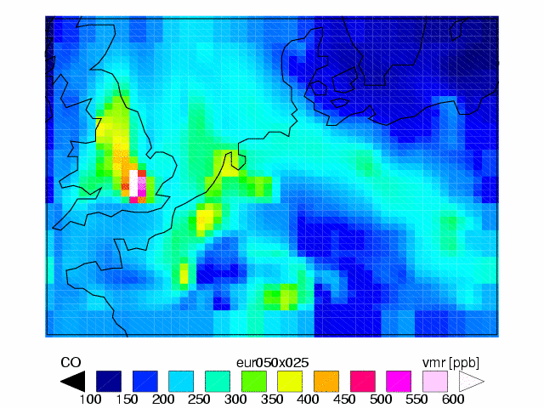
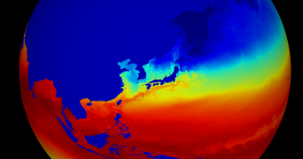
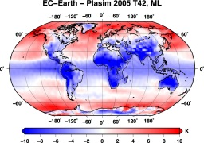
Online diagnostics for climate models
Current approach: offline diagnostics
HPC
Model outputs
Serial node
Diagnostics
Future approach: online diagnostics
Users need diagnostics for their analyses
Climate Models
HPC
Model outputs
Diagnostics
Diagnostics computed as Analytics as a Service
Diagnostics online (during model run)
Reduced data traffic
Diagnostics possible on the computing nodes
New diagnostics (data mining of extremes) possible
The user gets the results faster → crucial to adapt to climate change and to develop climate services (public and private)

Slide 15
XIOS to create diagnostics
I/O server developed at IPSL (FR)
Writes outputs in NetCDF
Configuration using XML files (flexible)
Right now, only NEMO (ocean) uses XIOS
BSC is porting XIOS to IFS (atmosphere)
XIOS computes diagnostics but some of them are computationally expensive

Slide 16
Porting Earth diagnostics to GPUs
How is defined the ocean heat content?
$$heatc=ρc_{p}\int_{h_{2}}^{h_{1}}{θ_{o}}$$
It is the integral of the seawater potential temperature between two levels multiplied by the density and the specific heat of water
Using python 2.7.9 and PyCuda package
Python wrapper for Nvidia CUDA
https://pypi.python.org/pypi/pycuda

Slide 17
Snippet

Slide 18
Test case
Ec-Earth 3.2 ORCA 0.25 L75
1442 x 1050 x 75 grid points
Irregular across all dimensions (although we are only concerned by the z dimension)
One timestep
Test machine: CTE-POWER
1 login node and 6 compute nodes, each of them:
2x IBM PowerNV 8335-GTB @ 4.00GHz (10 cores and 8 threads/core, total 160 threads per node)
256 GB of main memory distributed in 32 dimms x 8GB @ 2400MHz
2x nVidia Pascal P100 GPU with 16GB of memory.
GPFS via two fiber links 10 Gbit
Test run at the login node
Calculate ocean heat content from 0 to 300 meters depth

Slide 19
Performance
CPU mean time execution: 71.68 seconds
GPU mean time execution: 13.92 seconds
Actual time spend in GPU related tasks:
~ 200 ms moving data (4*450Mb aprox.) from and to GPU memory (taking advantage of NVLink)
~ 5 ms computing on the GPU
Speed up of more than 5x
When computing more than one timestep, you can overlap computation with the following
Next test, porting to FPGAs using PyOpenCL (same developer as PyCuda
Sea ice area and extend has also been ported to GPUs
Running simulations in an heterogeneous cluster

Slide 20
Going further

Slide 21
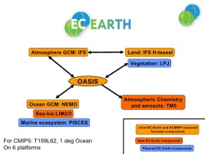
Adaptative ensemble simulations
Ensemble run
1 to 100 members
Ensemble run
1 to 50 members
Ensemble run
1 to 25 members
1
Compute instantaneous diagnostic
1
Compute instantaneous diagnostic
1
2
2
2
Complex
climate model
(EC-Earth)
…
…
…
100
100
100
after 1 week model simulation
after 1 week model simulation
perform the complete simulation
When members are stopped, the system will dynamically distribute resources to remaining members
Key Challenge
How can we perform this computation “instantaneously”?
Select a right diagnostic (climate science)
Work in XIOS I/O server and disk technologies (computer science)
Using PyCompSs to orchestrate the workflow

Slide 22
Discussion

Slide 23
Discussion: Post process in JLESC
Experiences in post processing Earth System model outputs in JLESC?
How do you produce and analyze unusually large model output efficiently?
Global simulation of nearly 1km from Riken.
Share experiences.
Tools, performance and diagnostic selection are key topics to achieve successfully the generation and post-process of such simulations.

Slide 24
Questions

Slide 25
Thank you!
For further information please contact
kim.serradell@bsc.es

