Slide 1
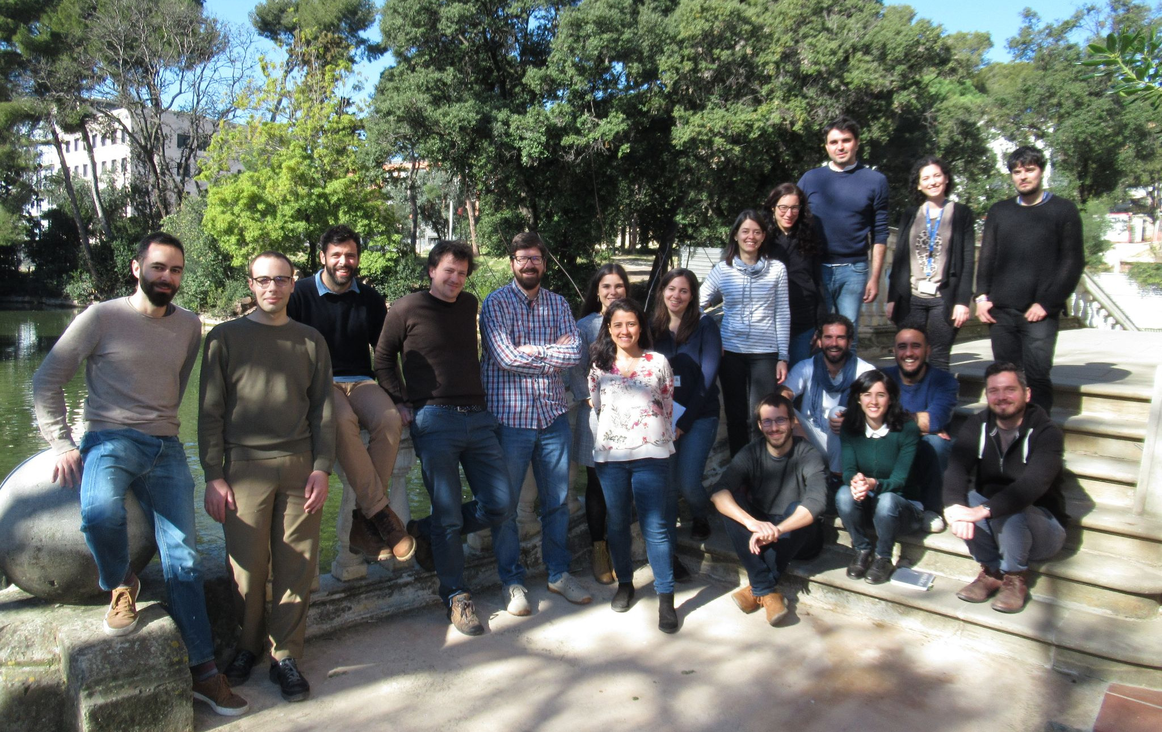
The Atmospheric Composition Group in a nutshell
Department Day meeting
27/05/2021

Slide 2
Main goal
To understand, constrain and predict the spatiotemporal variations of atmospheric pollutants across scales along with their effects upon air quality, health, weather and climate.
Cloud chemistry
Aerosol-cloud interactions
Photochemistry
Aerosol-radiation interactions
Long range transport
O₃, H₂SO₄, HNO₃, BC, OA, NH₄⁺, SO₄²⁻, NO₃⁻
dust
Emissions
NO_{x}, SO₂, NH₃, POA, soot, sea salt, VOC_{s}
Deposition

Slide 3
Keywords
Emission inventories, natural emissions, source apportionment
Ozone, mineral dust, secondary organic aerosols, iron cycle
Variability and trends, aerosol chemistry, aerosol-radiation-cloud, climate
Model development, global, mesoscale, urban
Forecasting, reanalysis, data assimilation, machine learning, observations
Field campaigns, health effects

Slide 4
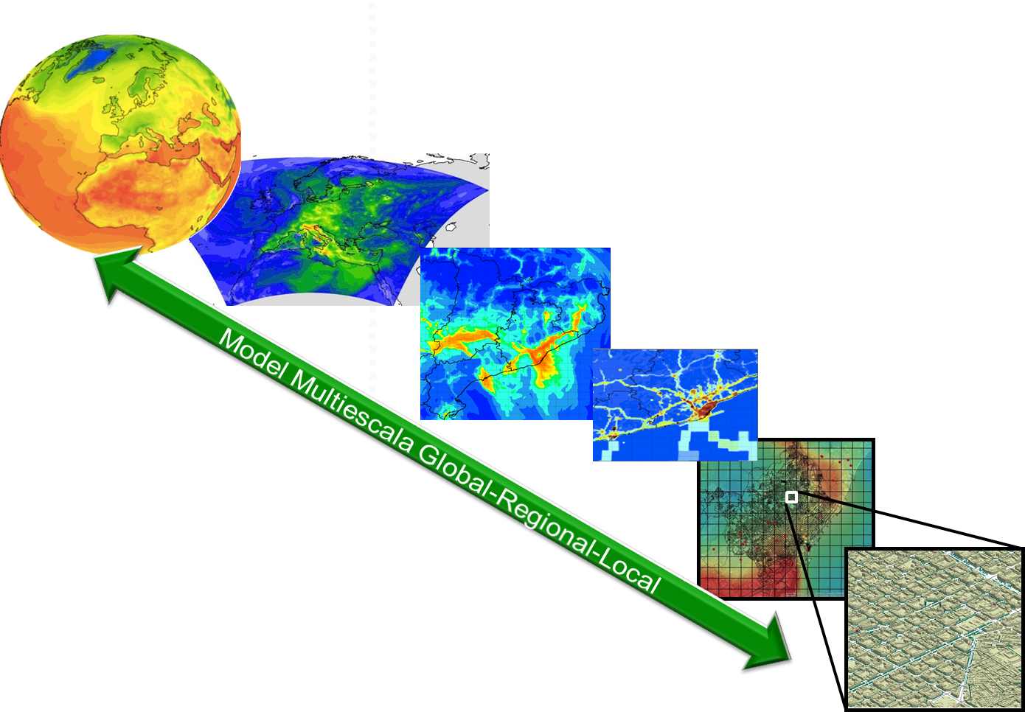
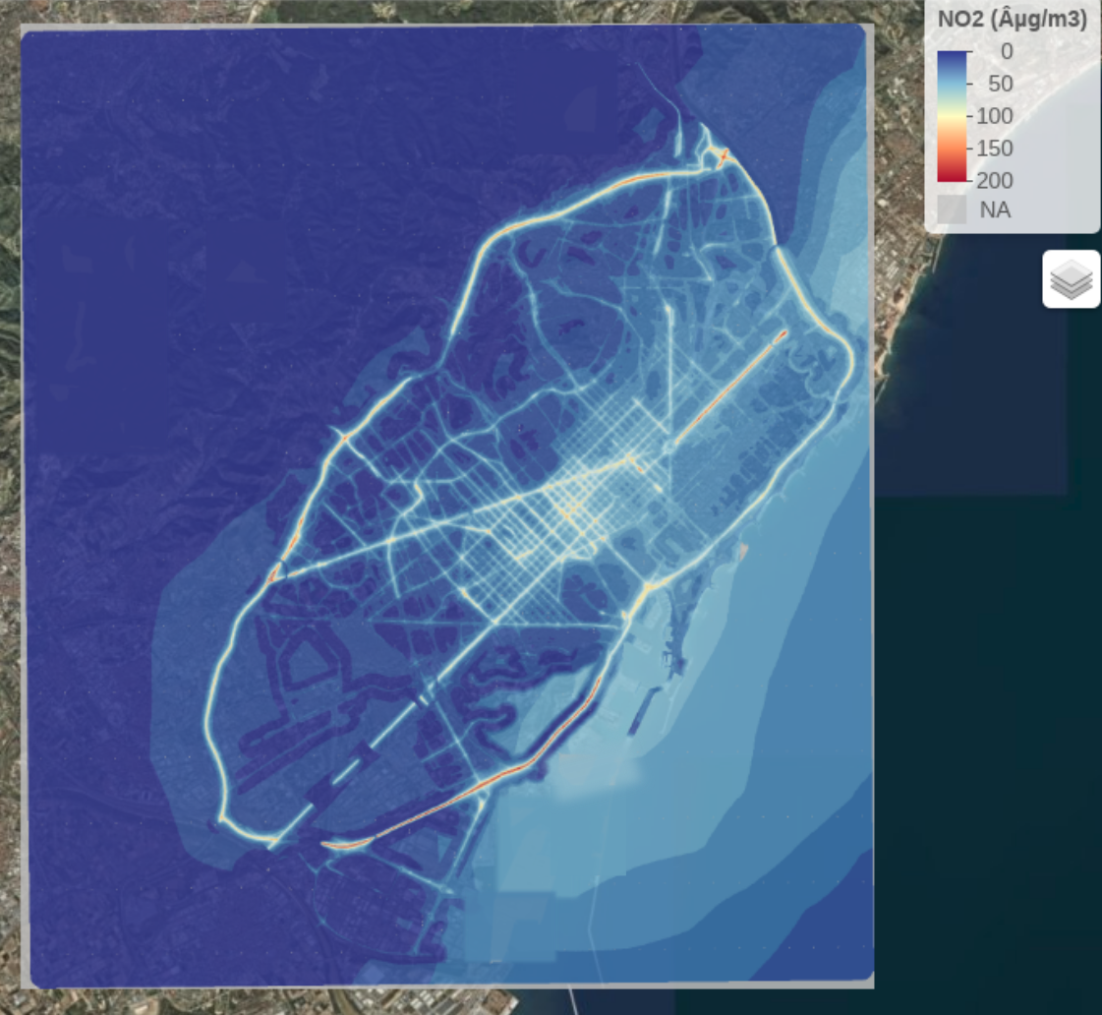
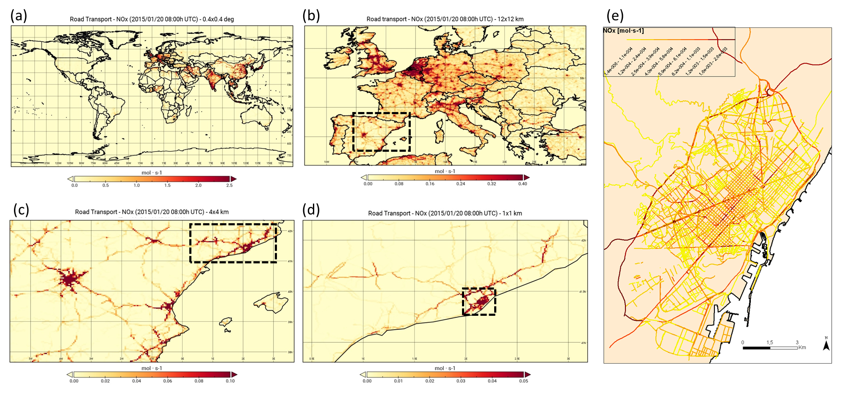
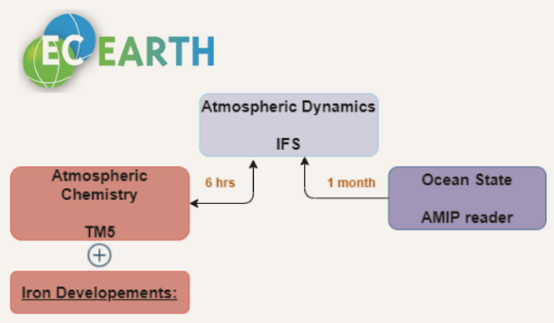
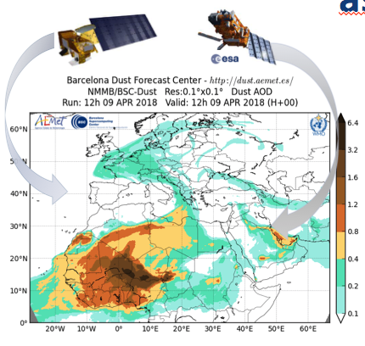
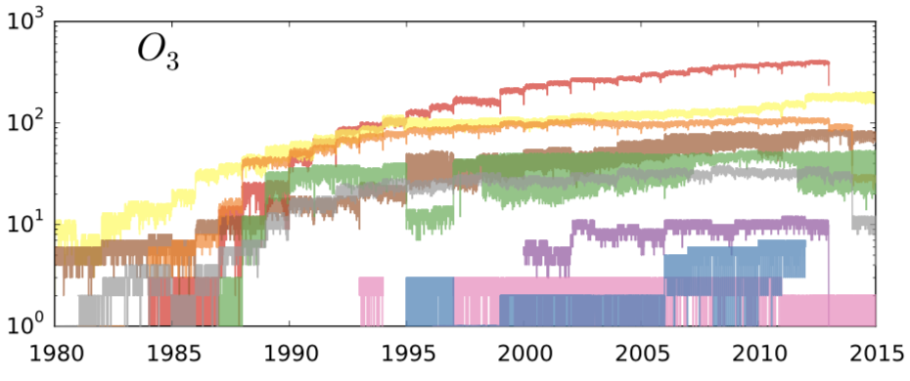
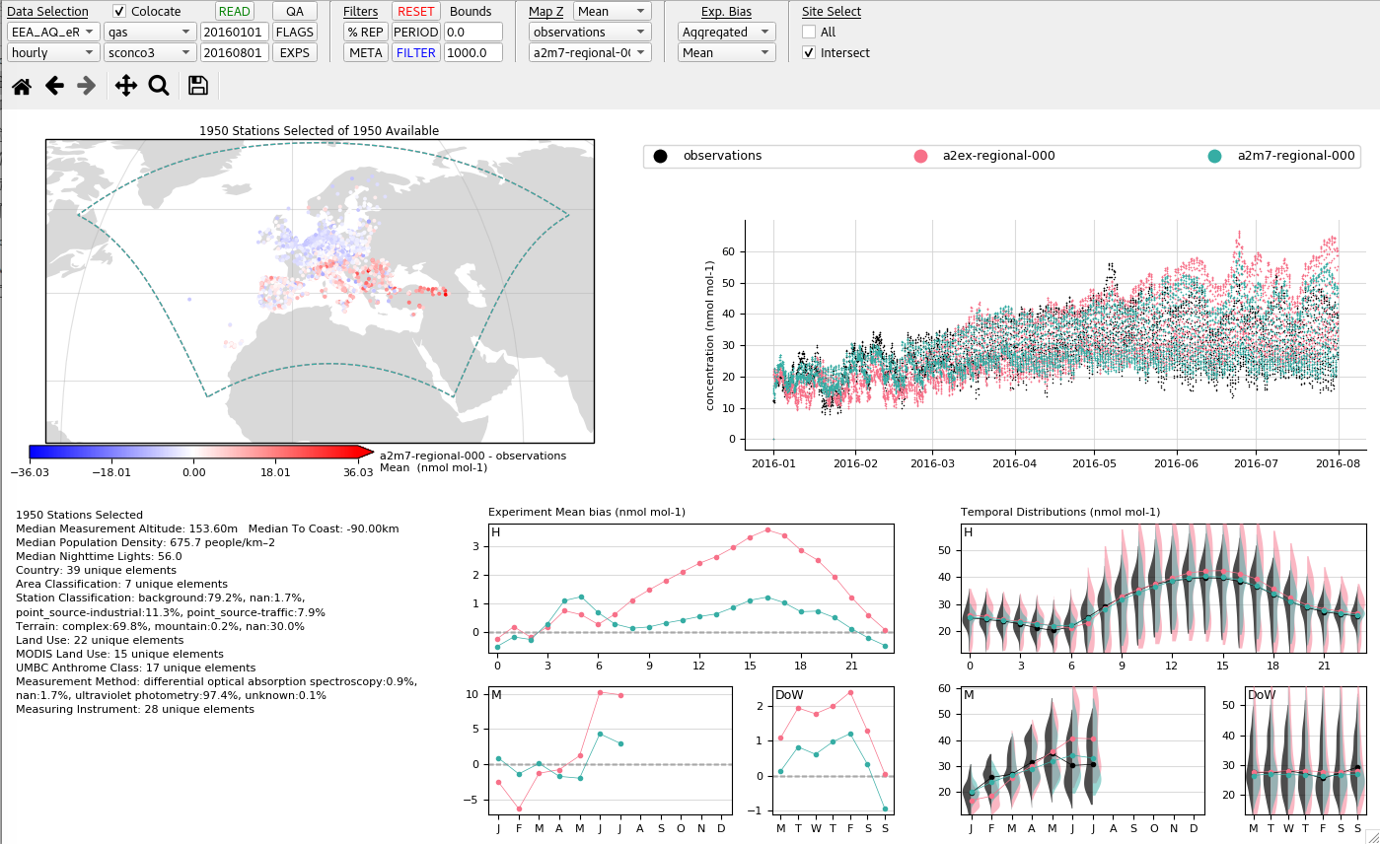
Model and tool developments
HERMESv3
MONARCH
CALIOPE-Urban
A python-based, open source, parallel and multiscale emission model
Street-scale dispersion model
On-line Atmosphere-Chemistry coupling
Multiscale: global to local (1km)
Telescoping nesting
Ready to be coupled with Urban model
EC-Earth3-Iron
LETKF DA
GHOST/Providentia
Ensemble based Data Assimilation system
Harmonised treatment of observations and dynamic/flexible evaluation system
Strong co-development with CES and ESS and starting with CP

Slide 5
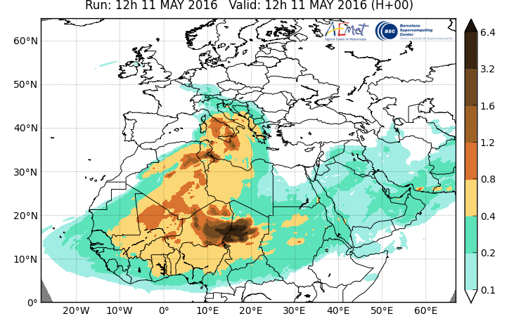
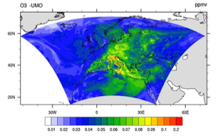
Forecasts, reanalysis, services
WMO Dust Regional Centers
Dust forecasts and and renalysis
CALIOPE Forecast system
ICAP global aerosol ensemble
Soon joining the CAMS air quality regional ensemble
In collaboration with CES and ESS

Slide 6
Ongoing and near-future projects
AXA Research Fund AXA Chair on Sand and Dust Storms
ERC Consolidator FRAGMENT
NASA EMIT
H2020 SOLWARIS, FORCES, AQ-Watch, CoCO2
CAMS 43, 50, 61, 81, 84, COP_66, COP_79, 2_35, 2_40
ERA4CS DustClim
ESA CCI, DOMOS
National Retos NUTRIENT, BROWNING, VITALIZE
Cost Action InDust
Contracts and other Encomienda Dust, Service agreement, Sedema, Generalitat

Slide 7
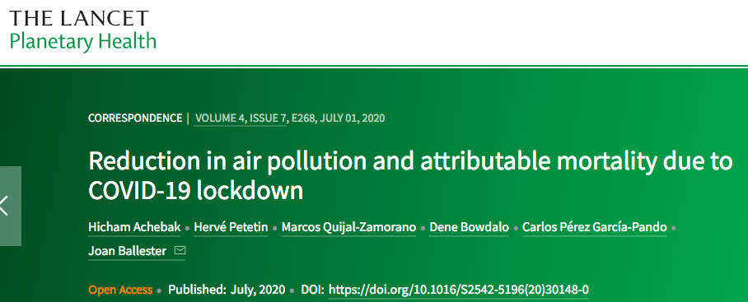
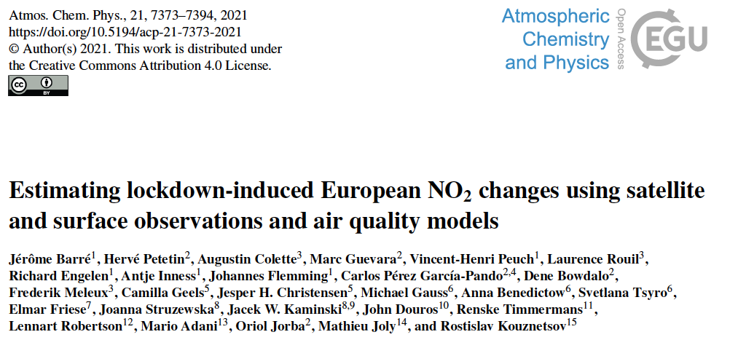
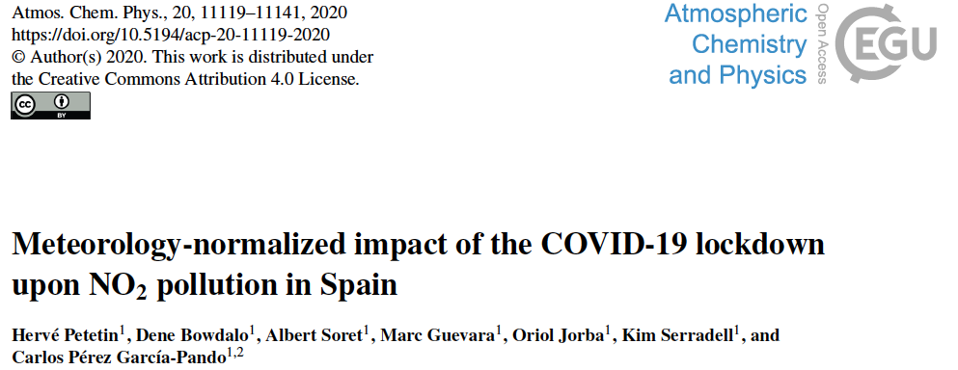
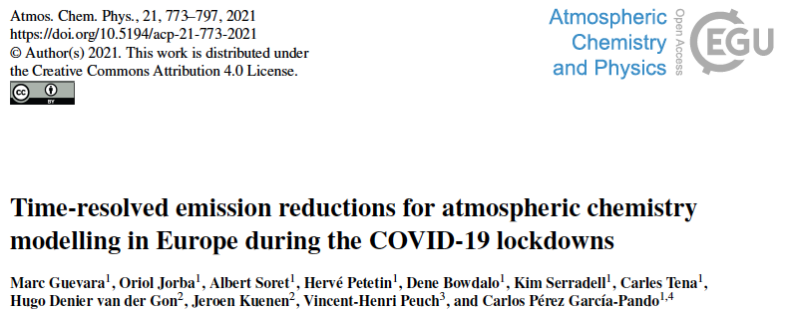
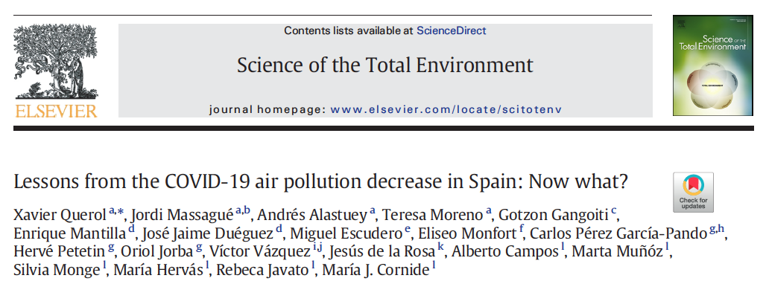
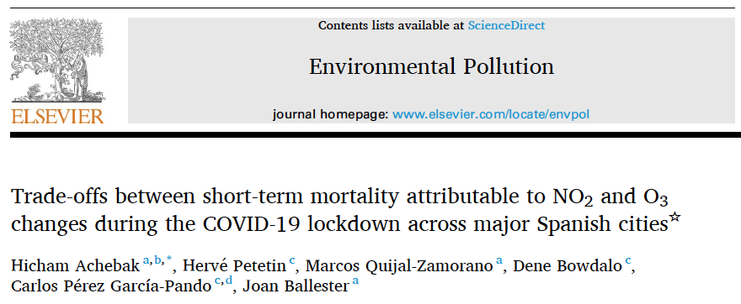
COVID-19
Health effects
NO₂ reductions, in situ, Spain
NO₂ reductions, satellite, models, Europe
Emission reductions
PM, O₃ changes and implications
Avoided short-term mortality in Spain
In collaboration with ISGlobal, CSIC and ECMWF

Slide 8
Who are we?
Carlos P.
Oriol J.
María G.
Enza Di T.
Visitors ex-BSC and collaborators
Marc G.
Sara B.
Jerónimo E.
Dene B.
long list of close collaborators from CES, ESS and CP
Thanks!
Montse C.
Arnau B.
Santiago E.
Roger G.
Franco L.
4 Open positions
Hector N.
Ruben S.
Elisa B.
Adolfo G.
Cristina G.

Slide 9
Today
Aerosol modeling
MONARCH
Iron modeling
EC-Earth
Dust field campaigns
FRAGMENT
Hector N.
Ruben S.
Elisa B.
Adolfo G.
Cristina G.

Slide 10
MONARCH:
organic aerosol and
dust heterogeneous chemistry
Hector Navarro - PhD Student
Ruben Sousse - PhD Student

Slide 11
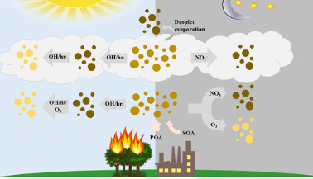
Why studying Organic aerosol (OA) ?
OA represents in some places more than 50% of total aerosols mass.
Chemistry of OA is currently not well understood.
Certain primary and secondary OA have a strong influence on radiative effect absorbing solar radiation. This type of OA is known as Brown Carbon (BrC).
Sources and chemistry of OA (Hems et al., 2021)
Notes:
my work focuses on studying OA optical properties
But, why is OA so important?
...bullet points
In this picture we can see a schematic representation of BrC processes in the atmosphere. From emissions sources (biomass burning and anthropogenic), secondary formation, and changes in its absorbing properties during its aging (darker particles represent stronger absorption properties).
Next slide please
‹#›

Slide 12
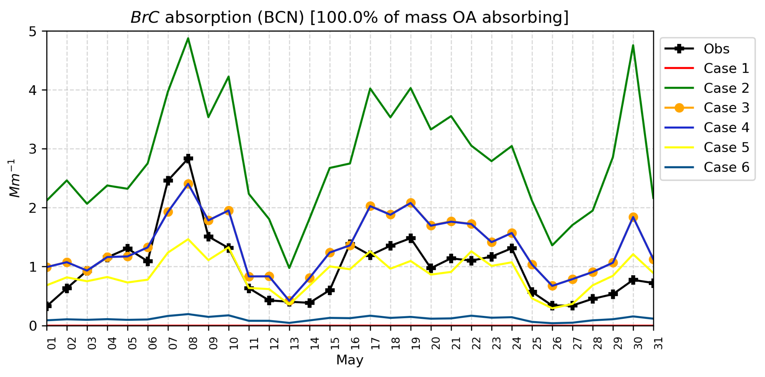
OA and BrC representation in MONARCH
We have performed sensitivity tests with different BrC fractions of OA to reproduce observations over Barcelona, Montseny, and Montsec EGAR stations:
OA scheme based on Pai et al. (2020):
Primary Organic Aerosols (POA)
Secondary Organic Aerosols (SOA)
anthropogenic SOA
biomass burning SOA
0.02 µm
0.02 µm
biogenic isoprene SOA
biogenic terpeneSOA
0.02 µm
In collaboration with:
0.02 µm
Notes:
So, what are we working on?
We have implemented a new OA scheme in the monarch model. In which OA is represented in primary and secondary species of different origin (anthropogenic, biomass burning and biogenic sources).
We are conducting simulations with the MONARCH model at the regional scale and are performing sensitivity tests perturbing the fraction of BrC in the atmosphere and its refractive index. Different cases are defined, from large abundance of BrC with strong absorbing properties both in its primary and secondary components, to the case where no BrC is present in the atmosphere.
Model results are compared with detailed measurements of particulate mass, composition and optical properties in Barcelona, Montseny and Montsec stations maintained by the EGAR-CSIC group, which we are collaborating in this work.
As you can see in the picture, we are finding that in the urban environment , the absorption attributed to organic aerosols derived from observations (black line) can be explained if most of organic is BrC (blue-orange lines). In the regional sites, not shown here, the BrC absorption is likely not dominated by a large abundance of BrC and the signal is more driven by the secondary contribution.
There still exists large uncertainty in the emission fraction and chemical aging of BrC, and we will continue this work to constrain its representation in the model.
Now, Ruben will continue explaining his work with the model.
‹#›

Slide 13
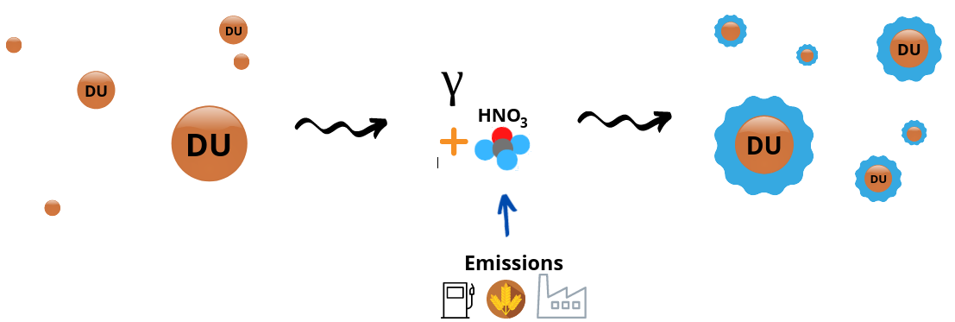
Dust heterogeneous chemistry
Assessing role of dust mineralogy in atmospheric chemistry
(as part of the FRAGMENT (ERC) project)
Dust is emitted and transported into the atmosphere
Heterogeneous chemical reactions
forming liquid coatings
Different sources →
different dust mineralogies
2
3
1
Uptake coefficient
Image credit: María Gonçalves

Slide 14
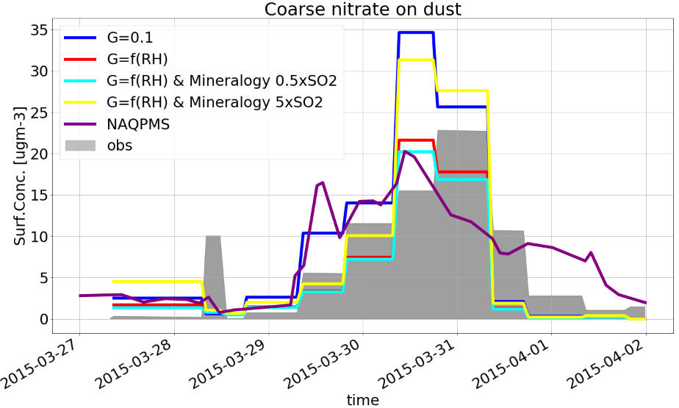
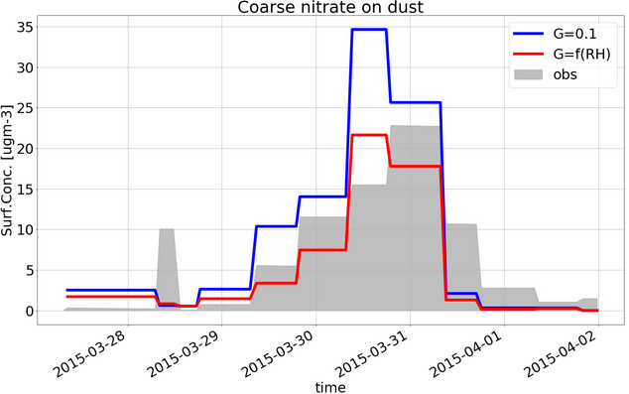
MONARCH implementation
In MONARCH we implemented the HNO₃ heterogeneous reaction on dust surface:
Sensitivity studies are performed and evaluated with observations
4
5
Uptake coefficient (𝛾) depends on:
Dust mineralogy (source)
Ambient humidity
etc.
Implementations are used in other FRAGMENT working groups (i.e. aerosol radiation, aerosol cloud interaction)
6
Notes:
Wang et al. 2019

Slide 15
Iron Modeling - EC-Earth
Elisa Bergas-Massó - PhD Student

Slide 18
Field campaigns in FRAGMENT
Cristina González Flórez - PhD Student
Adolfo González Romero - PhD Student

Slide 19
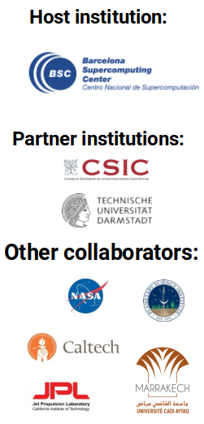
Frontiers in dust minerAloGical coMposition and its Effects upoN climaTe (FRAGMENT)
Image credit: C. Pérez García-Pando (PI of FRAGMENT)

Slide 20
Field campaigns in FRAGMENT
Successfully concluded
Ongoing preparations
Vatnajökull glacier, Iceland, August 2021
Postponed
Morocco, September 2022?
Mojave desert, California, USA, March 2022?
M’Hamid el Ghizlane, Morocco, September 2019

Slide 21
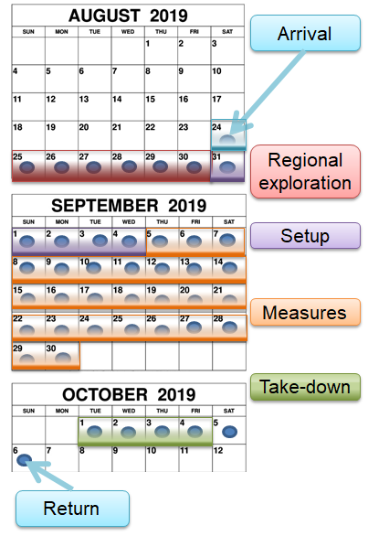
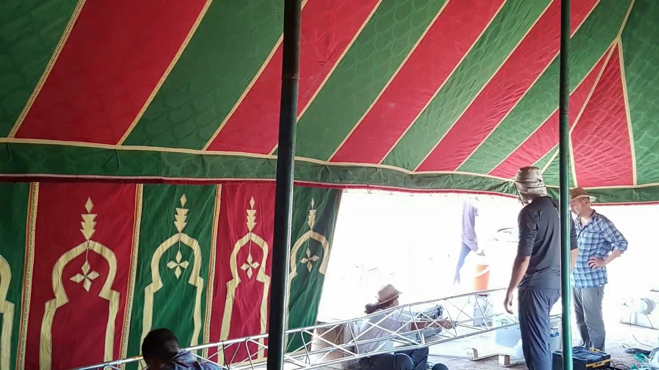
Experimental setup

Slide 22
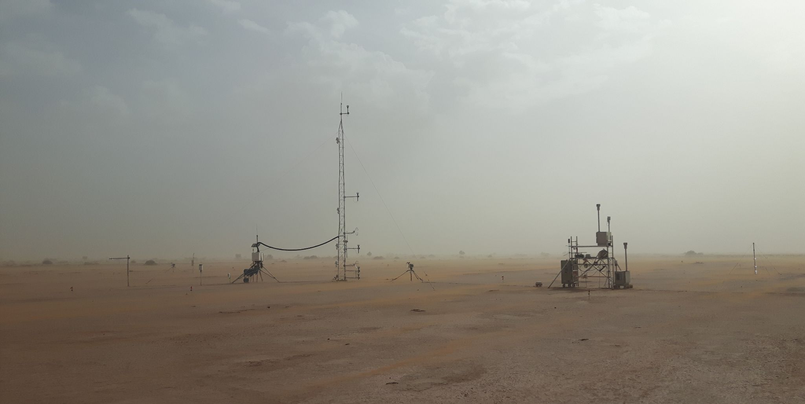
Meteorological & airborne measurements

Slide 23
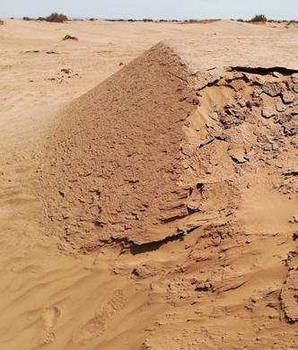
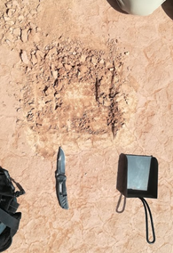
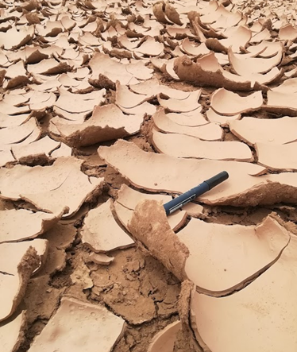
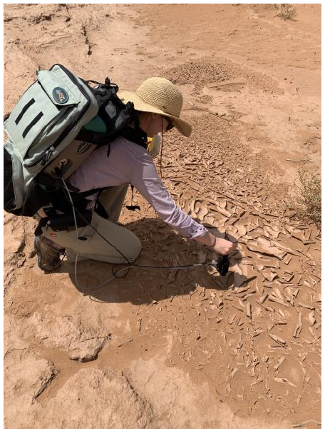
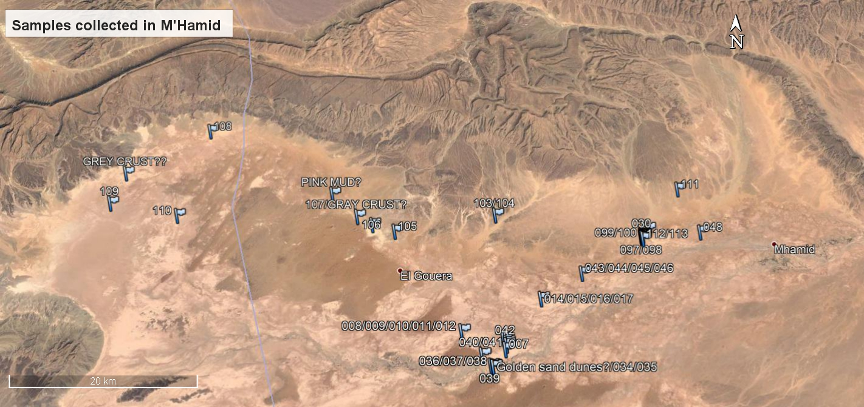
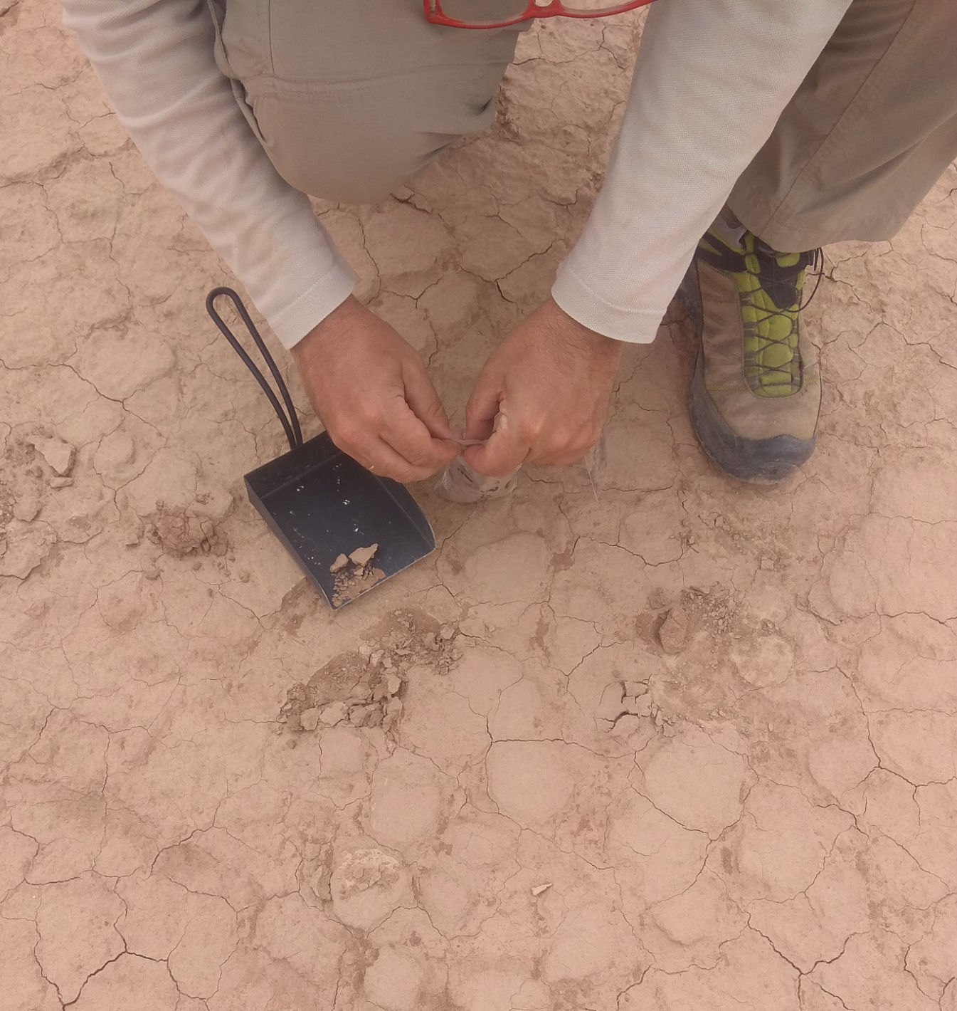
Local & regional soil sampling
Paved sediment
Dune
Sediment
Crust
Spectroscopy
IRIKI
CHEGAGA
Local Sampling
M’HAMID
OUED DRAA
Surface Sampling

Slide 24
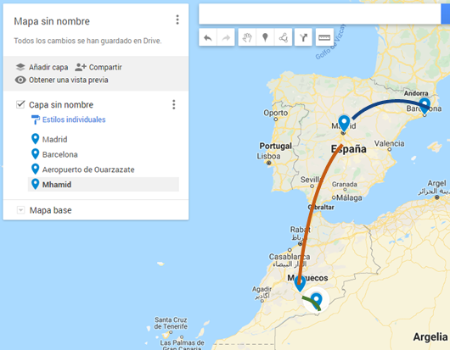
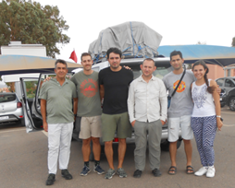
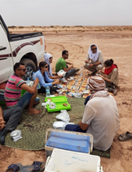

Slide 25
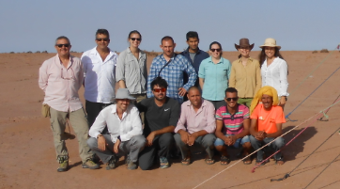
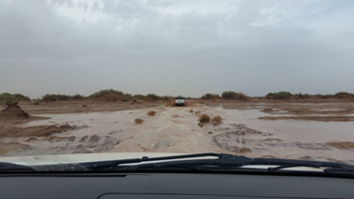
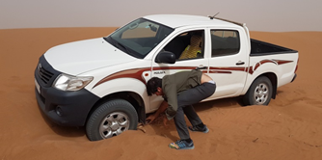
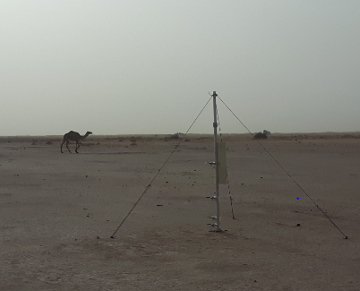
Floods in the desert?

Slide 26
Dust event
The main goal of these campaigns is to evaluate, monitor and sample dust events on the source area

Slide 27
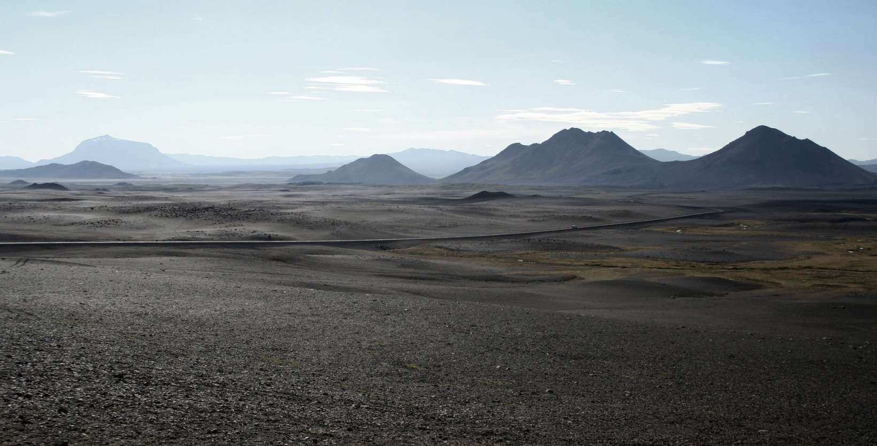
Next challenge….
Iceland

Slide 28
Thank you!!

