Slide 1
Sub-seasonal to seasonal climate predictions for energy
Boosting renewables in the energy mix
I Vigo, I. Christel, A Soret, J Cannata, A Manrique-Suñén, Ll Lledó, V Torralba, N Cortesi, Ll Palma, N González-Reviriego and F J Doblas-Reyes
Barcelona Supercomputing Center
Notes:
My pitch comes from a completely different perspective since I’m working in climate services. So I will introduce you a topic that has not been discussed yesterday. I’ll talk about a solution we are developing to support the increase the share of renewables in the energy mix. The project is S2S4E and it’s a 3 years H2020 project lead by BSC.

Slide 2
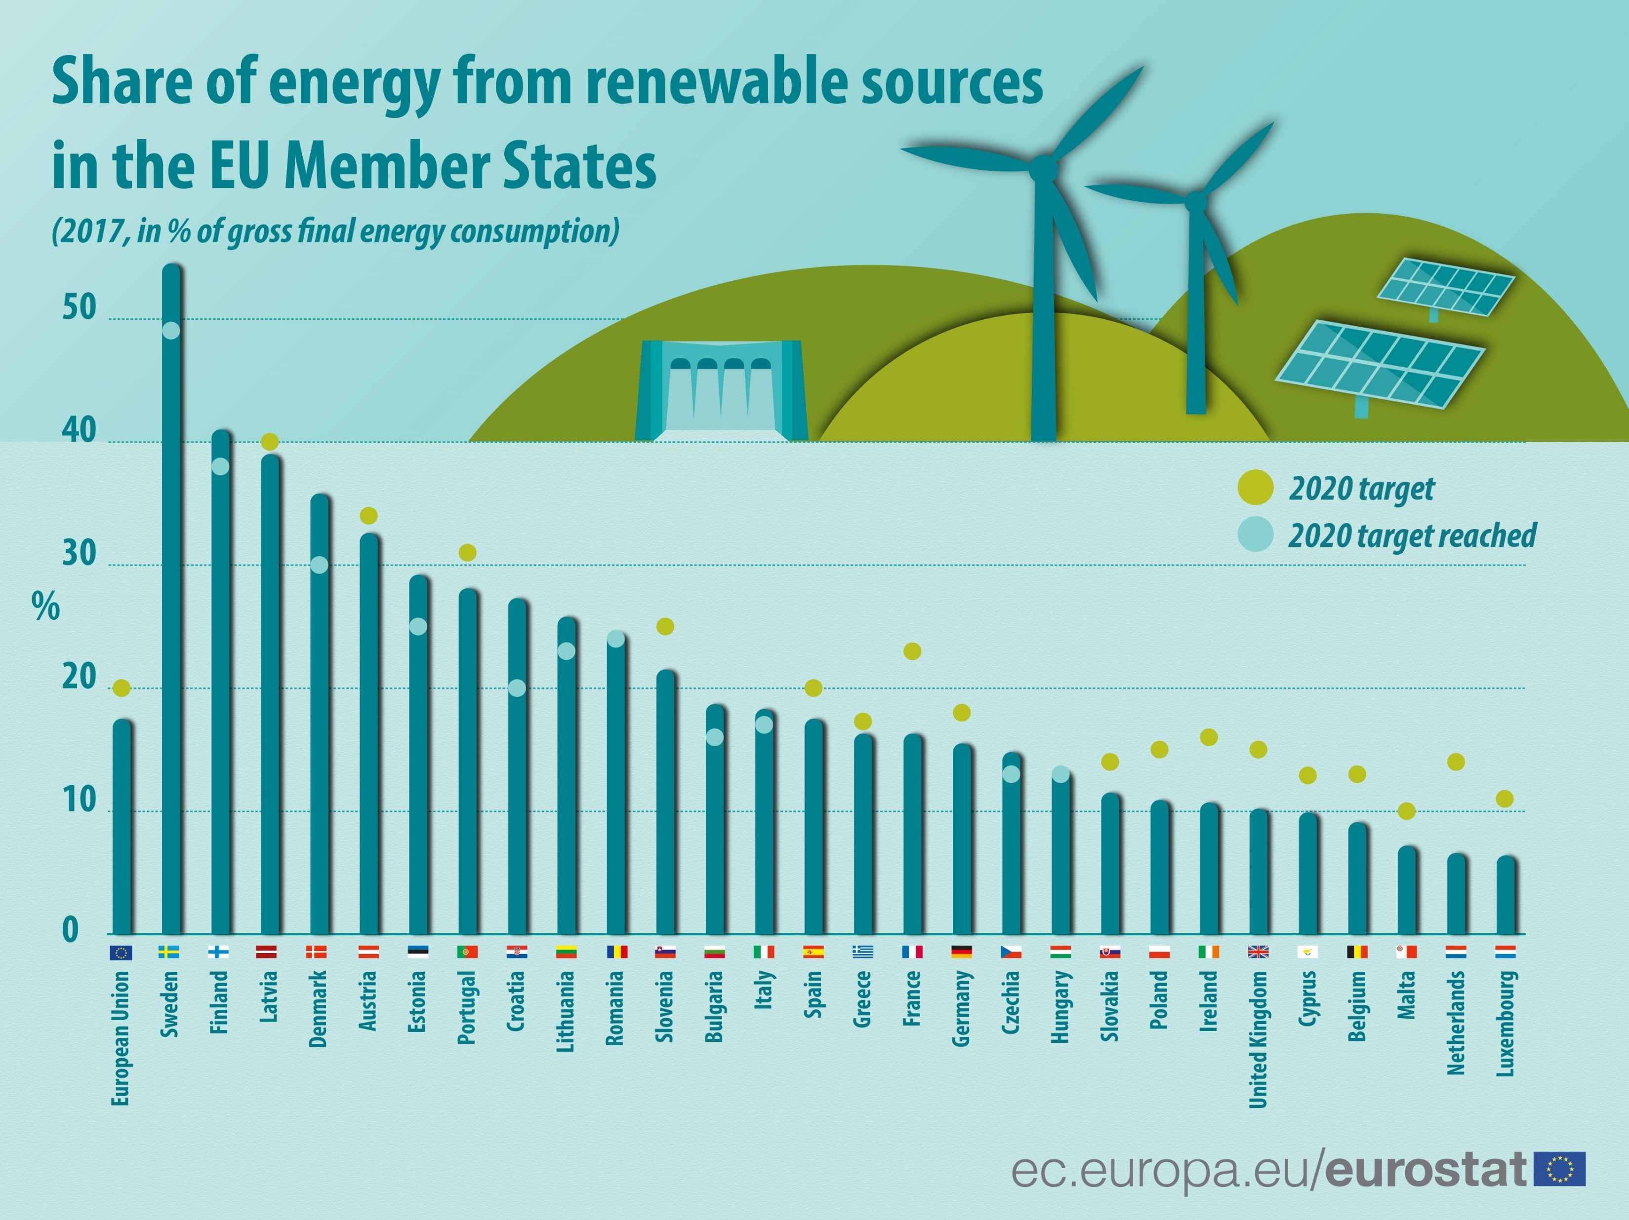
Notes:
The share of renewable energy in the energy mix is increasing, as it was highlighted from speakers from different countries. In Europe it will continue to increaseto meet the targets set to comply with emission reductions established in the Paris agreement.
(more integration of RE in the energy mix → intermittent nature → challenge to balancehigher sensitivity to climate varia)

Slide 3
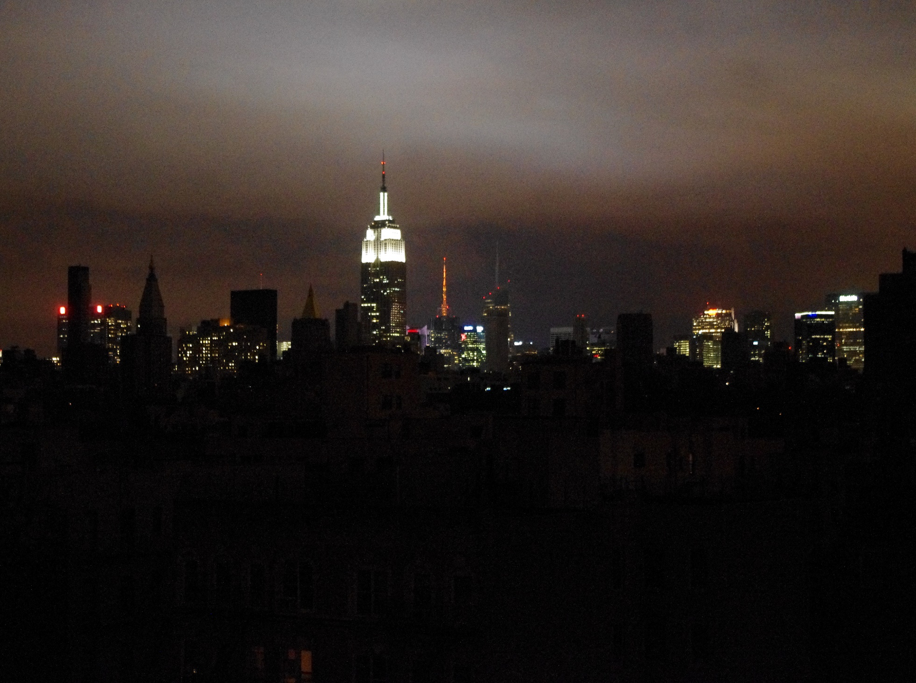
Notes:
(Blackout after hurricane Sandy in New York in 2012) Given the intermittent nature of renewable energy sources and increasing climate variability, the integration of renewables makes more challenging the balancing of demand and supply.

Slide 4
… and climate change too, but what about climate variability?
Link: https://youtu.be/PhbdyNnUliM
Notes:
The average temperature is increasing over time due to climate change (e.g. …) more interestingly we observe yearly fluctuations of temperatura and other climate variables due to climate variability. This implies that assuming that future conditions will be similar to past conditions, can lead to huge mistakes not accounting for climate variability and extrem events. climate predictions take into account changes in atmospheric dynamics, such as those caused by climate change, and therefore can better inform decision making

Slide 5
Weather Forecast
Climate Predictions
Multidecadal and Projections
Present-15d
10 d-1 month
1 month–7 month
2-30 years
20-100 years
●
●
●
●
●
S2S4E project
Notes:
What we are doing in the S2S4E Project is developing a solution targeted to the energy sector. We are developing a tool providing sub-seasonal forecasts and seasonal forecast for the coming weeks and up to the next 3 months. The solution is particularly innovative because it offers at the same time sub seasonal and seasonal forecast for wind, solar and hydro power as well as for energy demand

Slide 6
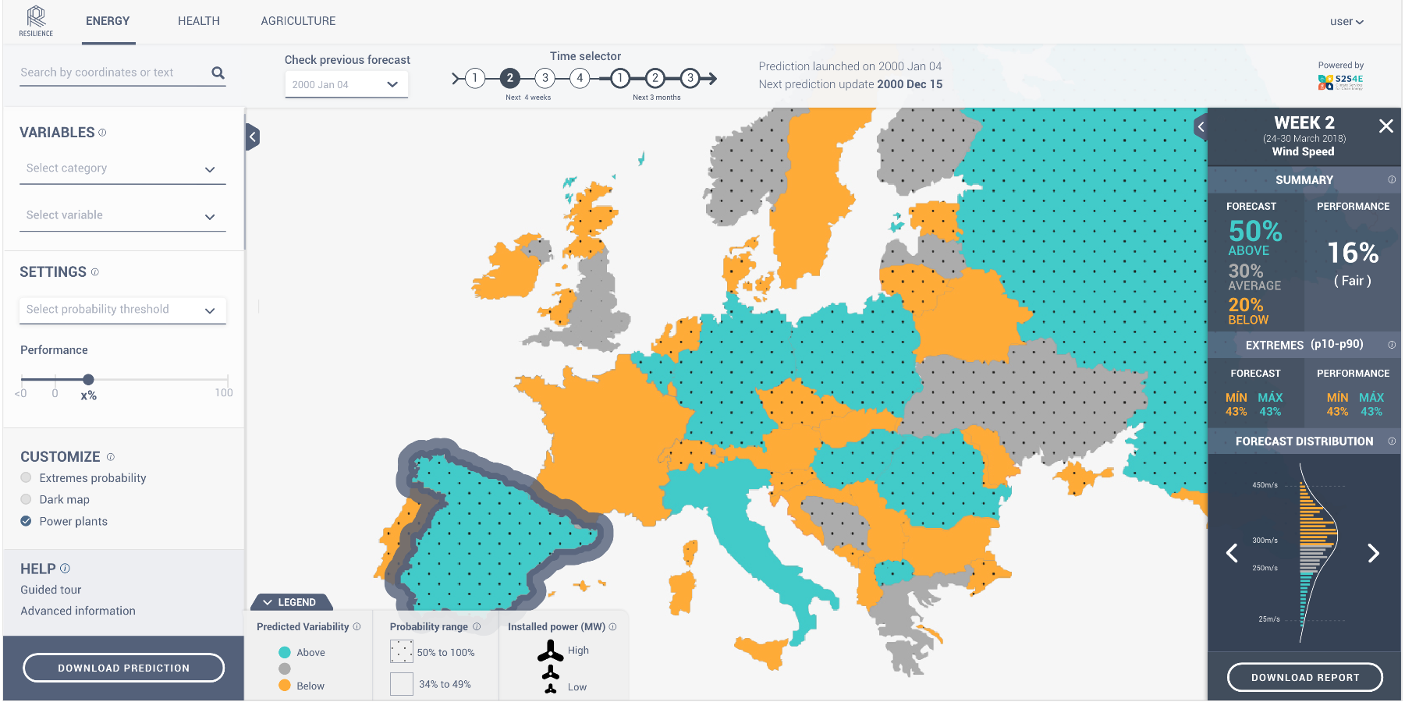
Decision Support Tool
Notes:
This is how the DST will look like. This is a screenshot of the prototype. I’m going to highlight some functionalities and show how it works

Slide 7
Categories
Essential Climate
Wind Energy
Solar Energy
Hydro Energy
Energy Balance
Variables
Climate variables (T, wind, precipitation, etc.)
Energy indicators (capacity factor, demand,etc.)
Notes:
For example you can start by selecting the variables of interest: you select a category, e.g. wind energy, and the you can select to show an energy indicator such as capacity factor

Slide 8
Past forecasts
for
Backtesting
Forecast for the:
next 4 weeks
next 3 months
Notes:
Here you can select which forecasts you want to display, 1w, 2w ahead up to 3m ahead. It is also possible to look into the past forecasts for backtesting.

Slide 9
Probabilistic forecast
with a measure of accuracy
Notes:
We provide a probabilistic forecast indicating if a variable is going to be on, above or below the average. In this example for Spain there is 50% probability of having wind speed above the average . In another we might have a probability of 80% above the average. This is probably a case more relevat for decisión making.. The tool always offers a measure of the forecast’s performance. Any value above zero indicates that the forecasts performs better than using climatology

Slide 10
Access to data, reports and advanced climate explanations
Notes:
Finally i’d like to highlight that it will be posible to download data, reports and to Access advanced climate explanation

Slide 11
Co-Production with industrial partners...
S2S4E
Industrial Partners
...and external stakeholders
Notes:
(PAUSE) this Tool has been co-developed with industrial partners and other stakeholders. EDPR, EDF & EnBW are energy Project partners and they have been highly involved in the creation of the tool and in finding the best ways of presenting the information. Additional stakeholder, including REE, also contributed in this process

Slide 12
Official EUSEW 2019 Side Event
DST LAUNCH EVENT
Thursday, June 20th, 14:00h
at
Norway House, Brussels
5 minutes walk from Berlaymont
Register at s2s4e@bsc.es
Notes:
The DST will be operational and open to everyone for testing starting from June until the end of the Project in November 2020. The official launch will be on the 20th of June in Brussles as official side event of the EUSEW19. Registrations are open.

Slide 13
Notes:
Thank you

