Slide 1
Seasonal Hurricane Predictions platform: Co-development of a climate service for the insurance sector & beyond
Marta Terrado, Philip Klotzbach, Marina Conde, Diana Urquiza, Andria Nicodemou, Louis-Philippe Caron
16-18 May 2022
Future risks and impacts of intense Mediterranean cyclones

Slide 2
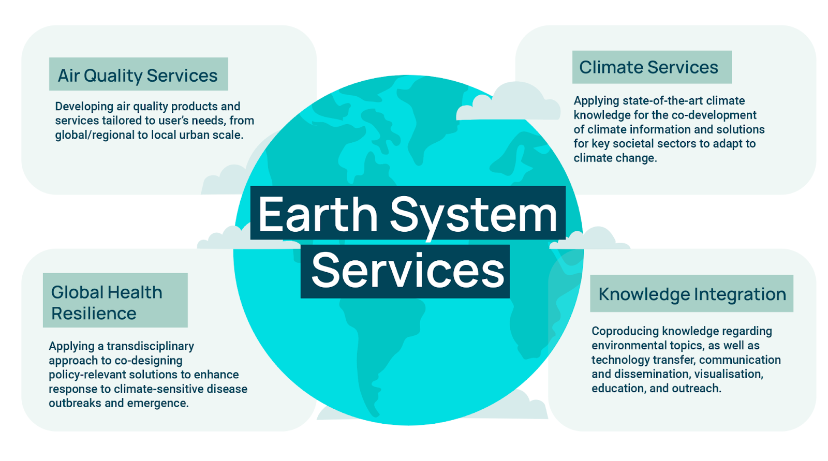
Earth System Services

Slide 3
Closing the gap between science & society
SERVICES → RESEARCH

Slide 4
Climate services
We coproduce climate information and services based on forecasts for timescales ranging from weeks to decades and beyond to support climate change adaptation in many socio-economic sectors, such as energy, agriculture, insurance and health.
Notes:
This slide is just to show that climate services are any piece of climate information that can be useful to advice decision-making, and this includes from raw data, to graphs, outlooks, a piece of advice or a decision-support tool, etc. In our team we focus on the provision of climate predictions that we tailor to the specific requirements of users to go from climate data to climate information

Slide 5
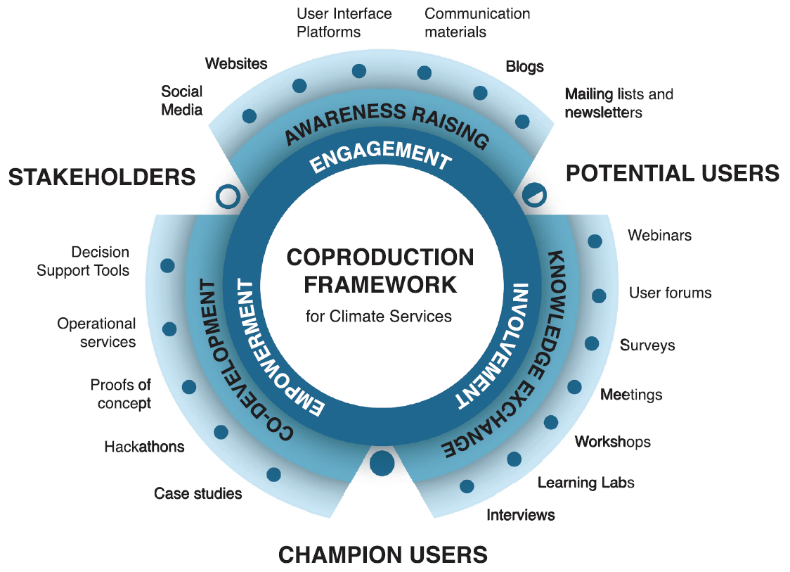
Coproduction framework
Bojovic et al. (2021) Global Environmental Change

Slide 6
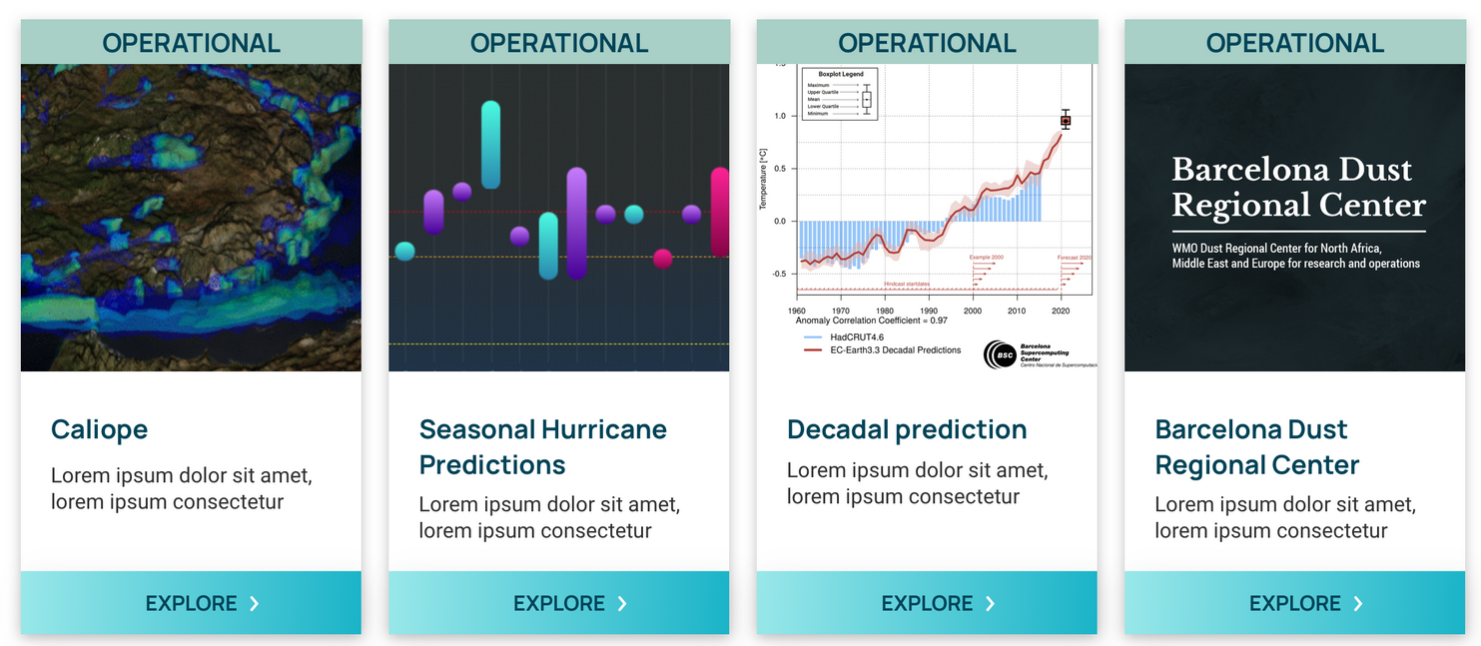
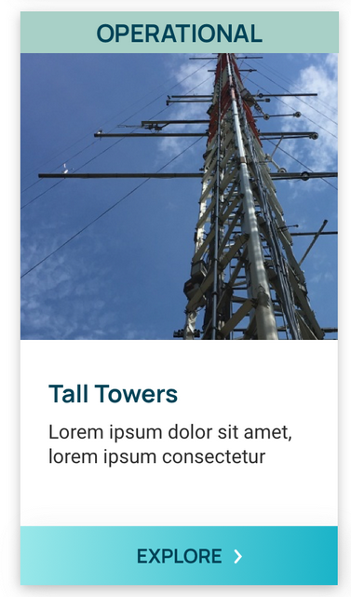
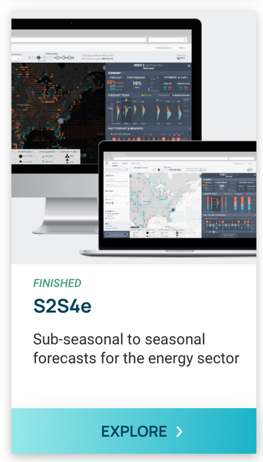
Operational Services
DST
Air quality forecasting system
Decadal climate prediction website
Dataset of hub-height wind observations
Platform centralising hurricane predictions
WMO SDS-WAS Regional Center for NAMEE

Slide 7
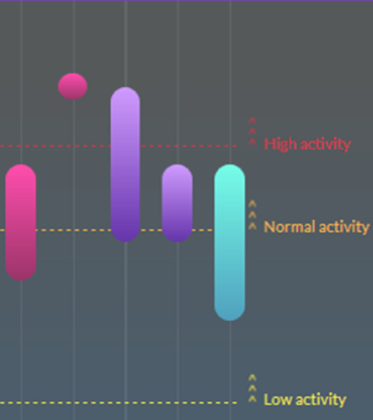
Seasonal hurricane predictions platform
Operational predictions of hurricane activity for the re/insurance sector
Climate service that brings together predictions from different centers that specialize in Atlantic hurricane forecasting
Developed by an interdisciplinary team of scientists, graphic designers and communication & visualisation experts together with users
Informative section for the general public & detailed section for the scientific community
www.seasonalhurricanepredictions.org
Platform launched in year 2016
Notes:
Various centres produce their own forecasts ahead of each hurricane season, which typically occurs between June and November. Although hurricane predictions are generally freely available, no regularly updated and centralised repository facilitating the comparison between different predictions and making this information easy to find existed to date

Slide 8
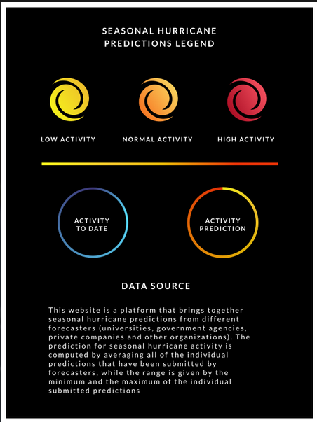
Seasonal hurricane predictions platform
Homepage >
Easy to understand information, synthetic
Accessibility/colour blind scales: enough contrast and intuitive colours
Important to test user experience

Slide 9
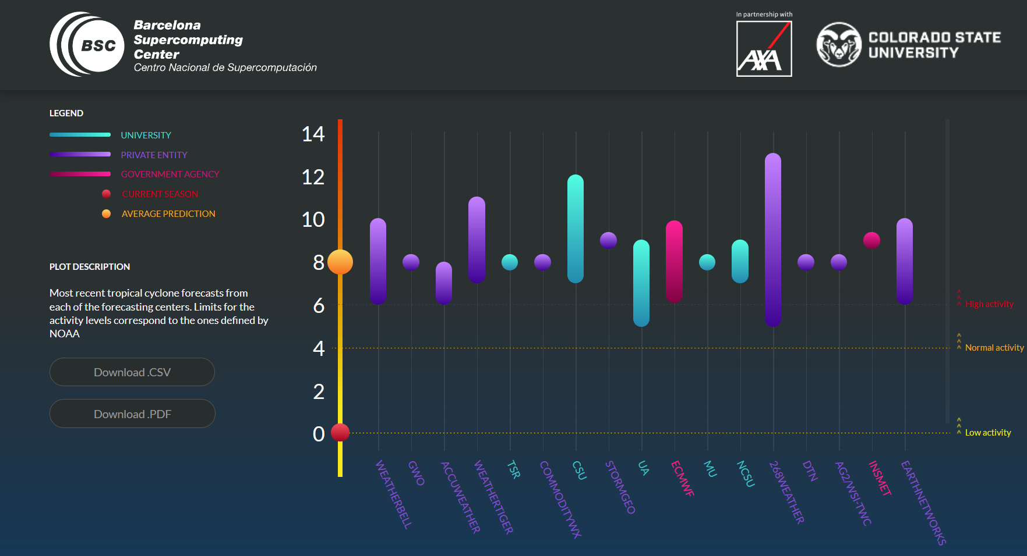
Seasonal hurricane predictions platform
Homepage >
More than 30 forecasters worldwide (universities, meteorological services, private companies)
Limits for categories will be adjusted to the tercile distributions from 1991-2020 (0-5 low, 6-8 normal, >9 high)
Notes:
Most recent hurricane forecasts from each of the forecasting centers. Limits for the activity levels correspond to the tercile distributions (low, normal and high activity) from 1991 to 2020.

Slide 10
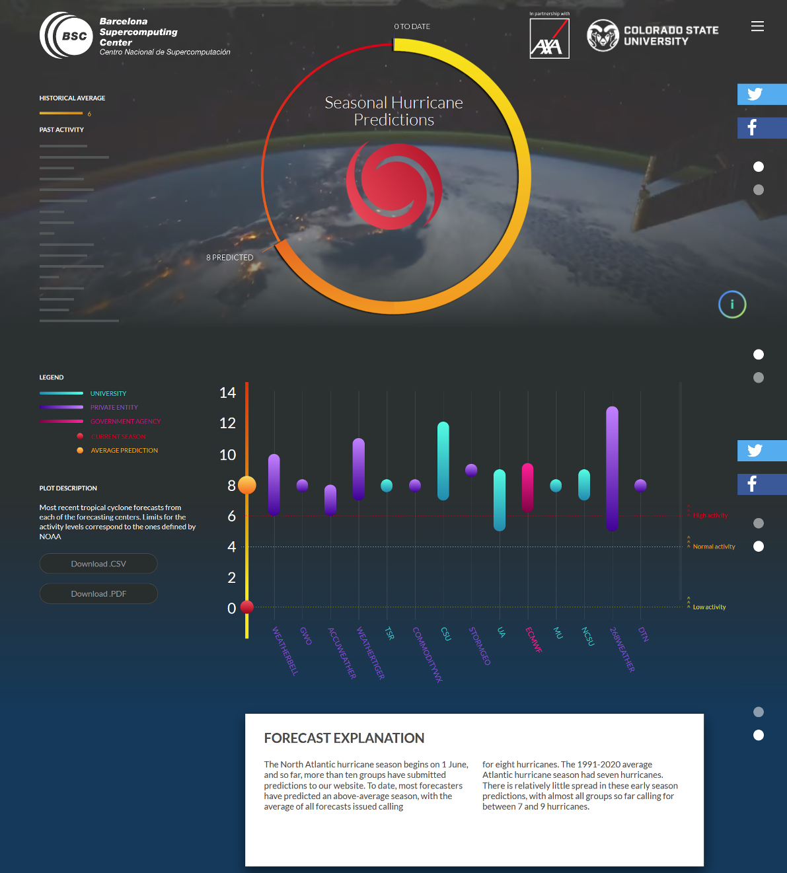
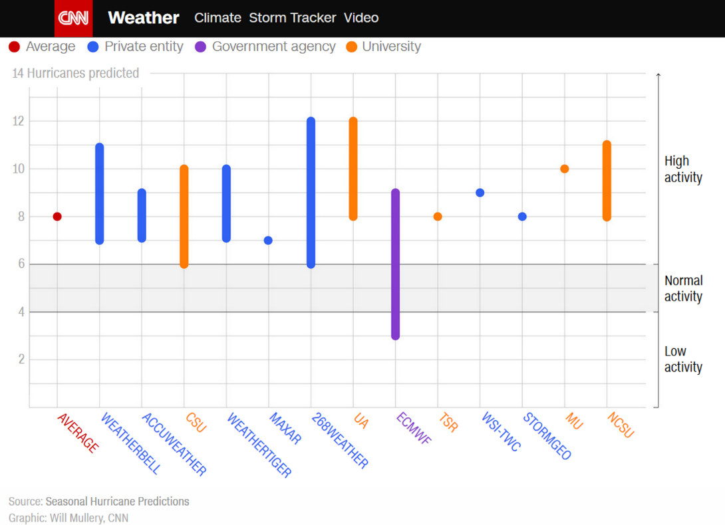
Seasonal hurricane predictions platform
Homepage – For non-experts: material for the wider public, journalists, and other audiences interested in information on hurricane forecasts
Information on observations from previous seasons back to 1966 (bar on the left)
Images and raw data can be downloaded for use, ensuring appropriate attribution
Notes:
1966- first year that the Atlantic was monitored by satellite

Slide 11
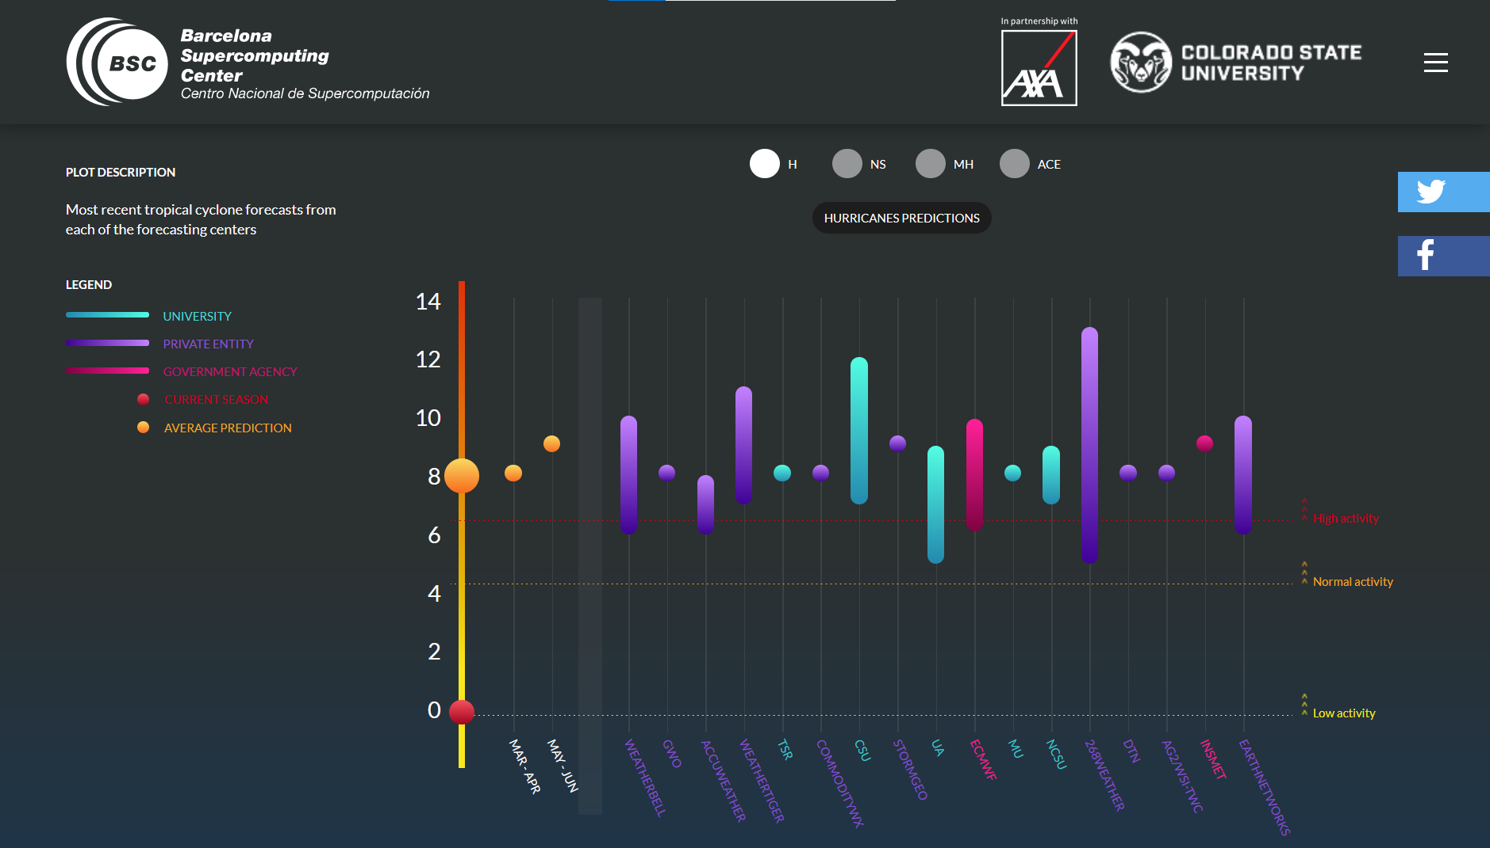
Seasonal hurricane predictions platform
Predictions >
(experts)
Additional variables: hurricanes, major hurricanes, named storms, and ACE
Classification per model type: statistical, dynamical, hybrid, machine learning, heuristic
Bi-monthly averages to track predictions’ evolution
Notes:
Predictions issued in March–April, May–June and July– August can be individually submitted by the forecasting centres. While some forecasters only issue a prediction for the whole season, others provide additional predictions as the season progresses. This is important to consider, since the closer to the hurricane season, the better the prediction should be. The last predictions provided by each forecaster are regularly averaged to compute the number of hurricanes that are expected to affect the North Atlantic basin in the upcoming season.

Slide 12
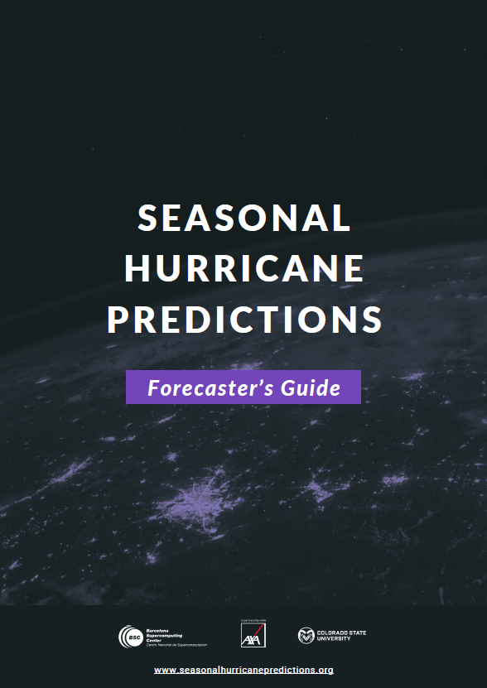
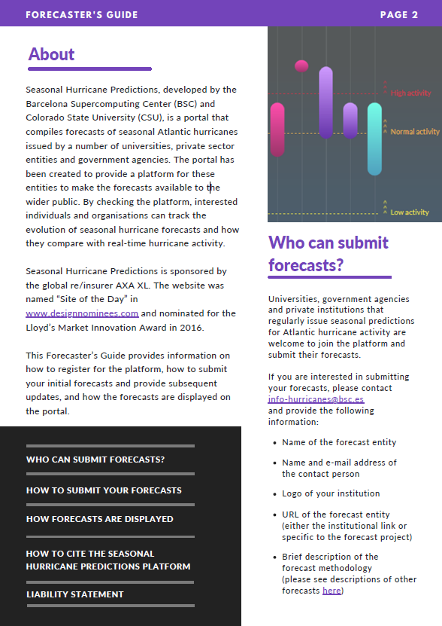
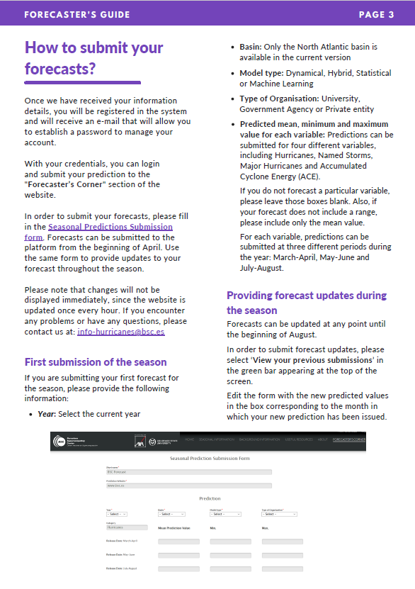
Seasonal hurricane predictions platform
Resources >

Slide 13
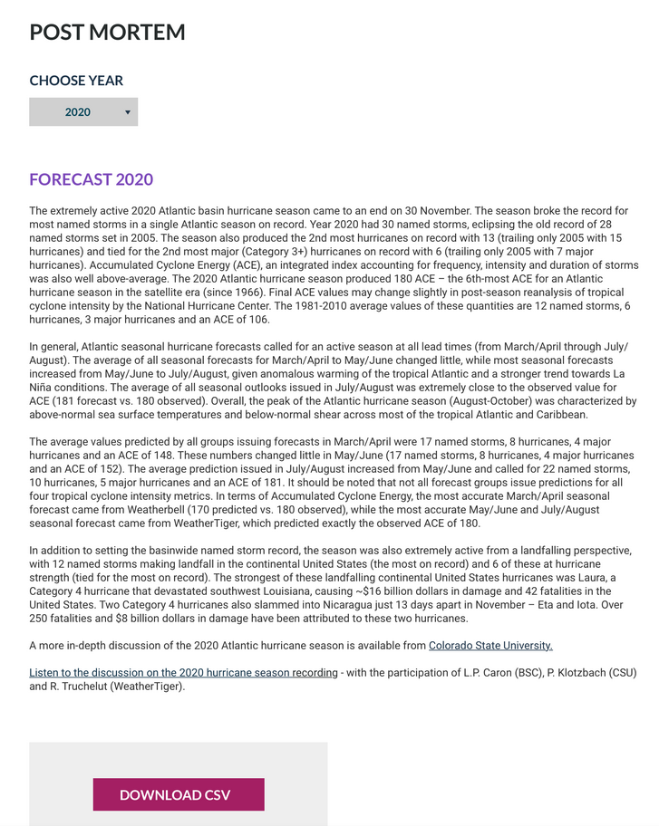
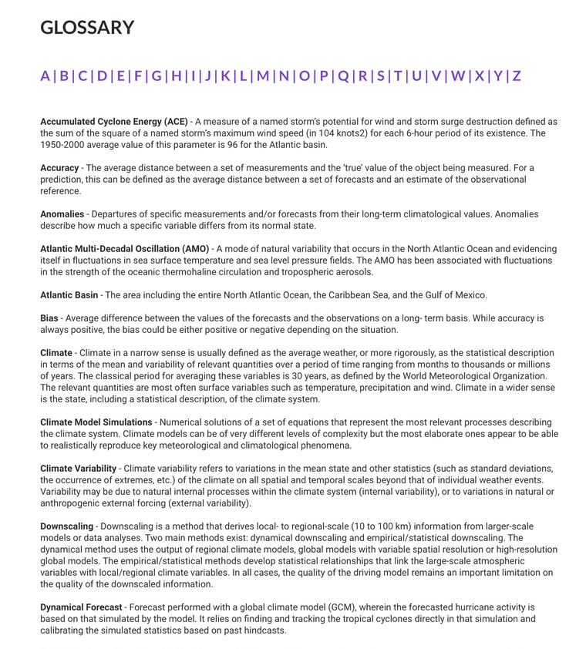
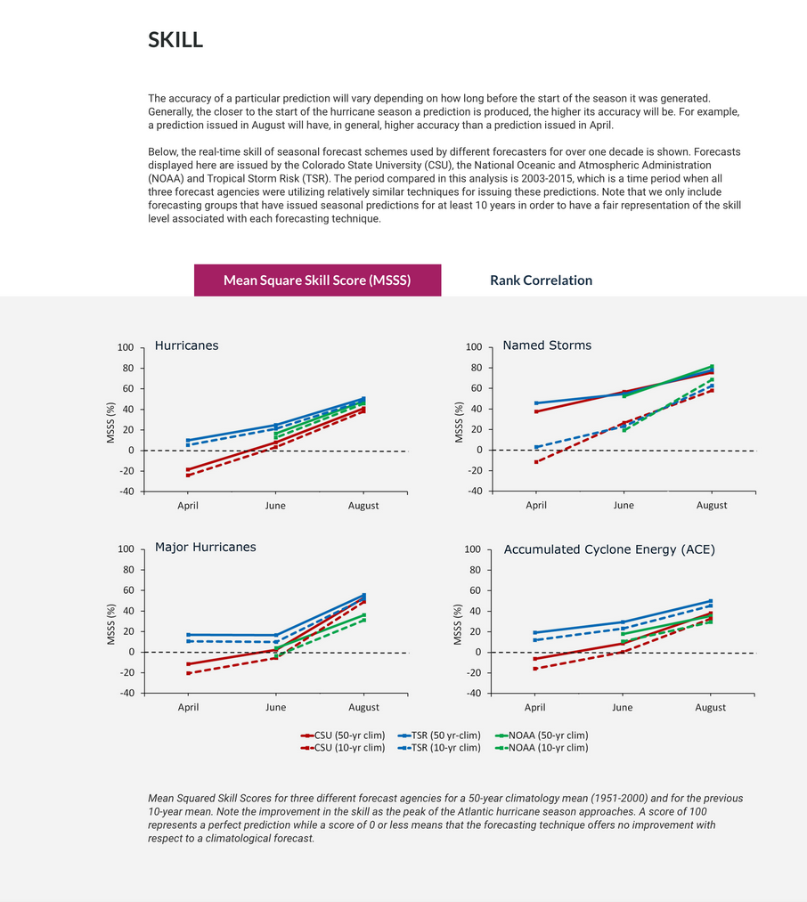
Seasonal hurricane predictions platform
Additional information >
Notes:
Other information available on the website include a post-mortem analysis of previous hurricane seasons and background information related to hurricanes and the conditions necessary for their formation

Slide 14
Re/insurance sector
Seasonal climate predictions can be useful for climate change adaptation in the re/insurance sector
Potential applications:
catastrophe evaluation
loss estimation/price determination
claim team preparation and client warning
Limitations:
predictions for the hurricane hazard (as opposed to the real-world risk)
risk assessment depending on exposure and vulnerability
Notes:
Users from the re/insurance sector identified the assessment of risk exposure to be useful for catastrophe evaluation and losses estimation. Knowing the probability of occurrence of extreme events in the near future, re/insurance companies can determine pricing and restrict pay-outs through upper and lower limits (deductibles) of liability or by imposing restrictions and exceptions to insurance contracts. Climate predictions can also be useful to direct the allocation of capital towards situations where risks are more likely to occur, and can also be used for client warning or claims team preparation when an affectation is foreseen.

Slide 15
Conclusions
Hurricane Seasonal Predictions is a climate service that provides operational predictions of hurricane activity to disseminate the scientific knowledge to the general public and promote uptake in the re/insurance sector
The predictions available on the platform provide information on hazards (not risk). More efforts are needed to identify and address unfilled needs from the re/insurance sector to better tailor the service and increase its use
Climate services can support adaptation and mitigation to climate change, but their use is not widespread due to barriers related to the standardization of climate service components (e.g. methods for quality assurance and control, methods to enhance usability, methods for the evaluation of effectiveness and performance)
The development of guidelines, good practices and recommendations to improve climate service tools and support multi-sectoral risk management is the objective of the Climateurope2 project (starting in September 2022)

Slide 16
Thanks!
The work presented has received funding from CN042500 - AXL sponsorship
marta.terrado@bsc.es

