Slide 1
Better observations, better forecasts?
F. Massonnet
O. Bellprat, F. J. Doblas-Reyes
ECMWF
29th February 2016

Slide 2
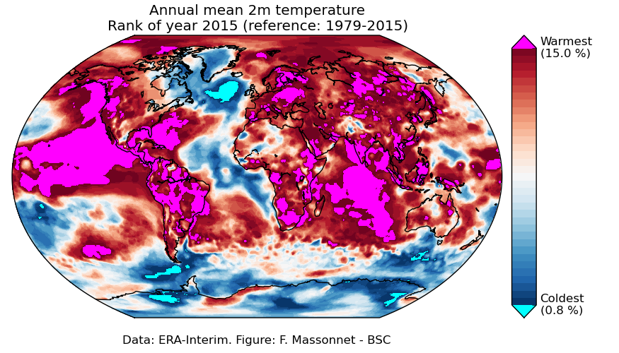
Our climate is changing rapidly
Data: ERA-Interim

Slide 3
The need for high-quality observations has never been as pressing as it is today
Climate is changing rapidly
but parts of our planet remain largely unexplored
Internal variability is large and underlying mechanisms are not completely understood
e.g. Deser et al., J. Clim, 2015
Model predictions/projections remain uncertain
Reliable observations are crucial for model evaluation
Notes:
Now what do we do with observations?

Slide 4
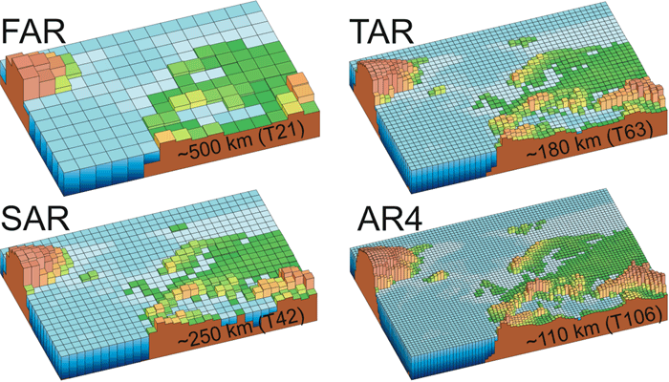
The classical approach of evaluation: several models for one observation
http://eo.ucar.edu/staff/rrussell/climate/modeling/climate_model_resolution.html

Slide 5
The classical approach of evaluation: several models for one observation
Metric of performance (e.g. correlation)
0.51
http://eo.ucar.edu/staff/rrussell/climate/modeling/climate_model_resolution.html
0.67
0.72
0.82
See e.g. Reichler and Kim, BAMS, 2008

Slide 6
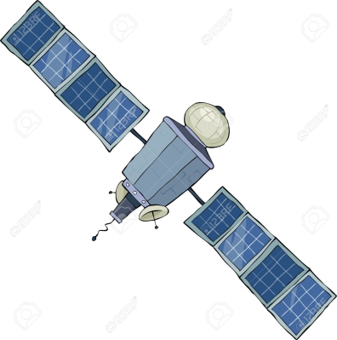
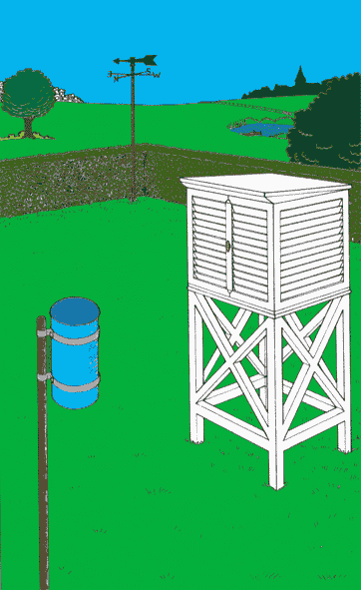
Reversing the paradigm: several observations for one model
0.81
0.63
http://eo.ucar.edu/staff/rrussell/climate/modeling/climate_model_resolution.html
0.72
0.32
Notes:
If we now take the model as granted, but let the verification product change, how do metrics, skill scores, etc. vary? And can we relate these variations in skill scores to the quality of the underlying product?
So all in all

Slide 7
« Better observations yield better forecast verification scores »
1. Intuition
2. Formalization
3. Confirmation
Notes:
Really open to discuss here

Slide 8
« Better observations yield better forecast verification scores »
1. Intuition
2. Formalization
3. Confirmation

Slide 9
If metrics of performance (e.g., correlation, RMSE) are appropriate tools to reflect the quality of a modelling/forecast system,
Reichler and Kim, BAMS, 2008 (CMIP3→CMIP5)
Scaife et al., GRL, 2014 (NAO; sampling)
Massonnet et al., The Cryosph., 2012 (sea ice)
Msadek et al., GRL, 2014 (sea ice)
then, they can also reveal the underlying quality of an observational dataset.
This is because metrics of performance are symmetric from a mathematical point of view.
Notes:
If we can agree on the fact that classical metrics of performance, like correlation and RMSE, are good proxies for model quality, then they are also good proxies for observation quality.

Slide 10
« Better observations yield better forecast verification scores »
1. Intuition
2. Formalization
3. Confirmation

Slide 11
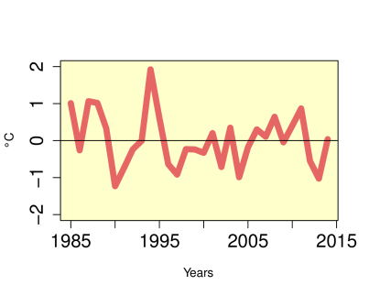
A signal-plus-noise toy model
Interannual variability
TRUTH
[Model from Weigel et al., QJRMS, 2008. See also Siegert et al., 2015]
Notes:
The framework is a simple emulation of ensemble forecasts in climate science which assumes that model and observations share a common predictable component, namely the truth
The advantage of this model is that it generalizes existing models and also that it is very simple to run and so tractable to make statistical estimations.
It’s also very handy to make analytical developments

Slide 12
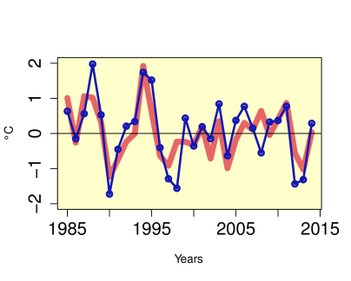
A signal-plus-noise toy model
Interannual variability
TRUTH
Interannual variability
Measurement and representativity error
OBS
Interannual variability
Model forecast error (physics, initial conditions, resolution) + irreducible error (atmosphere)
MODEL
All error terms are assumed to be uncorrelated
[Model from Weigel et al., QJRMS, 2008. See also Siegert et al., 2015]
Notes:
The advantage of this model is that it generalizes existing models and also that it is very simple to run and so tractable to make statistical estimations.
It’s also very handy to make analytical developments

Slide 13
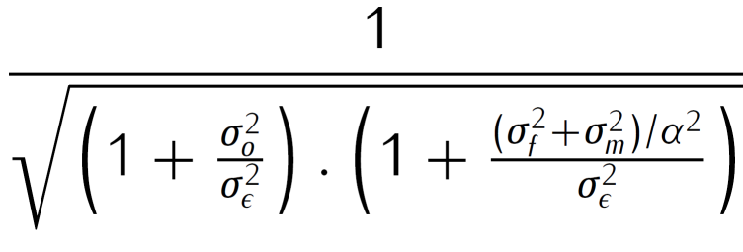
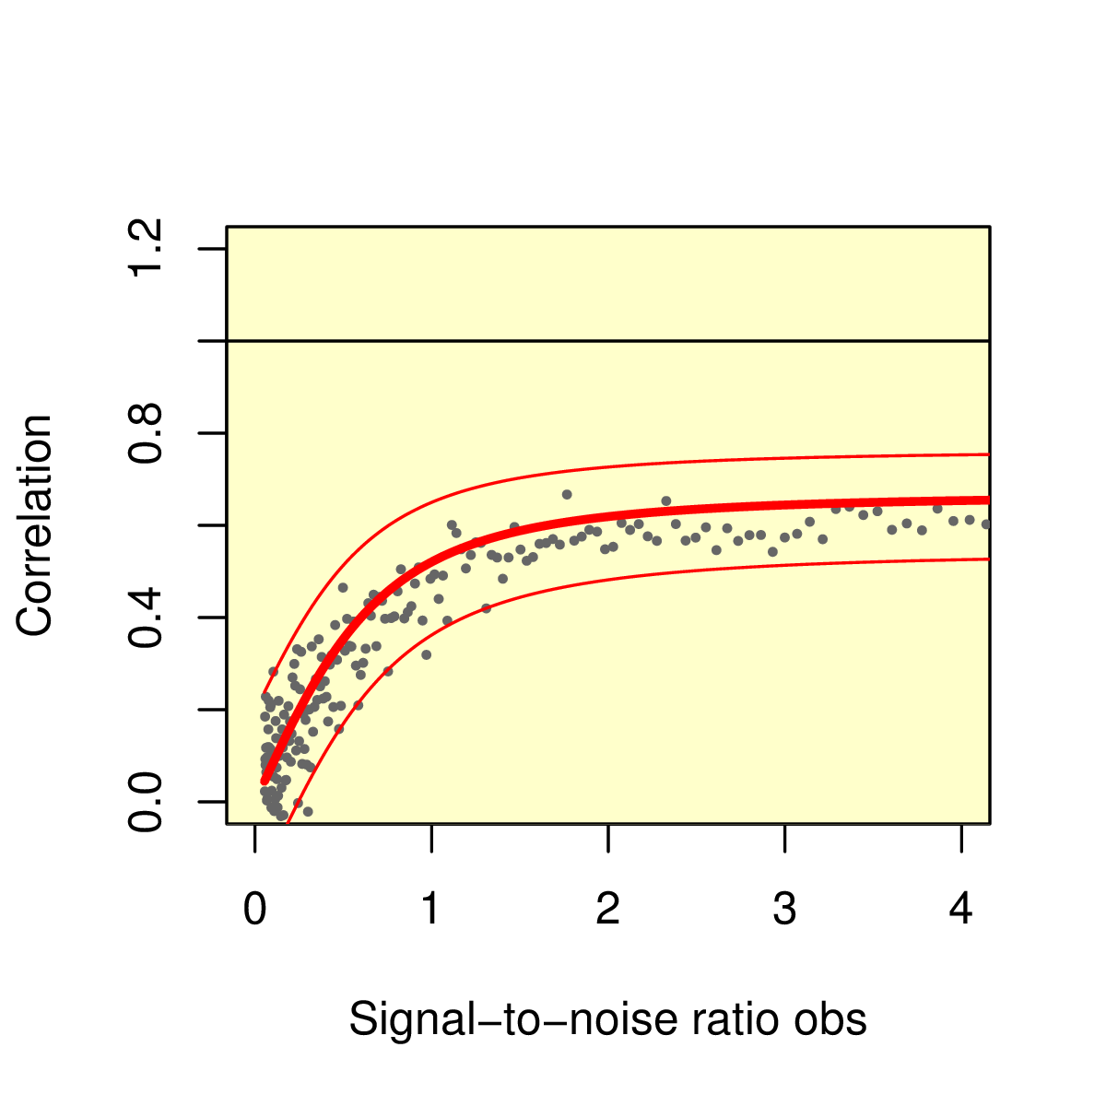
In this very simple paradigm, model and observational errors play interchangeable roles
If error statistics are known, the dependence can be predicted
Correlation increases when
Model explains more variability,
Model error decreases,
Climate signal is stronger,
Observational error decreases.
Notes:
The same reasoning can be applied for RMSE

Slide 14
« Better observations yield better forecast verification scores »
1. Intuition
2. Formalization
3. Confirmation

Slide 15
Seasonal forecasts of summer sea surface temperature
CanCM3/4, MPI-ESM-L/M/HR, CNRM, EC-EARTH (3 versions)
11 models
10 members
4-month forecasts initialized in May
440 forecasts (not independent from each other)
Period for evaluation: 1993-2009
ESA-CCI
ERA-Int
ERSST
HadISST
ERSST4
5 observational datasets for verification
(not independent from each other either)

Slide 16
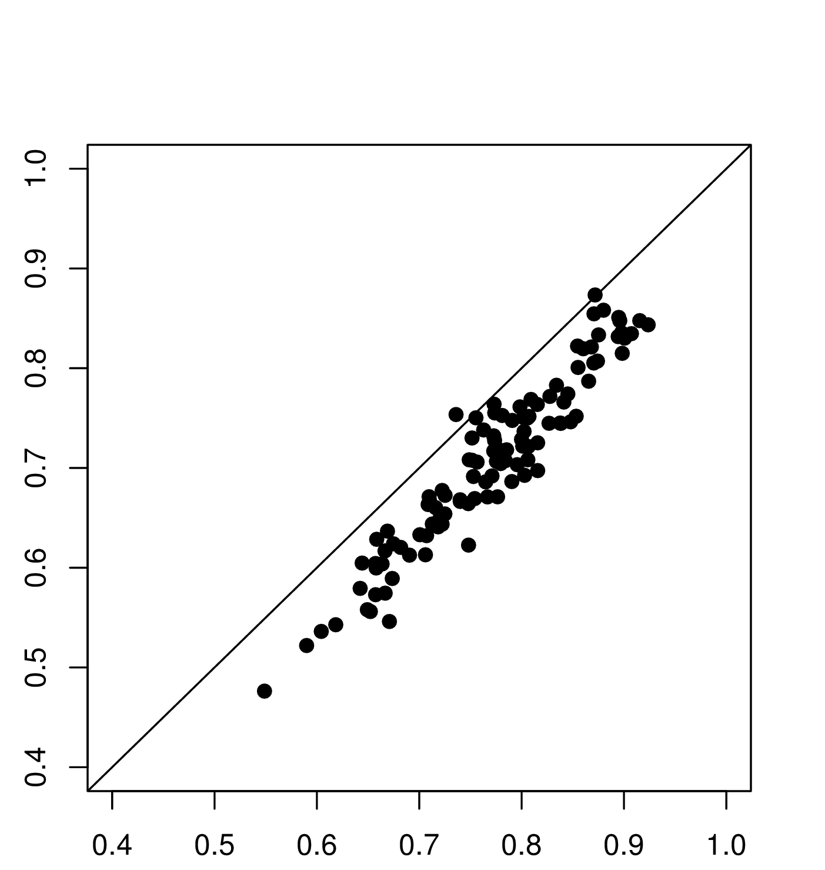
The choice of the validation product has a systematic impact on correlations
Skill of August forecast of SST (1993-2009)
Correlation when using ERSST for validation
Differences up to 0.1!
Correlation when using ESA for validation

Slide 17
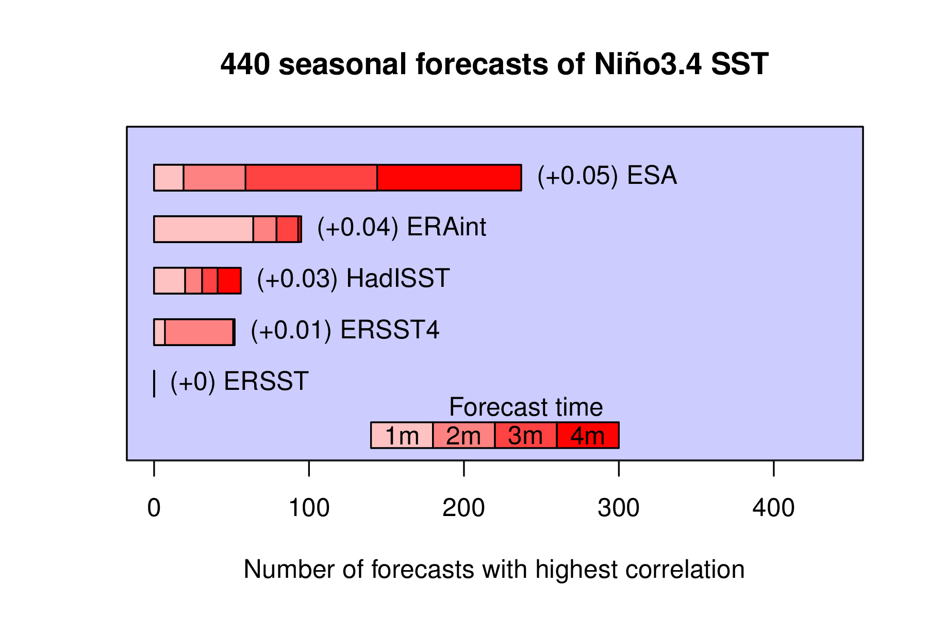
The most advanced product yields on average higher skill to the forecasts
ESA-CCI
Notes:
From now I’m going to do everything to disprove that this result

Slide 18
Such an extreme result is unlikely to have occurred by chance
1. Bootstrapping
- Synthetic data is generated from the known sample covariance matrix of the data that we modify so that, for each forecast, correlations are the same for all observations (our null hypothesis)
- With 10,000 trials, a result as extreme as the one we have happens ~1.2% of the time

Slide 19
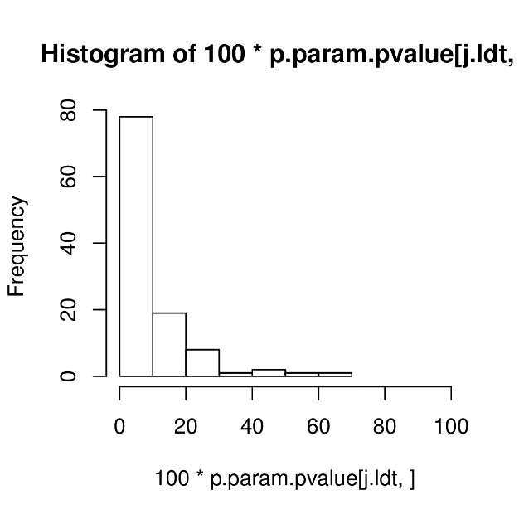
Such an extreme result is unlikely to have occurred by chance
1. Bootstrapping
2. Parametric test
[Steiger et al., 1981]
(the test detects changes in correlation in presence of non-independent samples)
- Synthetic data is generated from the known sample covariance matrix of the data that we modify so that, for each forecast, correlations are the same for all observations (our null hypothesis)
p-value of 110 Steiger tests to detect increase of correlation from ERSST (lowest) to ESA (highest)
- With 10,000 trials, a result as extreme as the one we have happens ~1.2% of the time
~85% of the forecasts have
p-value< 15%
Count
P-value [%]

Slide 20
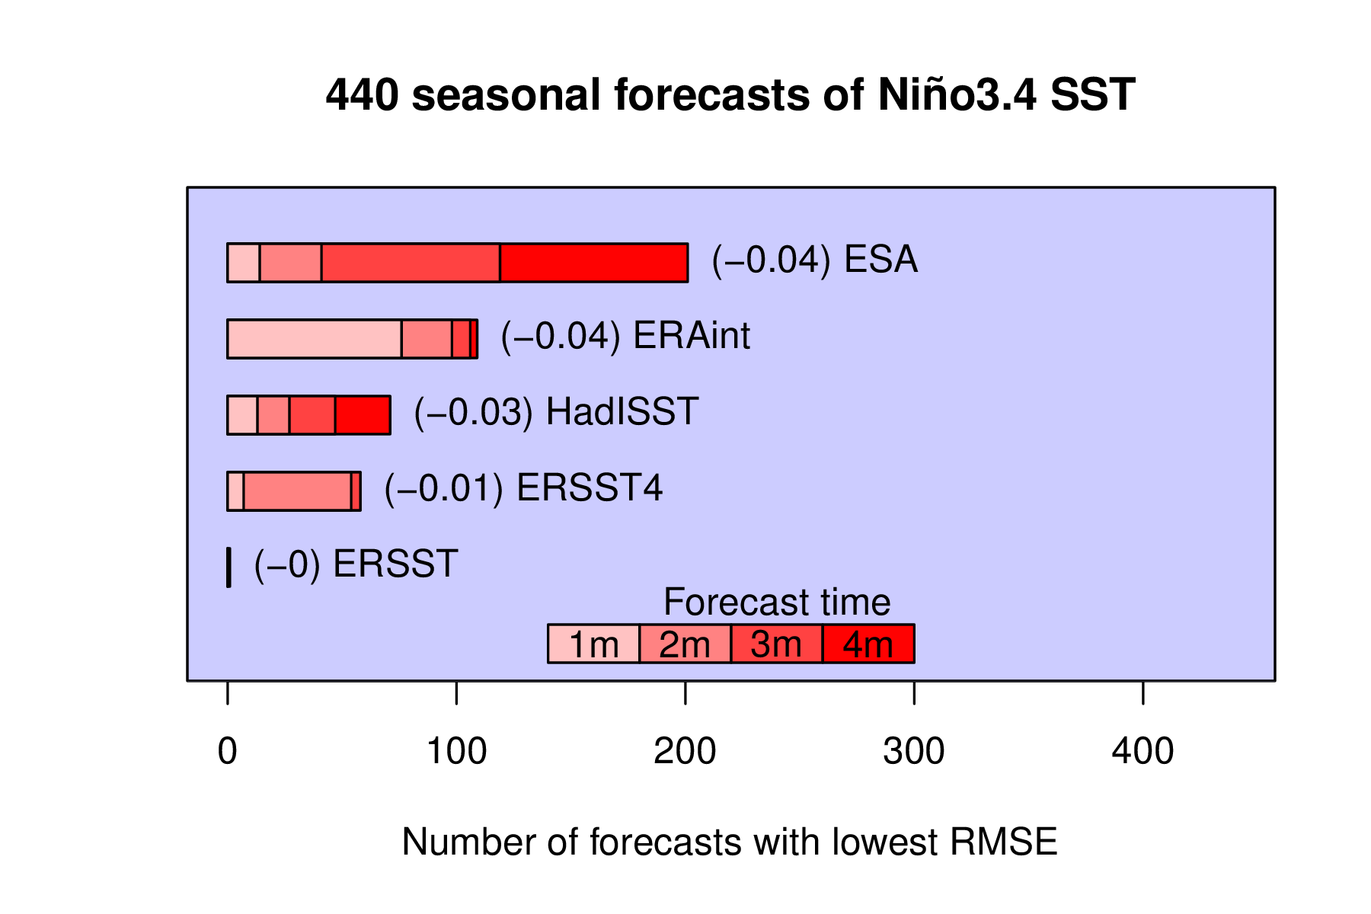
The result is robust when using an alternative metric of verification: RMSE
ESA-CCI

Slide 21
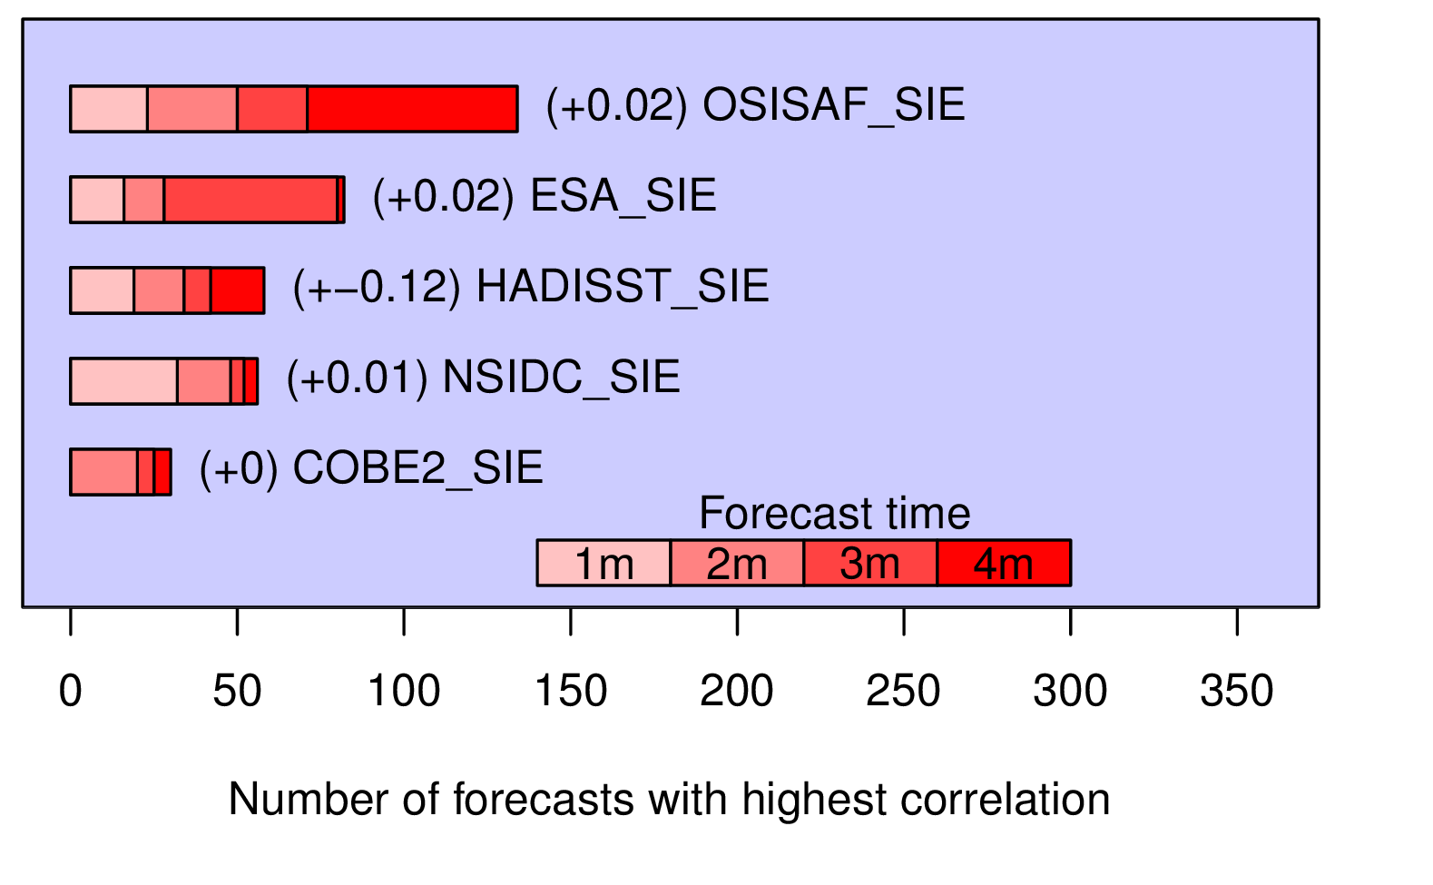
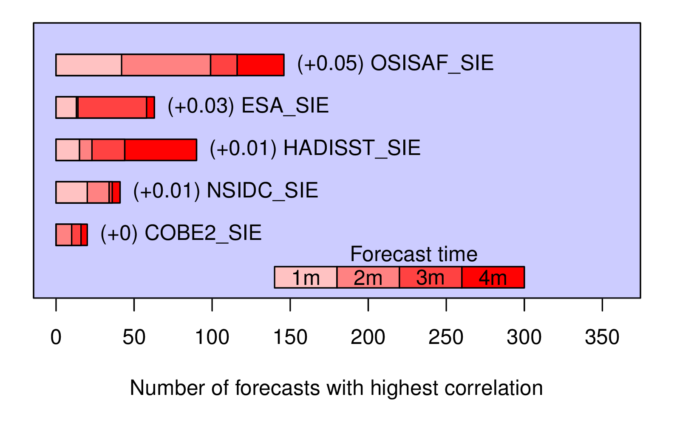
The test was repeated for another test case: sea ice
9 models x 10 members x 4 forecast times = 360 forecasts (ref. 1993-2008)
Initialization month: May
Without detrending
With detrending
OSI-SAF
OSI-SAF
ESA-CCI
ESA-CCI
HadISST
HadISST
NSIDC
NSIDC
COBE2
COBE2

Slide 22
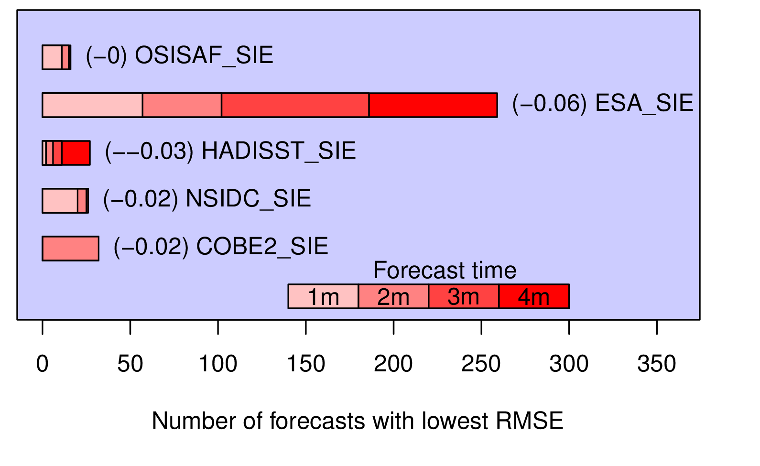
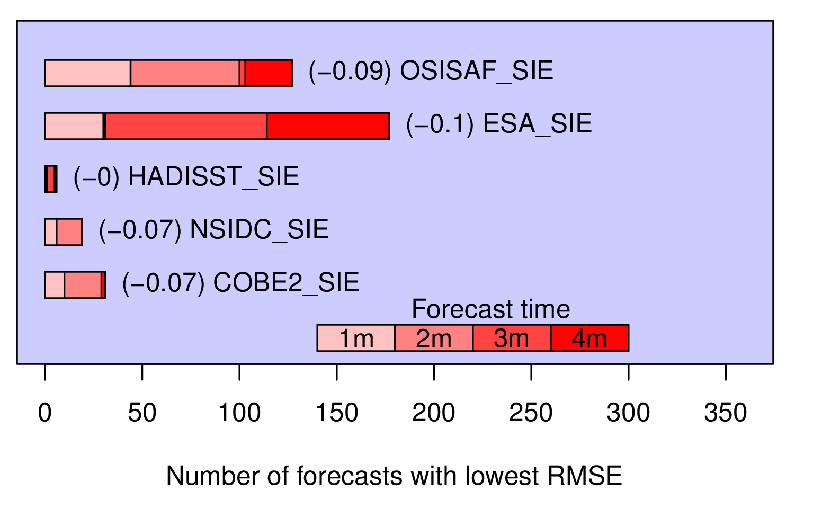
The test was repeated for another test case: sea ice
9 models x 10 members x 4 forecast times = 360 forecasts (ref. 1993-2008)
Initialization month: May
Without detrending
With detrending
OSI-SAF
OSI-SAF
ESA-CCI
ESA-CCI
HadISST
HadISST
NSIDC
NSIDC
COBE2
COBE2

Slide 23
Conclusions & Outlooks
Summary | Using three types of arguments (intuitive reasoning, idealized models, real forecasts) we find evidence that better observations increase forecast skill as we estimate it routinely in the community of seasonal forecasting.
Interpretation | These results are best understood if observations and models are considered at the same level (i.e., observations are not superior to models). Observational errors will systematically lower actual forecast skill, in the same way that model errors systematically lower forecast skill.
Recommendations | Models should not always be blamed for low performance. Observations can do this job easily! This overlooked source of error can give differences as large as differences from one model version to another. Modellers should be careful in picking their observational product, or at least use several of them.
Outlooks | Quantifying observational error propagation over time-averaged periods, space-averaged domains, is key to introduce observational uncertainty in current metrics of performance. Yet these error statistics depend on many unknowns, such as decorrelation time- and space-scales between grid-point, daily error statistics.

Slide 24
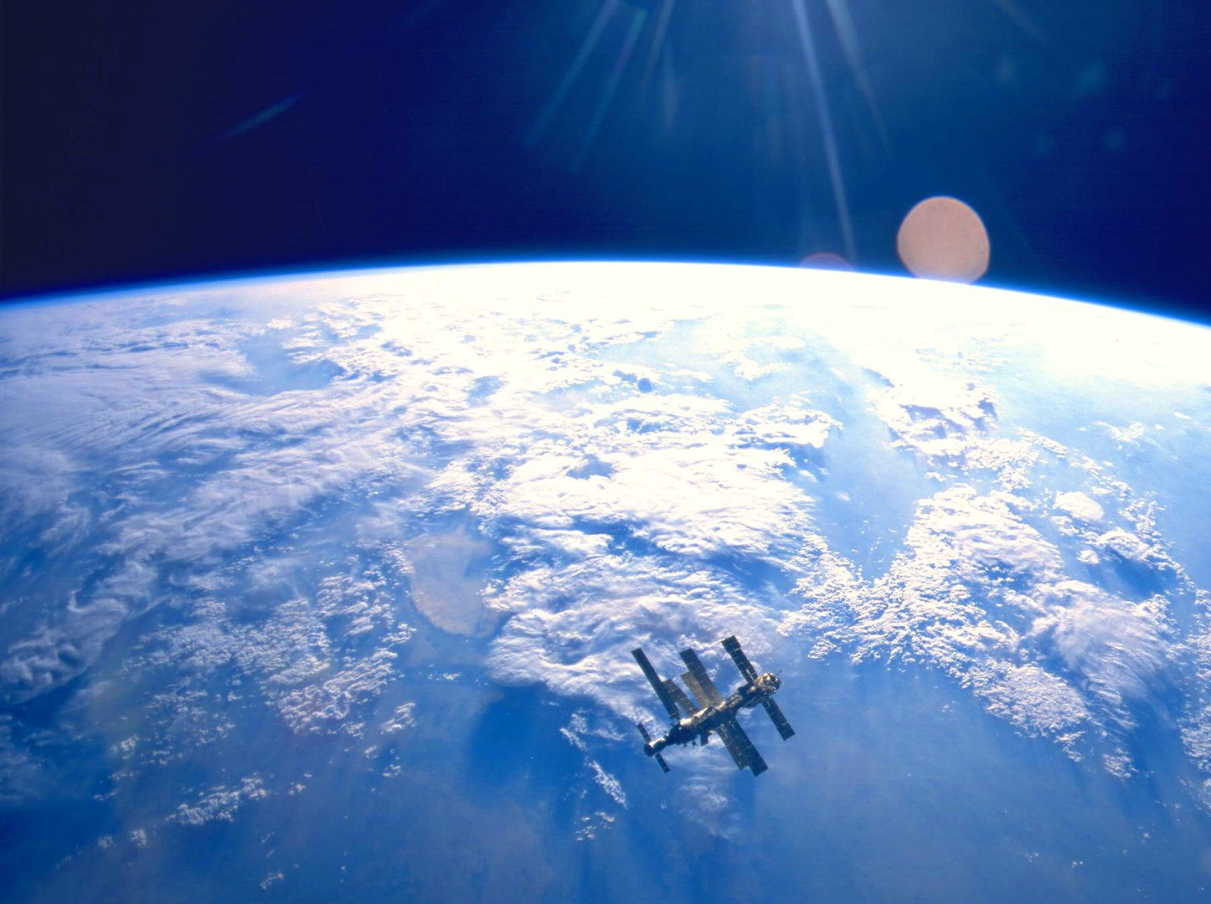
Thank you
francois.massonnet@bsc.es
@FMassonnet on Twitter
www.climate.be/u/fmasson
http://www.mrwallpaper.com/wallpapers/earth-space-orbit-satellite-1920x1080.jpg

Slide 25
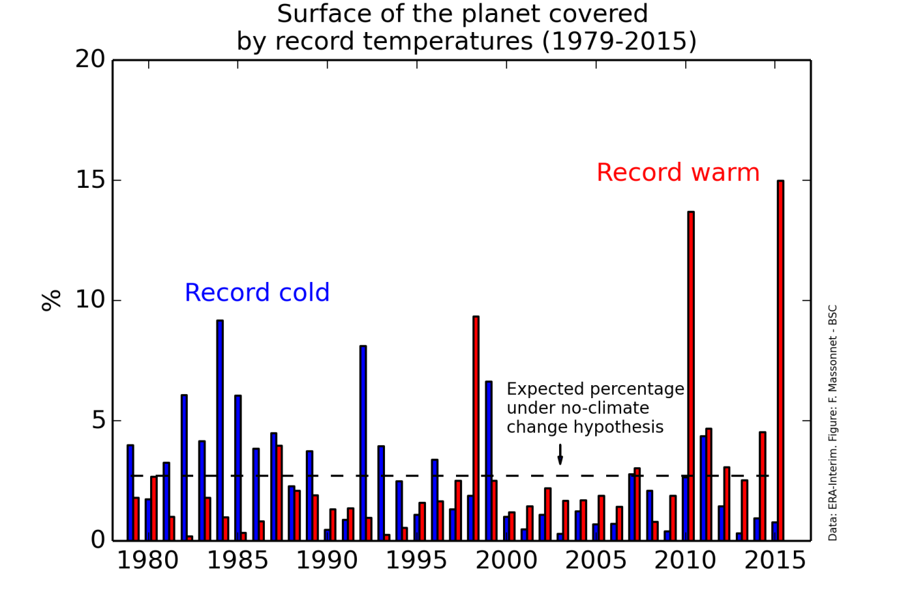
Our climate is changing rapidly
Notes:
- El Nino years

Slide 26
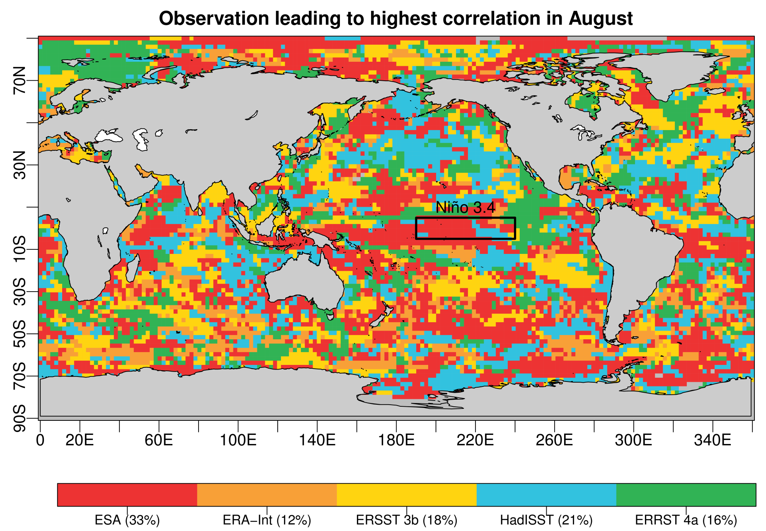

Slide 27
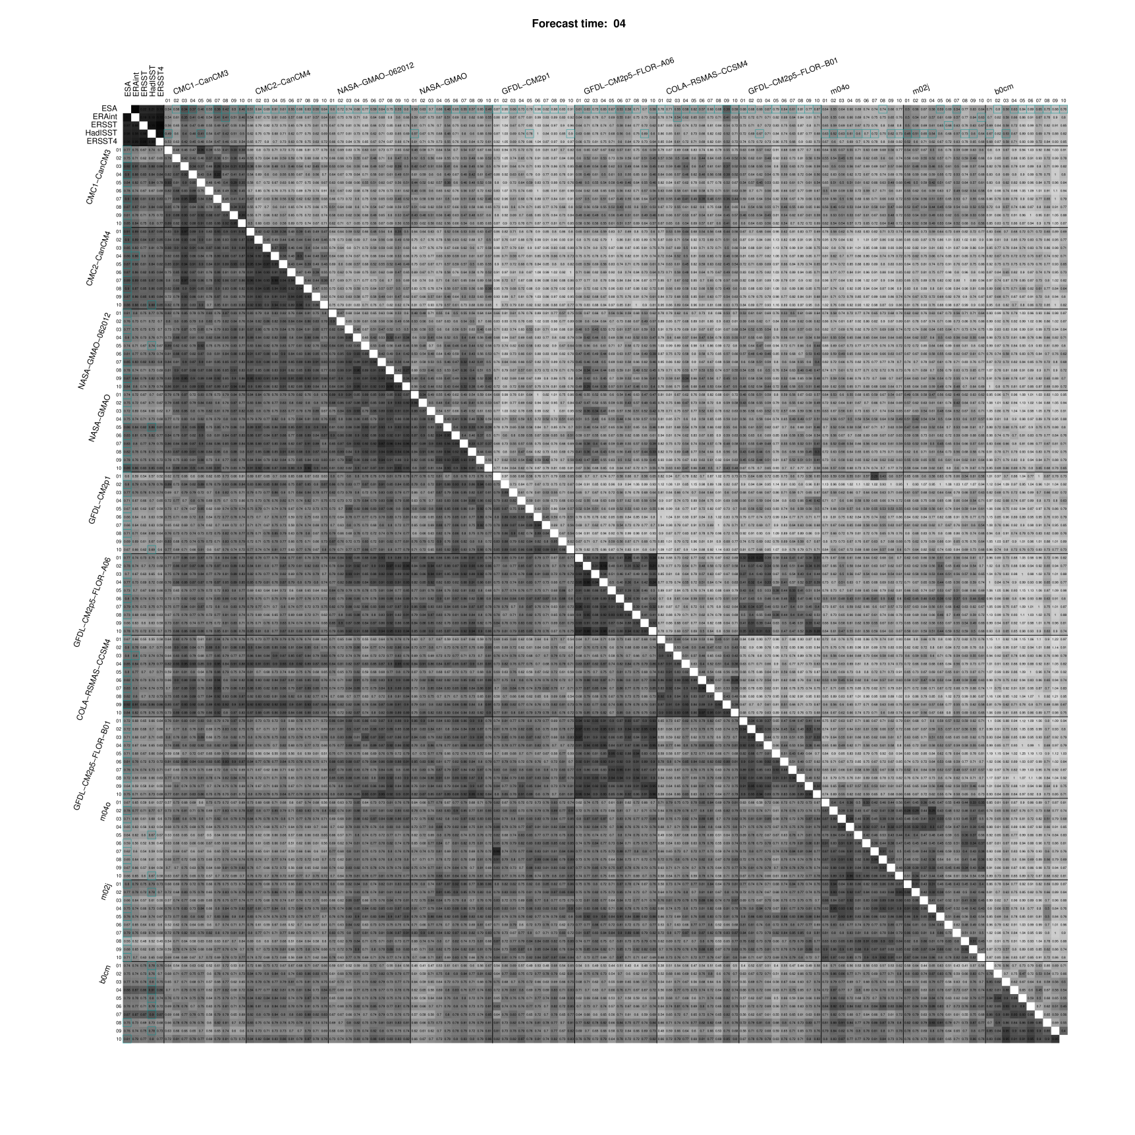

Slide 28
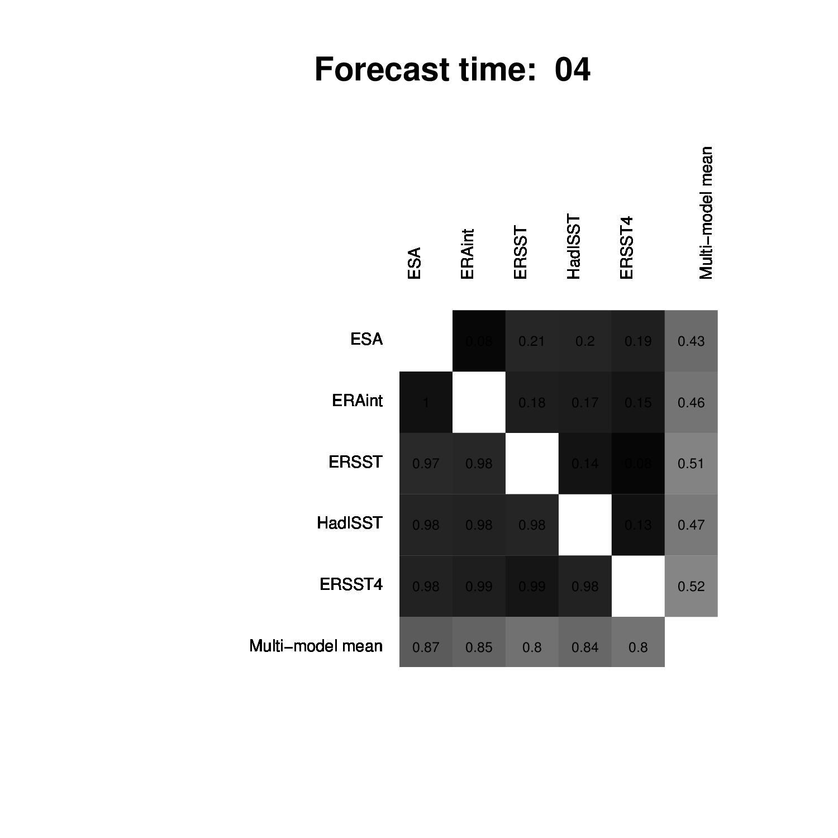

Slide 29
Same machine, same climate?
F. Massonnet
M. Asif, M. Acosta, O. Bellprat, E. Exarchou, J. García-Serrano, V. Guemas, M. Ménégoz, O. Mula-Valls, K. Serradell, F. J. Doblas-Reyes, X. Yepes
ECMWF
29th February 2016

Slide 30
Identifying sources of model error
Boundary conditions are wrong
Discretization errors
OBS
MOD
Initial conditions are wrong
Softwares / hardwares are wrong
Model physics is wrong
Notes:
The platforms, infrastructure and programs that we are using on a daily basis also have errors. There must be thousands of papers about these sources of uncertainty.
I found less than ten on this issue.
And because no one really knows how this error compares to these ones, or no one really wants to know, we decided at IC3 to the clear the air and address this problem following a systematic and controlled approach.

Slide 31
Software / harwdare is a multiple and underestimated source of model error
Round-off errors and floating-point representation
The order matters: associativity is no longer valid
$$(\sqrt{2}. π).e=\sqrt{2}.( π.e)$$
12.0771
≠
12.0777
Agressive optimization
Can degrade accuracy [Thomas et al. Wea. And Forecast., 2002]
Number of processors and their distribution
Processor topology defines order of operations [Thomas et al., Wea. And Forecast., 2002; Senoner et al., AIAA, 2008]
Compiler version
Different FORTRAN compilers can produce different outcomes [Lawrence et al., EOS, 1999]
Unpredictable hardware failures
[Düben and Palmer, Mon. Wea. Rev., 2014]
Notes:
And finally some aspects are just out of control: supercomputers are tired sometimes, too, and temporary faults can lead to number truncation.

Slide 32
Assessing climate-reproducibility is not straightforward
Three necessary conditions to validate ports of global atmospheric GCMs [Rosinski and Williamson, 1995]
1. During the first few time steps, difference between two runs should be much less than rounding error,
2. During the first few days, difference should not exceed error growth induced by bit-change on a machine,
3. The statistics of a long simulation must be unchanged.
Notes:
There were several conditions that were proposed to validate the porting of a climate model code, and I will focus on the third one

Slide 33
Machine 1
(Mare Nostrum, BSC)
Machine 2
(ECMWF)
Machine 3
(Ithaca, CFU)
Motherboard
Operating system
LINUX environment
Compilation flags
Identical
Identical
Identical
NetCDF, GRIB, HDF5 libraries
Different
Different
Different
# of processors
22+384+96
22+480+96
22+32+16
Autosubmit ensures identical configurations
Notes:
Focus on these two

Slide 34
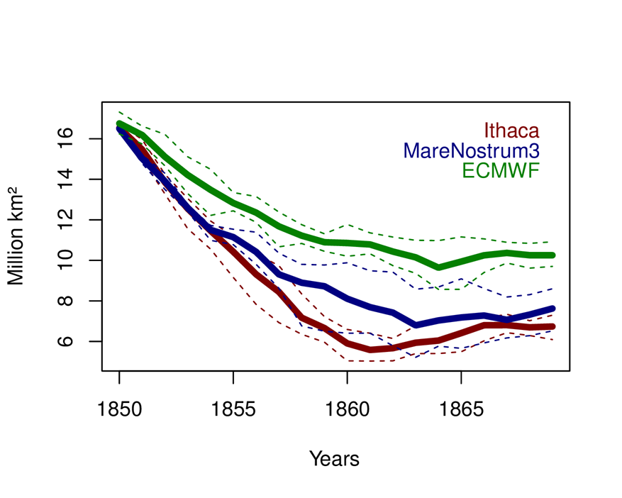
Initial results showed that hardware/software has an influence on the simulated climate
September Antarctic sea ice extent

Slide 35
Non-deterministic task in parallel applications
MPI reduction(+): order of summation depends on several external factors
Σ
A
B
C
D
E
F
G
H
8-cores MPI job

Slide 36
Model development has the following objectives
Accuracy
(be close to a reference)
Reproducibility
(be similar across configurations)
Performance
(use resources efficiently)
Compiler options let you control the tradeoffs between accuracy, reproducibility and performance
Notes:
It is NOT possible to achieve all three aspects at the same time. The developper has to choose which part he/she wants to favour
36

Slide 37
Topics to discuss
F. Massonnet
ECMWF
29th February 2016

Slide 38
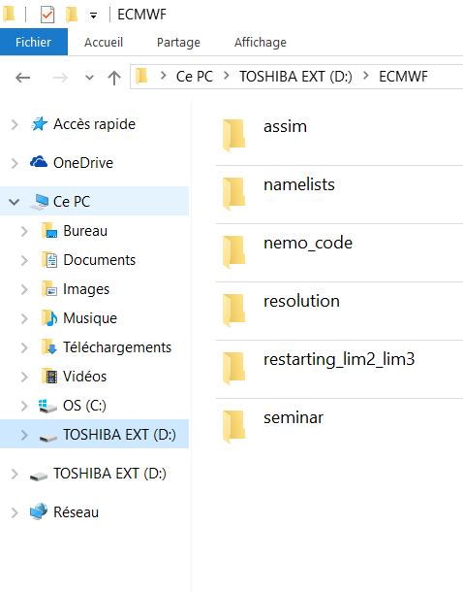
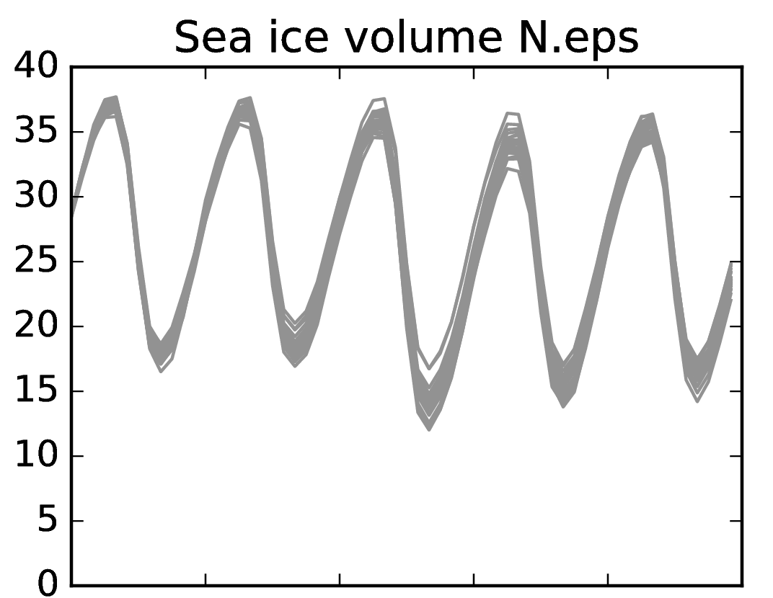
Topics to discuss
25-member ensemble ocean-sea ice simulation (1979-1982)
10³ km³
Perturbed atmospheric forcing
Ready for data assimilation? SMOS?
Ocean/ice covariances
…
NEMO3.6 / LIM3 / ORCA1
1979
1980
1981
1982
1983
1984

Slide 39
Topics to discuss
I have our NEMO3.6 namelists for three resolutions (ORCA2, 1, ¼°)
I also can point to relevant configuration files (bathymetry, runoff, initial conditions, etc.) to make sure we will be able to exchange restarts later on.

Slide 40
Topics to discuss
I have the NEMO code that was used to make the latest EC-Earth 3.2 simulationst at BSC.
We can discuss coupling strategy, although I’m not an expert in that.
I’m also happy to make tests regarding the importance of salinity in sea ice. Simulations can be launched from here and sensitivity experiments carried on.

Slide 41
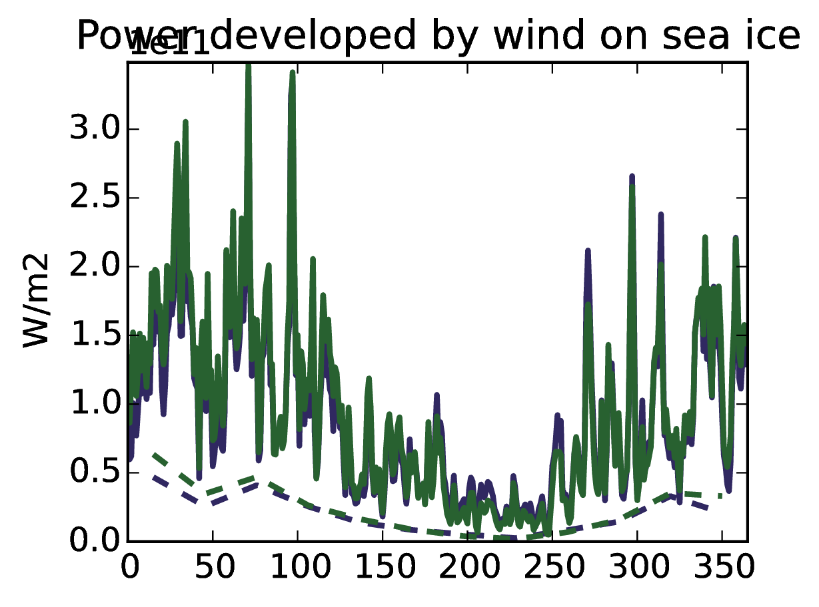
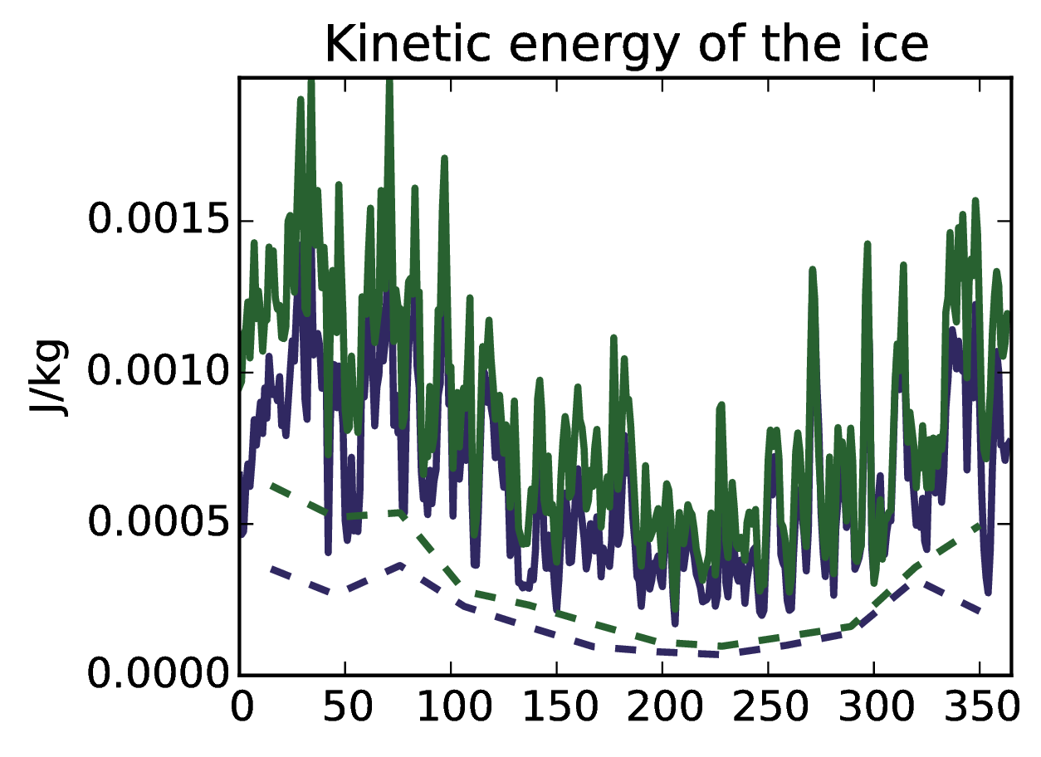
Topics to discuss
I have a set of three simulations at ORCA2, ORCA1, ORCA1/4°, and am happy to discuss how resolution can affect physics.

Slide 43
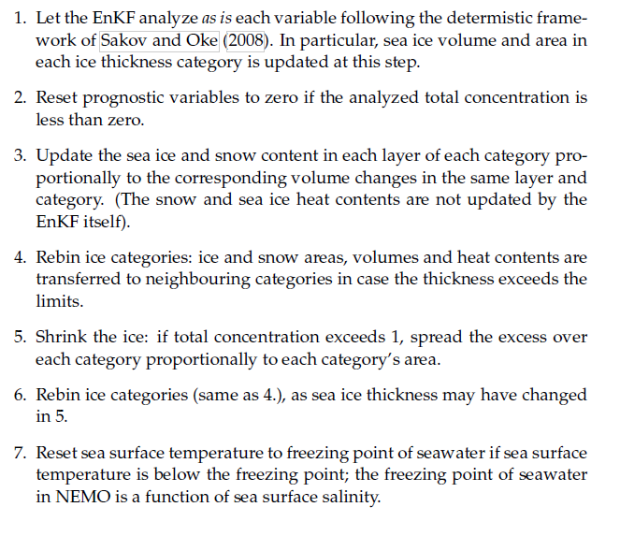
Topics to discuss
sanity_check.F90
sanity_check.py
From my PhD thesis

