Slide 1
Production and Use of Decadal Climate Predictions
F.J. Doblas-Reyes with many BSC and ASPECT Horizon Europe project colleagues
11 April 2025

Slide 2
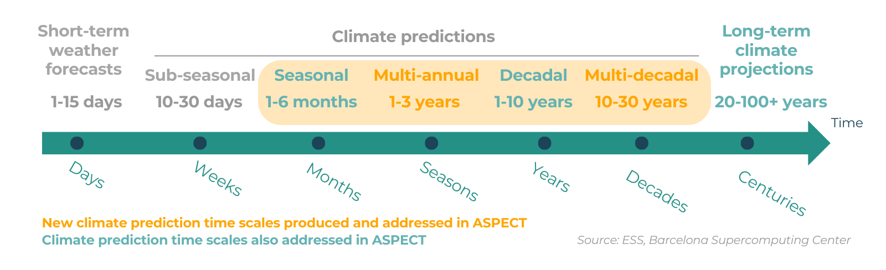
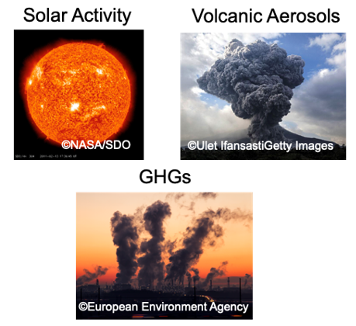
Time scales of interest
Initial-value driven
Forcing driven
MJO
ENSO
AMV
Climate change
Adapted from Meehl et al. (2009)

Slide 3
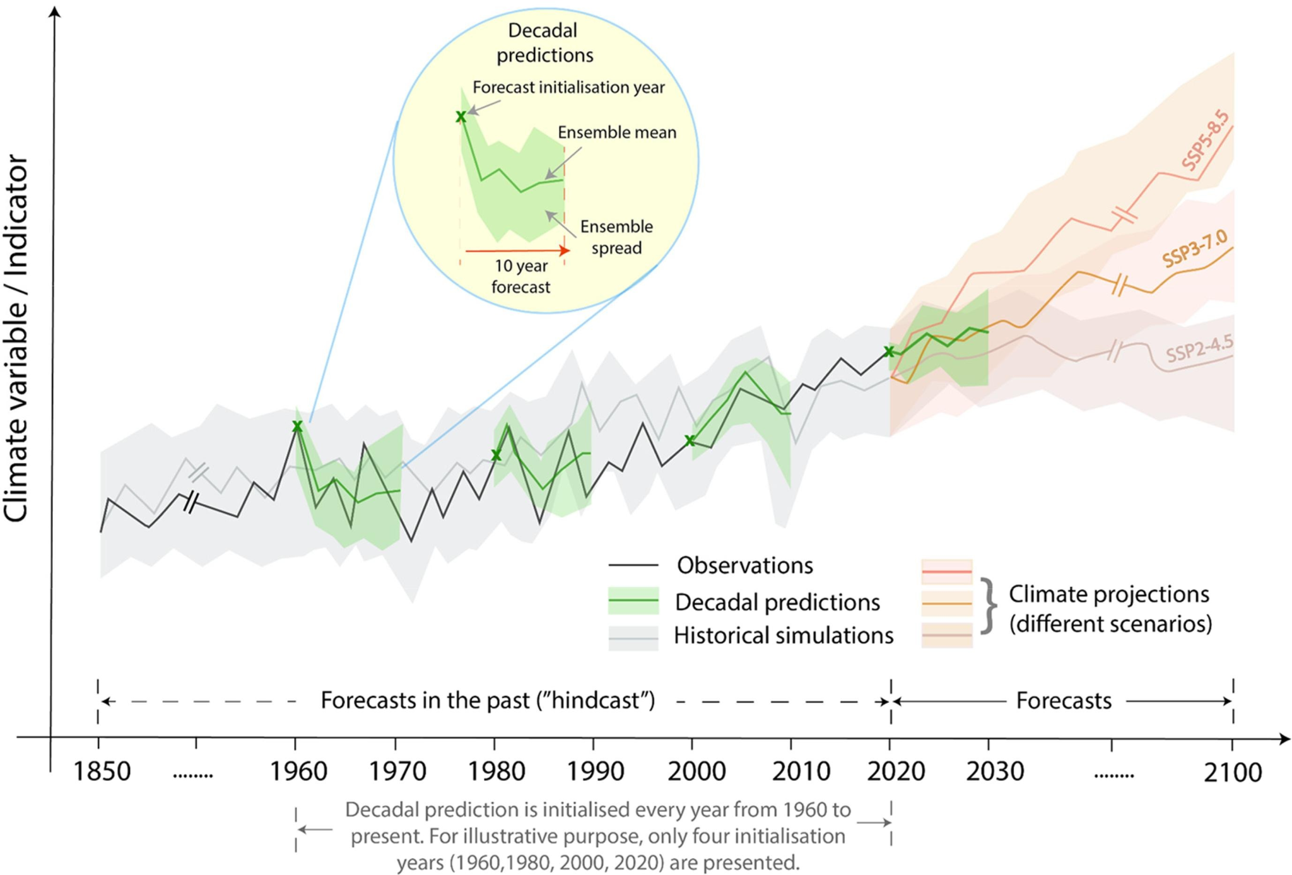
Decadal climate predictions
CMIP6 DCPP A+B (Boer et al., 2016):
Hindcast Period: 1960-present
Initialised: 1st November
Ensemble: 10 members
Forecast range: 10 years
Forcings: CMIP6 Hist up to 2024 + SSP245
3
HTESSEL
TL255L91
ORCA1L75
Full-field initialisation
ERA5
Ocean reconstruction forced with ERA5 fluxes, T and S restored at the surface towards ORA-S5 and nudged in the subsurface towards EN4 and nudged
Solaraju-Murali (2022)

Slide 4
Decadal climate predictions
BSC decadal forecasts:
The system skilfully simulates the regional features of past surface temperature variations.
Initialisation improves the information quality (wrt what climate projections would provide) in the tropical Pacific and North Atlantic areas.
The central subpolar North Atlantic suffers from initialisation shock and related drift.
Ensemble-mean correlation for the annual near-surface temperature
Evolution of the AMOC at 45°N
(Bilbao et al., 2021)

Slide 5
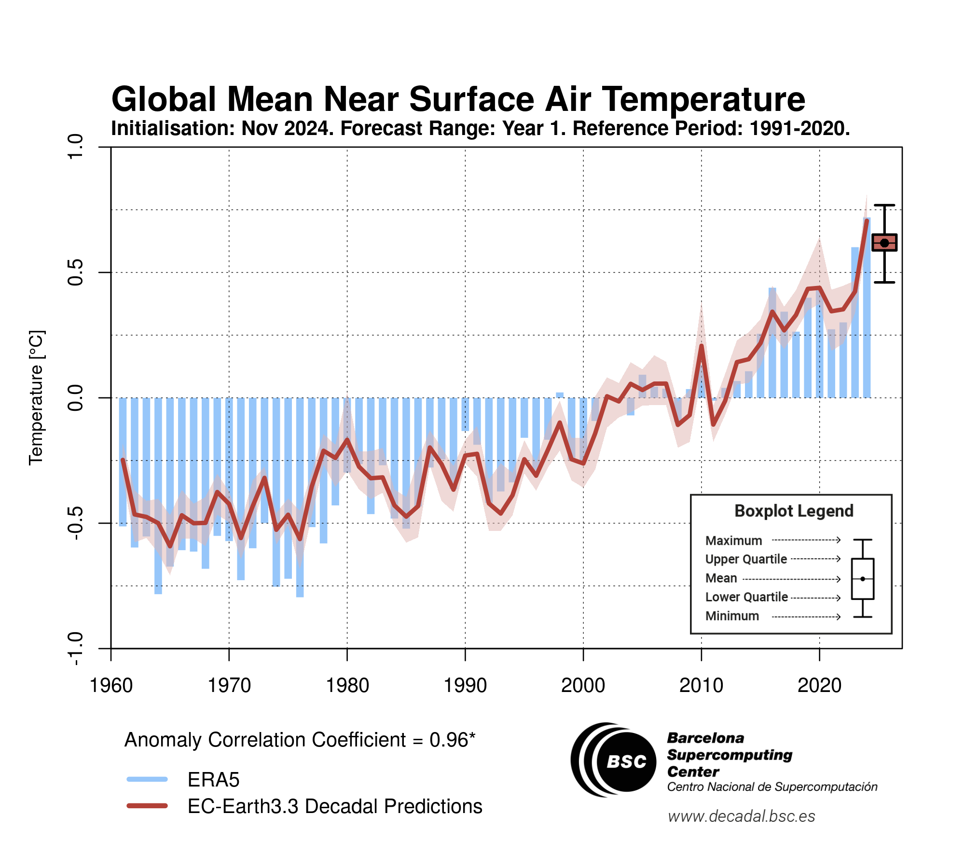
Decadal climate predictions: real time
https://hadleyserver.metoffice.gov.uk/wmolc/

Slide 6
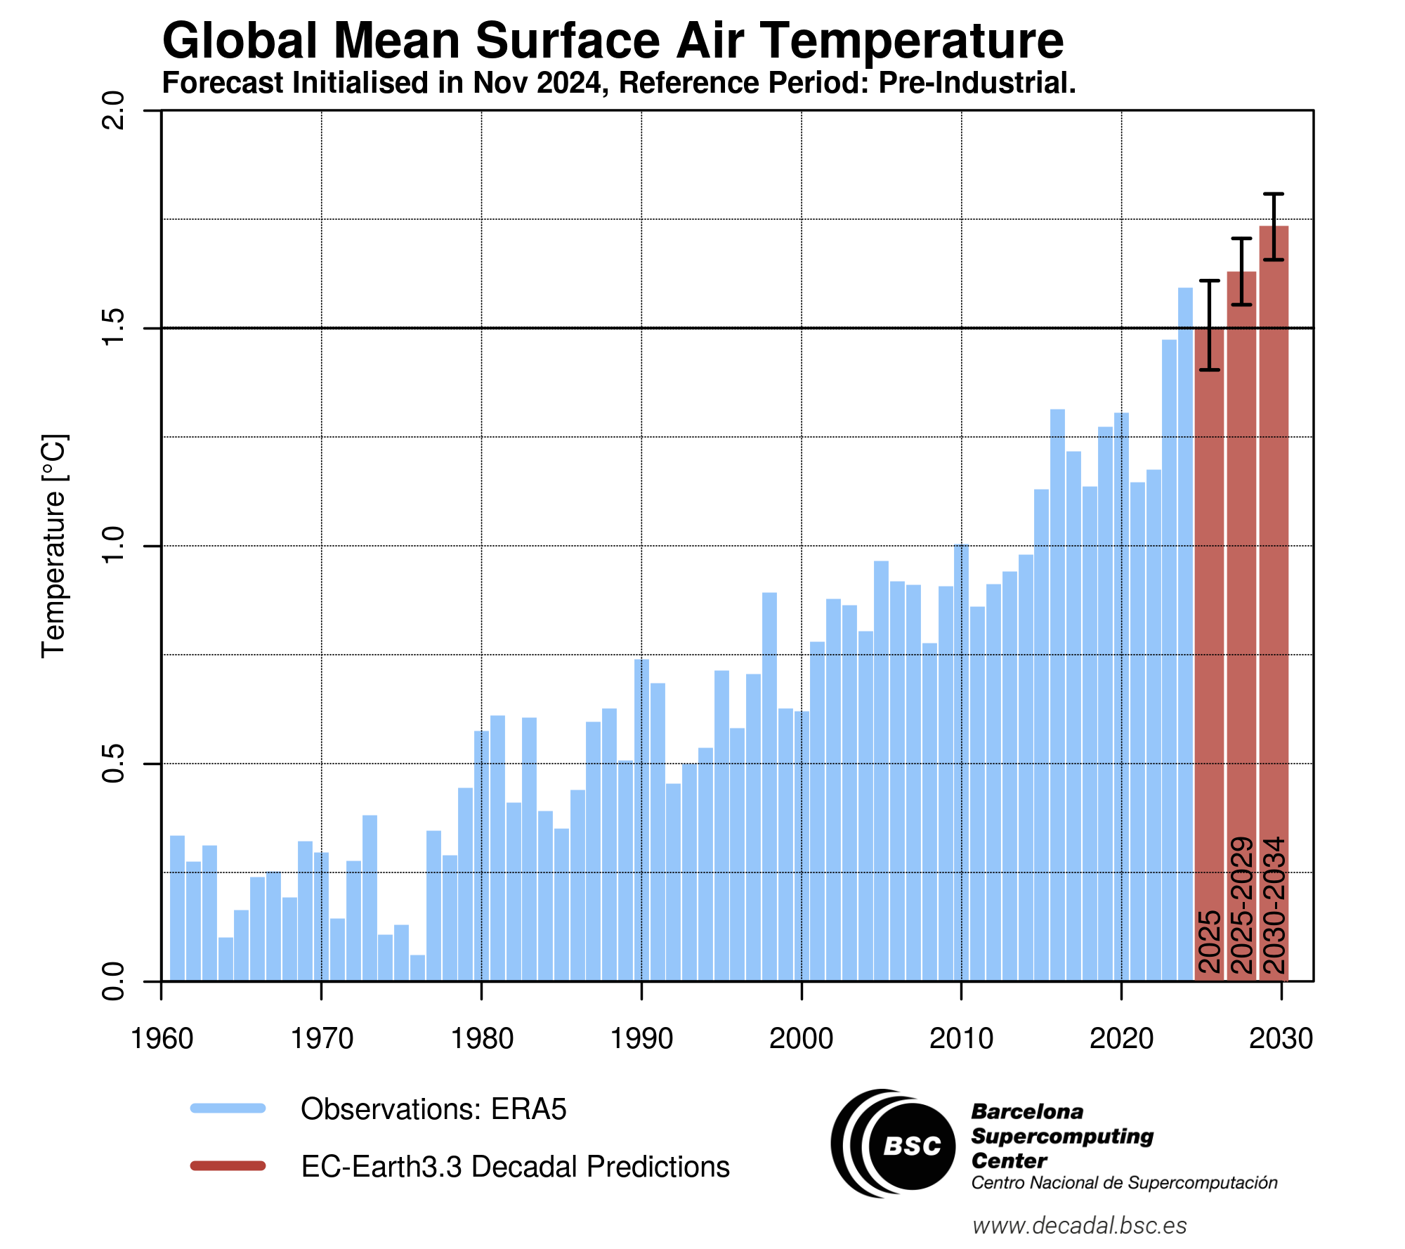
Decadal climate predictions: real time

Slide 7
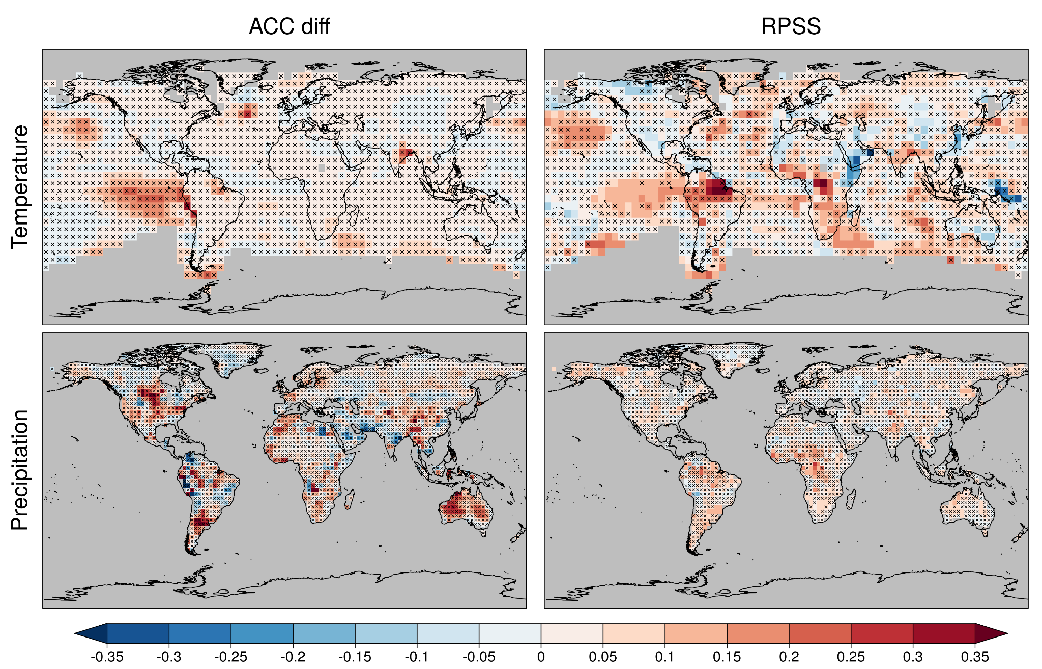
System design in decadal prediction
Systematic assessment of the multi-model decadal prediction forecast quality helps illustrating, among other things, the importance of a large enough operational multi-model.
Comparison between a research (DCPP, 169 members, 13 forecast systems) and an operational (C3S_34c, 40 members, 4 forecast systems, CMCC-CM2-SR5, EC-Earth3-i1, HadGEM3-GC3.1-MM and MPI-ESM1.2-HR)
DCPP worse than European multi-model ← | →DCPP better than European multi-model
Delgado-Torres et al. (2022)

Slide 8
Decadal climate predictions: carbon cycle
Predictions with EC-Earth3-CC simulate the carbon cycle interactively: includes LPJ-GUESS (vegetation), TM5 (atmospheric chemistry) and PISCES (ocean biogeochemistry).
The ocean and land carbon sinks determine the atmospheric CO2 concentration.
Ocean CO2 flux has high predictive skill, while for the land CO2 flux it is limited to 2 years.
Limited skill of land and ocean carbon dioxide sinks linked to biases in physical climate.
Contribution to Global Carbon Budget 2024.
(Etienne Tourigny)

Slide 9
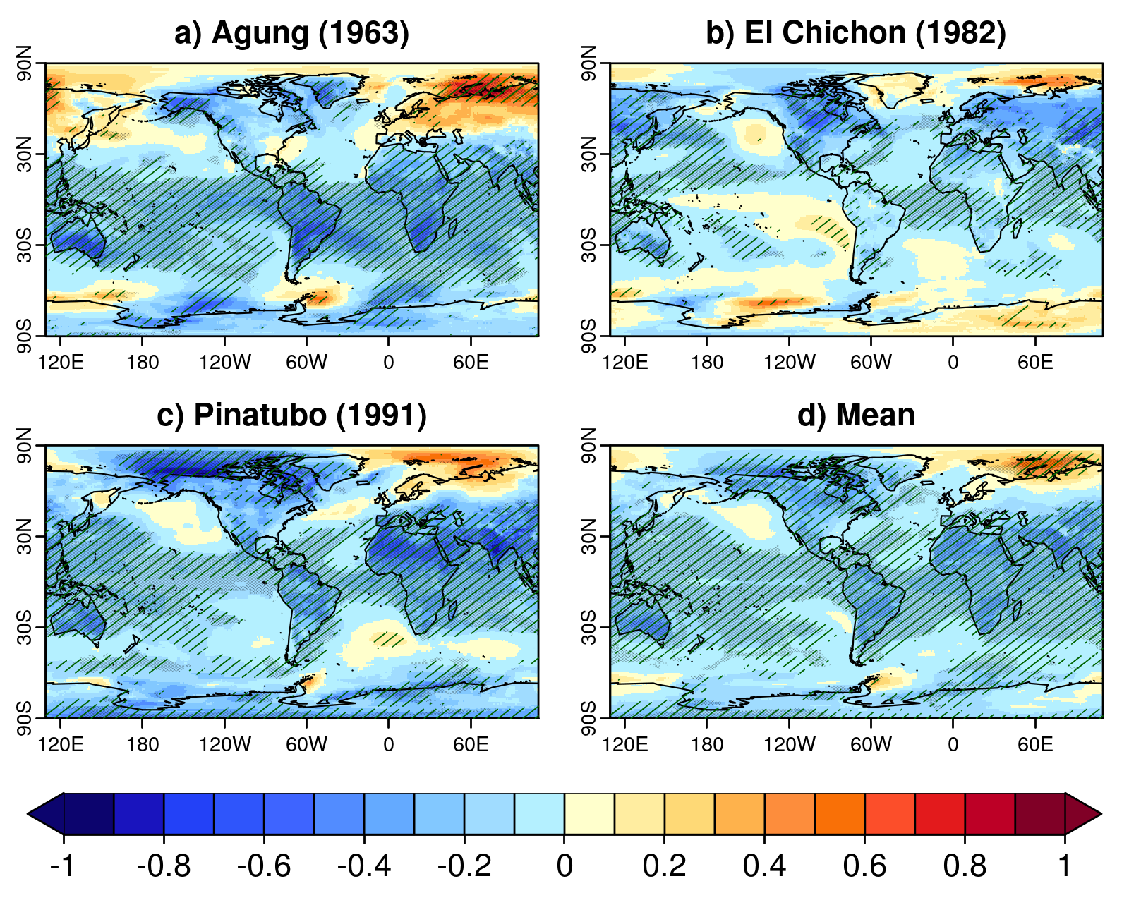
Decadal climate predictions: volcanic forcing
Real-time systems require a solution after an explosive volcanic eruption has taken place:
Six decadal prediction systems show strong agreement in post-volcanic radiative effects.
Dynamical responses (NAO, ENSO, AMOC…) are both model- and eruption-dependent.
A solution has been developed by the community (EVA).
Ensemble-mean near-surface air temperature difference volcanoes-no volcano
Global-mean near-surface temperature anomalies of multi-model predictions initialised in 1990
(Bilbao et al., 2024)

Slide 10
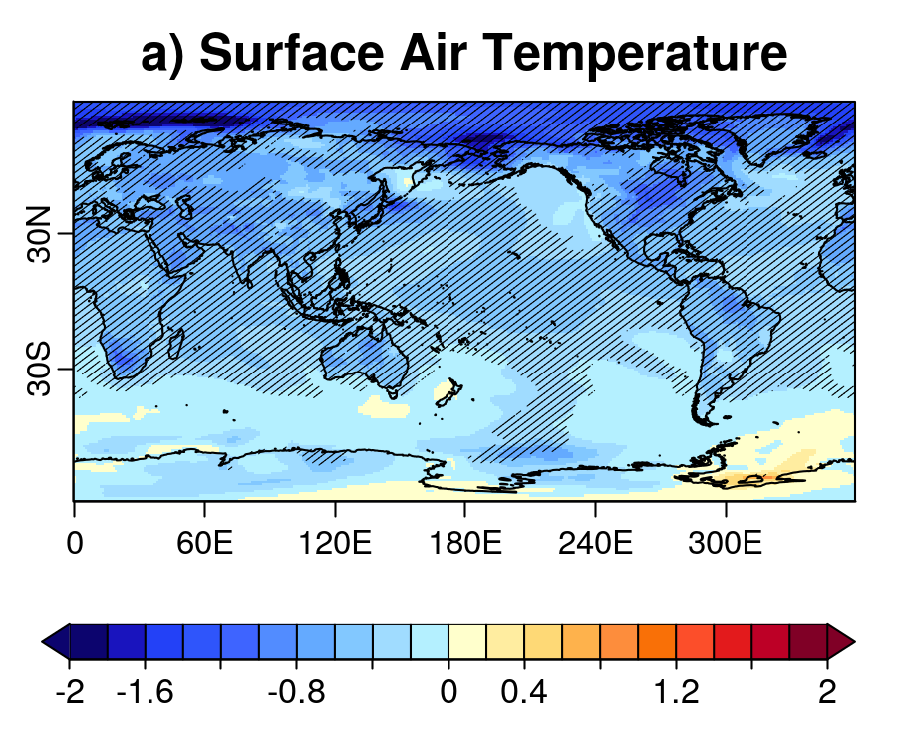
Decadal climate predictions: volcanic forcing
Explosive volcanoes are not included in the climate projections and predictions but create signatures that could last from years to decades.
Results from the Decadal Prediction Volcanic Response Readiness Exercise (VolRes-RE).
A 2xEl Chichón eruption is set in April 2022 for the EC-Earth3 decadal forecast started in late 2021 and the difference with respect to DCPP-A made.
TAS YR2-5
ºC
Bilbao et al. (2024)

Slide 11
Decadal climate predictions: volcanic forcing
Real-time systems require a solution after an explosive volcanic eruption has taken place:
Comparison of the volcanic forcings generated with EVA and EVA_H for Agung, El Chichón, and Pinatubo.
EVA and EVA_H forcings can be reasonable choices for predicting the post-volcanic radiative and thermal effects.
TOA
Near-surface air temperature
Stratospheric temperature
(Sospedra-Alfonso et al., 2024)

Slide 12
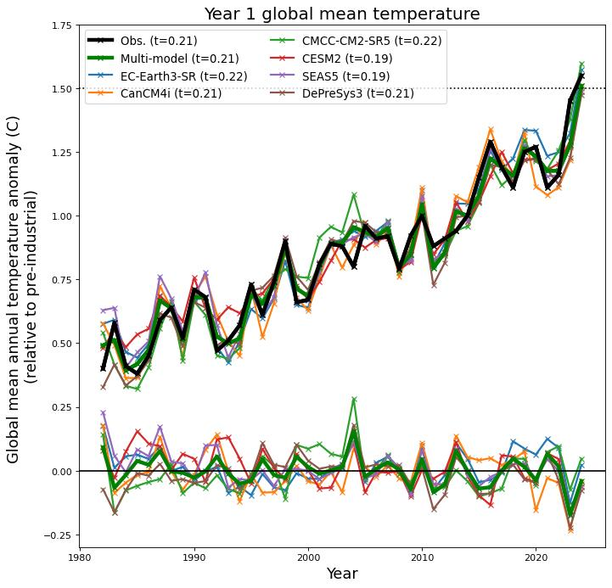
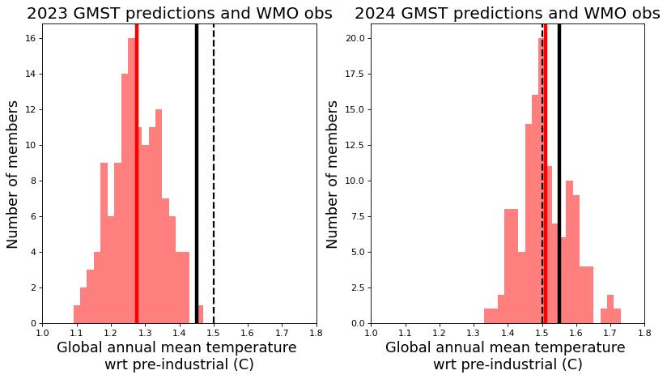
Decadal climate predictions: 2023
2023 was an exceptional year in terms of global-mean temperature. Multiannual and decadal prediction systems failed to predict the extraordinary anomaly.
Global-mean, annual-mean near-surface temperature anomalies (forecast year 1)
Global-mean, annual-mean near-surface temperature
2023 was the largest near miss in ~43 years of hindcasts, only 1 member (from 125) exceeded the observations; 2024 was well predicted with anomalies >1.5 K.
(Nick Dunstone, Met Office)

Slide 13
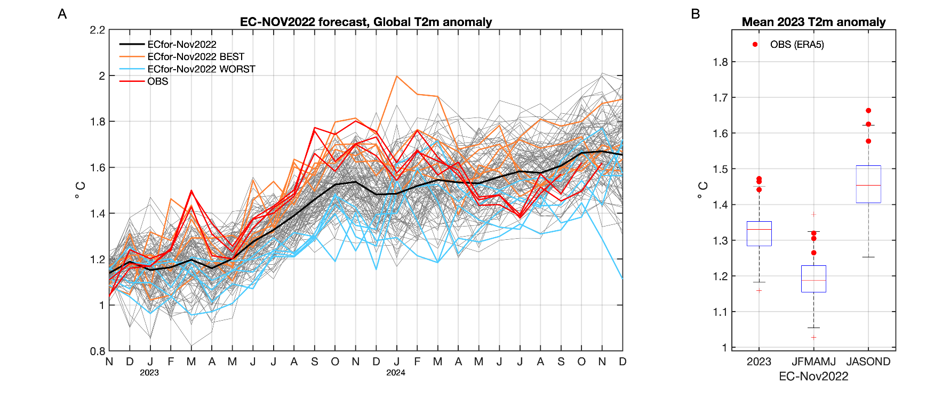
Decadal climate predictions: 2023
Record warmth in 2023 resulted from ENSO and Northern Hemisphere shortwave anomalies:
100-member ensemble started in Nov 2022: 70% of the 2023 warming was predictable.
Forecast accuracy depends on forecasting a strong El Niño in 2023 and anomalously high absorbed shortwave radiation in the Northern Hemisphere during spring and summer 2023.
2023 annual-mean near-surface temperature anomalies
Global-mean near-surface air temperature
(Blanchard-Wrigglesworth et al., submitted)

Slide 14
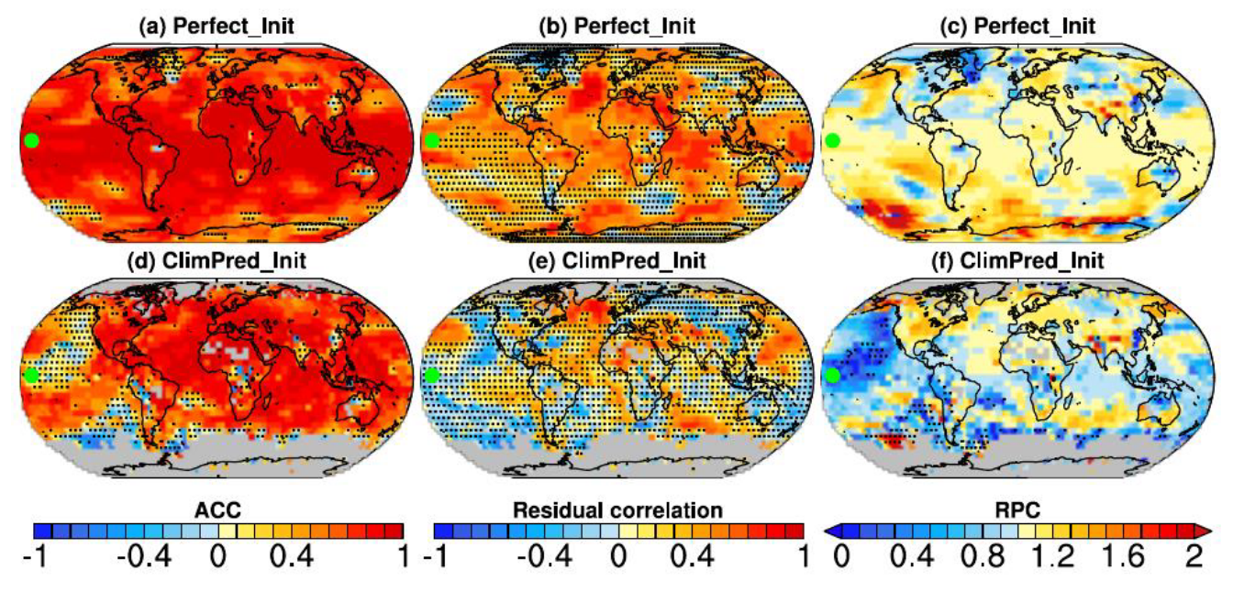
Decadal climate predictions: signal-to-noise paradox cycle
Perfect-model decadal predictions (i.e., ensemble initialised every year over 1960-2005 from a continuous historical simulation) with EC-Earth3 are also affected by the signal-to-noise paradox measured by the RPC = sqrt(r²_{(em,o)}/r²_{(em,m)})>1. And this is counterintuitive.
Metrics for the perfect-model 10-member hindcasts for near-surface air temperature (forecast period 2-9)
Metrics for the DCPP-A 10-member hindcasts for near-surface air temperature (forecast period 2-9)
(Mahmood et al., 2025)

Slide 15
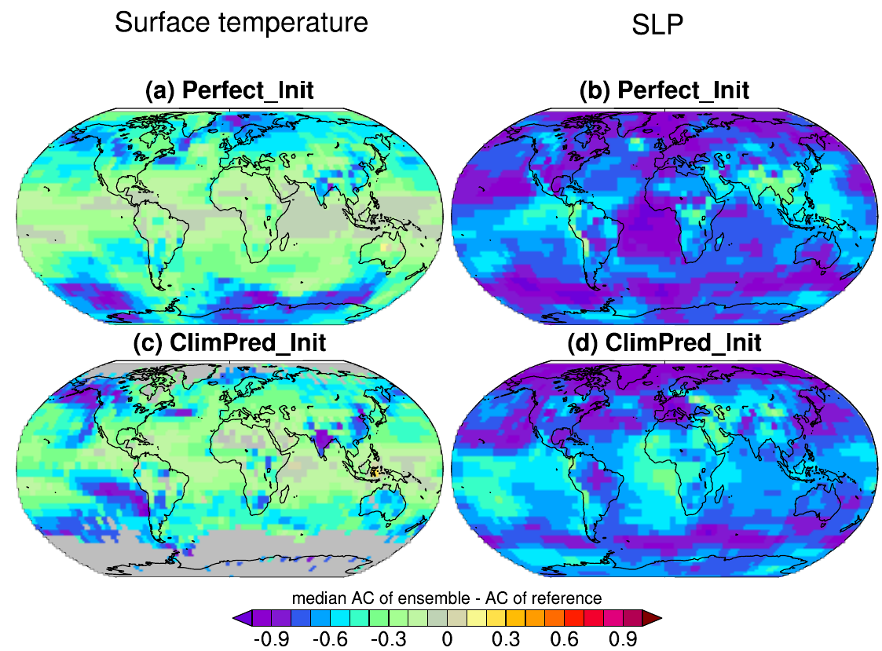
Decadal climate predictions: signal-to-noise paradox cycle
Coincidentally, difference in lag-1 autocorrelation between the ensemble members and the reference (observation in DCPP-A and continuous historical simulation in the perfect-model predictions) is always negative, which affects the nature of r²_{(em,o)} and r²_{(em,m)}.
Metrics for the perfect-model 10-member hindcasts for near-surface air temperature (forecast period 2-9)
Metrics for the DCPP-A 10-member hindcasts for near-surface air temperature (forecast period 2-9)
(Mahmood et al., 2025)

Slide 16
Decadal climate predictions: signal-to-noise paradox cycle
Coincidentally, difference in lag-1 autocorrelation between the ensemble members and the reference (observation in DCPP-A and continuous historical simulation in the perfect-model predictions) is always negative, which affects the nature of r²_{(em,o)} and r²_{(em,m)}.
r²_{(em,m)}
Results for near-surface air temperature
r(1)_{(em)}-r(1)_{(o)}
(Mahmood et al., 2025)

Slide 17
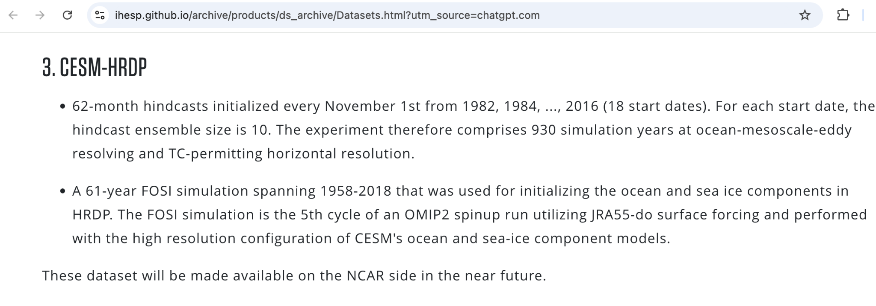
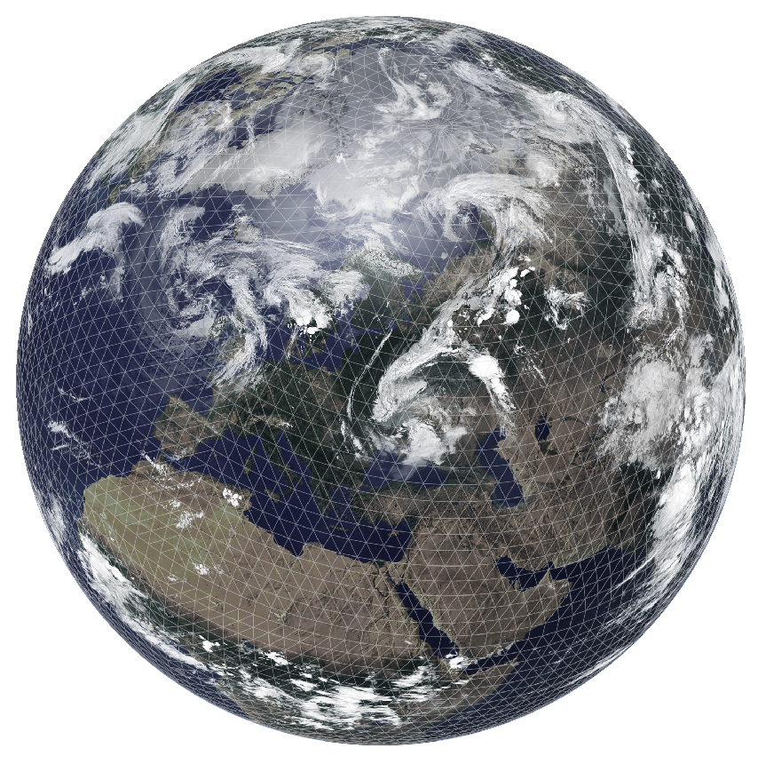
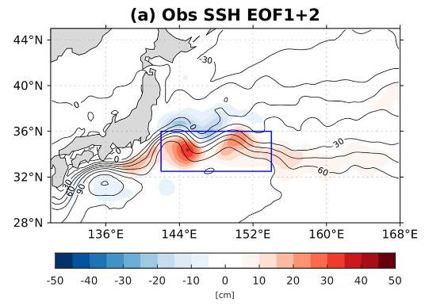
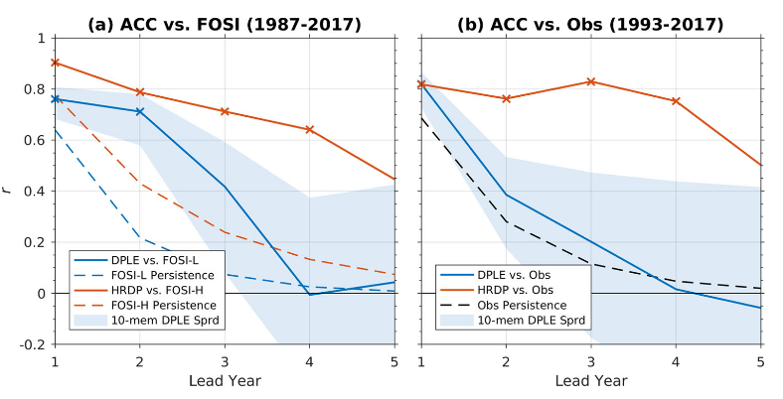
Eddy-resolving decadal climate predictions
PREDDYCT will use IFS-NEMO to conduct global scale predictions at 10-km resolution to investigate the role of mesoscale eddies and their interactions on the predictability of the climate of the North Atlantic region from seasonal to multiannual timescales
CESM-HRDP shows great skill in the Kuroshio Extension up to 4 yrs ahead, much higher than for CESM-DPLE (Kim et al., 2023)
IFS
NEMO
PREDDYCT
(Pablo Ortega)

Slide 18
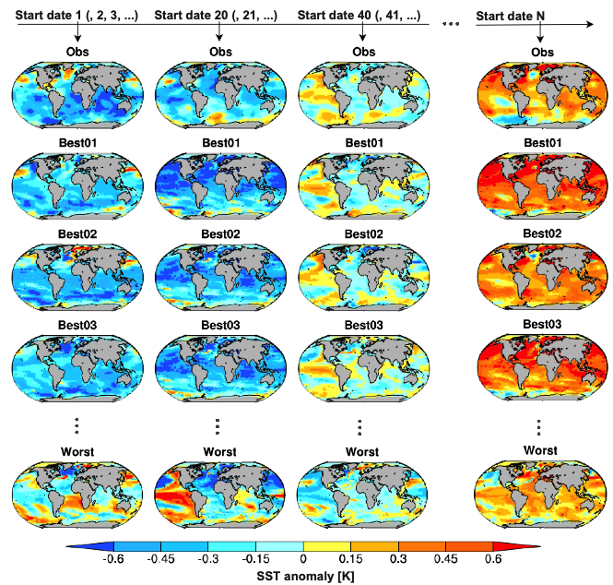
Decadal predictions by constraining projections
Constraining projections based on their agreement with global SST anomaly patterns from observations (‘poor-man initialisation’);
212 member simulations from 32 models.
(un-initialized) projections
Mahmood et al. (2021), Mahmood et al. (2022)

Slide 19
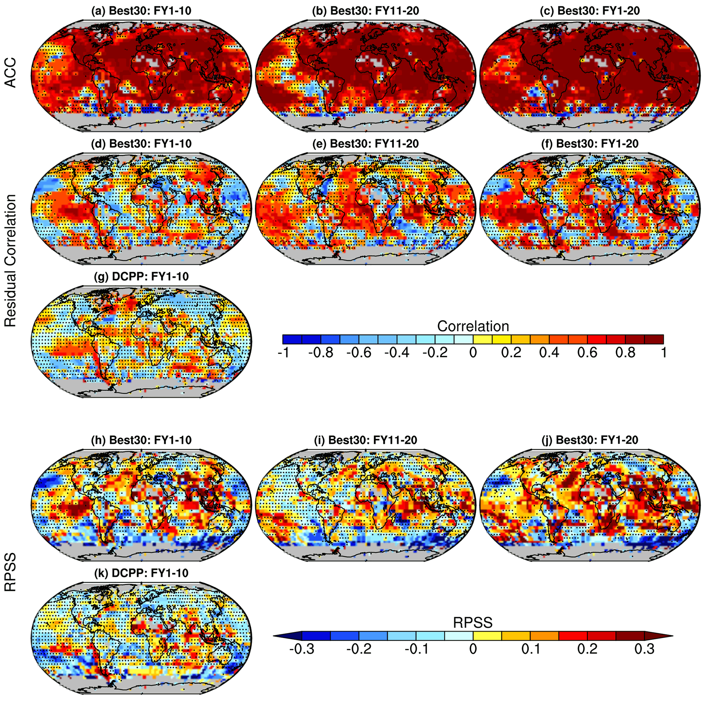
Decadal predictions by constraining projections
Ensemble-mean correlation (top row) and residual correlation of 10 and 20-year predictions for near-surface temperature anomalies with nine-year global SST selection and 30 best members
Mahmood et al. (2021), Mahmood et al. (2022)

Slide 20
Decadal predictions by constraining projections
RPSS (tercile categories) of 10 and 20-year predictions for near-surface temperature anomalies with nine-year global SST selection and 30 best members
Mahmood et al. (2021), Mahmood et al. (2022)

Slide 21
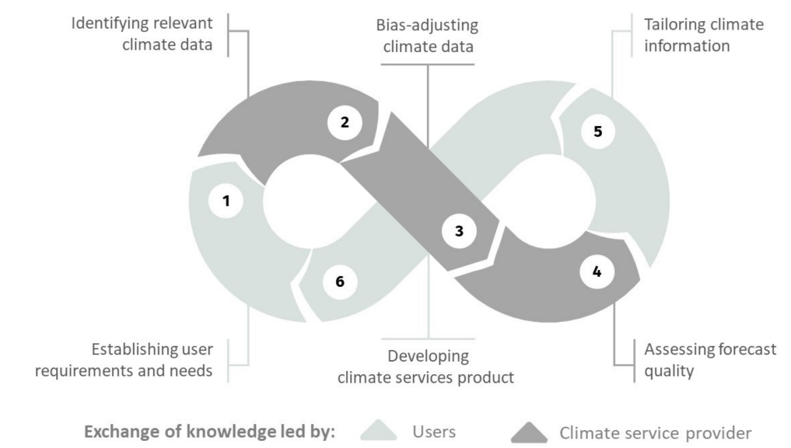
Climate services: Making data and knowledge useful
Climate services consist in the provision of climate information to support decision-making in context. The service component involves appropriate engagement and co-production approach, an effective delivery mechanism, an evaluation system, and the recognition of a variety of knowledge systems.
Bala Solaraju-Murali

Slide 22
Working with the user
The calibration does not work as expected!
Let’s see the 2023 global temperature anomalies!!
Narratives
Forecast postprocess
Visualisation
Assessment
Drivers
Building stories with meaning tailored to specific decisions
Data processing
Downscaling,
calibration,
constraints,
...
Data manipulation
Spatial visualisation of probabilities, interactive tools,
...
Metrics,
multivariate verification, process-based assessment,
...
EOF,
teleconnections,
weather regimes, clustering,
...
Climatology,
anomalies,
smoothing,
...
Reading,
reordering,
restructure,
regridding,
...
Núria Pérez-Zanón

Slide 23
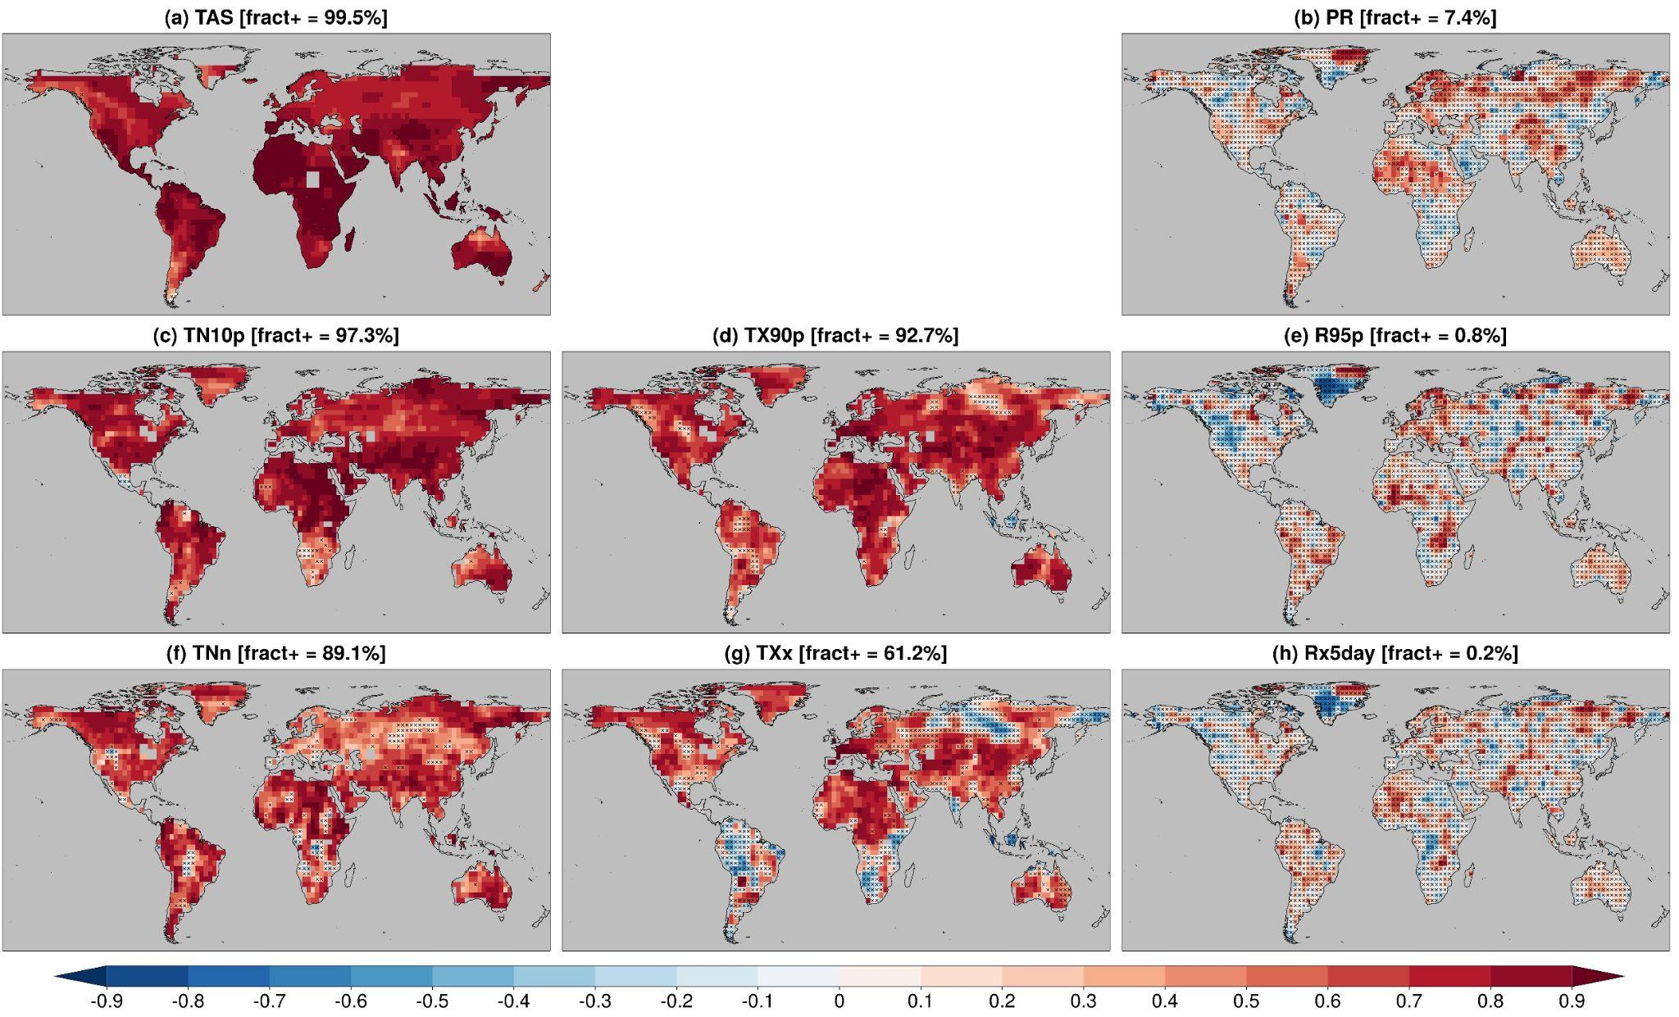
Univariate extreme indicators
High skill for mean and extreme temperature, lower skill for mean and extreme precipitation, limited to some regions.
Generally higher skill for mean variables than for extreme indices.
Spearman correlation of the DCPP multi-model ensemble mean for predictions of mean temperature and precipitation, and indices of the frequency of daily temperature and precipitation extreme events for the forecast years 1-5
Delgado-Torres et al. (2023)

Slide 24
Hot-dry compound extremes
Hot days as days above the 90th percentile of daily maximum temperature.
Dry days as days falling in a month with SPI/SPEI <=-1.
Compound hot-dry extreme events show significant skill in the 2-5 years range. Most skill is linked to the trend.
Spearman correlation for compound extreme indices (top) and added skill from initialisation measured with the residual correlation (bottom) for DCPP predictions and forecast years 2-5
Aranyossy et al. (submitted)

Slide 25
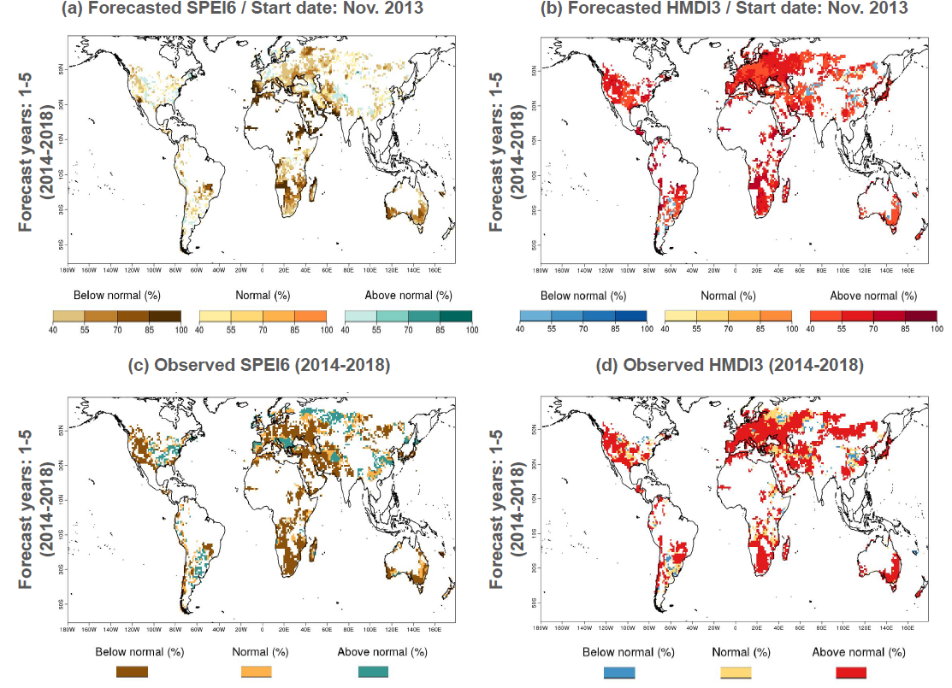
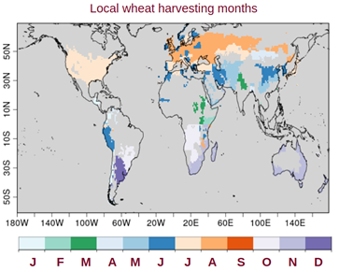
Product for food security
JRC is interested in multiyear predictions of global crop-related indicators.
The standardised precipitation-evaporation index (SPEI6) and heat magnitude day index (HMDI3) indicators were computed from the decadal prediction multi-model ensemble.
Multi-year probabilistic calibrated forecast (a, b) and observed (c, d) most likely tercile category of SPEI6 (left) and HMDI3 (right) for 2014–2018 over the wheat-harvesting areas with positive skill
Solaraju-Murali et al. (2022)

Slide 26
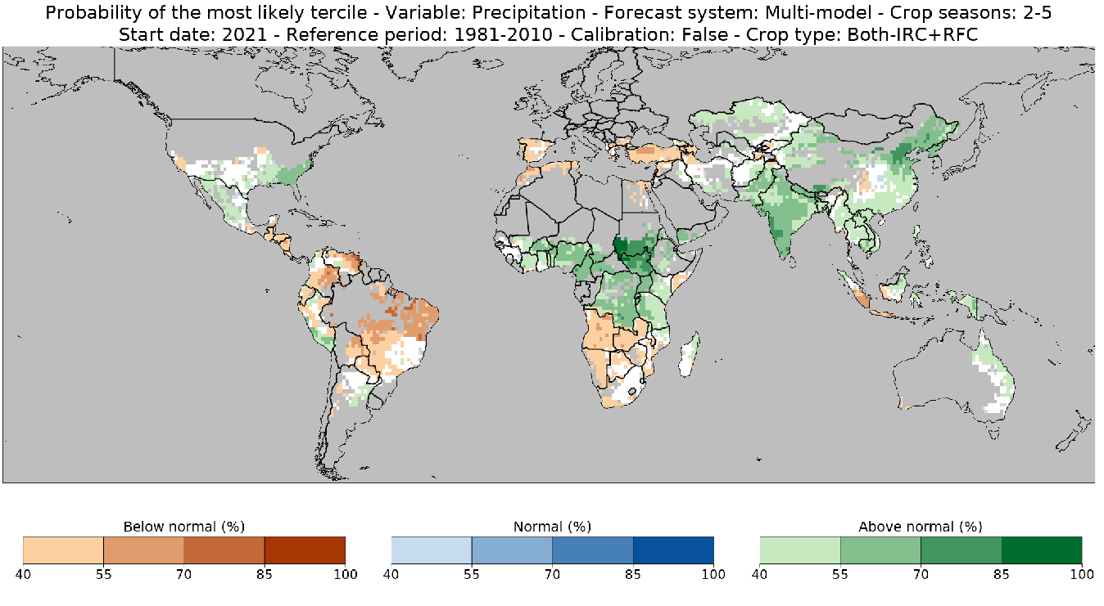
Product for cotton producers
Multi-model precipitation forecast targeting cotton production
Beginning and end month of relevant precipitation information for cotton production
Carlos Delgado-Torres

Slide 27
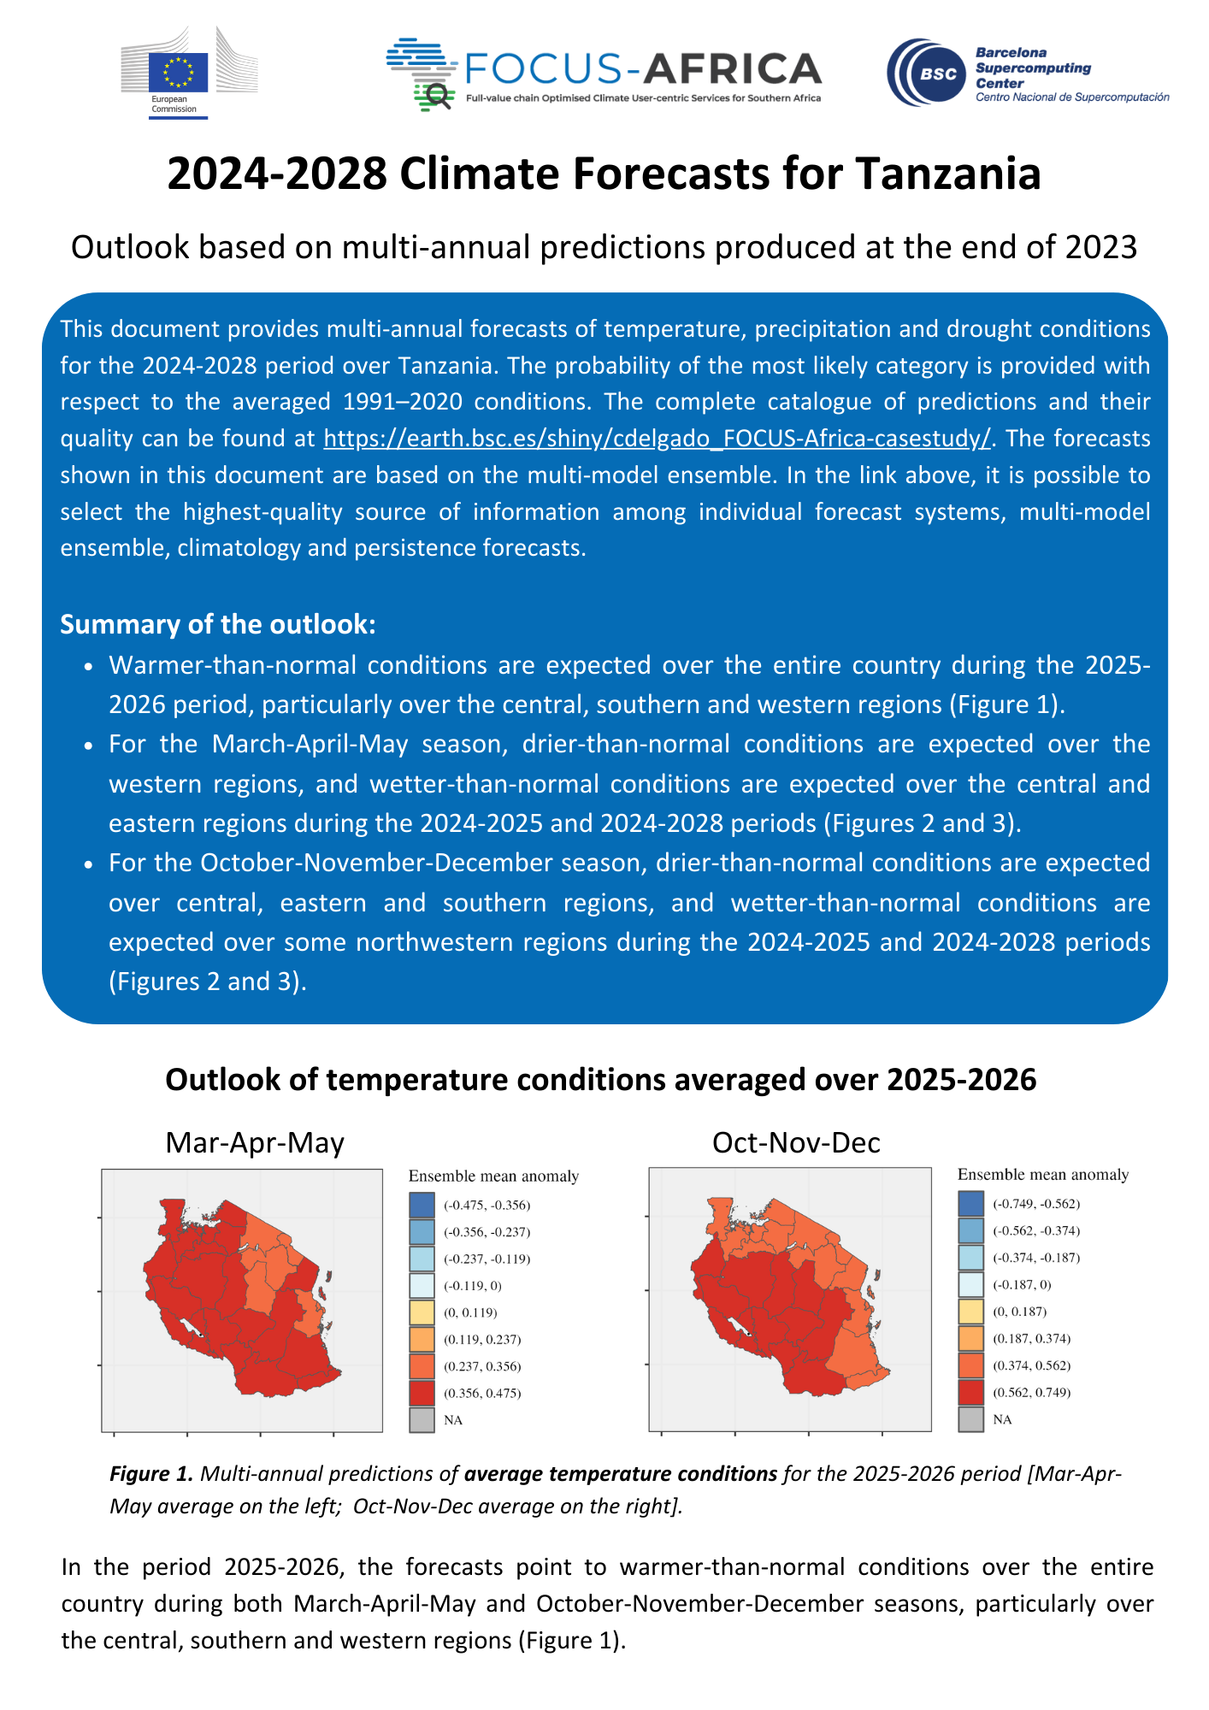
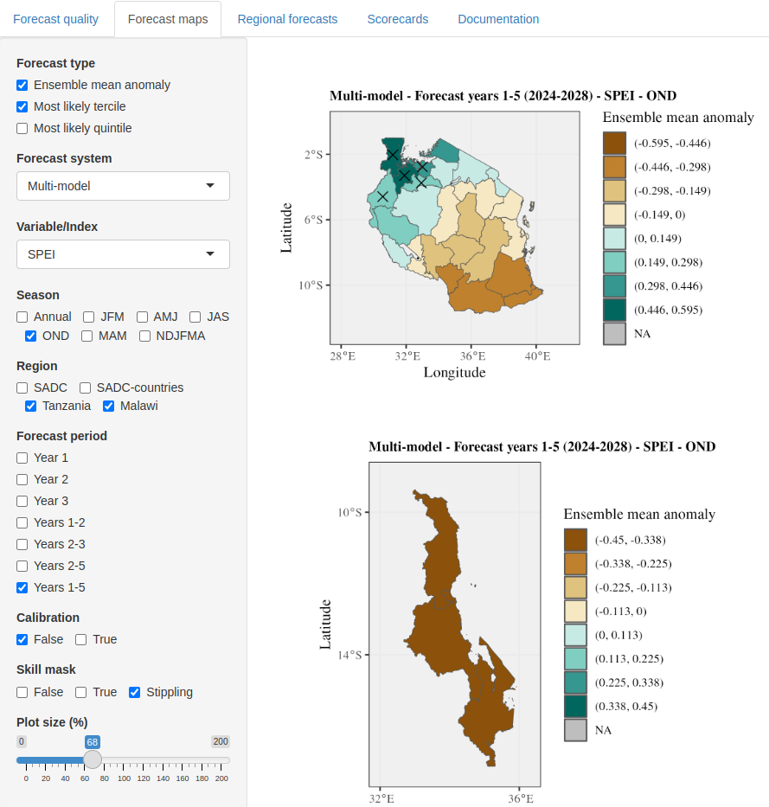
Products for regional farming
Climate information co-developed with local organisations (via field work) and the national weather services has been provided through printed bulletins summarising the predictions and an online interactive platform.
Delgado-Torres et al. (2025)

Slide 28
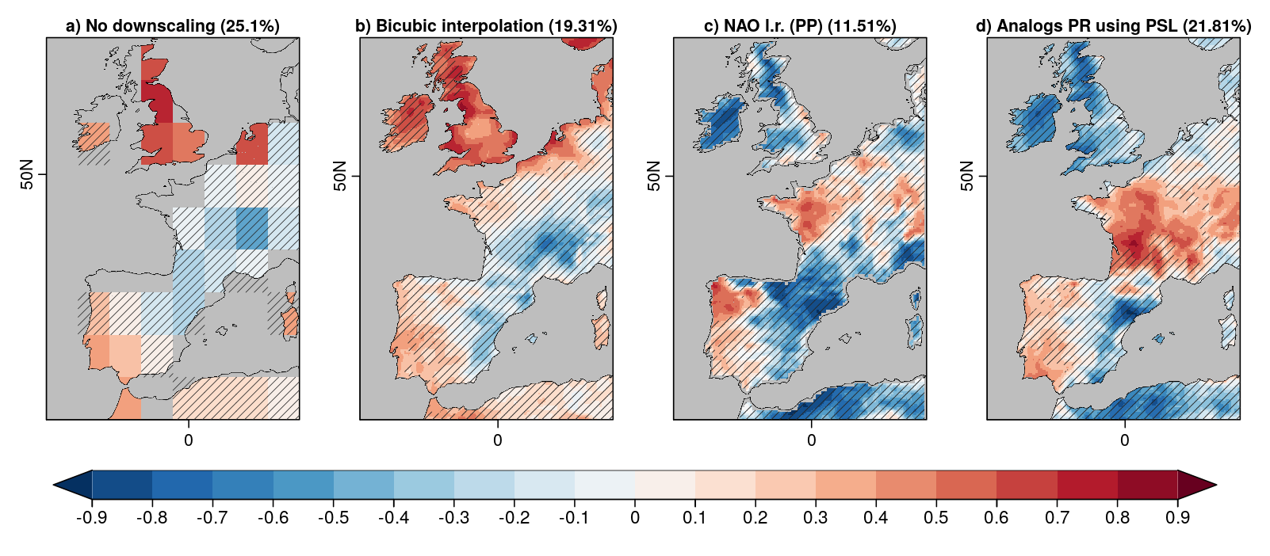
Statistical downscaling
Several statistical downscaling methods are tested to provide local-scale decadal predictions from the multi-model ensemble.
Sara Moreno-Montes

Slide 29
Summary
Decadal climate prediction has evolved substantially since its emergence 20 years ago.
Global producing centres are complemented by contributing centres delivering predictions every year with physical systems, including CO2 fluxes.
Systematic errors penalise severely decadal predictions.
Work on updated climate forcings is fundamental and needs to team up with shorter-term forecasting and reanalyses.
Predictions can support the understanding of climate anomalies (2023 warming).
A part of the signal-to-noise paradox in decadal predictions can be explained by the different nature of prediction and reference time series. This is common to prediction systems at other time scales.
There is an increasing number of examples of the use of decadal predictions in climate services.

Slide 30
Thanks and happy anniversary
francisco.doblas-reyes@bsc.es

Slide 31
Near-term seamless climate information
Skill of 20-year projections using previous observations to select a 30-member ensemble.
Heterogeneous improvements with respect to the full ensemble of historical simulations
Verification of the methods is important to the users
Di Luca et al. (2024, J. Climate)

Slide 32
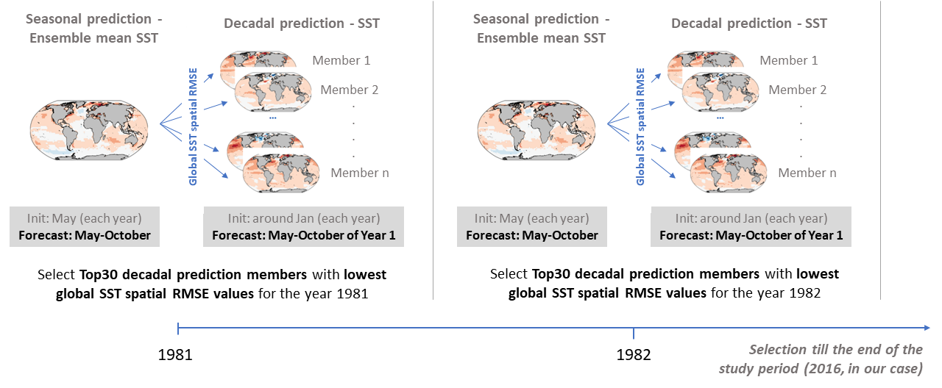
Temporal merging seasonal and decadal predictions
Solaraju-Murali et al. (in prep.)

Slide 33
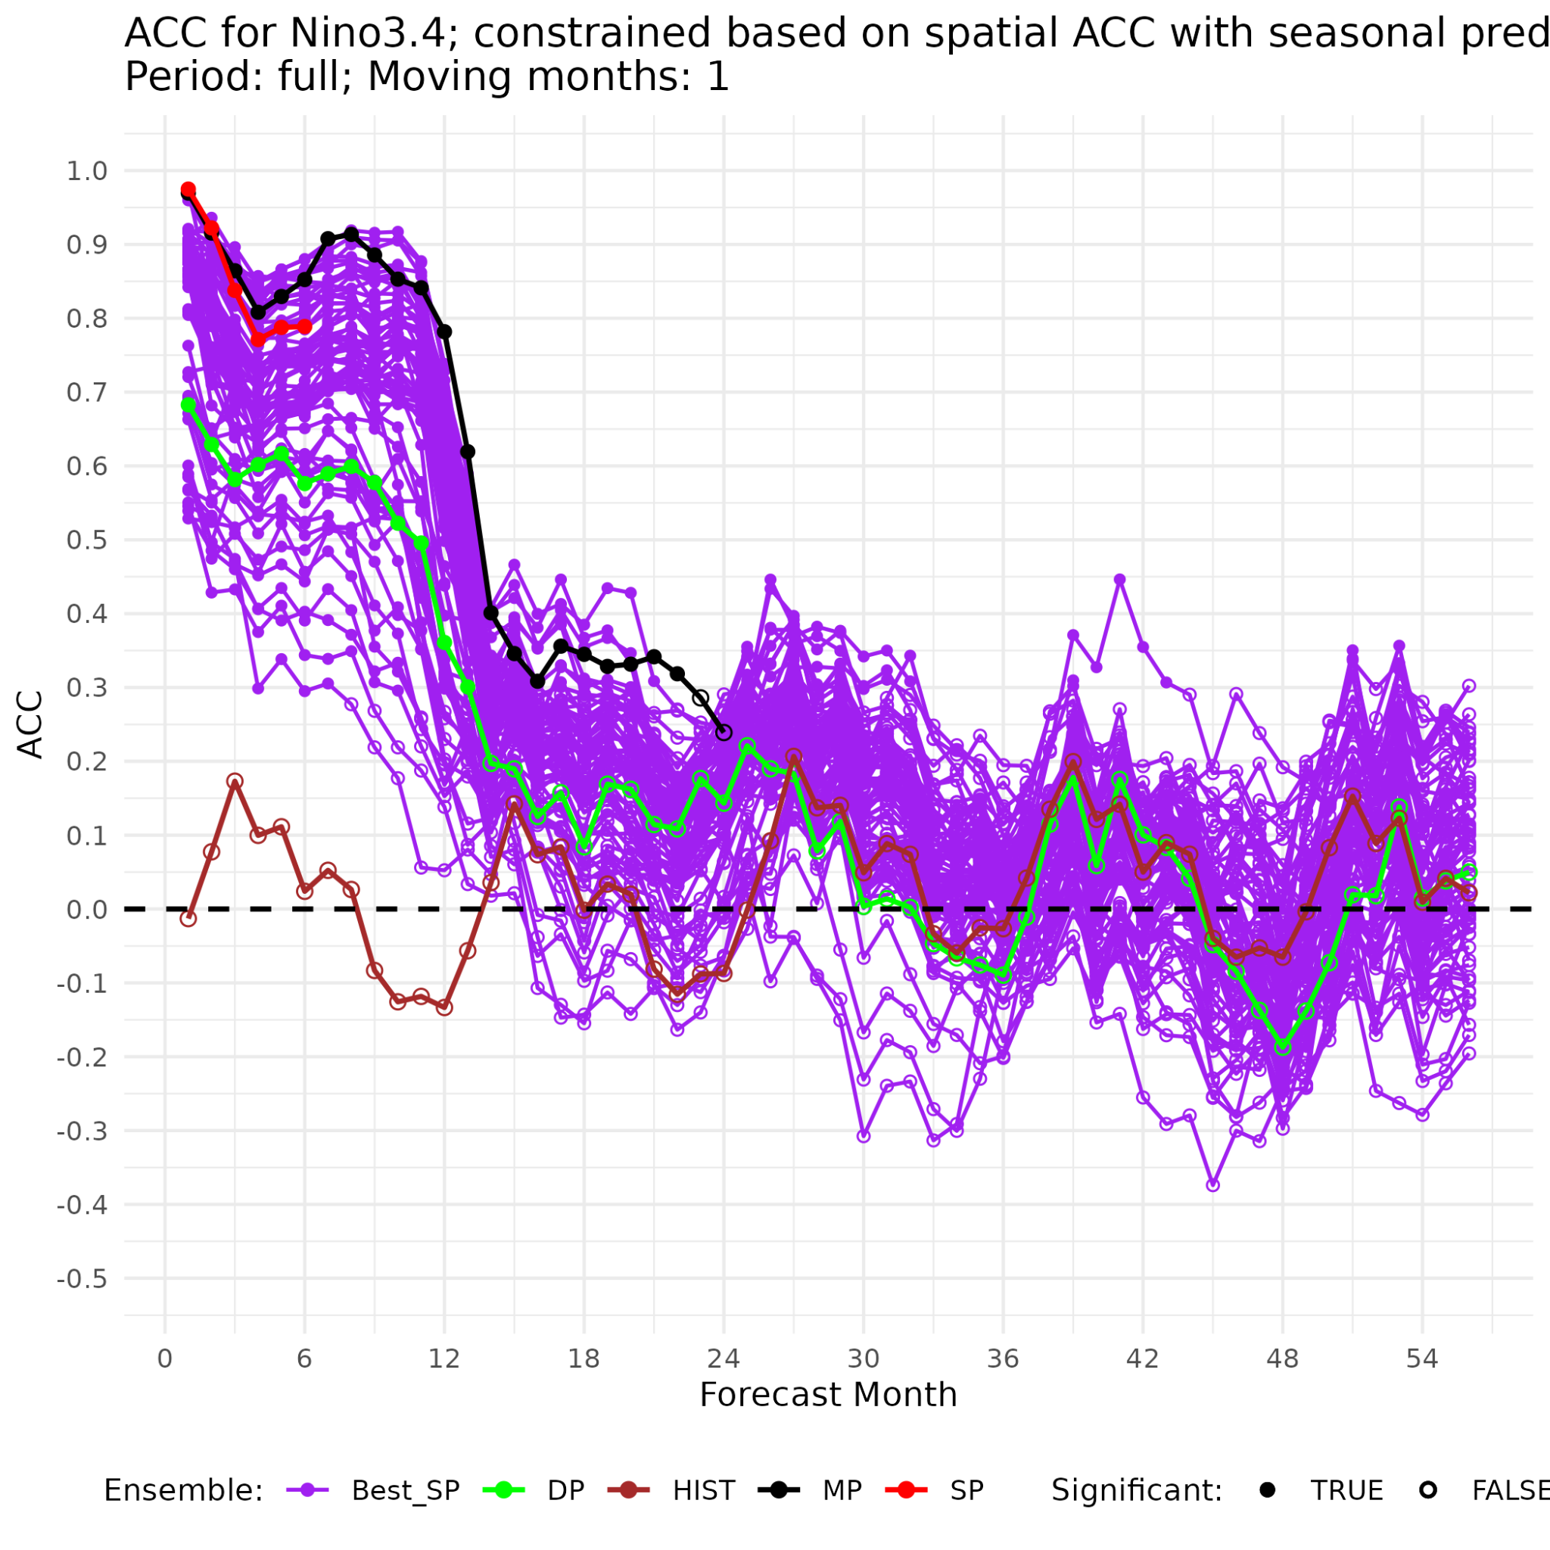
Niño3.4 forecast quality for seasonal, multia-annual, decadal and S2D constrained ensembles (May init.)
Decadal predictions constrained by previous observations
Decadal predictions constrained by seasonal predictions
Multi-annual predictions
Delgado-Torres et al. (in prep.)

Slide 34
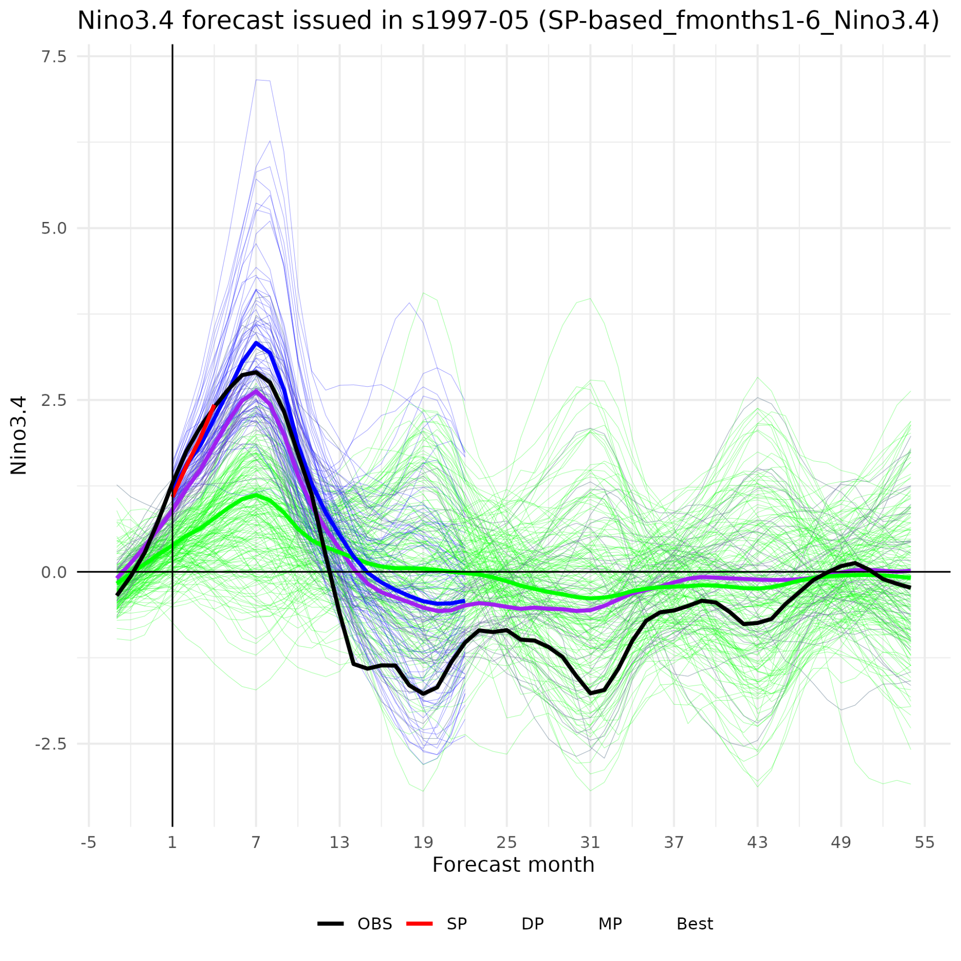
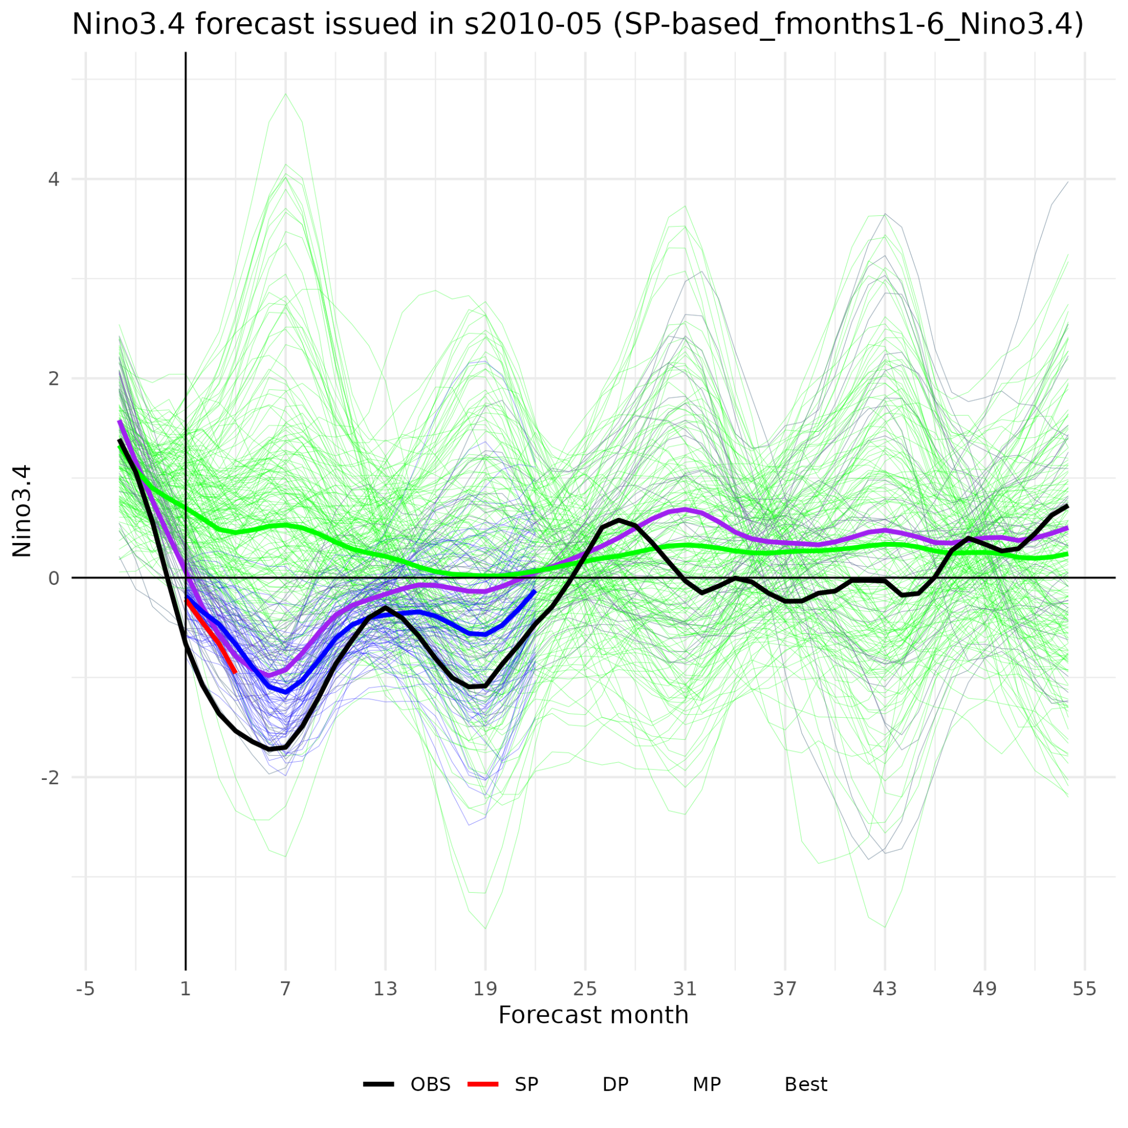
Seamless forecasts of Niño3.4 index
ERA5
Seasonal predictions initialised in May
Multi-annual forecast initialised in May
Decadal predictions initialised at the end of the previous year
Seamless forecast (decadal predictions constrained in May)
Delgado-Torres et al. (in prep.)

