Slide 1
EasyBuild site presentation:
BSC Earth Sciences
Kim Serradell
Computational Earth Sciences
25/01/2022
7th EasyBuild User Meeting

Slide 2
Outline
Who we are?
Why using EasyBuild?
Integration of EasyBuild in Earth Sciences workflow
Next steps

Slide 3
Disclaimer
This presentation is based on Earth Sciences experience, a research department from Barcelona Supercomputing Center.
It does not reflect any view or strategy from the Operations department, managers of the Mare Nostrum 4 (an other HPC).
This is a user presentation.

Slide 4
The MareNostrum 4 supercomputer
Total peak performance:
13,7 Pflops/s
Access: prace-ri.eu/hpc-access
Access: bsc.es/res-intranet

Slide 5
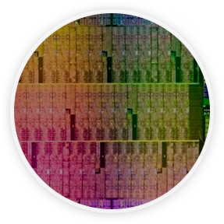
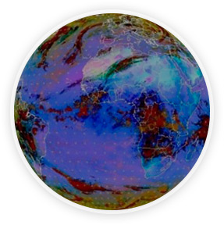
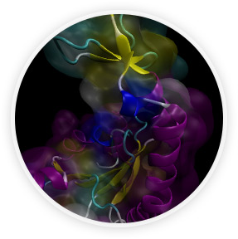
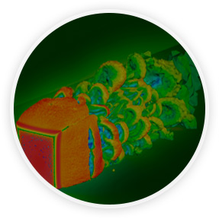
Mission of BSC Scientific Departments
Computer
Sciences
Earth Sciences
To influence the way machines are built, programmed and used: programming models, performance tools, Big Data, computer architecture, energy efficiency
To develop and implement global and regional state-of-the-art models for short-term air quality forecast and long-term climate applications
Life
Sciences
CASE
To understand living organisms by means of theoretical and computational methods (molecular modeling, genomics, proteomics)
To develop scientific and engineering software to efficiently exploit super-computing capabilities (biomedical, geophysics, atmospheric, energy, social and economic simulations)

Slide 6
BSC Earth Sciences
Environmental modelling and forecasting, with a particular focus on weather, climate and air quality
Modeling
air quality and
Sand and Dust Storms
Processes from urban to
Global and the impacts
on weather, health
and ecosystems
Climate
predictions
system from
subseasonal-to-decadal
forecasts
Research
and
Forecasts
Service Users Sectors
Infrastructures
Solar
Energy
Urban
development
Transport
Wind
Energy
Agriculture
Insurance

Slide 7
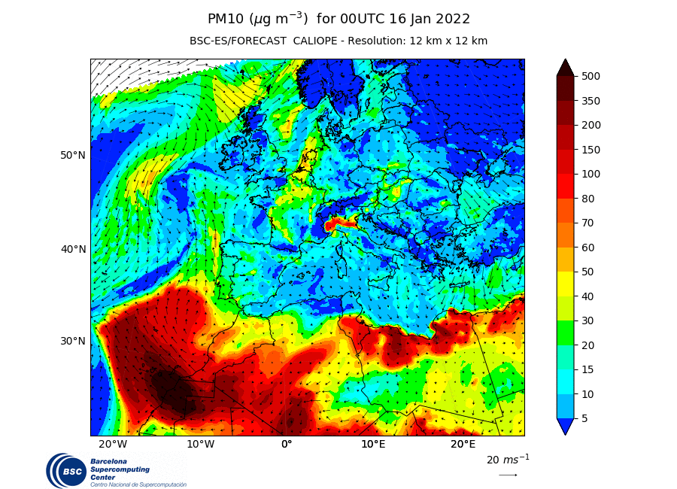
Why using EasyBuild?
Workstations
Virtual Machines
HPC’s

Slide 8
Functionalities
Reusability: users can develop on workstations and run in HPC
Stability: operational forecasting needs a freezed environment → (i.e. python packages)
Reproducibility: clear picture of the environment used to produce data
Deployment: reduced time when entering in a new cluster
Flexibility: different architectures (including Cloud) and improved migration (machine with updated OS)
Community: reuse and share easy-configs

Slide 9
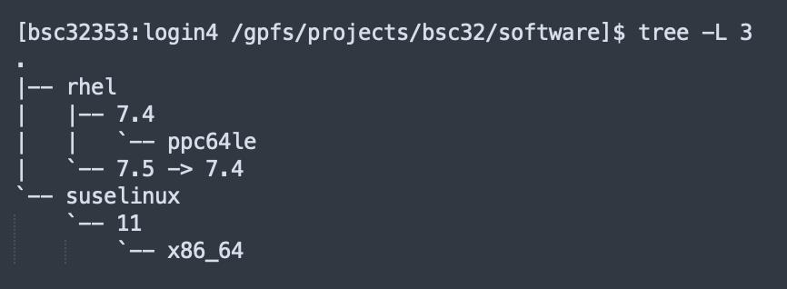
Current EB installations
Workstations and VMs
Production: foss-2015a
Pre-production (stopped): foss-2019b
HPC
Nord3: foss-2019b
Power 9: foss-2018b and fosscuda-2019b
Cirrus (Spanish Meteorological Agency): foss-2020a
Cloud
Huawei: foss-2019b
Oracle: foss-2019b
Hierarchichal structure for HPC modules

Slide 10
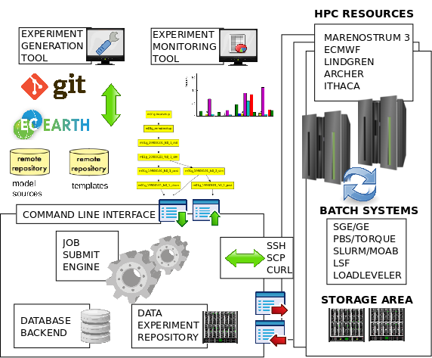
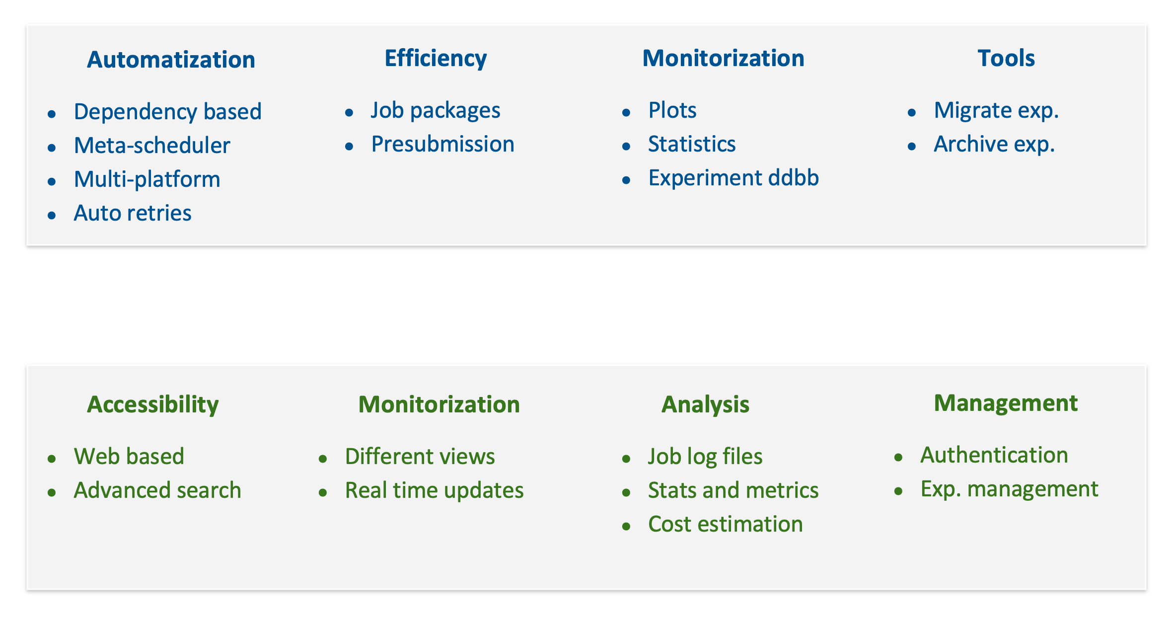
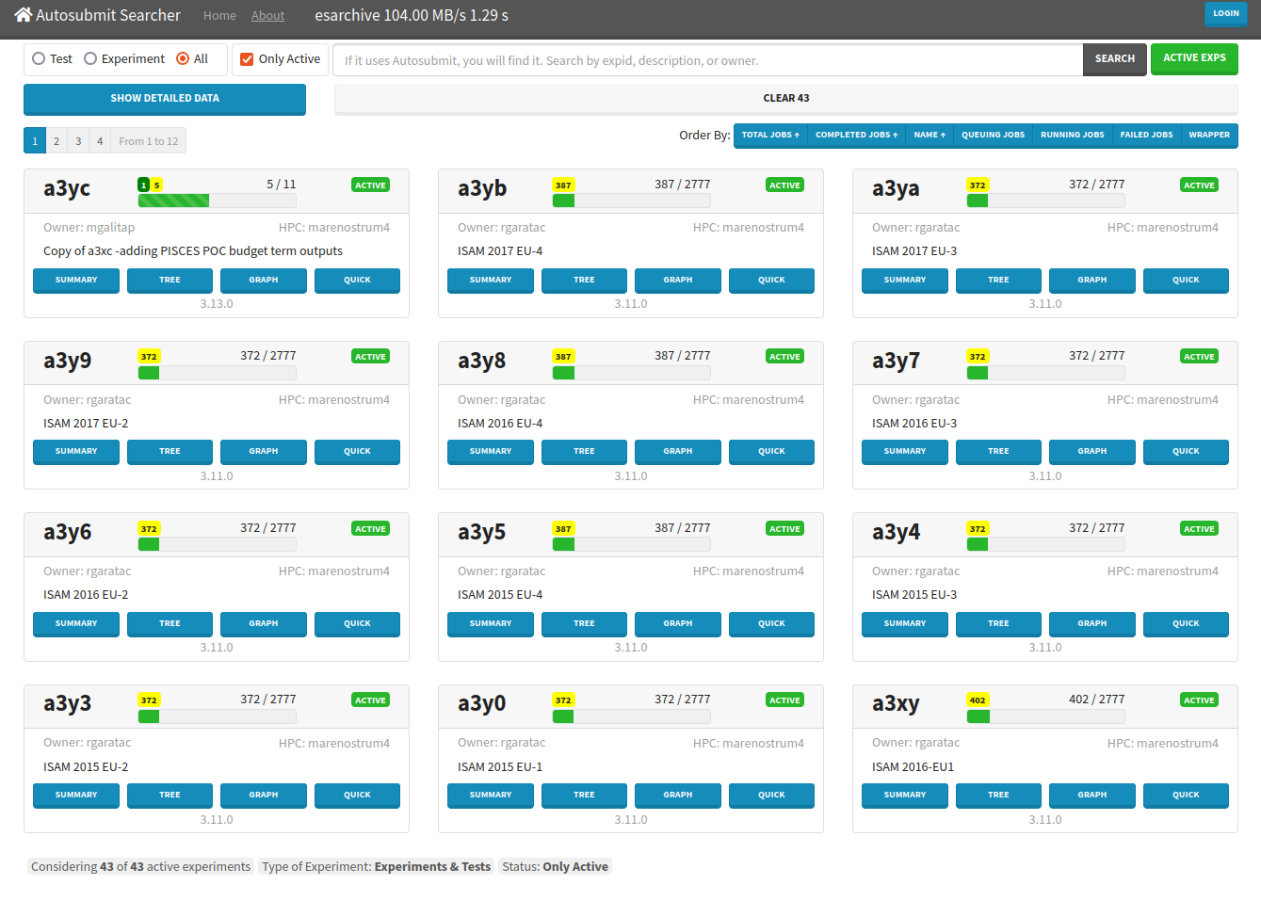
The workflow manager
Autosubmit web GUI
D. Manubens-Gil, J. Vegas-Regidor, C. Prodhomme, O. Mula-Valls and F. J. Doblas-Reyes, (2016). “Seamless management of ensemble climate prediction experiments on HPC platforms”, 2016 International Conference on High Performance Computing & Simulation (HPCS), Innsbruck, pp. 895-900. https://doi.org/10.1109/HPCSim.2016.7568429
W. Uruchi, M. Castrillo and D. Beltrán, (2021). “Autosubmit GUI: A Javascript-based Graphical User Interface to Monitor Experiments Workflow Execution”, Journal of Open Source Software, 6(59), 3049. https://doi.org/10.21105/joss.03049

Slide 11
Model workflow

Slide 12
Enhancing deployments
Steps to deploy our forecasts in a new machine
Access the machine
Deploy EB
Deploy our usual software stack
GCC, OpenMPI, netCDFs, ESMF… (and dependencies)
Python and R (+ packages)
Deploy our workflow manager (Autosubmit)
Deploy auto-model (templates with modules)
Run the model
Last year, MONARCH atmospheric chemistry model was running in AEMET new cluster (cirrus) in less than two weeks (with minimal interaction with local sysadmins)

Slide 13
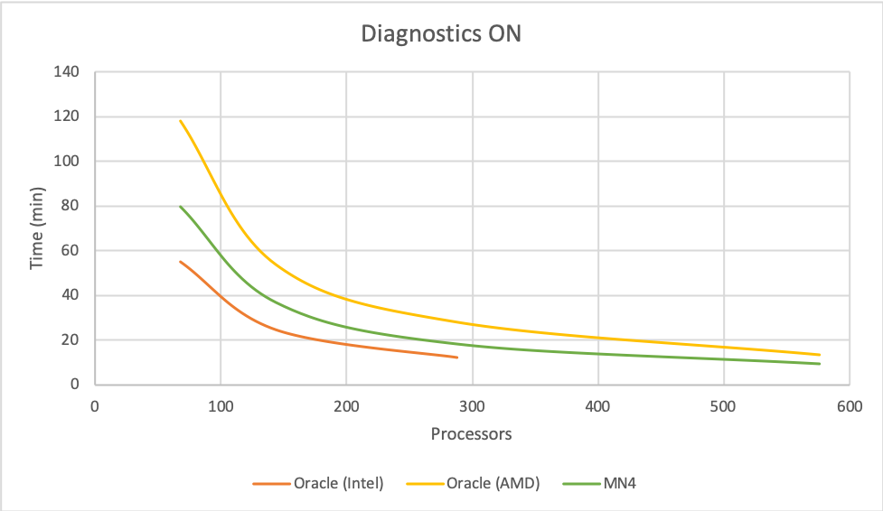
EasyBuild in the Cloud
In 2021, in collaboration with HPCNow!, we did a Proof Of Concept (PoC) using ORACLE Cloud to port our atmospheric chemistry worflow to the Cloud (BSC is not a 24/7 site)

Slide 14
What we need to improve
Update toolchains
Purging old modules
Sharing developed custom easy-configs
Involvement in EasyBuild community

Slide 15
Next steps
Update some of our toolchains
Continue to use EB as software deployment tool

Slide 16
Thank you
kim.serradell@bsc.es

