Slide 1
18 November 2020
Forecast quality assessment for operational climate prediction
Francisco J. Doblas-Reyes
with contributions from Joaquín Bedia, Nicola Cortesi, Nube González, Carlo Lacagnina, Llorenç Lledó, Raül Marcos, Núria Pérez, Jaume Ramón, Albert Soret, Marta Terrado, Verónica Torralba, Ilaria Vigo and many more

Slide 2
Climate information requirements
Salience: It refers to the relevance of information for an actor’s decision choices. Often interesting scientific questions are far from a real-world situation.
Credibility: It refers to whether an actor perceives information as meeting standards of scientific plausibility and technical adequacy. Sources must be trustworthy and/or believable.
Legitimacy: It refers to whether an actor perceives the climate information process as unbiased and meeting standards of political and procedural fairness.
Power
Reputation
Values
Transparency
Standards
Cash et al. (2003, PNAS)

Slide 3
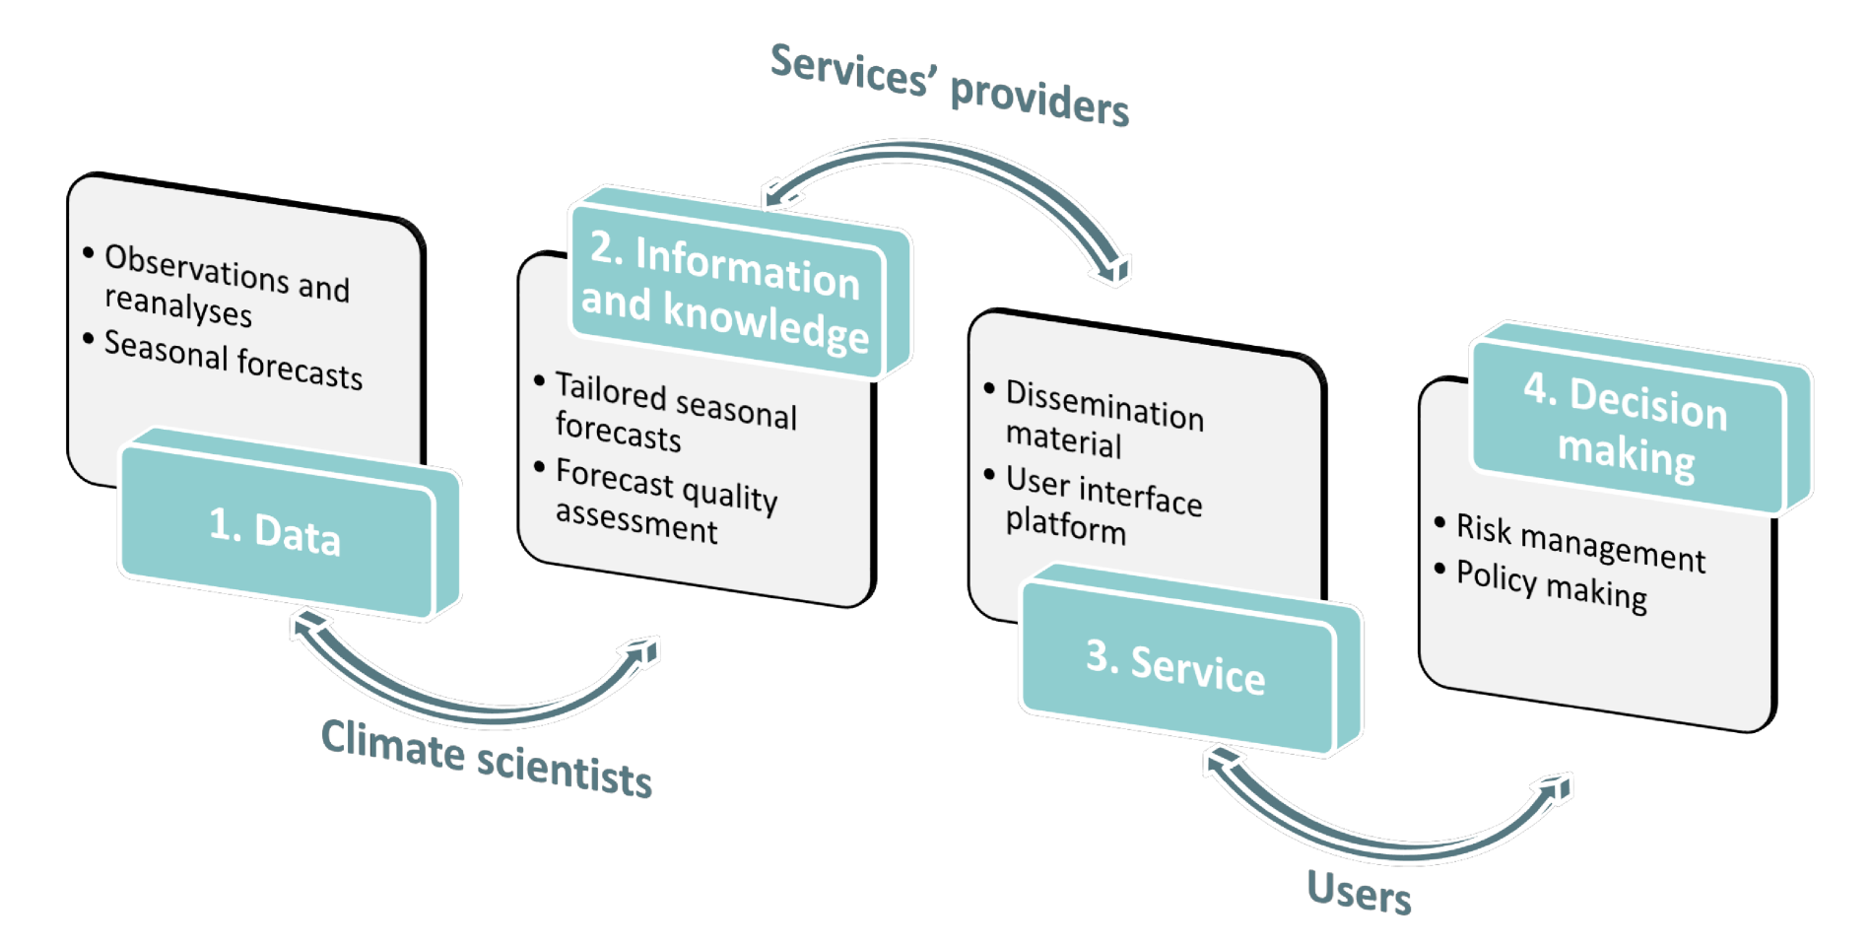
The research-provider-service paradigm
A service-oriented research agenda requires the traditional chain “research development-operations-service provision” to move both ways so that not only information quality is demonstrated, but user requirements are adequately addressed and value illustrated. This leaves a space for transdisciplinary research. This chain should not preclude basic research to take place though.

Slide 4
Barriers to use climate forecasts in applications
Some limitations for the use of climate forecasts in different socio-economic sectors.
Possible solution: to adapt the climate forecasts into a message to be integrated in decision-making.
Lack of awareness
Climate services
Forecast quality is an integral part of the service to the user
Goal: the development and incorporation of climate messages based on forecasts for planning, policy-making and practice at the global, regional and national scale.
Implementation method: co-production and co-design.
Difficult interpretation
Lack of expert synthesis
Notes:
To enable better management of the climate-related risks
To improve the resilience and adaptation to climate change

Slide 5
Forecast requirements identified by users
Targeted products need to become widely available, easy to access and understand by different professionals
Need to understand how the information provided can be used and integrated in users’ operations and activities.
Added value of using climate predictions needs to be better understood. The chain product-verification-predictability source needs to be established.
Need to reduce uncertainties and increase skill. The skill is too low to base decisions on them, since the cost/lost ratio can be high.
Better explanation of the link between climate predictions and climate change projections.
The information needs to be reliable enough.
Maybe need for fine spatial resolutions or allow focusing on local urban areas.
Forecast quality is an integral part of the service to the user because it is inseparable from the forecast product
Extracted from project deliverables of EUCP (D6.4), PRIMAVERA (D11.6) and EUPORIAS (D12.3). Additional sectoral comments in user engagement by S2S4E, APPLICATE, MED-GOLD, HIATUS and VISCA.

Slide 6
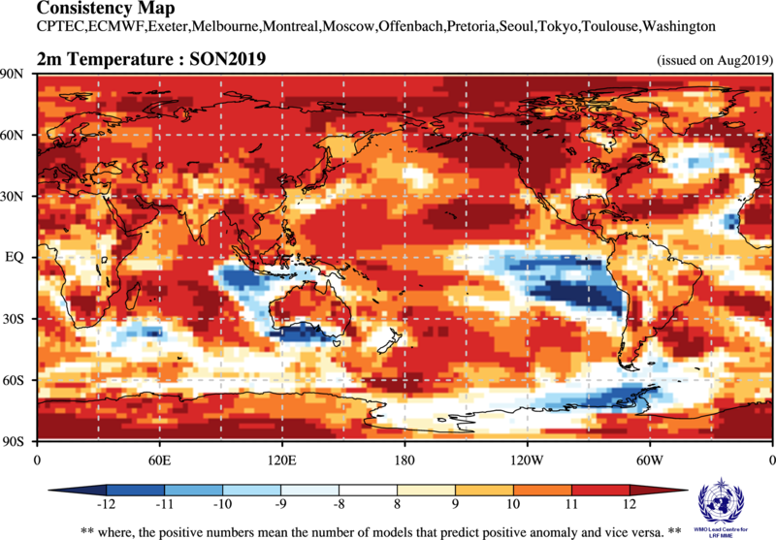
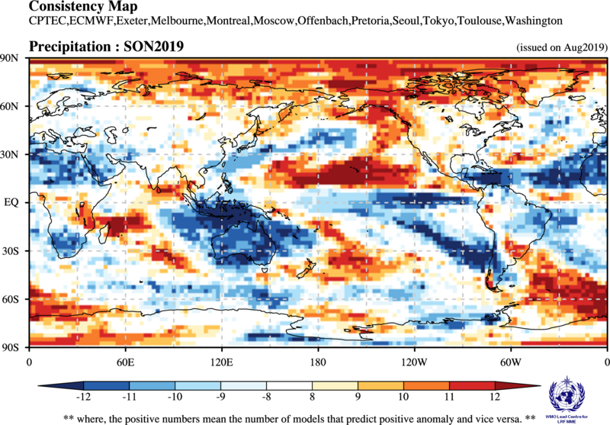
Users look for climate forecasts online
But some elements are missing:
Quality assurance
Traceability
Interpretation
Authority

Slide 7
Some key elements for users
Observational uncertainty: comparison between reanalyses in a forecast verification context.
Definition of standard procedures: standards are less common than one would expect.
Traceability and quality control: quality control and reproducibility of data and products is increasingly important in the research community, but its operational aspects are not solved yet.
User indicators: indicators often do not have the same level of skill as the meteorological variables.
Interpretation and communication: users are often not experts, and even when they are it is easy to misunderstand the existing information. Communication is a challenge
Synthesis and narratives: how to deal with multiple lines of evidence in the message constructions.

Slide 8
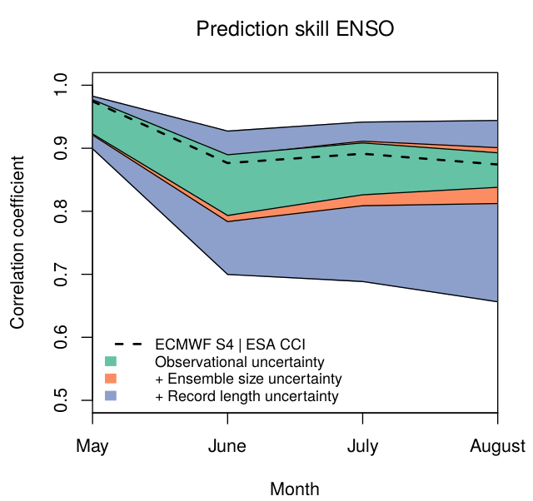
Sources of uncertainty of forecast quality
Observational uncertainty
Niño3.4 SST correlation of the ensemble mean for EC-Earth3.1 (T511/ORCA025) predictions with ERAInt and GLORYS2v1 initial conditions, and BSC sea-ice reconstruction started every May over 1993-2009.
Bellprat et al. (2017, Rem. Sens. Env.)

Slide 9
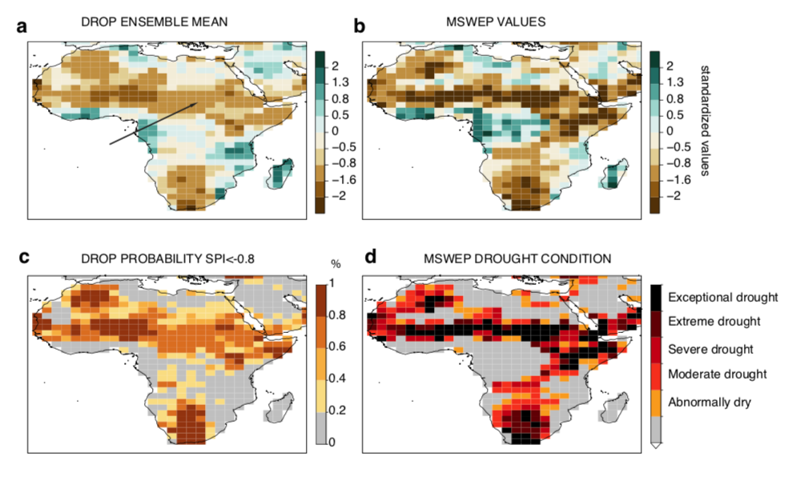
Observational uncertainty for monitoring
Observational uncertainty
Multisource observational estimates of drought using SPEI12 for 1984. Note the probabilistic observational estimates of drought.
Turco et al. (2019, BAMS)

Slide 10
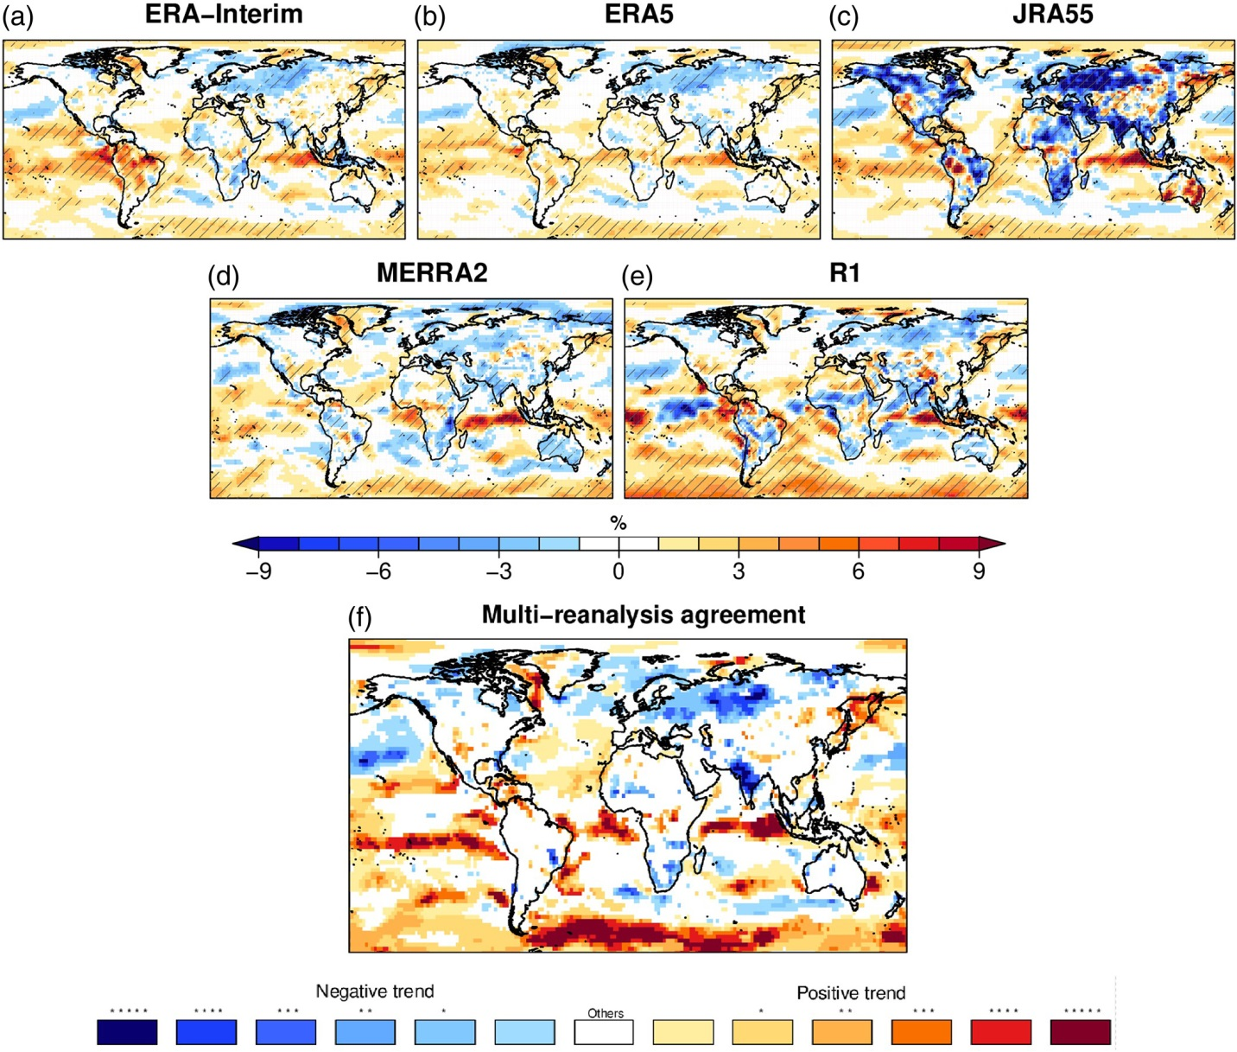
Observational uncertainty is relevant to users
Observational uncertainty
10-m wind speed trend (in percentage of the mean wind) for five reanalyses and agreement in the multi-reanalysis (MR) in DJF over 1981-2017.
The election of specific datasets as reference for the forecast verification can lead to different results
Ramon et al. (2019, QJRMS)

Slide 11
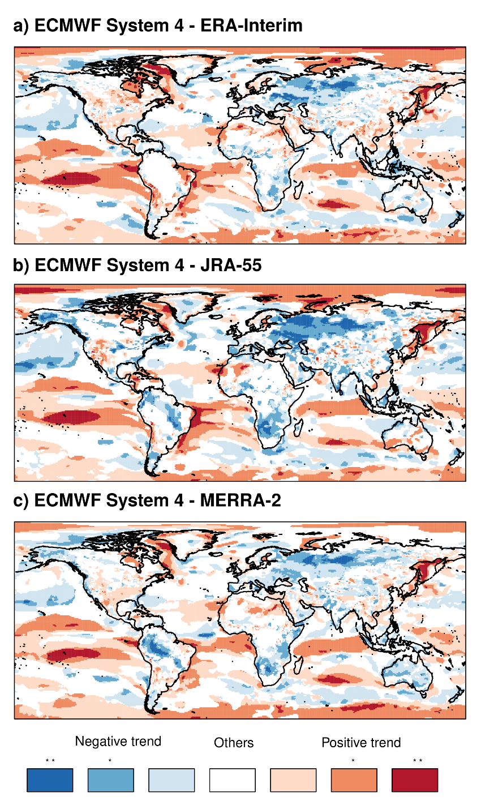
Observational uncertainty in verification
Observational uncertainty
Uncertainty from the observational reference should be taken into account by considering several datasets and evaluating the systematic errors in different moments of the probability distribution.
Target season: DJF Start date: 1st of Nov
Period: 1981-2015 Variable: 10-m wind speed
Clim ECMWFS4 – Clim reanalysis
sd (ECMWFS4) / sd(reanalysis)
Less wind
More wind
Less variability
More variability
Mean bias (m/s)
Standard deviation ratio
Trend coherence
V. Torralba
Notes:
11

Slide 12
Observational uncertainty in verification
Observational uncertainty
ECMWF System4
Period: 1981-2016
Season: DJF
Start date: 1st Nov
Variable: 10-m wind speed
V. Torralba

Slide 13
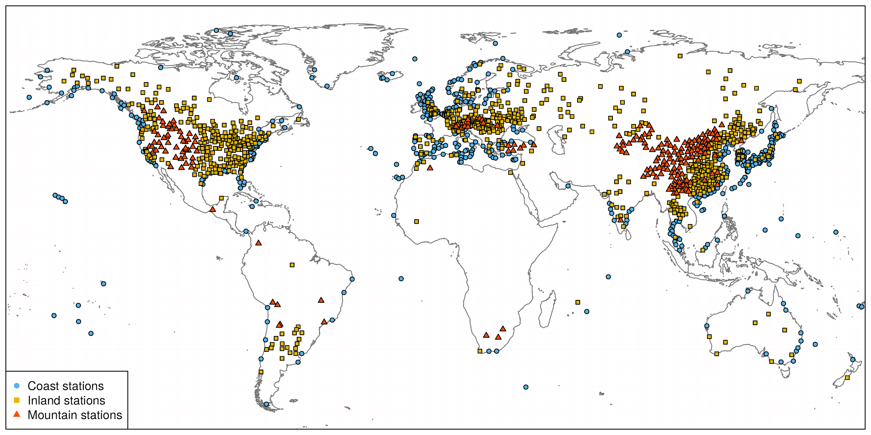
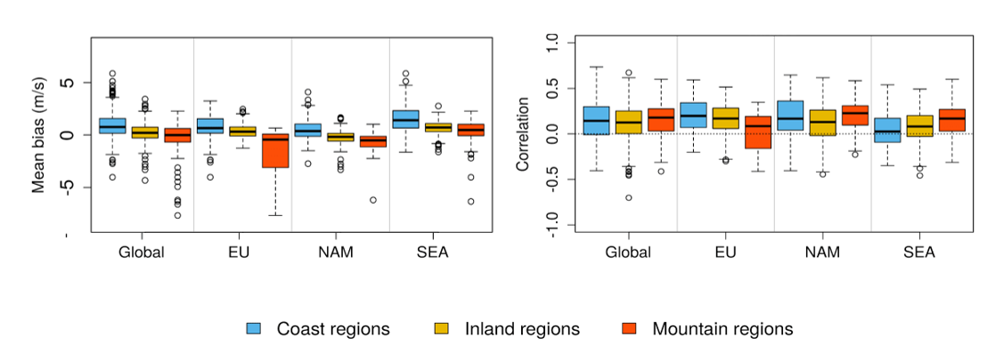
Observational uncertainty in verification
Observational uncertainty
The integration of in-situ observational data in the forecast verification and bias correction stages makes the verification more familiar to the user. The evaluation of the climate predictions on coastal, mountain and inland regions shows different effects.
ECMWF SEAS5
Period: 1981-2016
Season: DJF
Start date: 1st Nov
Reference: HadiSD
Variable: 10-m wind speed
V. Torralba
Notes:
Minola et al. 2020: This classification was suggested to be able to group weather stations
influenced by similar physical processes (Achberger et al.
2006): (1) coast stations are dominated by regional and local
circulations due to the difference between sea and land (e.g.,
sea breezes, turbulence due to step-like change in surface
roughness; Gustavsson et al. 1995; Borne et al. 1998); (2)
inland stations are strongly influenced by land surface pro-
cesses and land–atmosphere interactions; and (3) mountain
stations where wind conditions are influenced by both large-
scale circulation and localized circulation driven by the com-
plex topography.

Slide 14
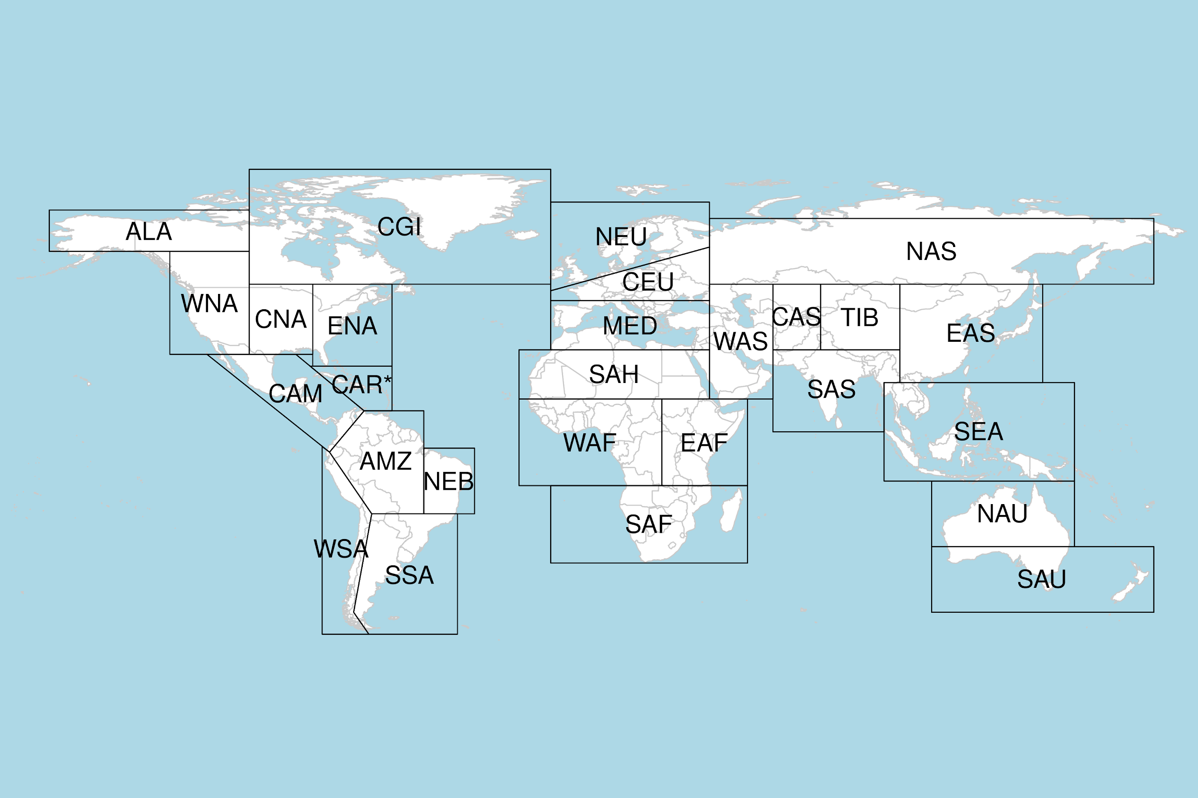
Observational uncertainty in verification
Observational uncertainty
Verification with two ground-based observational datasets and three reanalyses. The use of both types of datasets is very informative for wind energy users as they use them for the development of impact models and the long-term resource assessments.
ECMWF SEAS5 Period: 1981-2016
Season: DJF Start date: 1st Nov
V. Torralba

Slide 15
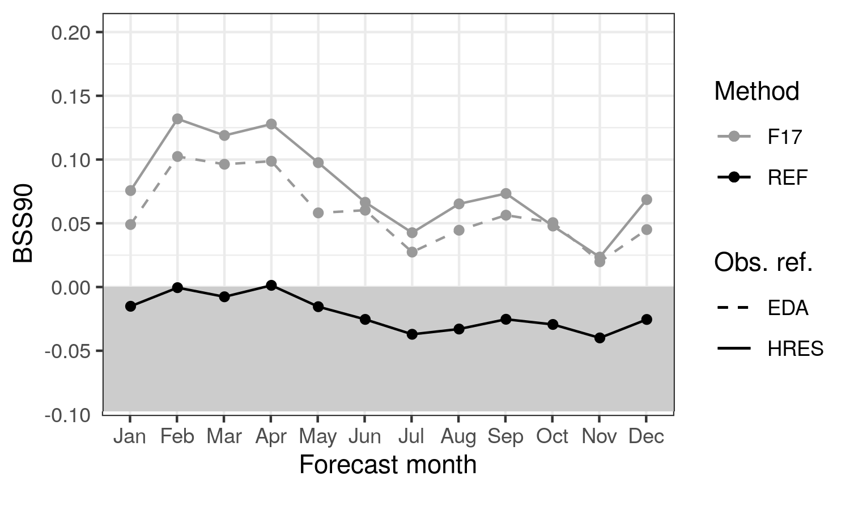
Observational uncertainty in verification
Observational uncertainty
Brier skill score for wind speed predictions above the climatological 90th percentile. Climatology as the reference forecast. Observational references from ERA5 ensemble (EDA) and high resolution (HRES) product with the Ferro (2017) method (F17) to obtain skill estimates in the presence of observational error.
“Failing to account for the effects of observation error when deciding between two forecasting systems could lead to the wrong choice and a high opportunity cost”
ECMWF SEAS5 Period: 1981-2016
Lead time: 1 month
Global coverage, 1,542 HadISD stations, which are the truth
J. Ramon

Slide 16
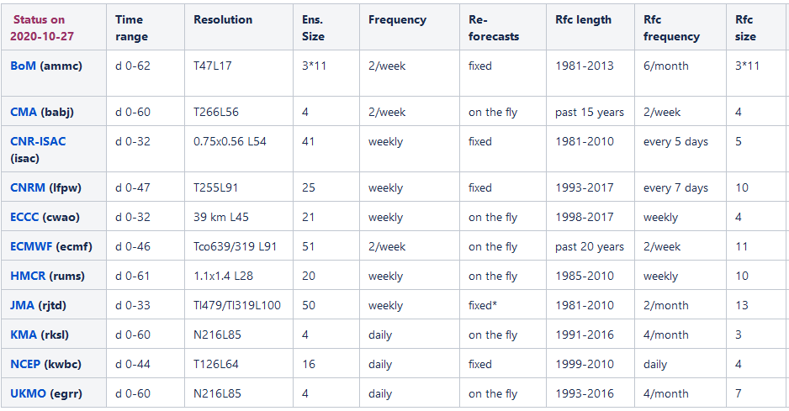
A non-trivial climatology definition
Standards
There is a large heterogeneity in the real-time subseasonal systems: different initialisations, hindcasts periods, etc.
Limited samples (even in the hindcasts) lead to : lack of robustness in forecast quality estimates, definition of the climatology, bias adjustment, etc.
Forecast
Hindcasts
Manrique-Suñén et al. (MWR, 2020)

Slide 17
A non-trivial climatology definition
Standards
20 years
(1996-2015)
M T M T M T M T M T M T M T M T M T M T M T M T M T M T
April
4th April
Weekly: 1 start date, 20 years
Monthly: All start dates in a calendar month, 8/9 start dates, 20 years
Monthly running window: Running window with 4 start dates before and after the target week, 9 start dates, 20 years
A. Manrique

Slide 18
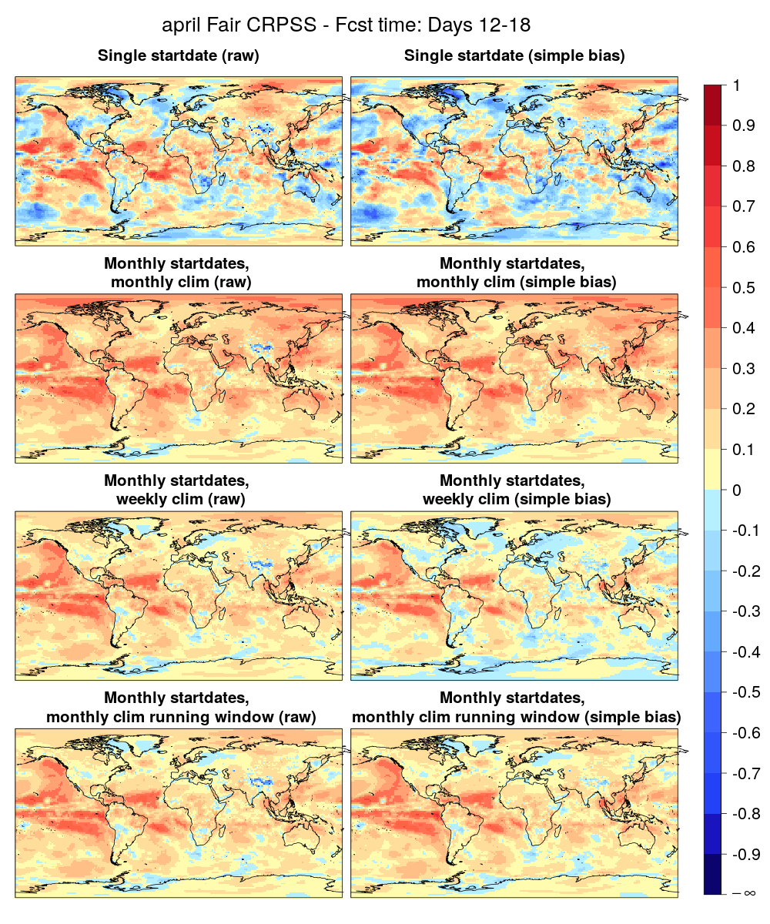
A non-trivial climatology definition
Standards
Weekly: too noisy
ECMWF-Ext-Ens 2016
Period: 1996-2015 Month: April
Reference: ERA Int
Variable: 2-m temperature
Other aspects to bear in mind include forecast timeliness, system updates, multi-model choices, etc.
Monthly: good skill, but …
Monthly running window, but weekly for the bias adjustment: lower skill , and too noisy for the adjustment
Monthly running window: more credible estimates
Manrique-Suñén et al. (MWR, 2020)

Slide 19
Vocabularies
Standards
Vocabularies are part of the development of the evaluation and quality control (EQC) and a pre-requisite for the inclusion of decadal predictions in the climate data store (CDS) of the Copernicus Climate Change Service.
Forecast time months 15-74 (years 2-5), lead time 1 year
Forecast time months 3-14 (year 1), lead time 0 years
Burst
Y
Y+1
Y+2
Y+3
Y+4
Y+5
1 Nov
Forecast time months 15-74 (years 2-5), lead time 1 year
Forecast time months 3-14 (year 1), lead time 0 years
Lagged
Y
Y+1
Y+2
Y+3
Y+4
Y+5
1 Nov
1 Oct
1 Sep
1 Aug
1 Jul

Slide 20
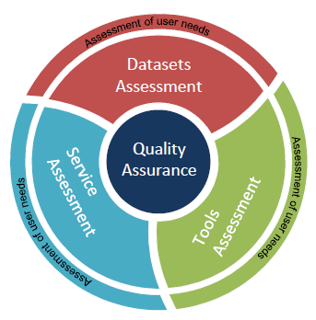
Evaluation and quality control
Traceability and quality control
The Copernicus Climate Change Service is developing the evaluation and quality control (EQC) function of the climate data store to:
Provide a user-led overarching EQC service for the whole CDS
Provide an independent quality assessment of both datasets and products
Forecast quality assessment is a part of the evaluation and quality control function

Slide 21
How traceable are both products and skill?
Traceability and quality control
Generalised metadata provision and workflow provenance is required to ensure a minimum quality of the forecast-based climate information.
J. Bedia

Slide 22
How traceable are both products and skill?
Traceability and quality control
Well-documented packages safely developed are indispensable in an operational context.
The Comprehensive R Archive Network
Version control system
package shared in ftp and web servers around the world
common standards for R users
easy installation
typical R documentation
typical warnings and error messages
checks
to work on different OS
structure and documentation
package size
installation time
...
track changes
issues discussion
tag versions
branching strategy
unit testing
continuous integration
Contributions and improvements
open a new issue
work in a new branch
follow function standards
review process
merge into the master branch
plan next release
Profiling tools
ProfVis and Rprof
scalability and parallelisation
N. Pérez

Slide 23
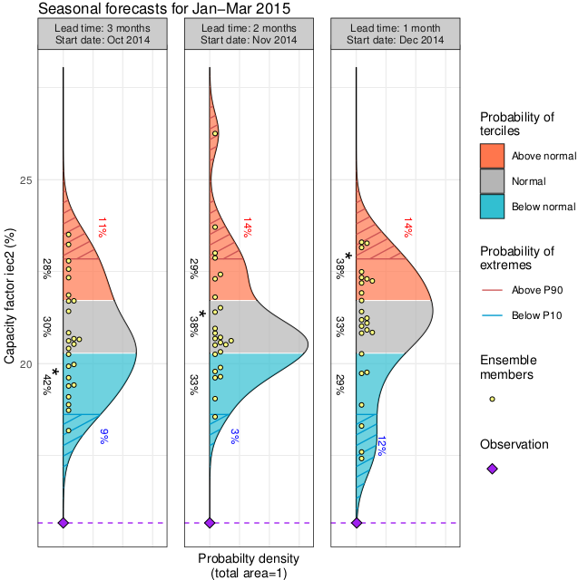
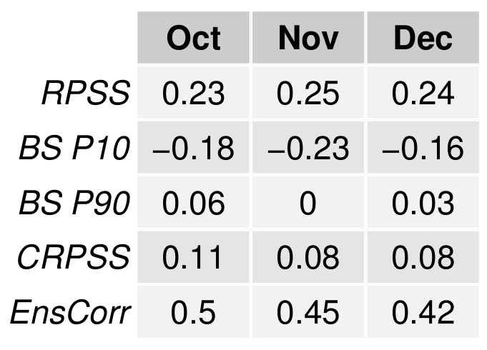
Seasonal prediction of wind capacity factor
User indicators
Seasonal predictions of DJF capacity factor over North America (124-95⁰W, 26-44⁰N) starting on the first of October, November and December for the first trimester of 2015, ECMWF SEAS5, reanalysis: ERA-Interim, hindcasts over 1993-2015.
L. Lledó

Slide 24
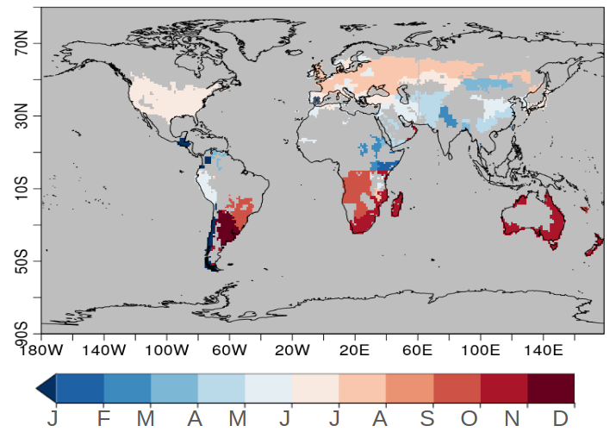
Decadal prediction of crop yield indices
User indicators
WMO recognised global producing centres of decadal predictions contribute with the definition of standards for decadal predictions data and products, while C3S promotes the evaluation of the European multi-model and the illustration of the decadal prediction use in, among other sectors, the agricultural sector.
SPEI6
HMDI3
Wheat harvesting month
Indicators:
Drought: Standardized Precipitation Evapotranspiration Index (SPEI6)
Heat Stress: Heat Magnitude Day Index (HMDI3)
B. Solaraju

Slide 25
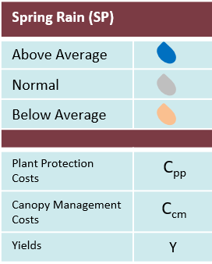
User value: wine making
User indicators
A wine producer is using seasonal forecasts of spring rain (provided in January) to make decisions about with the objective of maximising the payoff of the production of a 70 ha lot. Forecast value is user specific and is the basis for the user-oriented forecast application.
Action/Obs
Yearly value with respect to the business as usual option for each forecast possibility
€/70ha
+33.597,3
-8.371,2
-8.371,2
0
0
0
-21.343
-15.484
+6.636
Hit
€ / ha
I. Vigo

Slide 26
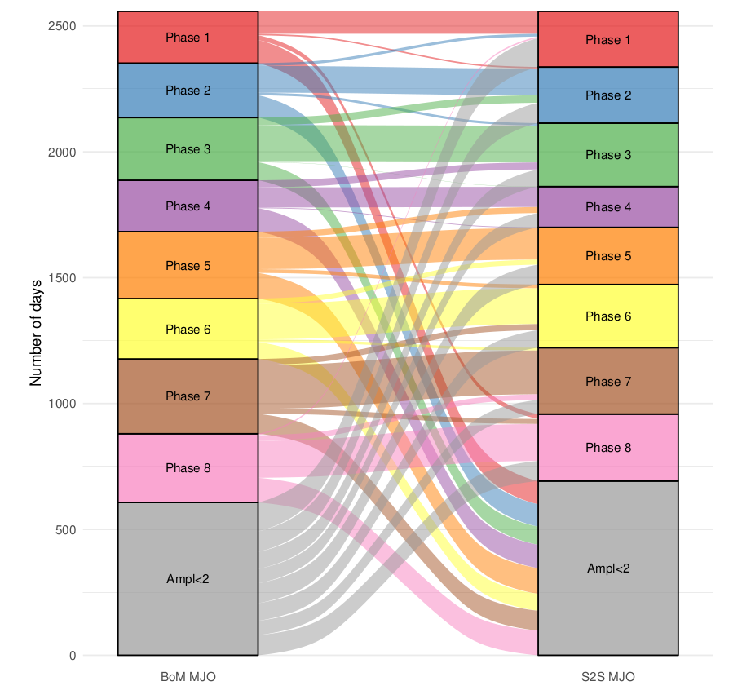
Do not underestimate the power of an image
Interpretation and communication
Observational uncertainty needs to be conveyed to users. The MJO phases for amplitudes above 2 from the BoM and S2S indices are compared over 1981-2017 and the challenge to verify the predictions illustrated. The days with amplitudes below 2 in both indices have been omitted.
Lledó and Doblas-Reyes (2020, MWR)

Slide 27
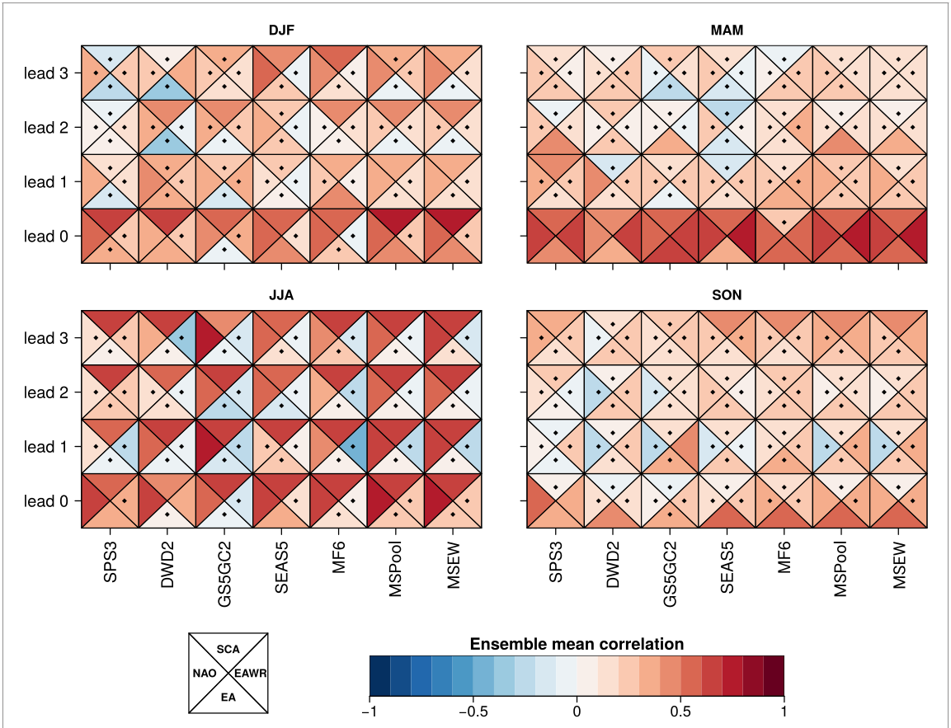
Do not underestimate the power of an image
Interpretation and communication
Scorecards and comprehensive displays of forecast quality measures become essential in a user-oriented service.
Forecast quality measures for the CMCC-CM3 operational seasonal forecast system from C3S.
N. Cortesi
Correlation for C3S seasonal forecasts of North Atlantic modes of variability.
Lledó et al. (2020, ERL)

Slide 28
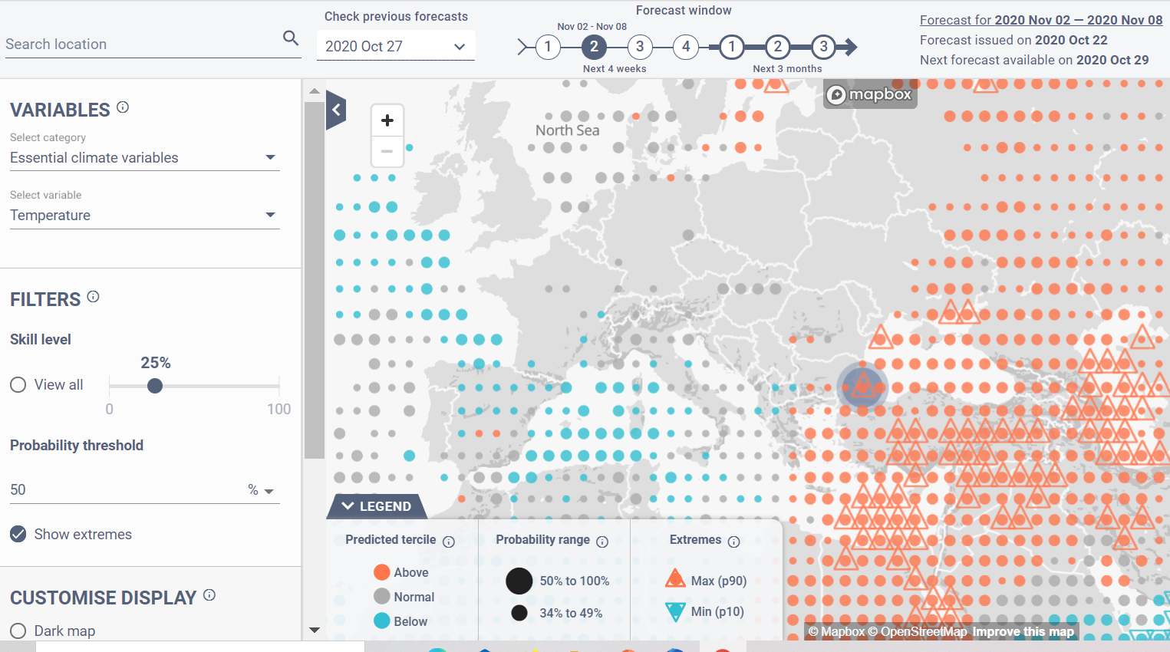
Prototypical climate services for energy
Interpretation and communication
S2S4E is developing a decision support tool for the renewable energy sector based on Copernicus climate forecasts, S2S, and NCEP operational predictions co-designed with the industry for periodic updates on the state of relevant climate variables.

Slide 29
The communication challenge
Interpretation and communication
Gamification is useful to illustrate the challenges of using and the value of seasonal climate predictions addressed to the wind energy sector:
Play against a reference taken from climatological frequencies.
The bets are proportional to the predicted probabilities.
The amount invested in the observed category is multiplied by 3.
▼
▼
▼
▼
play.google.com/store/apps
demo.predictia.es/roulette-app/mobile.html
Terrado et al. (2019, BAMS)

Slide 30
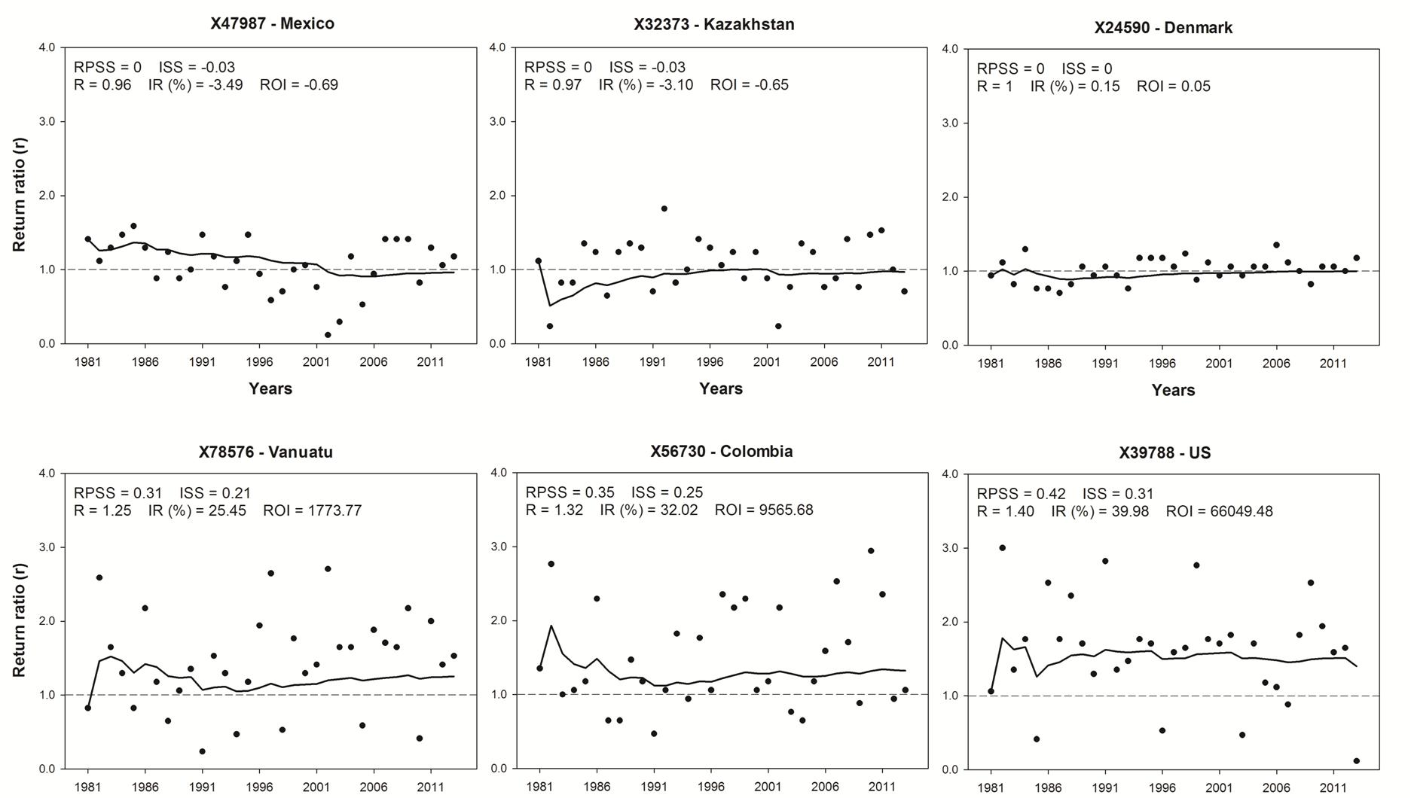
Illustrating the value of predictions
Interpretation and communication
Examples of return ratio for 33 betting runs for different points where wind power plants are installed:
Top row cases with RPSS=0, but ignorance skill score negative or zero.
Bottom row cases with RPSS>0.
Line for the geometric average of return ratios (interest rate).
Terrado et al. (2019, BAMS)

Slide 31
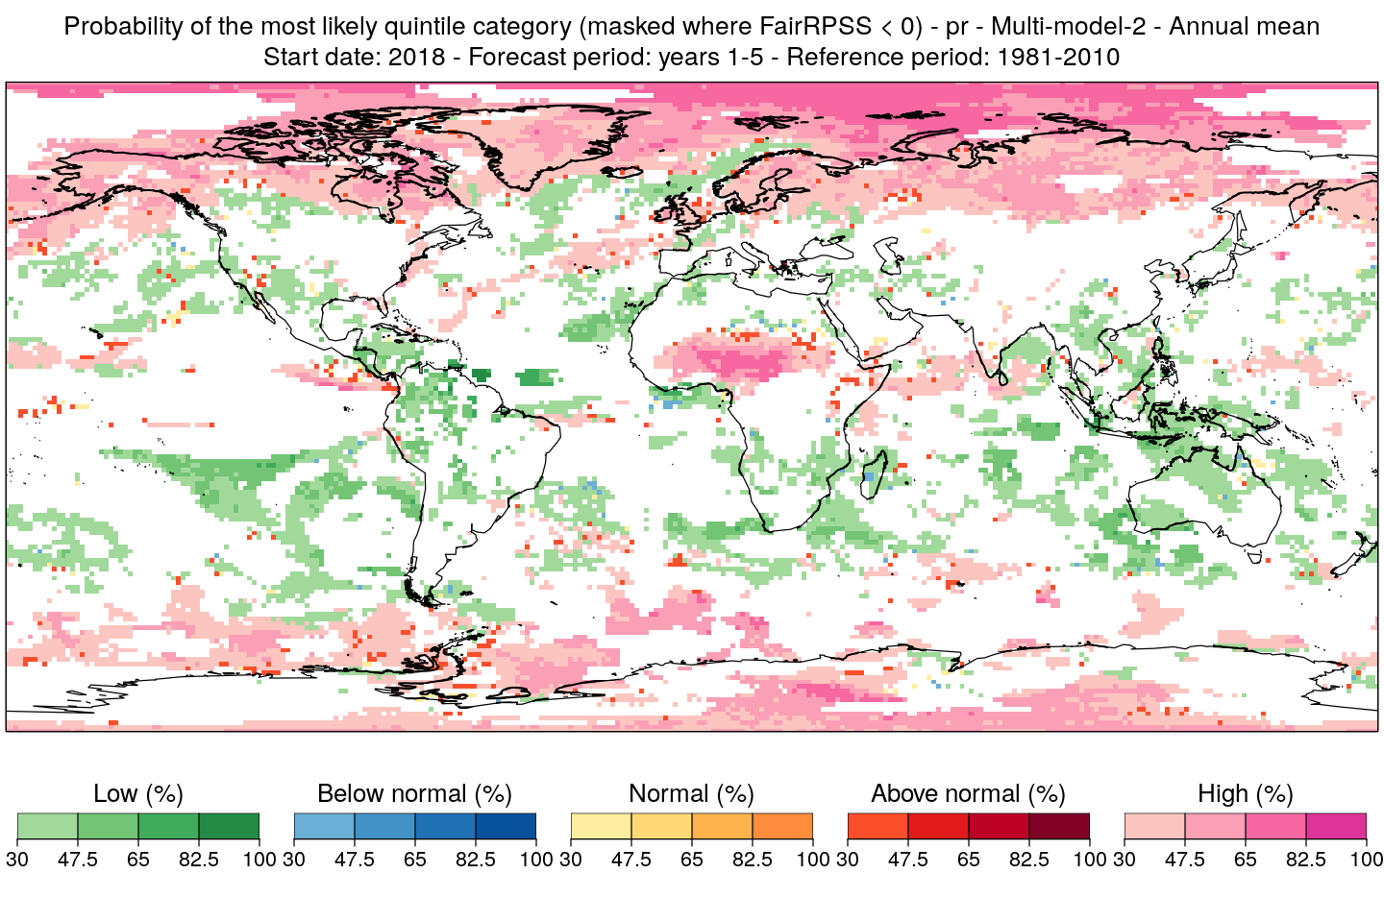
Multi-model climate predictions
Synthesis
Multi-model forecasts have been considered as an acceptable way to synthesise forecast information.
Decadal predictions of precipitation for forecast years 1-5 started near the end of 2018.

Slide 32
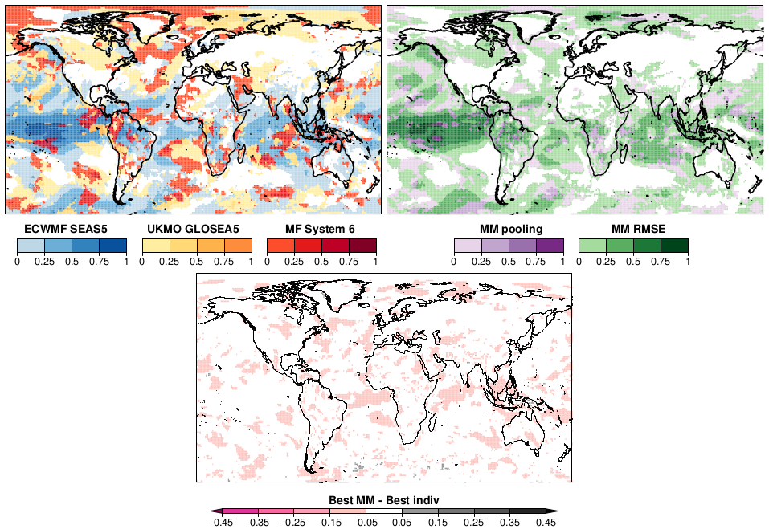
Multi-model climate prediction
Synthesis
However, users do not always understand why multi-model is the preferable option.
CRPSS of DJF two-metre temperature for C3S forecasts initialized in November, all systems bias adjusted (MVA) compared to a simple and weighted multi-model (as inverse function of RMSE). Bottom gain of the best multi-model with respect to the best single system. Verified against ERA Interim for 1993-2015.
V. Torralba

Slide 33
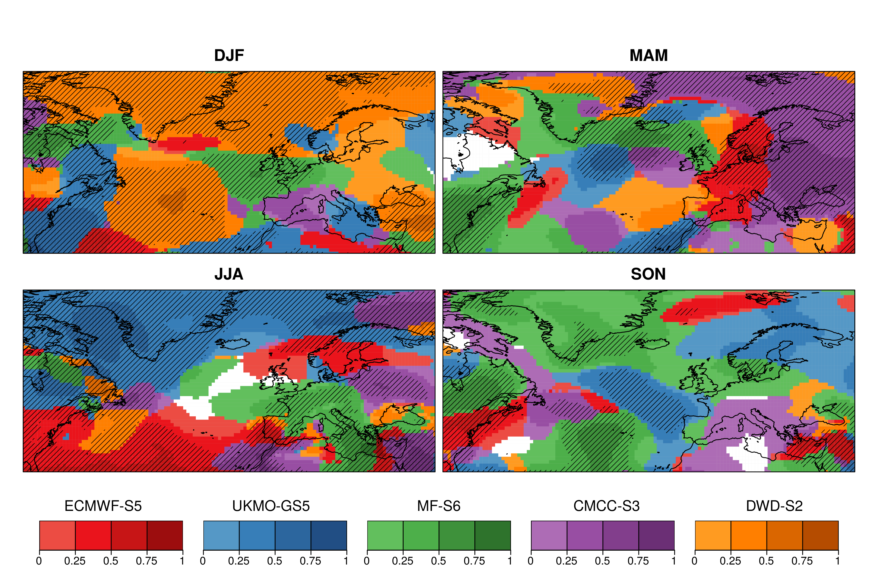
Multi-system forecast quality assessment
Synthesis
The systematic evaluation and intercomparison of different seasonal forecast systems is essential for the generation of a robust forecast product that is delivered in an operational climate service. This is a simple way of combine information from different systems to guide users about the potential of different seasonal forecast systems.
Period: 1993-2016
Season: DJF
Start date: 1st Nov, Feb, May, Aug
Reference: ERA5
Variable : Sea level pressure
Maximum correlation
V. Torralba

Slide 34
The non-exhaustive list of relevant elements
Observational uncertainty: comparison between reanalyses in a forecast verification context.
Definition of standard procedures: standards are less common than one would expect.
Traceability and quality control: quality control and reproducibility of data and products is increasingly important in the research community, but its operational aspects are not solved yet.
User indicators: indicators do not have the same level of skill as the meteorological variables.
Interpretation and communication: users are often not experts, and even when they are it is easy to misunderstand the existing information. Communication is a challenge
Synthesis and narratives: how to deal with multiple lines of evidence in the message constructions.

