Slide 1
Exeter, 6 October 2016
CLIMATE SERVICES:
The added value of
communication and social science
Isadora Ch. Jiménez
Earth Sciences Department, Earth System Services Group

Slide 2
Climate services
SCIENCE COMMUNITY
USERS
Climate modeling
Climate observations
Policy-makers
Public sectors
Business sectors
Notes:
Many efforts to understand the climate system, climate change and the way climate change will impact society and many sectors in industry. But to ensure that mitigation and adaptation measures are taken by policy makers and different industrial sectors we need to ensure that the state-of-the-art of climate science reaches this people.

Slide 3
Climate services
SCIENCE COMMUNITY
USERS
INTERMEDIARY PROVIDERS
Climate modeling
Climate observations
Research community in climate services
Emerging market in climate services
Policy-makers
Public sectors
Business sectors
Notes:
And this is the role of climate services. To ensure that this information serves real needs of real people.
Service demands a large amount of effort, only providing information doesn’t ensure that the right information is used by the right user in the right way.
So climate services should aim to guarantee that quality data with the best latest advances reaches users. Well stablished sound science is getting. Quality evaluations that ensure that the right information

Slide 4
From Climate science to Climate services
CLIMATE SERVICE ADDED VALUE
RESEARCH ADDED VALUE
CLIMATE
SCIENCE
Observations
Climate predictions
Climate projections
Climate variables
Bias adjustments
Skill and Reliability
Climate indices
Impact models
User-defined information
User Interface Platforms
Knowledge transfer
Performance assessment
Data
Information
Knowledge

Slide 5
Profiling a climate services team
Data
Information
Knowledge
75%
2
1
Face-to-face meetings
Sector conferences
Present climate predictions and understand user’s doubts
Climate services research community interaction
SCIENCE
KTT
1
25%
PhD
Post-Doc
Manager
Notes:
This production chain for climate services is carried out in many institutions, but it is done by actual people by teams. Here I want to explain our example at BSC on how the team has evolved multidisciplinary team as our understanding on climate services creation has grown

Slide 6
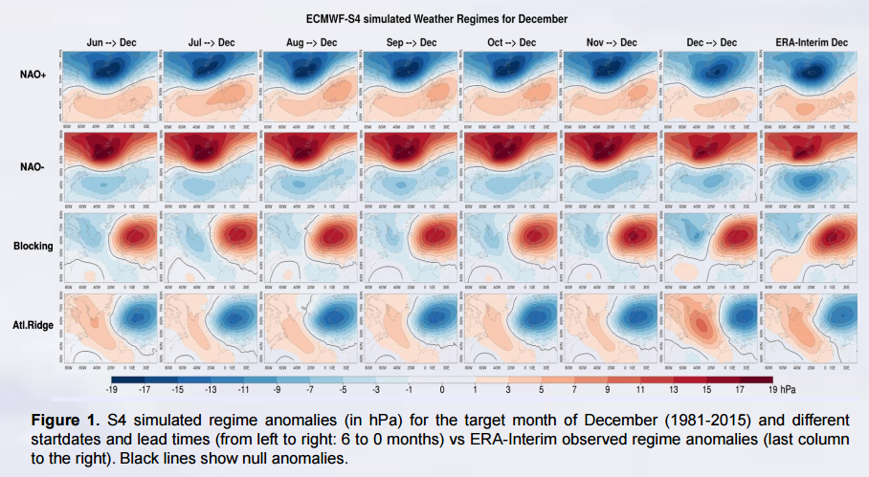
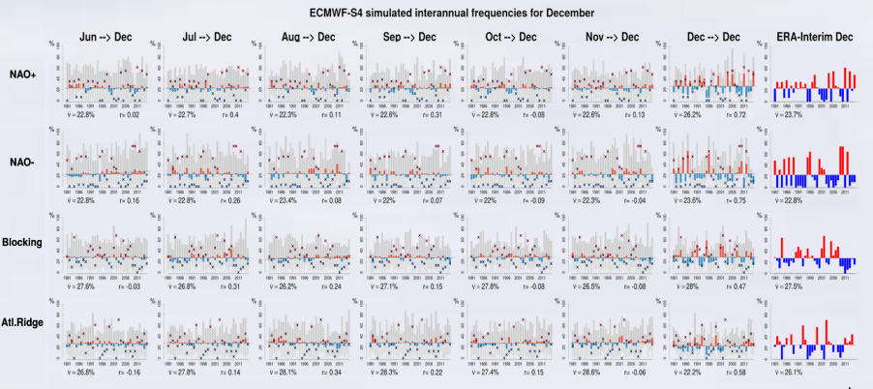
Climate Data
Cortesi et al. Weather regimes as a tool to validate seasonal forecasts (in prep)
Notes:
It is very important, but not necessarily easy to read, understand, choose, select,

Slide 7
Profiling a climate services team
Data
Information
Knowledge
75%
67%
2
1
1
1
2
Find the gaps in user understanding
Improve/translate scientific explanations to user-specific vocabulary
Communication material (fact sheets, outlooks)
All types of dissemination and user-engagement material (leaflets, videos, multimedia…)
SCIENCE
1
1
KTT
1
25%
33%
PhD
Post-Doc
Technical expert
Manager
Communication specialist
Notes:
This production chain for climate services is carried out in many institutions, but it is done by actual people by teams. Here I want to explain our example at BSC on how the team has evolved multidisciplinary team as our understanding on climate services creation has grown

Slide 8
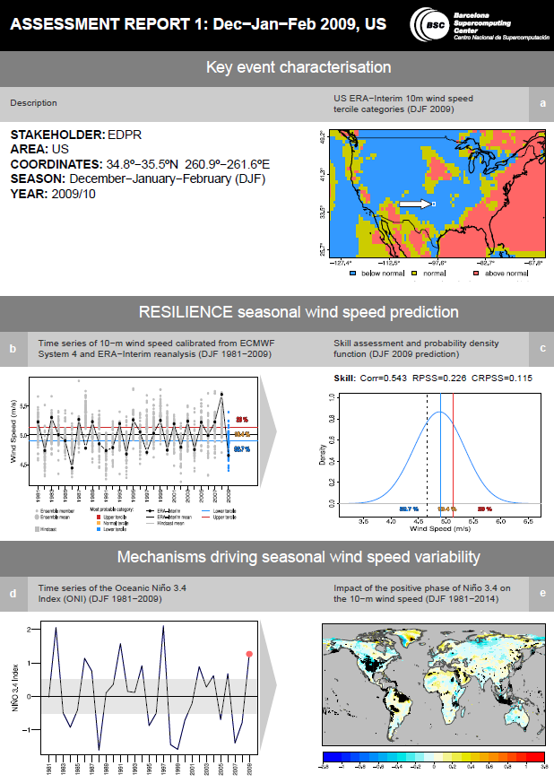
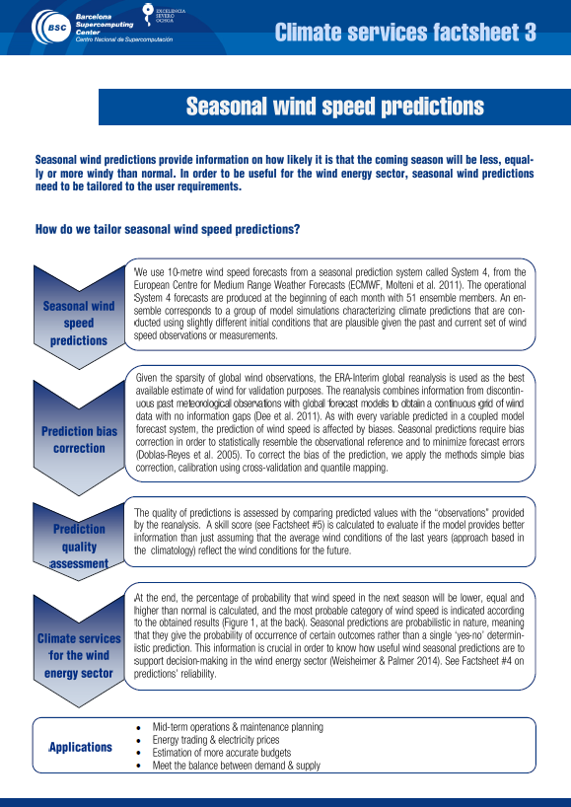
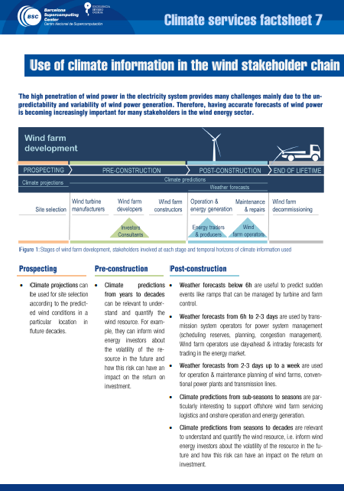
Climate information

Slide 9
Profiling a climate services team
Data
Information
Knowledge
75%
67%
60%
2
1
1
1
2
1
1
4
Systematic approach to users
Quantitative assessments of user-engagement measures
Analyse and publish the lessons learnt in our experience in climate services.
SCIENCE
1
1
1
2
1
KTT
1
25%
33%
40%
PhD
Post-Doc
Technical expert
Manager
Communication specialist
Social scientist
Notes:
This production chain for climate services is carried out in many institutions, but it is done by actual people by teams. Here I want to explain our example at BSC on how the team has evolved multidisciplinary team as our understanding on climate services creation has grown

Slide 10
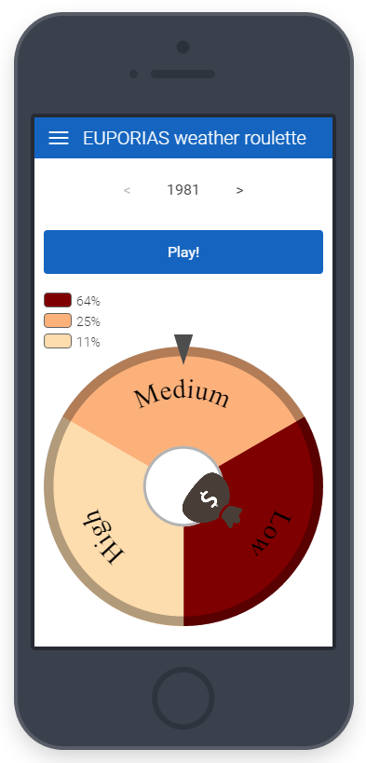
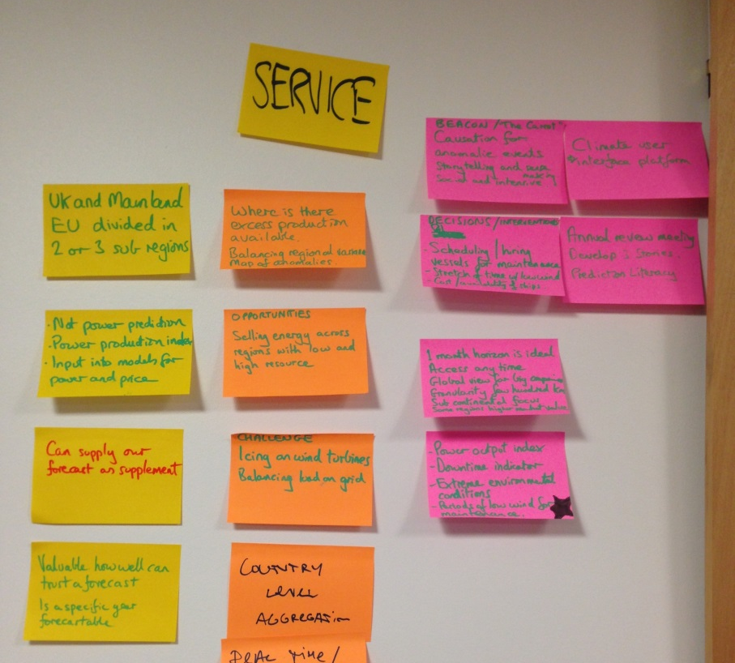
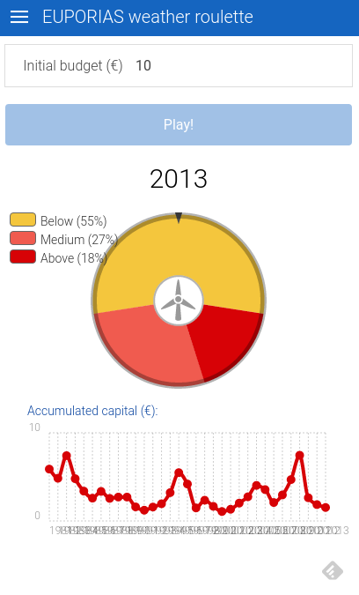
Climate knowledge
User engagement practices (workshops, focus groups, interviews, surveys
Reaching users in Innovative ways
Weather roulette app
Notes:
Improve user-engagement techniques

Slide 11
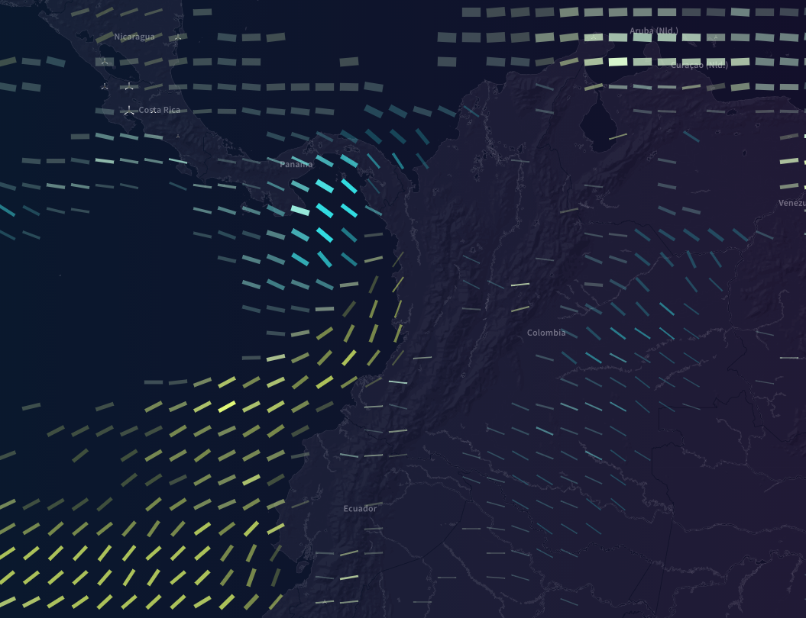
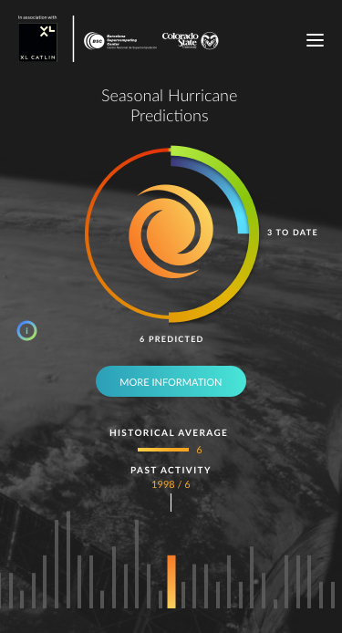
Climate knowledge
www.project-ukko.net
www.seasonalhurricanepredictions.org
Notes:
Final products, or services. That User friendly platforms

Slide 12
Profiling a climate services team
Data
Information
Knowledge
75%
67%
60%
50%
2
1
1
1
2
1
1
4
1
1
4
SCIENCE
1
2
1
2
1
1
1
2
1
KTT
1
25%
33%
40%
50%
Designer feedback on data visualisation (figures, color scales, etc)
Development of advanced data visualisation platforms
User interface evaluations (e.g. eye tracking)
PhD
Post-Doc
Technical expert
Manager
Communication specialist
Social scientist
Visualisation team
Notes:
This production chain for climate services is carried out in many institutions, but it is done by actual people by teams. Here I want to explain our example at BSC on how the team has evolved multidisciplinary team as our understanding on climate services creation has grown

Slide 13
Conclusions
Multidisciplinary teams allow multiple perspectives and problem-solving approaches. Distributed teams have very steep learning curves, it requires a lot of effort and time, and are not always easy to manage and facilitate.
PhDs
Post-Docs
Technical experts
Managers
Communication specialists
Social scientists
Visualisation team
Climate services can’t afford following a unidirectional path. More importantly: creating a climate service is not even a linear process.
Data
Information
Knowledge
Data
Information
Knowledge
Only by doing things different you can find different solutions
Notes:
Conclusions

Slide 14
Thank you!
Isadora.jimenez@bsc.es
@isadorachristel
The research leading to these results has received funding from the EU Seventh Framework Programme FP7 (2007-2013) under grant agreement GA 308291 and the Ministerio de Economía y Competitividad (MINECO) under project CGL2013-41055-R

