Slide 1
The (in)visibility of women in science
Anna Lupon CEAB-CSIC, Gender AIL
©Graciela Gil-Romera

Slide 2
Today’s talk
1. Women in science
2. The obstacles
3. The solutions

Slide 3
Women in science

Slide 4
POPULATION THEORY
SKEWED
SEX RATIO
BALANCED SEX RATIO

Slide 5
POPULATION THEORY
51%
Catalonia

Slide 6
POPULATION THEORY
51%
34%
Catalonia
Science in Catalonia

Slide 7
POPULATION THEORY
34%
40%
30%
Catalonia
World
Spain

Slide 8
POPULATION THEORY
48%
20%
Temporal Staff
Permanent Staff
“
«Dones i Ciència» Report,
Catalonia Goverment, 2018

Slide 9
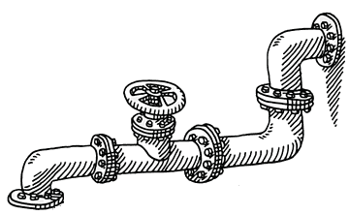
THE LEAKY PIPELINE

Slide 10
THE LEAKY PIPELINE
#FUNFACT:
50% WOMEN “DROP” ACADEMIA

Slide 11
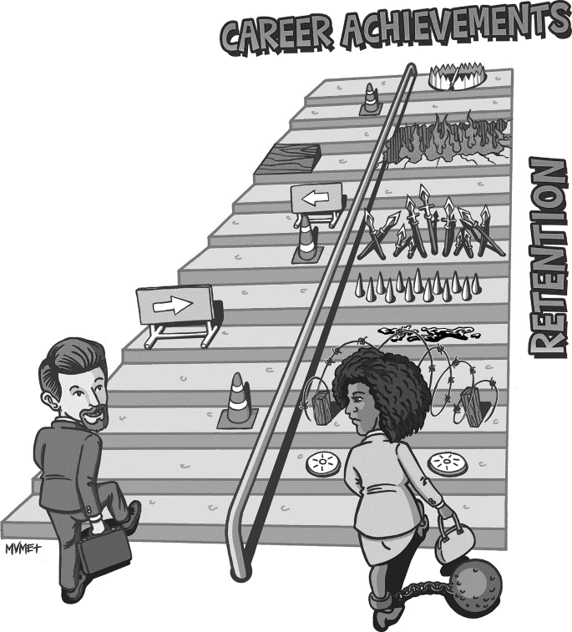
THE HOSTILE OBSTACLE COURSE
Asmeret A. Berhe et al., Nat. Geosci., 2022

Slide 12
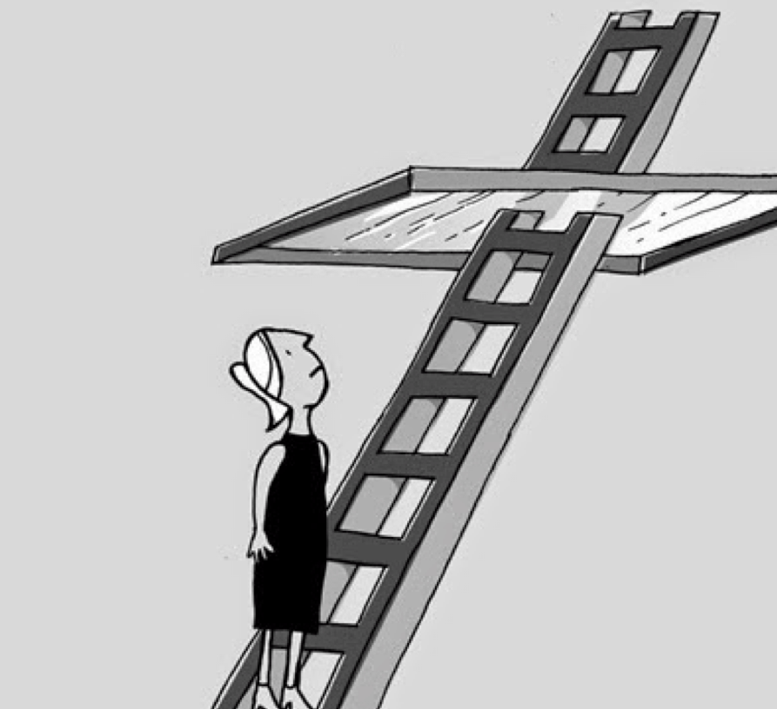
THE GLASS CEILING
% men highest level % men lower level
1
Similar opportunities
>1
Men have more opportunities

Slide 13
THE GLASS CEILING
% men highest level % men lower level
1
Similar opportunities
>1
Men have more opportunities
2.03
«Dones i Ciència» Report,
Catalonia Goverment, 2018

Slide 14
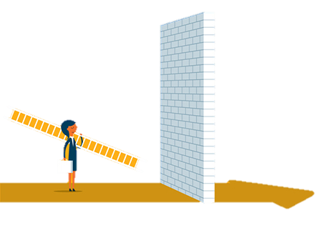
The obstacles

Slide 15
The obstacles
1. Steoretype
2. Evaluation bias
3. Chilly environment
4. Work-life balance

Slide 16
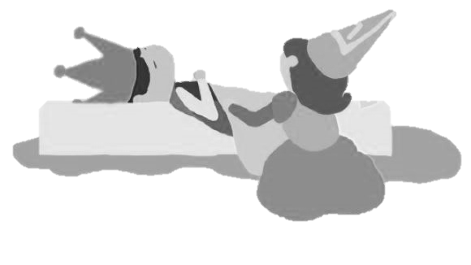
obstacle 1. stereotypeS

Slide 17
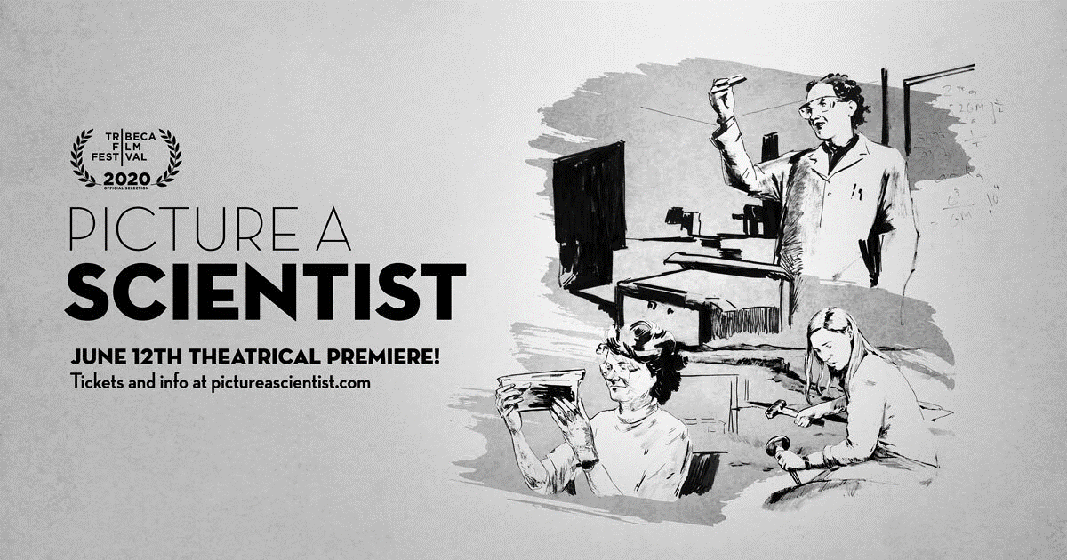
MAN
SCIENCE
WOMAN
HOME

Slide 18
MAN
SCIENCE
WOMAN
HOME
PAUL

Slide 19
MAN
SCIENCE
WOMAN
HOME
BIOLOGY

Slide 20
MAN
SCIENCE
WOMAN
HOME
ANNE

Slide 21
MAN
SCIENCE
WOMAN
HOME
KITCHEN

Slide 22
MAN
SCIENCE
WOMAN
HOME
MARK

Slide 23
MAN
SCIENCE
WOMAN
HOME
CHEMISTRY

Slide 24
MAN
SCIENCE
WOMAN
HOME
CHILDREN

Slide 25
MAN
SCIENCE
WOMAN
HOME
MARIA

Slide 26
MAN
SCIENCE
WOMAN
HOME
GARDEN

Slide 27
MAN
SCIENCE
WOMAN
HOME
ENGINEERING

Slide 28
MAN
SCIENCE
WOMAN
HOME
BEN

Slide 29
MAN
SCIENCE
WOMAN
HOME
KAREN

Slide 30
MAN
SCIENCE
WOMAN
HOME
LABORATORY

Slide 31
MAN
SCIENCE
WOMAN
HOME
SUSAN

Slide 32
MAN
SCIENCE
WOMAN
HOME
WEDDING

Slide 33
MAN
SCIENCE
WOMAN
HOME
COMPUTER

Slide 34
MAN
SCIENCE
WOMAN
HOME
MARTHA

Slide 35
MAN
SCIENCE
WOMAN
HOME
CLEANING

Slide 36
MAN
SCIENCE
WOMAN
HOME
JOHN

Slide 37
MAN
SCIENCE
WOMAN
HOME
PHYSICS

Slide 38
MAN
SCIENCE
WOMAN
HOME
BSC

Slide 39
MAN
HOME
WOMAN
SCIENCE

Slide 40
MAN
HOME
WOMAN
SCIENCE
SUSAN

Slide 41
MAN
HOME
WOMAN
SCIENCE
BIOLOGY

Slide 42
MAN
HOME
WOMAN
SCIENCE
KITCHEN

Slide 43
MAN
HOME
WOMAN
SCIENCE
JOHN

Slide 44
MAN
HOME
WOMAN
SCIENCE
MARIA

Slide 45
MAN
HOME
WOMAN
SCIENCE
CHILDREN

Slide 46
MAN
HOME
WOMAN
SCIENCE
ENGINEERING

Slide 47
MAN
HOME
WOMAN
SCIENCE
MARK

Slide 48
MAN
HOME
WOMAN
SCIENCE
GARDEN

Slide 49
MAN
HOME
WOMAN
SCIENCE
CHEMISTRY

Slide 50
MAN
HOME
WOMAN
SCIENCE
BSC

Slide 51
MAN
HOME
WOMAN
SCIENCE
MARTHA

Slide 52
MAN
HOME
WOMAN
SCIENCE
LABORATORY

Slide 53
MAN
HOME
WOMAN
SCIENCE
PAUL

Slide 54
MAN
HOME
WOMAN
SCIENCE
PHYSICS

Slide 55
MAN
HOME
WOMAN
SCIENCE
KAREN

Slide 56
MAN
HOME
WOMAN
SCIENCE
WEDDING

Slide 57
MAN
HOME
WOMAN
SCIENCE
ANNE

Slide 58
MAN
HOME
WOMAN
SCIENCE
PETER

Slide 59
MAN
HOME
WOMAN
SCIENCE
CLEANING

Slide 60
WHAT HAPPENED?

Slide 61
DRAW A SCIENTIST
5 YEARS OLD
50% women
Regardless the gender
15 YEARS OLD
20% women
42% girls vs. 4% boys
David I. Miller et al.
SRDC 2018

Slide 62
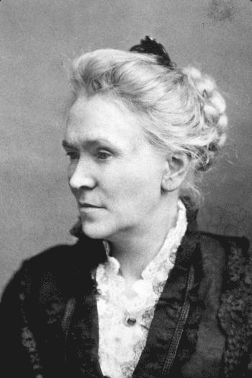
CAUSES: LACK OF ROLE MODELS
MATILDA
EFFECT
Women scientists
who have been ignored, denied credit
or dropped from sight.
Matilda J. Gage

Slide 63
BOOKS & MEDIA
In Spain, 40% of scientists are women, but ...
8%
17%
High school books
Newspapers
Ana López et al. 2009
http://meso.uv.es/informe/index.php

Slide 64
BOOKS & MEDIA
In Spain, 40% of scientists are women, but ...
TEST YOURSELF:
www.genderlimno.edu
8%
17%
High school books
Newspapers
Ana López et al. 2009
http://meso.uv.es/informe/index.php

Slide 65
CONFERENCES
52% of attendees were women, but ...
33%
30%
28%
33%
ORGANIZING BOARD
LAST AUTHOR
CONVENERS
KEYNOTE SPEAKERS
Anna Lupon et al.
PlosOne 2021

Slide 66
OBSTACLE 2.
EVALUATION
BIAS

Slide 67
IMPLICIT & EXPLICIT BIASES
IMPLICIT BIAS
EXPLICIT BIAS
Unconscious prejudice against female scientists, whose work is underestimated.
Conscious prejudice against female scientists, considering them inferior.
(related to sexism)

Slide 68
JENNIFER vs. JOHN
Same CV, different name
Corine A. Moss-Racusin et. al.
PNAS 2012

Slide 69
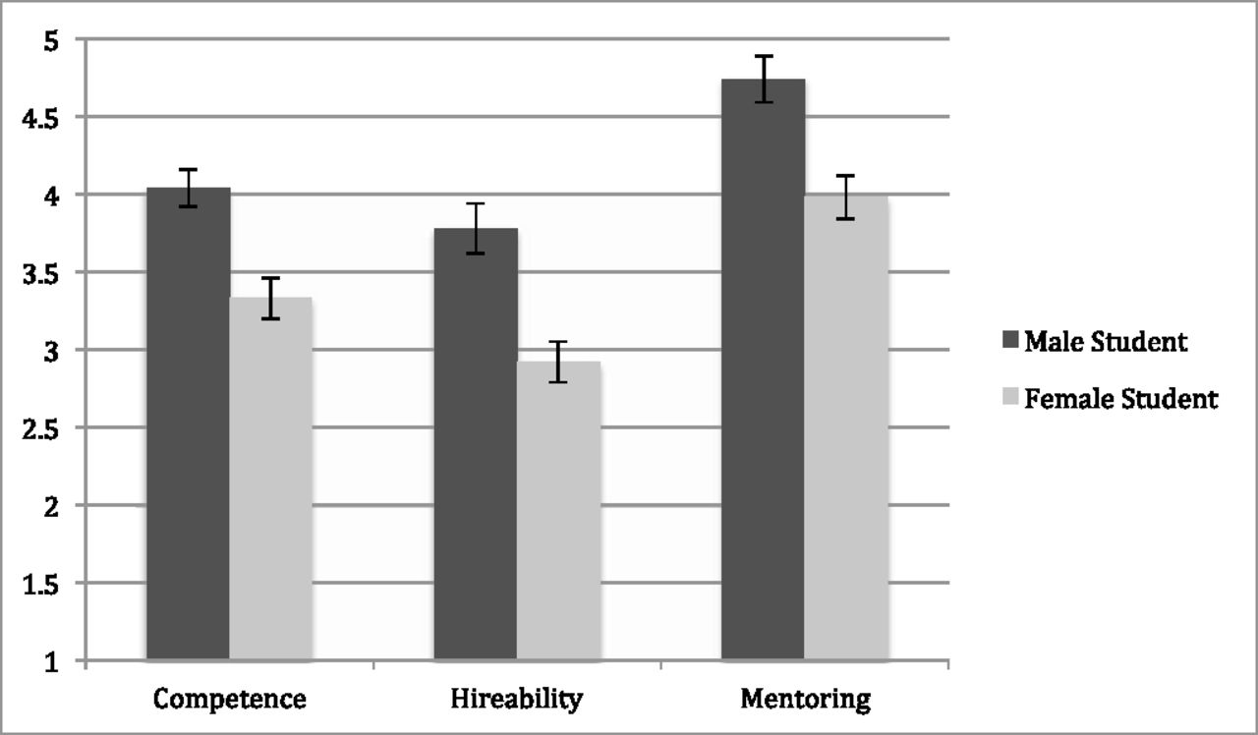
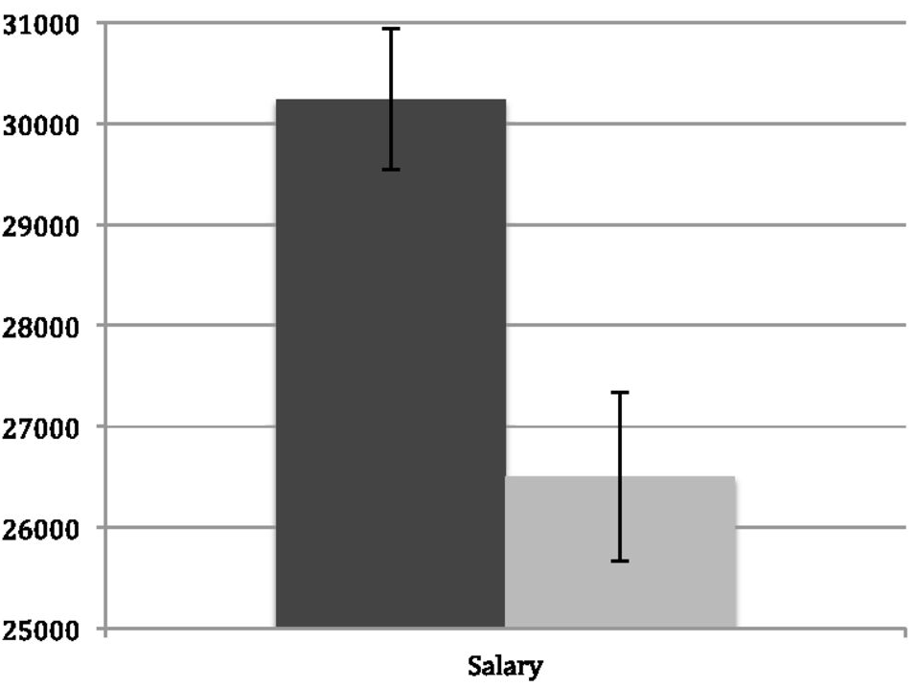
JENNIFER vs. JOHN
Same CV, different name
Grade: 1 point difference
Salary: 13% difference
Corine A. Moss-Racusin et. al.
PNAS 2012

Slide 70
JENNIFER vs. JOHN
 | John |  | Jennifer
 | Male Faculty | Female Faculty | Male Faculty | Female Faculty
Competence | 4.01 | 4.1 | 3.33 | 3.32
Hireability | 3.74 | 3.92 | 2.96 | 2.84
Mentoring | 4.74 | 4.73 | 4.00 | 3.91
#FunFact:
Both women & men have it!
Corine A. Moss-Racusin et. al.
PNAS 2012

Slide 71
SWEDISH MEDICAL UNIVERISTY
Assistant Professor
External reviewer score
Composite Bibliometric Score
Emma R. Andersson et al.
Front. Res. Metr. Anal., 2022

Slide 72
SWEDISH MEDICAL UNIVERISTY
Assistant Professor
#FunFact:
Both women & men have it!
External reviewer score
Composite Bibliometric Score
Emma R. Andersson et al.
Front. Res. Metr. Anal., 2022

Slide 73
obstacle 3.
Chilly enviroment

Slide 74
80% papers led by men only have male coauthors
80% awards are earned by men in Spain (2000-2015)
CHILLY ENVIRONMENT
70% plenary speakers in conferences are men
10% more citations papers written by men
Subtle cues of not belonging
Some sources: Vincent Larivière et al. Nature 2013; Charles W. Fox et al. Ecol & Evol 2019; Neven Caplar et al. Nat Astronomy 2017; Cooper M. Farr et al. BioScience 2017; Jacklyn Biggs et al. Sex Roles 2018.

Slide 75
THE ICEBERG
MURDER
RAPE
SEXUAL HARASSMENT
PHYSICAL & EMOTIONAL ABUSE
VISIBLE
DISRESPECT OF WOMEN
GENDER STEREOTYPES
SEXIST JOKES
UNEQUAL PAY
MERITOCRACY MYTH
SEXIST LENGAGUE
SUBTE EXCLUSION
INVISIBLE

Slide 76
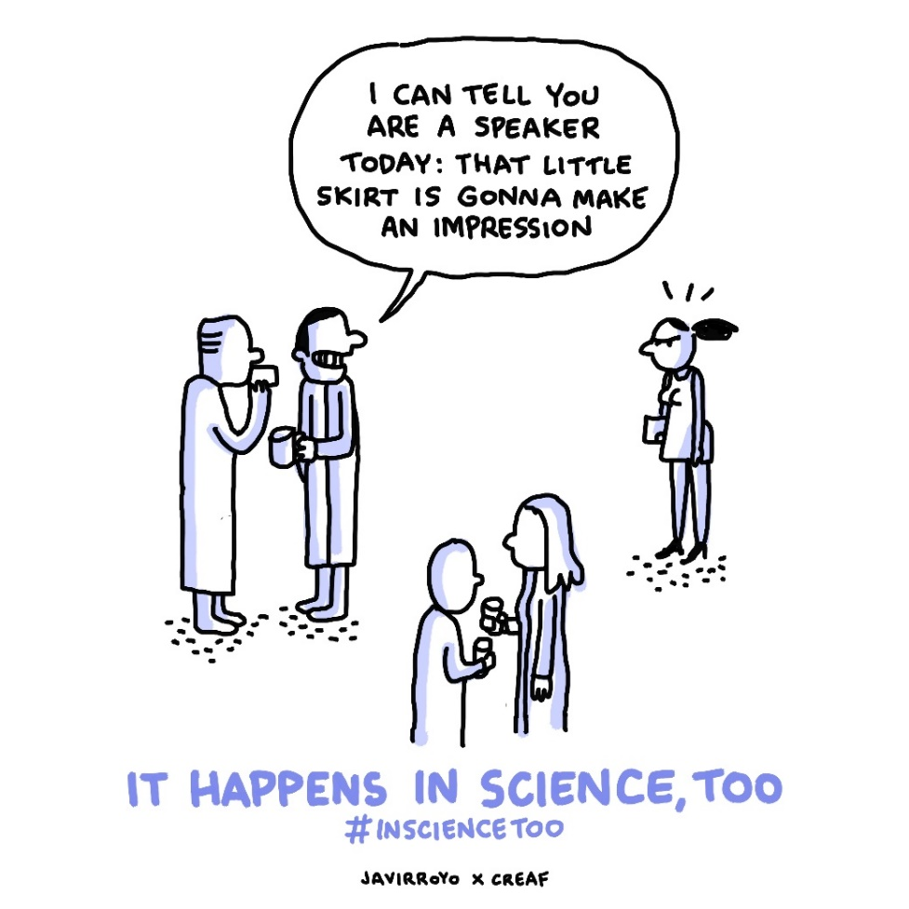
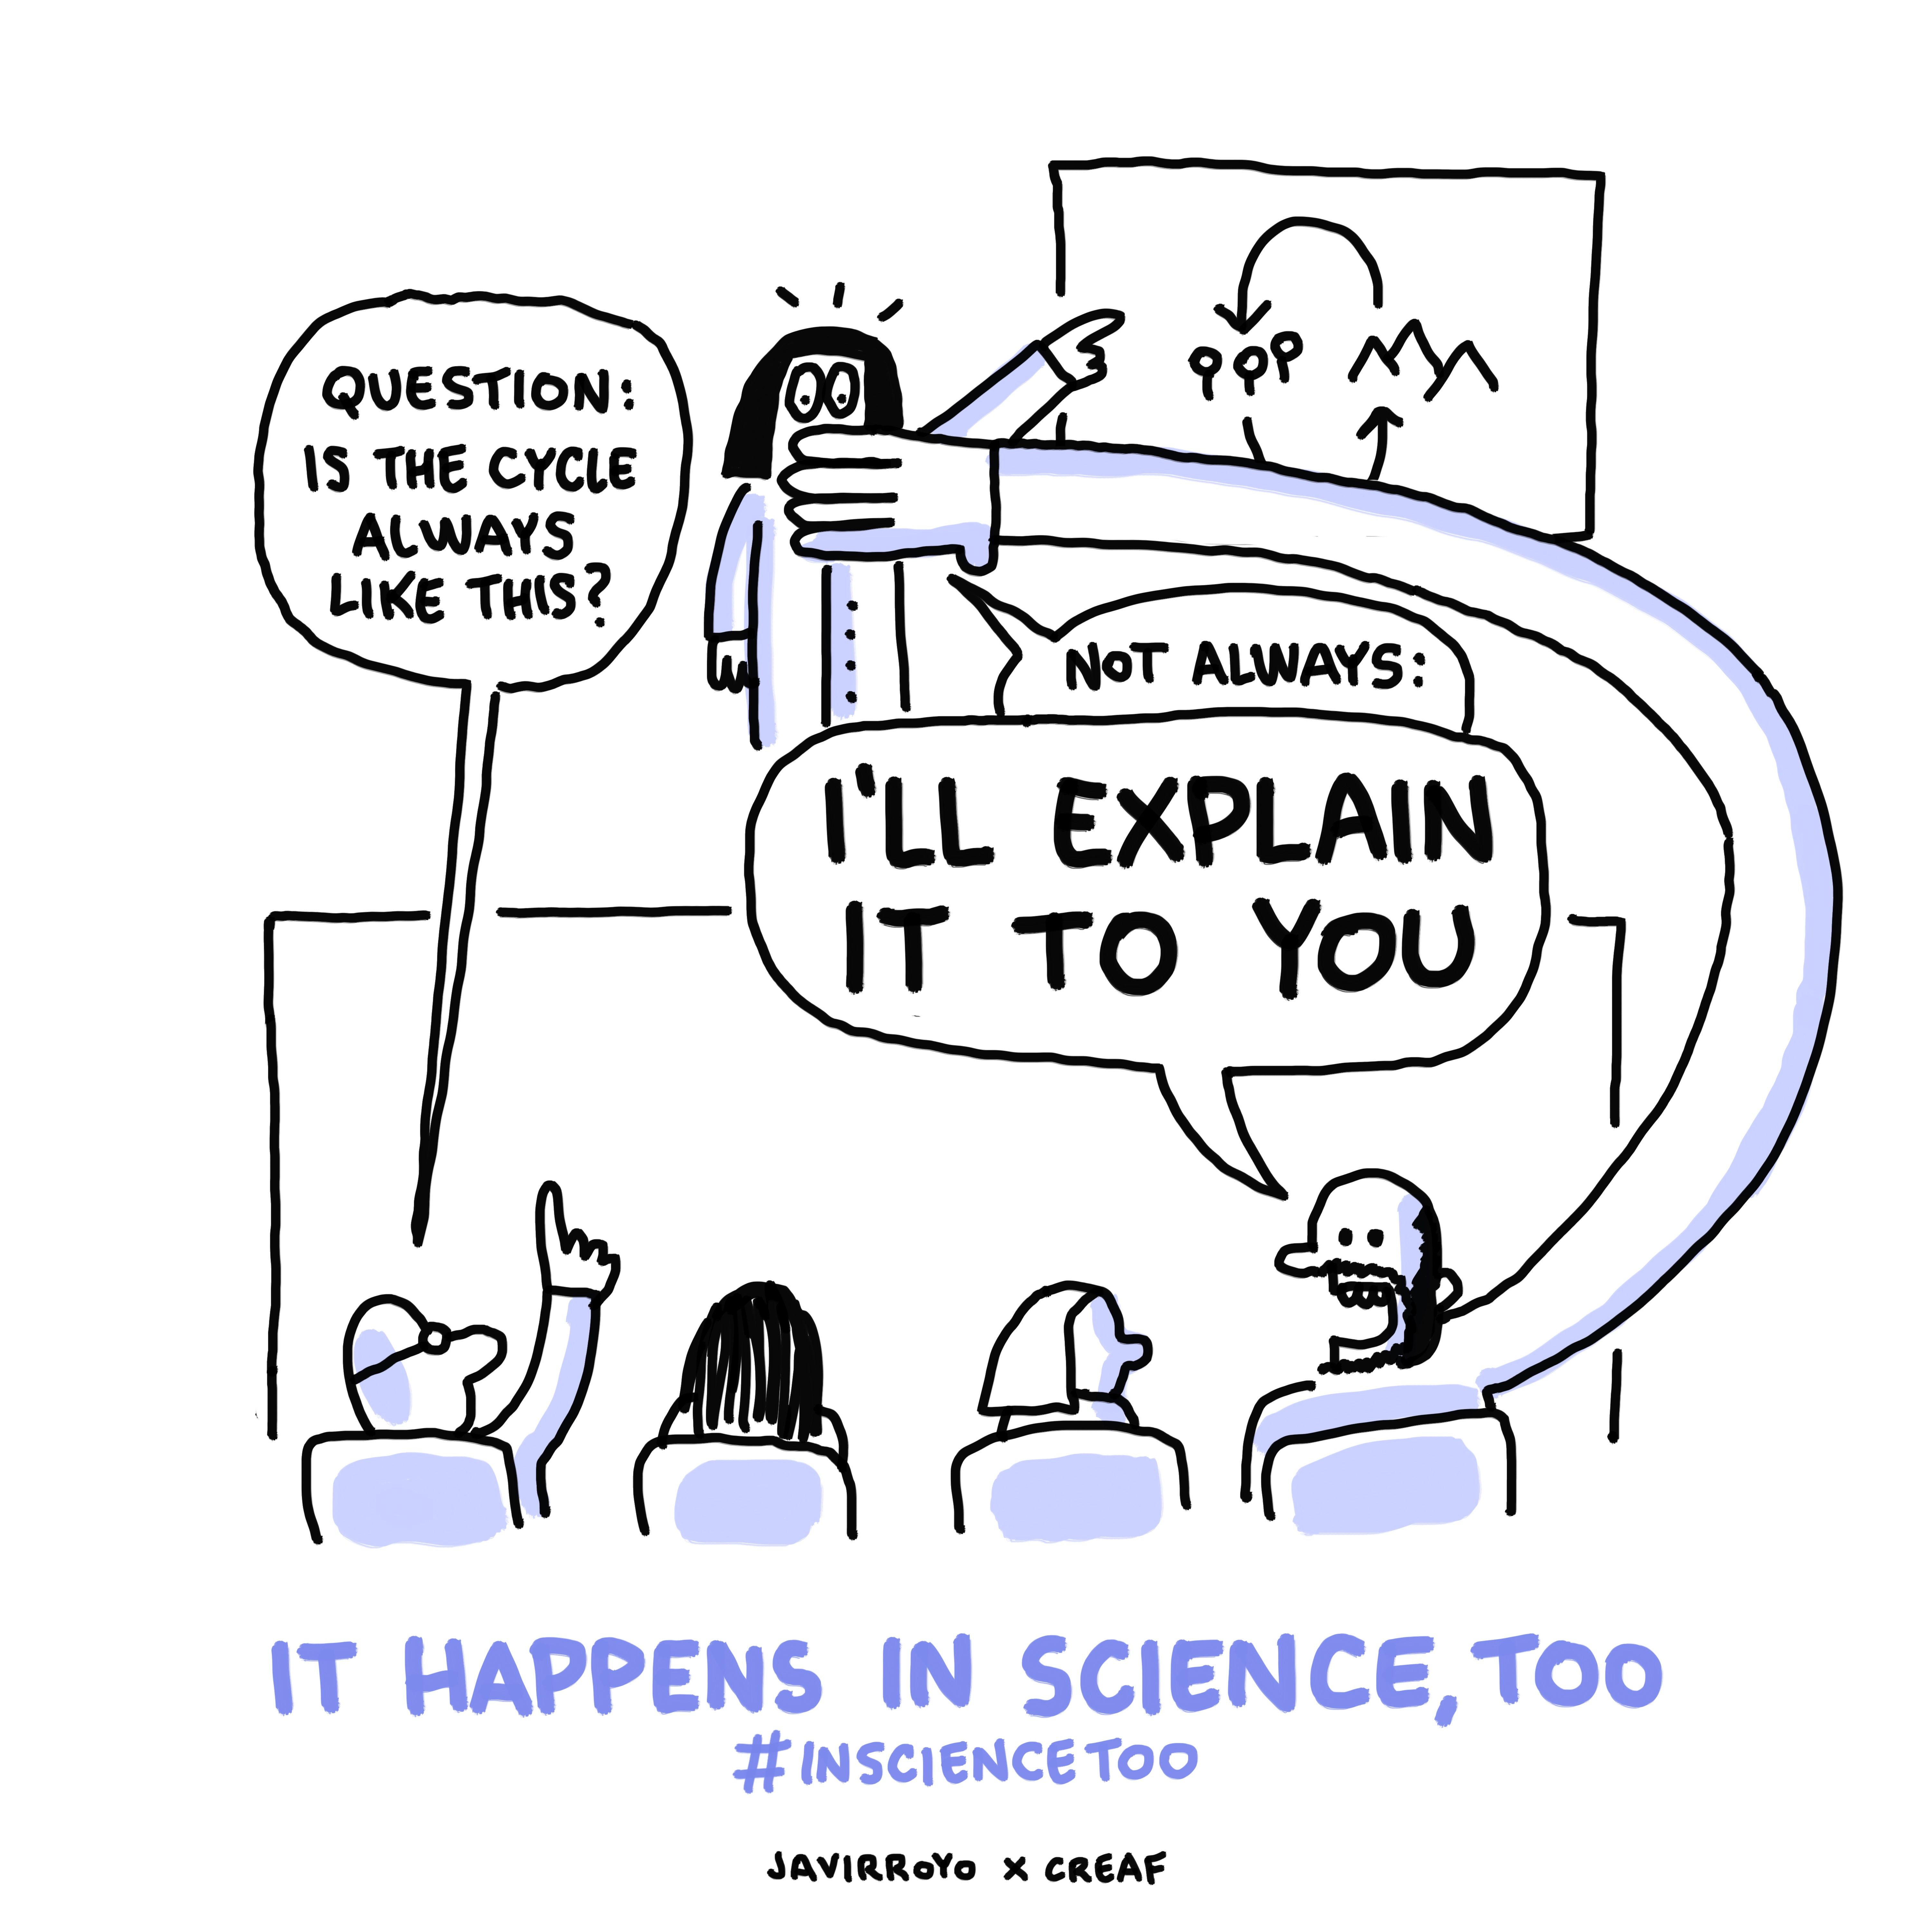
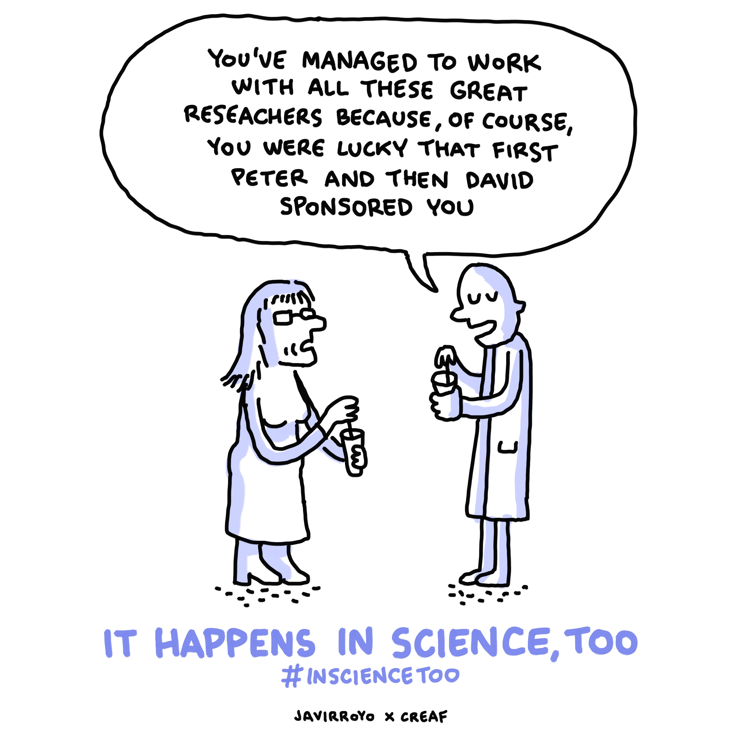
EXAMPLES

Slide 77
MORE EXAMPLES
27%
63%
80%
Have suffered sexual harassment
Feel isolated
Have experienced microaggressions
The Athena Factor, 2006

Slide 78
OBSTACLE 4.
WORK-LIFE BALANCE

Slide 79
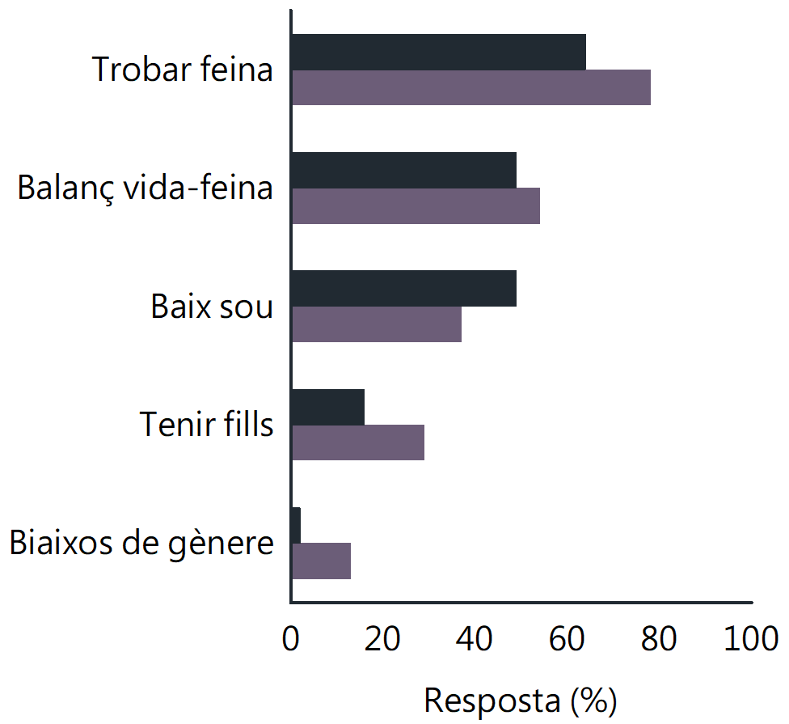
CAREER OBSTACLES
Job scarcity
Work-life balance
MATERNITY
VS.
PATERNITY
Low salary
Children
Gender bias
0 20 40 60 80 100
Answer (%)
Maria M. Sánchez-Montoya et. al.
Limnetica, 2016

Slide 80
COVID & TELEWORKING
WOMEN
MEN
PEOPLE IN CHARGE
DOMESTIC TASKS
OBSTACLES
MOOD
WORKING SPACE
WHO DOES THE DOMESTIC TASKS?
48% SHE
EQUAL 78%
DEI Commission
CEAB-CSIC, 2020

Slide 81
Removing the obstacles

Slide 82
RECOMMENDATIONS
Increasing women’s visibility books & newspapers papers, awards departments, conferences
WHAT CAN WE DO?
Notes:
Among a list of strategies that can be performed to reduce gender inequality at future research conferences, five of them were considered important by >60% of respondents:

Slide 83
ASSOCIATIVE GENDER SORTING
man & man,
woman & woman)
male
convener
Female
convener
48%
15%
KEYNOTE SPEAKER
88% MALE
KEYNOTE SPEAKER
66% FEMALE
Anna Lupon et al.
PlosOne 2021

Slide 84
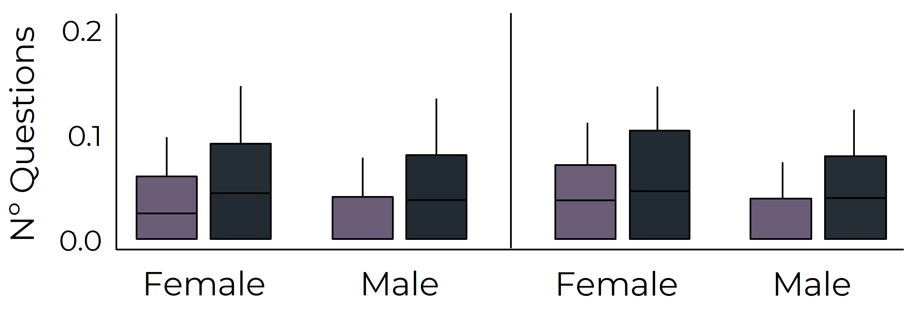
STEREOTYPE INOCULATION MODEL
SPEAKER
CONVENER
32% QUESTIONS
ASKED BY WOMEN
***
***
Female Questioner
Male Questioner
Anna Lupon et al.
PlosOne 2021

Slide 85
RECOMMENDATIONS
Increasing women’s visibility books & newspapers papers, awards departments, conferences
WHAT CAN WE DO?
Policies & Training policies gender balance objective evaluations double blind evaluations
Notes:
Among a list of strategies that can be performed to reduce gender inequality at future research conferences, five of them were considered important by >60% of respondents:

Slide 86
CHANGE IN EVALUATION
CV + arithmetic task – similar performance men vs women
Pairs of man-woman – 50% male lower performer
Only CV
Arithmetic task
self-reported
Arithmetic task objective report
Ernesto Rabuen et. al.
PNAS, 2014
Notes:
Among a list of strategies that can be performed to reduce gender inequality at future research conferences, five of them were considered important by >60% of respondents:

Slide 87
CHANGE IN EVALUATION
Probability of picking a candidate who is a:
Female
34%
34%
43%
Male low performer
70%
92%
64%
Only CV
Arithmetic task
self-reported
Arithmetic task objective report
Ernesto Rabuen et. al.
PNAS, 2014
Notes:
Among a list of strategies that can be performed to reduce gender inequality at future research conferences, five of them were considered important by >60% of respondents:

Slide 88
RECOMMENDATIONS
Increasing women’s visibility books & newspapers papers, awards departments, conferences
Speaking out about biases plenary talks & round-tables, initial statements, studies & workshops
WHAT CAN WE DO?
Policies & Training policies gender balance objective evaluations double blind evaluations
Notes:
Among a list of strategies that can be performed to reduce gender inequality at future research conferences, five of them were considered important by >60% of respondents:

Slide 89
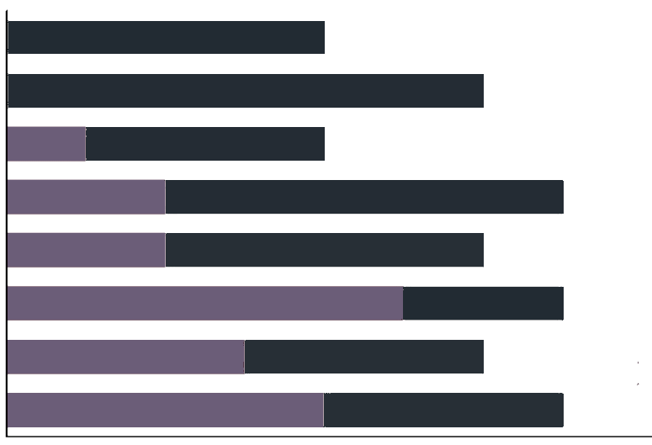
SPEAKING OUT
The GenderAIL was created
2006
2008
2010
2012
2014
2016
2018
2020
0 2 4 6 8
Plenary Speakers AIL Conferences
Notes:
Among a list of strategies that can be performed to reduce gender inequality at future research conferences, five of them were considered important by >60% of respondents:

Slide 90
RECOMMENDATIONS
Increasing women’s visibility books & newspapers papers, awards departments, conferences
Speaking out about biases plenary talks & round-tables, initial statements, studies & workshops
WHAT CAN WE DO?
Policies & Training policies gender balance objective evaluations double blind evaluations
Redesigning science structure of departments competitive vs. cooperative materials & location
Notes:
Among a list of strategies that can be performed to reduce gender inequality at future research conferences, five of them were considered important by >60% of respondents:

Slide 91
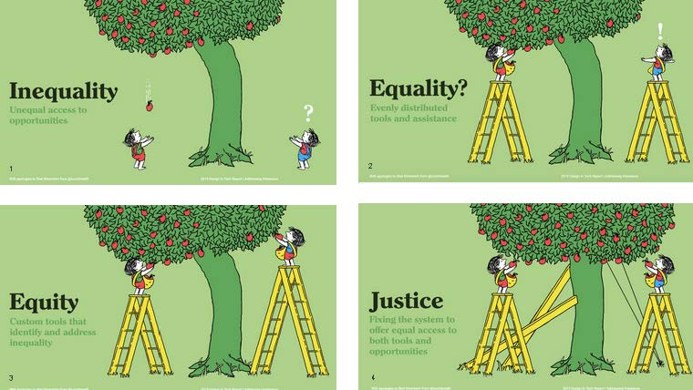
RECOMMENDATIONS

Slide 92
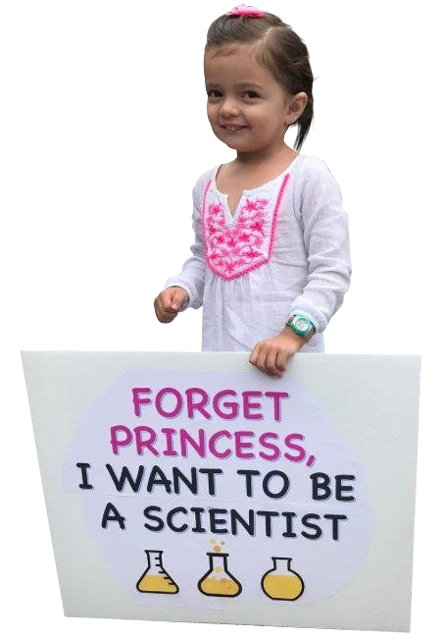
THANK
YOU!
@GenderAIL | genderscienceail@gmail.com | www.genderlimno.org
@AnnaLupon | alupon@ceab.csic.es | www.annalupon.com

Slide 93
ATTENDANCE TO TALKS
12%
7%
18%
Attendees
Female Speaker
Male Speaker
Anna Lupon et al.
PlosOne 2021

Slide 94
CONFERENCES
32%
% of respondents
17%
W
M
NO SATISFIED
VERY SATISFIED
Anna Lupon et al.
PlosOne 2021

