Slide 1
SPECS data repositories
Upload and access
PA Bretonnière (IC3 - BSC) - A. Stephens (STFC CEDA)
SPECS 4th GA - SMHI - 15-17/09/2015

Slide 2
SPECS data repositories
Status of the data
CMORization
Upload
Publication
ESGF update
Data access

Slide 3
Status of the data
Month 34/48:
CMORization running everywhere
Most of the institutes have already uploaded data to Jasmin
23 TB on Jasmin workspace - 31TB archived
3 datasets published on ESGF
1871 start dates uploaded

Slide 4
Status of the data
New shared document to facilitate the follow-up of the data movements:
https://docs.google.com/spreadsheets/d/1NSjt0l4TsoTQ8eayi1BhpPQQ7Jt4m_ZPKwnLetaig1A/edit?usp=sharing
Experiment | decadal | seasonal | horizlresImpact | soilMoistureInit | seaIceInit
Start date | 1992-2012 | 1981-2010 | 1993-2009 | 1981-2013 | 1979-2013
Data available on Jasmin workspace
Experiment | snowInit | improvedStratVertRes | phenology | aerosols | solarIrradiance
Start date | 1991-2012 | 1983-2013 | 1991-2013 | 1992-2010 | 2008-2015

Slide 5
ESGF update
Security incident detected in June
Update of the software stack and revision of security levels of the nodes ongoing
New policy about checksums (md5 -> sha256 )
Nodes expected to be back the week of the 21st of September
SPECS data will be visible 2 weeks after because of republication

Slide 6
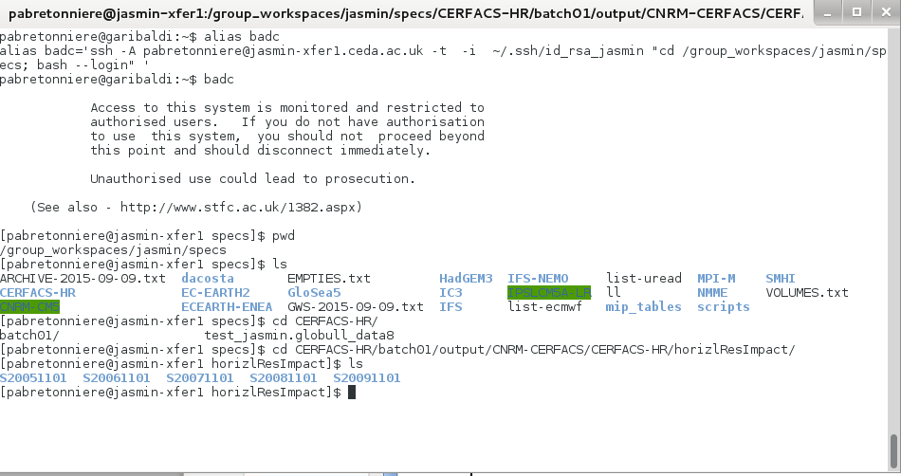
Data access
Browsing SPECS Jasmin workspace or archive in command line
ssh -A username@jasmin-xfer1.ceda.ac.uk
cd /group_workspaces/jasmin/specs ; cd /badc/specs

Slide 7
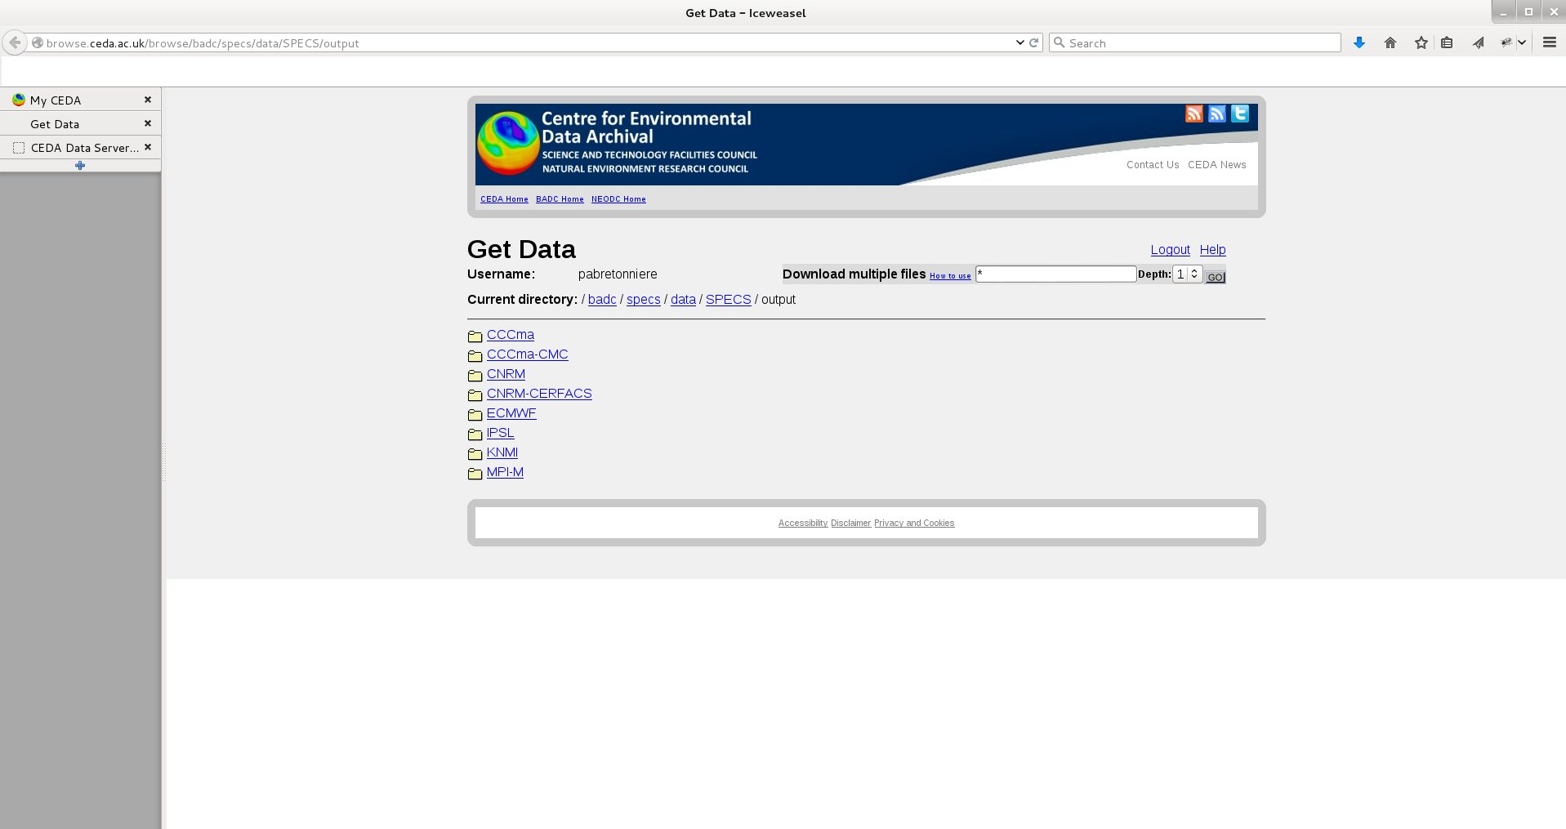
Data access
Web browser: This is a web-based service that allows you to browse the archive and download individual or multiple files (using the zip facility).
http://browse.ceda.ac.uk/browse/badc/specs/data/SPECS/output

Slide 8
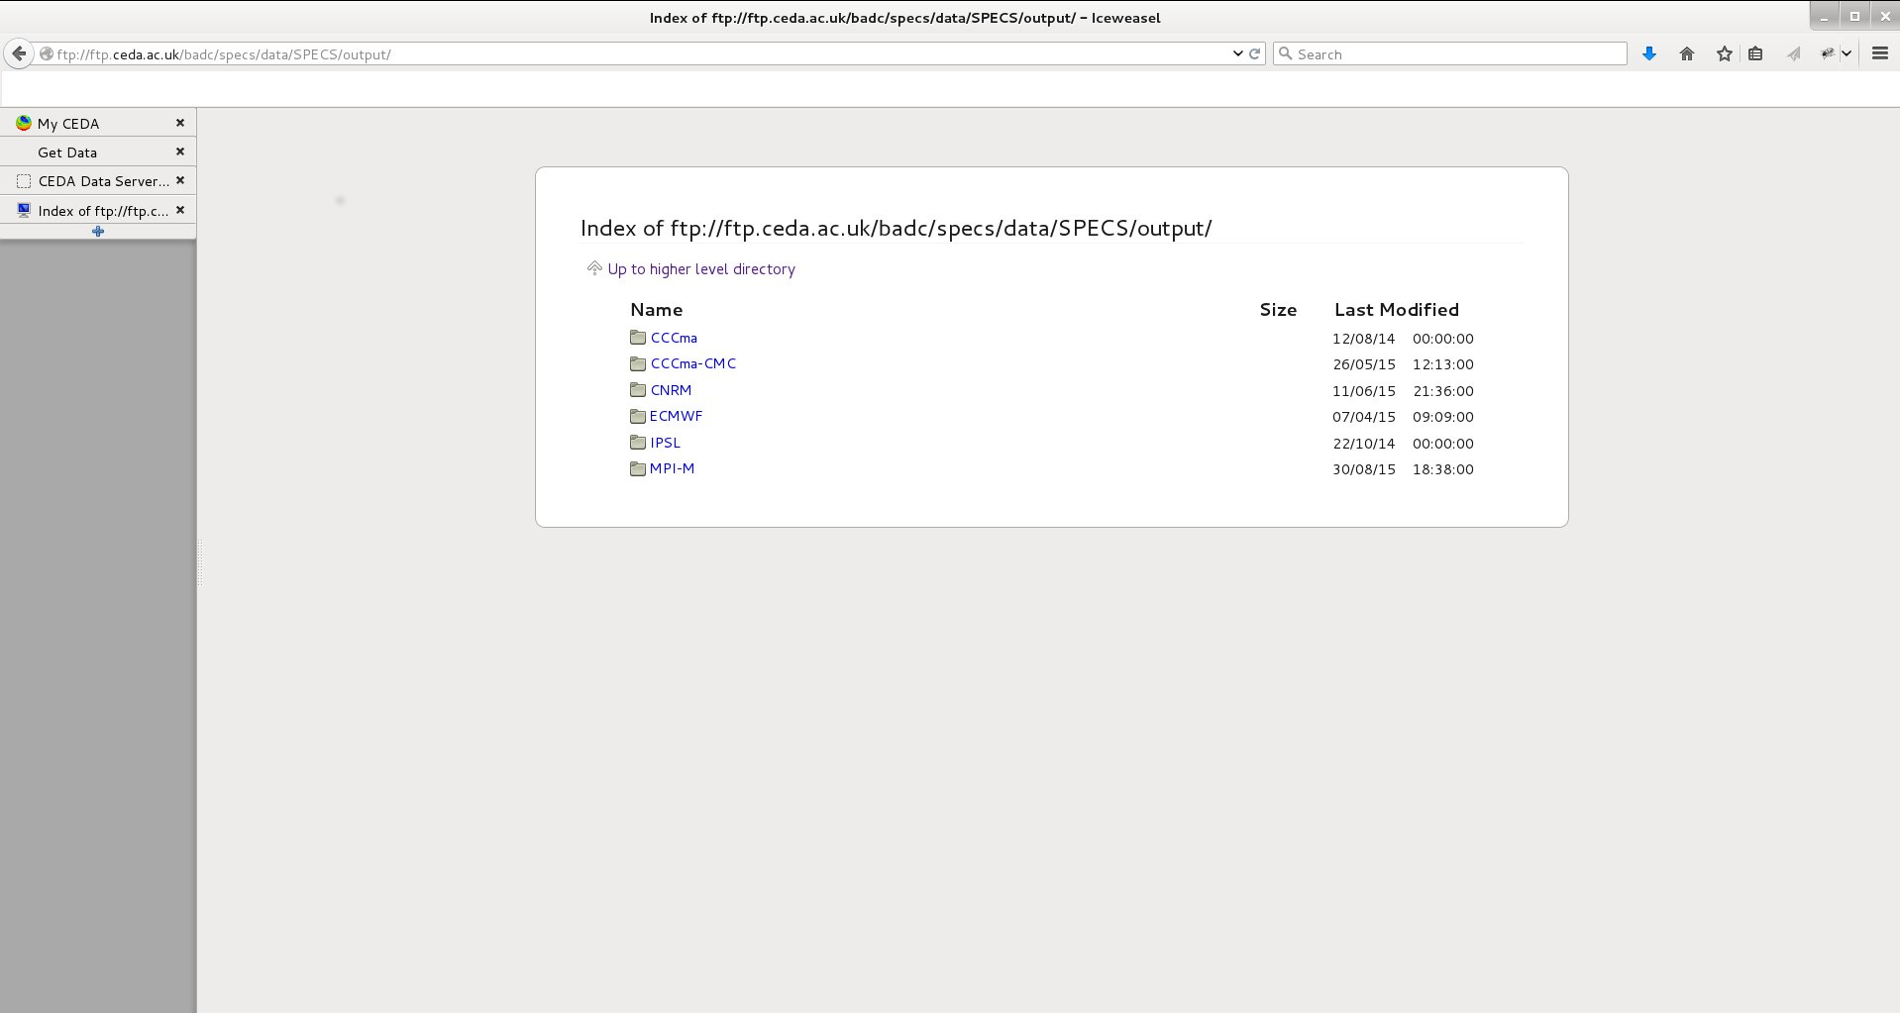
Data access
FTP server: ftp://ftp.ceda.ac.uk/badc/specs/data/SPECS/output

Slide 9
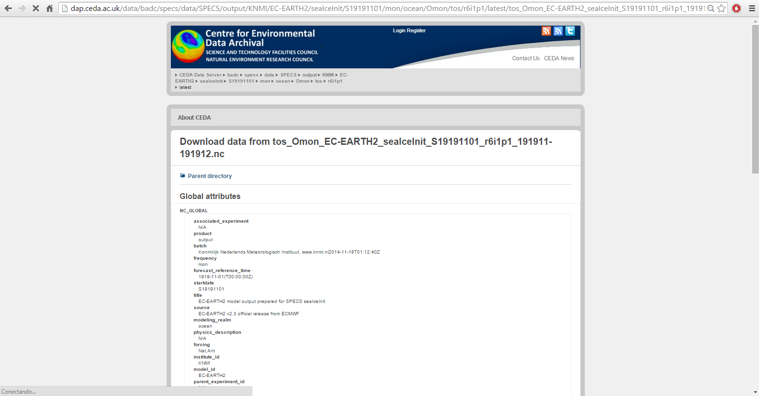
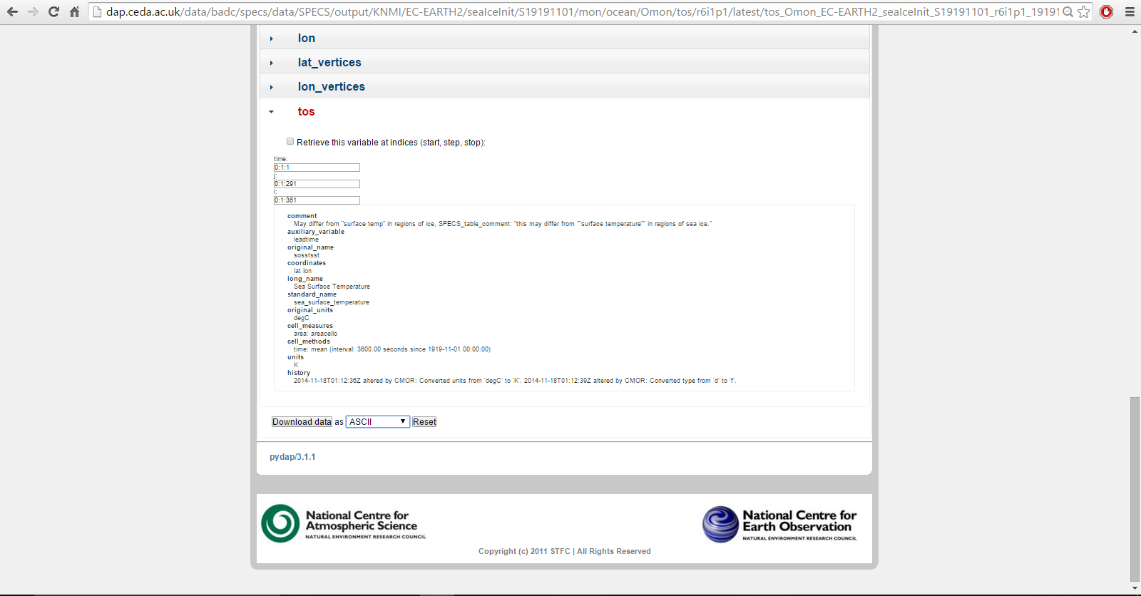
Data access
OpenDAP service: This is a web-based service that allows you to browse the archive download or subset files. It uses the OpenDap protocol for subsetting and is also accessible programmatically across the network
http://dap.ceda.ac.uk/data/badc/specs/data/SPECS/output

Slide 10
Conclusions
CMORization, upload and QC is taking time but data repositories are being populated to be shared among partners
The several different ways to access to the data allow a permanent and reliable access to the data
Work ongoing to solve the ESGF issues
For any information, SPECS wiki or pierre-antoine.bretonniere@ic3.cat
http://www.specs-fp7.eu/wiki/index.php/Data#Data_access

