Slide 1
Earth Sciences Department at the BSC
Road transport measures to improve air quality
Possible collaborations with SEAT
March, 2015

Slide 2
Outline
Objective
Introduction.
BSC and the Earth sciences department.
Air quality modelling.
Tools
Assessment of road transport management measures to improve air quality. Earth Sciences department experience.

Slide 3
Objective
The main objectives of this presentation is to give an overview of:
Our expertise regarding air quality modelling and its application for the assessment of road transport management measures.
Possible synergies and collaborations between BSC and SEAT.
Potential collaborations:
To analyze emission reductions (both air quality and green house gases; GHG) due to fleet renewal (electrified vehicles, new emission standards, etc.)
To assess air quality related impacts due to fleet renewal.
Combine observational data (massive sensor networks) with modelling techniques thanks to the availability of supercomputing resources an our experience in Big Data and internet of things.

Slide 4
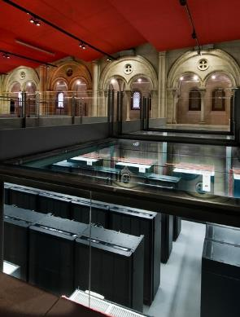
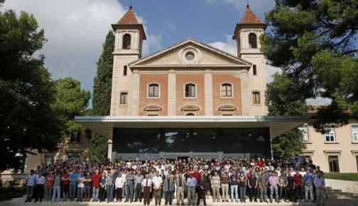
Introduction. Barcelona Supercomputing Center (BSC)
BSC is the National Supercomputing Facility in Spain. BSC manages MareNostrum, one of the most powerful supercomputers in Europe. The mission of BSC is to investigate, develop and manage information technology in order to facilitate scientific progress.
MareNostrum 3

Slide 5
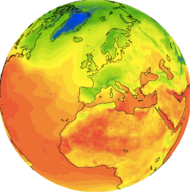
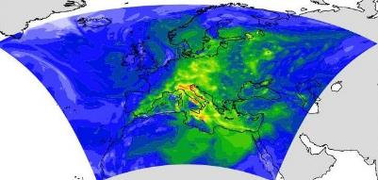
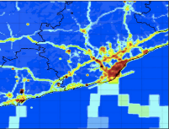
Introduction. Earth Sciences department at the BSC
Towards modeling the Earth System:
Development and implementation of regional and global state-of-the-art
models for air quality, meteorology, climate and health studies
Multiscale Models from Global to Local Scales

Slide 6
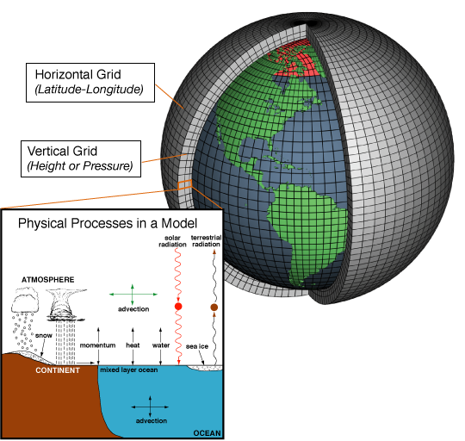
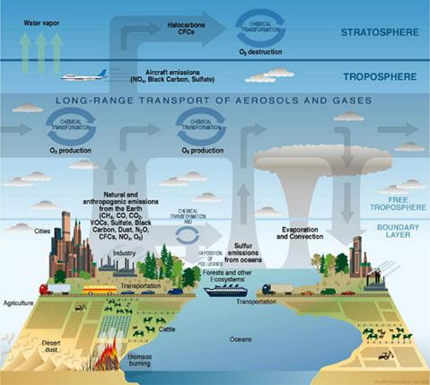
Introduciton. Air quality modelling
We model atmospheric composition processes by applying air quality modelling systems
Air quality modelling systems resolve atmospheric dynamics by combining: emission models, meteorological models and air quality models.

Slide 7
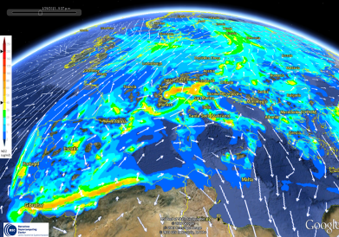
Tools
By combining highly qualified scientific researchers and in-house software and model developers, BSC has developed a complete range of air quality modelling tools to meet user requirements.
Main tools:
Air quality model: NMMB/BSC-AQ
Emission model: HERMES
Air quality forecast system: CALIOPE
Decision support tool: Source apportionment
Urban scale models

Slide 8
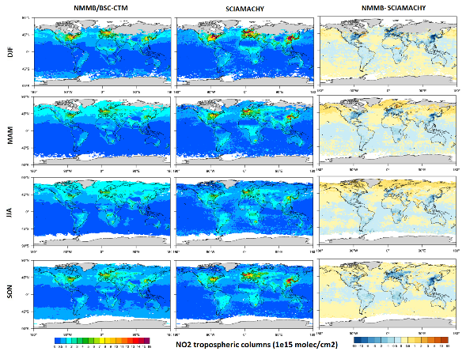
Tools. Air quality model: NMMB/BSC-AQ
The NMMB/BSC-AQ is an online multi-scale atmospheric model designed and developed at BSC-CNS in collaboration with NCEP, NASA and IRI.
(Spada et al., 2014 and Badia et al., 2014)
Multi-escale: from global (e.g at 0.1º spatial resolution) to regional scales.
Fully on-line coupling meteo-chemistry.
Forecast and diagnostic mode
NO₂ tropospheric columns modelled with the NMMB/BSC-AQ model (left) and comparison with satellite observations (Schicachy).

Slide 9
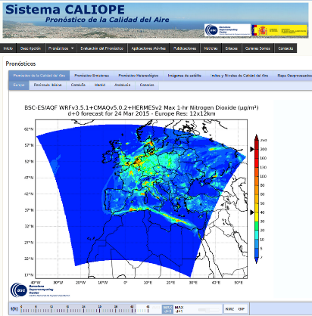
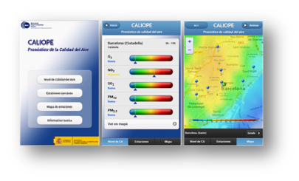
Tools. Air quality forecast system: CALIOPE
Air quality forecast systems provide air quality related information for the coming days and for the application of short term action plans for air quality managers.
Information is delivered using both online or custom applications:
www.bsc.es/caliope

Slide 10
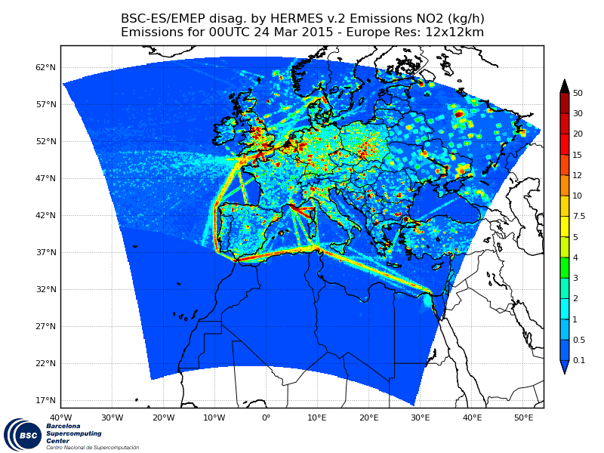
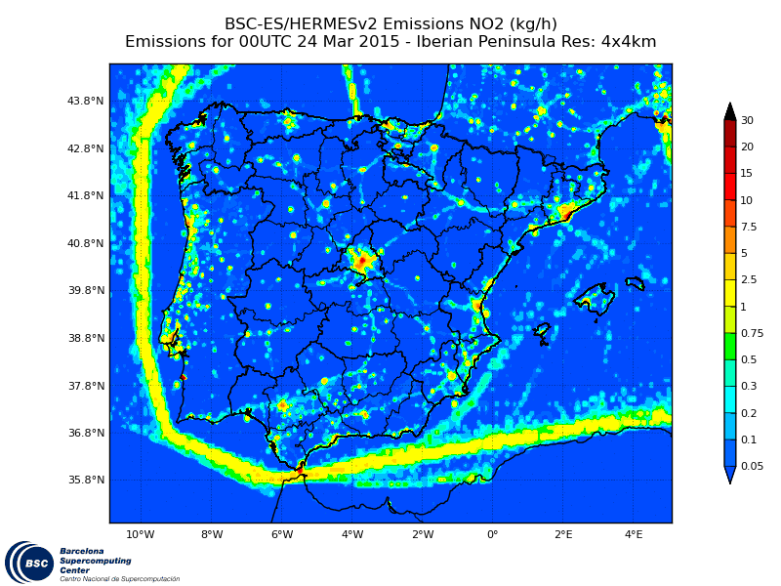
Tools. HERMES emission model
HERMESv2 (Guevara et al, 2013)
HERMESv2.0 is a in-house bottom-up emission model that estimates anthropogenic and biogenic emissions at a high spatial and temporal resolutions (1 km x 1 km, 1h).
Hourly NO₂ emissions for Europe and Spain

Slide 11
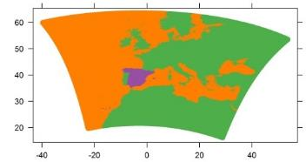
Tools. Source apportionment
Source apportionment is a decision support tool which provides comprehensive description of air quality related problems by relating emission sources and their air quality impacts.
LTO
Iberian Thermal Low
North Western Advection
Iberian Thermal Low
Air quality impacts by regions: Spain, Europe and others.

Slide 12
Tools. Micro-scale urban models
Micro-scale models to further assess air quality related problems in urban environments.
Currently, we are exploring the potential benefits of these kinds of models in collaboration with TNO, CSIC and U. Averio-CESAM.
Left: Satellite image of Barcelona. Detail of Passeig de Gràcia street, from Diagonal street (top left corner) to Plaça Catalunya (bottom right corner).
Right: For the same area: Locations of several traffic stations (red dots) and the corresponding road network with traffic information. Detailed information of the buildings including the height of each building.

Slide 13
Tools. Sensor networks for air quality studies.
As air quality management problems become more complex, there is a need for enhanced air quality and exposure monitoring capabilities.
Mobile sensor networks have the potential to developing spatially resolved data on air quality in local areas and allow monitoring near emissions sources helping communities understand near-source exposures.
The BSC is involved in the GrowSmarter European project which aims to simulate city uptake of smart solutions.

Slide 14
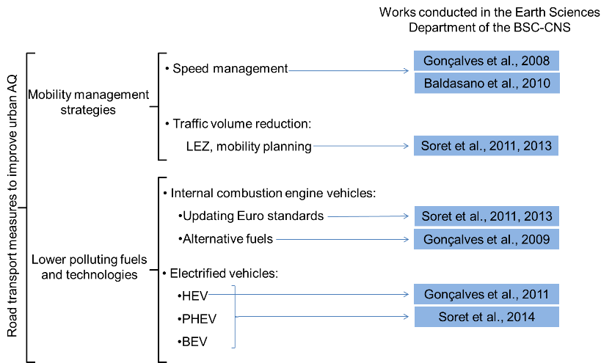
Road transport measures to improve air quality. Earth Sciences department experience
Experience on emission and air quality assessments. Several works have analyzed the impact of different management measures regarding road transport sector:

Slide 15
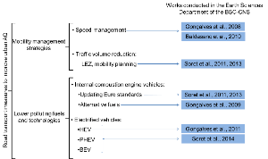
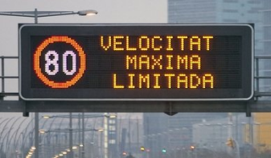
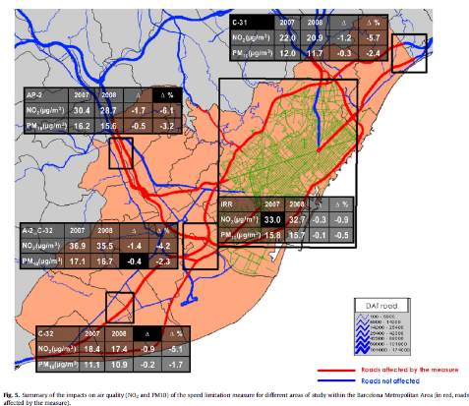
Road transport measures to improve air quality. Speed management
The earth sciences department was working in the technical commission to implement speed management in the road access to Barcelona.

Slide 16
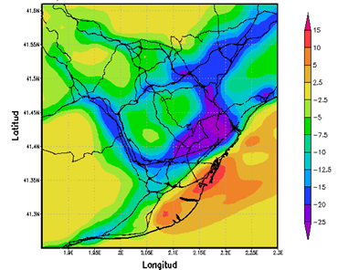
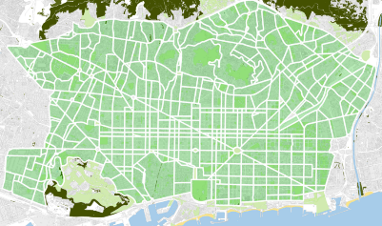
Road transport measures to improve air quality. Traffic volume reduction
The earth sciences department collaborated in the implementation of the superblocks in Barcelona.
NO₂ 24 h averaged variations with
the introduction of Superblocks
Source: BCNEcologia
(Left) Future Barcelona street network organized in superblocks, the aim of the measure is the reduction of VKT. (Right) This reduction of VKT implies a reduction in emissions and an improvement on air quality.

Slide 17
Road transport measures to improve air quality. Lower polluting fuels and technologies. Fleet renewal
Two studies have been performed in order to analyze the impact of fleet renewal:
By introducing natural gas vehicles.
Introducing new Euro standards in internal combustion vehicles
Detailed information of the vehicular fleet is available within HERMES which allows us for comprehensively assess these kind of studies.

Slide 18
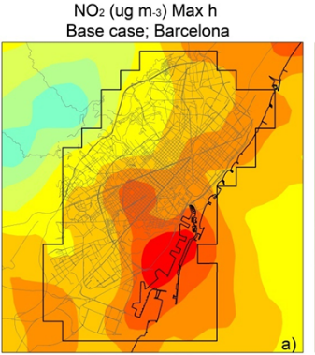
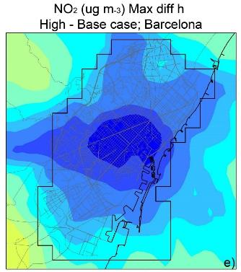
Road transport measures to improve air quality. Fleet electrification
The air quality impacts of fleet electrification has been analyzed for the cities of Barcelona and Madrid.
Left: NO₂ maximum h values in Barcelona (red >200 µg/m³)
Right: Reductions due to fleet electrification (blue >25 µg/m³)

Slide 19
References
Badia, A., Jorba, O., 2014. Gas-phase evaluation of the online NMMB/BSC-CTM model over Europe for 2010 in the framework of the AQMEII-Phase2 project. Atmospheric Environment. Elsevie. doi: 10.1016/j.atmosenv.2014.05.055
Baldasano, J.M., Gonçalves, M., Soret, A., Jiménez-Guerrero, P., 2010. Air pollution impacts of speed limitation measures in large cities: the need for improving traffic data in a metropolitan area. Atmospheric Environment. 44, 2997-3006. Doi:10.1016/j.atmosenv.2010.05.013.
Guevara M, Martínez F, Arévalo G, Gassó S, Baldasano JM. An improved system for modelling Spanish emissions: HERMESv2.0. Atmospheric Environment. 2013 ;81:209 - 221.
Gonçalves, M., Jiménez-Guerrero, P., López, E., Baldasano, J.M., 2008. Air quality models sensitivity to on-road traffic speed representations: Effects on air quality of 80 km h-1 speed limit in the Barcelona Metropolitan area. Atmospheric Environment, 42, 8389-8402.
Gonçalves, M., Jiménez-Guerrero, P., Baldasano, J.M., 2009. High resolution modeling of the effects of alternative fuels use on urban air quality: introduction of natural gas vehicles in Barcelona and Madrid Greater Areas (Spain). Science of the Total Environment, 407, 776-790.
Gonçalves, M., Jiménez-Guerrero, P., López, E., Baldasano, J.M., 2011. The challenge of improving urban air quality: effects of hybrid cars, introduction in Barcelona and Madrid (Spain). Int. J. Environment and Pollution, 47, 70-78.
Soret, A., Jimenez-Guerrero, P. and Baldasano J.M., 2011. Comprehensive air quality planning for the Barcelona Metropolitan Area through traffic management. Atmospheric Pollution Research. 2, 255-266. Doi:10.5094/APR.2011.032
Soret, A., Jiménez-Guerrero, P., Andrés, D., Cárdenas, F., Rueda, S., Baldasano, J.M., 2013. Estimation of future emission scenarios for analysing the impact of traffic mobility on a large Mediterranean conurbation in the Barcelona Metropolitan Area (Spain). Atmospheric Pollution Research. 4, 22-32. Doi:10.5094/APR.2013.003.
Soret, A., Guevara, M., Baldasano, J.M., 2014. The potential impacts of electric vehicles on air quality in the urban areas of Barcelona and Madrid (Spain). Atmospheric Environment. In Press. Doi: 10.1016/j.atmosenv.2014.09.048
M Spada; O Jorba; C Pérez García-Pando; Z Janjic; JM Baldasano. On the evaluation of global sea-salt aerosol models at coastal/orographic sites. Atmospheric Environment. Elsevier, 2014. doi: 10.1016/j.atmosenv.2014.11.019

Slide 20
Thank you!
For further information please contact:
oriol.jorba@bsc.es
albert.soret@bsc.es
services-es@bsc.es

