Slide 1
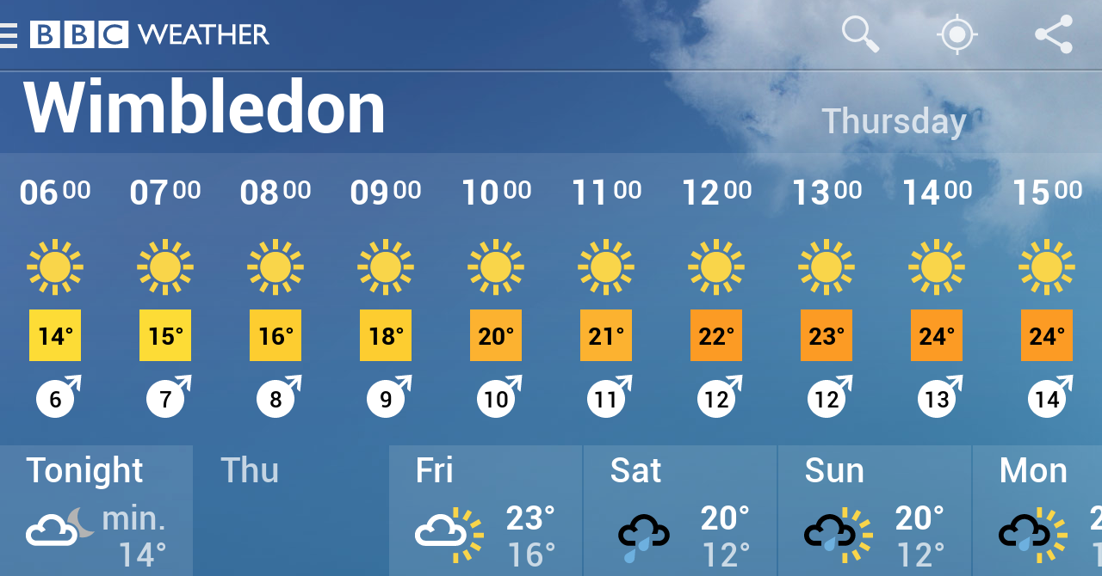
Weather forecast is a familiar concept …

Slide 2
… and climate change too, but what about climate variability?
Link: https://youtu.be/PhbdyNnUliM

Slide 3
Will it be a cold or rainy winter this year?

Slide 4
Is going to have a snowy winter this year?

Slide 5
Forecasting beyond a few days is key to balance energy supply and demand

Slide 6
..and is essential for other sectors too

Slide 7
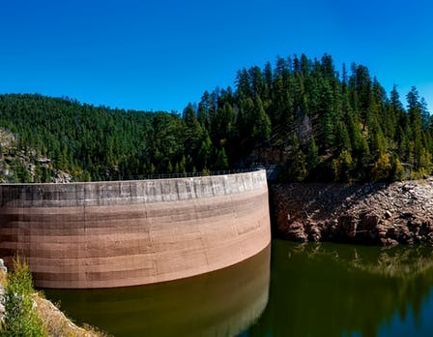
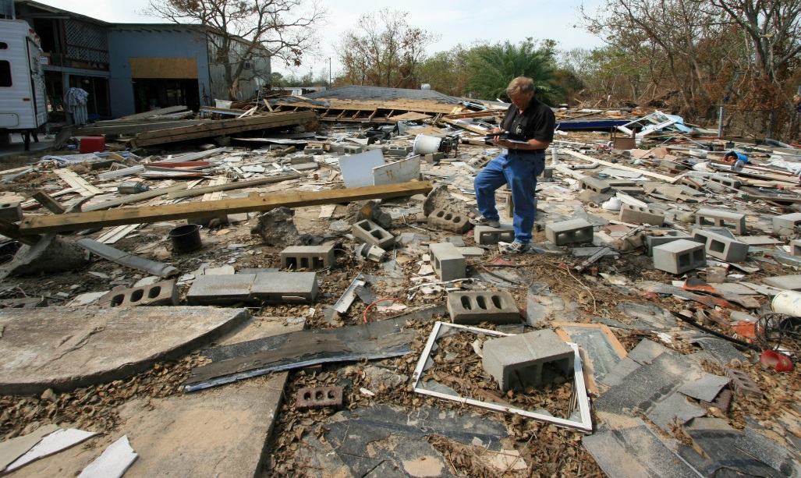
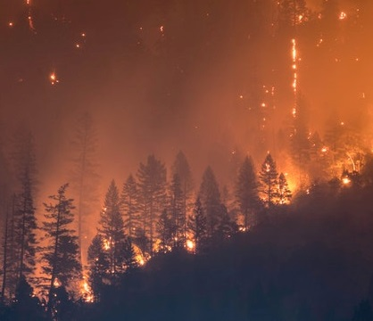

Slide 8
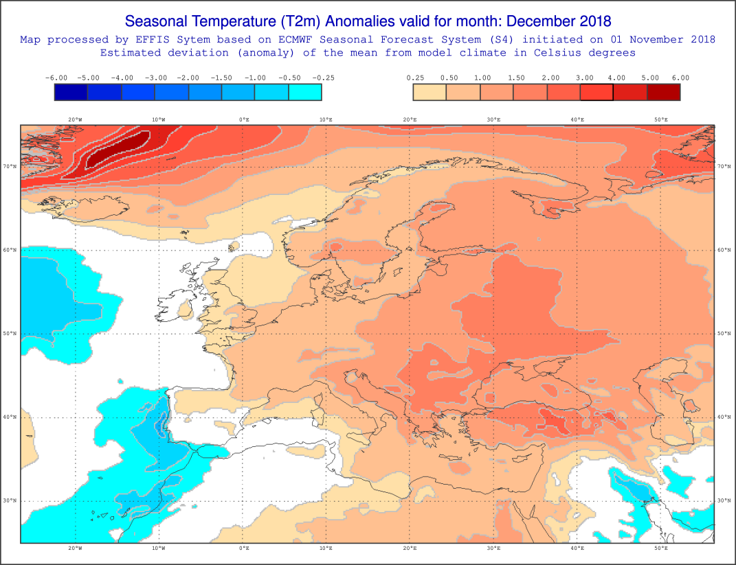
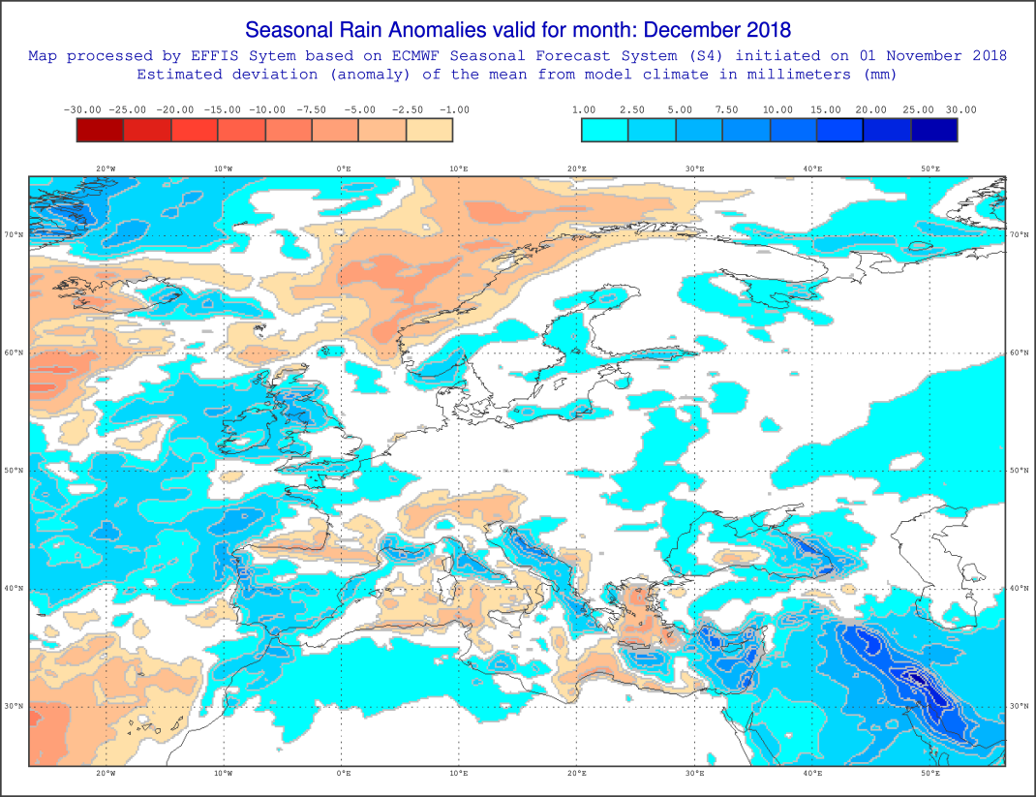
Will it be a cold or rainy winter this year?
The maps are based on the ECMWF Seasonal Forecasting System 4 and are provided to EFFIS (JRC). S4 anomalies of temperature and rainfall are estimated from the mean deviation of the seasonal forecast from the model climate. The maps highlight the areas which are expected to be colder/warmer and dryer/wetter (than normal) over Europe and Mediterranean countries

Slide 9
Potentials questions for Part III A. Soret:
How can we predict climate for the coming season if we cannot predict the weather next week?
Can you illustrate the use of climate information for the energy sector taking into account different windows forecast.

Slide 10
Logos and codes (Jaro, remember to include the codes, you should ask it to all the contributors):
These projects have received funding from: the Horizon 2020 programme under grant agreements n° 776787, 776613, 730253, 776467, and the Ministerio de Economía y Competitividad (MINECO) as part of the HIATUS project CGL 2015-70353-R and CLINSA project CGL 2017-85791-R.

Slide 11
Supplementary material

Slide 12
Predictability
How can we predict climate for the coming season if we cannot predict the weather next week? Slow components (sea surface temperature, soil moisture, etc.) force the atmosphere.
OCEAN
CIRCULATION
SOIL MOISTURE
ATMOSPHERE
SNOW COVER
SEA ICE EXTENT

Slide 13
Climate services
User: How much energy will I produce next month?
Scientist: Skill assessment, bias adjustment, probabilistic information, etc.

Slide 14
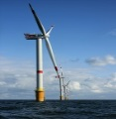
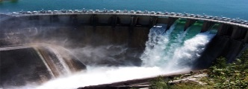
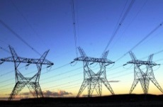
Applications
Weather forecast
Climate predictions
Climate projections or multidecadal
Sub-seasonal
Seasonal
Decadal
1-15 days
10 d-1 month
1-6 months
1-30 years
20-100 years
Time
Applications for wind/solar/hydro generation
Post-construction decisions
Energy producers:
commit energy sales for next day
Grid operators: Market prices and grid balance
Energy traders: Anticipate energy prices
Plant operators: planning for cleaning and maintenance
Post-construction decisions
Energy producers: Resource management strategies
Energy traders: Resource effects on markets
Plant operators: Planning for maintenance works, especially offshore wind O&M
Plant investors: anticipate cash flow, optimize return on investments
Pre-construction decisions
Power plant developers: Site selection. Future risks assessment.
Investors: Evaluate return on investments
Policy-makers: Asses changes to energy mix
River-basin managers: understand changes to better manage the river flow
Applications for demand
Daily operation decisions
Grid operators:
Anticipate hot/cold days.
Schedule power plants to reinforce supply.
Energy traders: Anticipate energy prices.
Mid-term planning
Grid operators:
Anticipate hotter/colder seasons Schedule power plants to reinforce supply.
Energy traders:
Anticipate energy prices.
Long-term planning
Grid operators:
Anticipate addition of more capacity. Adaptation of transmission lines
Policy-makers:
Plan addition of more capacity.
Understand changes to energy mix

Slide 15
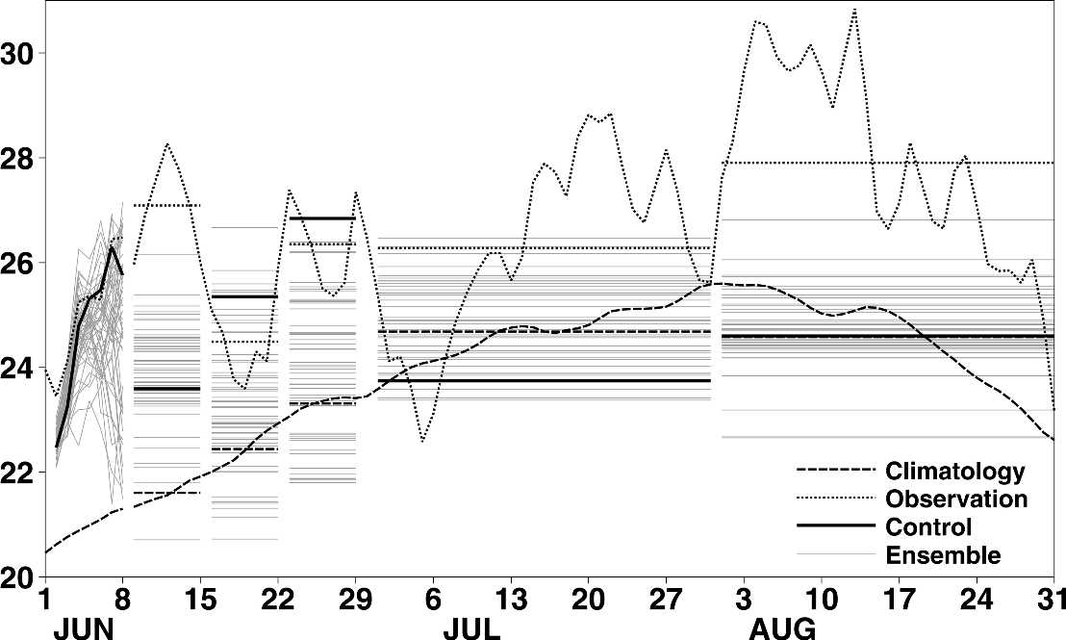
Seamless forecasts
Heat wave 2003.Prediction of temperature produced by ECMWF
Observations (dotted) and forecasts (solid) made by ECMWF at the beginning of June of European 2-m land temperatures ( C).
Source: Rodwelland-Doblas-Reyes, 2006

Slide 16
Case study: heat wave and wind drought in Spain. Sep 2016

Slide 17
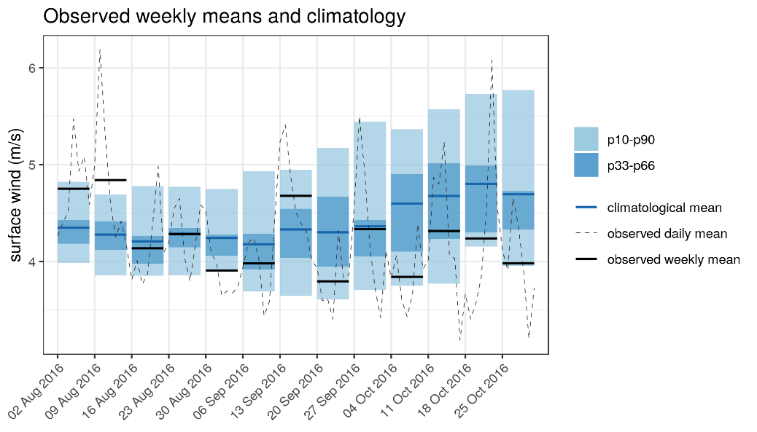
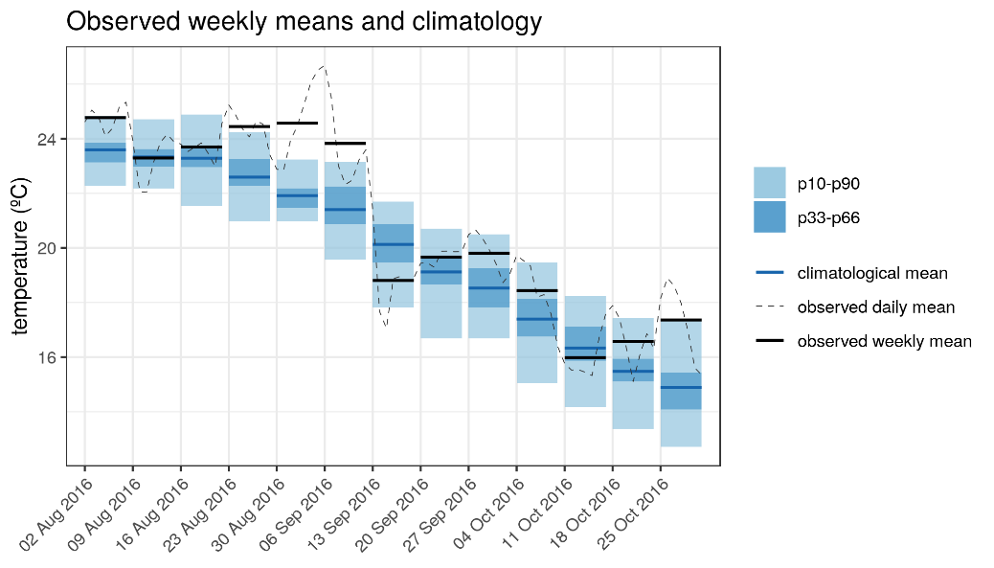
Heat wave and wind drought in Spain. Sep 2016
The cold spell over Europe created a combination of large increase in electricity demand and lower than usual hydro and wind power generation.
Surface wind and temperature anomalies. With respect climatology (1981-2017)

Slide 18
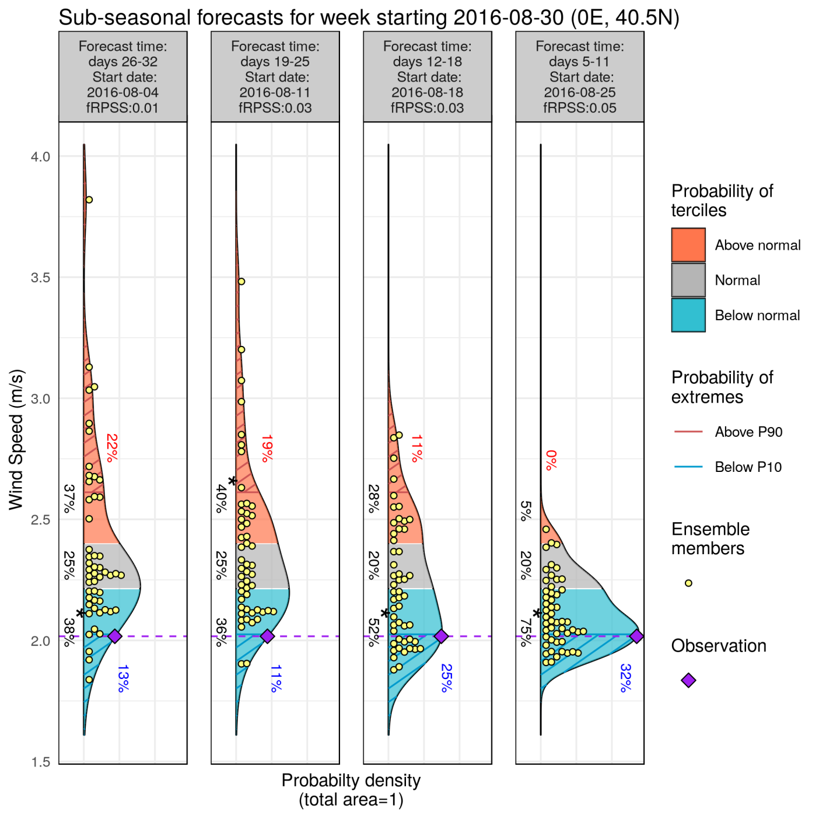
Forecast available: wind
System: ECMWF monthly prediction system
Reanalysis: ERA-Interim
Bias adjusted –calibrated
Hindcast: 1996-2015
Lat= 40.5 N/Lon = 0 E

Slide 19
Forecast available: temperature
System: ECMWF monthly prediction system
Reanalysis: ERA-Interim
Bias adjusted –calibrated
Hindcast: 1996-2015
Lat= 40.5 N/Lon = 0 E

Slide 20
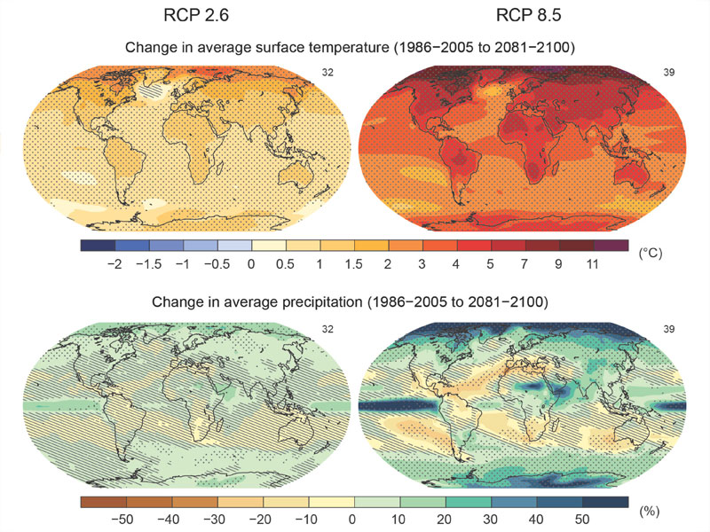
… and climate change too, but what about climate variability?
(Illustration: IPCC Assessment Report 5, 2013)

