Slide 1
Jeju, Korea, 21 September 2016
Modeling the dust cycle at BSC
From R&D to operational forecast
Sara Basart (sara.basart@bsc.es), E. Terradellas, O. Jorba, E. DiTomaso, L. Vendrell, F. Benincasa and K. Serradell

Slide 2
BSC-CNS Earth Sciences Department
What
Environmental modelling and forecasting
Why
Our strength …
… research …
… operations …
… services …
… high resolution …
MareNostrum supercomputer
How
Develop a capability to model air quality processes from urban to global and the impacts on weather, health and ecosystems
Implement climate prediction system for subseasonal-to-decadal climate prediction
Develop user-oriented services that favour both technology transfer and adaptation
Use cutting-edge HPC and Big Data technologies for the efficiency and user-friendliness of Earth system models
Earth system services
Climate prediction
Atmospheric composition
Computational Earth sciences

Slide 3
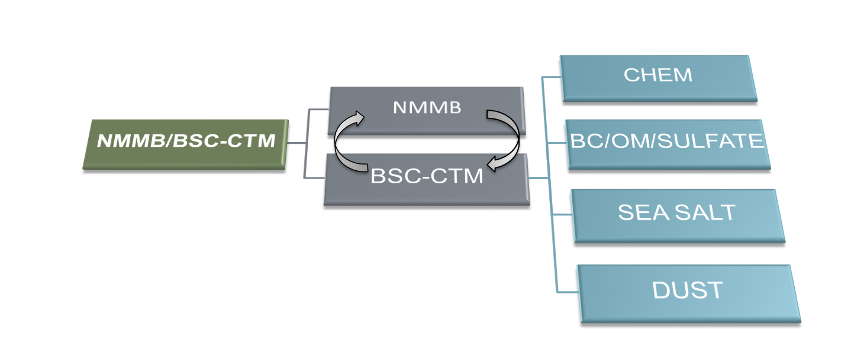
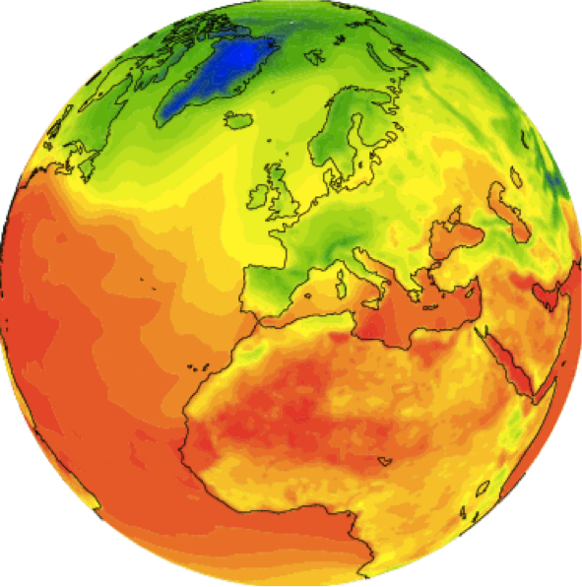
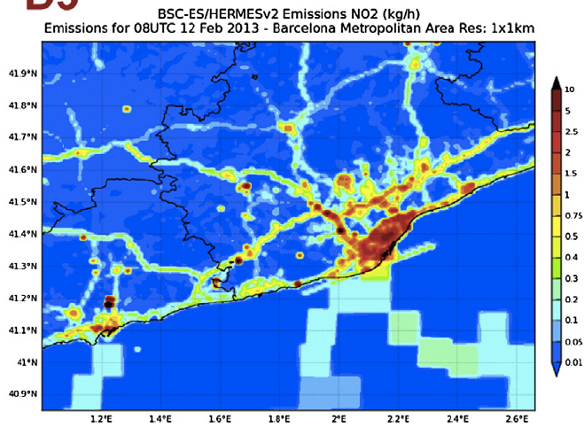
Atmospheric Composition: NMMB/BSC-CTM
· The main system is build on the meteorological driver NMMB
· Multiscale: global to regional scales allowed (nesting capabilities)
· Nonhydrostatic dynamical core: single digit kilometre resolution allowed
· Fully on-line coupling: weather-chemistry feedback processes allowed
· Enhancement with a data assimilation system
Multiscale Model from Global to Local Scales
http://www.bsc.es/earth-sciences/nmmbbsc-project

Slide 4
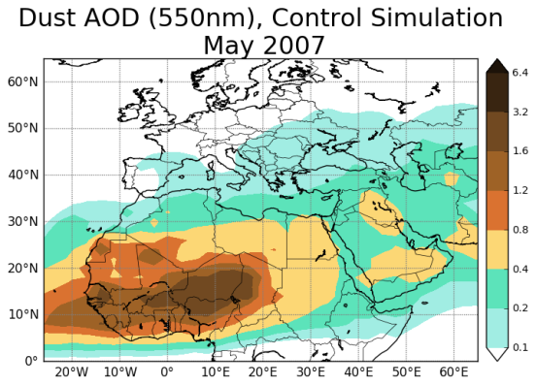
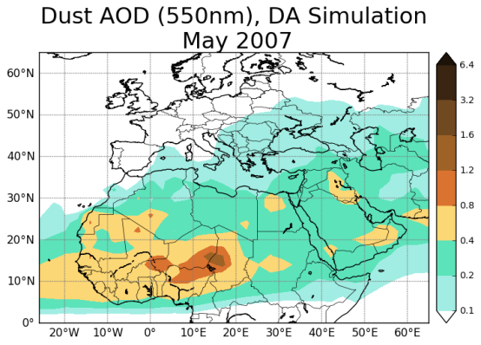
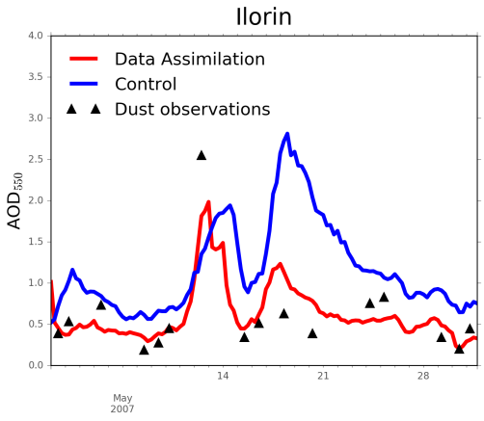
NMMB/BSC-CTM: Aerosol data assimilation
observations
NMMB/BSC-CTM coupled with a Local Ensemble Transform Kalman Filter (LETKF) for the assimilation of aerosol optical depth observations
member 1
LETKF
ensemble forecast
member 2
…
member N
ensemble mean analysis
model
analysis-initialized forecast
Mineral dust application
The ensemble forecast is based on
uncertainties in the dust emission
scheme
vertical flux,
size distribution at emission
threshold on friction velocity
AERONET Validation
(DiTomaso et al., GMD, submitted)
Notes:
Better description of current and forecast conditions for dust with data assimilation

Slide 5
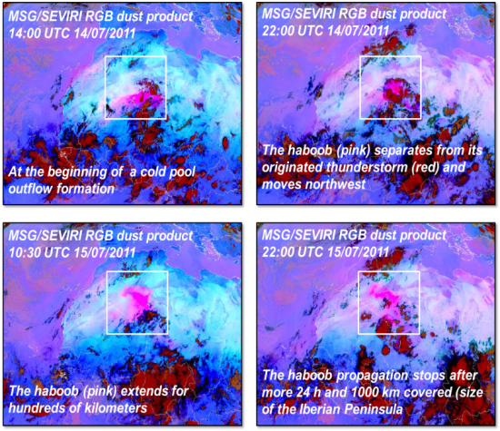
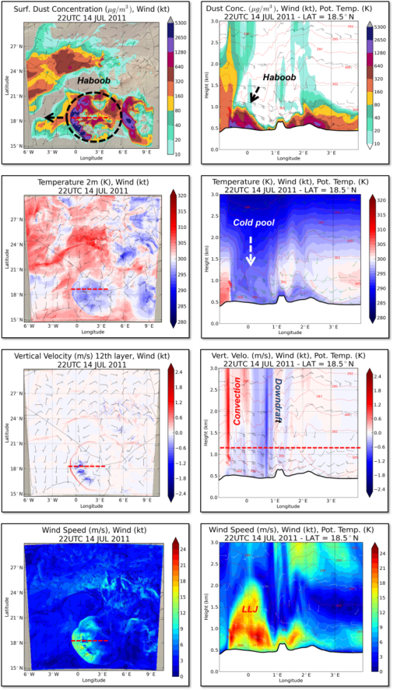
Mineral dust: haboobs (with explicit convection)
MODEL CONFIGURATION
Study domain: 6ºW-10ºE to 15ºN-31ºN
Study period: from 14 to 15 July 2011
Horizontal resolution: 0.03ºx0.03º (about 3 km)
Vertical resolution: 60σ-layers (12-15σ-layers in the first 1000 m)
Cold start (No data assimilation)
(Vendrell et al., Aeolian Res., in preparation)
Notes:
While global models of the dust cycle are used to investigate dust at large scales and long-term changes, regional dust models are the ideal tool to study in detail the processes that influence dust distribution as well as individual dust events. One of the current challenges in dust forecasting is to be able to simulate haboobs because their impacts in health, air quality and transportation. Haboobs are convective dust storms characterize by walls of blowing dust that move quickly and can propagate hundreds of kilometers.
The slide shows the results of the NMMB/BSC-Dust high-resolution simulation (at 3km x 3km, horizontal resolution with explicit convection) for a study case of a Saharan Haboob. The event occurred on 14-15 July 2011 over Algeria and was initiated as a consequence of a mesoscale convective system.
As shown in the slide the model is able to reproduce the key elements associate to a Haboob (e.g. cold pool outflows, or high near-surface wind speeds and dust concentrations). Despite this, there are still uncertainties in the haboob simulation because of the small-scales associated with its formation such as the location deviation (inherent in the convective events), or misrepresentation of turbulence, as well as in some model components (i.e. source mask, deposition scheme, size distribution or model initialization) that are under research.

Slide 6
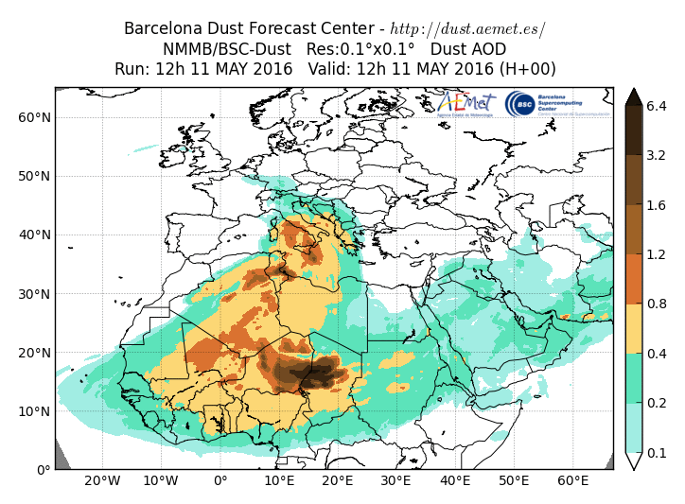
Mineral Dust Services
Daily dust operational forecast (global and regional domains)
Contribution to the ICAP multi-model ensemble
(global) http://icap.atmos.und.edu
WMO Dust Centers
SDS-WAS. North Africa, Middle East and Europe
Regional Center. http://sds-was.aemet.es
started in 2010 – Research
Barcelona Dust Forecast Center.
First specialized WMO Center for mineral dust prediction.
http://dust.aemet.es started in 2014 - Operational
http://www.bsc.es/earth-sciences/mineral-dust/nmmbbsc-dust-forecast

Slide 7
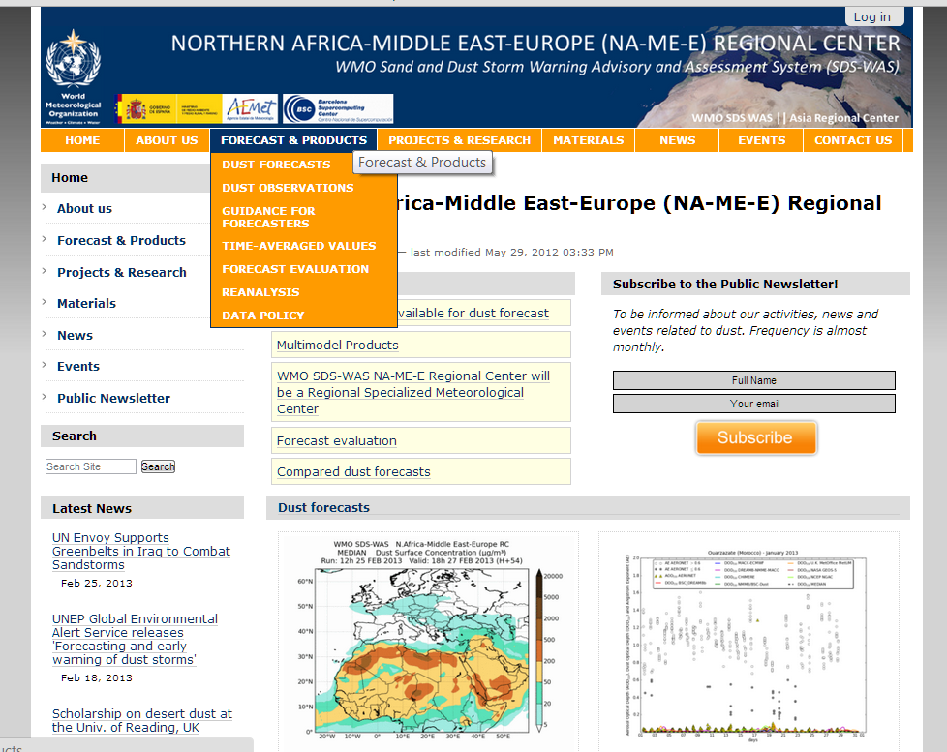
SDS-WAS NAMEE: Dust Forecasts
FORECAST AND PRODUCTS
Data exchange
Joint visualization
Common forecast evaluation
Generation of multi-model products
Calculation of monthly evaluation metrics
New sources of data for model evaluation
Sharing model output data files
Time-averaged products
http://sds-was.aemet.es/

Slide 8
SDS-WAS NAMEE: Dust Forecasts
Dust prediction models provide 72 hours (at 3-hourly basis) of dust forecast (AOD at 550nm and surface concentration) covering the NAMEE region.
http://sds-was.aemet.es/

Slide 9
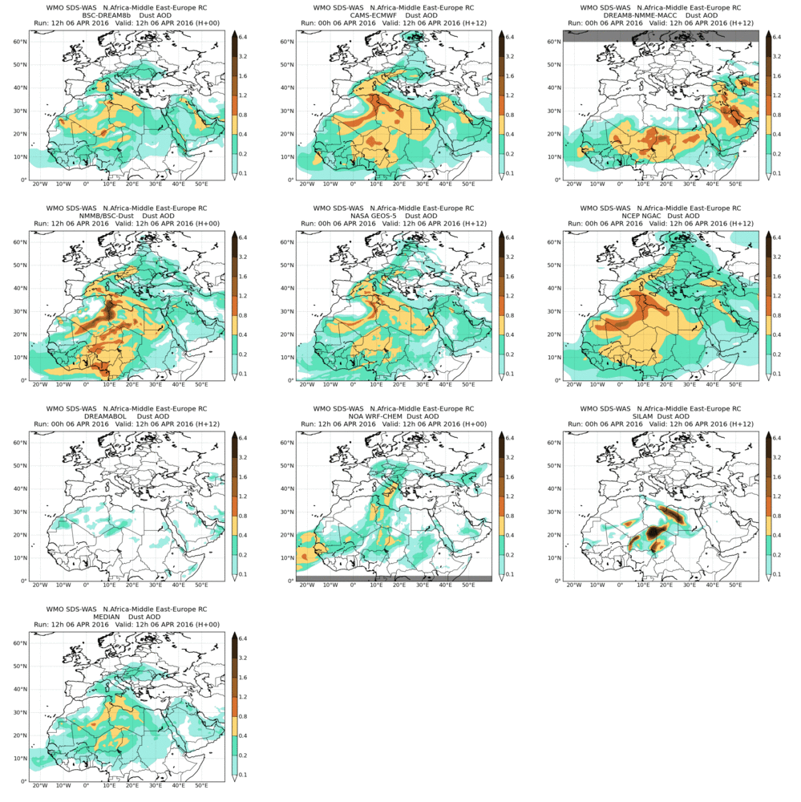
SDS-WAS NAMEE: Joint visualization
AOD at 550nm
from 6-Apr-2016 12:00 to 9-Apr-2016 00:00
http://sds-was.aemet.es/

Slide 10
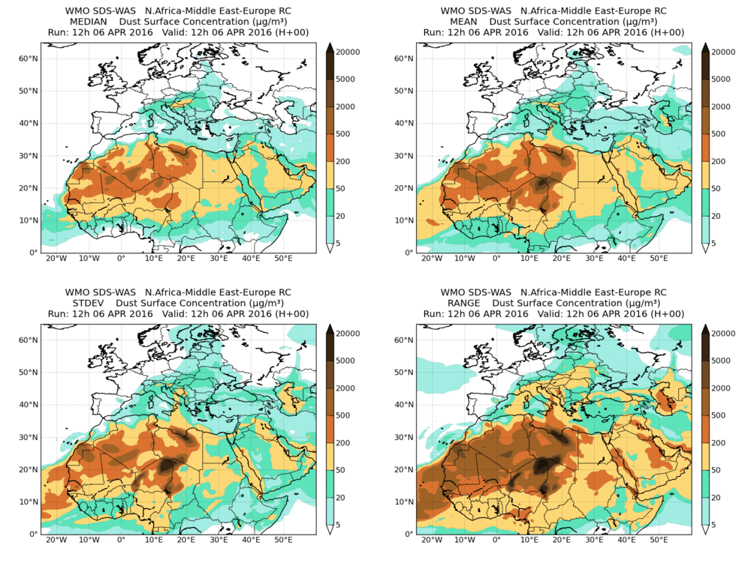
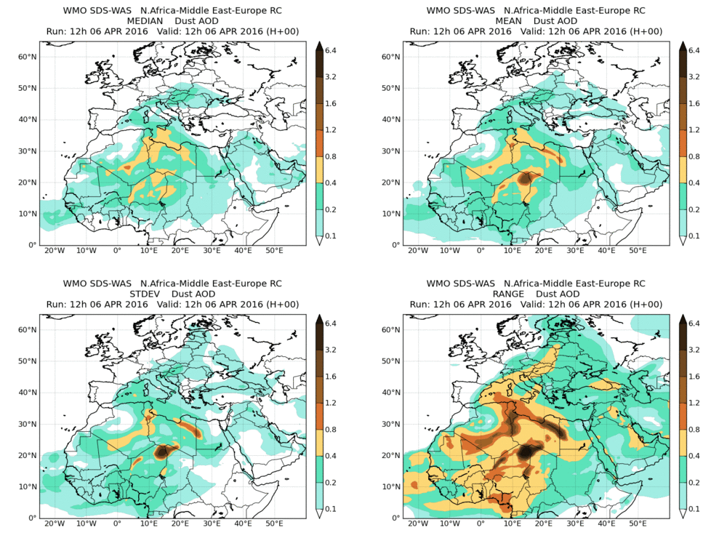
SDS-WAS NAMEE: Multi-model
Surface concentration
DOD at 550nm
from 6-Apr-2016 12:00 to 9-Apr-2016 00:00
Model outputs are bi-linearly interpolated to a common 0.5ºx0.5º grid mesh. Then, different multi-model products are generated:
CENTRALITY: median - mean
SPREAD: standard deviation – range of variation
http://sds-was.aemet.es/
Terradellas et al. “SDS-WAS multi-model ensemble” presentation at 16:45

Slide 11
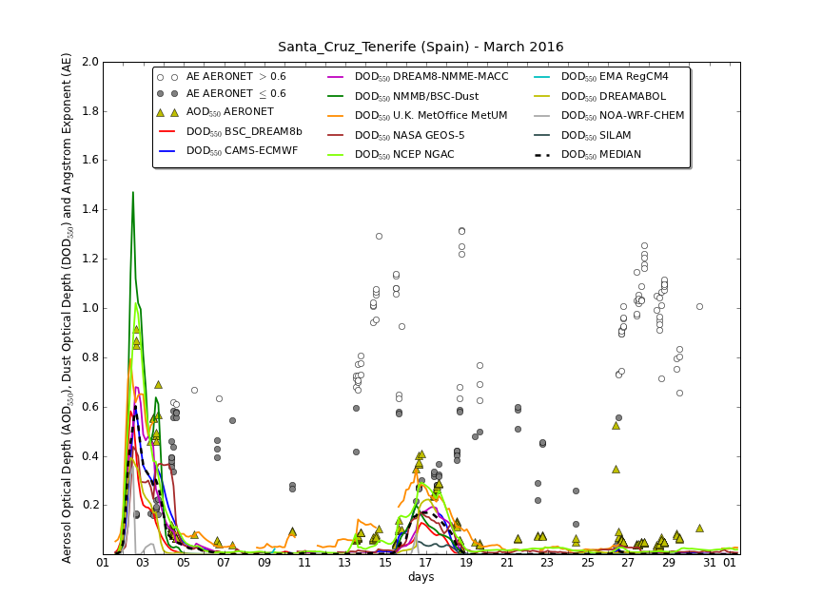
SDS-WAS NAMEE: NRT AERONET
A set of evaluation metrics are selected: Bias, RMSE, correlation coefficient and FGE
Calculations evaluation metrics are done for:
monthly/seasonal/annual
sites and regions
http://sds-was.aemet.es/

Slide 12
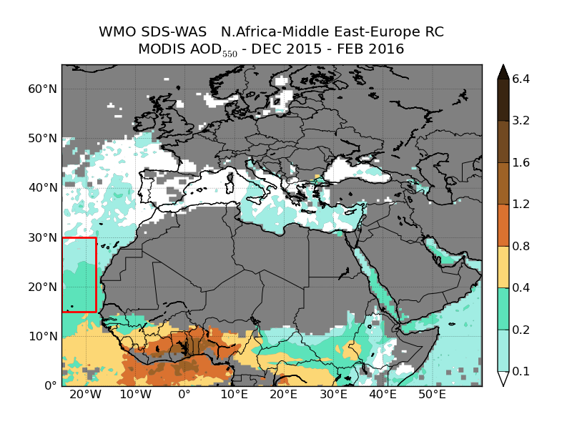
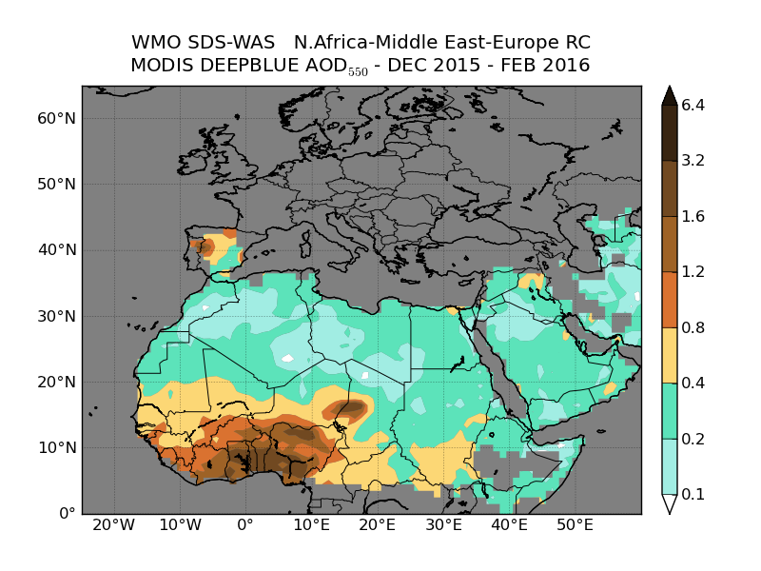
SDS-WAS NAMEE: MODIS
http://sds-was.aemet.es/

Slide 13
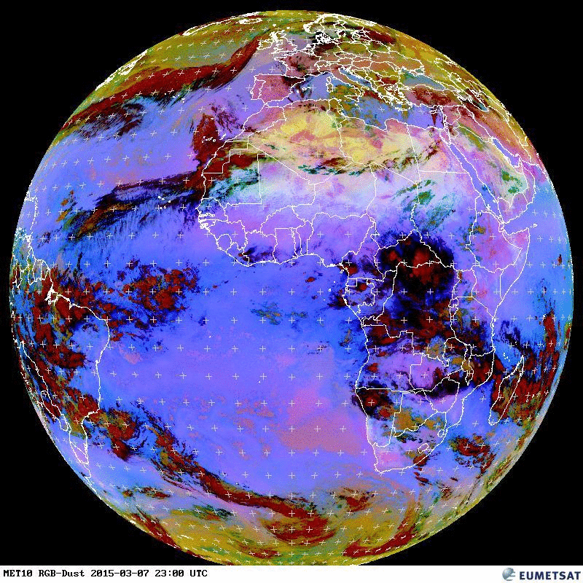
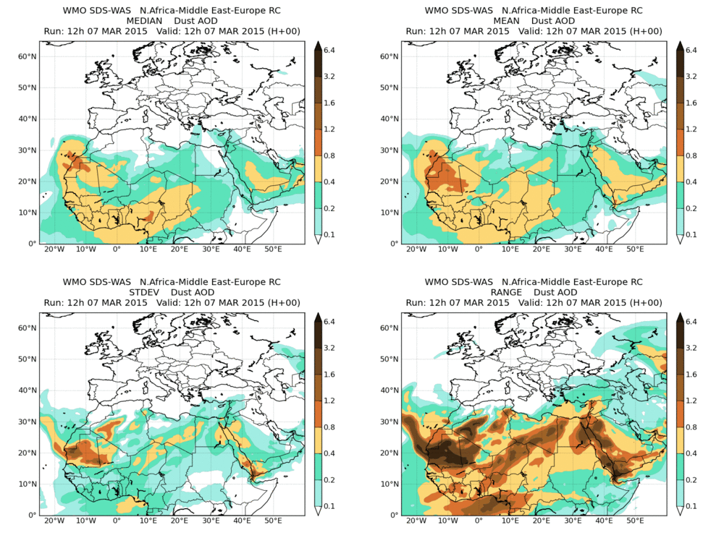
SDS-WAS NAMEE: Model evaluation
7 March 2015
New observational datasets for model evaluation in Northern Africa
http://sds-was.aemet.es/

Slide 14
SDS-WAS NAMEE: Model evaluation
AQ networks: Canary Islands 2013-2014
Not all PM10 is dust: Local sources
Dust filter: Moving 40th percentile of 30 days, 15 days before and 15 days after (Escudero at al. 2007).
http://sds-was.aemet.es/

Slide 15
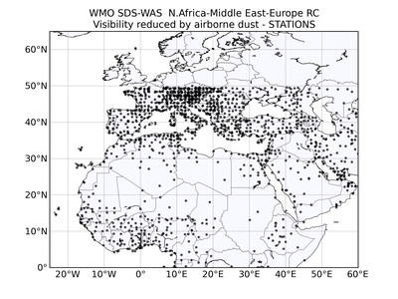
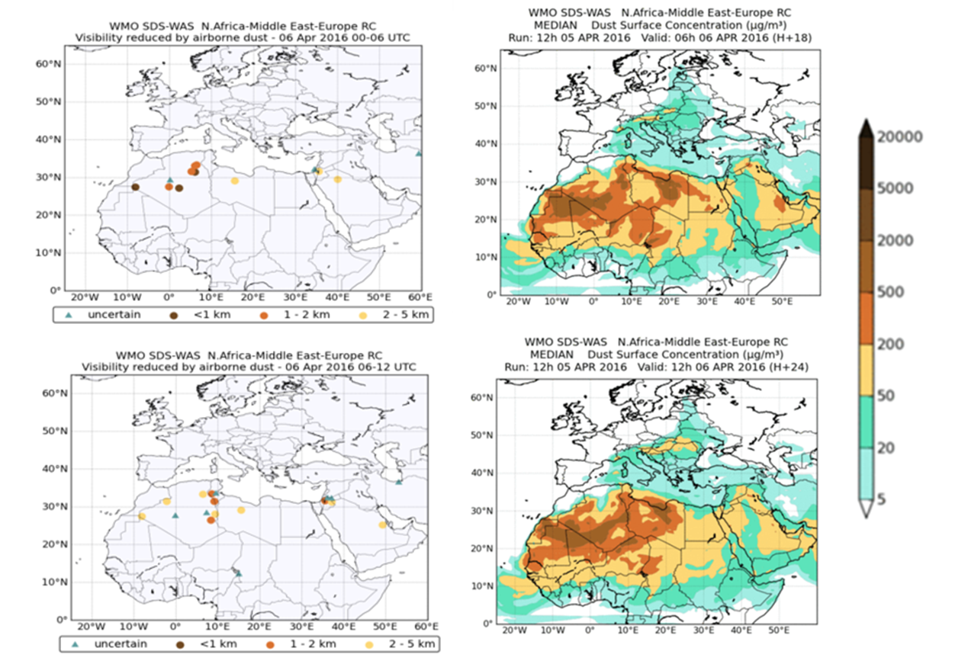
SDS-WAS NAMEE: Model evaluation
NRT visibility evaluation: 6th April 2016 0-12UTC
http://sds-was.aemet.es/

Slide 16
SDS-WAS NAMEE: Model evaluation
Ceilometer
Santa Cruz de Tenerife and Granada (Spain)
Lidar
M’Bour (Senegal)
+ High density of stations
- Qualitative products
- Low number of stations
+ Quantitative products
http://sds-was.aemet.es/projects-research/evaluation-of-model-derived-dust-vertical-profiles

Slide 17
Barcelona Dust Forecasting Center
In 2014, the First Specialized Center for Mineral Dust Prediction of WMO is created
NMMB/BSC-Dust selected to provide operational forecasts for NAMEE region
http://dust.aemet.es/
@Dust_Barcelona

Slide 18
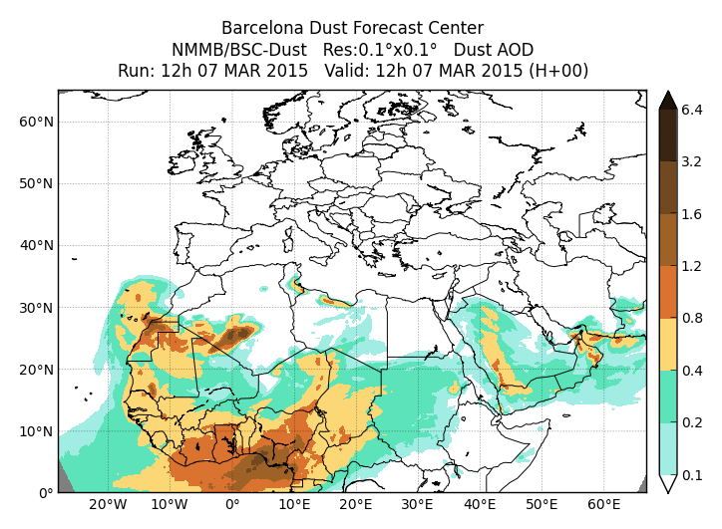
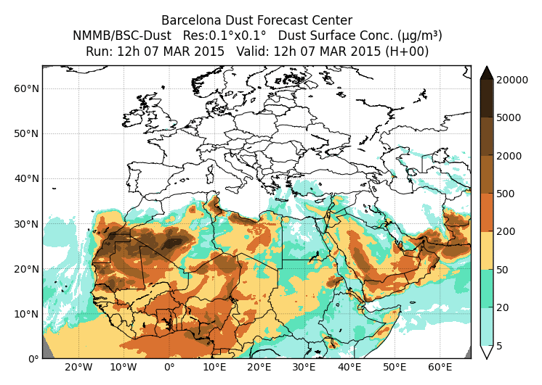
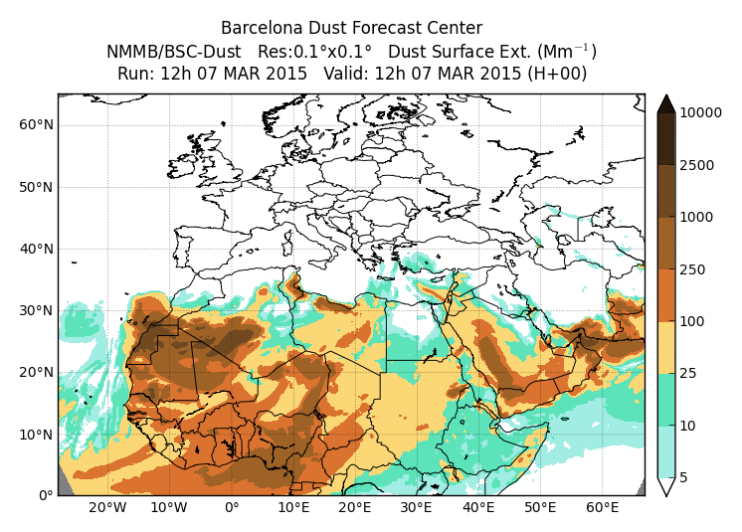
BDFC: Dust Forecasts products
Dust Optical Depth at 550nm
Dust Dry Deposition
Dust Load
Dust Surface Concentration
Dust Surface Extinction at 550nm
Dust Wet Deposition
http://dust.aemet.es/
@Dust_Barcelona

Slide 19
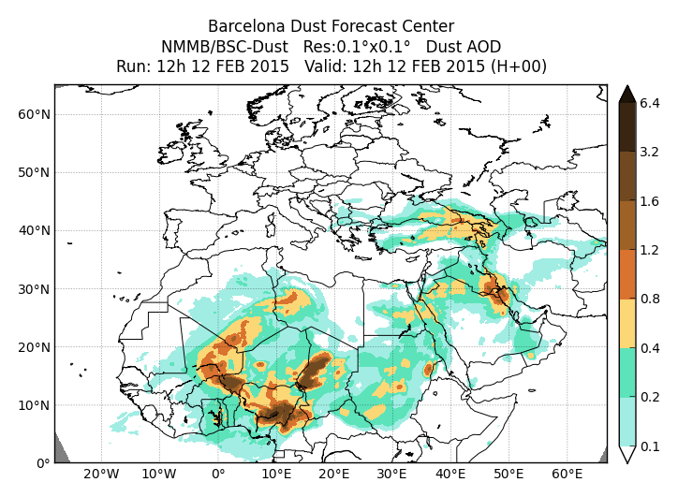
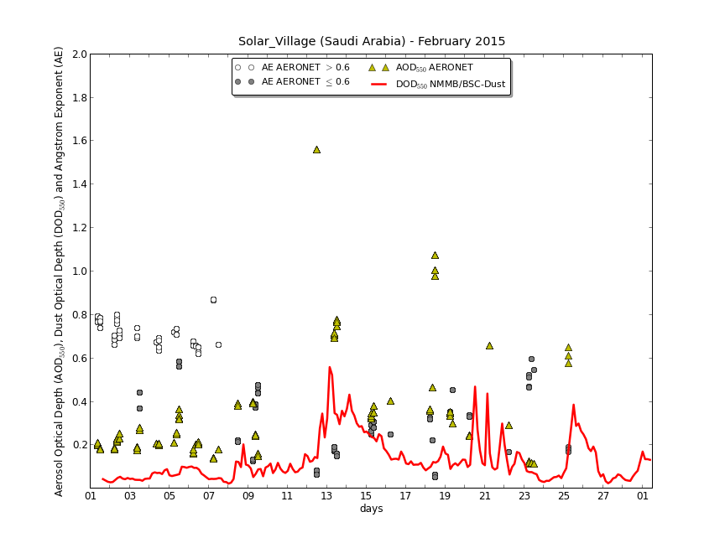
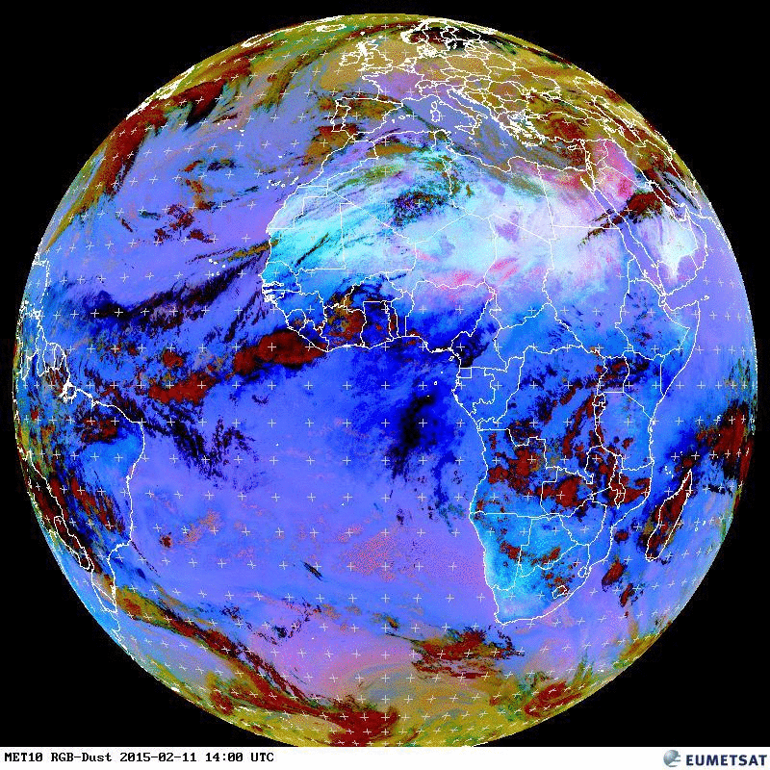
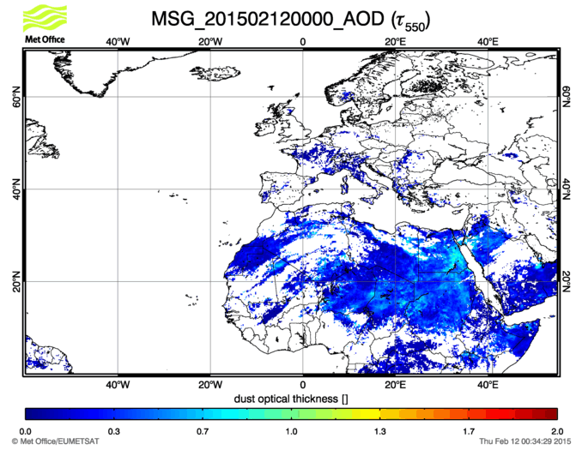
BDFC: Dust event Middle East Feb 2015
http://dust.aemet.es/
@Dust_Barcelona

Slide 20
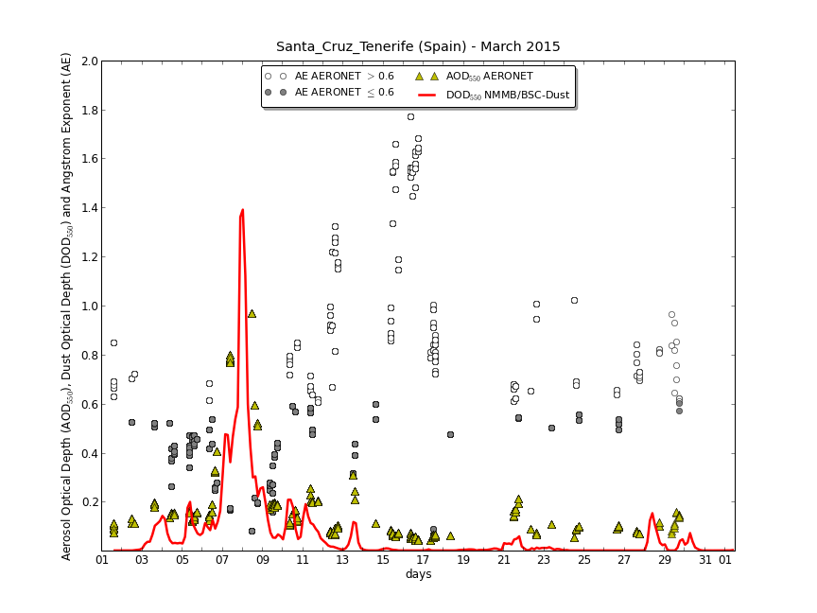
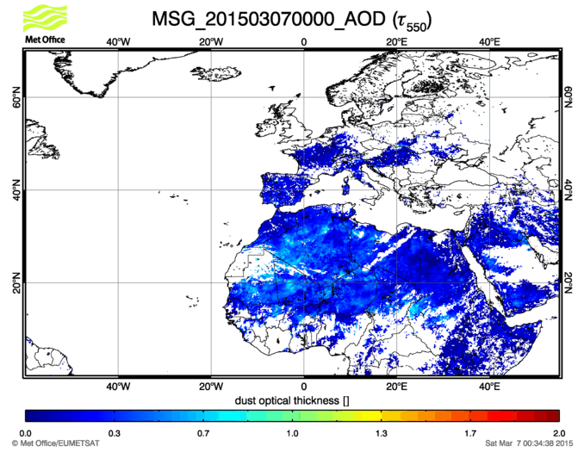
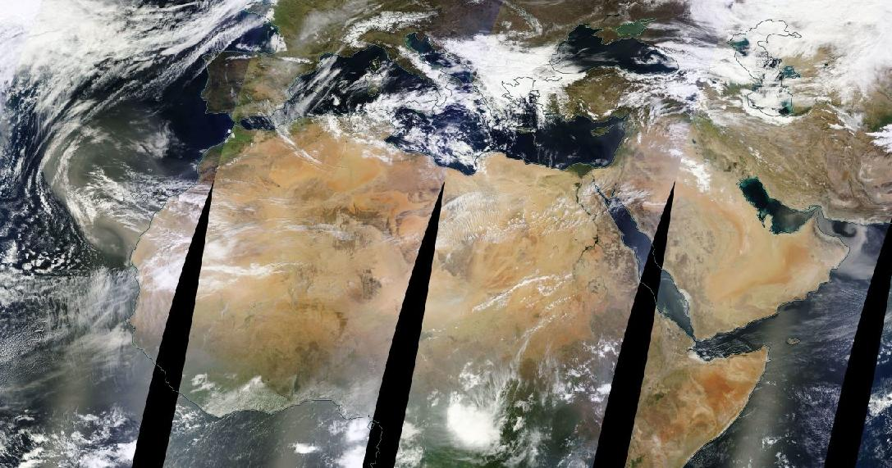
BDFC: Dust event Canary Islands Mar 2015
MODIS composite 8th March
from EOSDIS World Viewer
http://dust.aemet.es/
@Dust_Barcelona

Slide 21
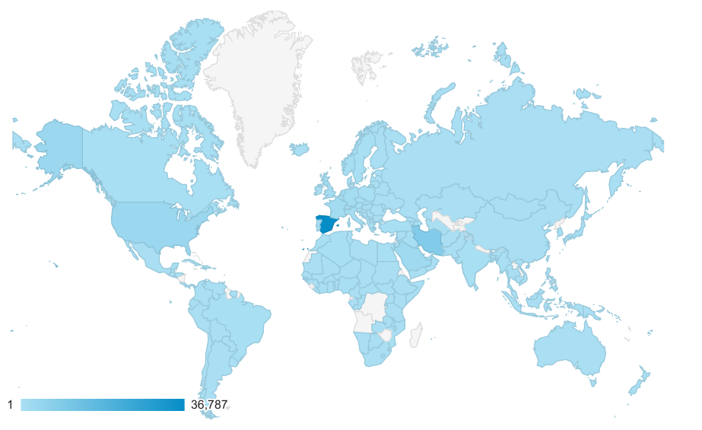
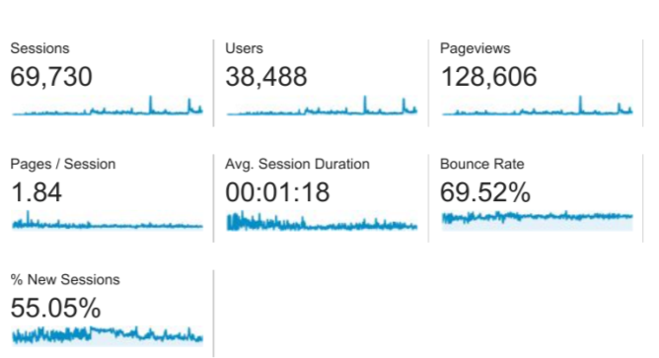
BDFC: Users
Website visits: 1 January 2015 – 28 July 2016
22 Feb: Sahel and IP event
18 Jun: Arabian event
26 Aug: Algeria event
10 Feb: Middle East event
http://dust.aemet.es/
@Dust_Barcelona

Slide 22
Summary and conclusions
Ongoing NMMB/BSC-Dust model developments to improve the quality of daily dust forecast includes:
Data assimilation of satellite aerosol products for mineral dust analysis
Exploration of the advantages of the high-resolution simulations (> 4km spatial horizontal resolution) → Haboobs and complex terrains
Ongoing activities of the WMO Dust Centers includes:
Model evaluation including data from satellites, and lidar, Sun-photometer and in-situ networks, both for gaseous and aerosol species, covering multiple time-scales.
Increased education and awareness to promote the information and forecasts that are publically and freely available
Establishment of appropriate communication channels for the dissemination of interpreted dust forecasts at a frequency that enables preparedness (i.e. through weather news networks, text message alerts)

Slide 23
Thank you! The authors thank Carlos Pérez, García-Pando, José Mª Baldasano, Antonis Gkikas, Alba Badia, Michele Spada, Vincenzo Obiso, Karsten Haustein, Beartrice Marticorena, Philippe Goloub, Alberto Cazorla and Canary Government as well as AERONET, MODIS, U.K. Met Office MSG, MSG Eumetsat and EOSDIS World Viewer principal investigators and scientists for establishing and maintaining data used in the present contribution. Also special thank to all researchers, data providers and collaborators of the WMO SDS-WAS NA-ME-E Regional Node.
For further information please contact
sara.basart@bsc.es

