Slide 1
Mineral dust modeling for optimizing operation and maintenance procedures in concentrated solar power plants
Eleni Karnezi¹ (eleni.karnezi@bsc.es), Fabian Wolfertstetter², Paula Moehring², Natalie Hanrieder², Stefan Wilbert², Sara Basart¹, Albert Soret¹, Oriol Jorba¹, Carlos Pérez Garcia-Pando¹
¹Earth Sciences Department, Barcelona Supercomputing Center (BSC)
²German Aerospace Center (DLR), Institute of Solar Research
11/09/2019
EMS conference, Lungby, Denmark

Slide 2
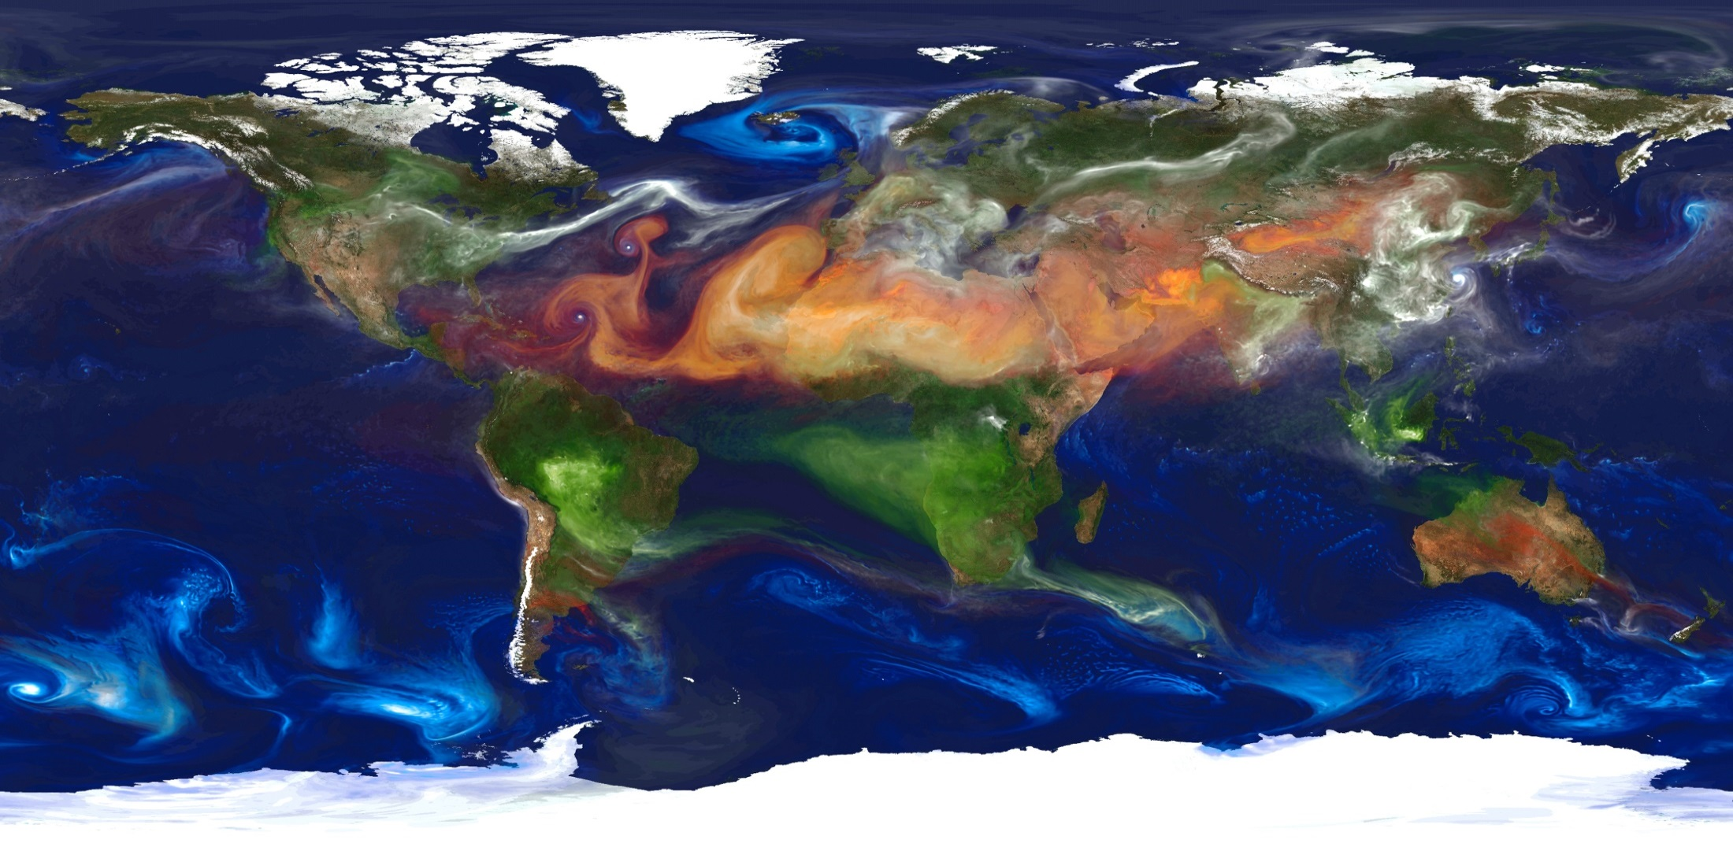
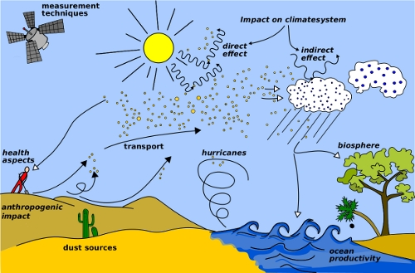
Dust cycle, its extension and impacts
Image from WMO website (http://www.wmo.int/pages/prog/arep/wwrp/new/hurricanes.html)
Organic Carbon + Elemental carbon
Dust
Sulfate
Sea salt
NASA | GEOS-5 Aerosols
Ecosystems, meteorology and climate
Air Quality and Human Health
Aviation and Ground Transportation
Energy and industry
Agriculture and fishering
Astrophysics
Notes:
Dust transport is a global phenomenon and the surface winds are the main driver of it. This is a simulation from NASA using GEOS-5 and the GOCART (Goddard Chemistry Aerosol Radiation and Transport) Model. With orange it shows the dust transport and we see that it mostly transported in the Northern Hemisphere.
Dust and dust transport has many impacts, most of them adverse. In climate it has in two way, in direct by scattering and absorbing solar radiation and indirectly by acting as a ccn so in having an effect in cloud formation. It can contribute to high levels of PM10 and cause health problems as asthma and more respiratory and cardiovascular diseases and for long time exposure, even premature death. It can cause also disruption through flight delays and closure on highways. Impacts on energy, as solar energy, with soiling effects as our focus today and solar irradiance. In agriculture and fishering, where with the deposition of dust, the nutrients that are included can favor both. Finally on the observations of stars, in astrophysics.

Slide 3
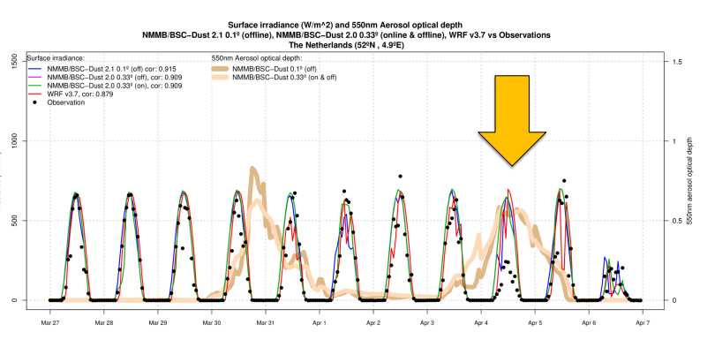
Dust impacts on Solar energy
Solar irradiance
The presence of dust reduce the incoming solar irradiance through direct radiative effect
but also indirectly, through favouring cloud formation
Soiling
panels efficiency and water management
(Soret et al., 2016 )
Notes:
Dust intrusion from Africa favored the cloud formation.
All models, here BSC models with multiple resolutions and WRF with their forecasts overpredicted solar irradiance. Measurements showed more cloud cover that day than the models predicted.
Dust act like barriers and they decrease panels efficiency.
CSP plants are being implemented in dusty environments such as Middle East and North Africa where solar radiation is high. But usually in these areas, water is in scarcity or very expensive.
The minimization of soiling-induced losses together with the reduction of cleaning costs is a challenge for operators and project planners.

Slide 4
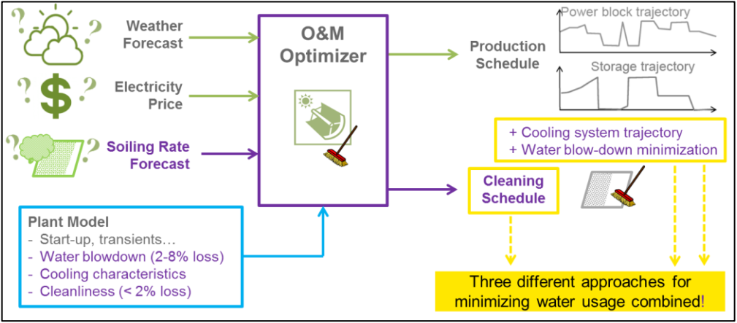
SOLWARIS project
Provide near to market solutions for reducing the water consumption of CSP
H2020 SOLWARIS project targets a significant reduction in the water used by CSP plants (by 35% for wet cooled & by 90% for dry cooled). In this way more of 0.5 M€/year of operational cost for a 50 MW CSP plant will be saved in the future.
→ O&M optimizer supported by soiling forecasts assures that innovative water-saving technologies are used in the best way.
Objective: to deploy a soiling forecast!
Notes:
The project focuses on the efficiency of innovations on solar field cleaning, power-block cooling, water recycling system, and plant operation strategy. The social acceptance of CSP will be increased by detailed analysis of case studies and education of local population to the benefits of solar energy.
WP2 includes the development of an unique soiling forecast product that will be included in the O&M optimizer. This additional input information will assure that innovative water-saving technologies are used in the best way.
Soiling forecast model will be developed coupling the outputs of an atmospheric composition model with a soiling model.

Slide 5
Merge of dust-soiling model
(Wolfertstetter et al., 2018 )
The DLR Institute of Solar Research (SF) is the largest research entity in Germany investigating and developing concentrating solar technologies to provide heat, electricity and fuel.
DLR has developed a soiling model that has been validated for two sites during WASCOP –Water Saving for Concentrated Solar Power (H2020 project).
Notes:
We couple the dust regional-global NMMB-MONARCH model developed and maintained by BSC and the WASCOP soiling model developed by DLR.
Both models will exchange several parameters like particle number concentration by size, and other measured weather parameters.
a) Annual average of modelled column-dust optical depth at 550 nm for 2015 based on BSC-DUST b) Soiling rate (SR) determined with the WASCOP empirical model from ground atmospheric measurement data and plotted against the measured soiling rate for PSA. Data in daily resolution from 2.5 years.

Slide 6
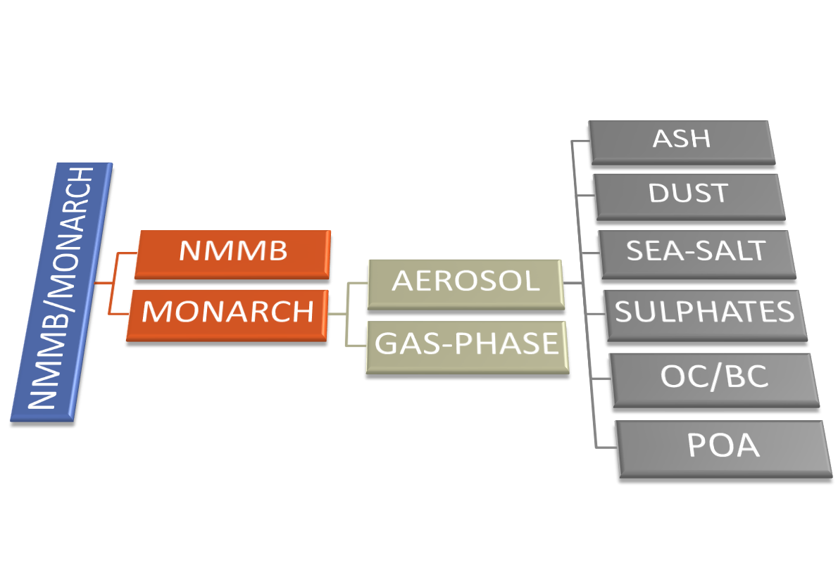
NMMB-MONARCH:
Atmospheric Composition and Air Quality
· The main system is build on the meteorological driver NMMB
· Multiscale: global to regional scales allowed (nesting capabilities)
· Nonhydrostatic dynamical core: single digit kilometre resolution allowed
· Fully on-line coupling: weather-chemistry feedback processes allowed
· Enhancement with a data assimilation system
Known as NMMB/BSC-Dust
Notes:
BSC has developed the NMMB-MONARCH model (multiscale online nonhydrostatic atmosphere chemistry model) that can be run either globally or regionally, thanks to its unified nonhydrostatic dynamical core. It is based on thee online coupling of the meteorological model with a full aerosol-chemistry model.
And NMMB/BSC-Dust model specifically contains the dust module embedded online with NMMB and provides weather and dust forecasts.
Ncep- gfs (Global forecast system), a weather forecast model produced by the National Centers for Environmental prediction.

Slide 7
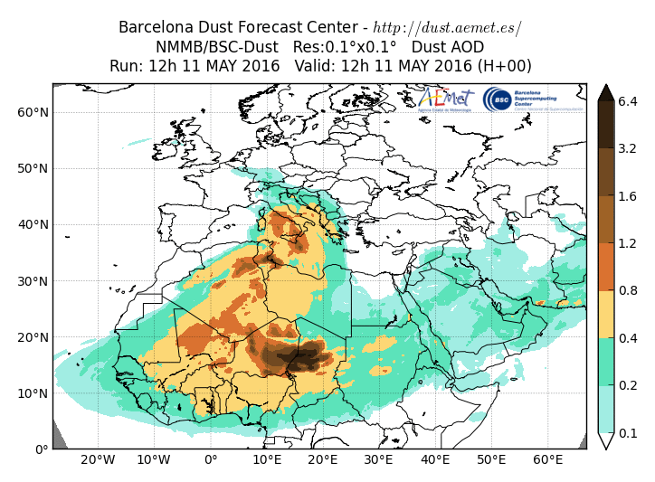
Mineral Dust Services
BSC dust operational forecast (global and regional domains)
Contribution to the SDS-WAS (regional, 3-days forescast) and ICAP (global, 5-days forecasts) multi-model ensembles
WMO Dust Regional Centers
Barcelona Dust Forecast Center. First specialized WMO Center for mineral dust prediction. Started in 2014 - Operational
http://dust.aemet.es
@Dust_Barcelona
SDS-WAS Regional Center. Sand and Dust Storm Warning Advisory and Assessment System. Started in 2010 – Research
http://sds-was.aemet.es
Notes:
SDS-WAS sand and dust storm warning advisory and assessment system
At the global scale, the model contributes to the ICAP International Cooperative for Aerosol Prediction multi-model ensemble.
The NMMB-MONARCH dust regional daily forecasts contribute to the Regional Center of the WMO Sand and Dust Storm Warning Advisory and Assessment System (SDS-WAS) dust forecast model intercomparison (https://sds-was.aemet.es) and it is the reference model of the operational WMO Barcelona Dust Forecast Center (https://dust.aemet.es/).

Slide 8
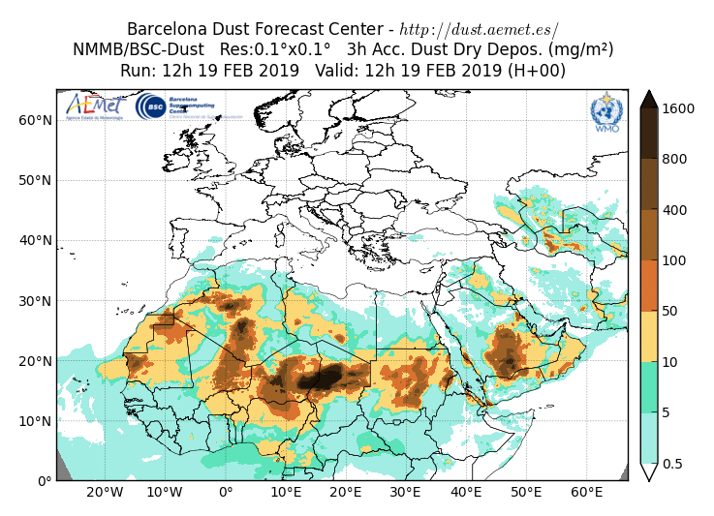
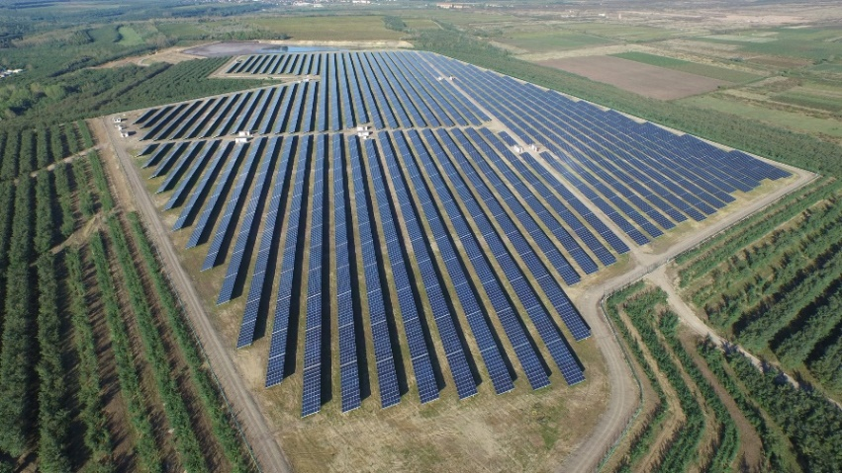
Soiling-Downscaling
Biggest solar plant in EU in Hungary is
300,000m² → This is 0,3km2 vs 100km² from the model
Operational regional dust forecasts
MONARCH
Prediction over specific locations
DLR soiling model
Notes:
8
Objective: Evaluation of 24h forecast of the MONARCH model for dust and meteo!!

Slide 9
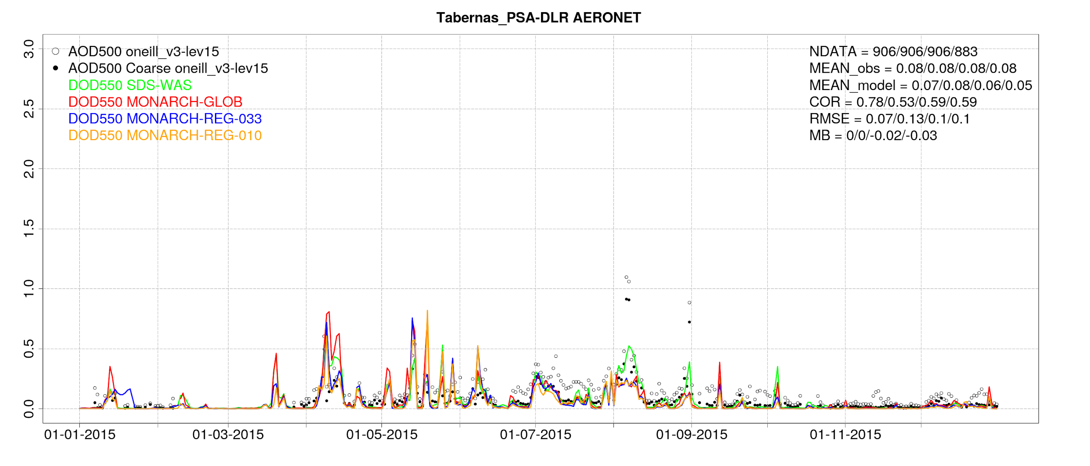
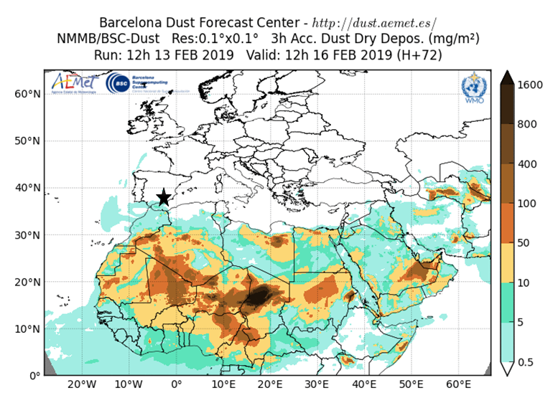
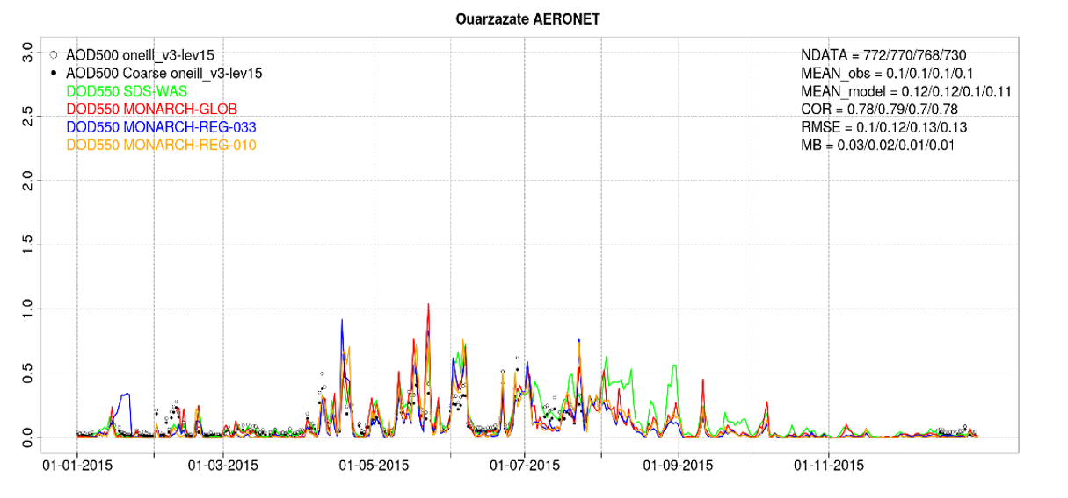
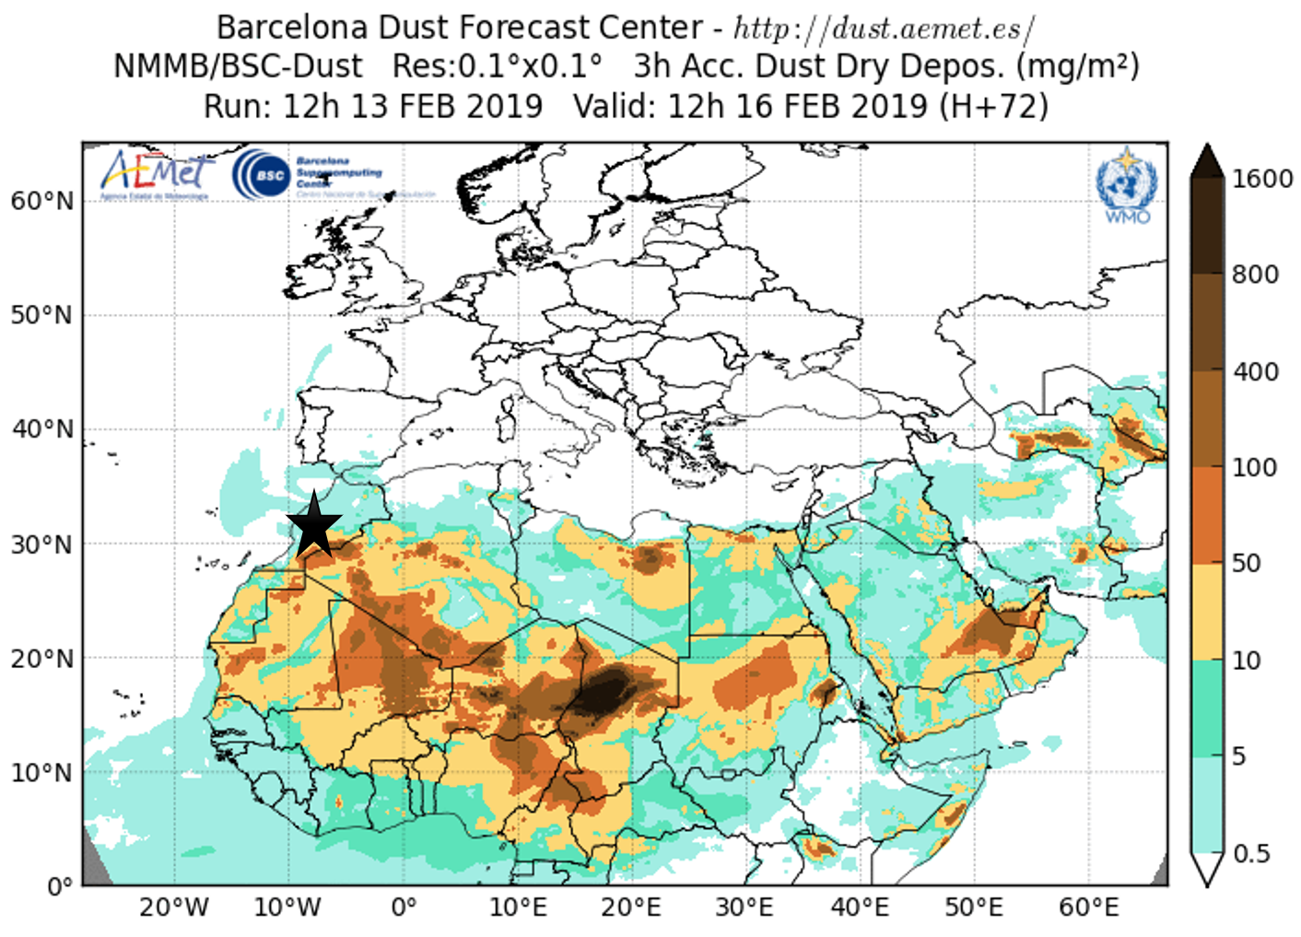
Dust: Model evaluation results 2015
Notes:
BSC model is going to be run for the years selected from DLR in order to provide inputs for the soiling model.
Its evaluations until now for various AERONET stations are satisfactory.
24-hour forecasts (on 3-hourly basis) of dust aerosol optical depth (DOD) from NMMB-MONARCH daily operational forecasts (MONARCH-GLOB, MONARCH-REG-033 and MONARCH-REG-010) have been validated for the year of 2015 against AERONET SDA AODcoarse cloud-screened observations over the study region and compare with the SDS-WAS Multi-model Median DOD. The SDS-WAS Multi-model Median DOD is obtained from twelve dust prediction models participating in SDS-WAS Regional Center.

Slide 10
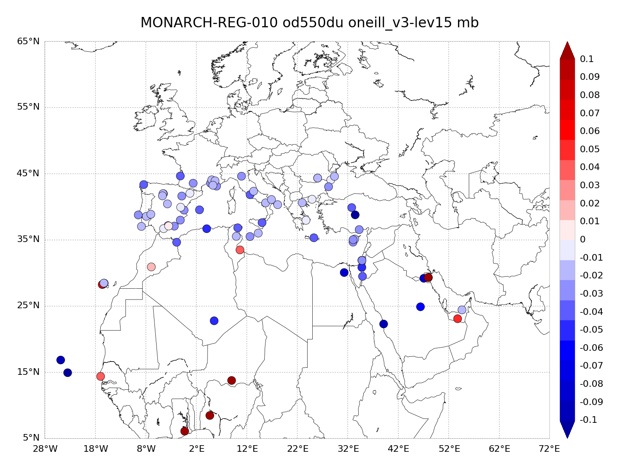
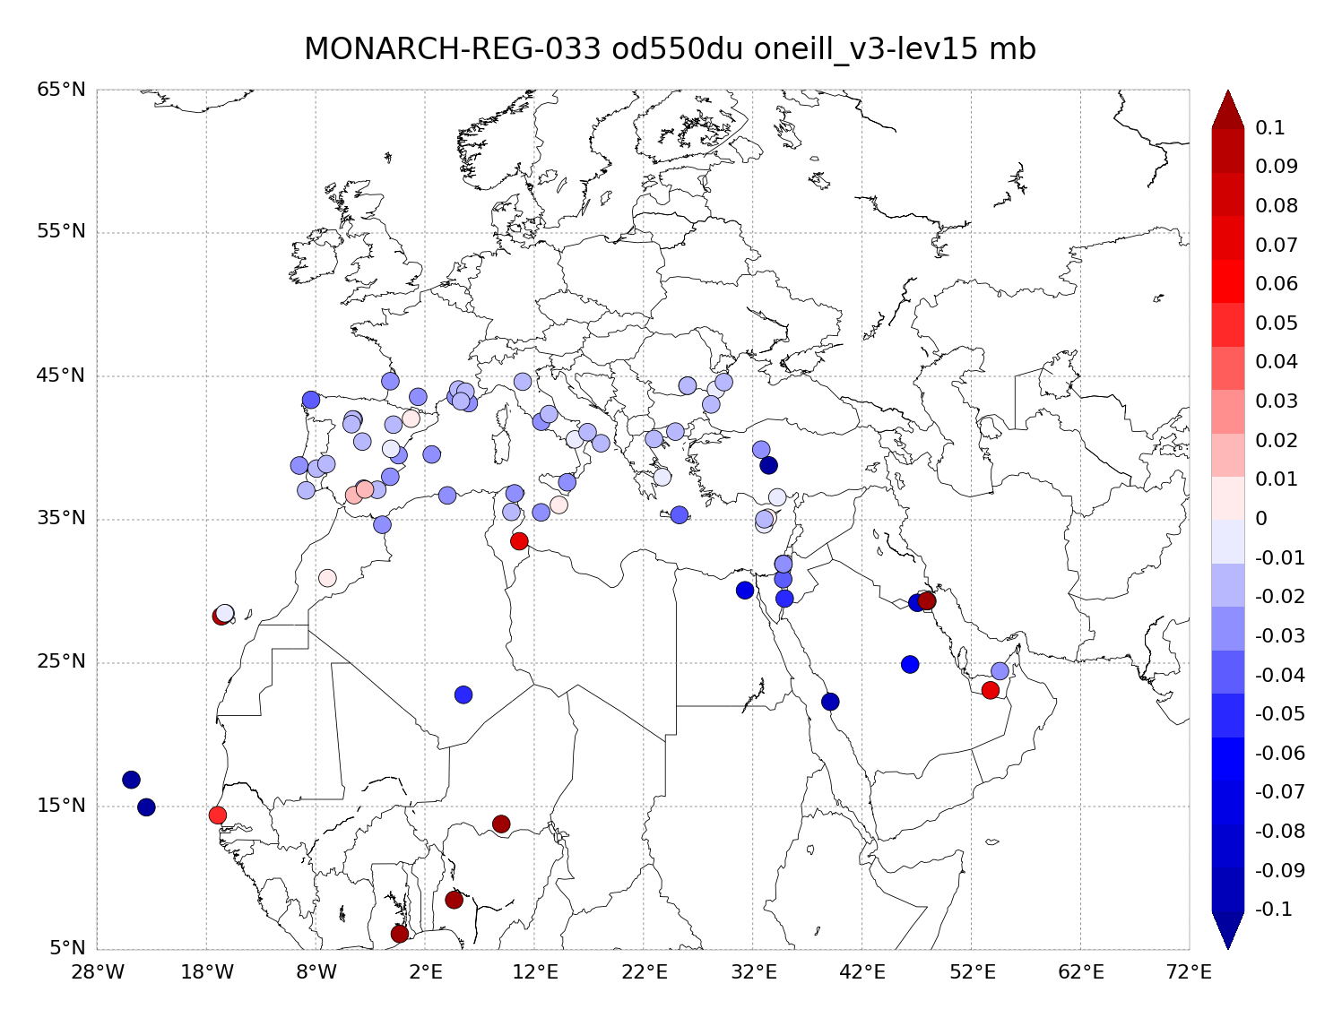
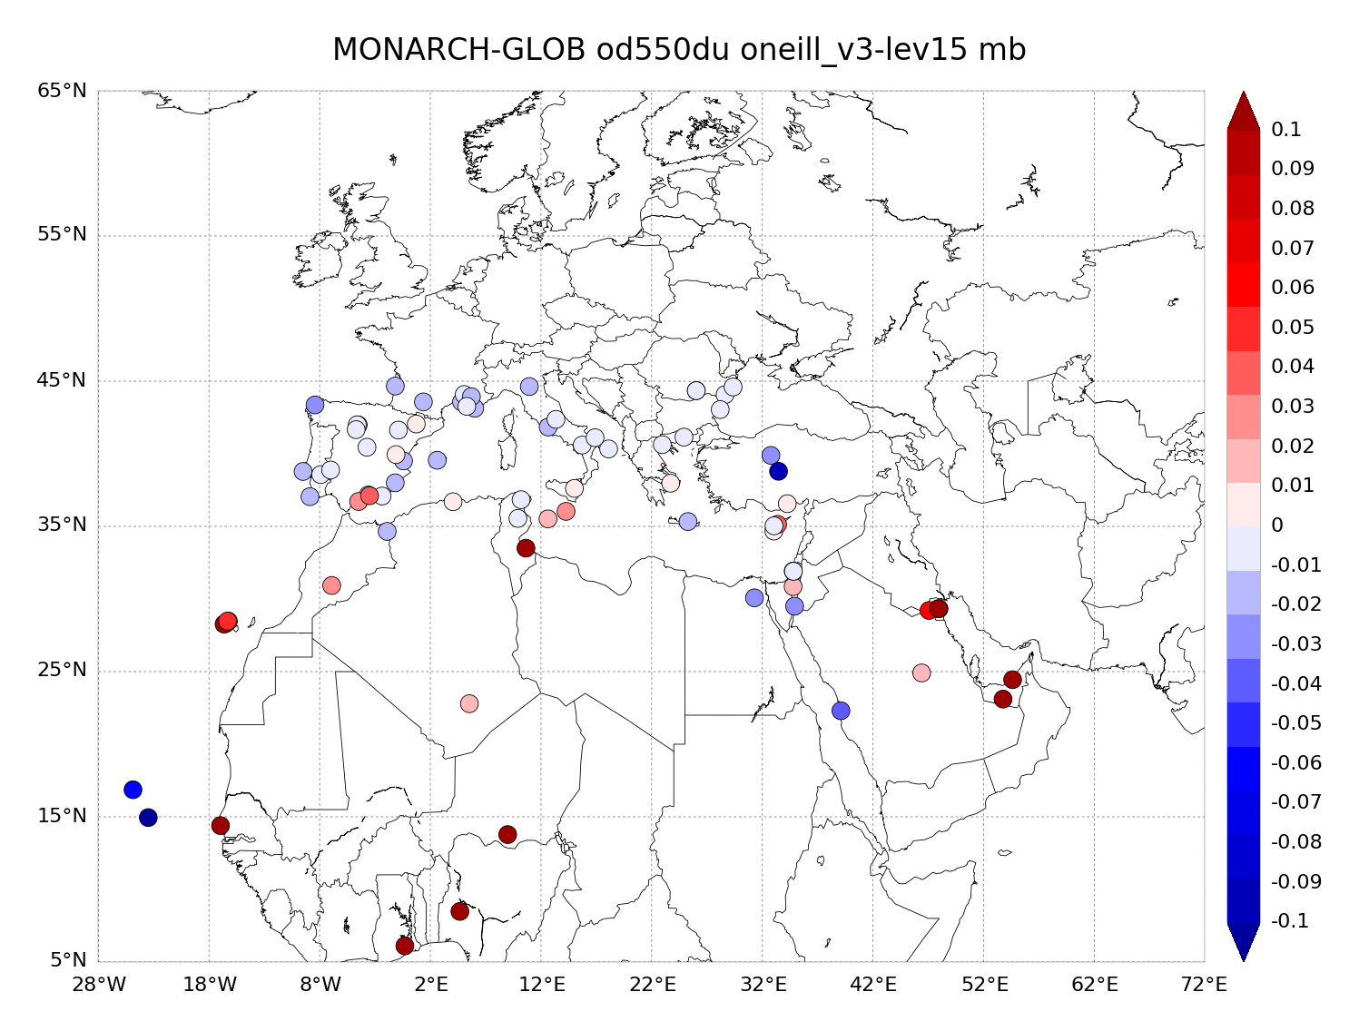
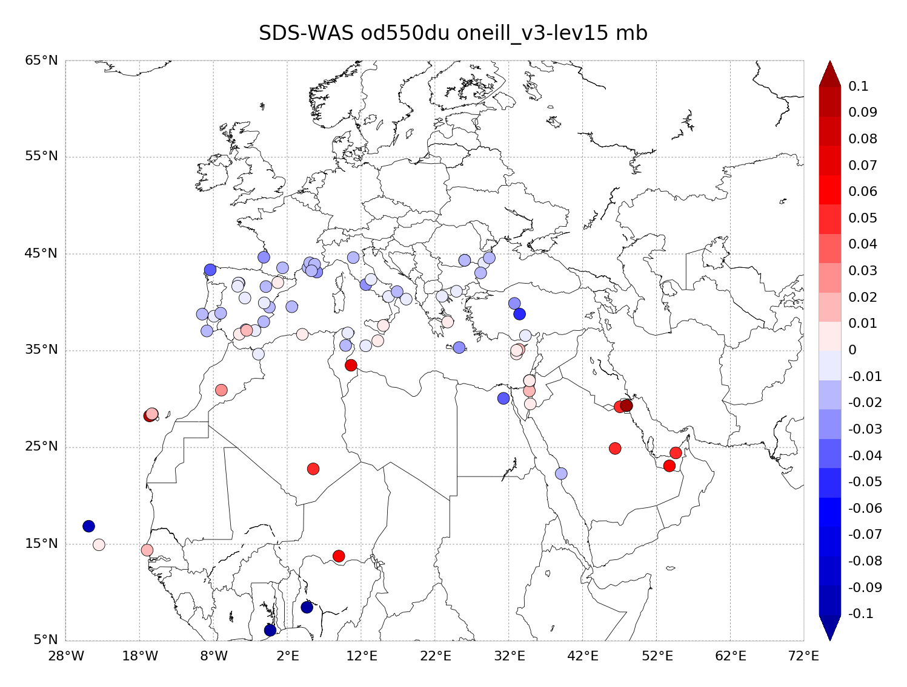
Dust AOD Evaluation: AERONET in-situ 2015
Notes:
from NMMB-MONARCH daily operational forecasts (MONARCH-GLOB, MONARCH-REG-033 and MONARCH-REG-010) have been validated for the year of 2015 against AERONET SDA AODcoarse cloud-screened observations over the study region and compare with the SDS-WAS Multi-model Median DOD. The SDS-WAS Multi-model Median DOD is obtained from twelve dust prediction models participating in SDS-WAS Regional Center.
MB

Slide 11
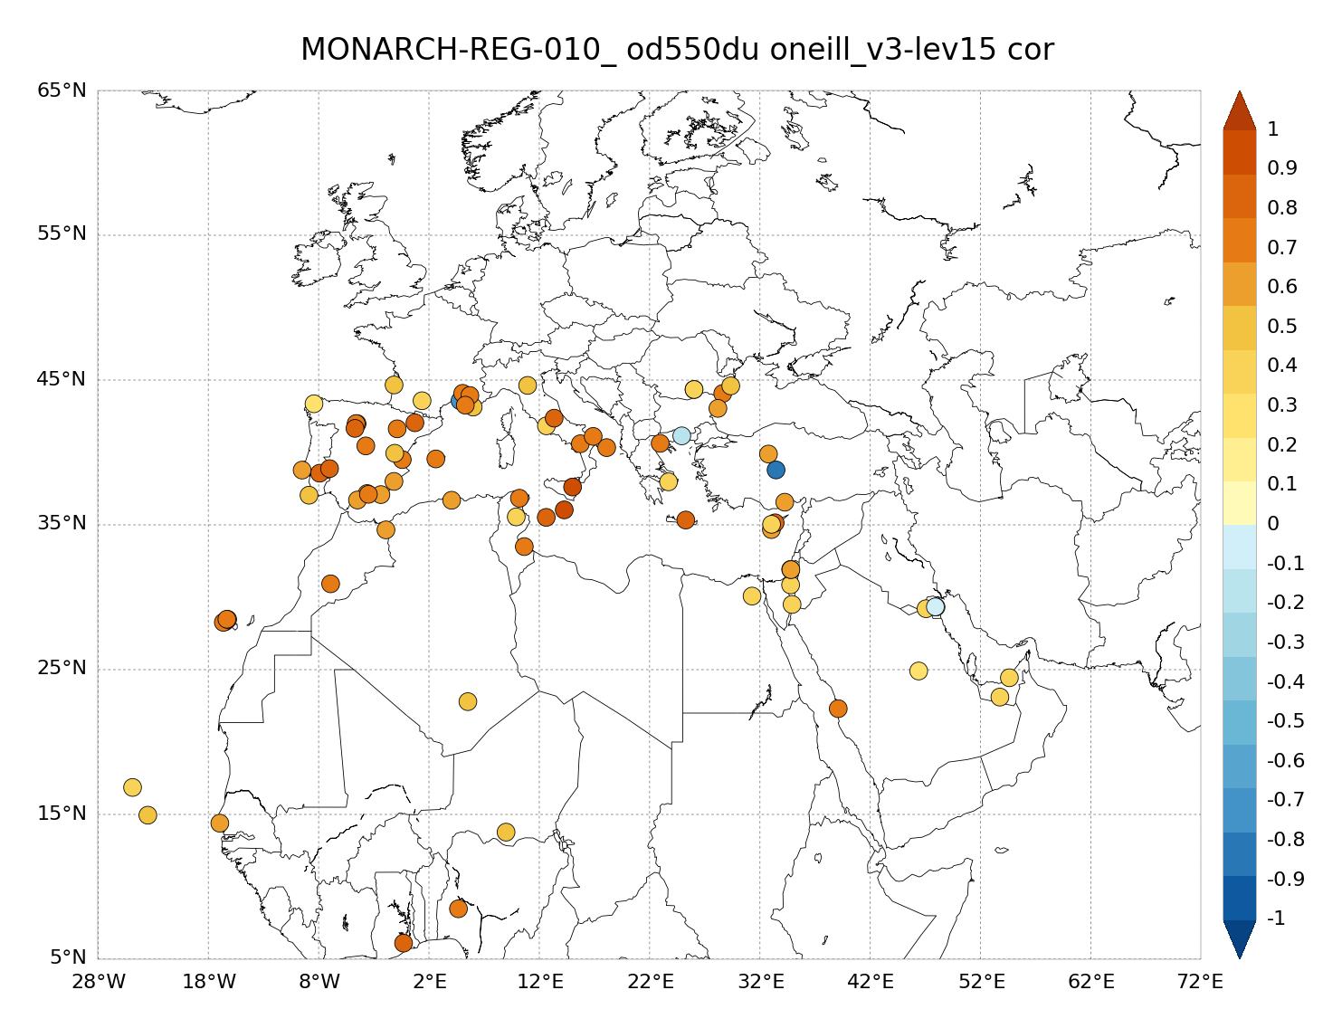
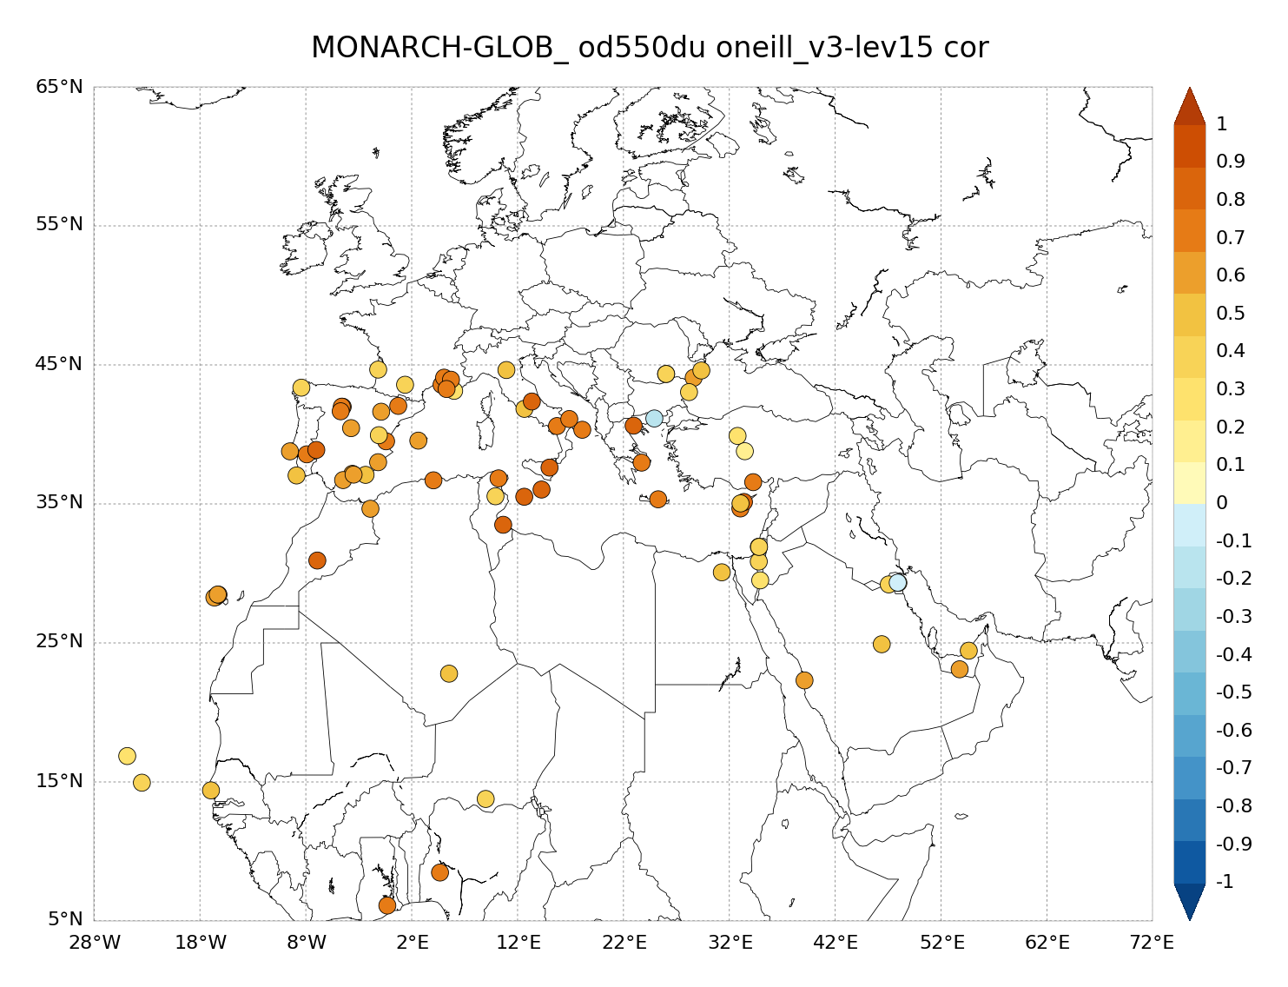
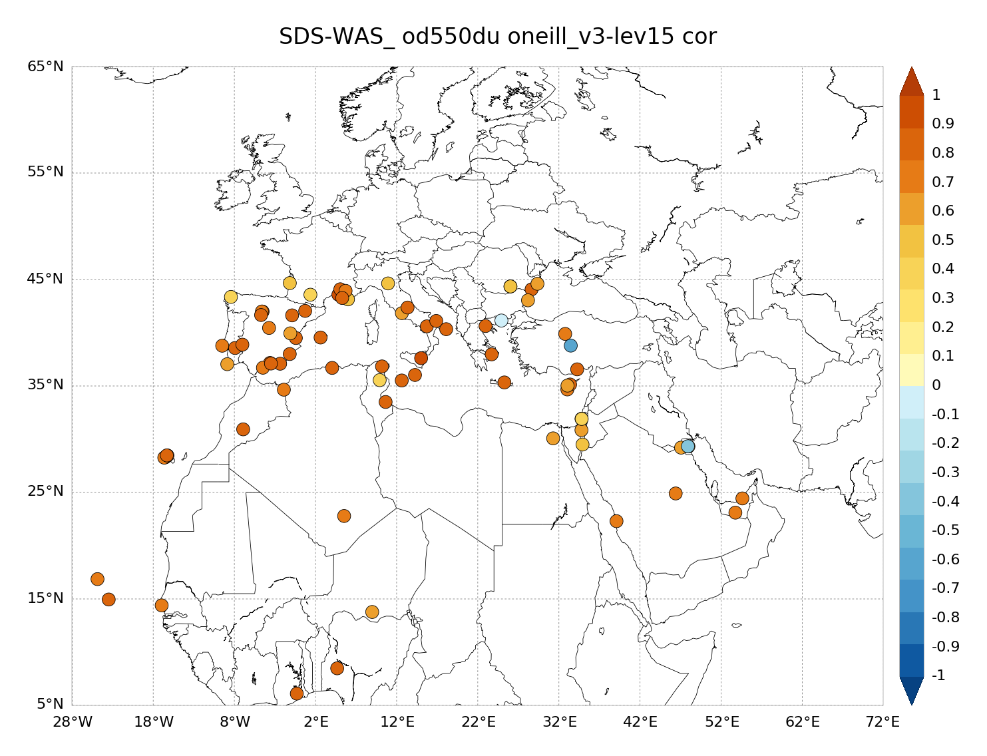
Dust AOD Evaluation: AERONET in-situ 2015
Notes:
from NMMB-MONARCH daily operational forecasts (MONARCH-GLOB, MONARCH-REG-033 and MONARCH-REG-010) have been validated for the year of 2015 against AERONET SDA AODcoarse cloud-screened observations over the study region and compare with the SDS-WAS Multi-model Median DOD. The SDS-WAS Multi-model Median DOD is obtained from twelve dust prediction models participating in SDS-WAS Regional Center.
Correlation

Slide 12
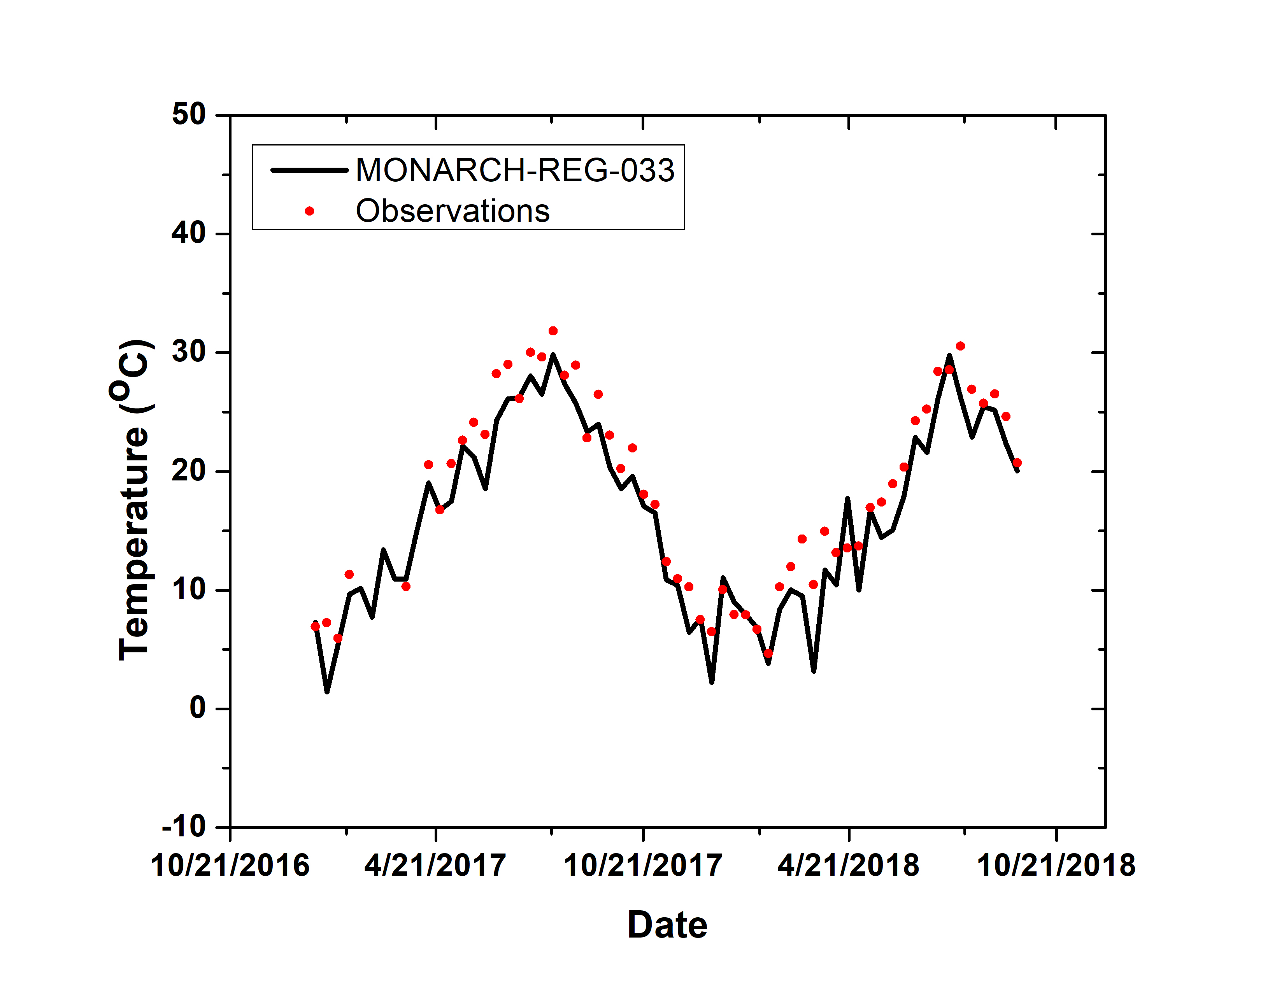
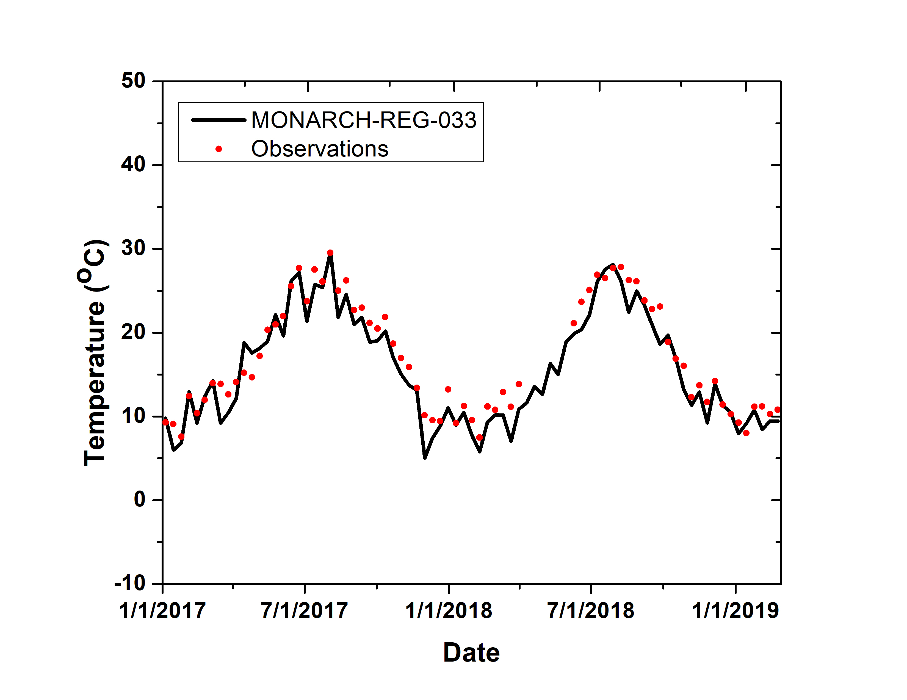
Meteo: Model evaluation results for temperature for the years for 2017-2018
Missour, Morocco
Tabernas, Spain
T_{BSC}= 16.3 ºC
T_{DLR}= 18.5 ºC
MB= 1.9
COR= 0.97
RMSE=2.6
T_{BSC}= 15.6 ºC
T_{DLR}= 16.9 ºC
MB= 1.5
COR= 0.97
RMSE=1.9
Notes:
with some cold bias in Morocco, soil moisture over deserts are overestimated in the GFS analysis and may be one of the sources of this bias

Slide 13
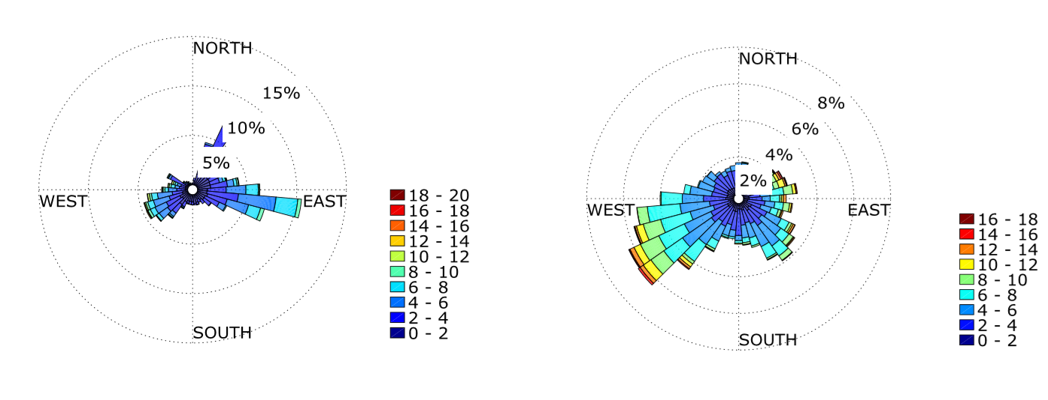
Meteo: Model evaluation results for wind rose for the years 2017-2018
Tabernas, Spain
Observations
MONARCH-REG-033
Notes:
wind bias related to model resolution (better in flat terrain that in complex terrain, resolution particularly important for wind direction) and limitations of the boundary layer (mesoscale models have a lot of problems simulating low winds)

Slide 14
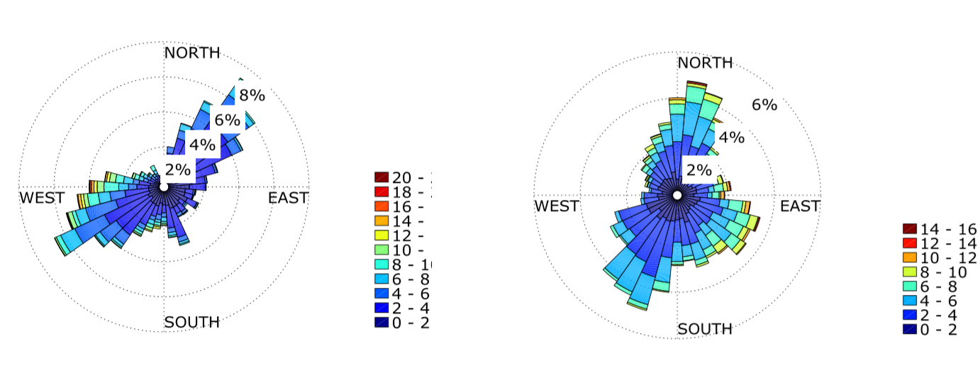
Meteo: Model evaluation results for wind rose for the years 2017-2018
Missour, Morocco
Observations
MONARCH-REG-033
Notes:
wind bias related to model resolution (better in flat terrain that in complex terrain, resolution particularly important for wind direction) and limitations of the boundary layer (mesoscale models have a lot of problems simulating low winds)

Slide 15
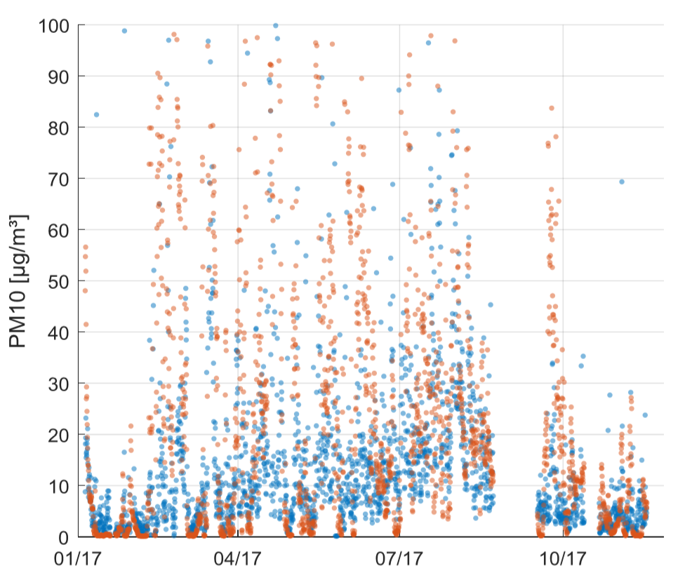
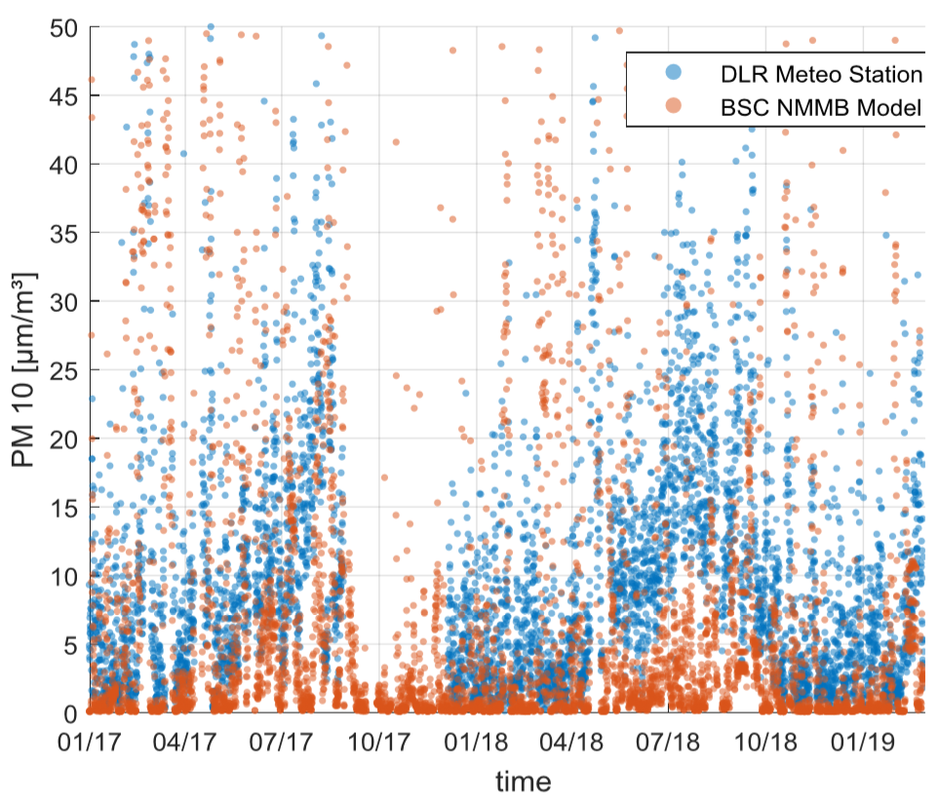
Model evaluation results for PM₁₀ for the years 2017-2018
Tabernas, Spain
Missour, Morocco
● Observations
● MONARCH-REG-033
● Observations
● MONARCH-REG-033
Notes:
bias in surface concentration due to dust schemes, lack of other aerosols
In those periods where the model is underestimating the observations in Tabernas (particularly in summer months), we are doing ongoing work for characterising the aerosol in this site (local sources vs regional transport). Better results are found in Missour.

Slide 16
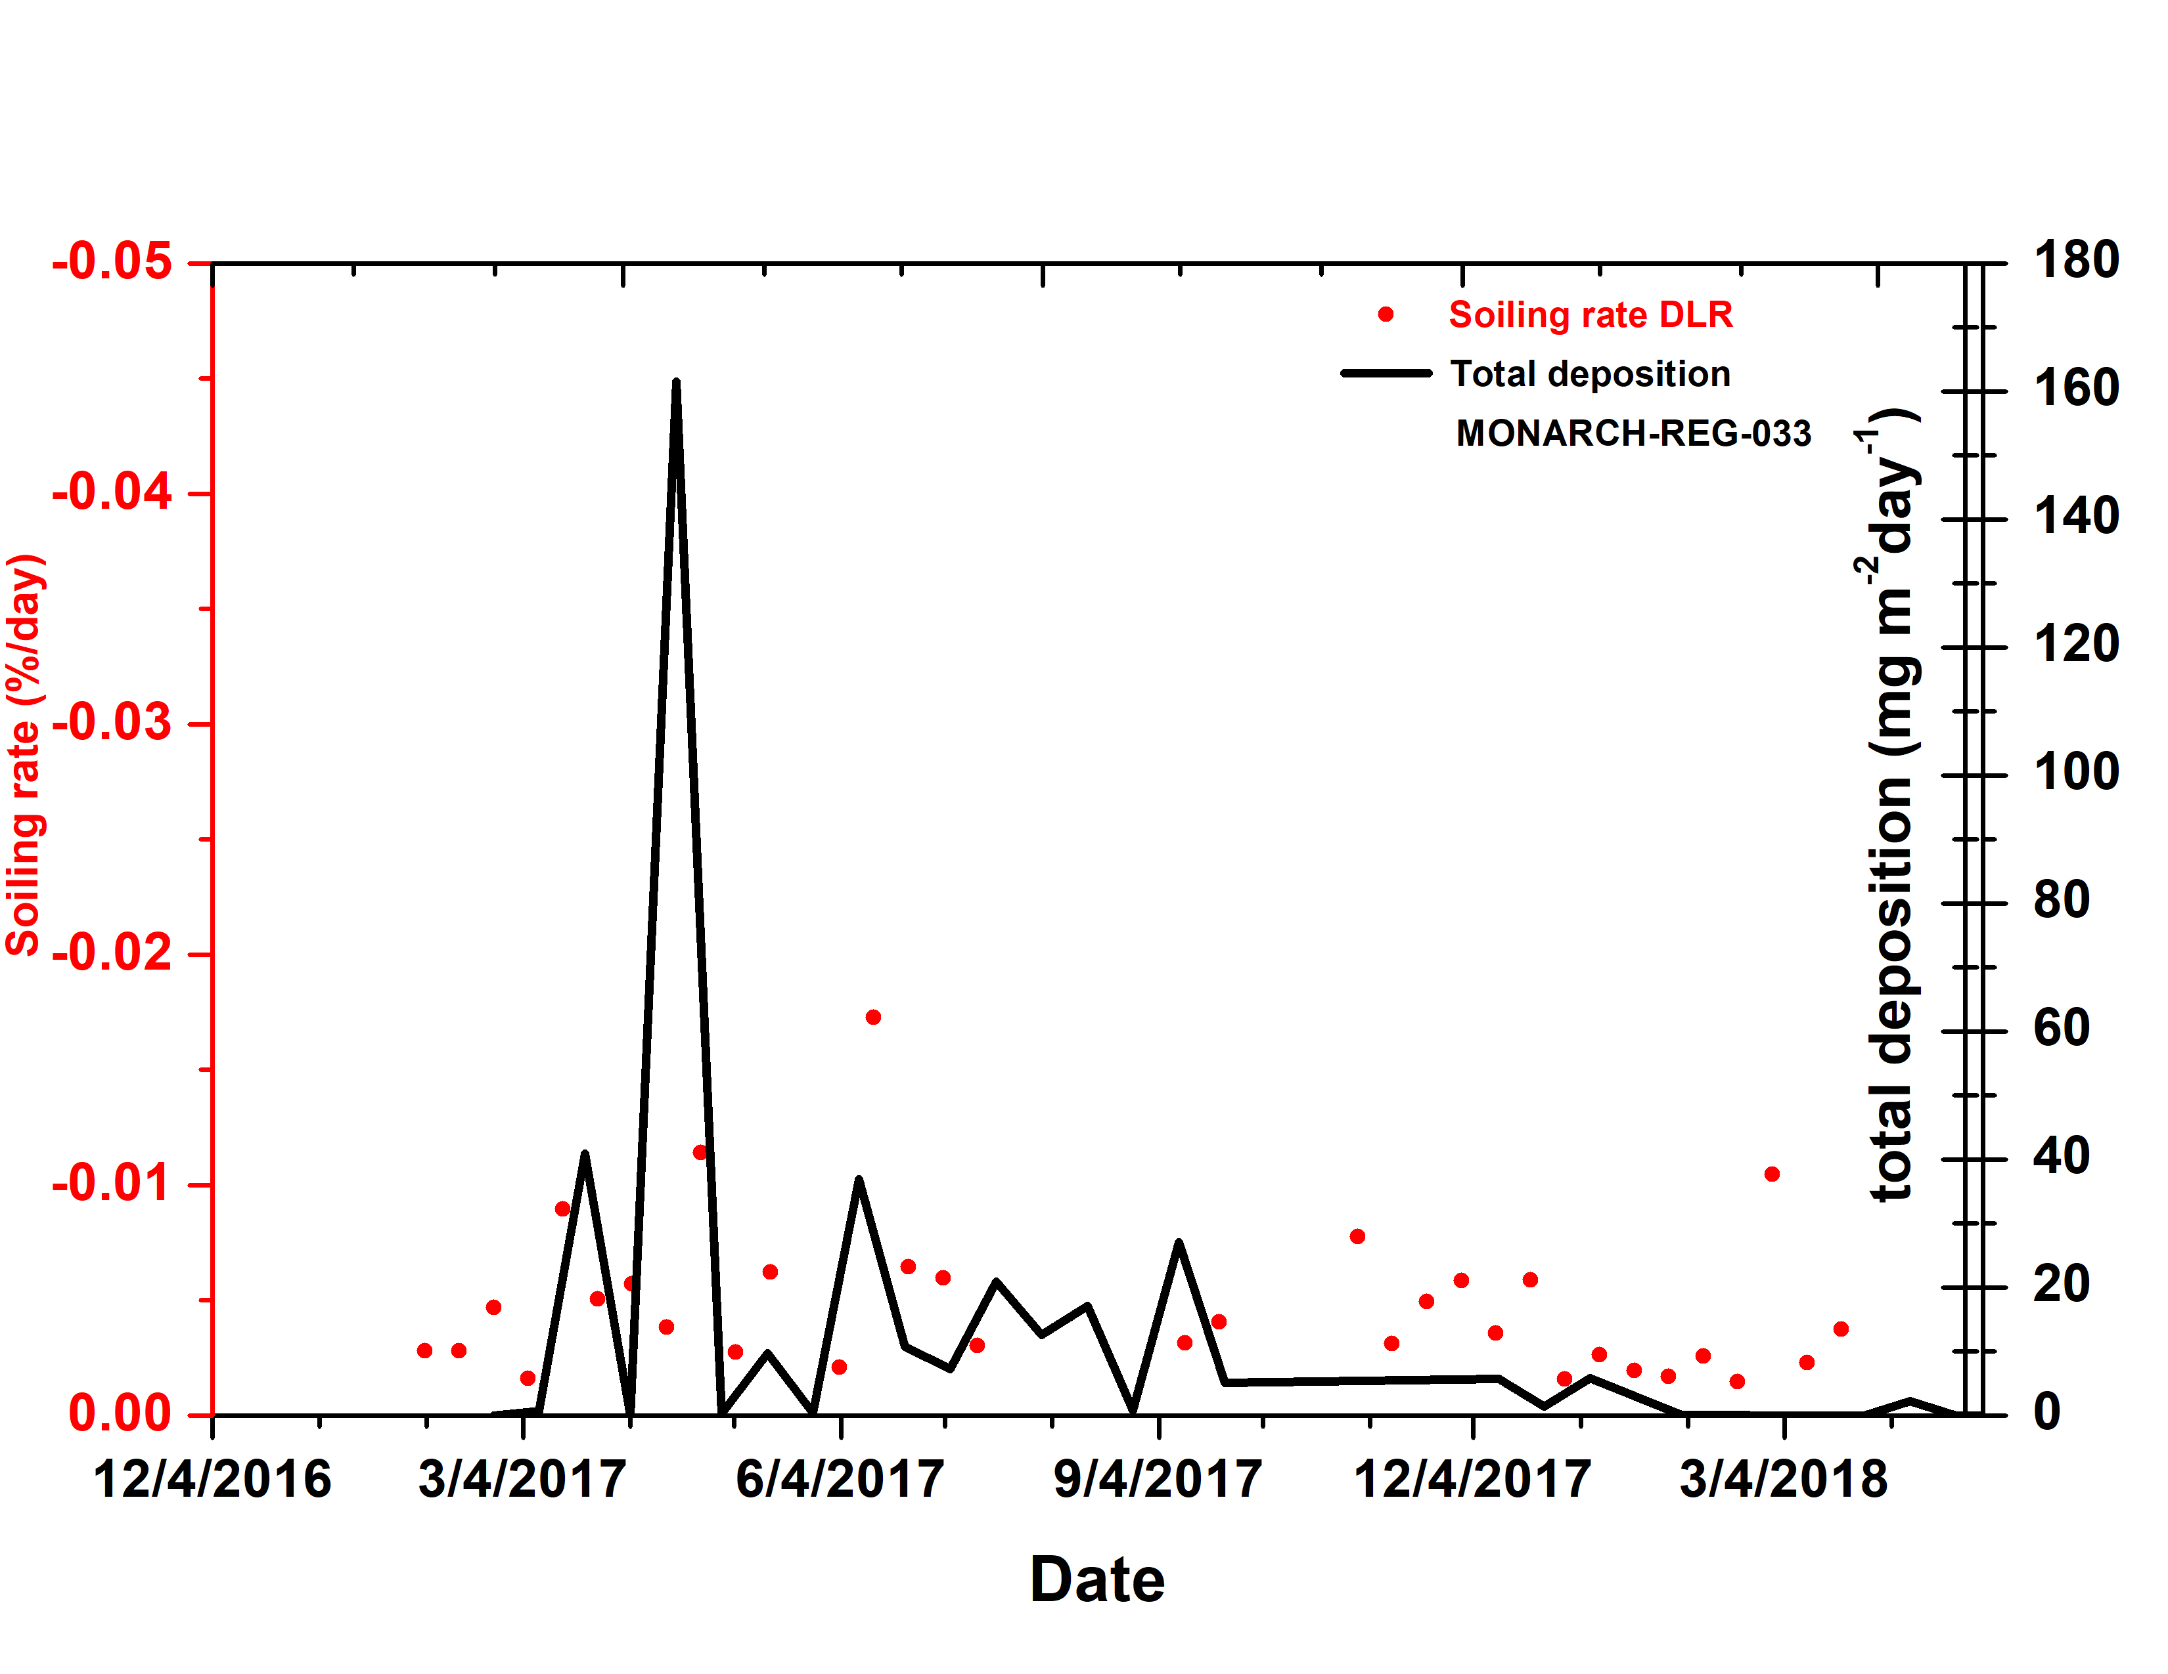
Soiling rate vs total dust deposition
Notes:
Show the different comparison that we are considering in our project, emphasis on understanding the relationship between soiling and deposition.
The soiling rate is the loss in cleanliness or reflectance of the solar mirror per day. The values are in day⁻¹.
At day 1, the cleanliness is 0.8 and at day 2 it is 0.78 à the soiling rate is -0.02 per day!
We are comparing only-dust model simulations against full-aerosols observations. Ongoing analysis is focusing only on African days

Slide 17
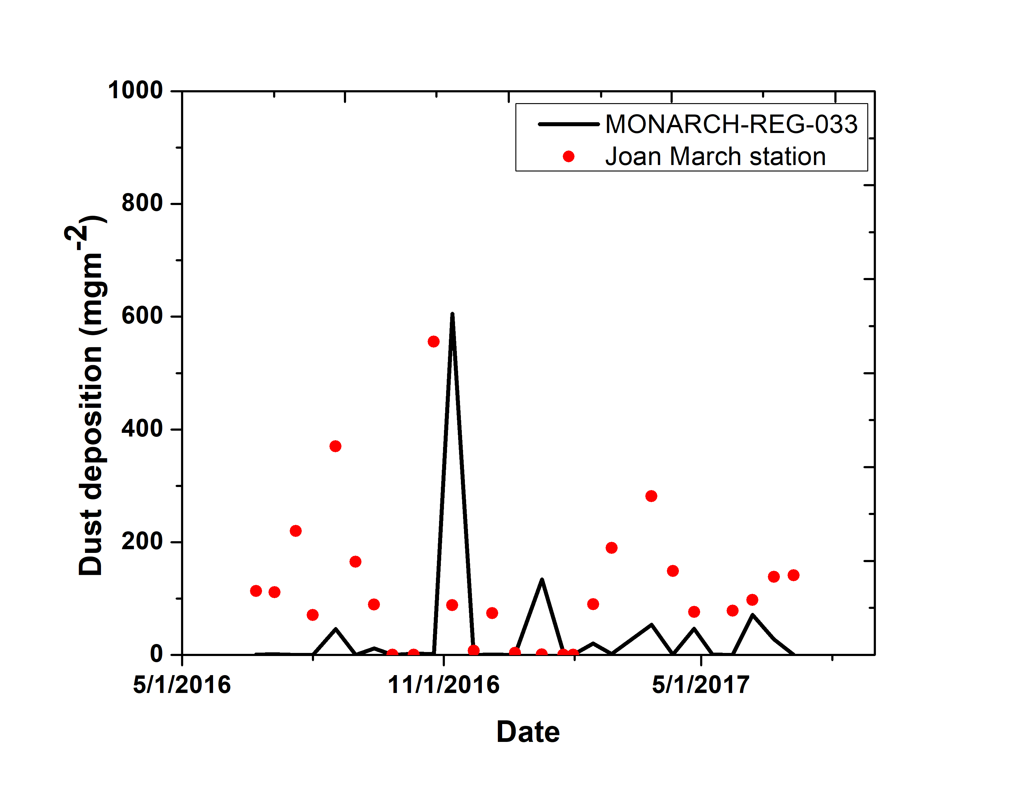
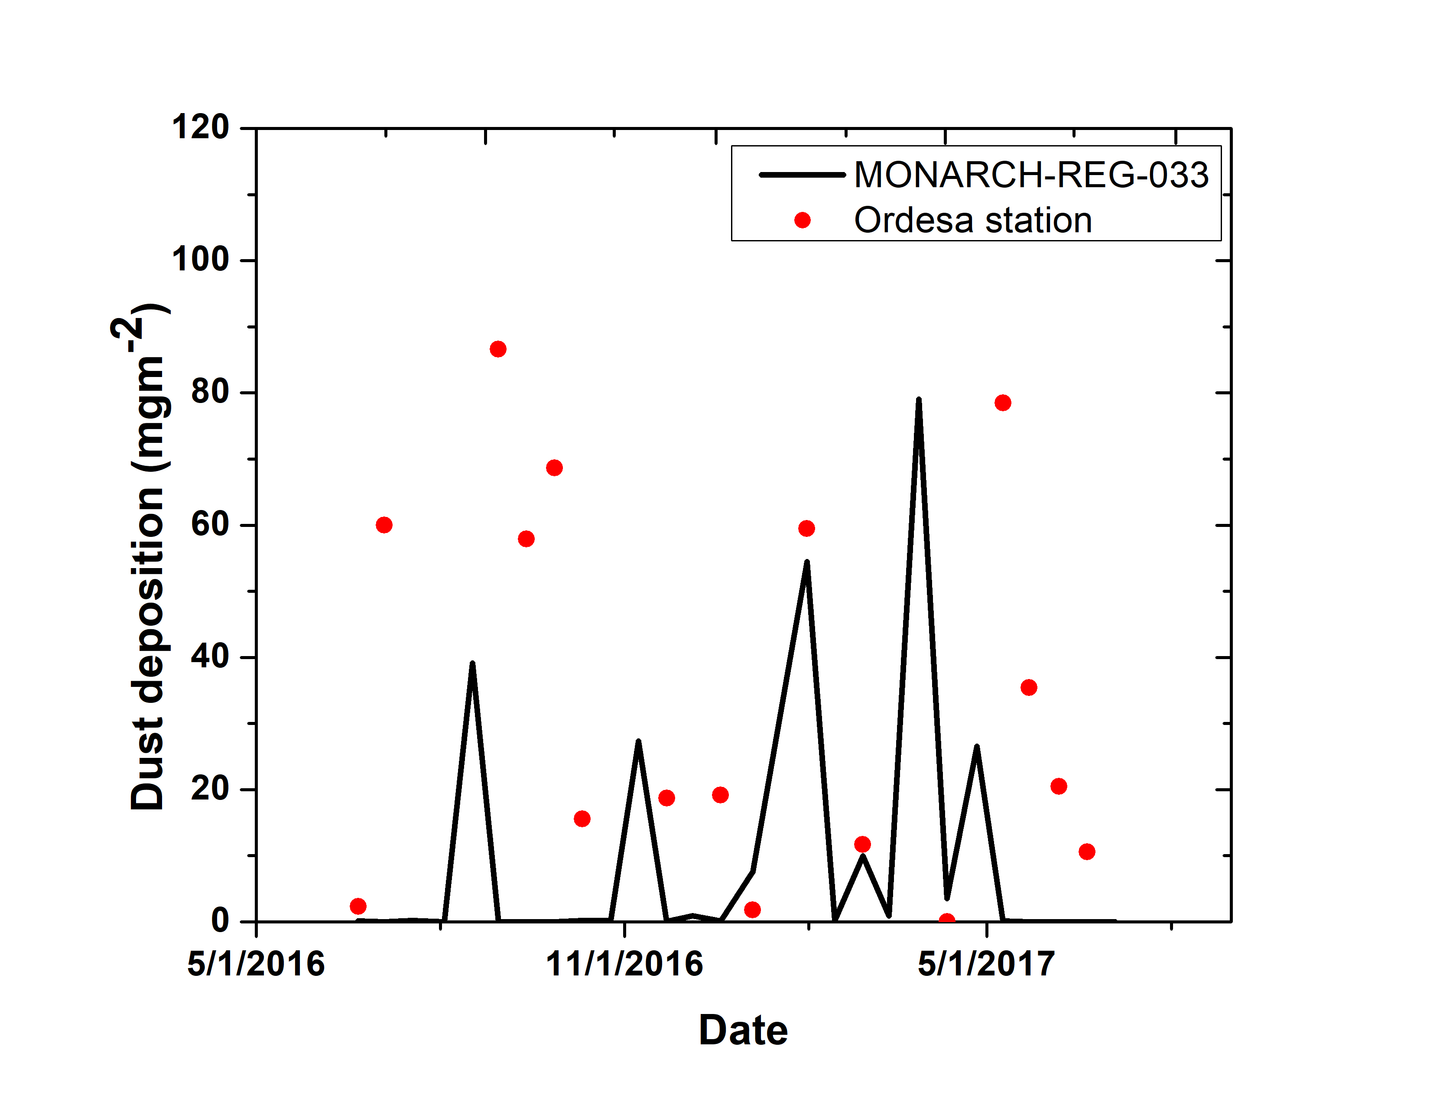
Model evaluation results for deposition data over Iberian Peninsula, preliminary
Joan March
Ordesa
From Jorge Pey, CSIC, Instituto Pirenaico de Ecología
Notes:
this is a unique network in the Iberian Peninsula (from Jorge Pey) that provides dust-deposition for a period of years in 14 stations

Slide 18
Summary
Within H2020 SOLWARIS we will provide operational soiling forecasts.
To achieve this objective, the dust atmospheric NMMB-MONARCH model will be coupled with a soiling model.
The evaluation of NMMB-MONARCH (the inputs used by the soiling model) shows that the model can predict the desert dust cycle over North Africa, Middle East and Europe.
Over southern Spain and Morocco, where is focusing the project, the model is capturing the timing and the magnitude of the dust events.
The 3 experiments considered (from 100 to 10km) have similar skills scores in the dust comparison with AERONET for long-range transport regions.
The meteorology is relatively well captured by the model. Model underestimates <2K (in absolute error) in annual basis.
For wind, it can predict the main wind pattern although overestimates wind speed. This can be linked to the spatial representation of the sites considered and the resolution of the model evaluated.
For the PM10 comparisons, in those periods where the model is underestimating the observations in Tabernas (particularly in summer months), ongoing work for characterising the aerosol in this site (local sources vs regional transport). Better results are found in Missour.
For soiling we are comparing only-dust model simulations against full-aerosols observations. Ongoing analysis is focusing only on African days.
Next steps: Deposition evaluation on 14 station in Iberian Peninsula is ongoing, impact of the resolution on the model results (downscaling to <5km), contribution of other relevant aerosols.
Notes:
the model will be improved with enhanced dust schemes, refined meteorology (finer resolution if needed), and considering the contribution of other relevant aerosols for Tabernas site.
Operational soiling forecasts: up to 5-days soiling forecasts based on the daily operational dust MONARCH system.
A soiling rate map: based on a dust NMMB-MONARCH reanalysis for Northern Africa, Middle East and Europe.

Slide 19
Thank you
eleni.karnezi@bsc.es
Notes:
InDust (COST Action CA16202, www.cost-indust.eu). Also thanks to AXA Research Fund for funding aerosol research at the Barcelona Supercomputing Center through the AXA Chair on Sand and Dust Storms.

