Slide 1
Task 3.2: Improved skill of seasonal prediction of water cycle and precipitation
Markus Donat, Andrea Manrique, Louis-Philippe Caron, Niti Mishra, Chloé Prodhomme
IMPREX GA 2018, Valencia
01 Oct 2018
IMPREX is funded by the EU H2020 Framework Programme under grant agreement no. GA 641811)

Slide 2
Improving skill of seasonal predictions (?)
By…
Improving the model / prediction system
Increasing the model resolution
Land-surface initialisation
Postprocessing
Impose empirical relationships e.g. to NAO
Combining different models/prediction systems
Bias correction

Slide 3
(1) Improving the model / prediction system
initialization of the model with realistic soil moisture conditions (as opposed to climatological mean)
increase the model atmosphere and ocean resolutions

Slide 4
Improvements from initializing soil moisture
Twin sets of experiments (SM_Clim, SM_init) for boreal summer (MJJA), 1992-2010
5 forecast systems: MPI-ESM, ECMWF System4, CNRM-CM5, EC-Earth v2.3 and GloSea5
Ardilouze, C. et al. (2017) Multi-model assessment of the impact of soil moisture initialization on mid-latitude summer predictability. Clim. Dyn., 49, 3959-3974.
Notes:
Land initialisation from ERALand, Jules (offline driven, GloSea), and MPI some GCM nudhging
Clim just averages all Inits

Slide 5
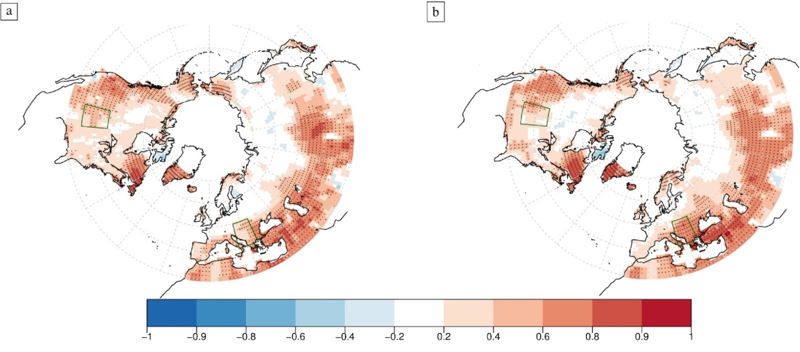
Improvements from initializing soil moisture
SM Clim
SM Init
ACC,
Tmean JJA
Ardilouze et al. (2017) Clim. Dyn., 49, 3959-3974

Slide 6
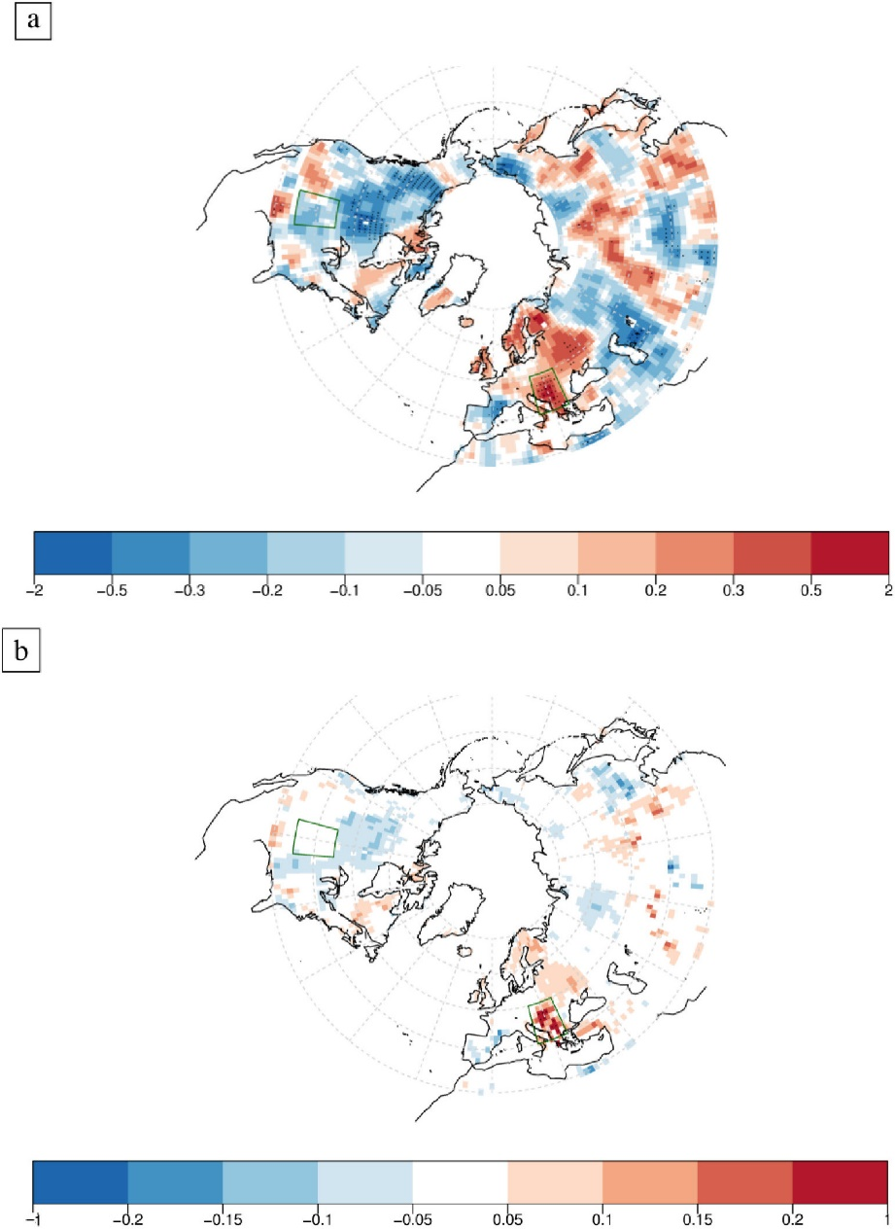
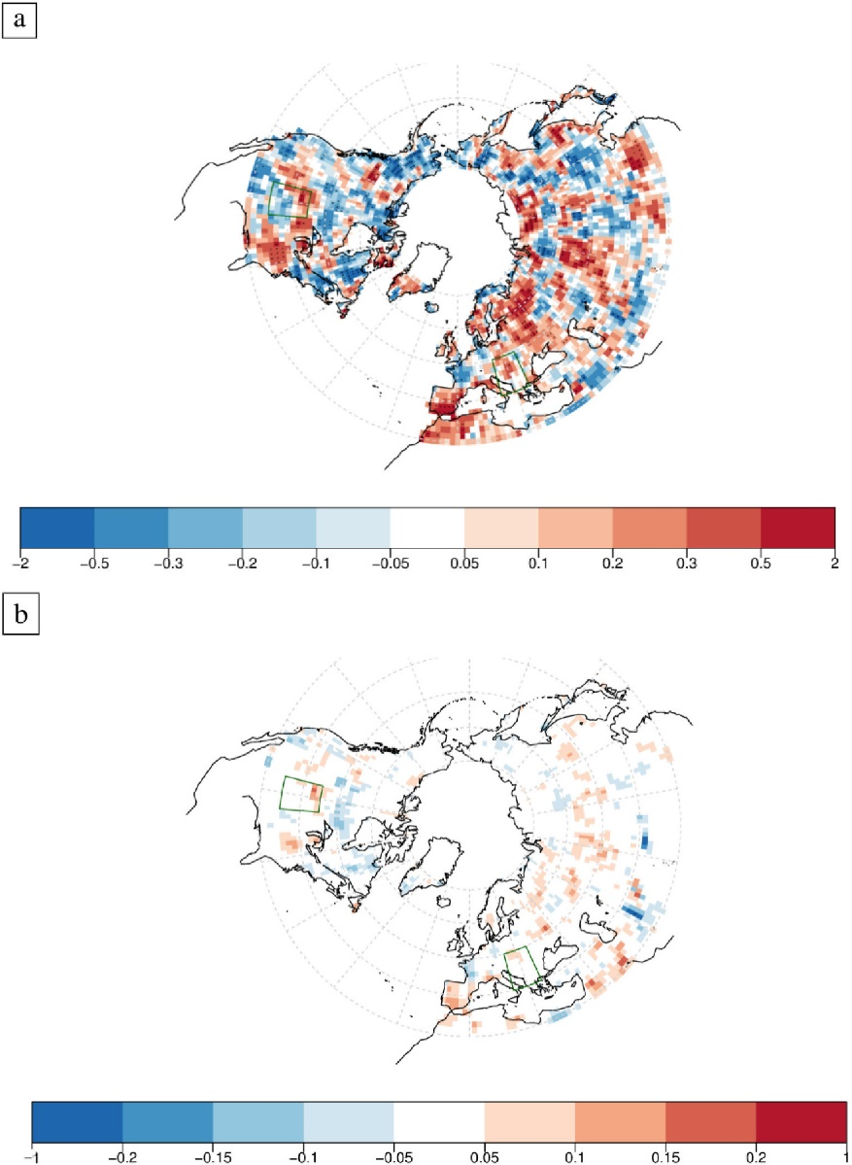
Improvements from initializing soil moisture
Tmean (JJA)
ACC (Init) – ACC (Clim)
Precipitation (JJA)
-> SM initialisation regionally improves temperature skill in SE Europe,
Generally poor skill for precipitation, improvements less conclusive
RMSE (Init) – RMSE (Clim)

Slide 7
Improvements from initializing soil moisture
Tmean JJA, de-trended anomalies Balkan region
Black: ERA-Int, Red: SM_ini, Blue: SM_clim
-> SM initialisation regionally improves the simulated inter-annual variability of summer temperature
Ardilouze et al. (2017) Clim. Dyn., 49, 3959-3974

Slide 8
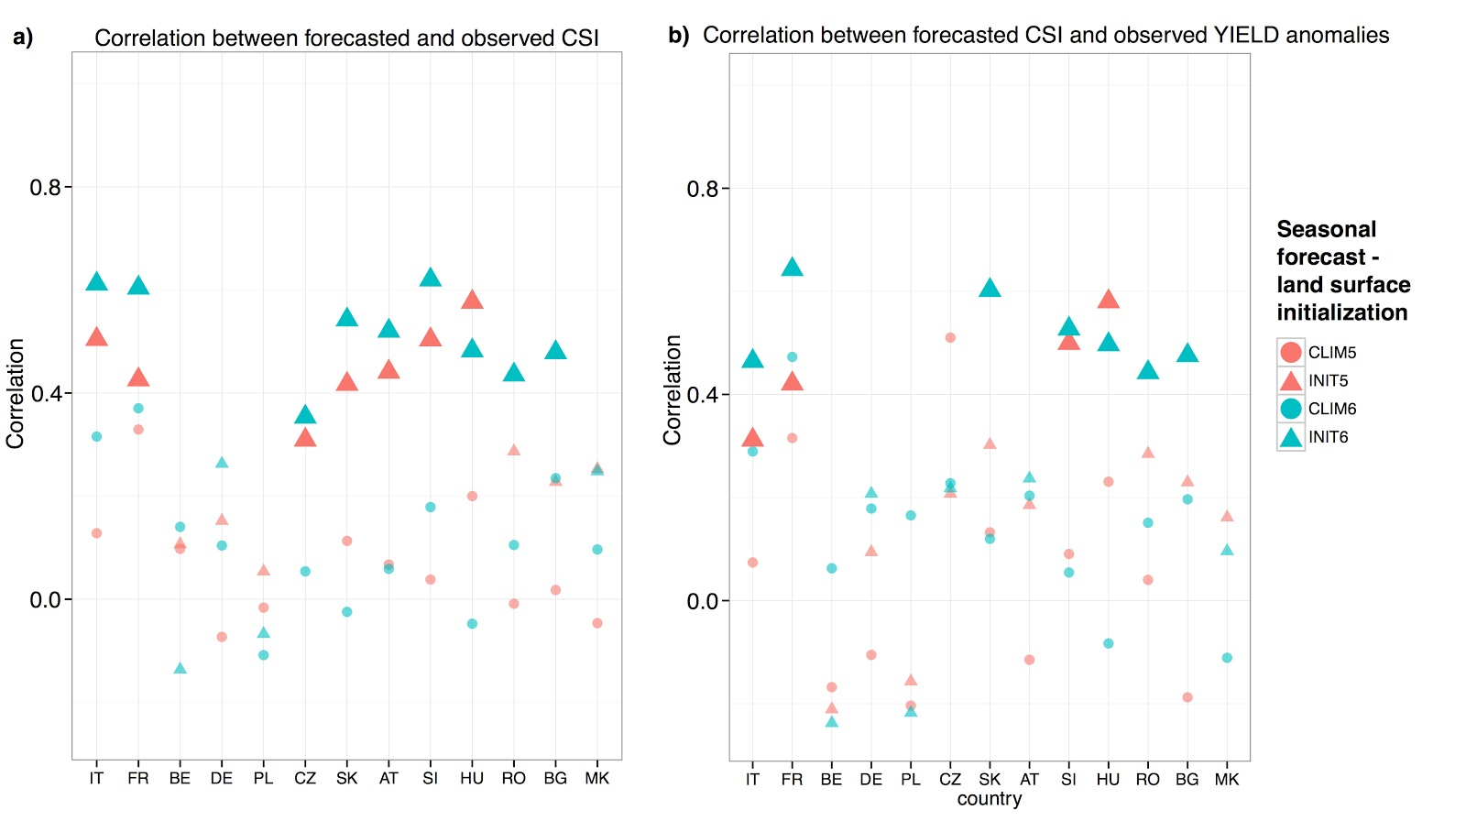
Impact of Soil Moisture Initialization on Seasonal Forecast of Maize Yield
Example application to agricultural yields:
-> SM initialisation improves maize yield estimated in Europe
Ceglar, A. et al. (2018) Sci. Rep., 8:1322
Estimate maize yield anomalies (Y) based on combined stress index from SPEI and HDD
Notes:
CSI – combined stress index

Slide 9
Improvements from increasing model resolution
SRes (standard): atmosphere T255 (approx. 0.7° lat x lon), 91 vertical levels,
ocean 1° (with refinements around equator and poles), 46 vertical layers
IRes (intermediate): ocean resolution increased 0.25° , 75 vertical layers
HRes (high res): atmosphere T511 (~0.35°),
ocean 0.25° , 75 vertical layers
Prodhomme et al (2016) , J. Clim., 29, 9141-9162

Slide 10
Improvements from increasing model resolution
e.g. reduced bias in atmospheric blocking frequency
-> reduced bias in atmospheric blocking in the high-resolution simulations
Prodhomme et al (2016) , J. Clim., 29, 9141-9162

Slide 11
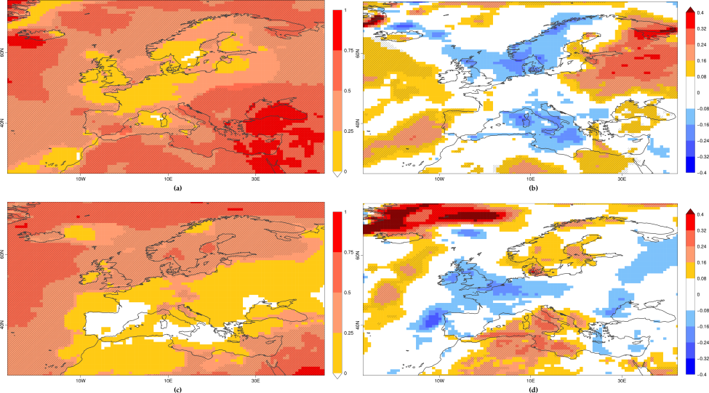
Improvements in next generation dynamical prediction system?
ECMWF System 5 versus System 4, e.g. Tmean
-> mixed pattern of regional skill improvements and reductions
System 5
System 5 – System 4
Tmean (JJA)
Tmean (DJF)
(Anomaly Correlation Coefficient, ACC; 1981-2015)

Slide 12
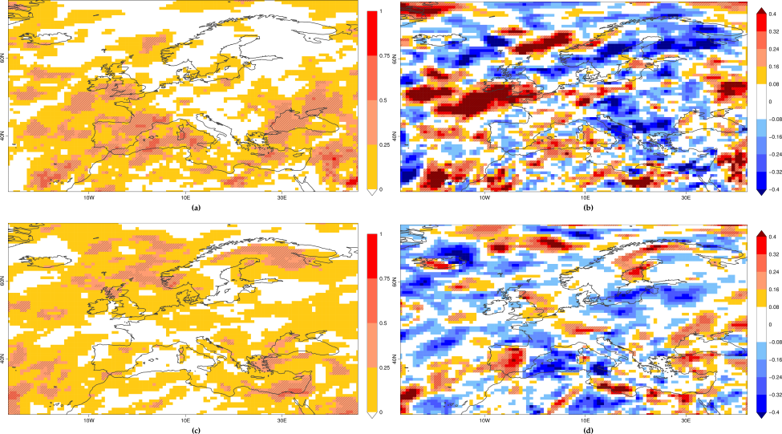
Improvements in next generation dynamical prediction system?
ECMWF System 5 versus System 4, e.g. Precipitation
System 5
System 5 – System 4
Precip (JJA)
 | surface temperature |  | maximum surface temperature |  | precipitation
 | JJA | DJF | JJA | DJF | JJA | DJF
Bisagno | -0.11 | 0.02 | -0.14 | 0.0 | -0.15 | 0.03
Jucar | -0.01 | 0.01 | -0.01 | -0.07 | -0.02 | -0.27
Lake Como | -0.09 | -0.05 | -0.10 | -0.07 | 0.03 | 0.01
Llobregat | -0.06 | -0.04 | -0.03 | -0.06 | -0.16 | -0.09
Messara | 0.12 | -0.11 | 0.13 | -0.13 | -0.26 | -0.20
Rhine-Meuse | 0.02 | -0.20 | 0.03 | -0.20 | 0.14 | 0.08
Segura | -0.05 | 0.08 | -0.07 | -0.04 | 0.25 | -0.16
Thames | 0.02 | -0.18 | 0.02 | -0.16 | 0.29 | 0.10
Umealven | -0.16 | 0.08 | -0.16 | 0.07 | 0.05 | 0.05
Precip (DJF)
(Anomaly Correlation Coefficient, ACC; 1981-2015)

Slide 13
(2) Skill improvements from processing the seasonal predictions model output

Slide 14
Imposing empirical (observed) NAO relationship
Idea:
- seasonal precipitation in Europe is correlated with NAO, and NAO can be skilfully predicted
- Models struggle with spatial patterns of NAO, and therefore local relationships
- Impose observed relationships to model-predicted NAO
Courtesy: Nicky Stringer, Met Office

Slide 15
Imposing empirical (observed) NAO relationship
raw adjusted
Correlation ensemble mean P vs E-Obs
(DJF, similar for JFM, FMA)
Regional time series of
seasonal mean precipitation
e.g. NW Scotland
Jucar
-> skill improvement (precipitation) in areas with positive correlations with NAO (i.e. NW Europe)
Courtesy: Nicky Stringer, Met Office

Slide 16
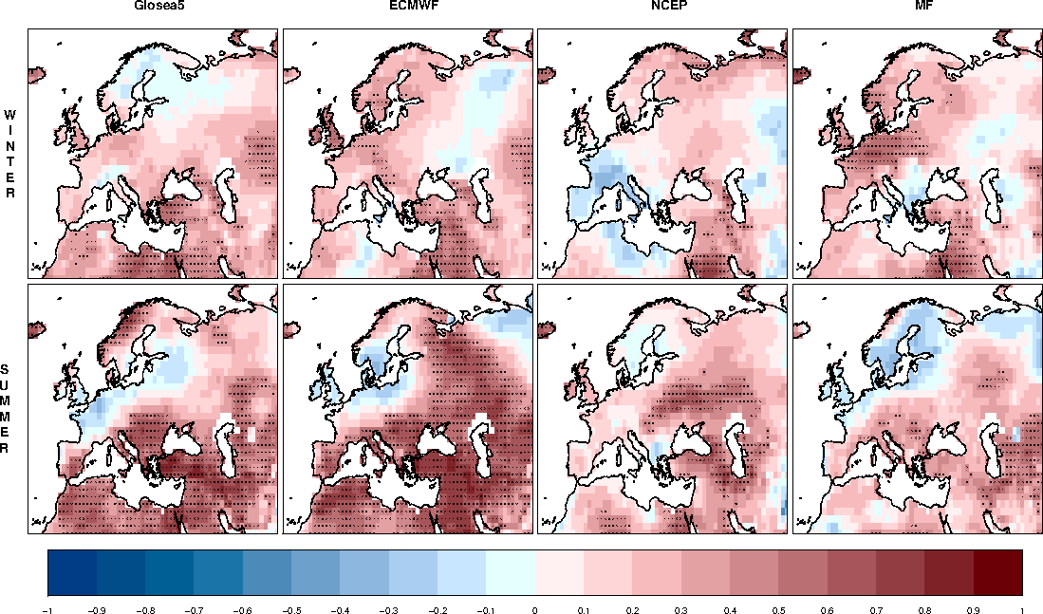
Multi-Model Skill Assessment
ACC seasonal temperature in different models
Mishra, N, C Prodhomme and V Guemas (2018), Climate Dynamics

Slide 17
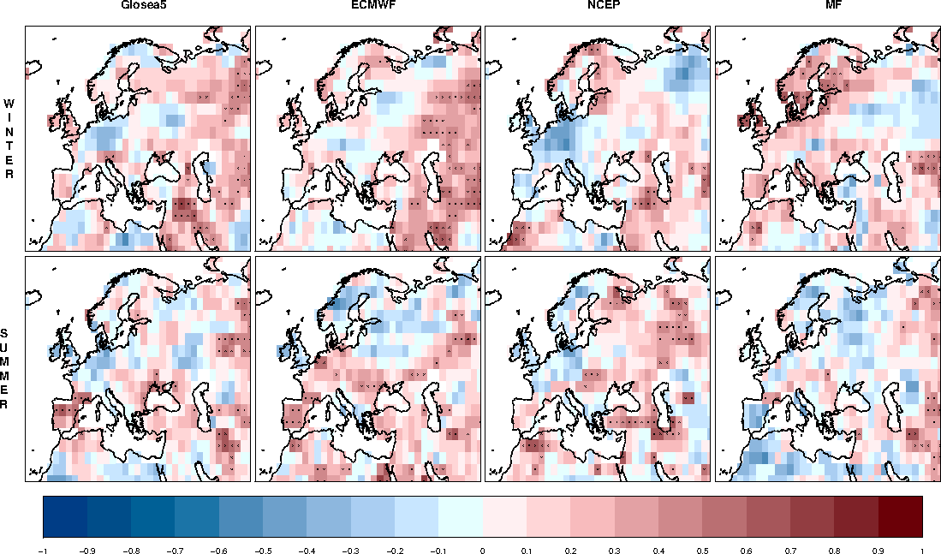
Multi-Model Skill Assessment
ACC seasonal precipitation in different models
Mishra, N, C Prodhomme and V Guemas (2018), Climate Dynamics

Slide 18
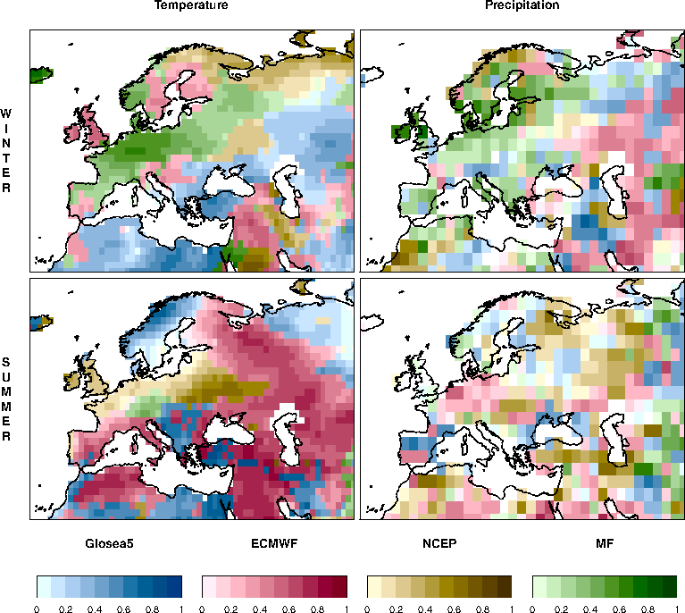
Multi-Model Skill Assessment
Maximum positive ACC
among the four individual models
Mishra, N, C Prodhomme and V Guemas (2018), Climate Dynamics

Slide 19
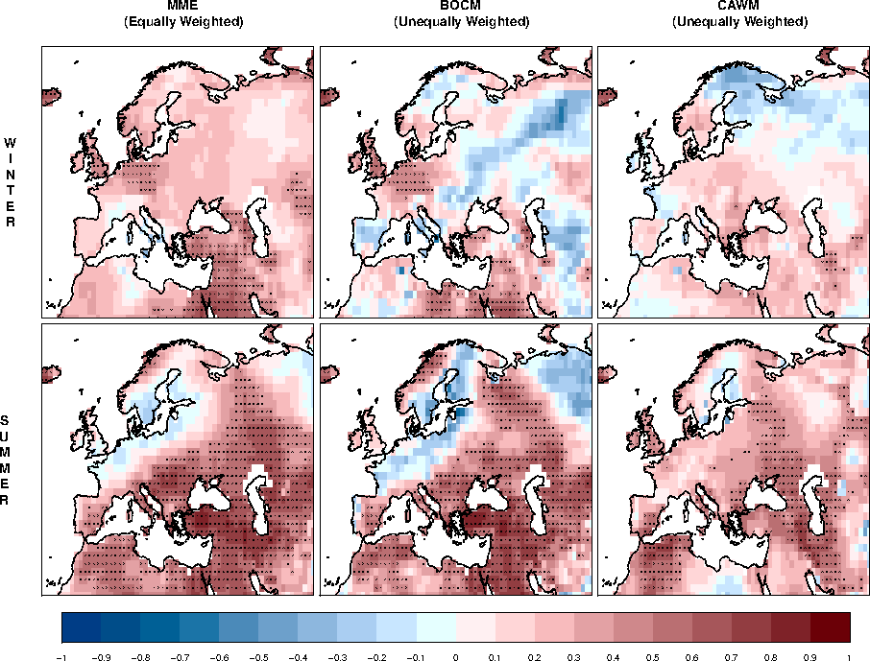
Multi-Model Skill Assessment
-> Ensemble average skill similar to best individual model, performance-based weighting shows no improvement
Mishra, N, C Prodhomme and V Guemas (2018), Climate Dynamics

Slide 20
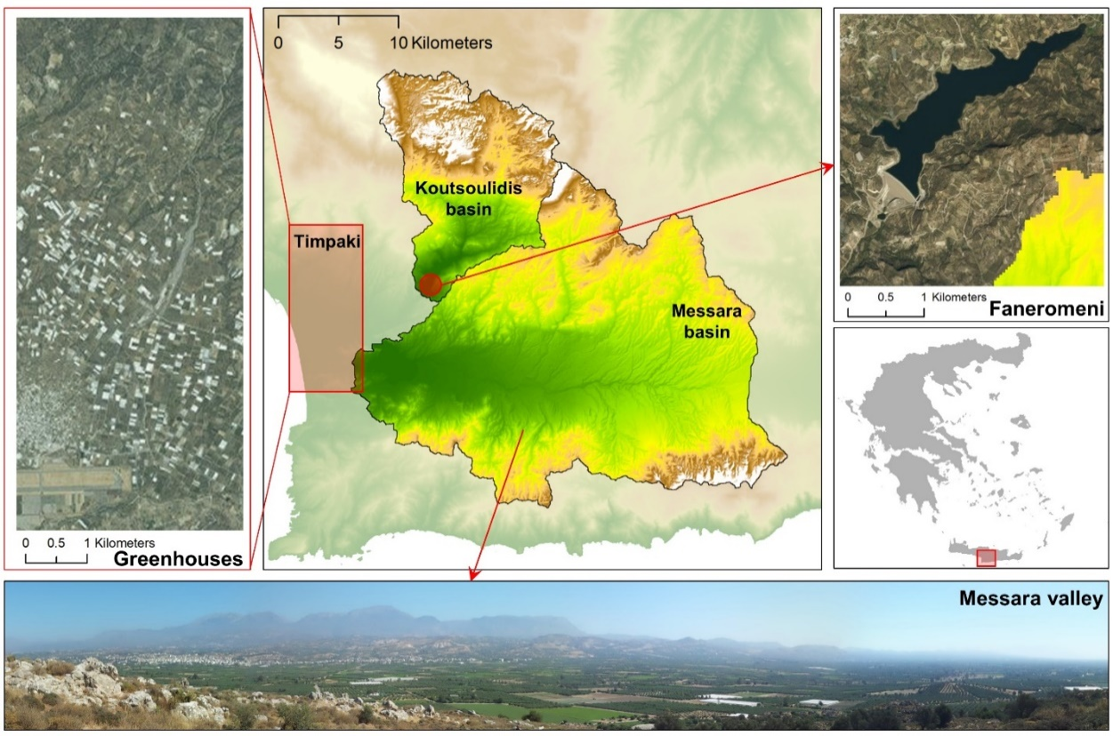
Case study Koutsoulidis basin, Crete, Greece
Courtesy: TUC

Slide 21
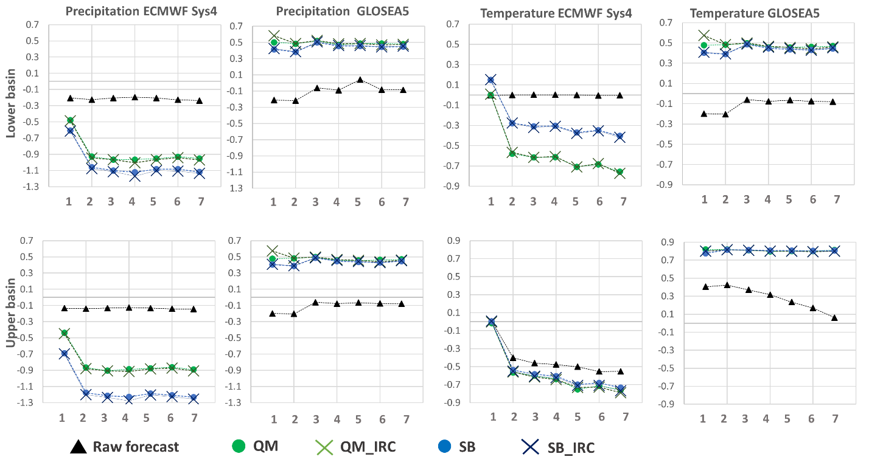
Case study Koutsoulidis basin, Crete, Greece
-> Mixed effect from Bias correction
Continuous Ranked Probability Skill Score (CPRSS) for monthly forecast data
QM: quantile mapping
SB: Simple bias correction
IRC: Individual realisations correction
Courtesy: TUC

Slide 22
Effect of calibration on subseasonal predictions: e.g. T2m
Anomaly correlation
raw
-> Calibration not necessarily improves forecast skill (but improves reliability)
calibrated
ECMWF monthly prediction system: 11 members, 20 yrs hincast (1996-2015)
Verification: ERA-Interim

Slide 23
Summary
Reasonable skill of seasonal predictions for temperature but generally low skill for precipitation
Some regional (small) improvements of prediction skill by
Initialising observed soil moisture
Increasing the model resolution
Smart processing of the model output can also improve skill
E.g. imposing observed empirical relationship between NAO and precipitation
Combining multiple models
Mixed results from bias correction, and calibration

Slide 24
Thank you
markus.donat@bsc.es
IMPREX is funded by the EU H2020 Framework Programme under grant agreement no. GA 641811)

Slide 25
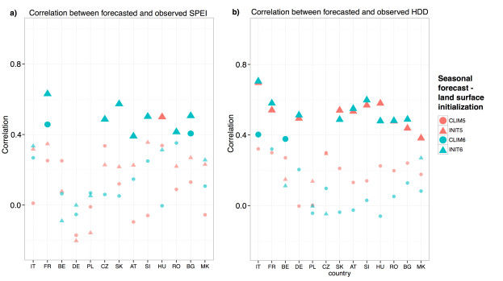
Impact of Soil Moisture Initialization on Seasonal Forecast of Maize Yield
Ceglar, A. et al. (2018) Sci. Rep., 8:1322

Slide 26
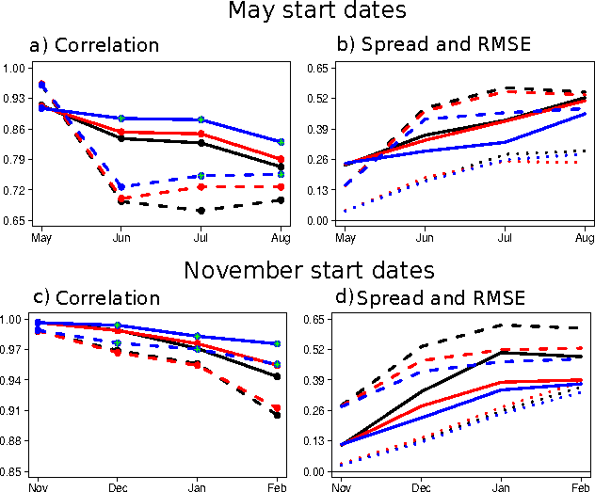
Improvements from increasing model resolution
e.g. improved ENSO predictions (Niño3.4)
SRes (black),
IRes (red),
HRes (blue)
Obs reference:
ESA (solid), ERSST (dashed)
Prodhomme et al (2016) , J. Clim., 29, 9141-9162

Slide 27
Subseasonal predictions: 2m T raw
ECMWF monthly prediction system: 11 members, 20 yrs hincast (1996-2015)
Verification: ERA-Interim

Slide 28
Effect of calibration on subseasonal predictions: e.g. T2m
ECMWF monthly prediction system: 11 members, 20 yrs hincast (1996-2015)
Verification: ERA-Interim
Calibration: Inflation method
Calibration improves reliability, not forecast skill

