Slide 1
Description of WP 3.10 and 3.11
Enza Di Tomaso, Martina Klose, Carlos Pérez García-Pando
Barcelona Supercomputing Center

Slide 2
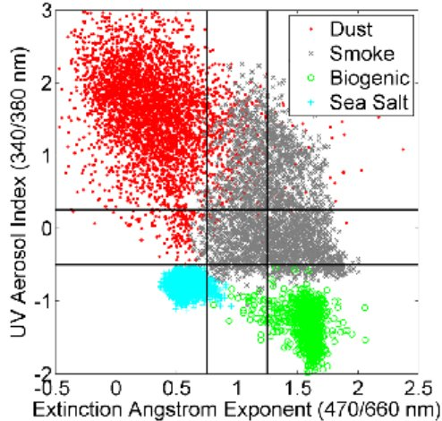
WP 3.10 & 3.11 - Motivations
Current aerosol (and dust) data assimilation is mainly based on retrievals in the visible part of the electromagnetic spectrum, and with no information on aerosol speciation
IASI dust retrievals have the potential to overcome these drawbacks. A previous CCI case study made by BSC showed the potential of IASI for dust DA but with a few important limitations.
(Vries et al., 2015)
Notes:
Limitation previous study:
- global coarse resolution simulation
- L3 (1 degree aggregation) observations
- conversion to VIS AOD
- limited period
- no synergy with other ECVs that can impact the model first-guess
IASI dust AOD features:
- observations available day time and night time
- over ocean and over land (desert)
- 10 μm: detection of dust aerosol coarse mode (infrared wavelengths and ‘‘V’’ shaped depression of the Brightness Temperature)
- pixel level uncertainty

Slide 3
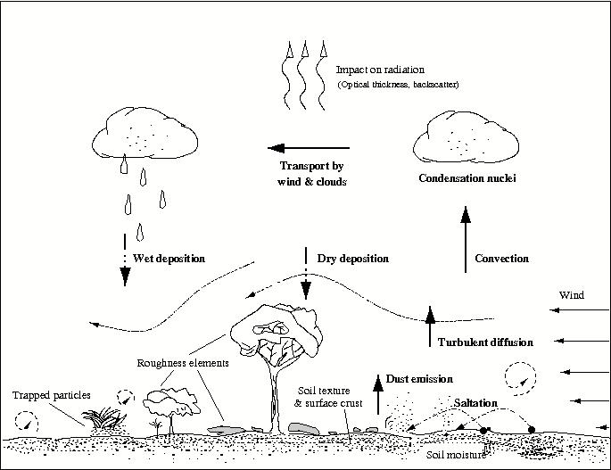
WP 3.10 & 3.11 - Motivations
Current use of Land Cover information in dust models is provided at a coarse resolution and is related to green vegetation only.
Surface characteristics are important for dust emissions
(Knippertz et al. 2014)
Notes:
Different vegetation types affect differently dust emissions
Currently used in MONARCH (BSC model):
Land cover type:
- Meteorological component estimates aerodynamic roughness length (z0) based on USGS 94-category land use and regionally (N Africa and Asia) uses 1/4x1/4 degree resolution z0 based on POLDER-I (Laurent et al. 2008)
(Green) Vegetation cover fraction:
- The meteorological and land-surface component uses USGS monthly climatology at 1km resolution
- The dust module uses MODIS LAI at 0.1x0.1 degree resolution, at a monthly variation, and available for 2000-2015
- to calculate a drag partition to correct the threshold friction velocity for sediment mobilization
- to estimate the erodible (bare) area for dust flux calculation
- [optional] to scale dust flux

Slide 4
WP 3.10 - Description
WP3.10: Assessment of the potential of CCI/CCI+ data to constrain mineral dust simulations at the regional scale
ECVs involved: Aerosol dust and High Res LC
CCI IASI dust data will be assimilated in model simulations, while CCI+ high resolution land cover data (once data will become available) will be used to enhance the NMMB-MONARCH’s land use type, with a consequent impact on dust emissions

Slide 5
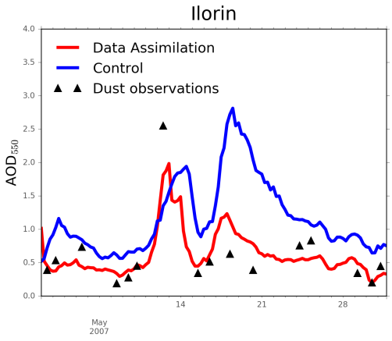
WP 3.10 - Aims
Aims:
- demonstrating the use of CCI/CCI+ data to produce dust analyses at the regional scale;
- assessing the synergy of CCI aerosol data (in particular when constraining atmospheric concentrations over dust source areas) with CCI+ land cover data (used for an enhanced characterization of dust emissions);
- set the basis for the assessment activity 11 on the production of a pilot dust reanalysis, where the impact on dust cycles at different temporal scales will be evaluated;
- providing feedback on these ECVs to the ESA CCI/CCI+ teams.

Slide 6
WP 3.11 - Description
WP3.11: Production of a pilot dust reanalysis at the regional scale
ECVs involved: Aerosol dust and High Res LC
CCI IASI dust data will be assimilated in model simulations for the reanalysis period. Simulations will make use also of CCI+ high resolution land cover data, once these will become available, in order to enhance the NMMB-MONARCH’s land use type.

Slide 7
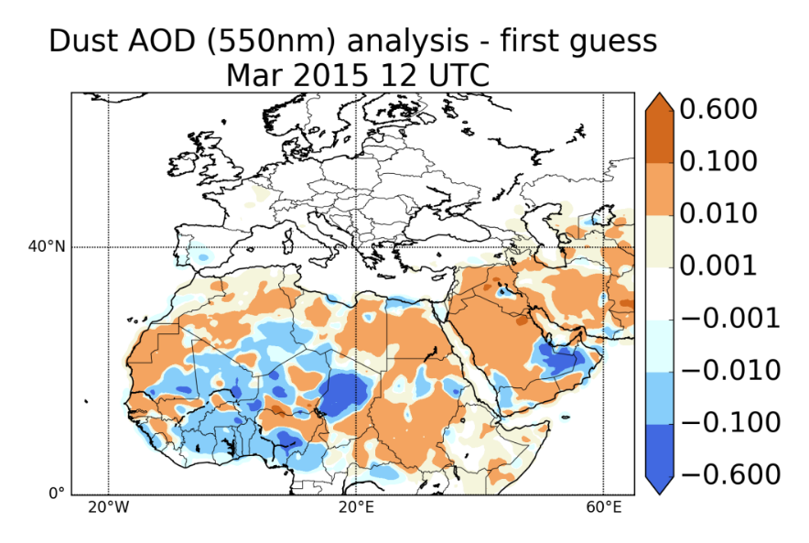
WP 3.11 - Aims
Aims:
- producing a pilot dust regional reanalysis based on CCI/CCI+ data, over a 1 year period
- detection of systematic (spatial and temporal) patterns of data impacts on the dust analysis through statistics of innovations
- assessing whether their integration in model simulations can improve the monitoring of mineral dust and the characterization of dust cycles

Slide 8
WP 3.10 & 3.11 - Interactions
Planned interactions:
CCI+ ECV teams: LC, HRLC teams
Initial discussions: domain, variable values&types, temporal resolution, period, format
CCI ECV teams: email discussion started with ULB (C3S ECV)
External:
DustClim consortium (dust reanalysis)
WMO SDS-WAS hosted by BSC/AEMET
Links within CMUG: Aerosol global reanalysis (ECMWF)
Notes:
Questions to raise during the Integration Meeting

Slide 9
Additional back-up slides

Slide 10
WP 3.10 & 3.11 - Motivations
Currently used in MONARCH (BSC model):
Land cover type:
- Meteorological component estimates aerodynamic roughness length (z0) based on USGS 94-category land use and regionally (N Africa and Asia) uses 1/4x1/4 degree resolution z0 based on POLDER-I (Laurent et al. 2008)
(Green) Vegetation cover fraction:
- The meteorological and land-surface component uses USGS monthly climatology at 1km resolution
- The dust module uses MODIS LAI at 0.1x0.1 degree resolution, at a monthly variation, and available for 2000-2015
- to calculate a drag partition to correct the threshold friction velocity for sediment mobilization
- to estimate the erodible (bare) area for dust flux calculation
- [optional] to scale dust flux

Slide 11
WP 3.10 - Actions
Actions:
- processing IASI dust aerosol data to follow the assimilation cycles
- implementation of an observation operator for the thermal infrared
- identifying optimal assimilation settings for observation error statistics and covariance localization
- implementation of the use of CCI+ high resolution land cover to characterize the model land type
- DA simulations on a regional domain covering Northern Africa, Europe
and the Middle East for specific dust events (usually lasting 1 to 10 days) during the active dust season
- assessment of the impact of assimilating the data during relevant dust events and validation with independent observations

Slide 12
WP 3.11 - Actions
Actions:
- production of a pilot reanalysis over the course of a specific year characterized by relevant dust events
- statistical analysis of innovations throughout dust cycles at different temporal scales
- reanalysis validation with independent observations
- comparison of the dust reanalysis with other reanalyses

Slide 13
WP 3.10 & 3.11 – Scientific questions
Scientific questions:
- Which is the added value of assimilating thermal infrared retrievals?
- Which is the impact of IASI data assimilation at the regional scale in high resolution simulations?
- Are CCI (pixel-level) uncertainties realistic?
- Does enhanced land type information improve the first-guess of mineral dust tracers, and consequently dust analyses?
- Are the used CCI/CCI+ ECVs consistent?
- Can CCI/CCI+ data improve aerosol reanalysis?
- Can CCI/CCI+ data improve in particular the characterization of dust cycles?
- How well does the regional dust reanalysis compare to global reanalyses?

Slide 14
WP 3.10 & 3.11 – Expected outcomes
A data assimilation/modelling assessment of CCI/CCI+ data will be of added value to the standard CCI experiments as it will provide a different perspective to the evaluation efforts, and will allow to assess ECVs for cross-consistency.
A reanalysis assessment is able to showcase the potential of CCI/CCI+ data to contribute to the formulation of management and mitigation plans of different socio-economic sectors. A dust reanalysis in particular can be used to provide resources for studying the impact of dust on health, weather and climate.
BSC's strong links to specific user communities through its WMO SDS-WAS activities can guarantee the visibility of such potential for the data considered.

