Slide 1
Computational Earth Sciences
February 2020
Earth Sciences Department

Slide 2
Barcelona Supercomputing Center Centro Nacional de Supercomputación
BSC-CNS objectives
Supercomputing services
to Spanish and EU researchers
R&D in Computer, Life, Earth and Engineering Sciences
PhD programme, technology transfer, public engagement
Spanish Government 60%
Catalan Government 30%
Univ. Politècnica de Catalunya (UPC) 10%
BSC-CNS is
a consortium
that includes

Slide 3
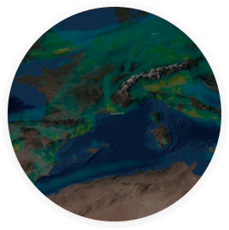
HPC: An enabler for all scientific fields
Materials, Chemistry & Nanoscience
Engineering
Astro,
High Energy
& Plasma Physics
Advances leading to:
Improved Healthcare
Better Climate Forecasting
Superior Materials
More Competitive Industry
Life Sciences & Medicine
Earth Sciences

Slide 4
The MareNostrum 4 supercomputer
Total peak performance:
13,7 Pflops/s
Access: prace-ri.eu/hpc-access
Access: bsc.es/res-intranet

Slide 5
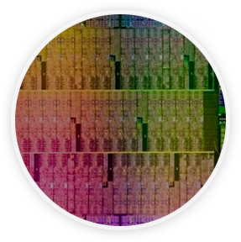
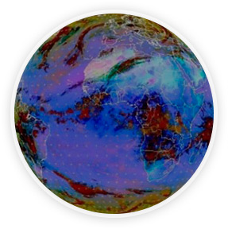
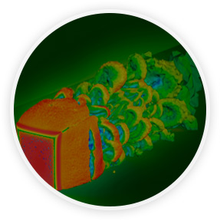
Mission of BSC Scientific Departments
Computer
Sciences
Earth Sciences
To influence the way machines are built, programmed and used: programming models, performance tools, Big Data, computer architecture, energy efficiency
To develop and implement global and regional state-of-the-art models for short-term air quality forecast and long-term climate applications
Life
Sciences
CASE
To understand living organisms by means of theoretical and computational methods (molecular modeling, genomics, proteomics)
To develop scientific and engineering software to efficiently exploit super-computing capabilities (biomedical, geophysics, atmospheric, energy, social and economic simulations)

Slide 6
Earth Sciences
Environmental modelling and forecasting, with a particular focus on weather, climate and air quality
Modeling
air quality and
Sand and Dust Storms
Processes from urban to
Global and the impacts
on weather, health
and ecosystems
Climate
predictions
system from
subseasonal-to-decadal
forecasts
Research
and
Forecasts
Service Users Sectors
Infrastructures
Solar
Energy
Urban
development
Transport
Wind
Energy
Agriculture
Insurance

Slide 7
Computational Earth Sciences

Slide 8
CES in Earth Department
4 groups ~ 105 people

Slide 9
Structure
Performance Team
Models and Workflows Team
Data and Diagnostics Team
Provide HPC Services (profiing, code audit, …)
Apply new computational methods
Development of HPC user-friendly software framework
Provision of data services
Big Data and Artificial Intelligence in Earth Sciences
Support the development of atmospheric research software
Visualization

Slide 10
Interdisciplinary work
Weather and Climate Science
Computational Earth Sciences
Computer Science
Knowledge about the mathematical and computational side of Earth System Applications
Knowledge about the specific needs in HPC of the Earth System Applications
Researching about HPC methods specifically used for Earth System Applications

Slide 11
Members
Multidisciplinary team with different IT profiles
Currently, 32 members
1 manager
22 research engineers
4 postdocs
1 PhD student
3 students
1 external consultant
Foster internal BSC interdepartmental collaboration, specially Computer Science to apply their research
Develop a constant collaboration with UAB and UPC computer science schools to recruit students to join the team

Slide 12
Projects
Currently, CES is involved in:
H2020 projects
ESiWACE2: Center of Excellence
ESCAPE-2 FET: Energy-efficient SCalable Algorithms for weather and climate Prediction at Exascale
IMMERSE: Improving Models for Marine EnviRonment Services
IS-ENES3: third phase of the distributed e-infrastructure of the European Network for Earth System Modelling (ENES)
Contracts
Harmonie Consortium (HIRLAM model)
BSC research agreements (IBM and Intel)
C3S512: The Evaluation and Quality Control (EQC) function of the Copernicus Climate Change Service (ECMWF)
Services
Several PRACE Type C to improve HPC Earth Sciences codes

Slide 13
Supporting modelling activities

Slide 14
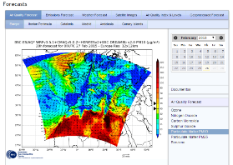
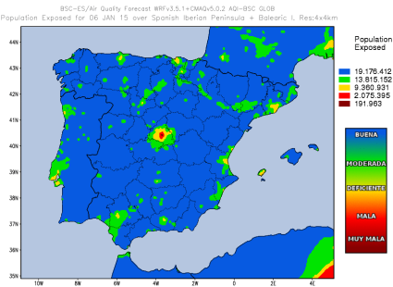
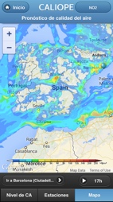
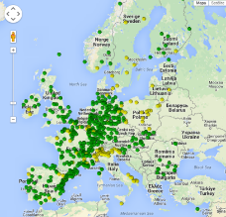
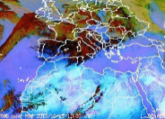
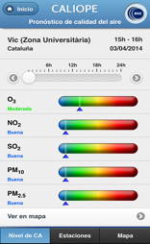
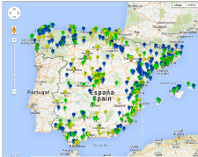
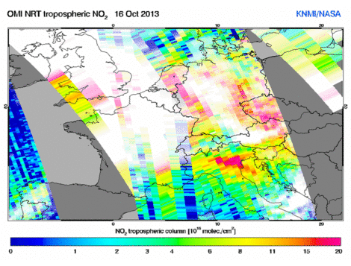
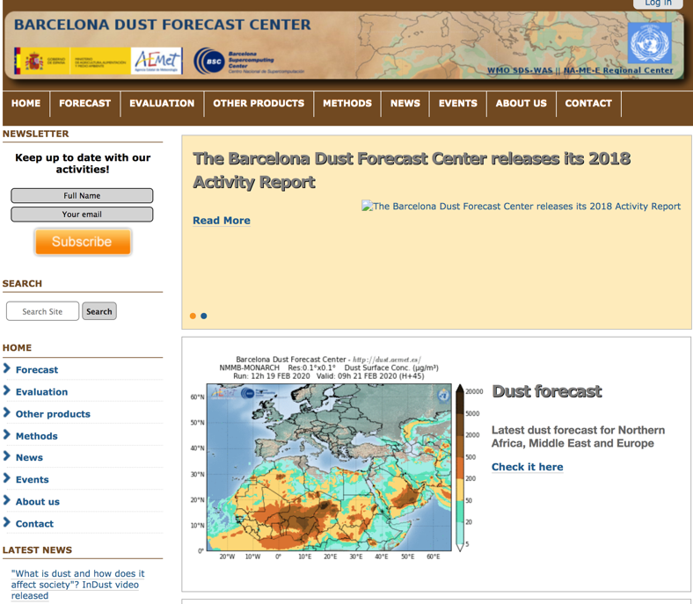
Atmospheric Composition Forecasts
AQF CALIOPE system: daily forecast and evaluation
Daily forecast for meteorology, emissions and air quality: Europe (12km), Iberian Peninsula (4km), Andalusia, Catalonia and Madrid (1km), since 2007
Forecast products
Dust Forecasts

Slide 15
EC-Earth
Earth System Model
Reliable in-house predictions of global climate change
Part of a Europe-wide consortium
Being used in large European project
PRIMAVERA
EUCP
IS-ENES3
ESiWACE2
3.3 version
IFS + NEMO + OASIS
Involved in 4.0 implementation

Slide 16
ESGF
The Earth System Grid Federation (ESGF) is an international collaboration for the software that powers most global climate change research, notably assessments by the Intergovernmental Panel on Climate Change (IPCC).
ESGF manages the first-ever decentralized database for handling climate science data, with multiple petabytes of data at dozens of federated sites worldwide.
BSC hosts a Tier-2 datanode with more than 600 Tb.

Slide 17
Performance activities
Since 1991
Based on traces
Open Source: https://tools.bsc.es/
Extrae: Package that generates Paraver trace-files for a post-mortem analysis
Paraver: Trace visualization and analysis browser
Includes trace manipulation: Filter, cut traces
Dimemas: Message passing simulator
Trace files
Simulated trace files
Application
DIMEMAS simulator
EXTRAE library
Paraver
Paraver
Trace visualization
DIMEMAS generated trace. Target = ideal machine

Slide 18
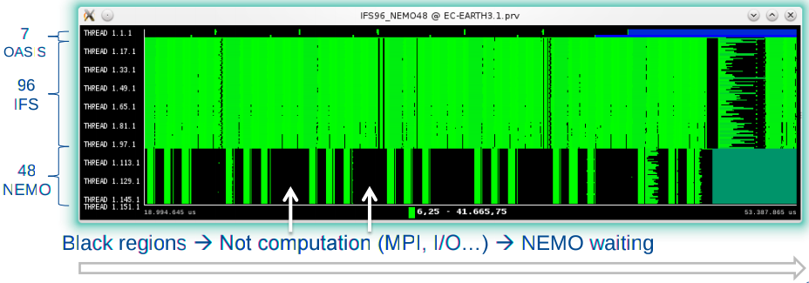
Profiling EC-Earth
Motivation: Finding a good configuration to optimize the resources usage
IFS T255L91-ORCA1L46
Configuration widely used in production
Using 7 cores for OASIS, 96 for IFS and 48 for NEMO
1 day simulation traces
Traces generated in burst mode (only computational regions > 100us)
Paraver view: Useful duration (displays duration of computational bursts)
18

Slide 19
Software development

Slide 20
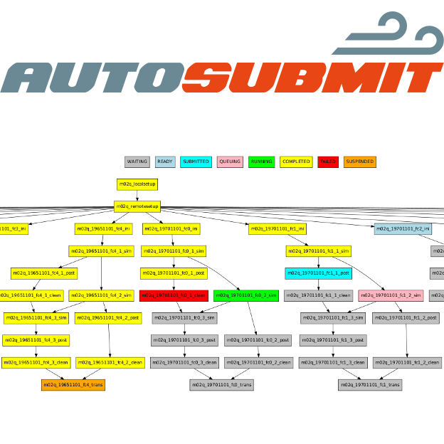
Workflow Manager
Autosubmit
A versatile tool to manage Weather and Climate Experiments in diverse Supercomputing Environments
https://pypi.python.org/pypi/autosubmit/

Slide 21
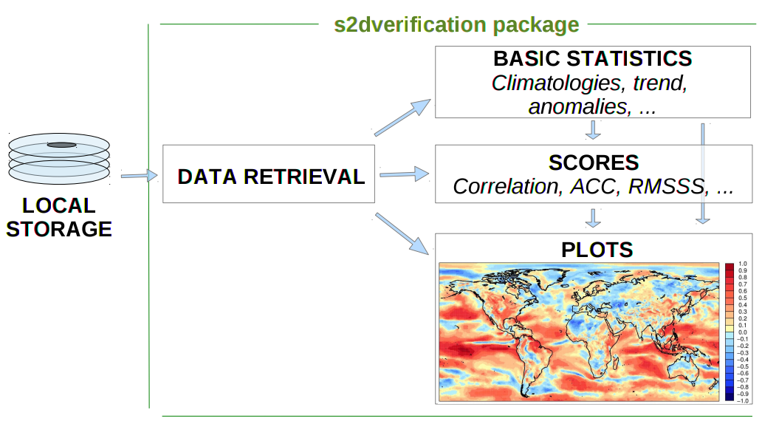
R Analysis Tools
s2dverification – startR – CSTools
Tools to load and verify forecasts through the computation of typical prediction scores against one or more observational datasets or reanalyses

Slide 22
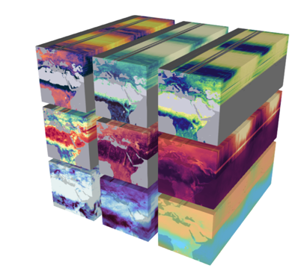
BSC-ES AI and Machine Learning projects
Computer Vision algorithms for supervised pattern recognition applied to extreme weather/climate events on on CMIP6/ERA5 data
Prediction of the number of named storms in a hurricane season
Detection (tracking) of a single hurricane and short-term forecasting
Assessment of the rate of extreme events in future climate scenarios (ASTERISKS H2020 proposal). Collaboration with the Climate Prediction and the High Performance AI groups
Development of surrogate Deep Learning models, using image-to-image translation techniques, to replace costly parameterizations in dynamical climate models
Statistical correction of air quality forecasts with Machine Learning algorithms. Collaborations with Services
Courtesy of Carlos Alberto Gomez Gonzalez, STARS MSCA-COFUND fellow

Slide 23
Thank you
kim.serradell@bsc.es

