Slide 1
Edinburgh, 16th February 2017
Seasonal Predictions
of Wind Power Generation
are Now Possible
Llorenç Lledó, Albert Soret, Francisco J. Doblas-Reyes
Resource Assessment 2017
WindEurope technology workshop

Slide 2
COPERNICUS Program
CLIM4ENERGY
Tailoring climate services
for the energy industry
Seasonal forecast service
for wind power
Providing a wealth of free climate data
clim4energy.climate.copernicus.eu

Slide 3
1. Monthly Budgets & Anomalies

Slide 4
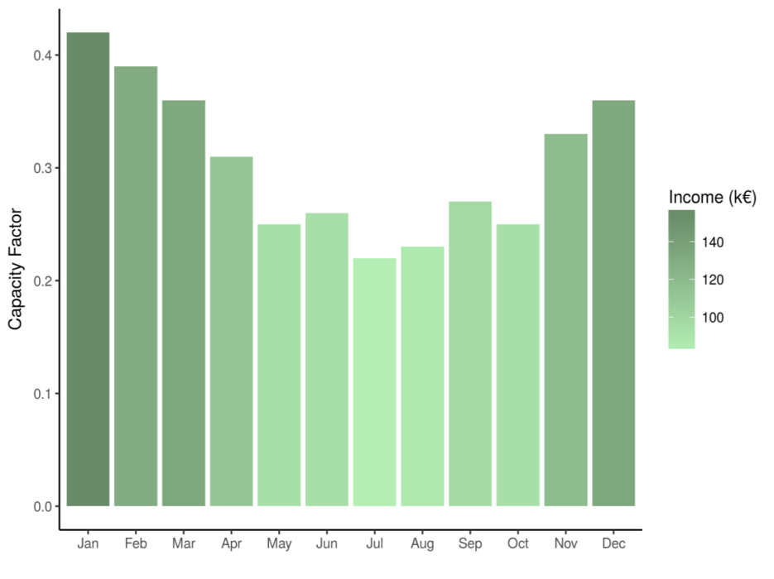
Monthly budgets
Climatology:
a summary of
past conditions
Uncertainty estimates
(Inter-Annual Variability)

Slide 5
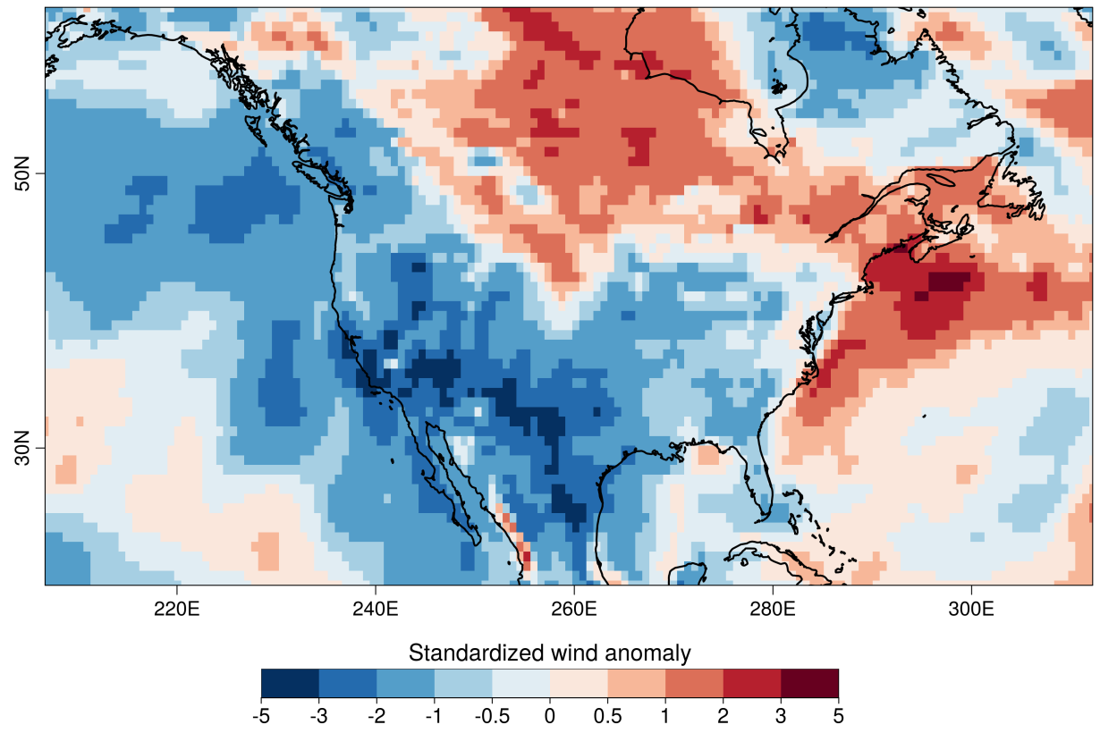
2015 US wind drought
“US clean energy suffers from lack of wind”
Financial Times, September 2015.
“El Niño Buffers U.S. Wind Power Dreams”
Wall Street Daily, September 2015.
“El Niño blowing down wind projections in US”
Fierce Energy, July 2015.
Q1 2015
“We never anticipated a drop-off in the wind resource as we have witnessed over the past six months”
David Crane, RNG, September 2015.

Slide 6
Can we anticipate anomalies?
ATMOSPHERE
OCEAN
CIRCULATION
SEA ICE EXTENT
Coupled
Ocean-Atmosphere
global models
SNOW COVER
SOIL MOISTURE
ECMWF System4
MeteoFrance System5
UKMO GloSea5
NCEP CFSv2

Slide 7
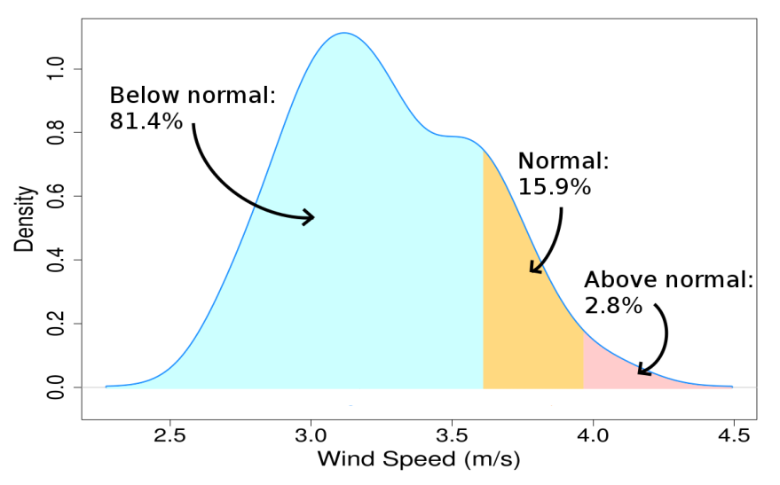
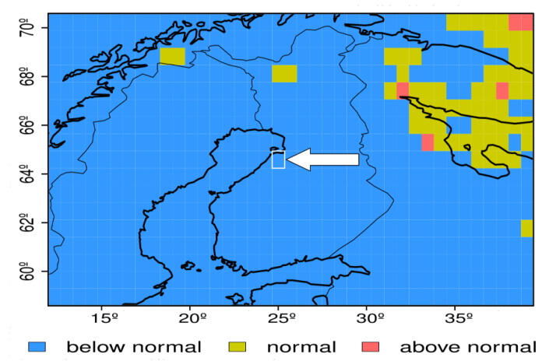
Example 1
AVG WIND SPEED FORECAST
Location: Finland (64.5N 25.0E)
Period: DJF 2009/2010
Issued: 1st November 2009
Source: ECMWF System4
OBSERVED TERCILE
Period: DJF 2009/2010
Source: ERA-Interim

Slide 8
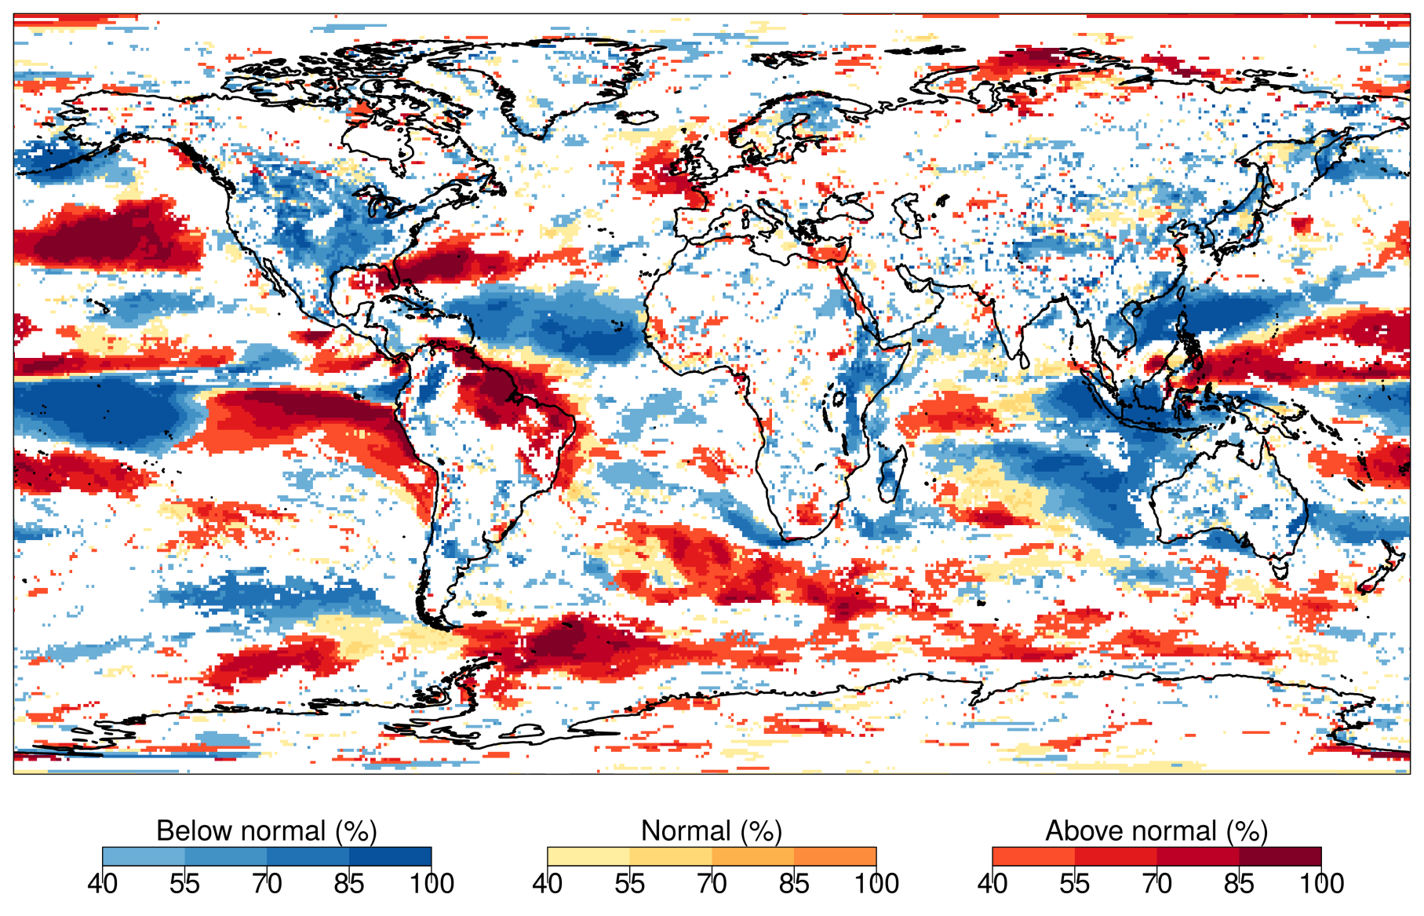
Example 2
Wind speed forecast
DJF 2015/16
ECMWF System4
Most Likely Tercile
[probability>40%]

Slide 9
2. Tailored applications

Slide 10
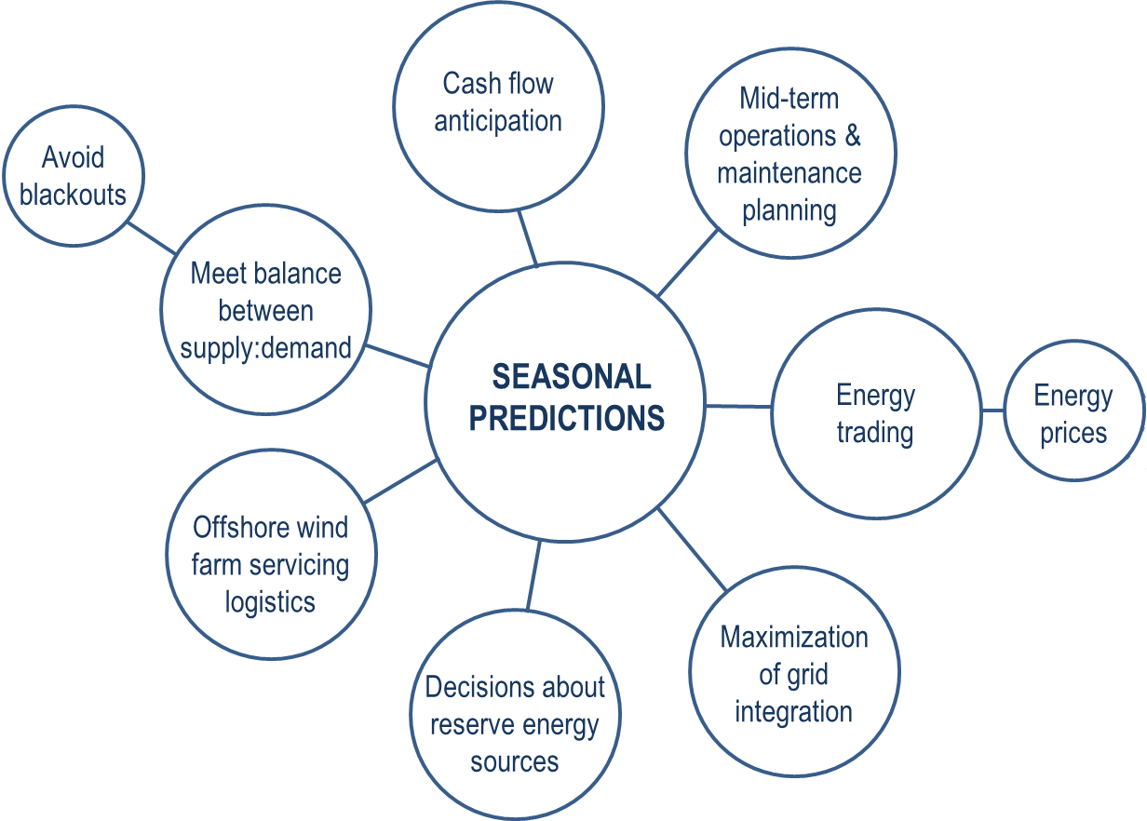
Applications

Slide 11
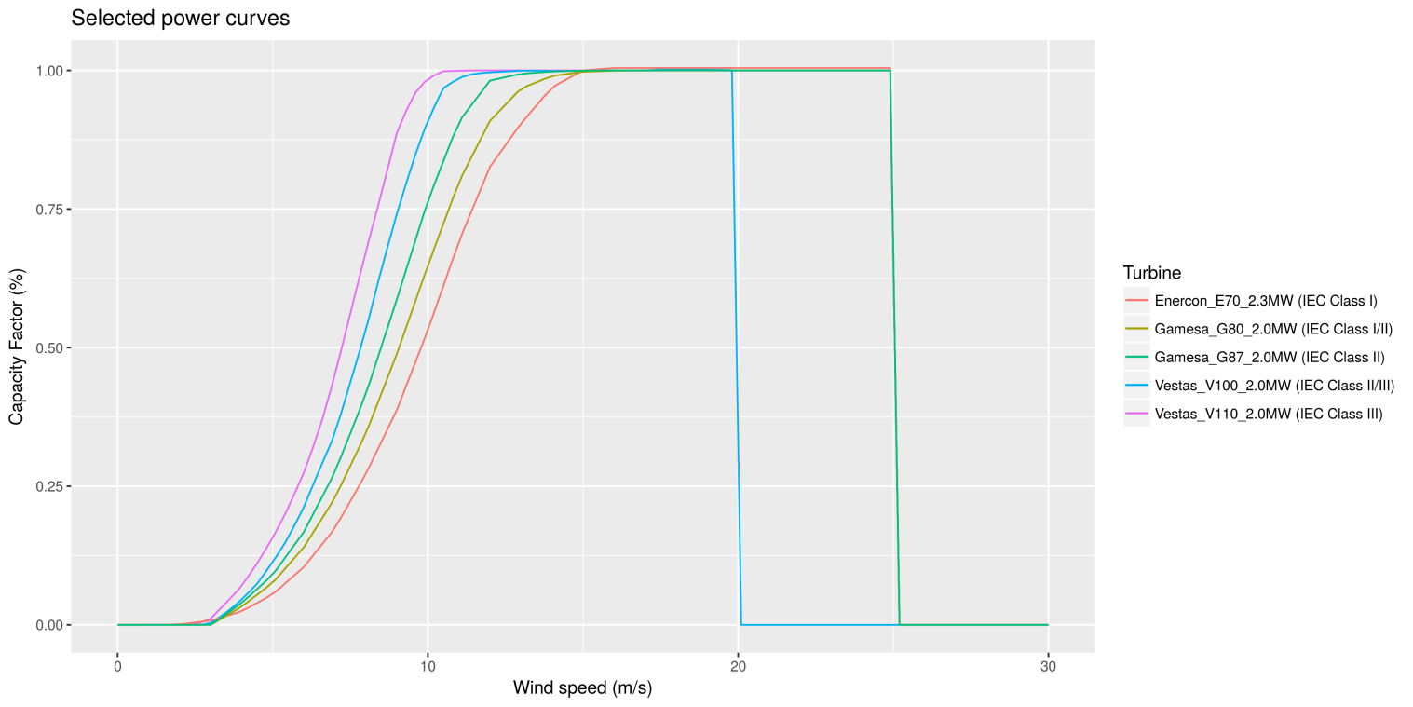
Capacity factor
Independent of:
number of installed turbines
nameplate capacity of installed turbines
Using manufacturer power curves for three turbines representing IEC classes.

Slide 12
Capacity factor anomalies
Observed anomalies (ERA-Interim)

Slide 13
3. How good are those forecasts?

Slide 14
Skill assessment
“A prediction has no value without an estimate of forecasting skill based on past performance”
Skill assessment for DJF (1981-2013)
Displaying: Ranked Probability Skill Score [RPSS]

Slide 15
Example 3
SKILL SCORES
CRPSS = -0.01
RPSS = 0.08
EnsCorr = 0.44

Slide 16
4. Visualization

Slide 17
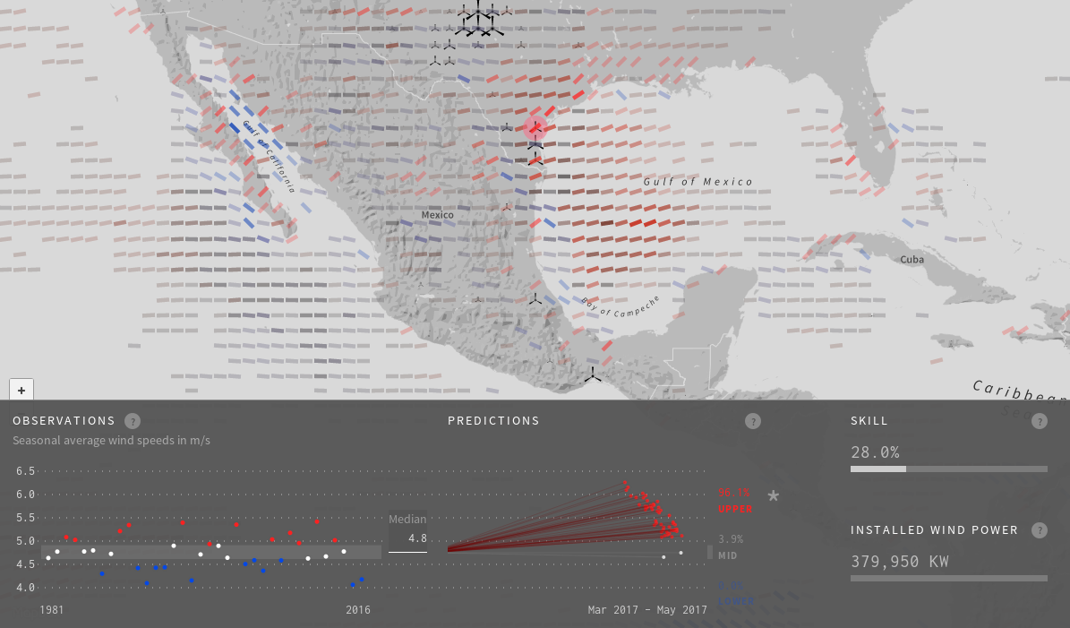
Proof of Concept
MAM 2017 forecasts
now available as a
Proof of Concept
bsc.es/projects/earthscience/project-ukko/map.html

Slide 18
5. Teleconnections

Slide 19
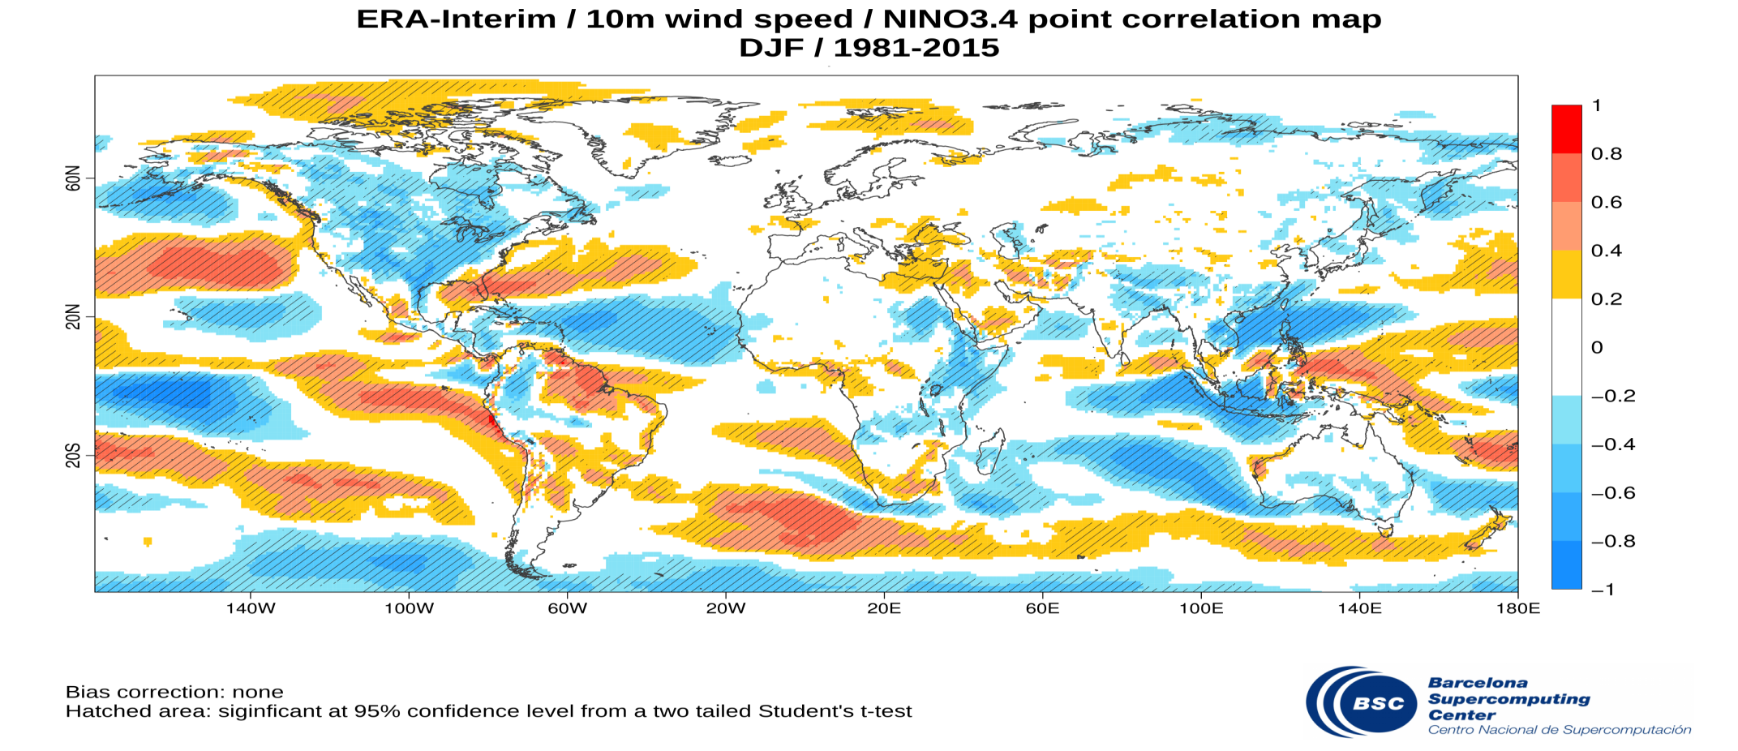
Impact of ENSO on wind

Slide 20
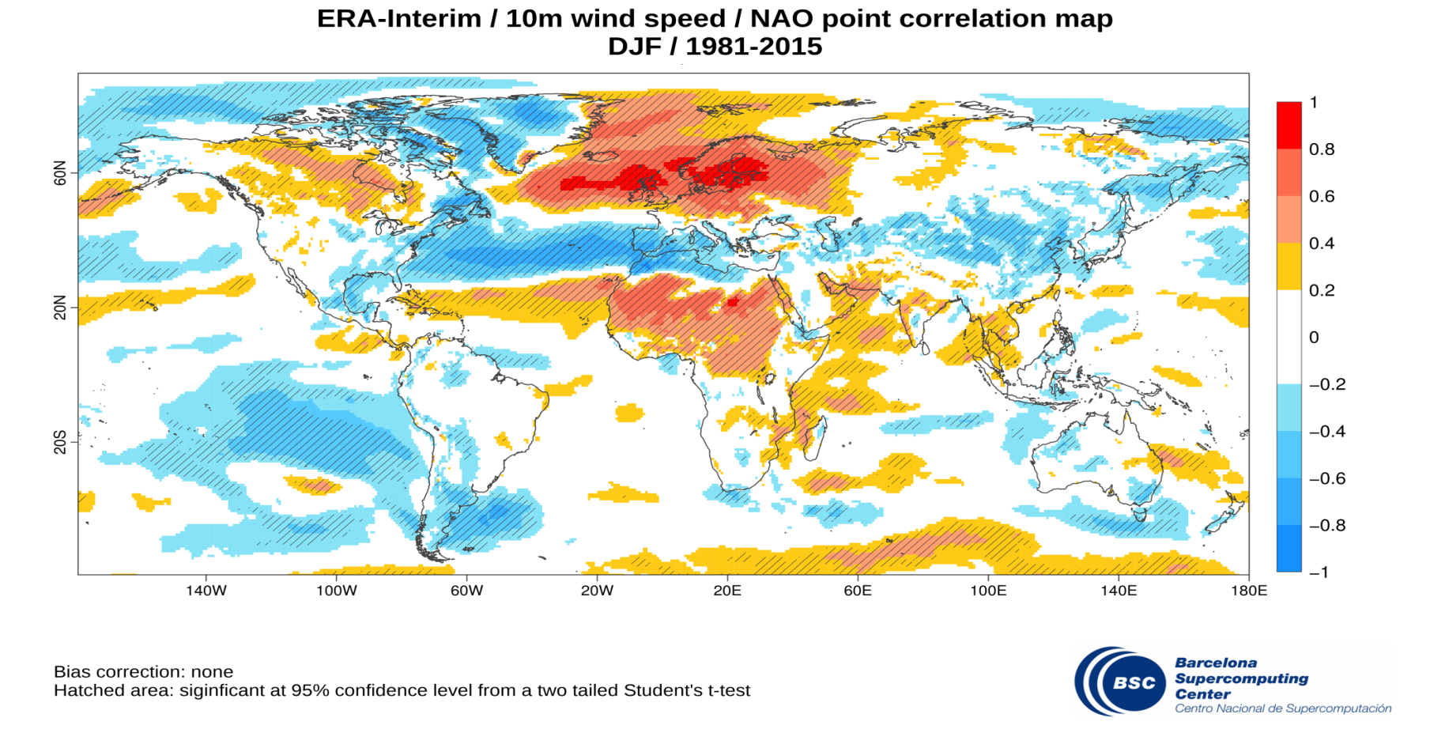
Impact of NAO on wind

Slide 21
6. Conclusions

Slide 22
Conclusions
Conclusions
Dynamical models can anticipate extreme events
Tailored service helpful for several applications
Assessing forecast quality is crucial before making decisions
Open questions
Economic impact of those loses?
Which decisions would you take in view of those forecasts?

Slide 23
Thank you!
For further information please contact
llledo@bsc.es

