Slide 1
A multi-model analysis of the predictability of North Atlantic ocean heat content (OHC)
Teresa Carmo-Costa
Ana Camargo, Emanuel Dutra, Roberto Bilbao, Jon Robson, Annika Reintges, Pablo Ortega*
PhD Fellowship: PD/BD/142785/2018

Slide 2
Motivation
The global ocean has been warming unevenly in time and space following the rise in GHG emissions
Global SST mean anomaly
Global OHC 0-2000m mean anomaly
The spatio-temporal differences can obey to inhomogeneities n the distribution of some external forcers (such as tropospheric aerosols) as well as to influences from internal climate variability.
SST trend in 1854-2019
OHC 0-2000m trend in 1955-2019
García-Soto et al. (2021)

Slide 3
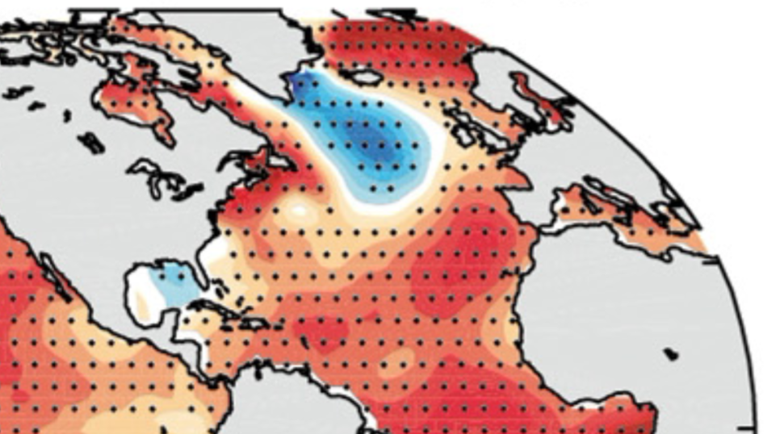
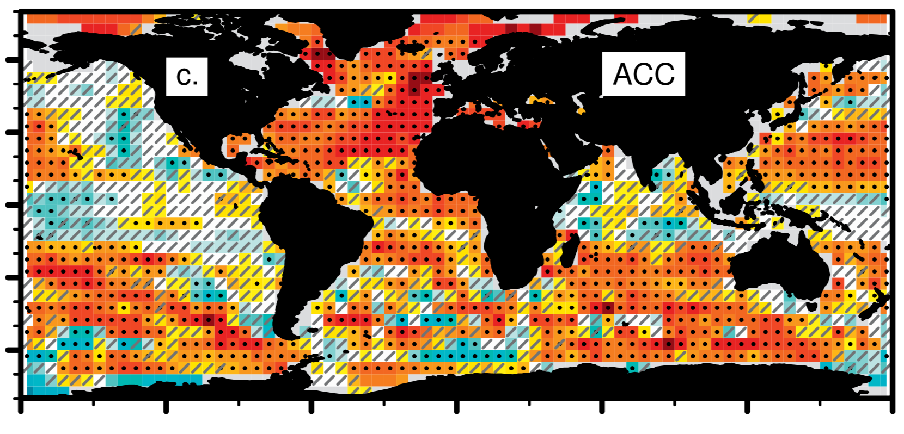
Motivation
The North Atlantic stands out as a region with important regional differences, including a local cooling
Global SST mean anomaly
The North Atlantic is also a key region for decadal variability and predictability, with important contributions from both external forcings and internal variability processes that can be hard to disentangle.
SST trend in 1854-2019
Skill for OHC300 LY 5-9 in CESM-DPLE
García-Soto et al. (2021)
Yeager et al. (2018)

Slide 4
Scope of the study
Main goal: To investigate the relative role of forced and internal processes on the variability and predictability of North Atlantic OHC in a CMIP6 multi-model context.
Scientific approach: Comparing 2 analogous multi-model ensembles of simulations DCPP-A retrospective predictions and historical experiments (same models and ensemble sizes)
Specific questions addressed:
Can all models skilfully predict North Atlantic OHC at decadal scales?
Are there regions more predictable than others?
Are there major differences across models?
Can some mean model features explain the differences in predictive skill? And if yes, how?
What is the specific role of atmospheric-driven surface fluxes and density stratification in deep convective regions?
Can our insights guide the development/tuning of future climate prediction models?
Skill for OHC300 LY 5-9 in CESM-DPLE
Yeager et al. (2018)

Slide 5
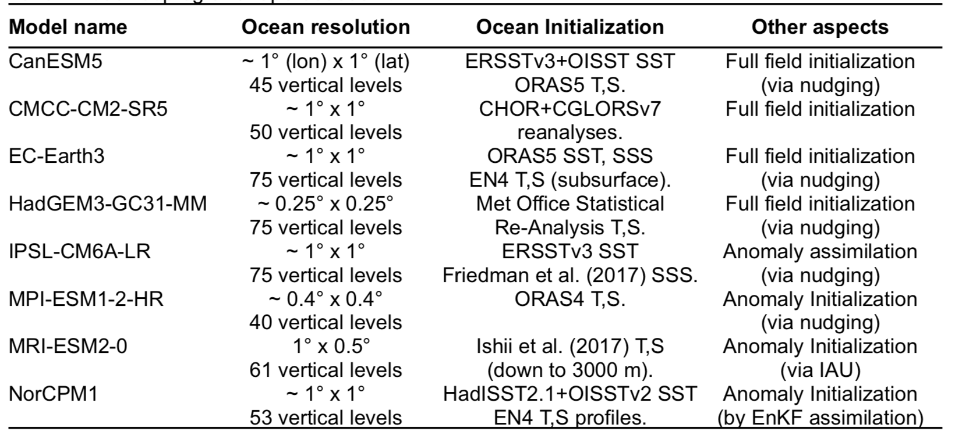
Model Selection
Both ensembles are based on the same 8 models, with the following characteristics:
For consistency, all models contribute with 10 members to both HIST/DCPP ensembles, except for HadGEM3-GC31-MM and MPI-ESM1-1-HR, which contribute with 5 and 4 members, respectively.

Slide 6
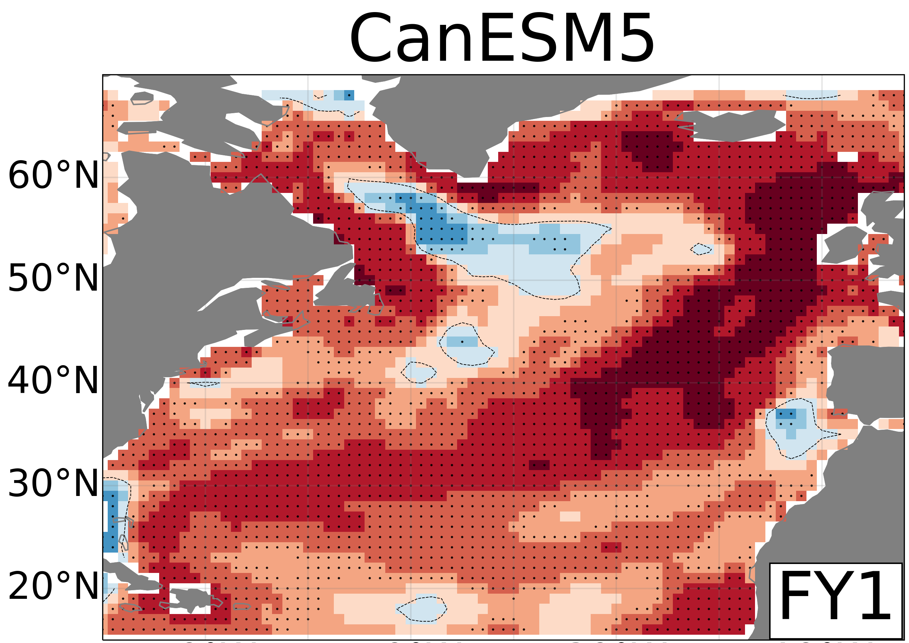
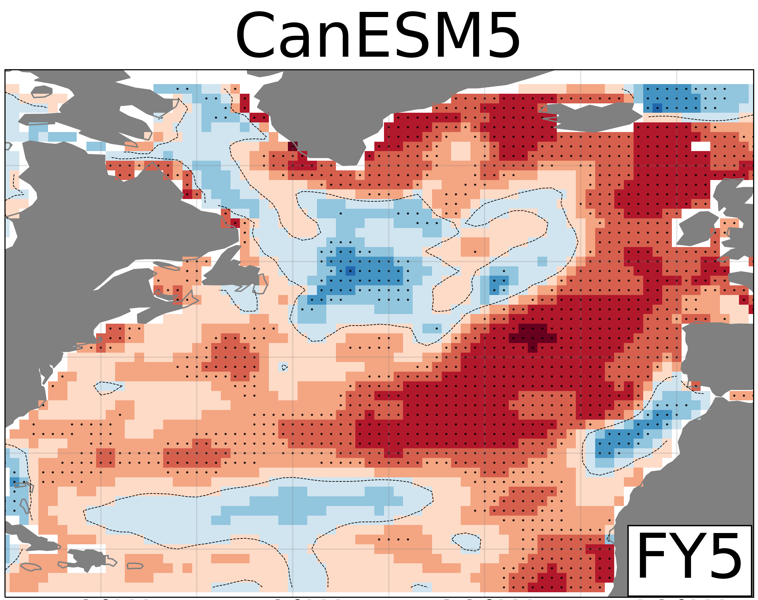
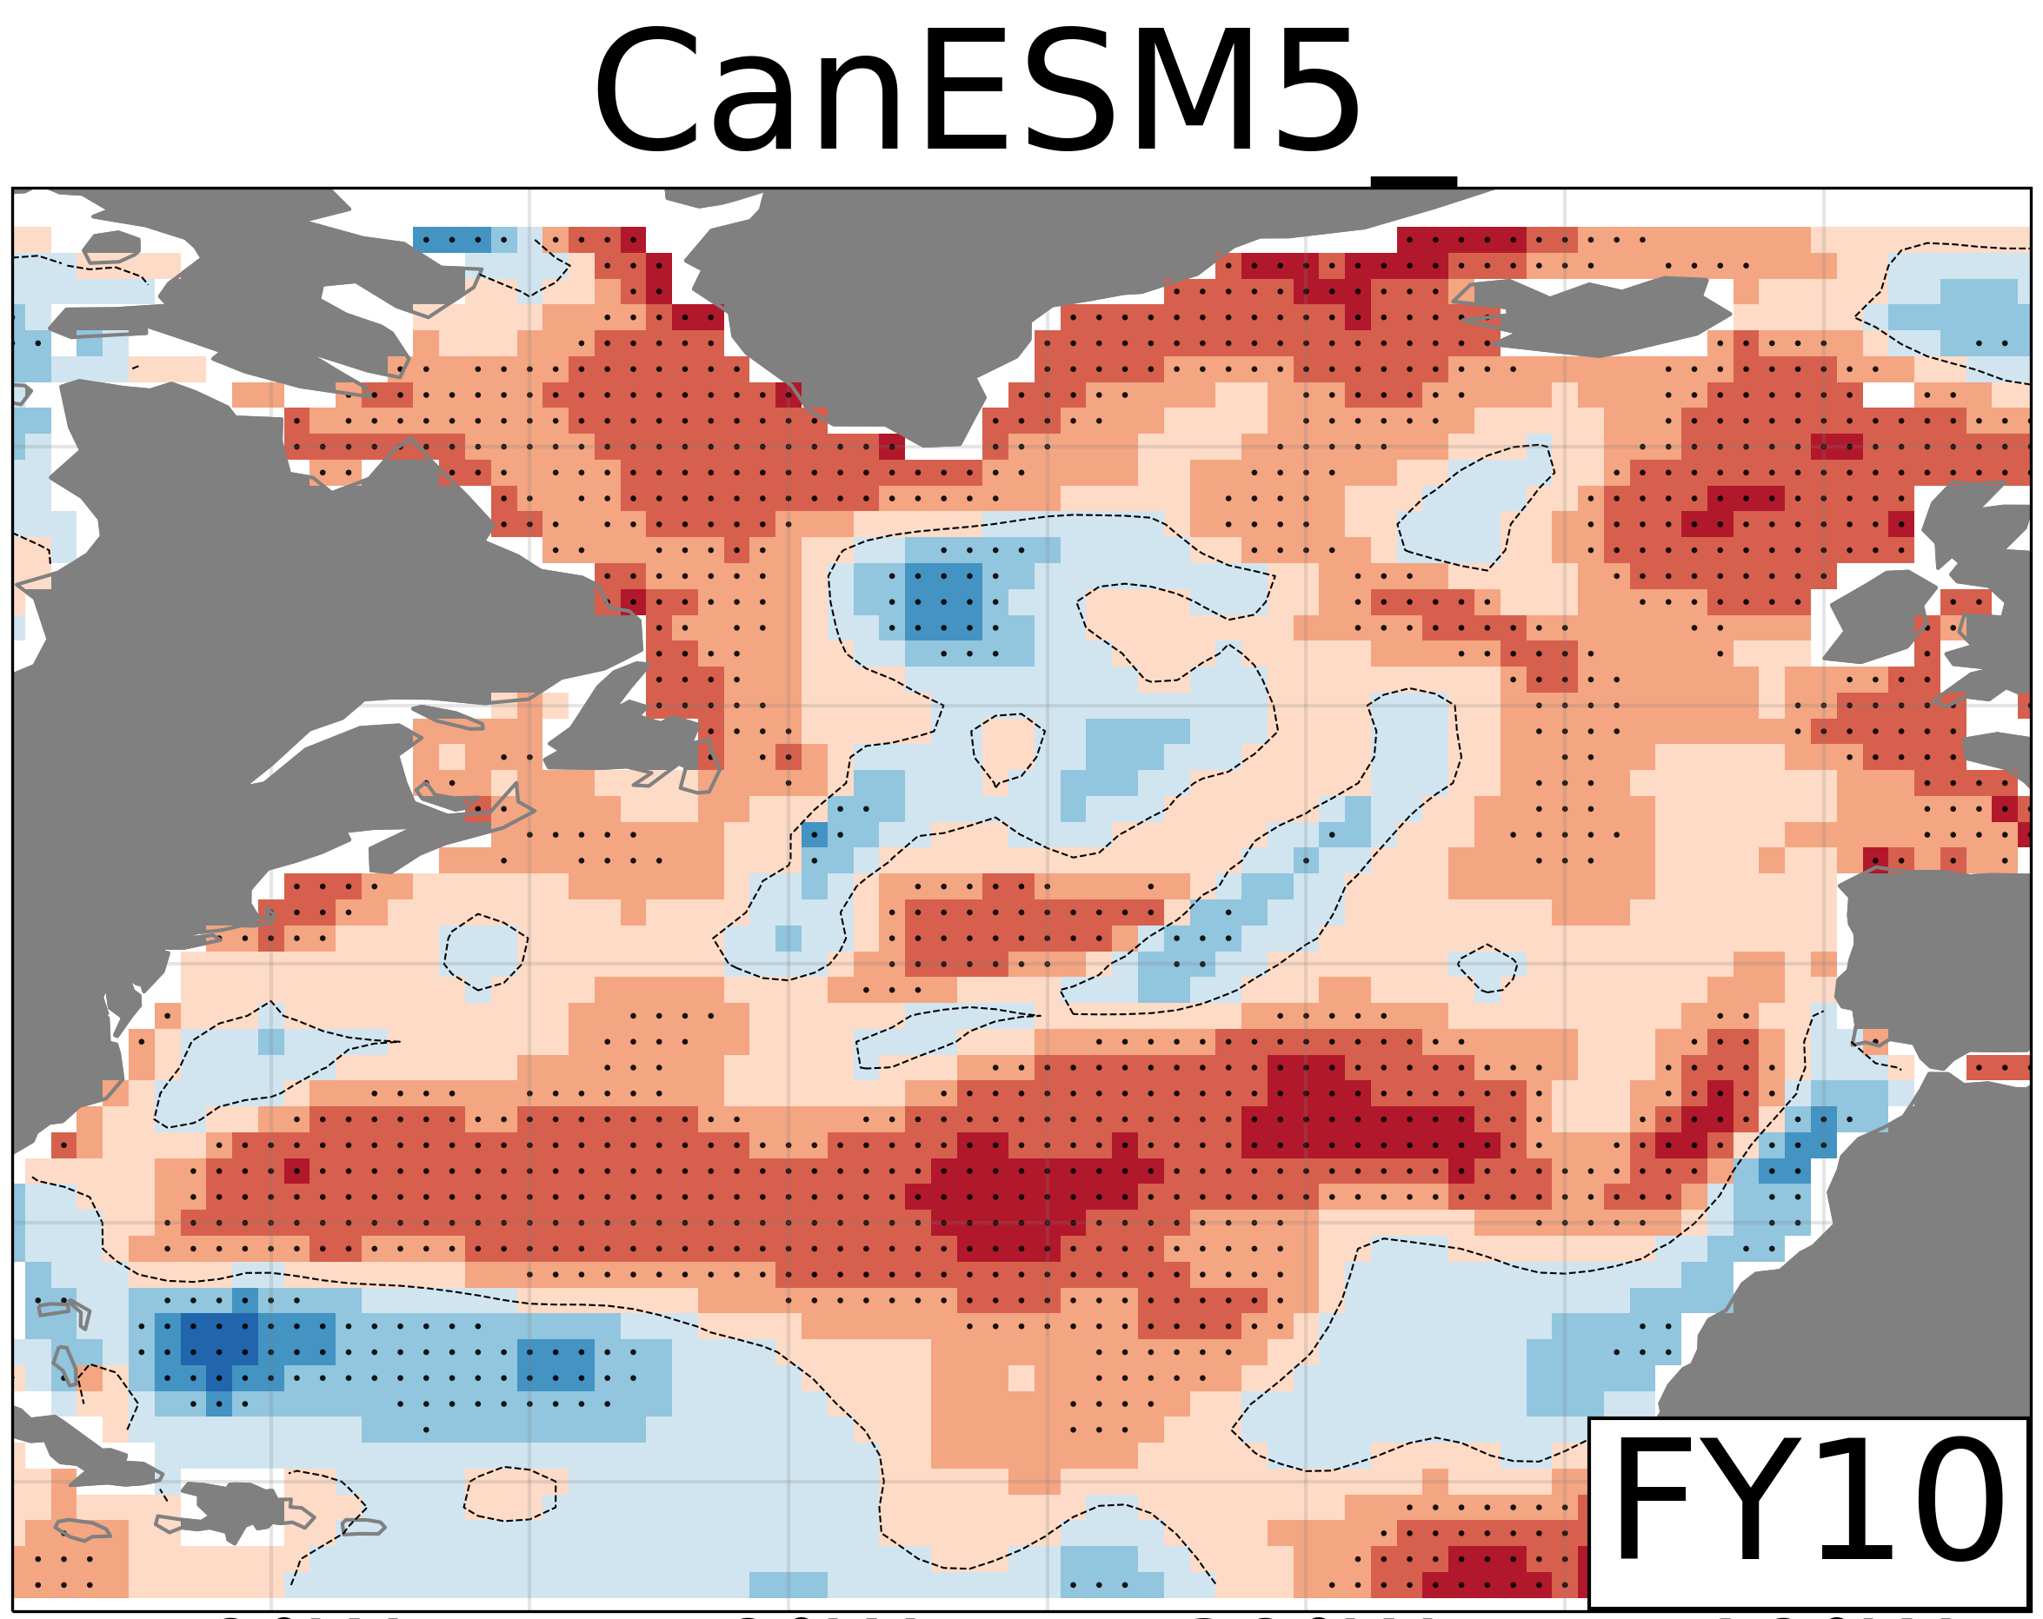
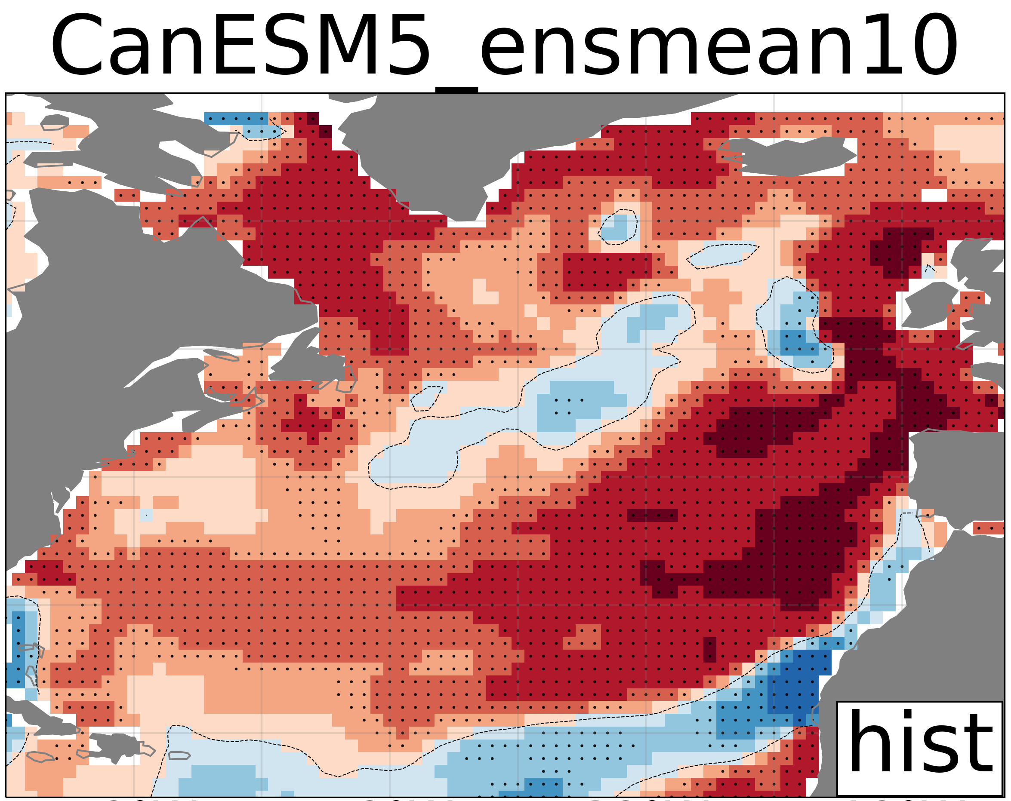
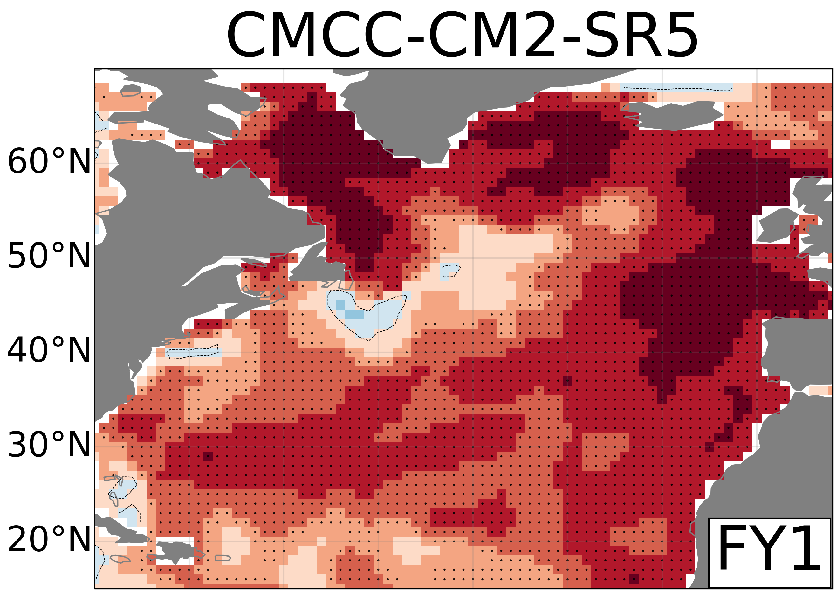
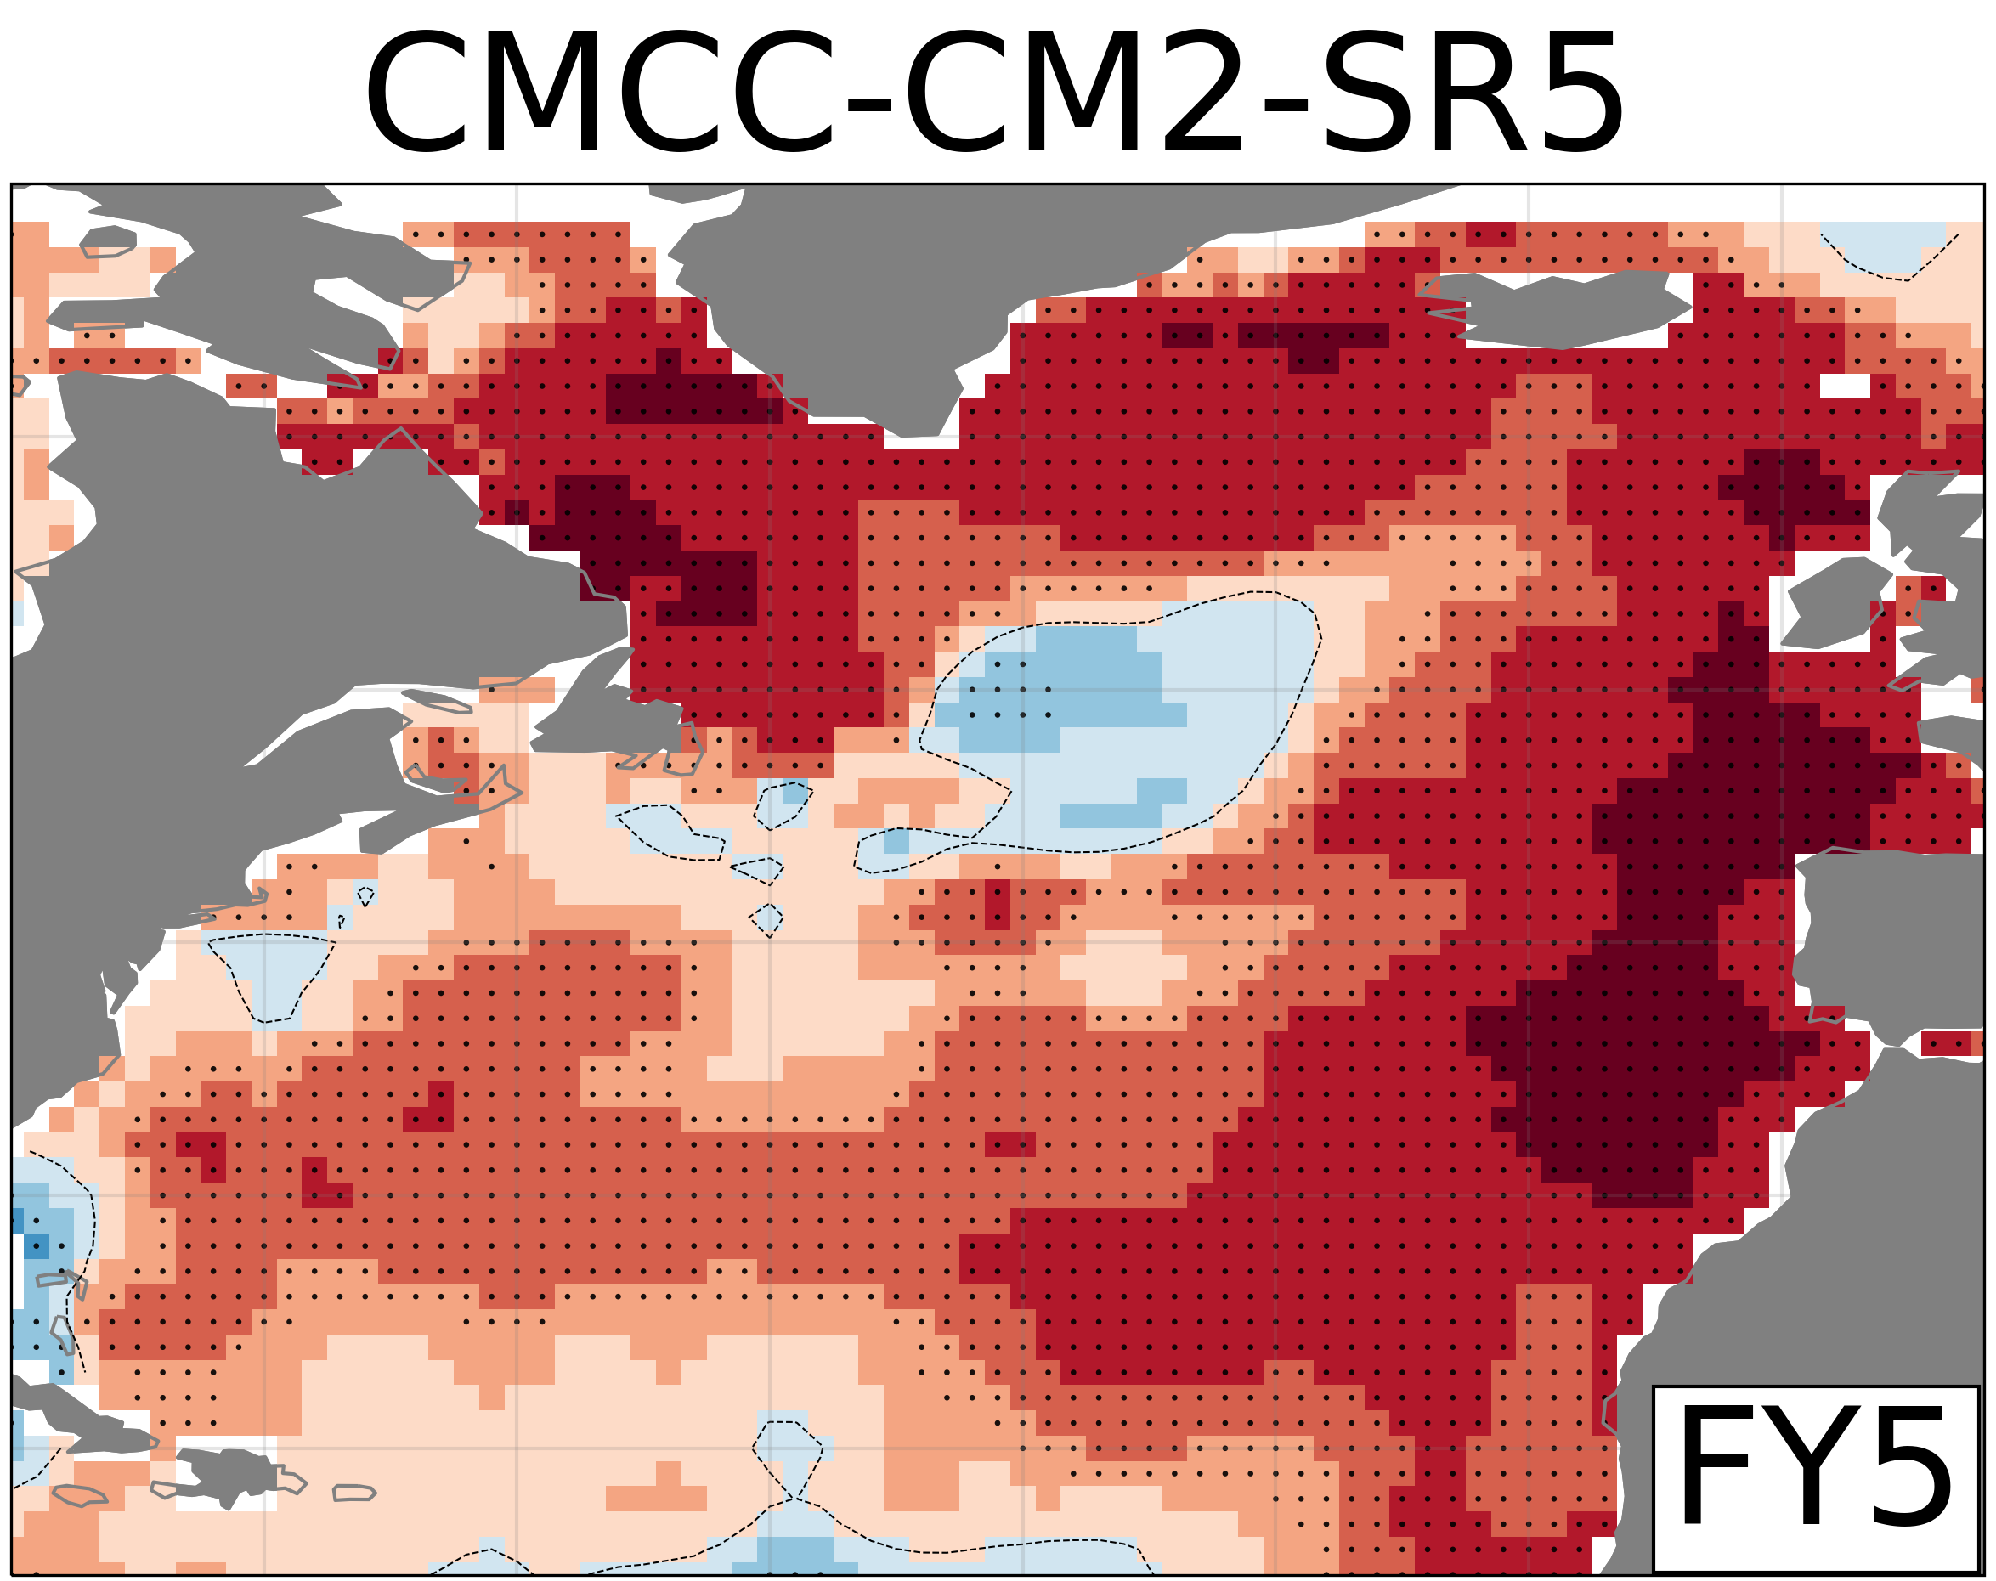
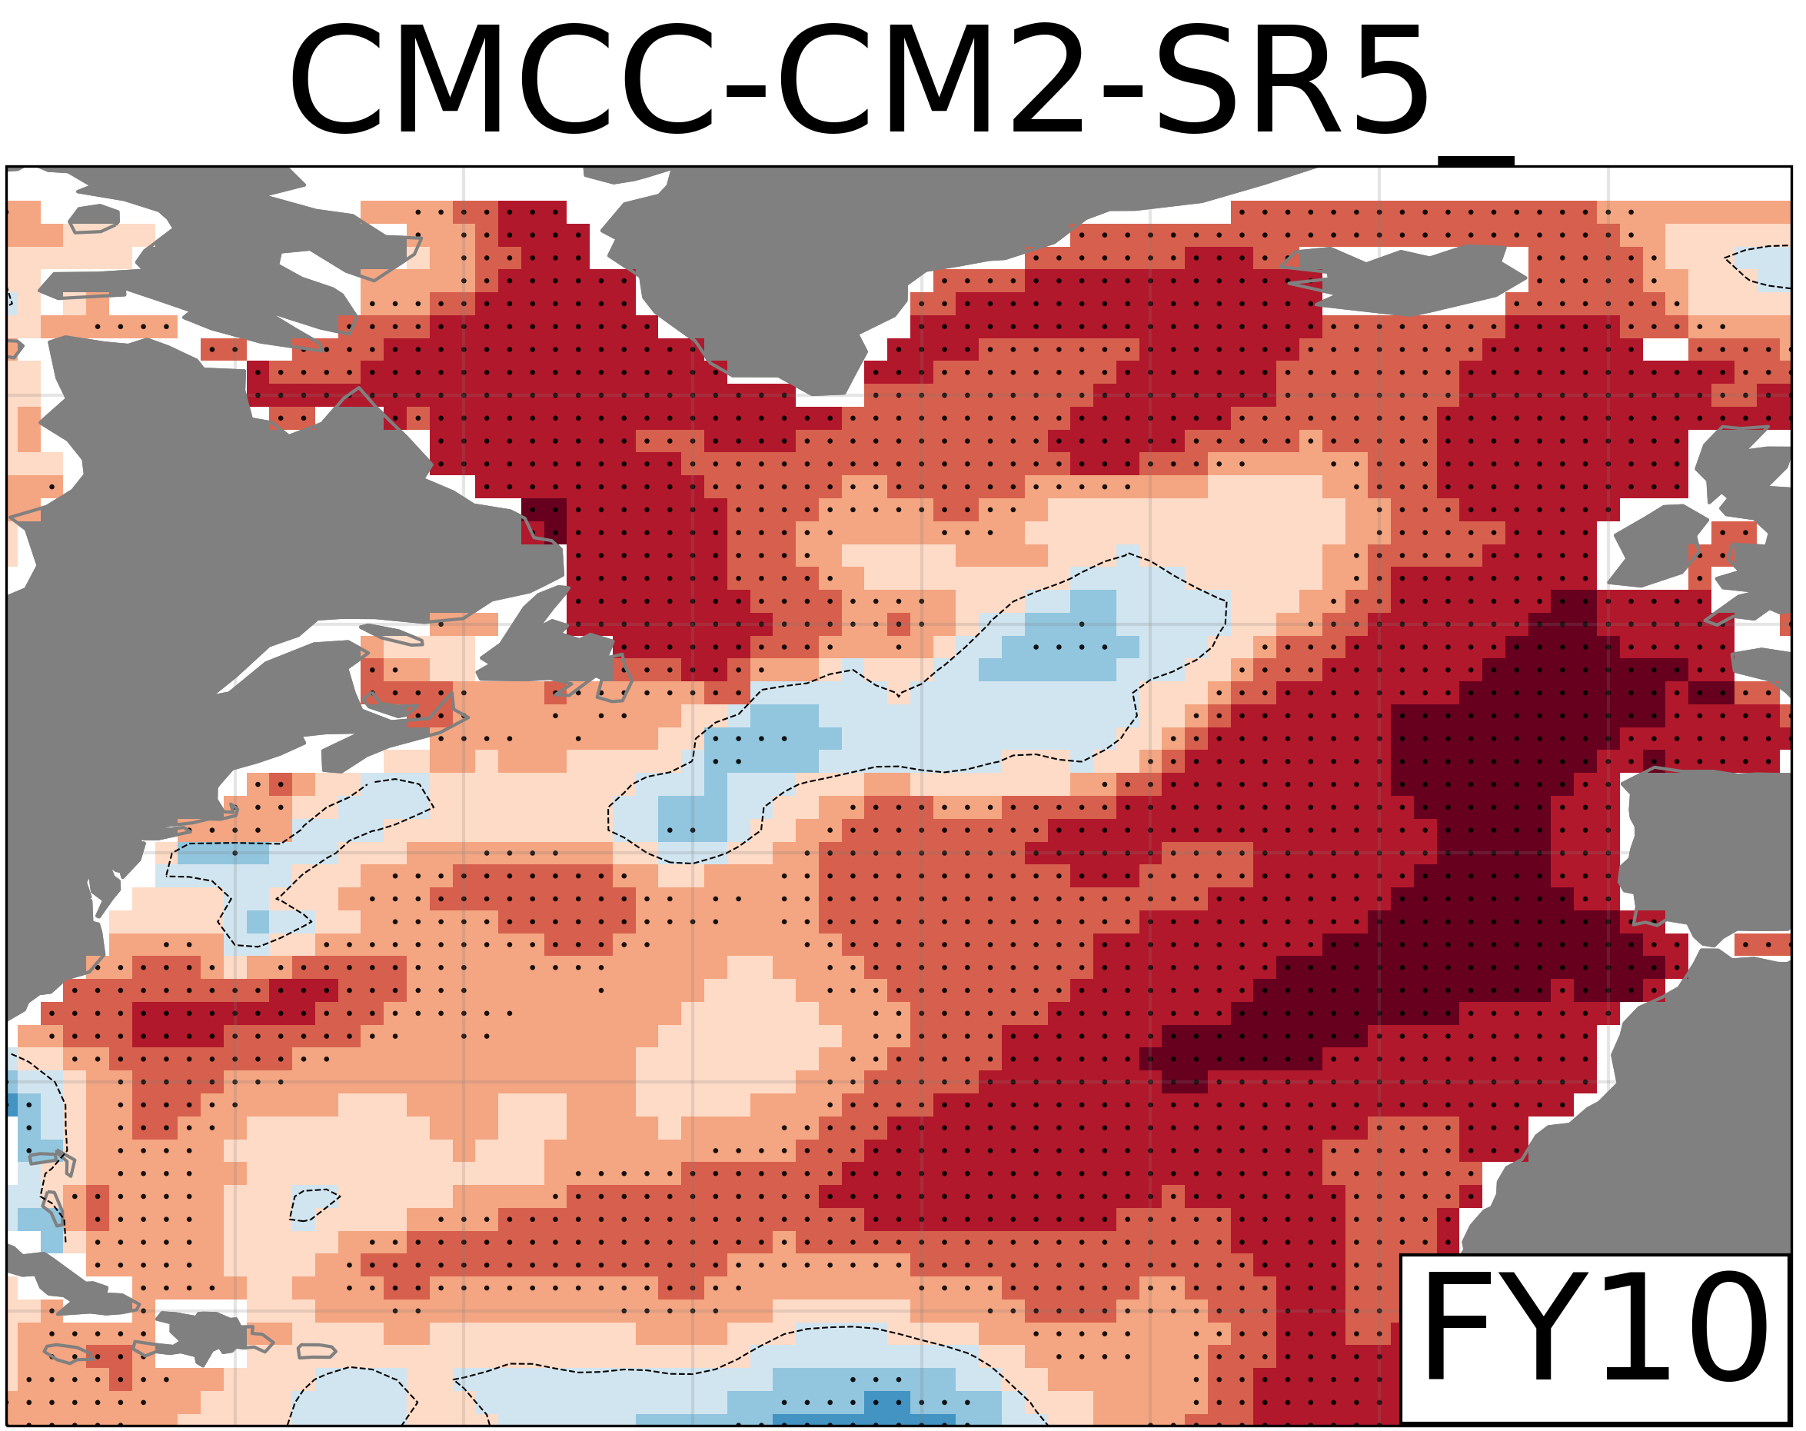
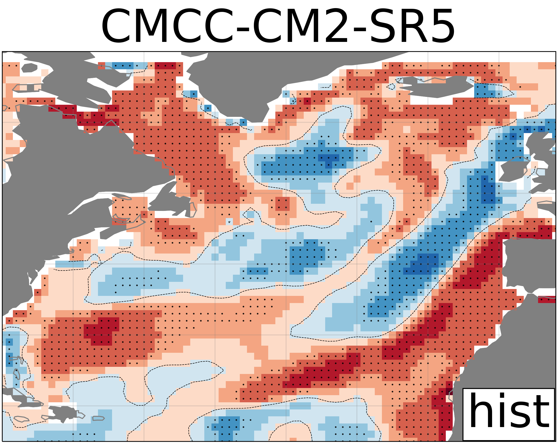
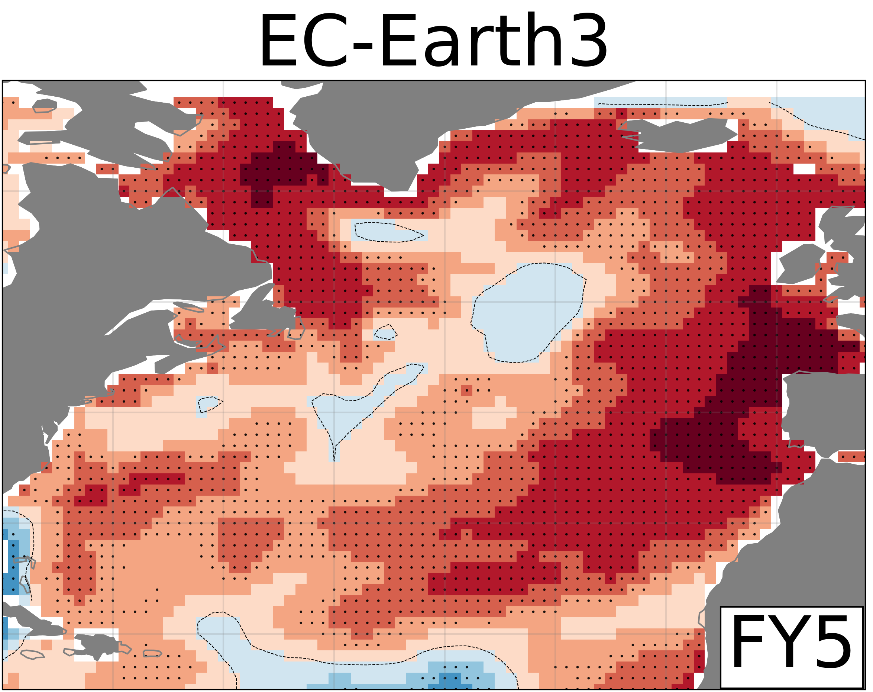
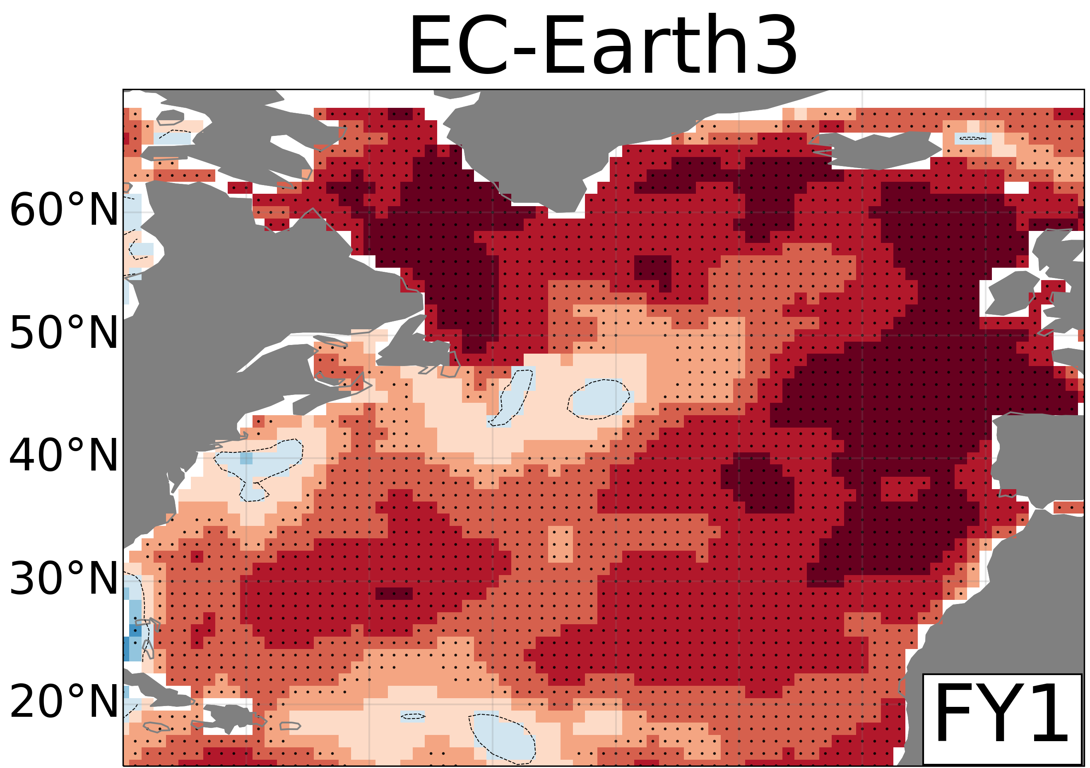
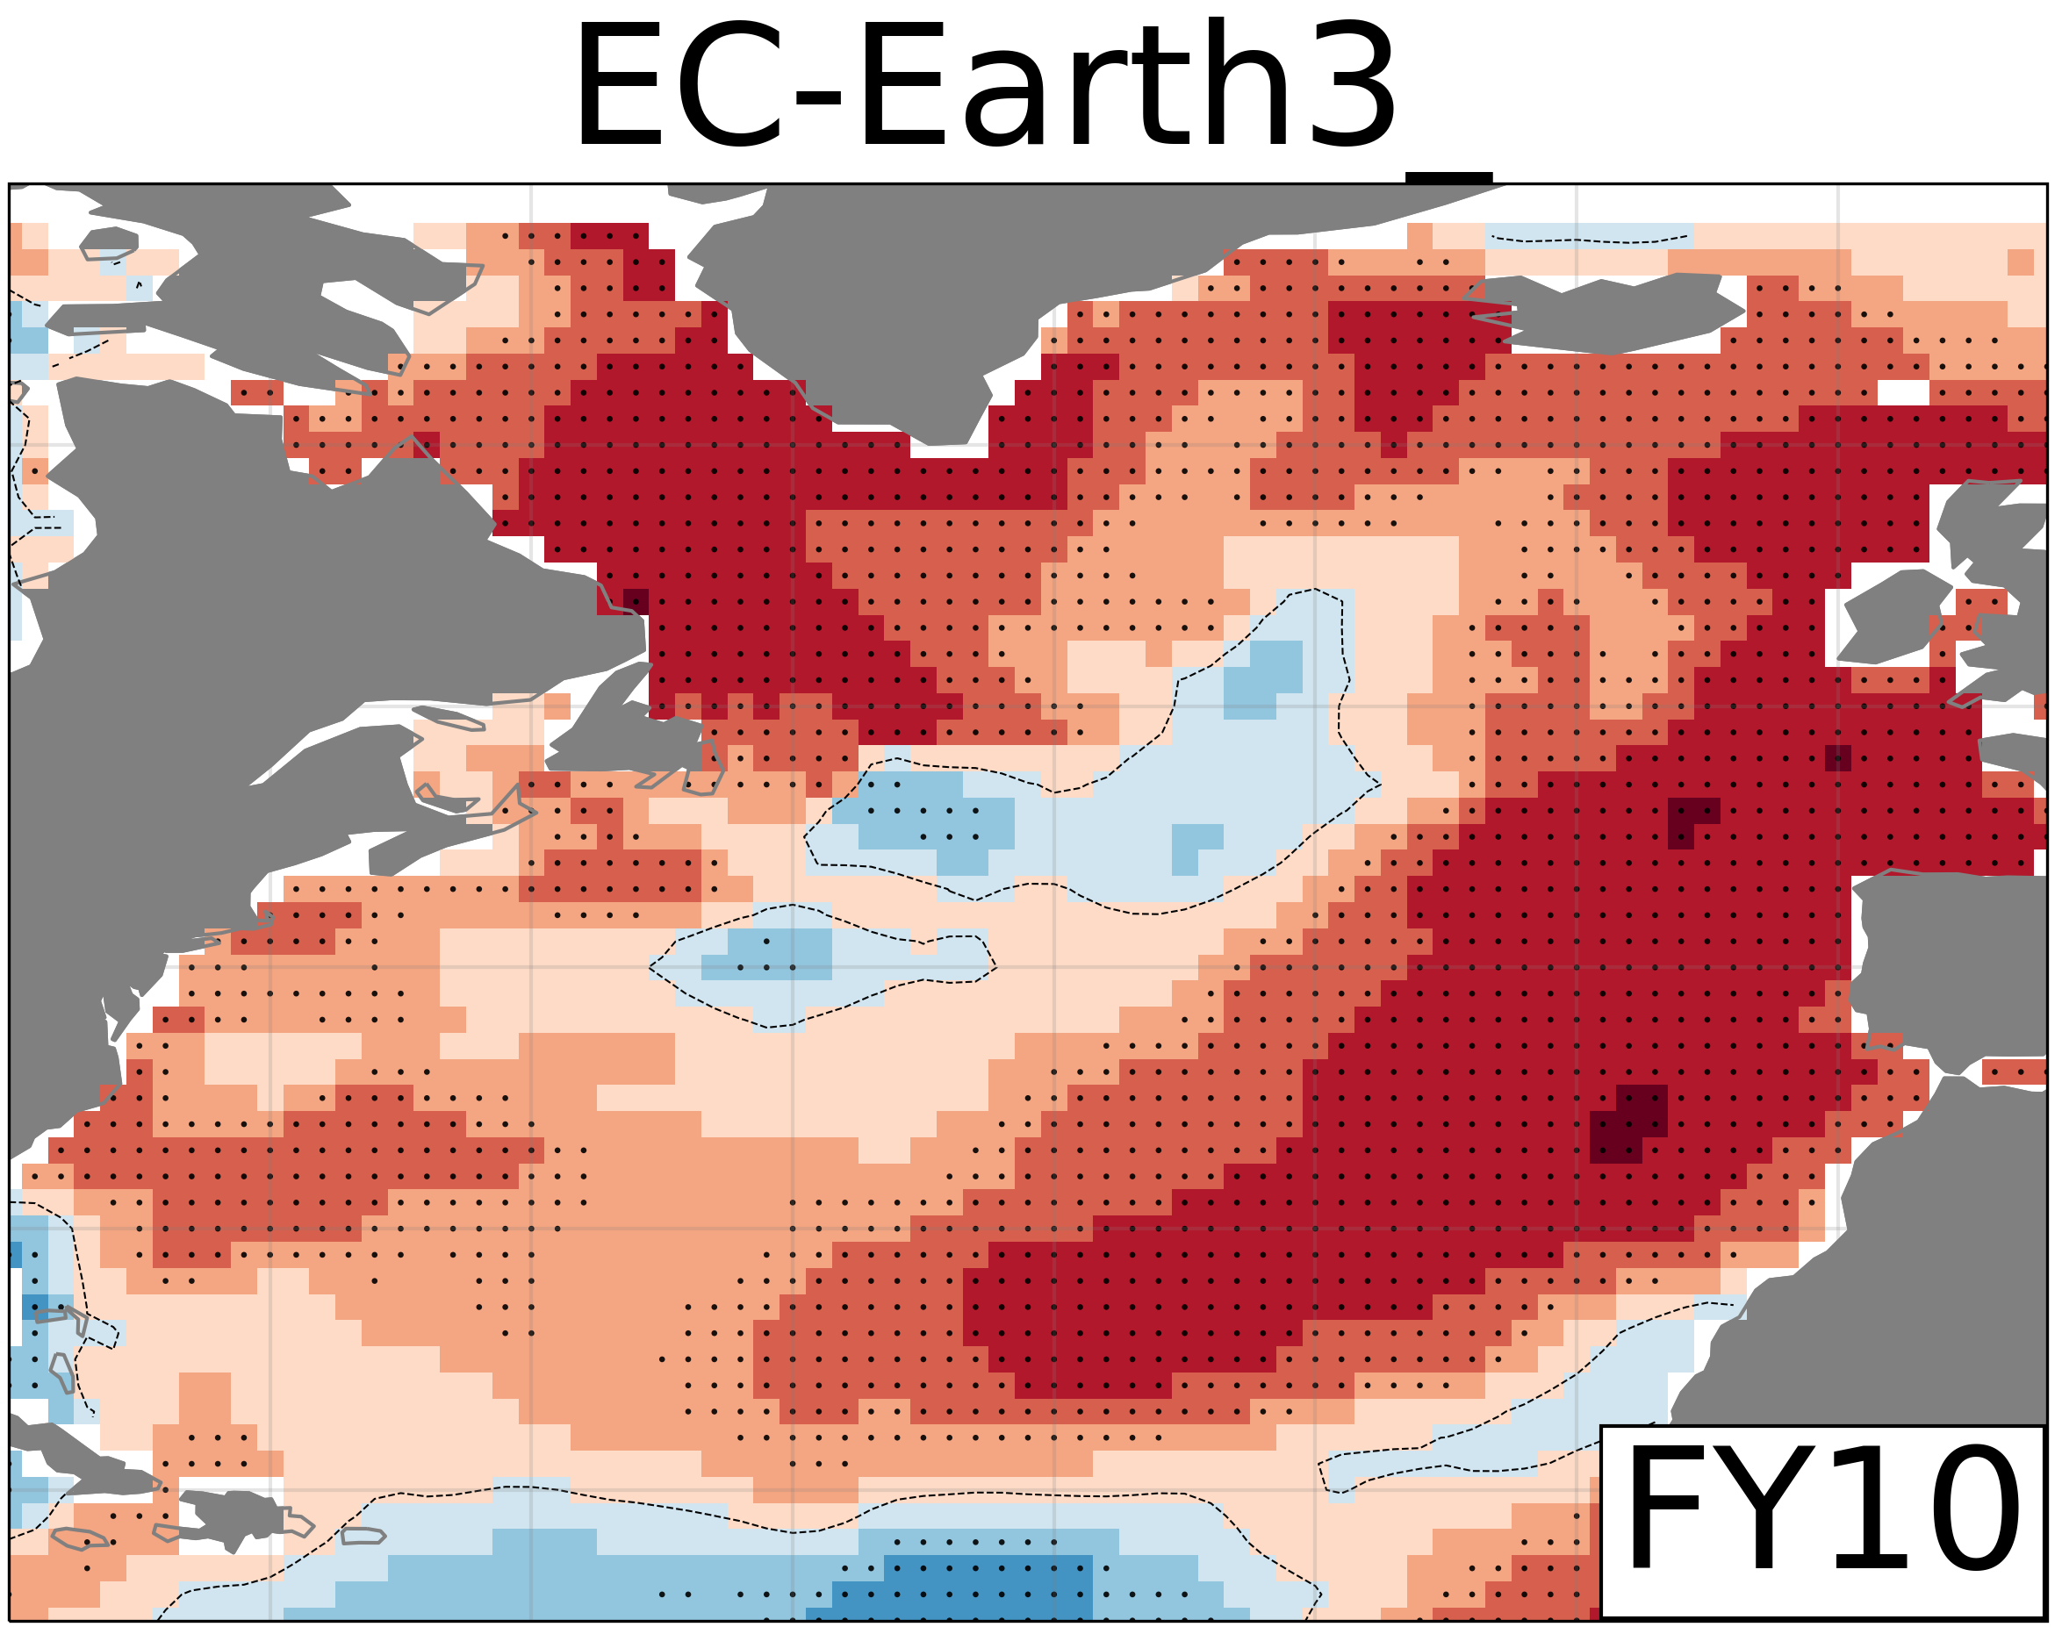
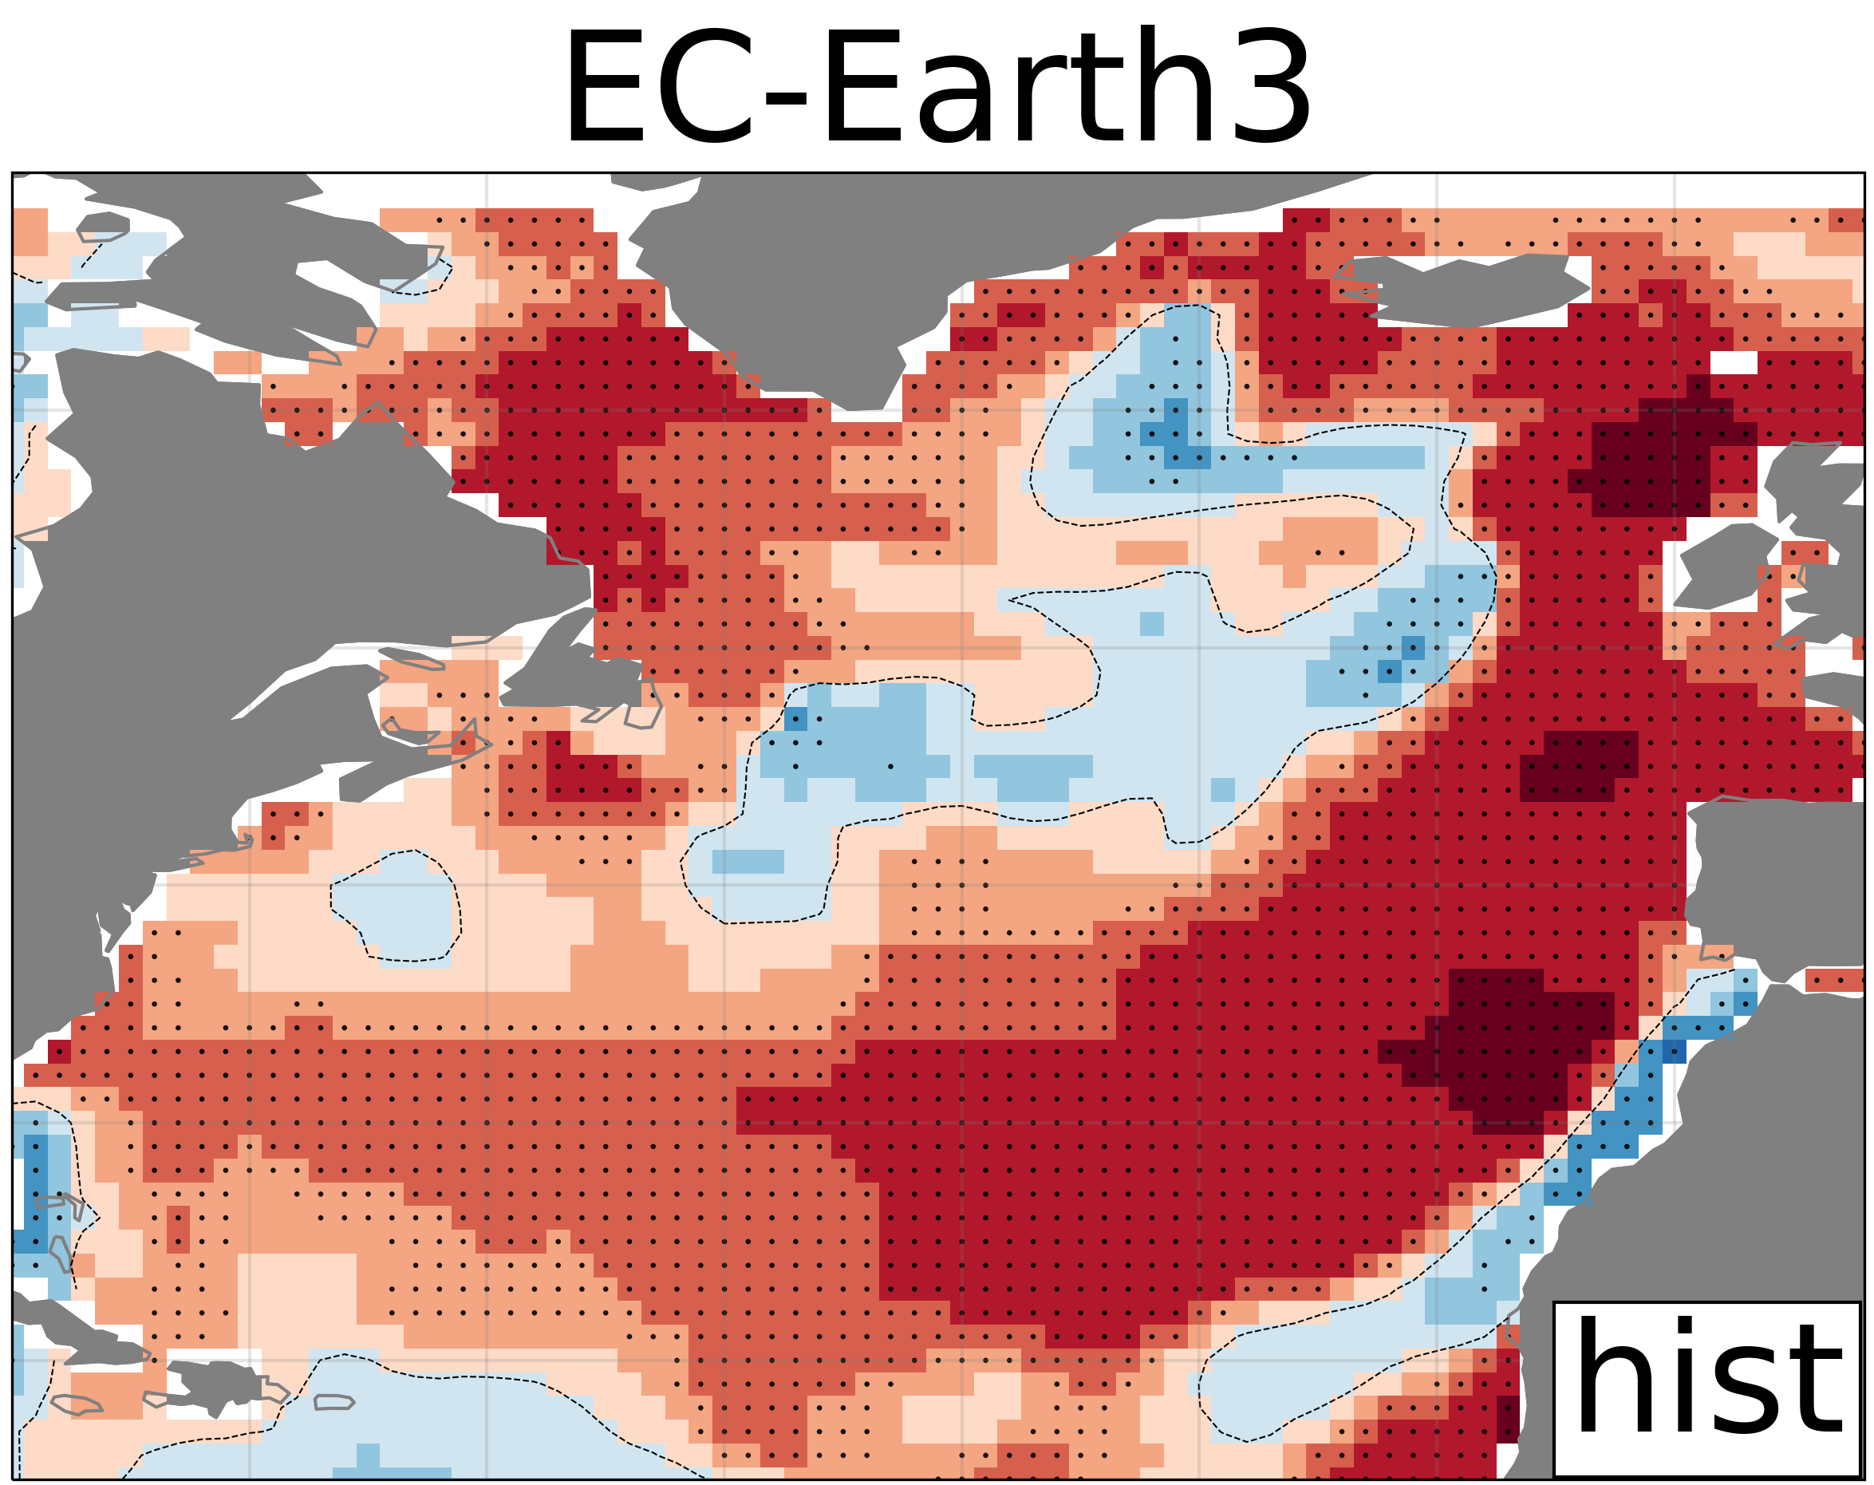
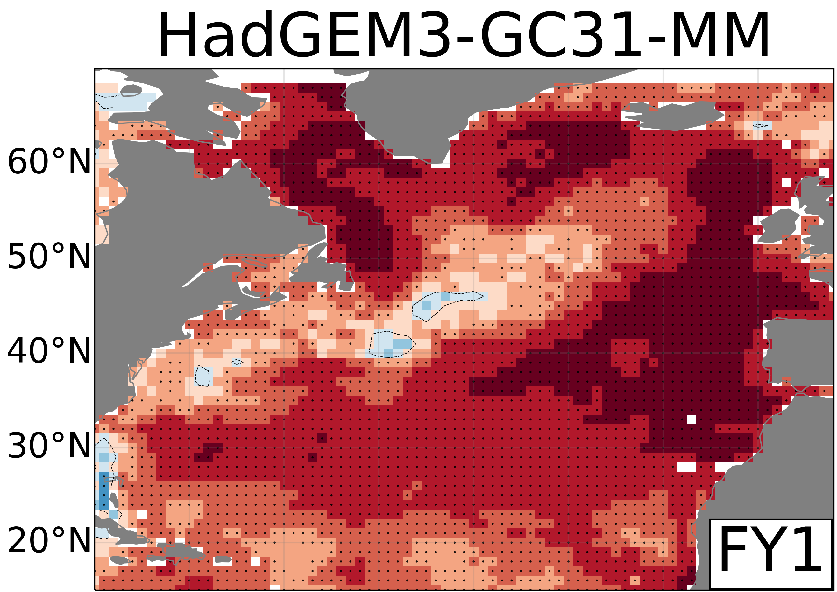
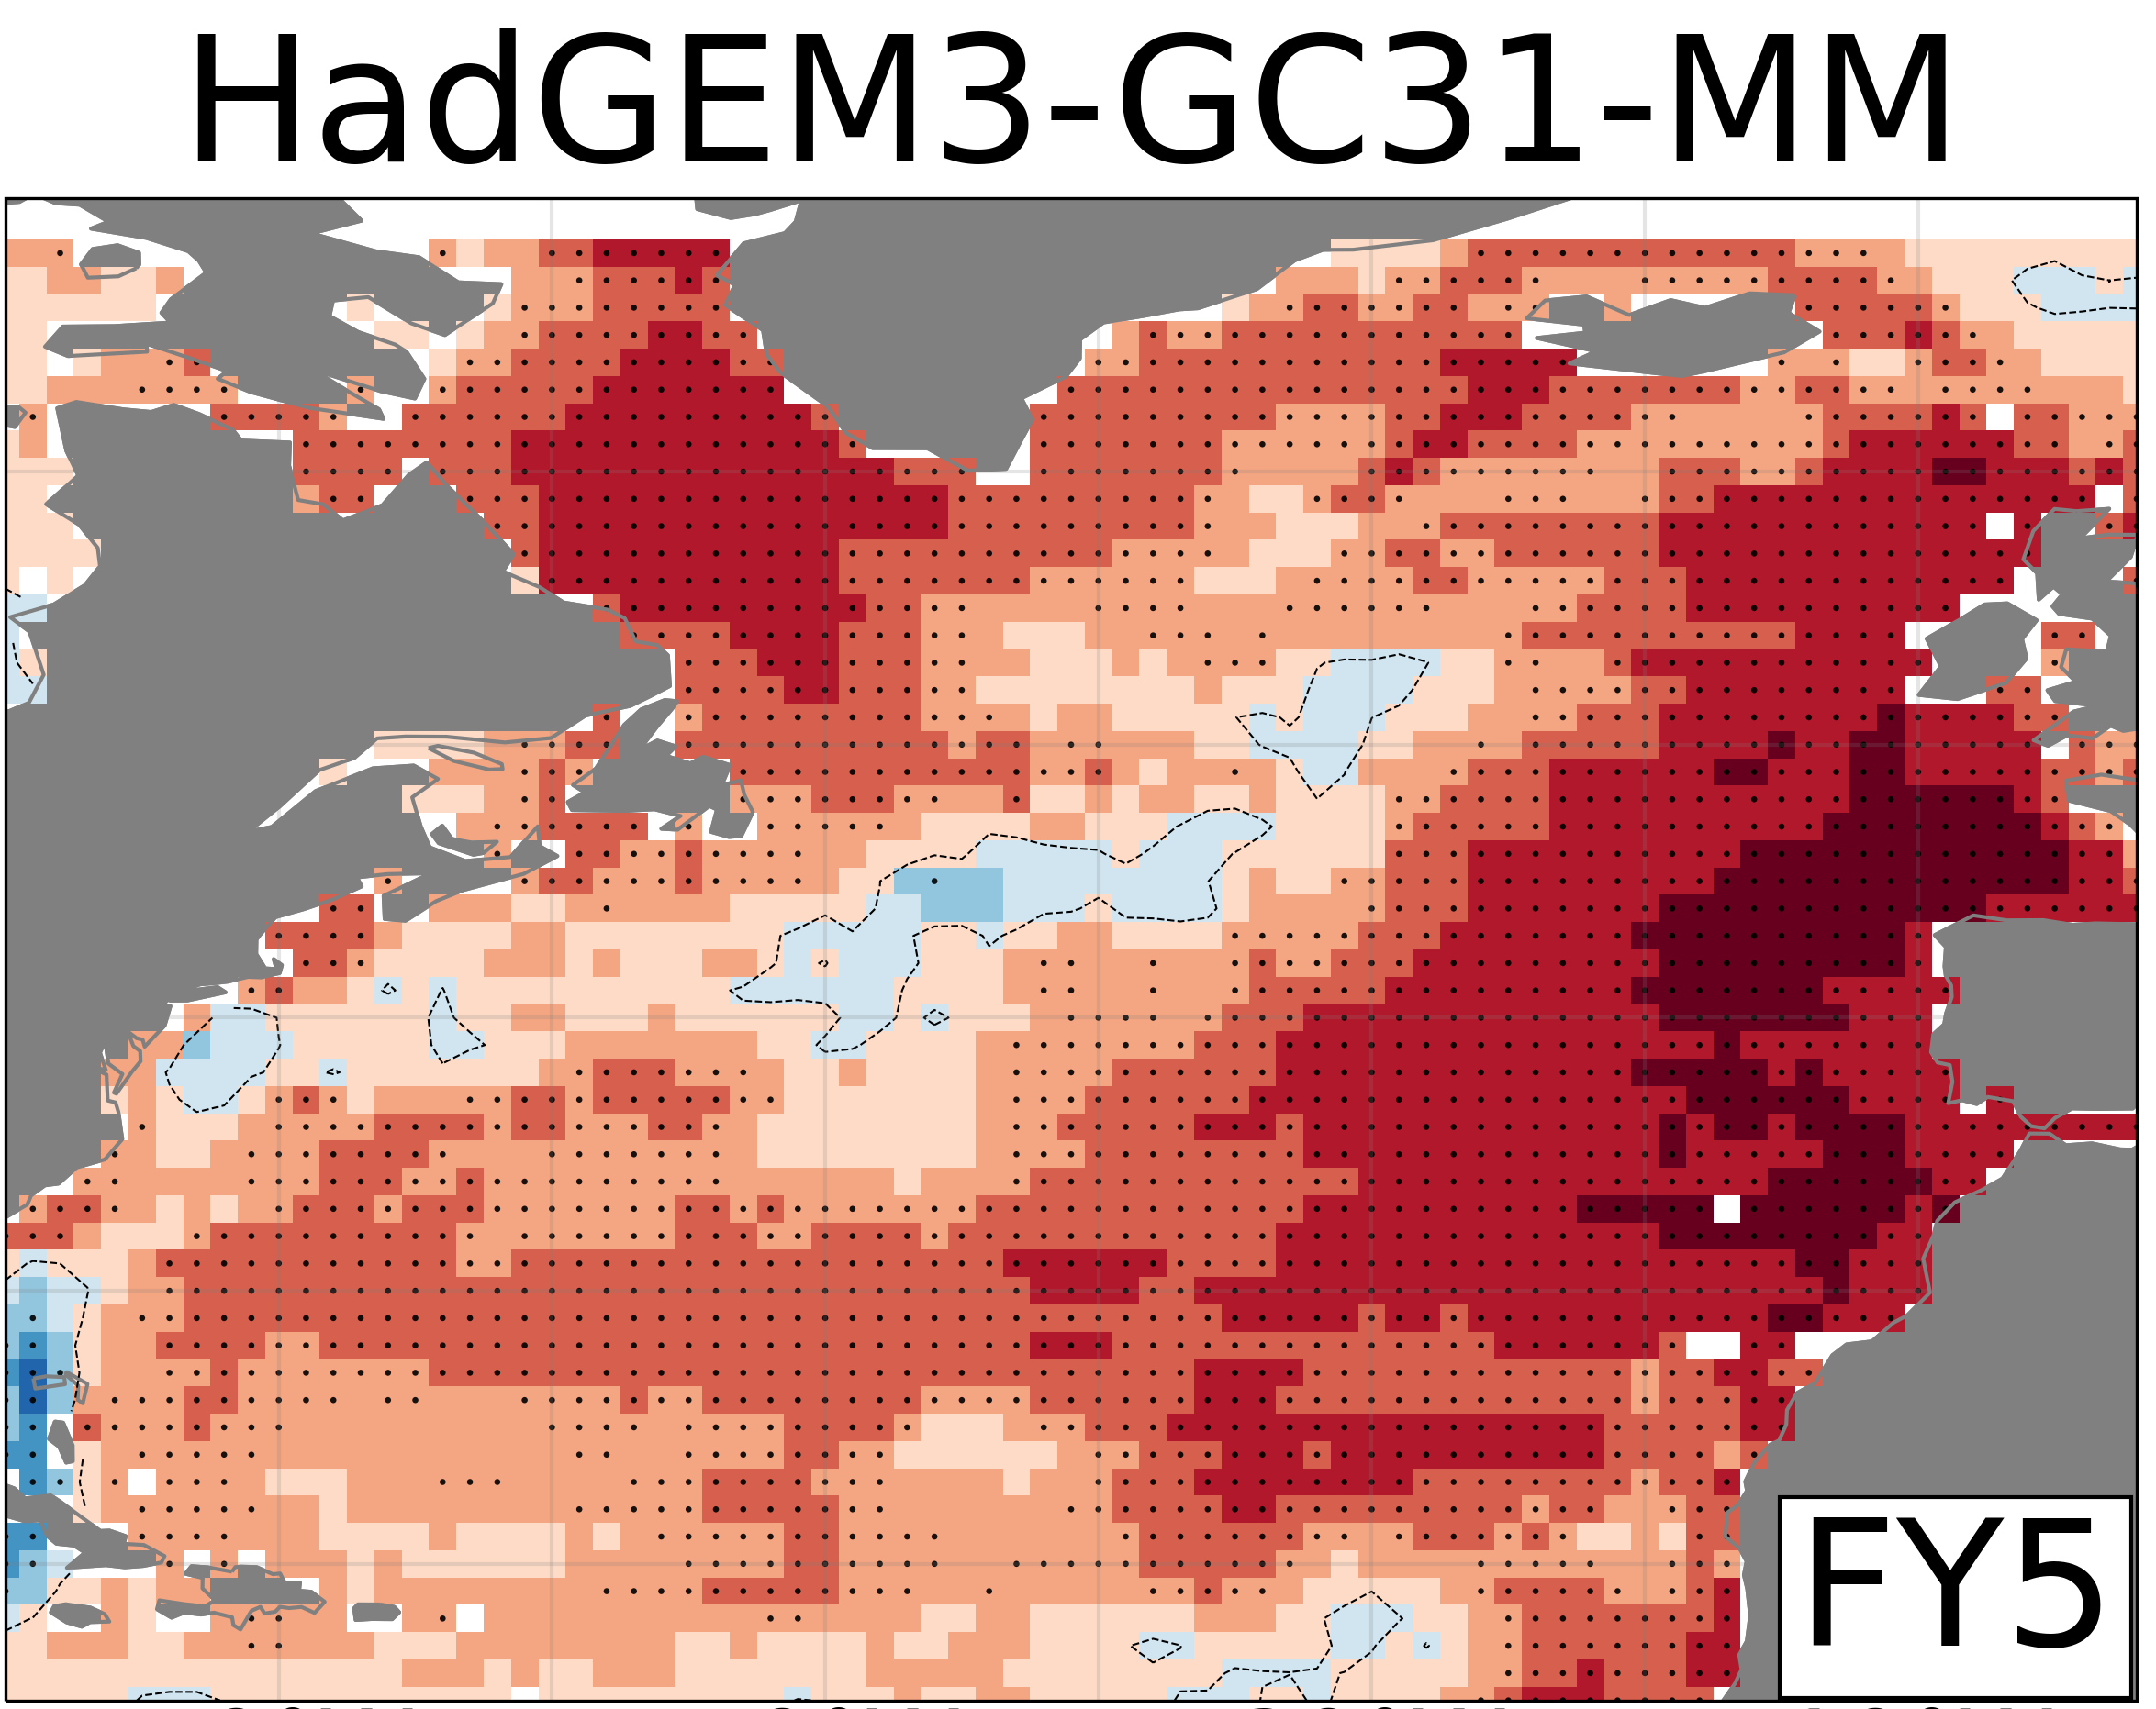
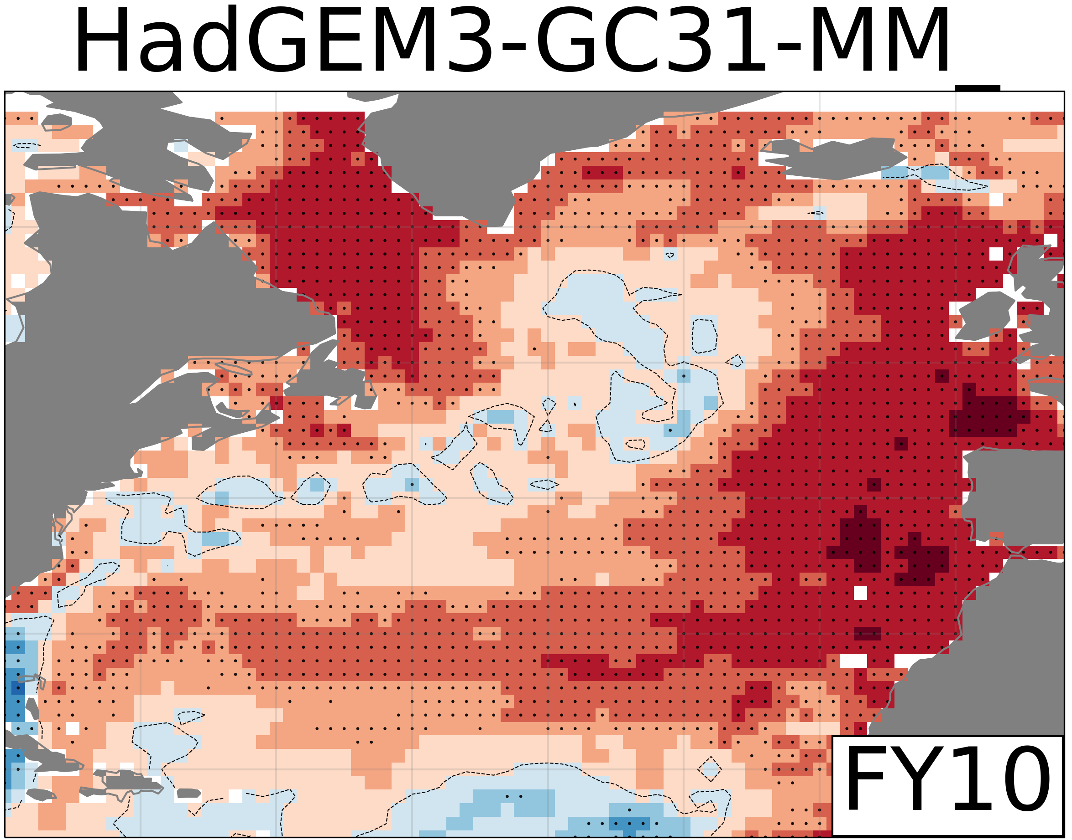
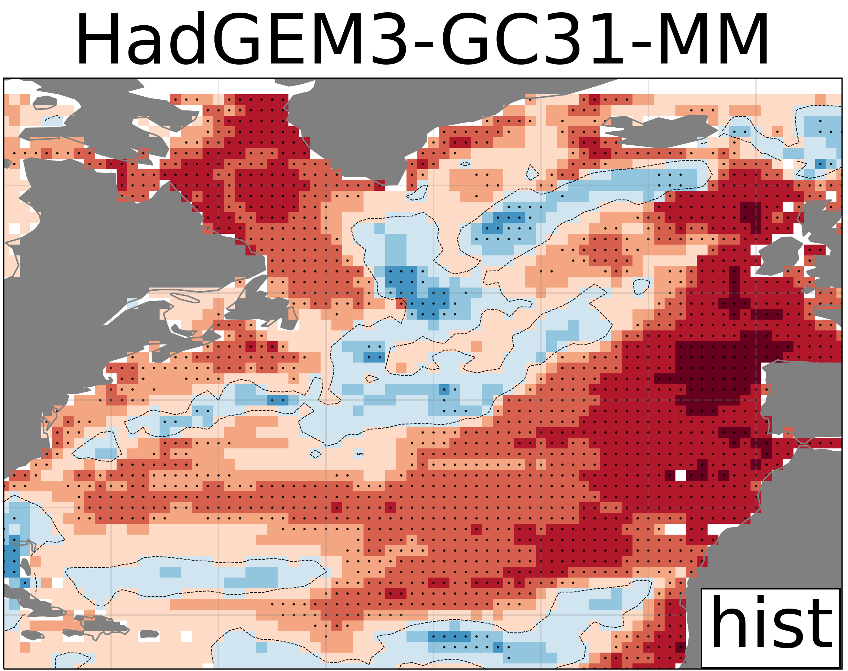
Predictive skill of OHC from 0-700m (Anom. Init.)
DCPP LY1
DCPP LY5
DCPP LY10
HIST
1.0
CanESM
Study Period
1970-2014
0.8
0.6
0.4
CMCC-CM2
0.2
Anomaly Correlation Coefficient
0.0
-0.2
EC-Earth3
-0.4
-0.6
-0.9
HadGEM3-GC31
-1.0

Slide 7
Predictive skill of OHC from 0-700m (Anom. Init.)
DCPP LY1
DCPP LY5
DCPP LY10
HIST
1.0
CanESM
Study Period
1970-2014
0.8
0.6
In some models initialization can substantially change the simulated forced response
0.4
CMCC-CM2
0.2
Anomaly Correlation Coefficient
0.0
-0.2
EC-Earth3
-0.4
-0.6
-0.9
HadGEM3-GC31
-1.0

Slide 8
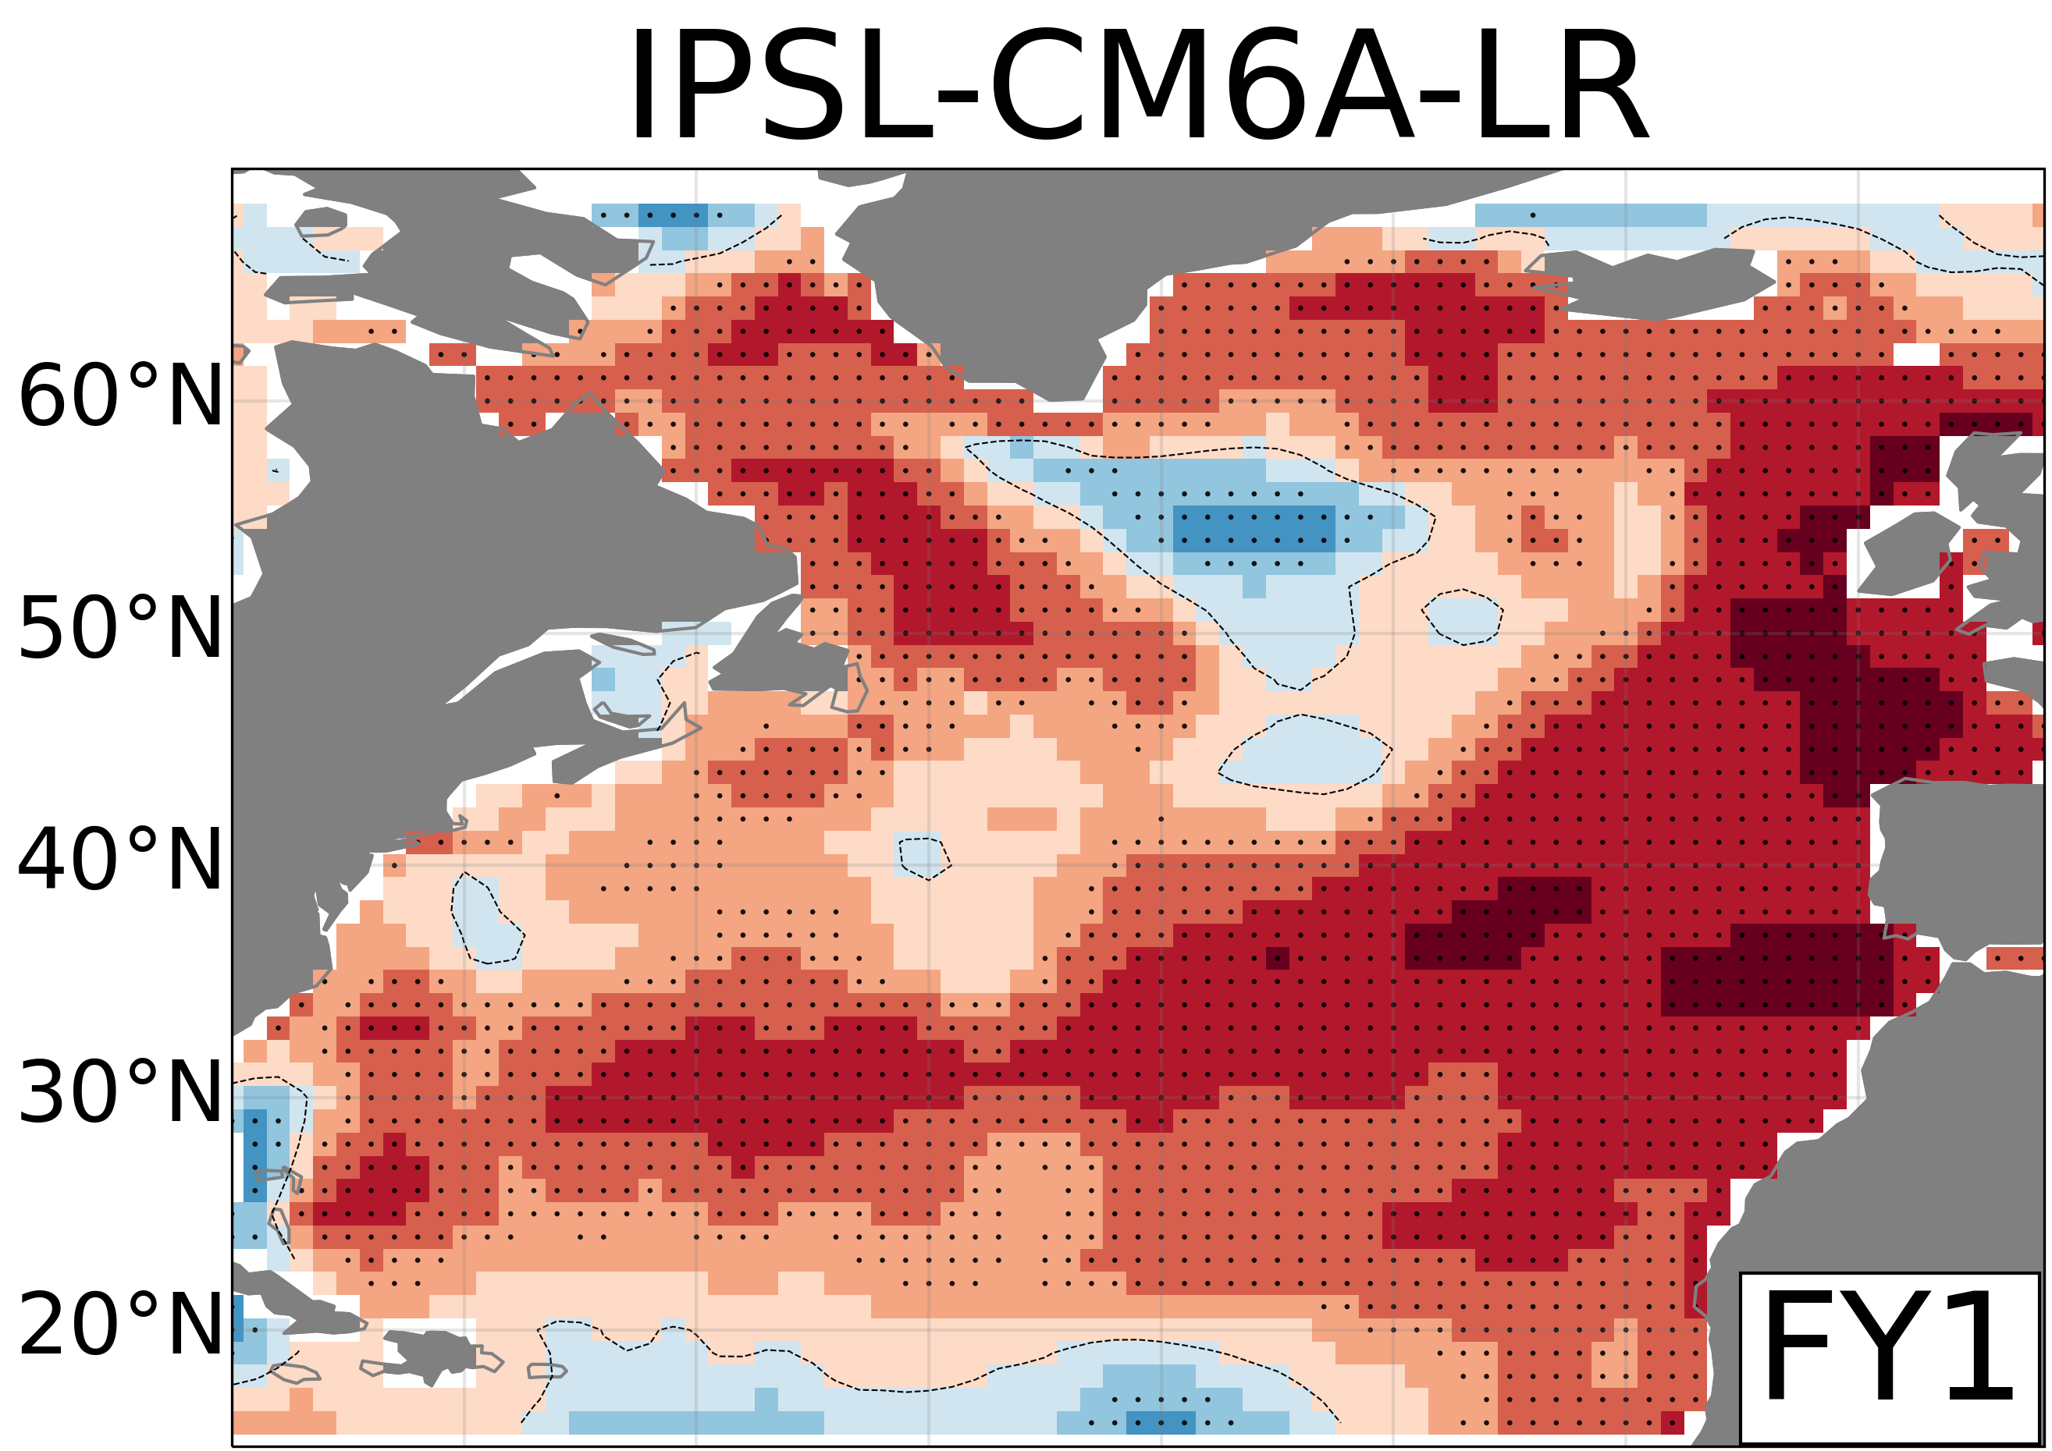
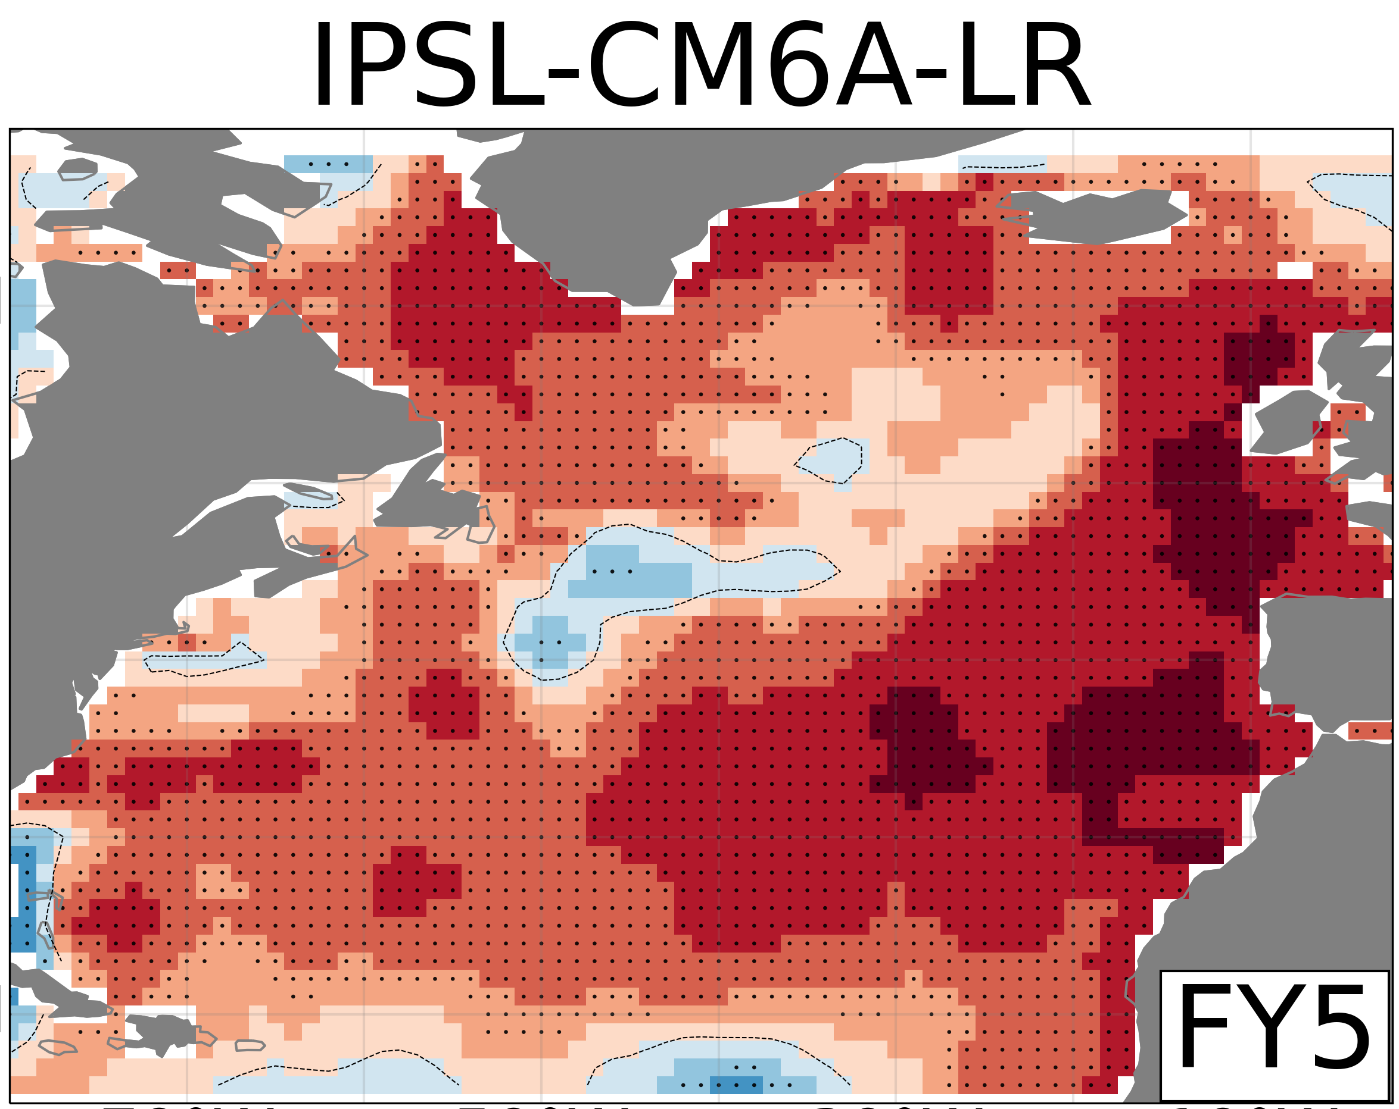
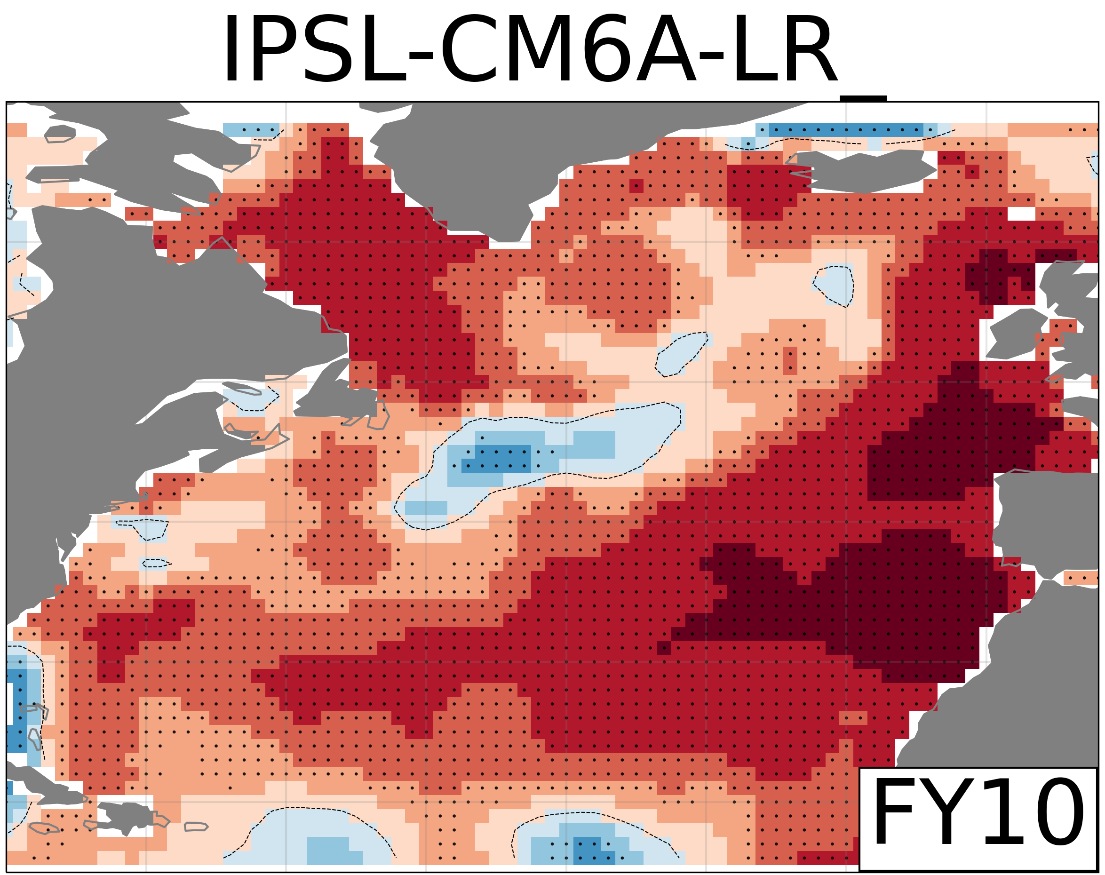
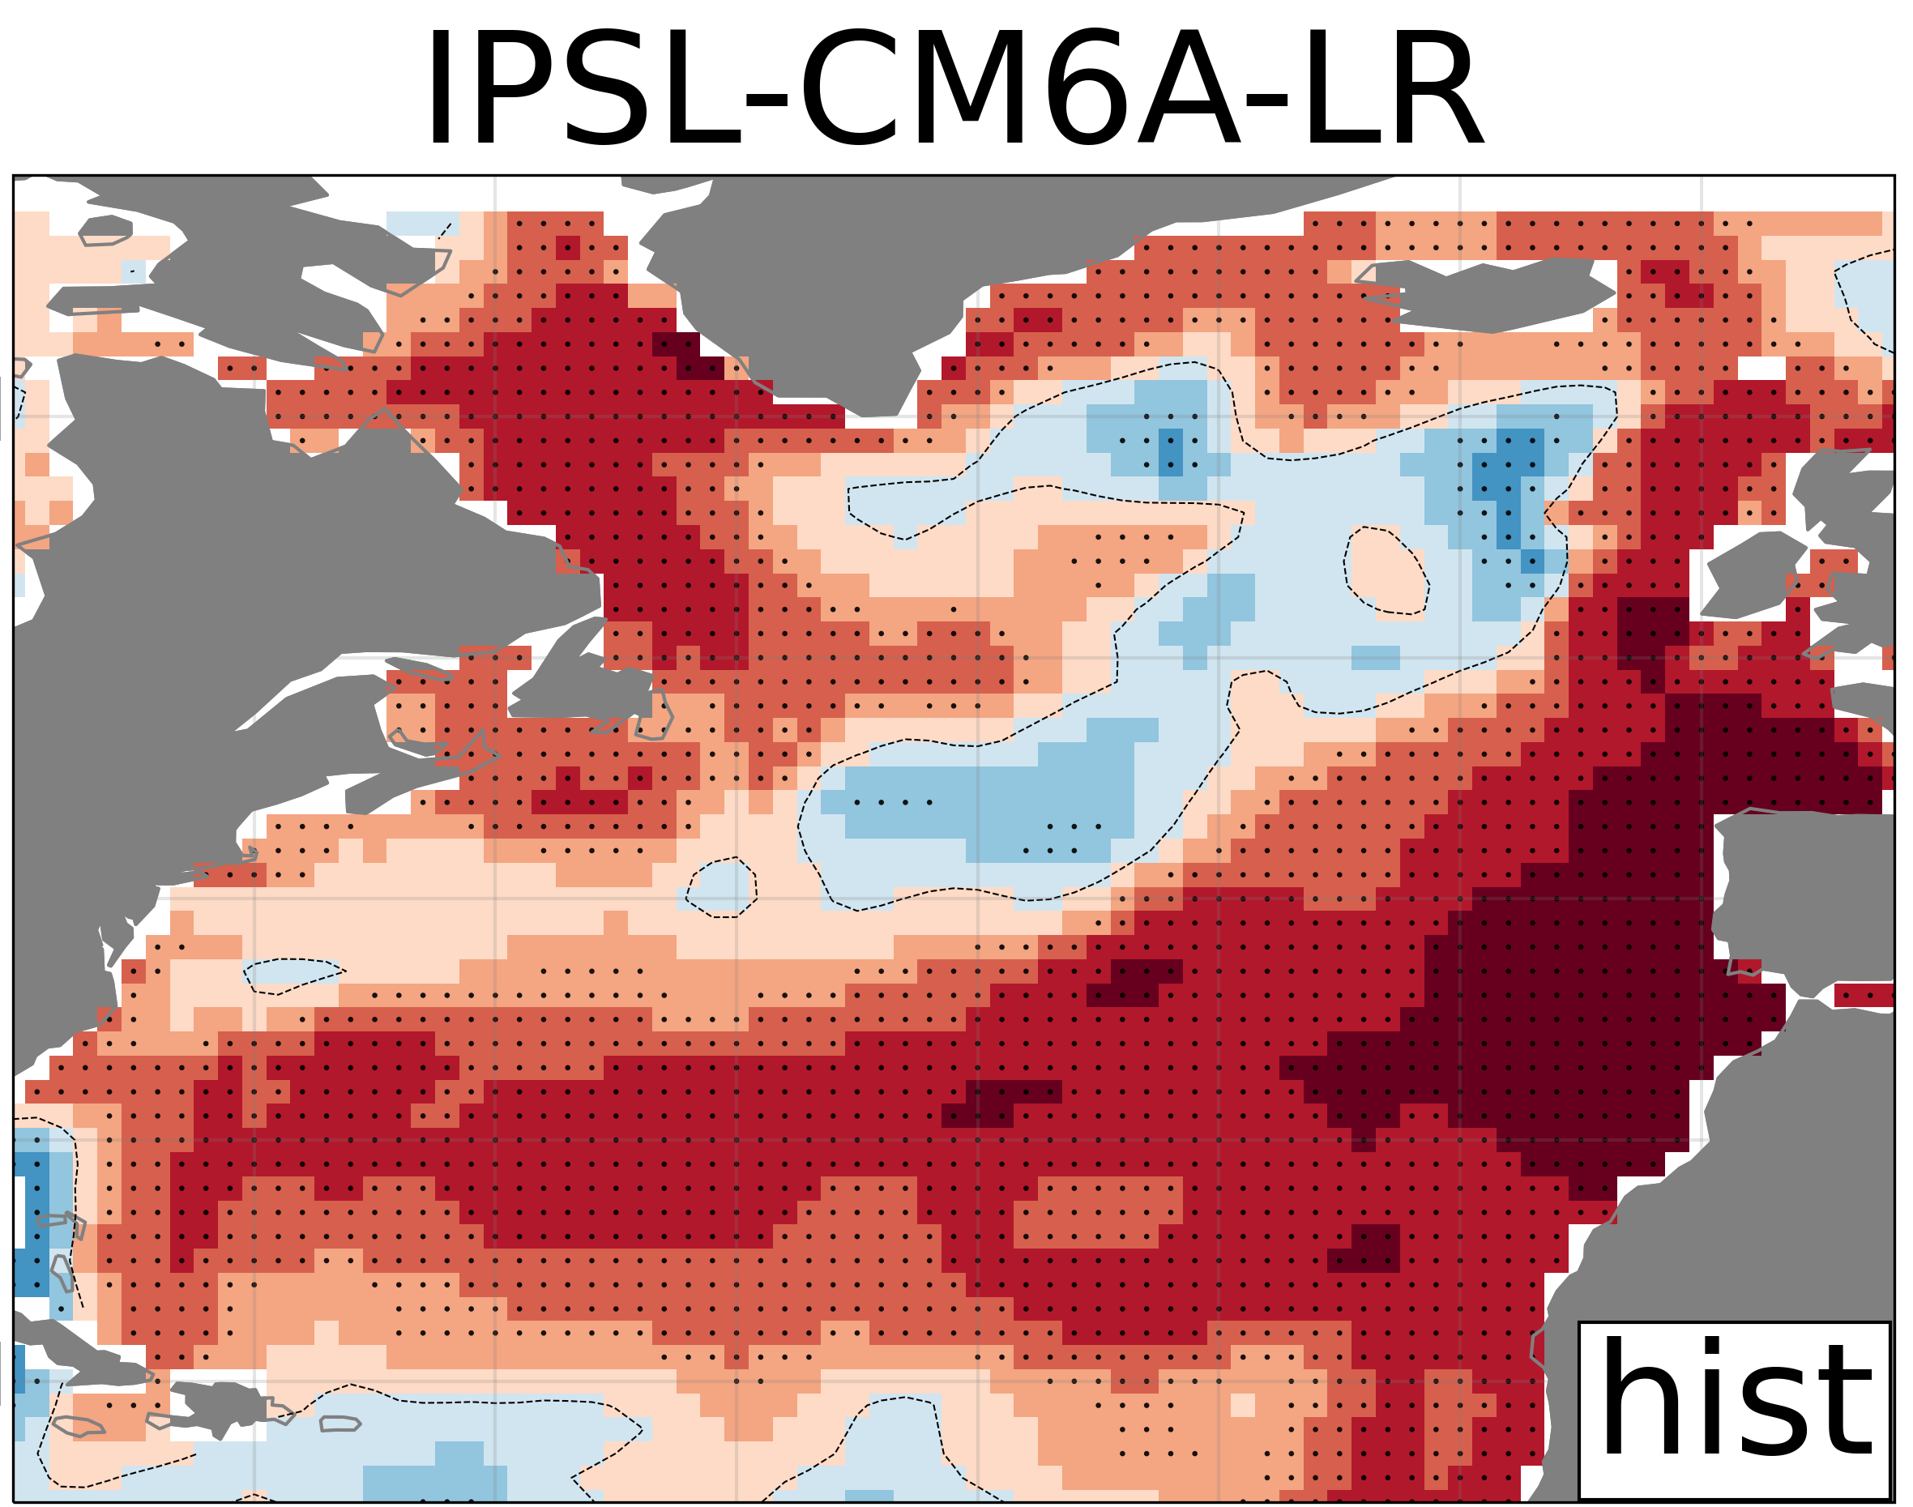
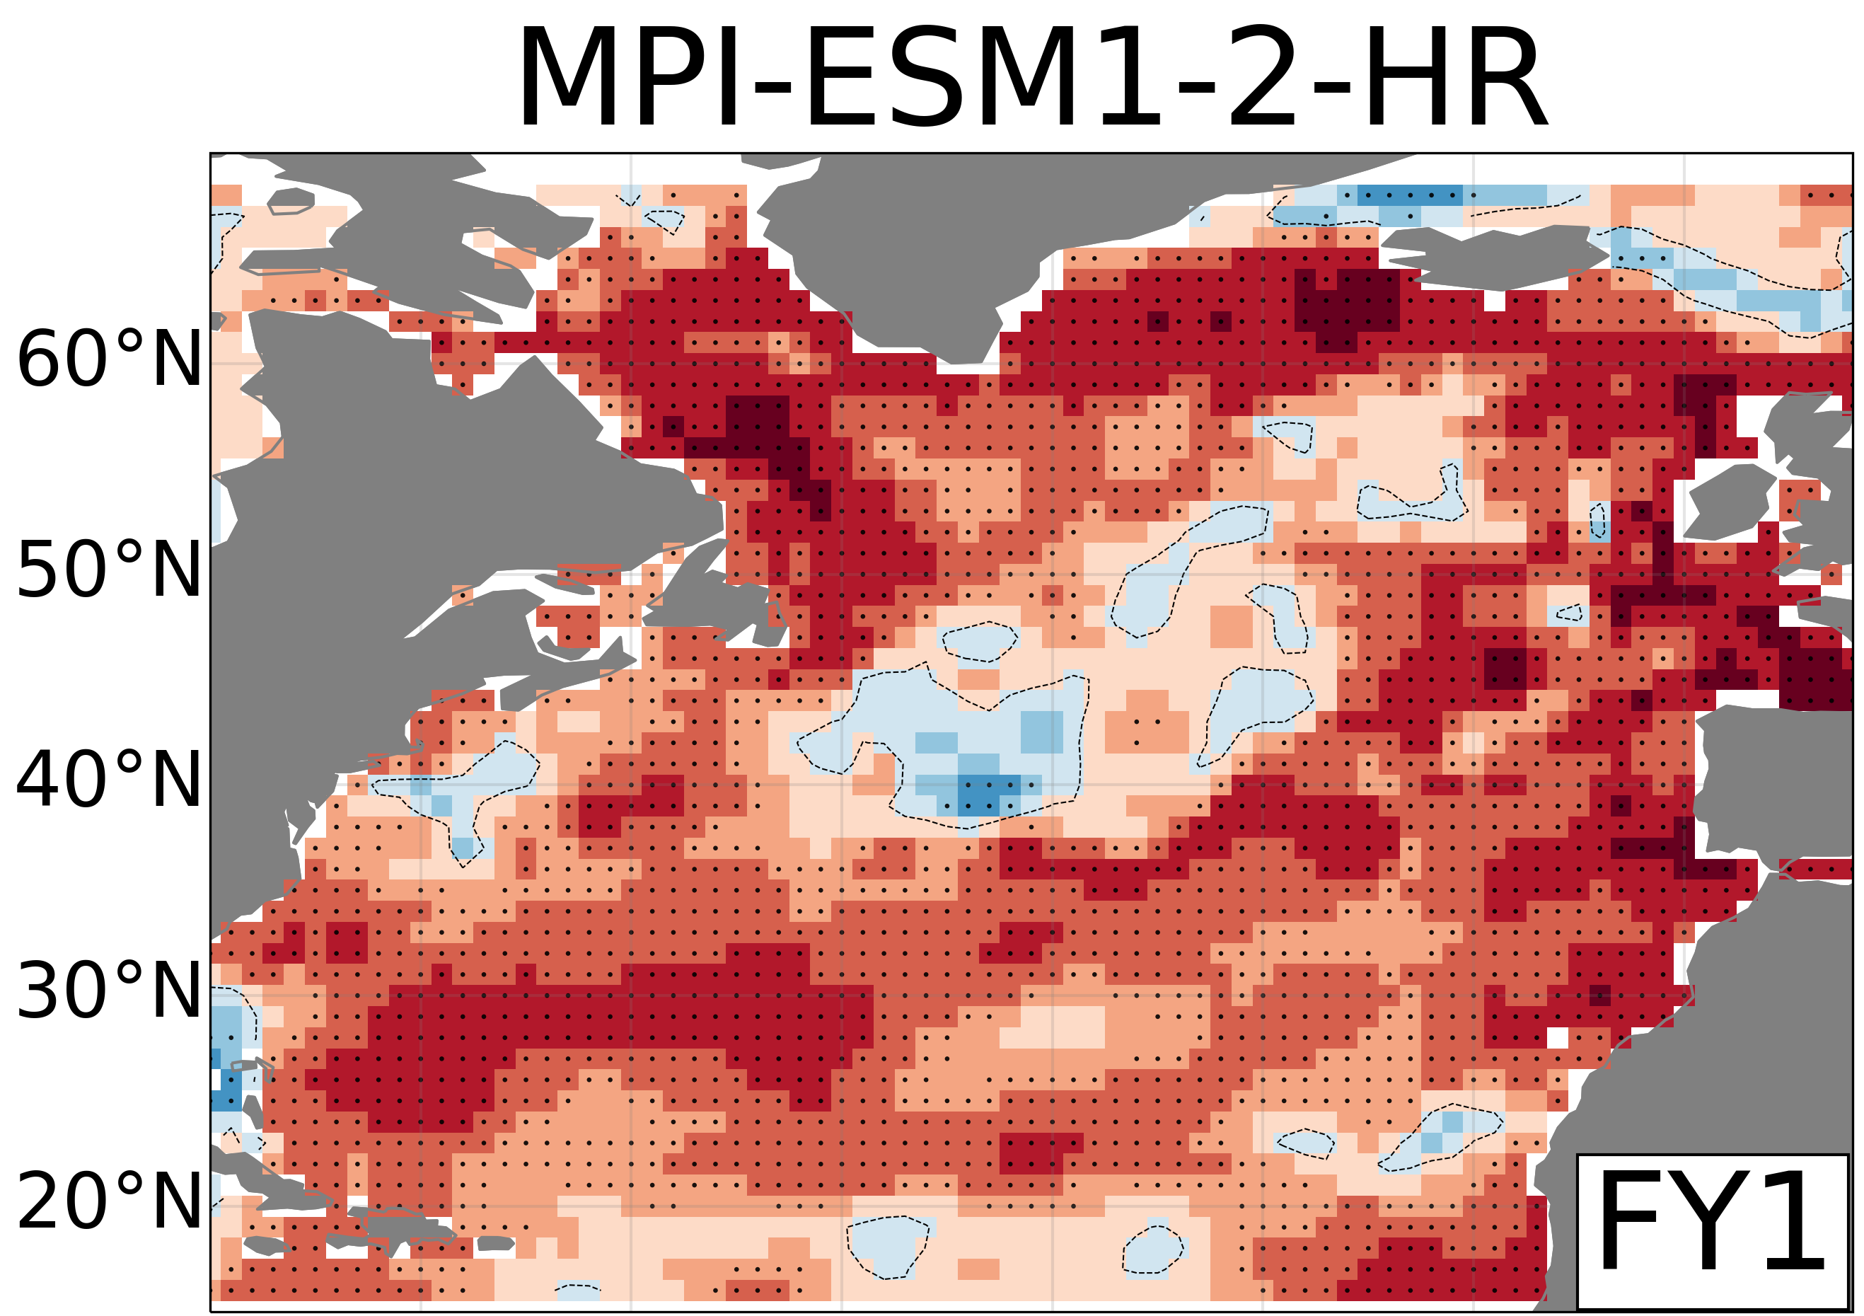
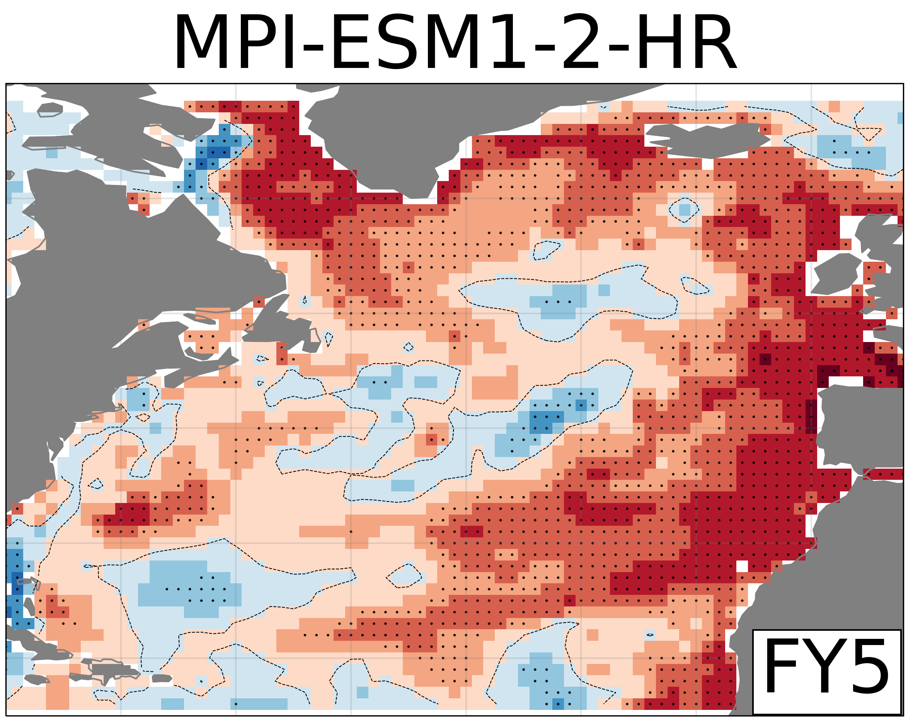
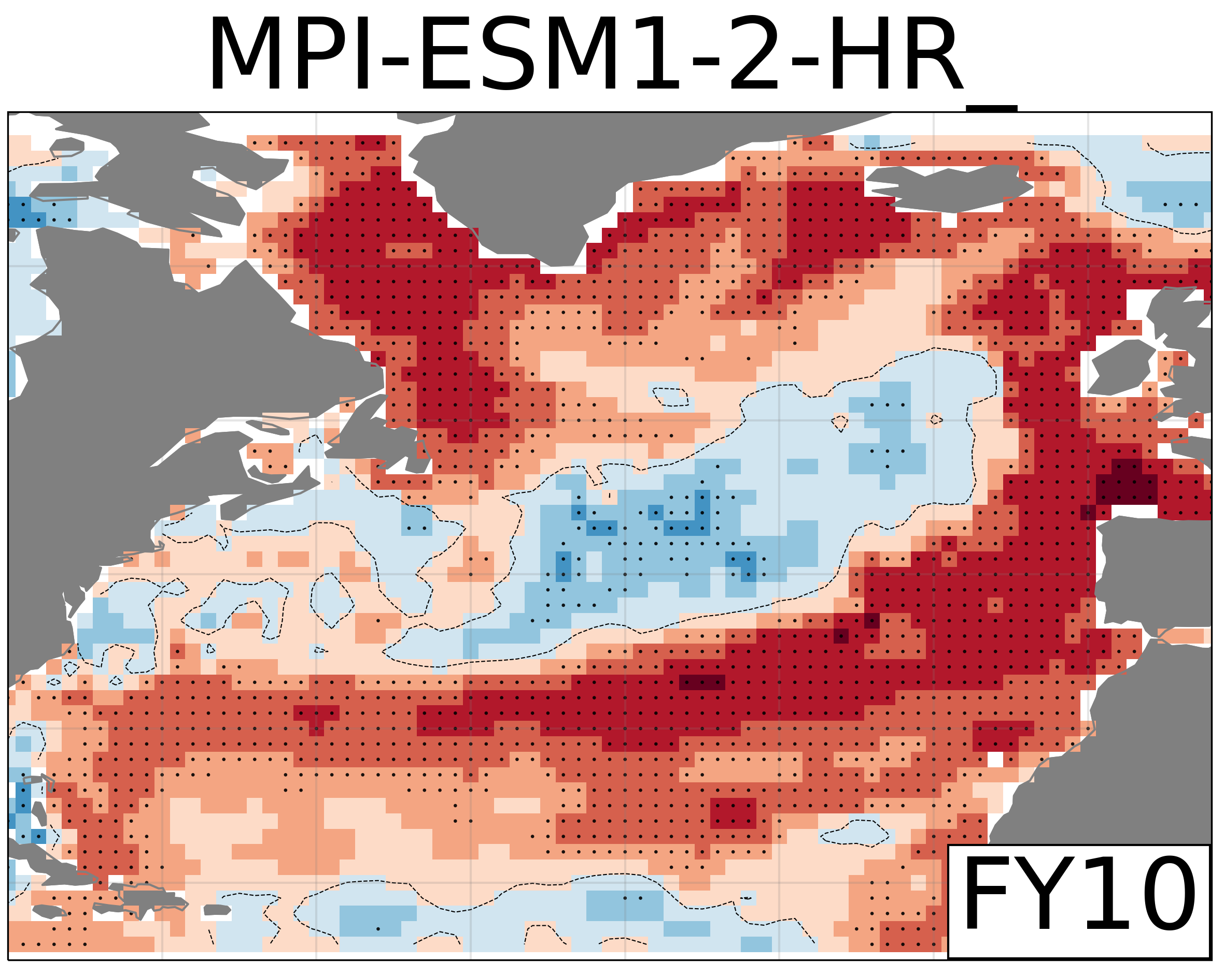
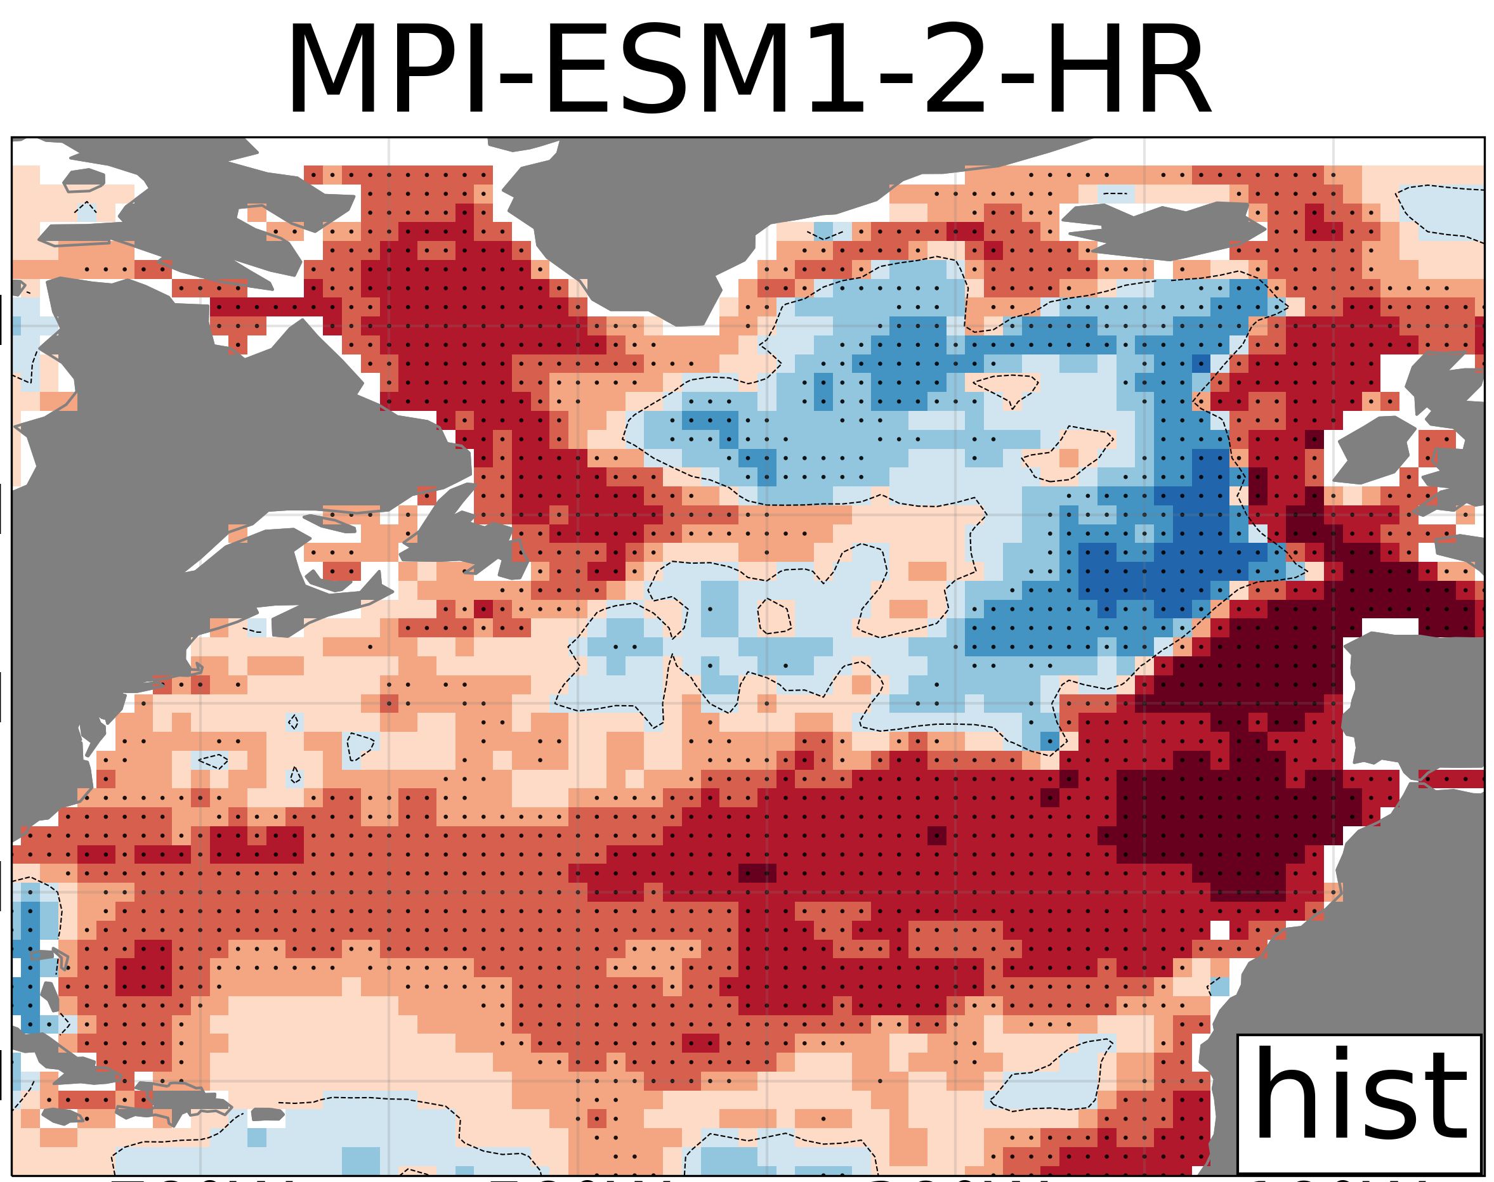
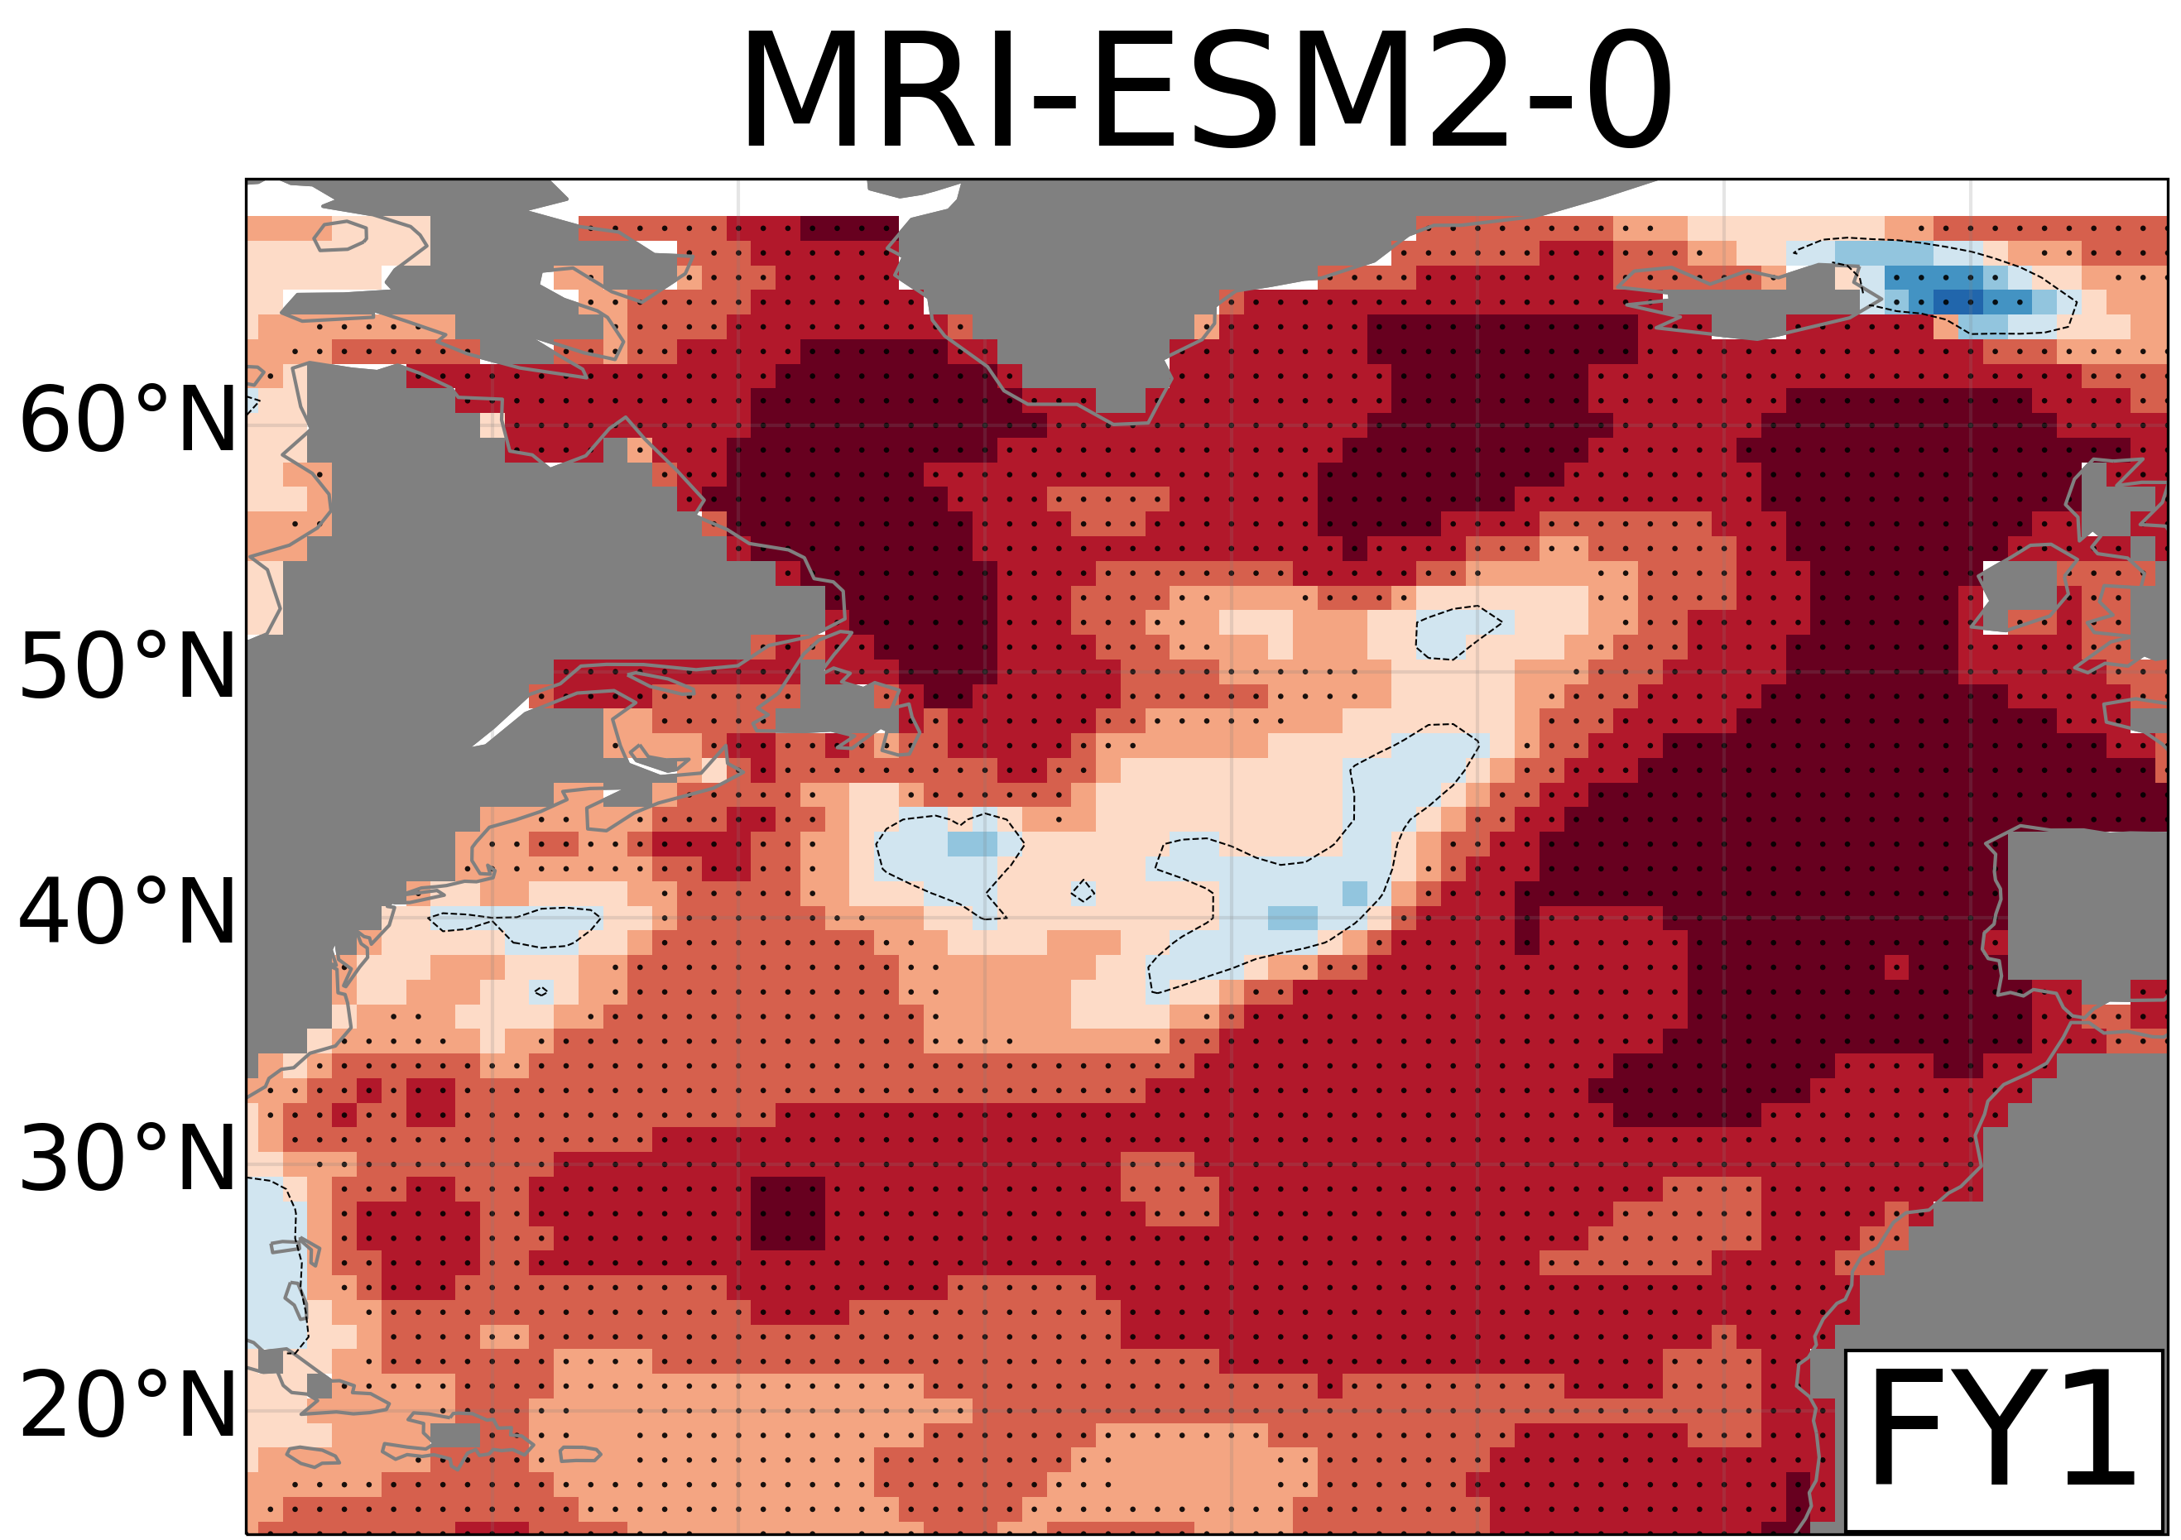
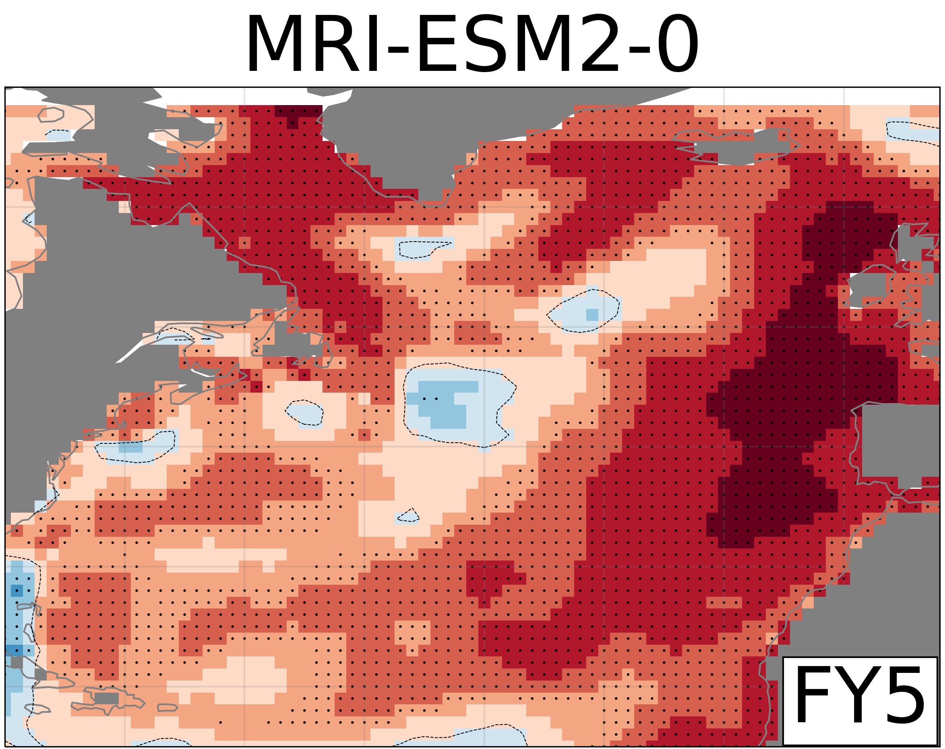
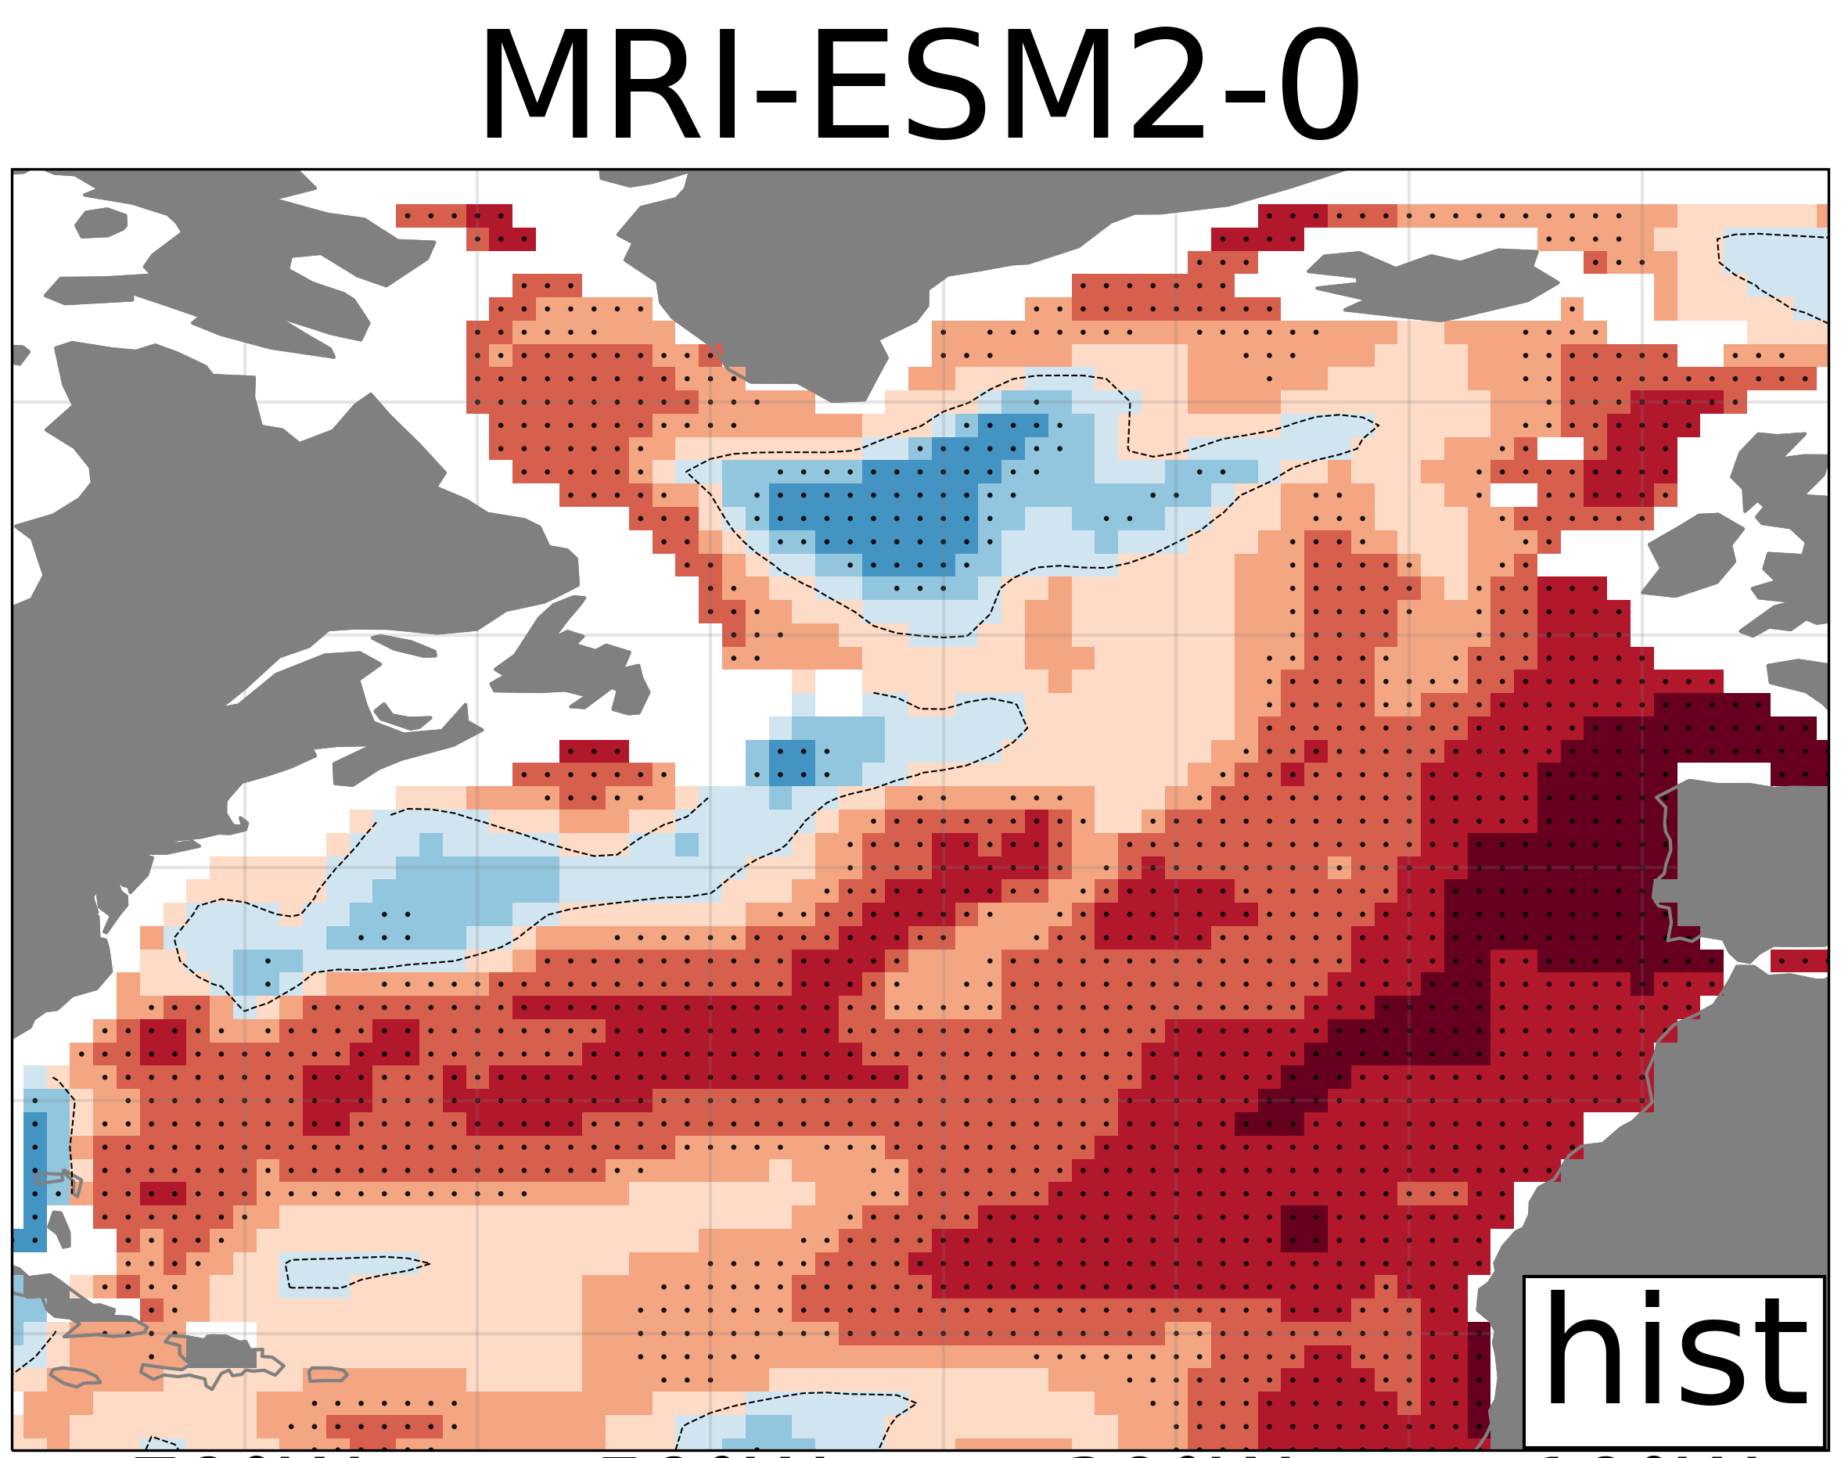
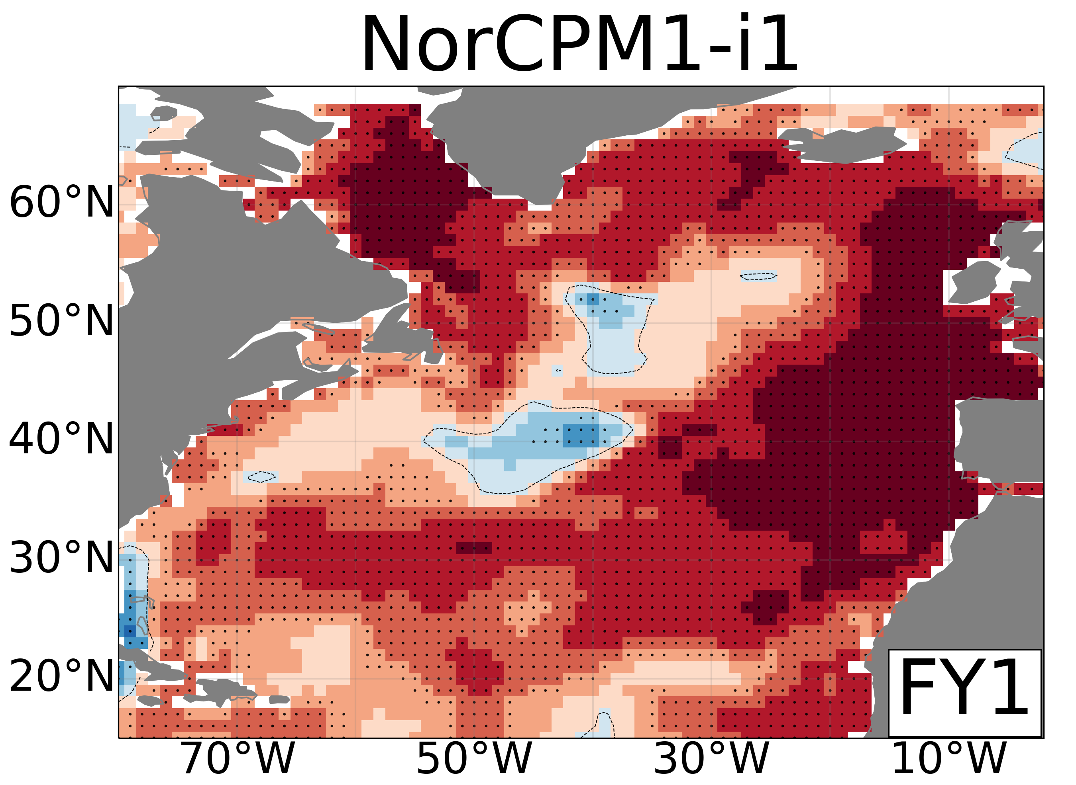
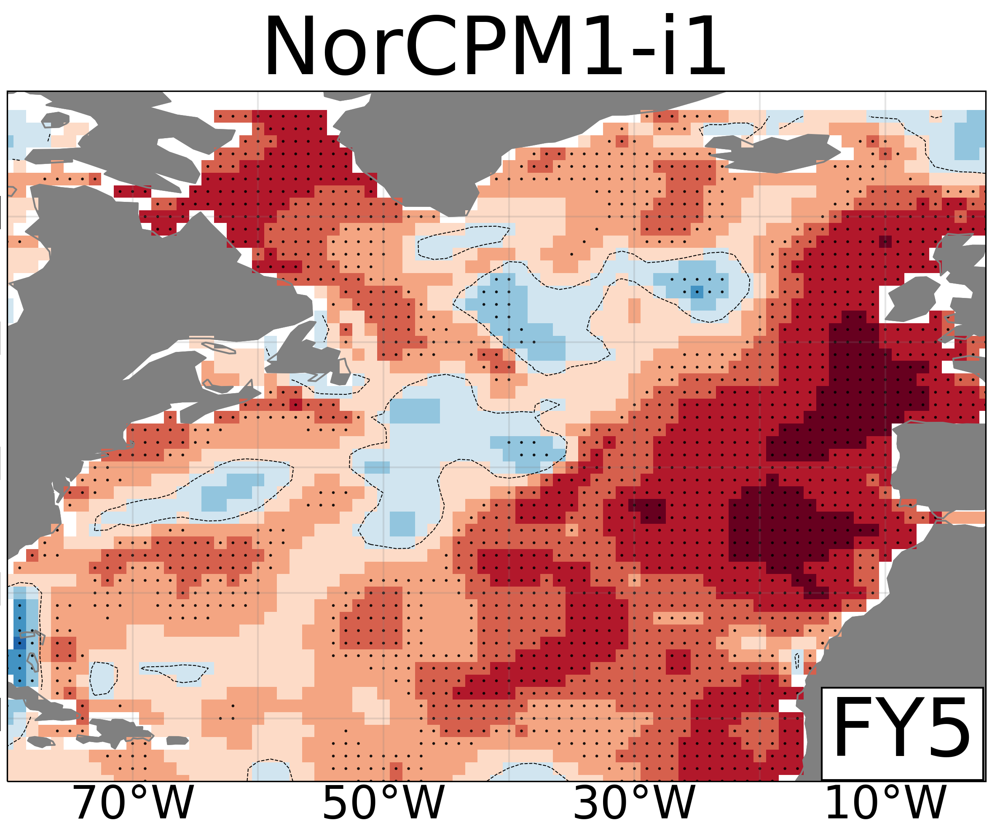
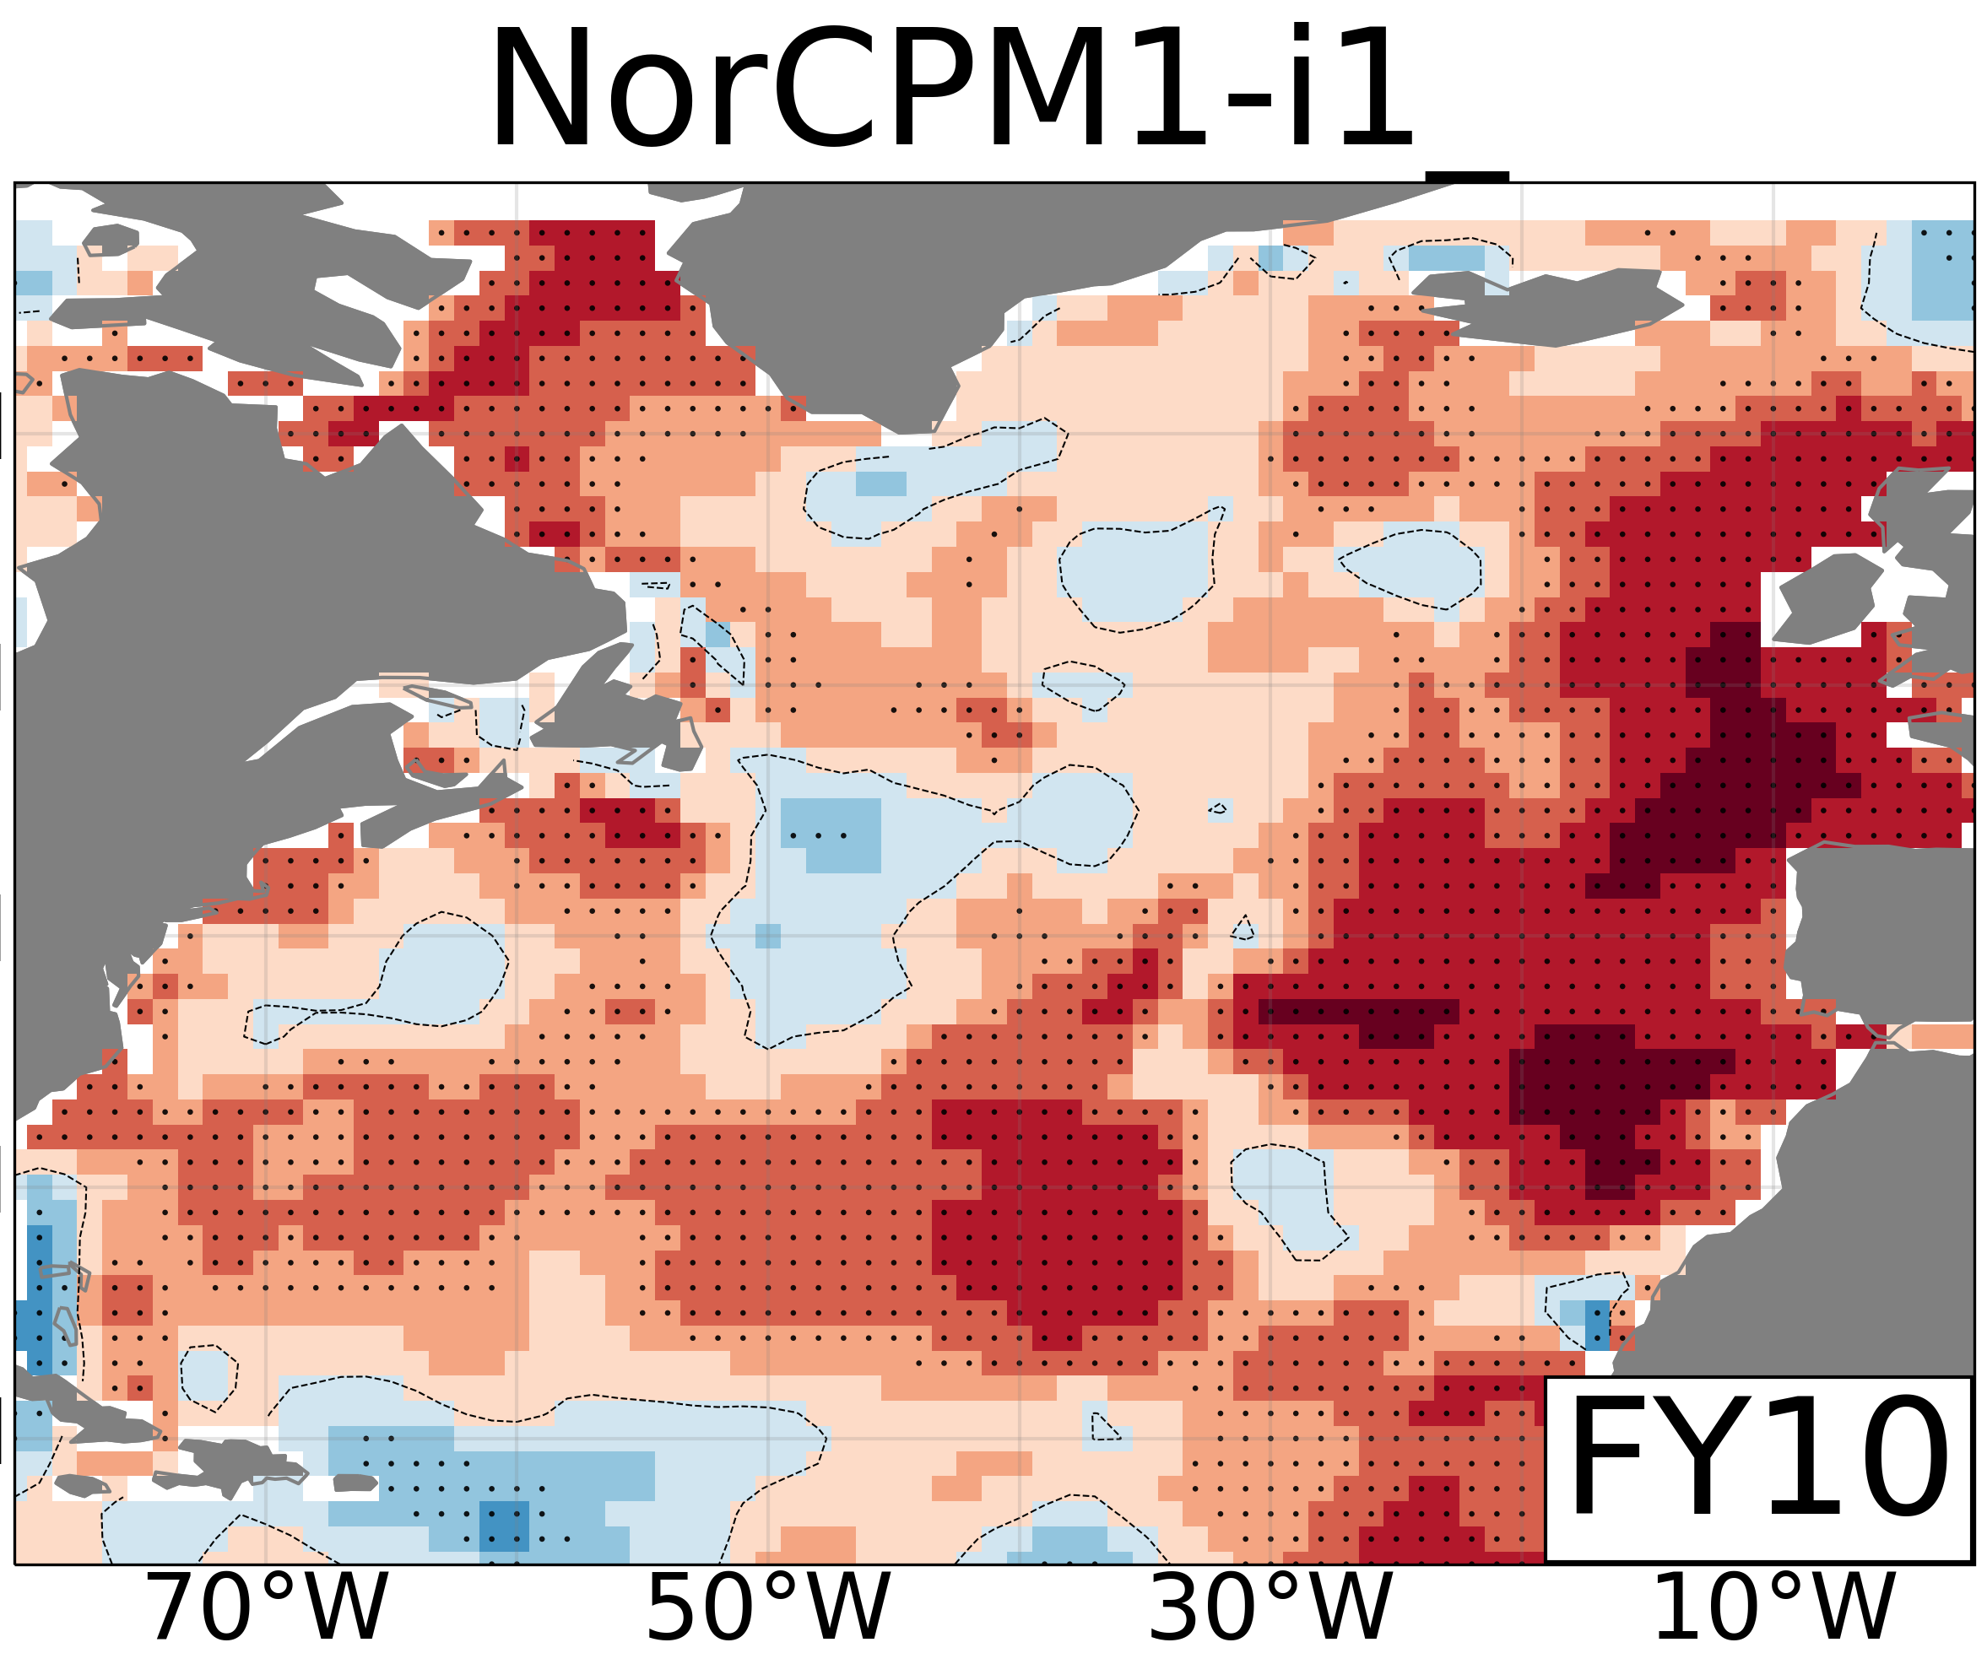
Predictive skill of OHC from 0-700m (Full Field Init.)
DCPP LY1
DCPP LY5
DCPP LY10
HIST
1.0
IPSL-CM6A
Study Period
1970-2014
0.8
0.6
0.4
MPI-ESM1-2
0.2
Anomaly Correlation Coefficient
0.0
-0.2
MRI-ESM2
In some models initialization can substantially change the simulated forced response
-0.4
-0.6
-0.9
NorCMP1
-1.0

Slide 9
Predictive skill of OHC from 0-700m (Full Field Init.)
DCPP LY1
DCPP LY5
DCPP LY10
HIST
1.0
IPSL-CM6A
Study Period
1970-2014
0.8
0.6
0.4
MPI-ESM1-2
0.2
Anomaly Correlation Coefficient
0.0
-0.2
MRI-ESM2
-0.4
-0.6
Models can largely disagree in the % of OHC variance that is externally forced
-0.9
NorCMP1
-1.0

Slide 10
Predictive skill of OHC from 0-700m (Full Field Init.)
DCPP LY1
DCPP LY5
DCPP LY10
HIST
1.0
IPSL-CM6A
Study Period
1970-2014
0.8
0.6
0.4
MPI-ESM1-2
0.2
Anomaly Correlation Coefficient
0.0
-0.2
MRI-ESM2
-0.4
-0.6
Important differences are also seen on the predictive skill of initialized predictions
-0.9
NorCMP1
-1.0

Slide 11
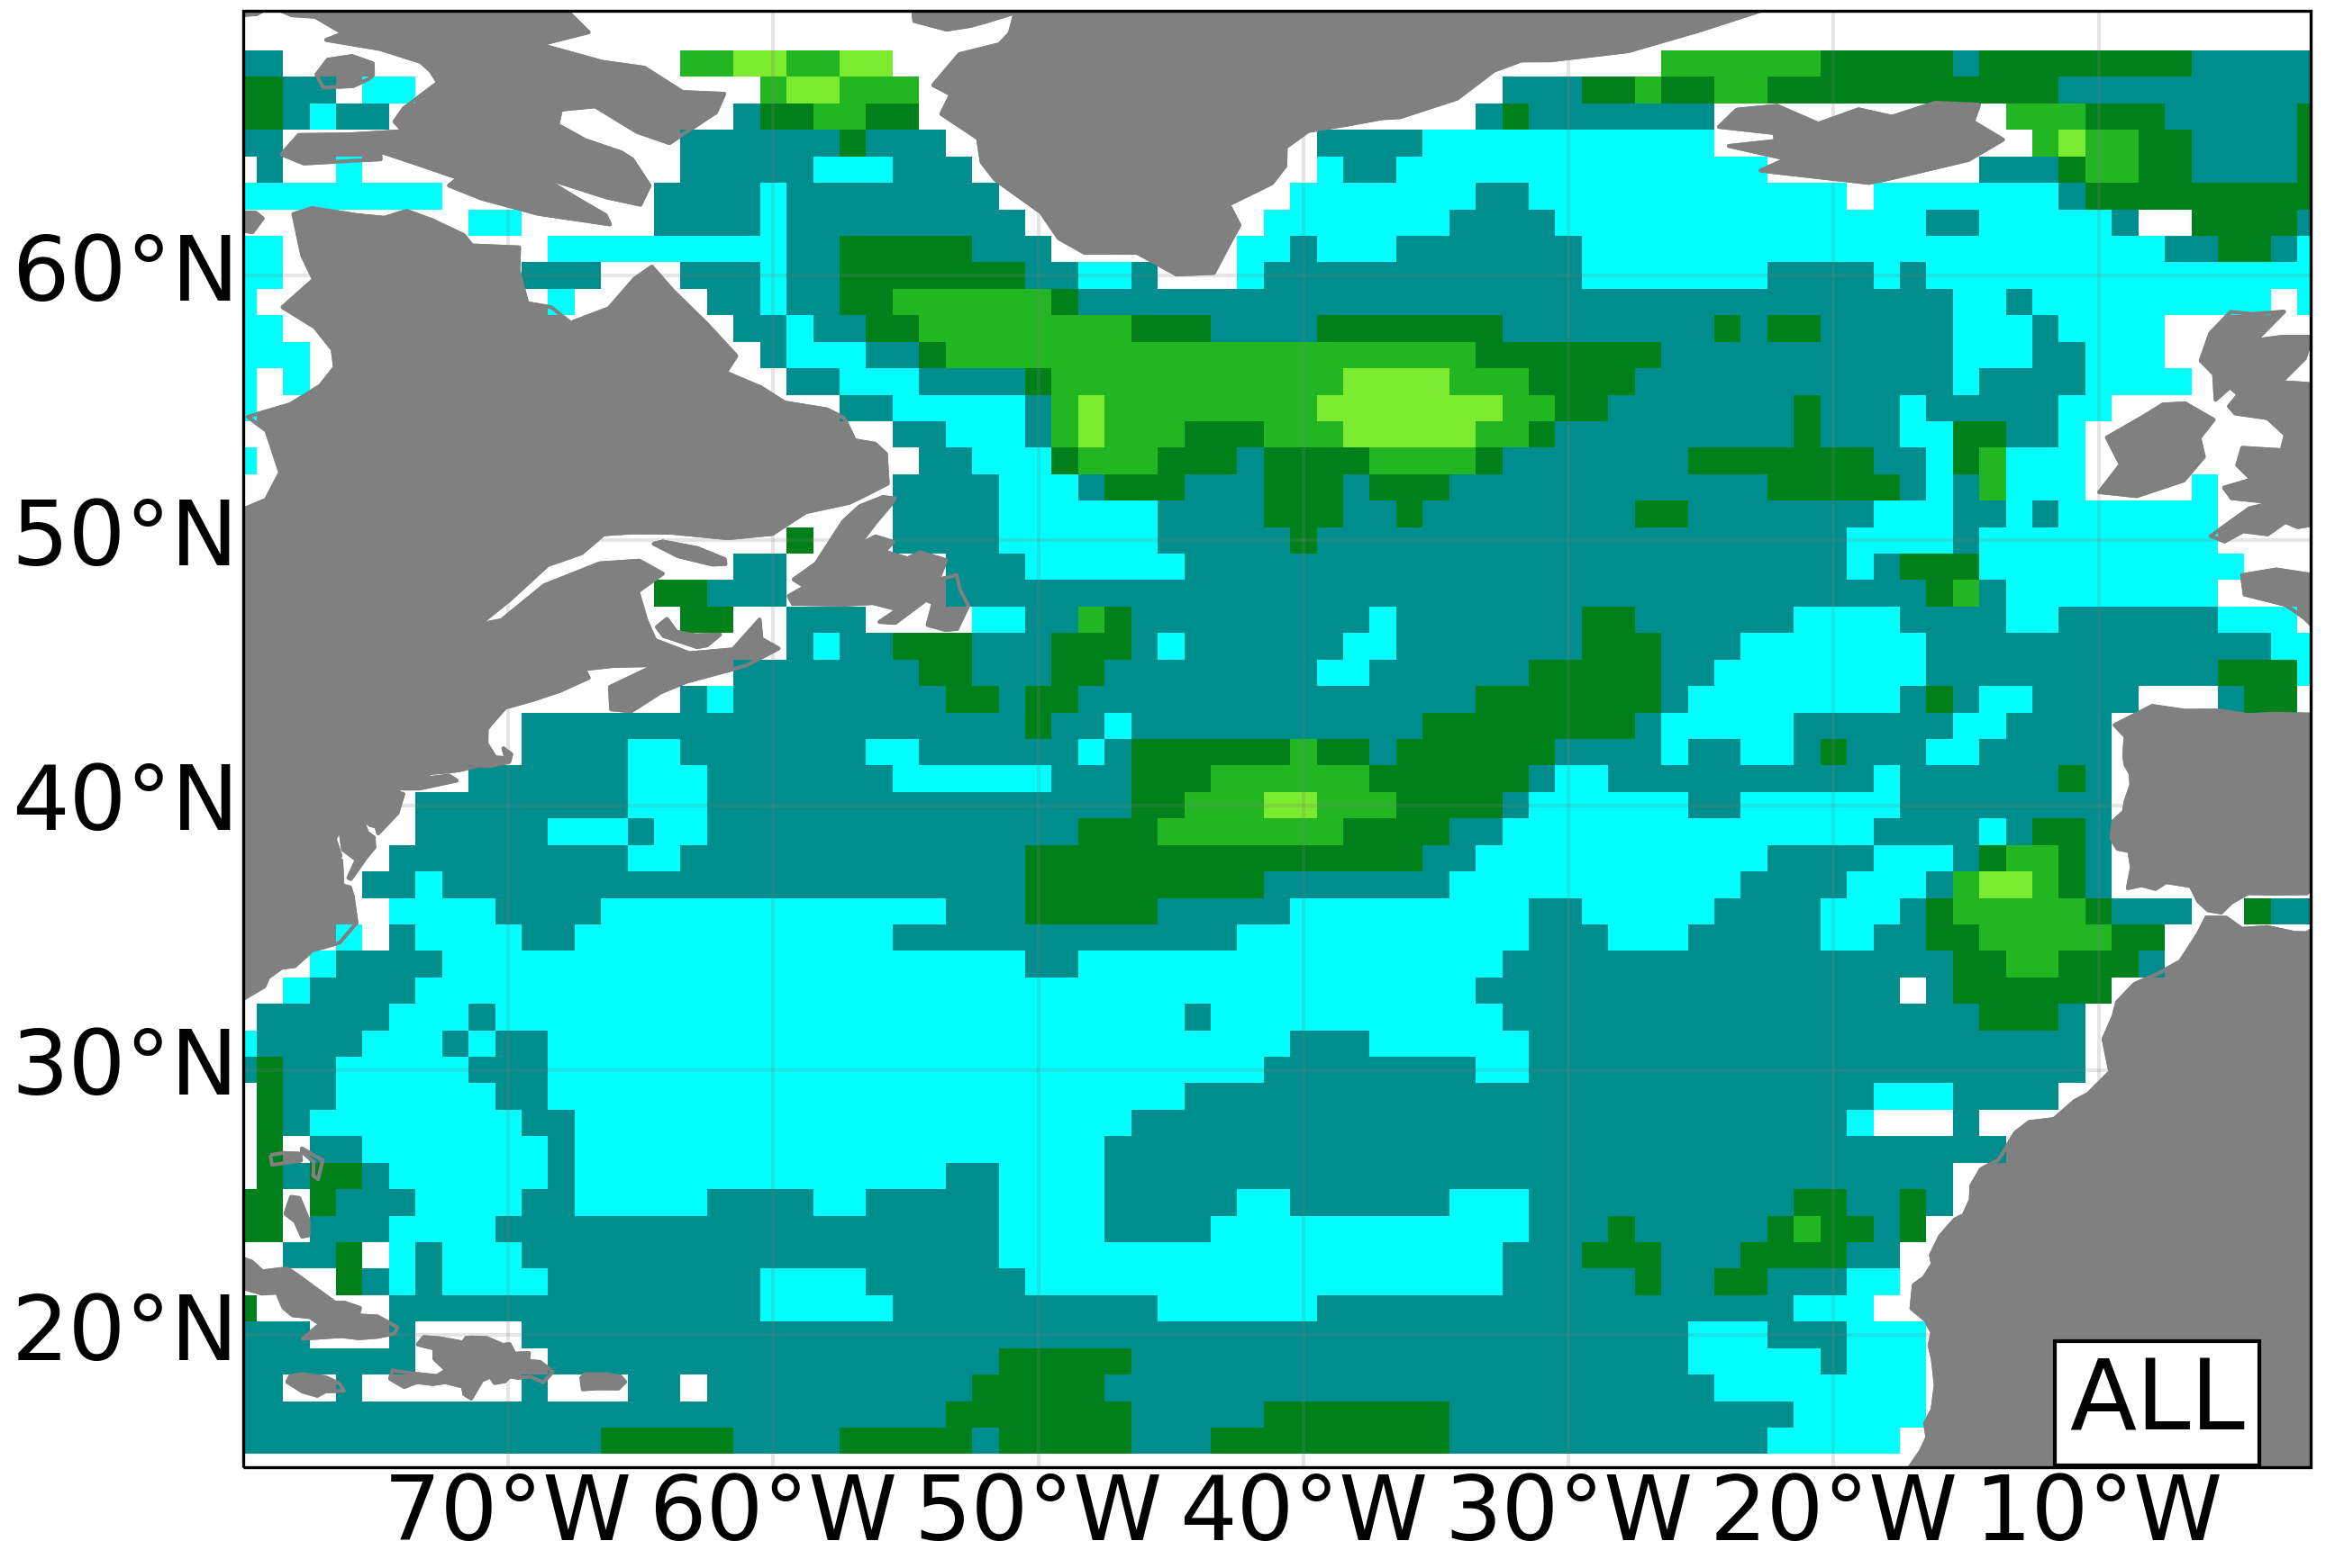
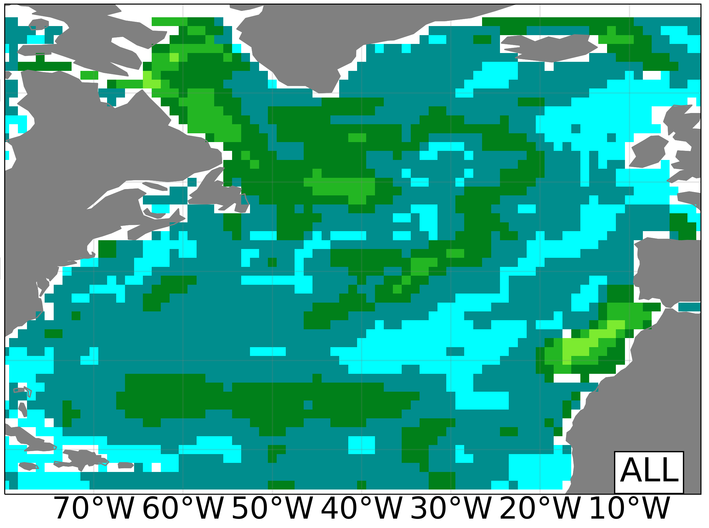
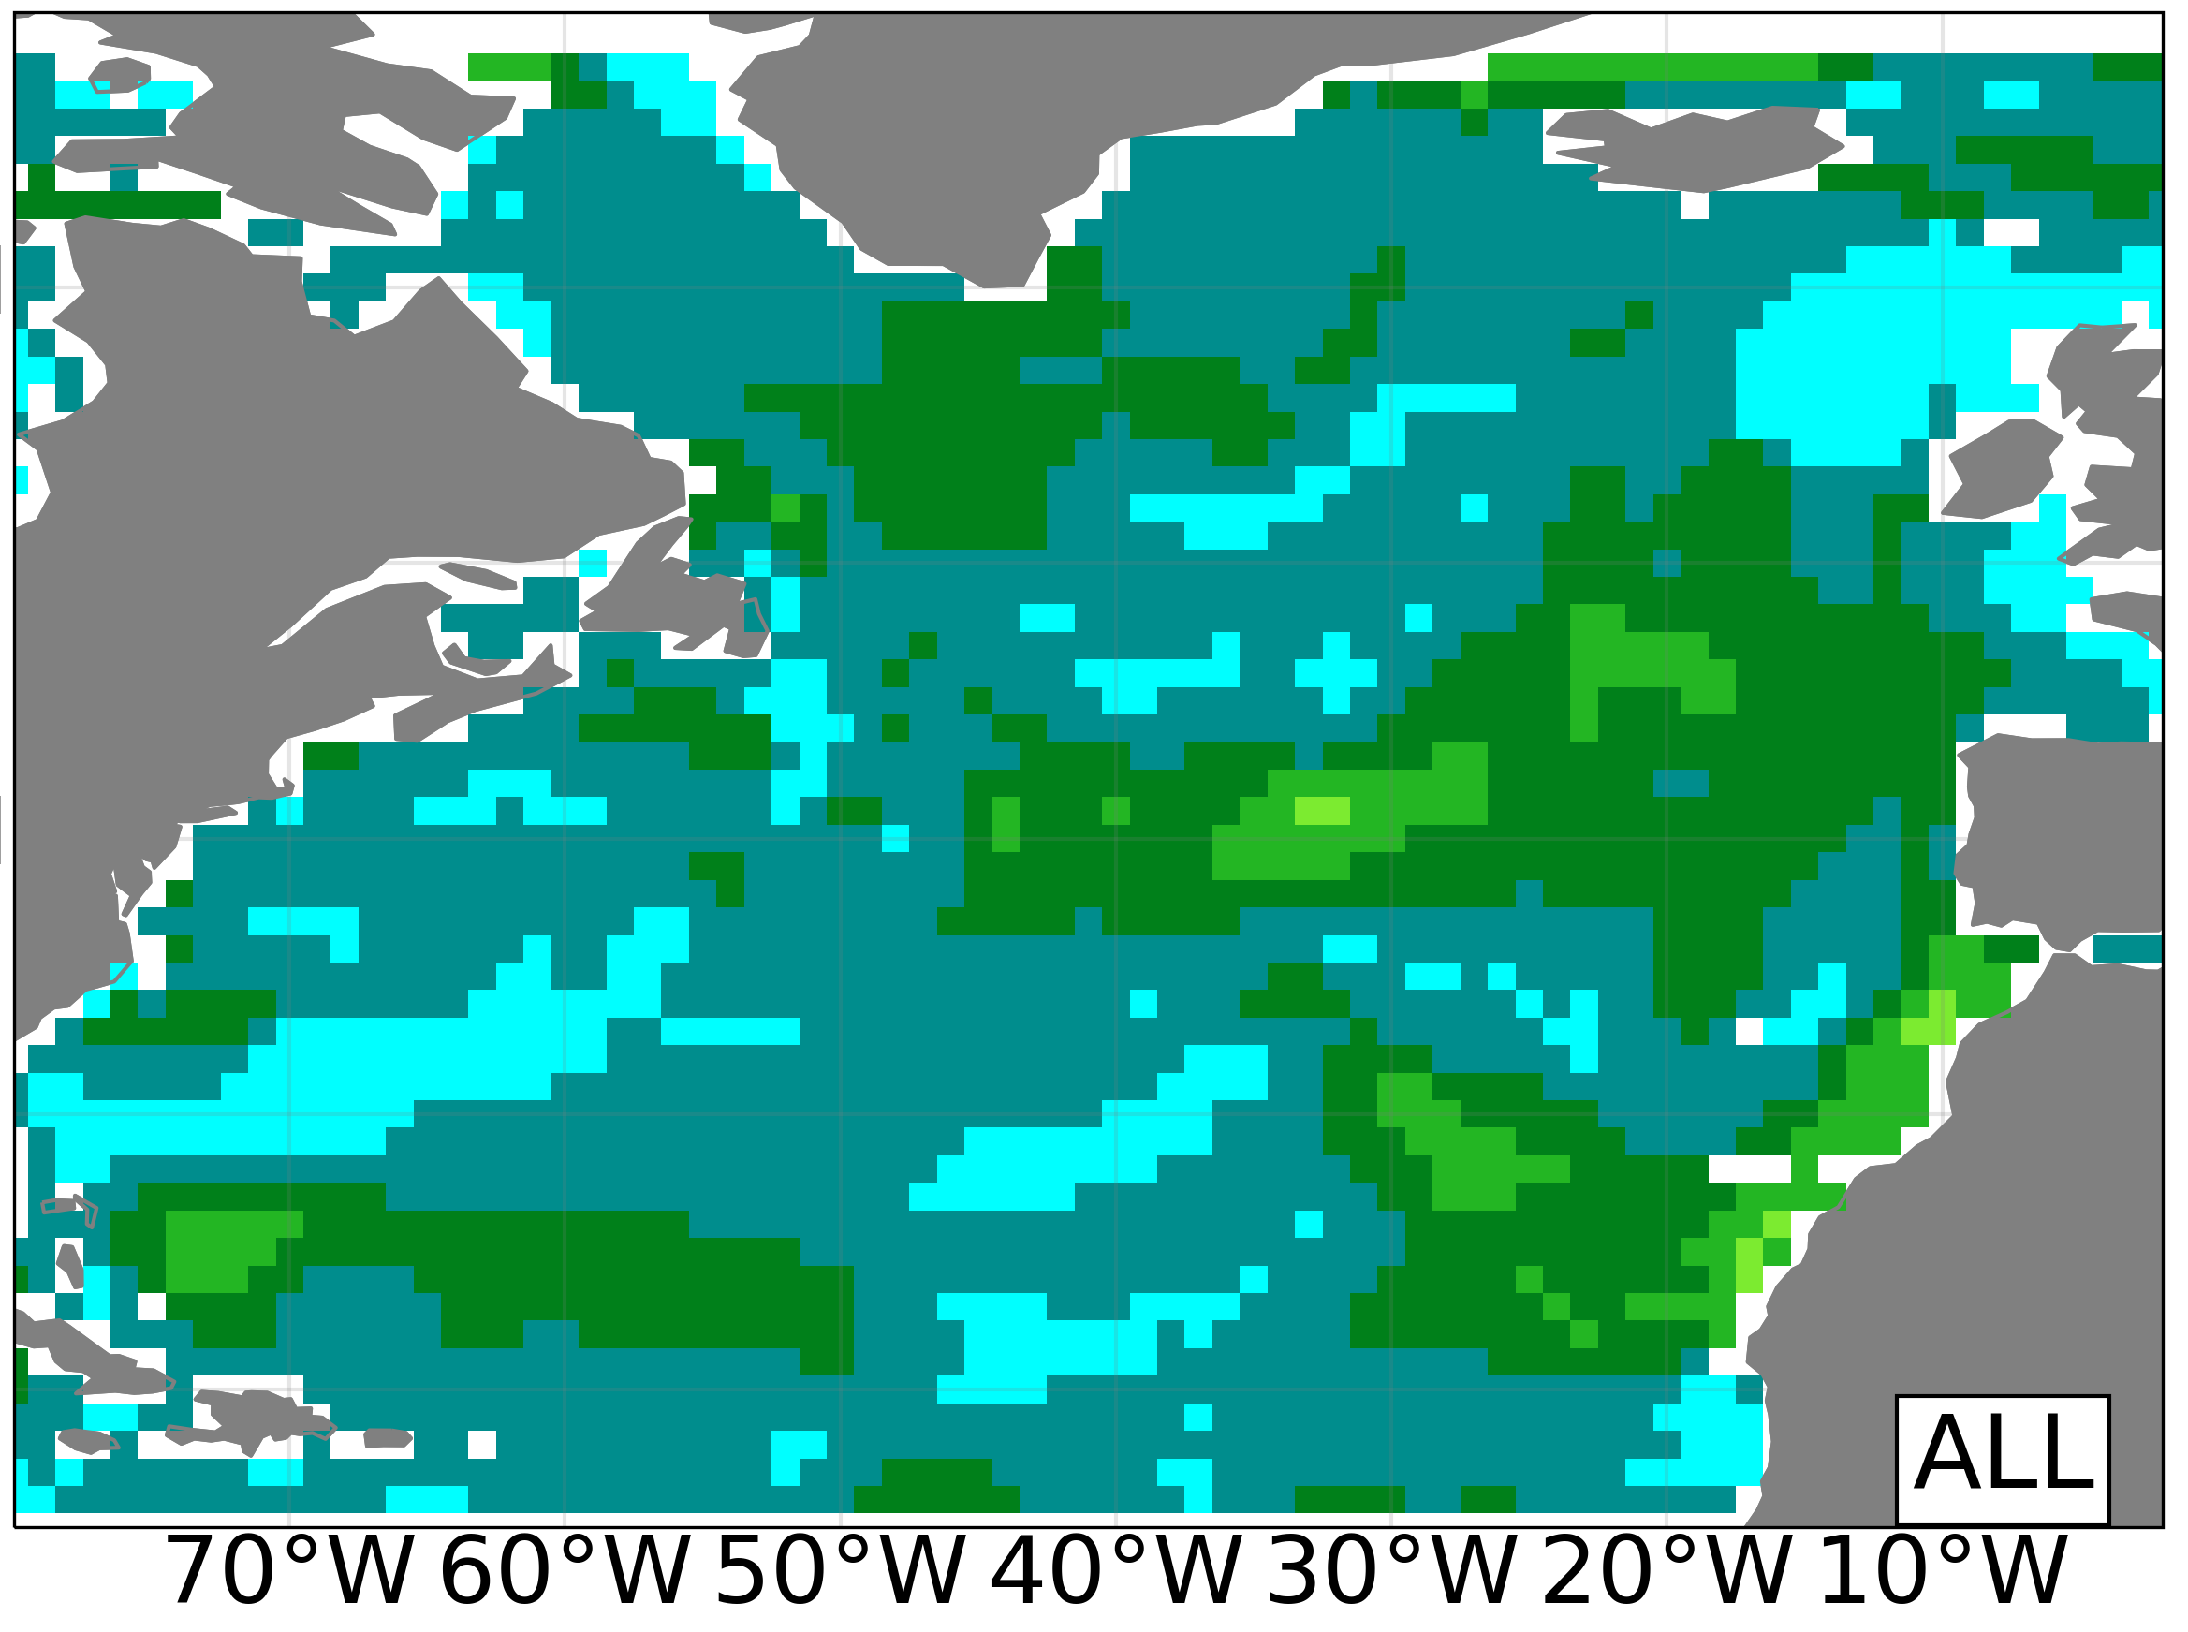
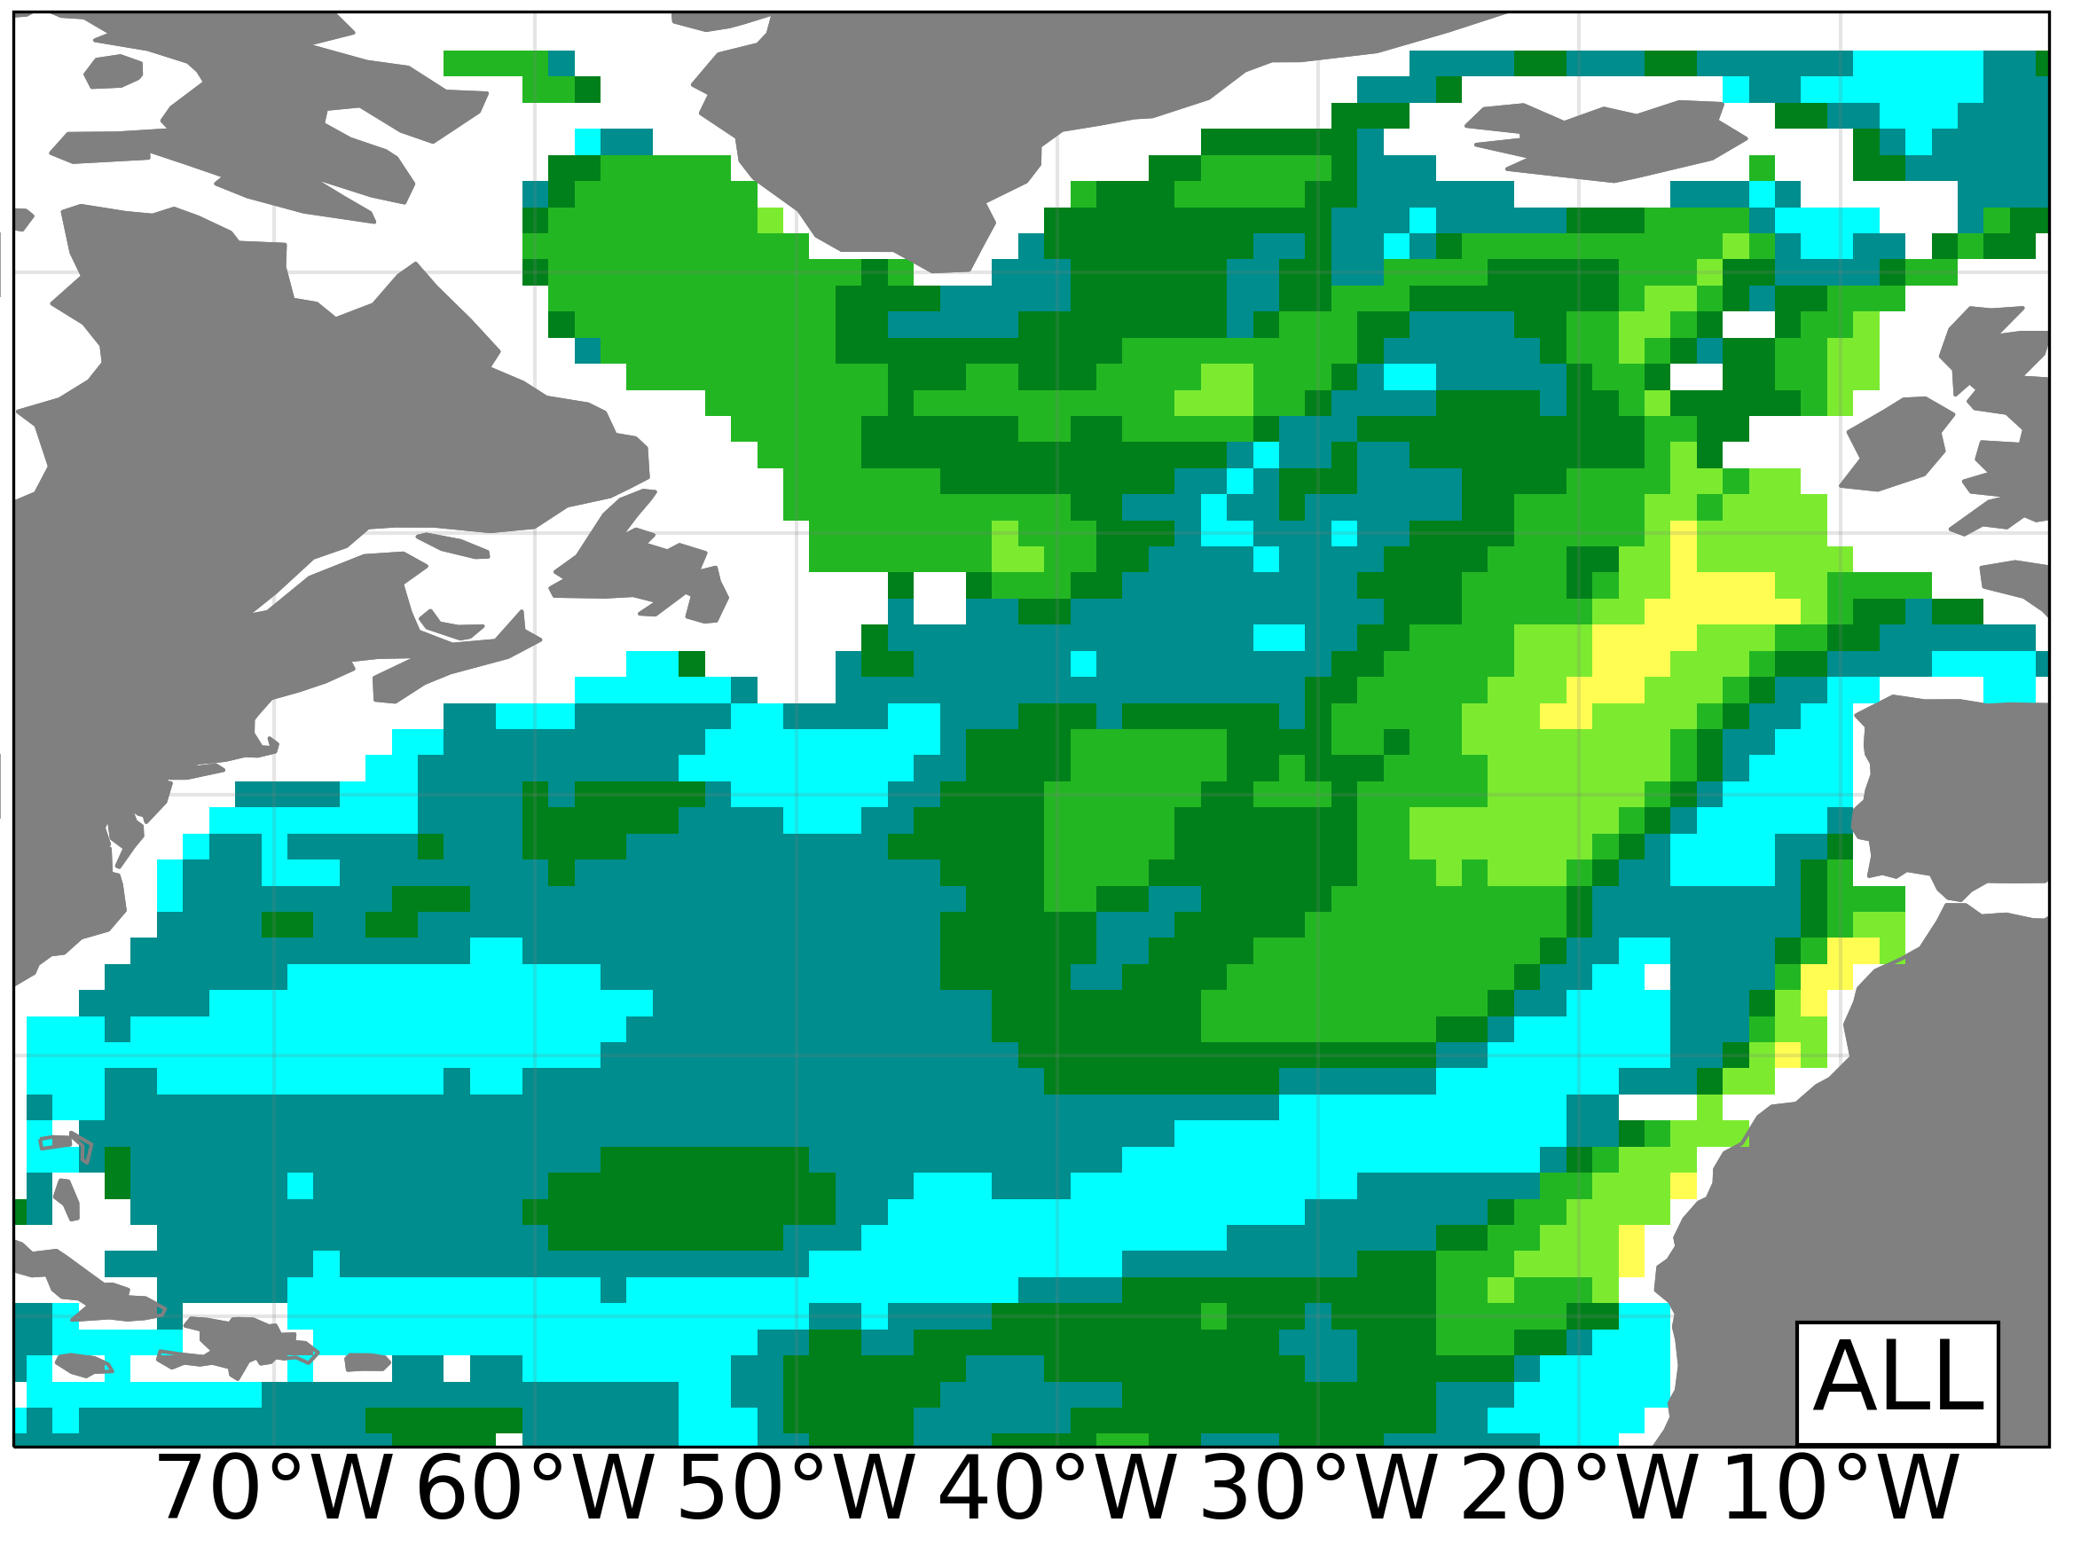
Inter-model differences in preditive skill of OHC700
Standard deviation across-models of the ACC for the OHC700
Study Period
1970-2014
DCPP LY1
DCPP LY5
DCPP LY10
HIST
MPI-ESM1-2
Standard deviation of ACC in model space
0.0
0.1
0.2
0.3
0.4
0.5
0.6
0.7
0.8
0.9
1.0
The Labrador Sea emerges as one of the regions with larger inter-model differences
Can we link those differences in skill to specific mean model properties?

Slide 12
Preconditioning role of Labrador Sea stratification
Mean Labrador Sea density (in DJF)as a function of forecast time
Study Period
1970-2014
DCPP LY1
DCPP LY5
DCPP LY10
HIST
Some differences in local skill might emerge from the fact that models like CanESM, IPSL and EC-Earth are too stratified while NorCPM1 shows barely no stratification

Slide 13
Preconditioning role of Labrador Sea stratification
Mean Labrador Sea density (in DJF)as a function of forecast time
Study Period
1970-2014
Mean Labrador Sea density stratification vs local OHC skill
1000 m – surface
DCPP LY1
DCPP LY5
DCPP LY10
HIST
Stronger stratification in Labrador Sea linked to more OHC variability explained by the forcings
Improving stratification via initialization does not necessarily lead to better OHC skill (e.g. CanESM)

Slide 14
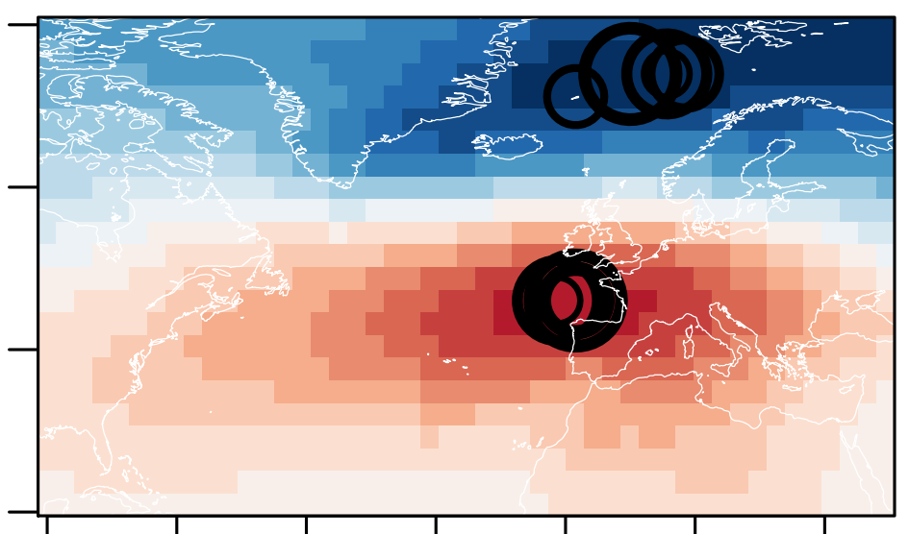
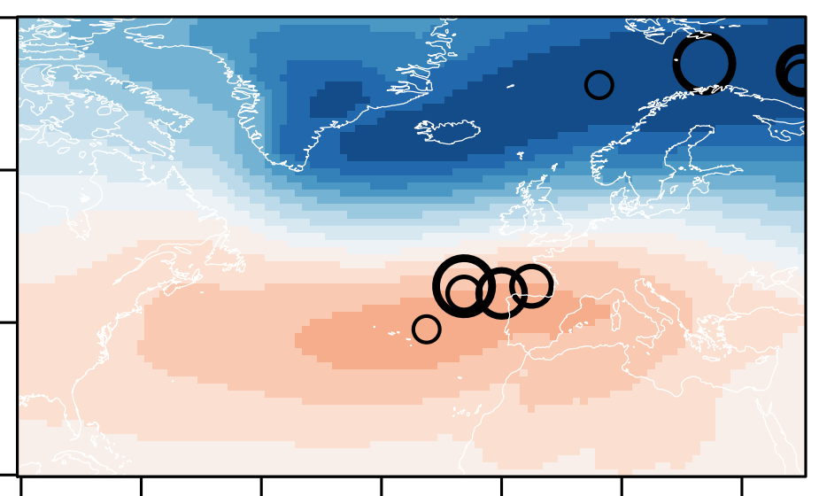
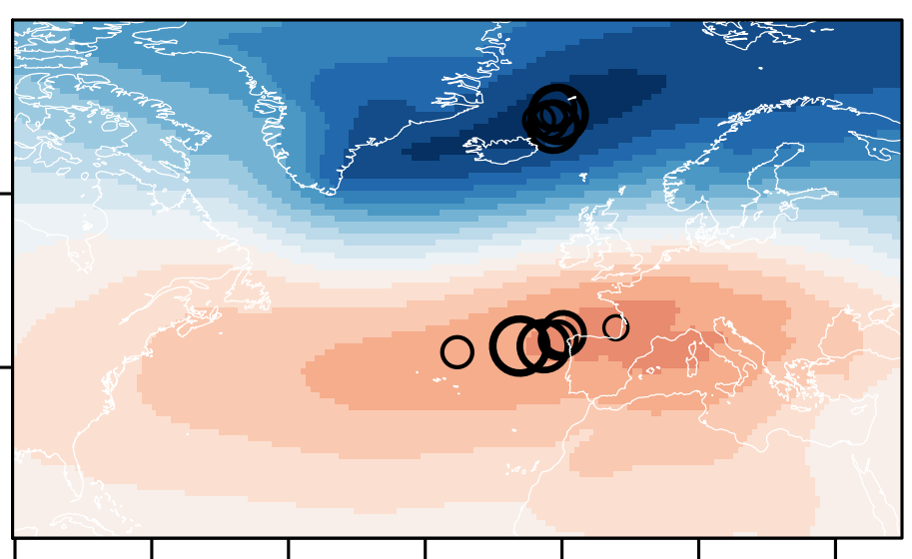
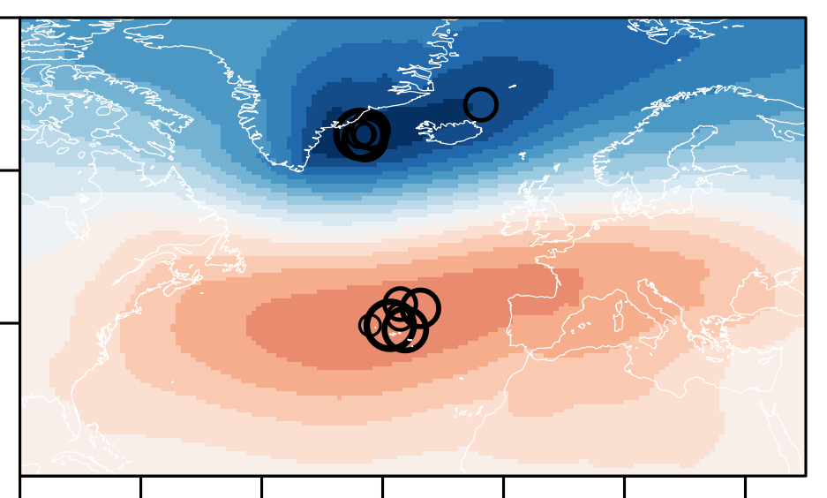
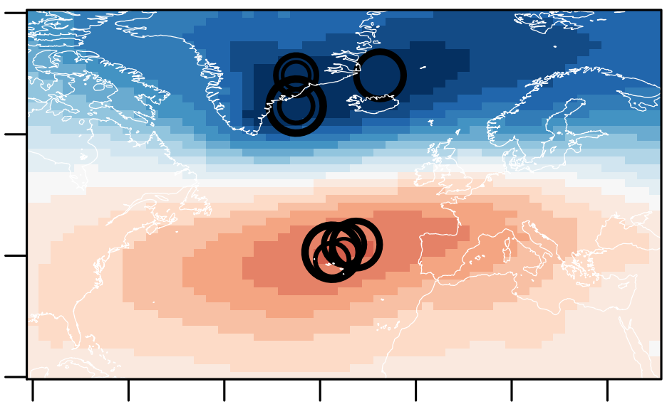
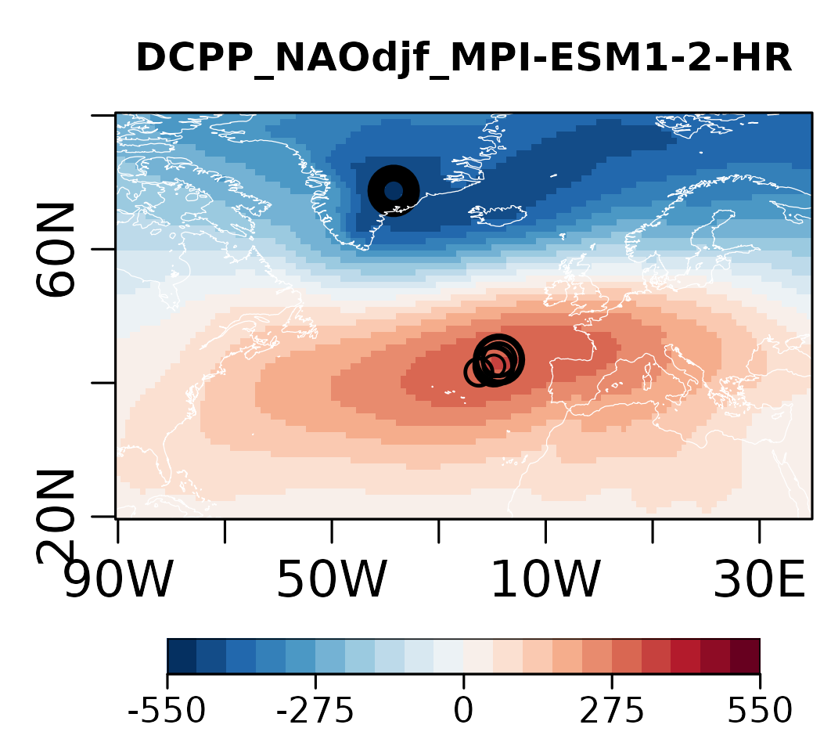
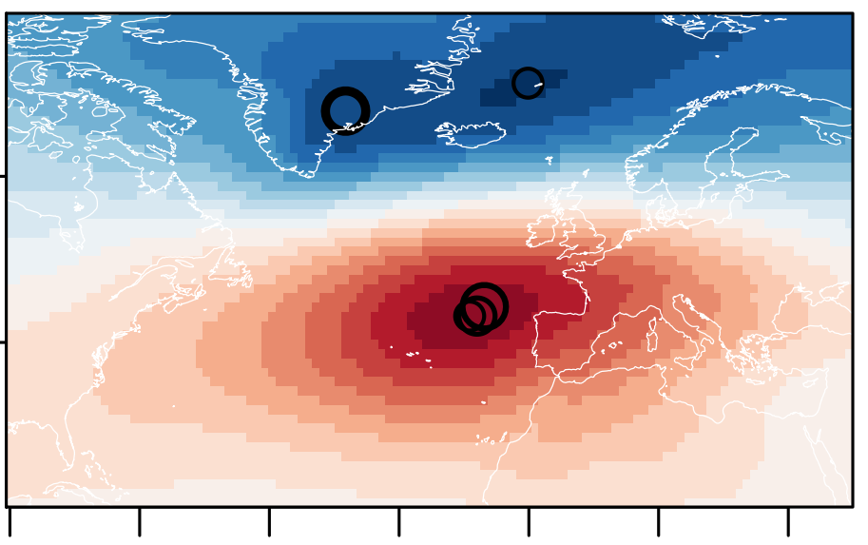
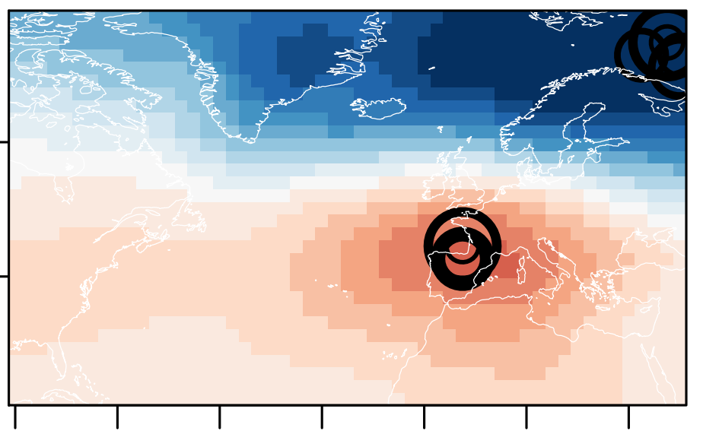
The NAO as a driver of local surface heat fluxes
NAO pattern as first EOF of DJF sea level pressure in the DCPP simulations
CanESM
CMCC-CM2
EC-Earth3
HadGEM3-GC31
IPSL-CM6A
MPI-ESM1-2
MRI-ESM2
NorCMP1
DCPP LY1
DCPP LY5
DCPP LY10
HIST
sea level pressure anomaly (in Pa)
-5.5
-2.75
0
2.75
5.5
The centres of action of the NAO do not experience major changes with forecast time
Notable inter-model differences can be found, in particular in the location of the low-pressure system

Slide 15
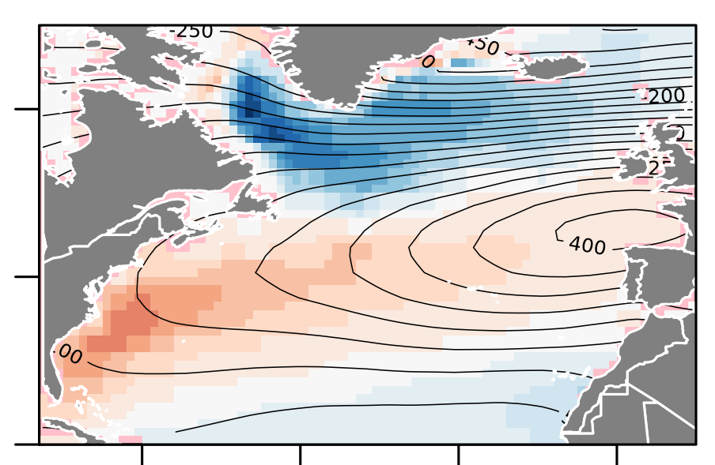
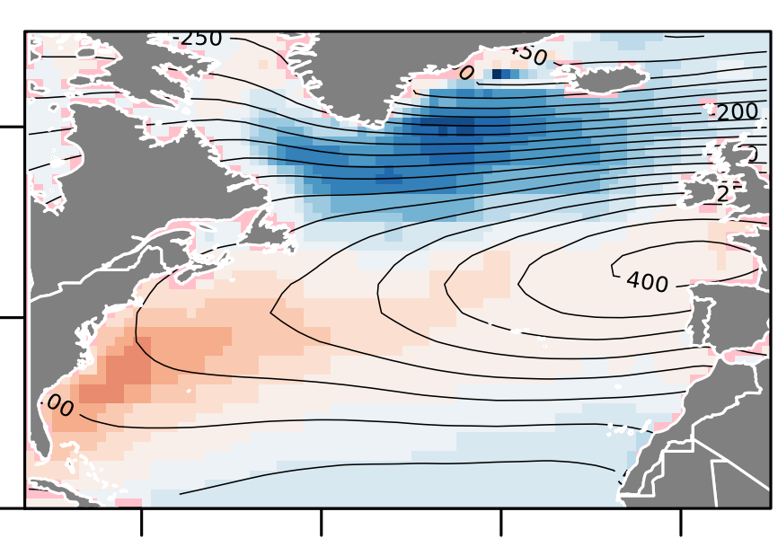
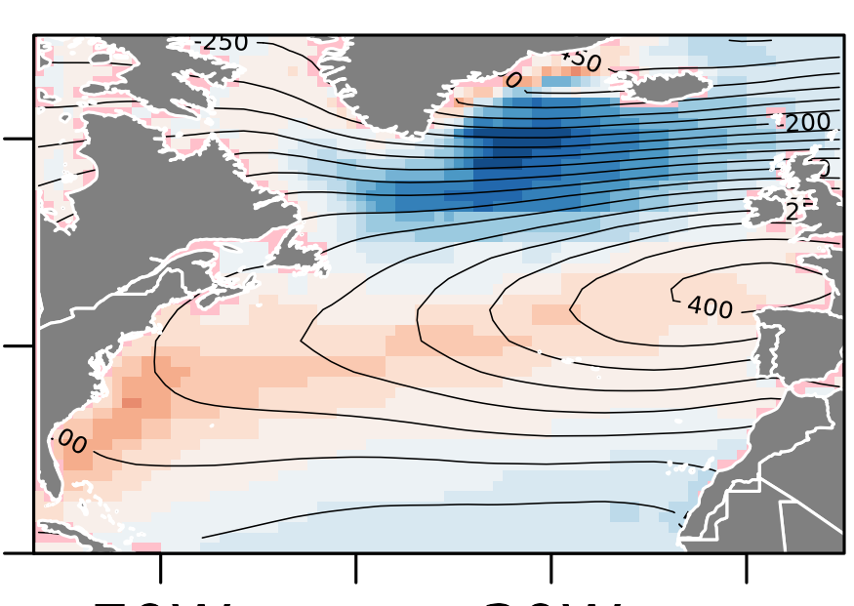
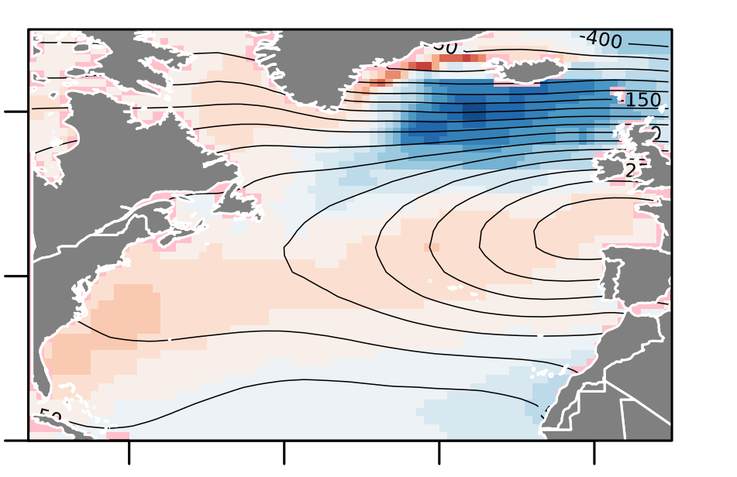
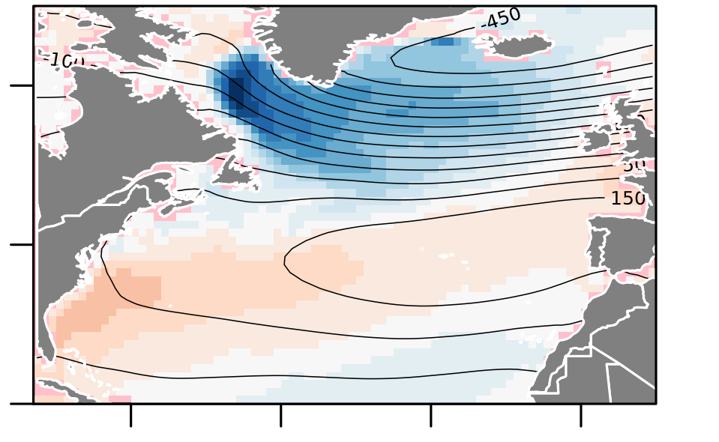
The NAO as a driver of local surface heat fluxes
Regression pattern NAO vs Surface Heat Fluxes
CanESM
50
Study Period
1970-2014
DCPP LY1
DCPP LY5
DCPP LY10
HIST
25
CMCC-CM2
0
Regression Coefficient (In W/m2)
EC-Earth3
DCPP LY5
DCPP LY10
HIST
-25
HadGEM3-GC31
-50
Despite the quasi-stationary location of its centres of action, the NAO forcing over Labrador Sea can change with forecast time, which could be due to the erosion of initial stratification conditions

Slide 16
The NAO as a driver of local surface heat fluxes
Regression pattern NAO vs Surface Heat Fluxes
IPSL-CM6A
50
Study Period
1970-2014
DCPP LY1
DCPP LY5
DCPP LY10
HIST
DCPP LY1
DCPP LY5
DCPP LY10
HIST
25
MPI-ESM1-2
0
Regression Coefficient (In W/m2)
MRI-ESM2
DCPP LY5
HIST
-25
NorCMP1
-50
As expected, this problem does not seem to affect the anomaly initialized predictions

Slide 17
Inter-model differences in the surface heat fluxes
Standard deviation across-models of the mean net surface heat fluxes (SHF)
DCPP LY1
DCPP LY5
DCPP LY10
HIST
Standard deviation in model space
0
40
80
120
160
Standard deviation across-models of NAO-driven SHFs
DCPP LY1
DCPP LY5
DCPP LY10
HIST
Standard deviation in model space
0
10
20
30
40

Slide 18
Take home messages
All models and forecast systems show high levels of predictive skill for North Atlantic OHC, although with important regional discrepancies, both in the forced and predictable signals.
Mean model properties in the Labrador Sea can explain some of the differences in OHC skill.
Mean Labrador Sea density stratification is a critical factor controlling how much of the simulated OHC variability is externally forced
Differences in the NAO regional expression could also contribute to the differences in skill, via changes in the surface heat fluxes, which can themselves be sensitive to the density stratification conditions

Slide 19
Other related features with inter-model differences
Standard deviation across-models of the ACC for the OHC700
DCPP LY1
DCPP LY5
DCPP LY10
HIST
MPI-ESM1-2
Standard deviation of ACC in model space
0.0
0.1
0.2
0.3
0.4
0.5
0.6
0.7
0.8
0.9
1.0
Standard deviation across-models of the mean sea ice concentration in DJF
Standard deviation of ACC in model space
0
3
6
9
12
15
18
21
24
27
30

Slide 20
CanESM5.FY1
FY5
FY10
HIST
CMCC-CM2-SR.FY1
FY5
FY10
HIST
FY5
FY10
HIST
EC-Earth3.FY1
HadGEM3-GC31-MM.FY1
FY5
FY10
HIST
IPSL-CM6A-LR.FY1
FY5
FY10
HIST
MPI-ESM1-2-HR.FY1
FY5
FY10
HIST
MRI-ESM2-0.FY1
FY5
HIST
NorCPM1.FY1
FY5
FY10
HIST

Slide 21
SeaIce-conc djf climatology for HIST

