Slide 1
Work on numerical precision in NEMO
Oriol Tintó Prims
PhD Candidate
4/04/2019
ESCAPE-2 VVUQ Workshop

Slide 2
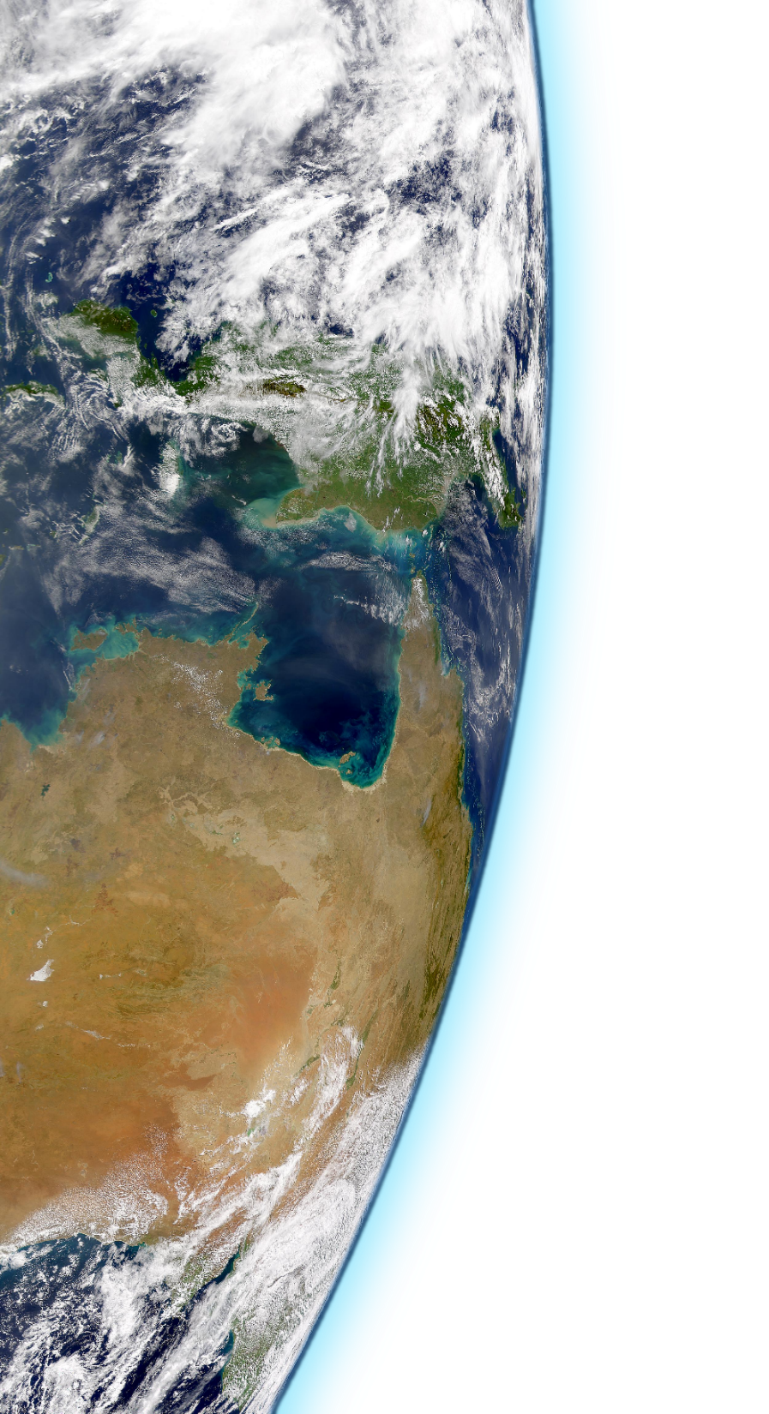
Outline
Introduction
Precision analysis algorithm
Verifying a modification
NEMO precision analysis!
Conclusions

Slide 3
Introduction

Slide 4
Motivation
Nowadays,
only computational models have the potential
to provide geographically and physically consistent estimates.
Source: @ed_hawkins
Notes:
Script:
What mainly motivates our work is the fact that the world is experiencing a global warming, the climate is changing and the consequences can be severe for the planet and the human-kind.
What can we do against it? Given the situation and our position as a scientists, we can have an impact by producing information that can be a game-changer. Reliable projections (what if?), analysis of impact (where it will hit harder), and anything useful to help adapt the climate change can be a driver for policy-making in the right direction. Only the computational models have the potential to produce geographically and physically consistent estimates. However, the models still have room for improvement and it is necessary to keep reducing the uncertainties.
(What a computational model tries to do is to resolve numerically the mathematical model associated to a physical reality. In the case of the ocean, we do have a mathematical model that describes how the water behaves (Navier-Stokes). However, although the model describes quite well how a fluid behaves, it is not straightforward to use them to describe the whole ocean. The equations have to be discretized and after that, a domain has to be described. In the ocean, there are flow features of different sizes, from large scale eddies that can reach thousands of kilometers to small scale turbulence. The smallest features that are relevant enough to be represented are of the order of 10⁻³ m and timescales of about 1 second. To represent the full ocean with a domain that could resolve these features, we would need to use 1.3 · 10²⁷ cells, more or less the same amount of atoms of a 2 year kid. Since it is (and will be for a long time) impossible, the modelers had to resort on parametrizations. The parametizations try to account for sub-grid scale effects using only grid-scale information and currently are one of the major sources of uncertainty. Increasing the resolution of the models, there are more phenomena that can be simulated explicitly and less parametrizations are required, potentially reducing the uncertainty of the models. Improving how the models use the computational resources, we will allow experiments that nowadays are impossible helping to push forward our knowledge about the ocean and about earth’s climate.)
During my thesis, I helped to improve the performance of the model in many different ways trying to approach the performance issues from different fronts. At 2016 we learned about the work done at ECMWF regarding the use of single precision for IFS simulations and it was clear that a similar approach for NEMO had a lot of potential.
After some experiments blindly-moving all model variables to single precision, we saw that sadly the trivial path was degrading the quality of the simulations beyond what is acceptable.
We decided then that we should find a way to exploit mixed-precision safely.
To do so, we developed a method to identify which variables can effectively use reduced precision and which ones need to keep the double-precision.
The method relies on a tool called reduced precision emulator that (with significant work) allows us to simulate the effect of reducing the precision.
Basically, the method consists in three steps:
Define an accuracy test: Is this simulation accurate?
Implement the emulator into the code: automatize it or it won’t happen.
Scan the variables: algorithm to find an optimal set.
Accuracy test: ?
Implementing the emulator: we want a version of the code where we can specify the precision of each variable through a namelist.
Doing so, we can directly compare the obtained results and determine if a specific set breaks the model or not.
Scan algorithm: ~O(3) variables that are not completely independent between them. Divide and conquer approach, with downscaling and multi-evaluation.
Results: Using the method in NEMO the results are awesome.
Conclusions: The method works and the potential is great for other ocean-models and precisions too.

Slide 5
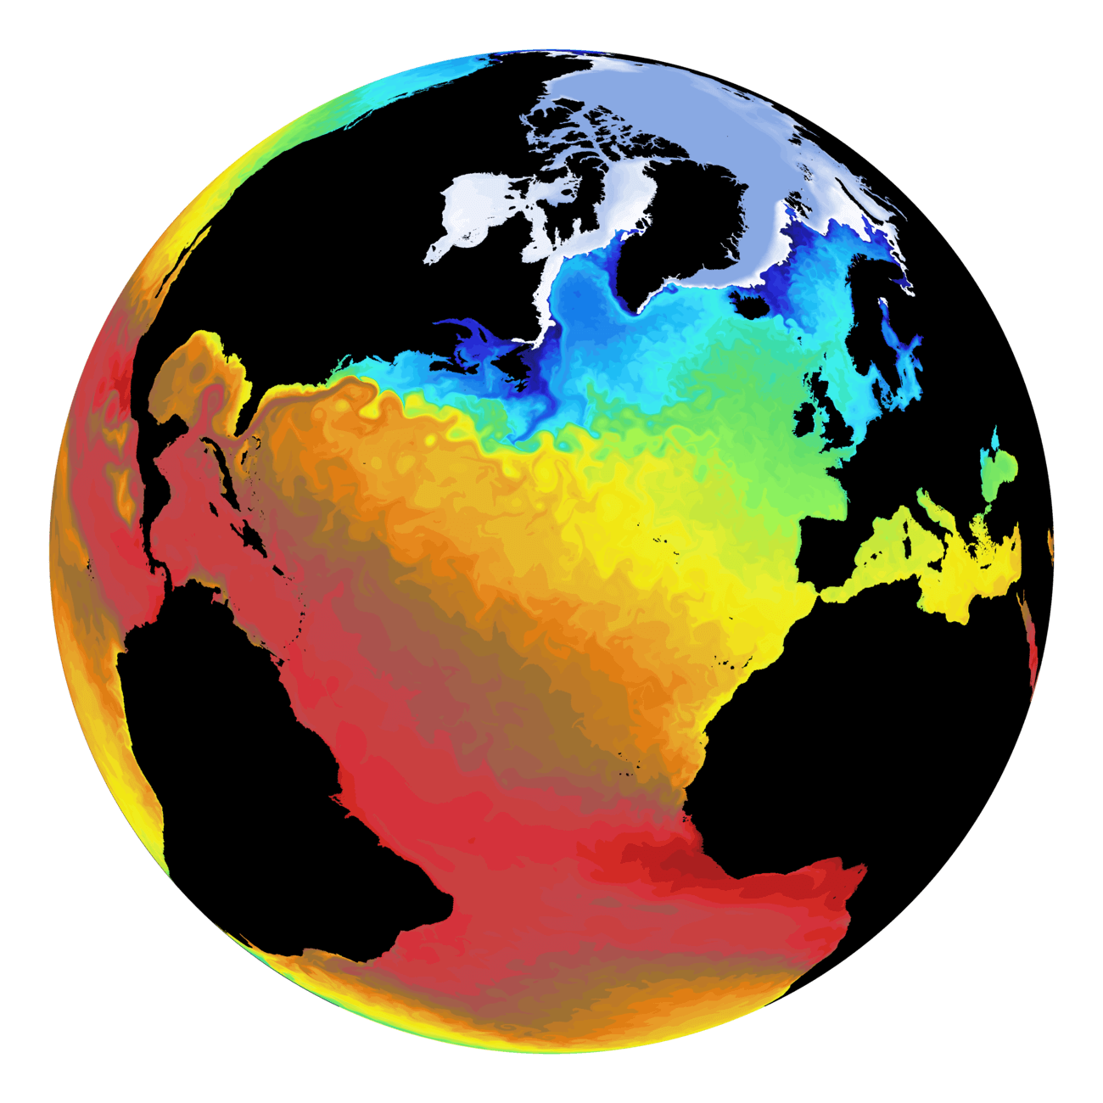
Nucleus for European Modeling of the Ocean (NEMO) is a state-of-the-art global ocean model
It is used in oceanographic research, operational oceanography, seasonal forecast and climate studies
The objective of my thesis:
Improve model’s capacity to exploit modern supercomputers.
Sea Surface Temperature
Current Velocity

Slide 6
Motivation
We want to make models faster and cheaper to:
... reduce costs.
...allow new kinds of experiments.
... better use the available resources.
... make better science!

Slide 7
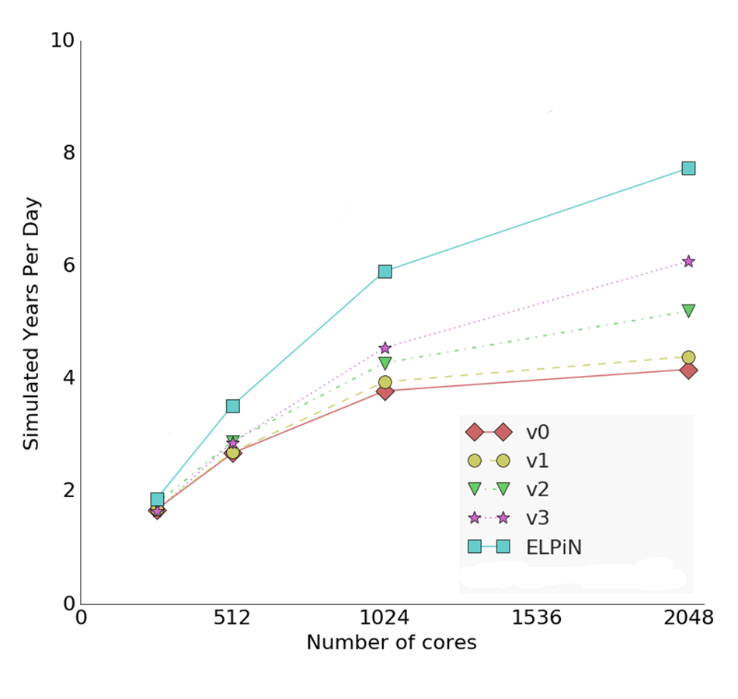
Motivation
Previous work:
Impact on ORCA 1/4 NEMO 3.6 – LIM3 running on Marenostrum 3
~ 2x

Slide 8
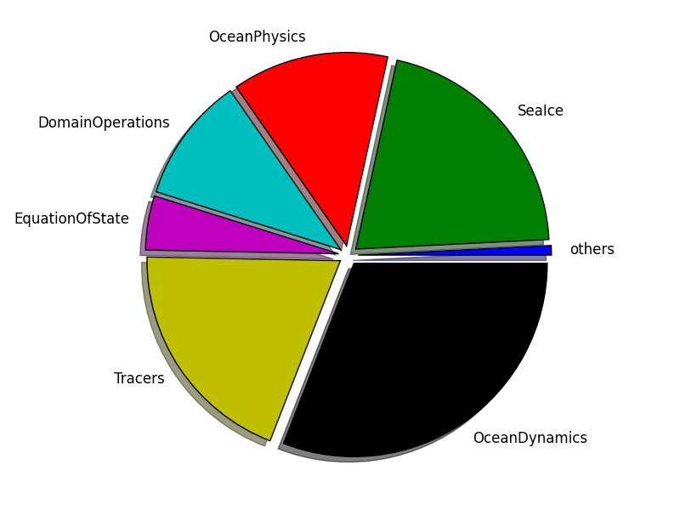
Why mixed precision?
MIXED PRECISION
We need something that can
benefit the whole code

Slide 9
Why mixed-precision has appeared as a performance opportunity?
How was the situation?
Reticence to use less precision.
64-bit arithmetic performance was comparable to 32-bit performance.

Slide 10
Risks of low precision
source: http://www-users.math.umn.edu/~arnold/disasters/ariane.html

Slide 11
Why mixed-precision has appeared as a performance opportunity?
What changed now?
Lower precision – better performance
Vendors turning to half-precision arithmetic due to the ML hype.

Slide 12
What does it mean?
There are smart strategies to use less precision to solve problems that originally required higher precision.
Many times, that’s not even necessary because the higher precision is not required in the first place.
In Earth System models, few alternatives can provide benefits of the same magnitude for the same amount of effort.
We can benefit from reduced precision performance if we learn how to “safely” use less precision

Slide 13
How we can do that?
Being able to verify the results
Being able to use the reduced precision emulator in the full model
Perform a precision analysis!

Slide 14
Precision Analysis Algorithm

Slide 15
Analysis Algorithm
Basic ideas:
If we are able to launch simulations using reduced precision, we can directly evaluate the impact it has on the outputs.
If we can find a way to easily change the precision used by each real variable, we can develop an automatic algorithm to find out which variables can use reduced precision and which ones need to keep high-precision.

Slide 16
Analysis Algorithm
[0 1 2 3 4 5 6 7 8 9]

Slide 17
Analysis Algorithm
[0 1 2 3 4 5 6 7 8 9]
[0 1 2 3 4]
[5 6 7 8 9]

Slide 18
Analysis Algorithm
[0 1 2 3 4 5 6 7 8 9]
[0 1 2 3 4]
[5 6 7 8 9]
[0 1 2]
[3 4]

Slide 19
Analysis Algorithm
[0 1 2 3 4 5 6 7 8 9]
[0 1 2 3 4]
[5 6 7 8 9]
[0 1 2]
[3 4]
[3]
[4]

Slide 20
Analysis Algorithm
[0 1 2 3 4 5 6 7 8 9]
[0 1 2 3 4]
[5 6 7 8 9]
[0 1 2]
[3 4]
[3]
[4]

Slide 21
Analysis Algorithm
[0 1 2 3 4 5 6 7 8 9]
[0 1 2 3 4]
[5 6 7 8 9]
[0 1 2]
[3 4]
[3]
[4]

Slide 22
Analysis Algorithm
[0 1 2 3 4 5 6 7 8 9]
[0 1 2 3 4]
[5 6 7 8 9]
[0 1 2]
[3 4]
[3]
[4]

Slide 23
Analysis Algorithm
[0 1 2 3 4 5 6 7 8 9]
[0 1 2 3 4]
[5 6 7 8 9]
[0 1 2]
[3 4]
[3]
[4]

Slide 24
Analysis Algorithm
[0 1 2 3 4 5 6 7 8 9]
[0 1 2 3 4]
[5 6 7 8 9]
[0 1 2]
[3 4]
[3]
[4]

Slide 25
Analysis Algorithm
[0 1 2 3 4 5 6 7 8 9]
[0 1 2 3 4]
[5 6 7 8 9]
[0 1 2]
[3 4]
[3]
[4]
Variable 4 must be kept in double-precision.
More info: How to use mixed precision in ocean models. https://www.geosci-model-dev-discuss.net/gmd-2019-20/

Slide 26
Analysis Algorithm
[0 1 2 3 4 5 6 7 8 9]
[0 1 2 3 4]
[5 6 7 8 9]
[0 1 2]
[3 4]
[3]
[4]

Slide 27
Analysis Algorithm
[0 1 2 3 4 5 6 7 8 9]
[0 1 2 3 4]
[5 6 7 8 9]
[0 1 2]
[3 4]
[3]
[4]

Slide 28
Analysis Algorithm
[0 1 2 3 4 5 6 7 8 9]
[0 1 2 3 4]
[5 6 7 8 9]
[0 1 2]
[3 4]
[3]
[4]
Variables 0-4 must be kept in double-precision.

Slide 29
Validating a simulation

Slide 30
Validating a simulation

Slide 31
Verifying a simulation

Slide 32
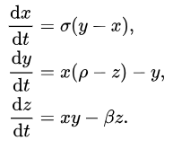
Verifying a non-linear model:
a simple example
A simple example:
Lorenz system

Slide 33
Verifying a non-linear model:
a simple example
https://drive.google.com/open?id=1FeVlOX4DL8GlXAAKdAPytQCQgNFdNJ5H

Slide 34
Verifying a non-linear model:
a simple example
https://drive.google.com/open?id=14H-2dsZl0zkcGcxiaFIBnMAUdo5kuqHO

Slide 35
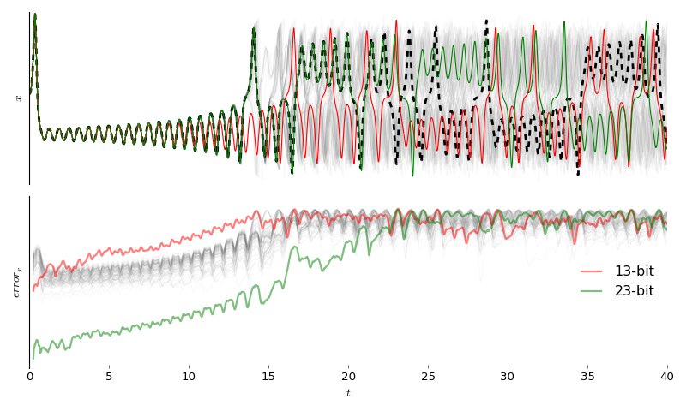
Verifying a non-linear model:
a simple example

Slide 36
NEMO
Precision Analysis

Slide 37
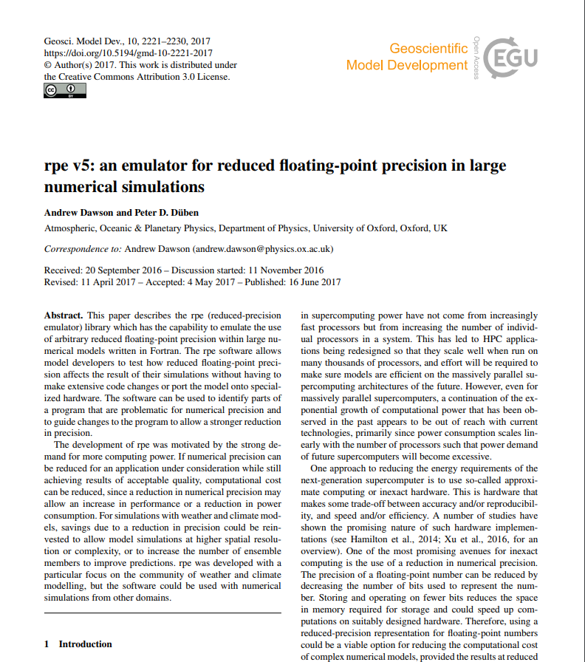
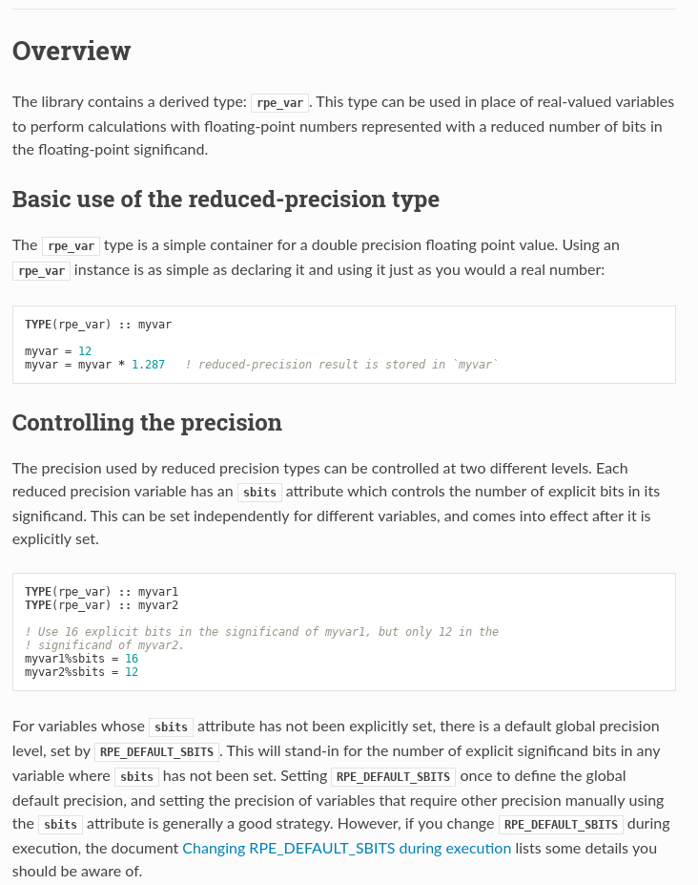
Reduced Precision Emulator

Slide 38
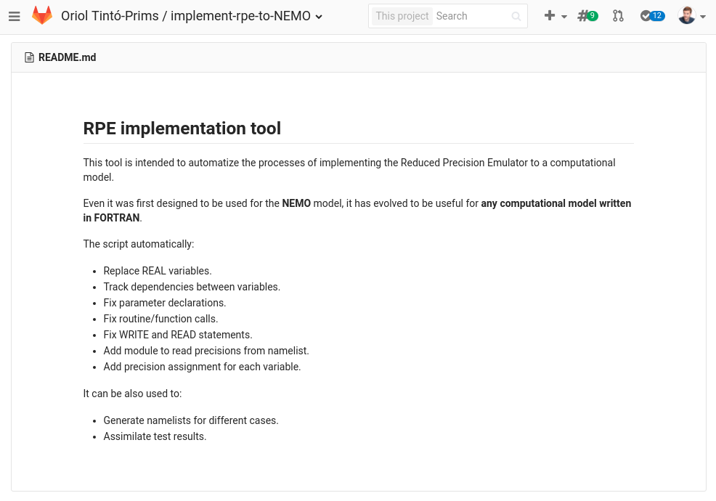
Implementing the emulator
A Python tool to automate the implementation process was created.

Slide 39
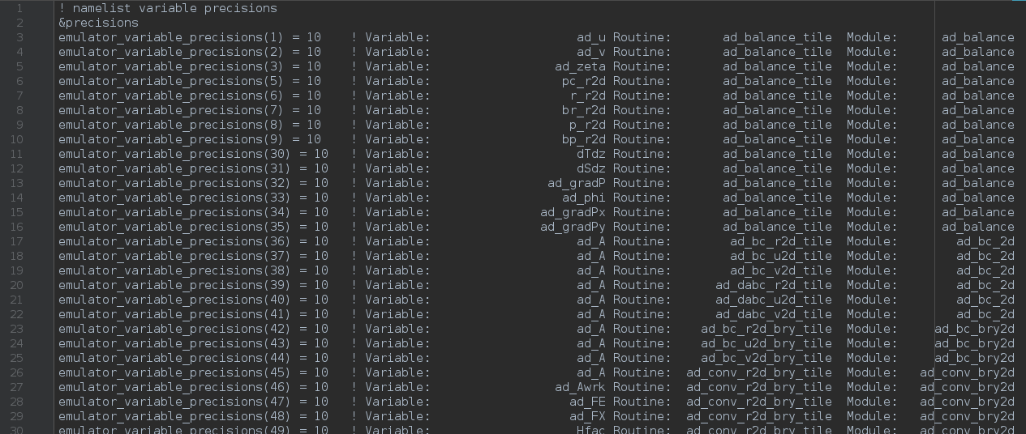
RPE in NEMO:
What we can do with it?
With a single binary, we can specify the number of significant bits used for each real variable declaration within the code through a namelist.

Slide 40
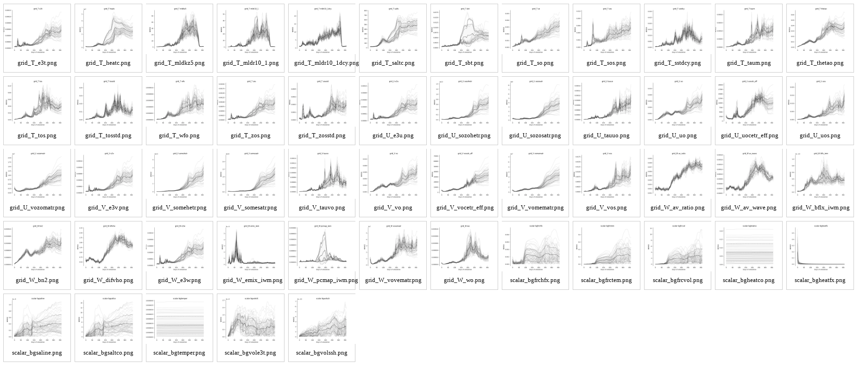
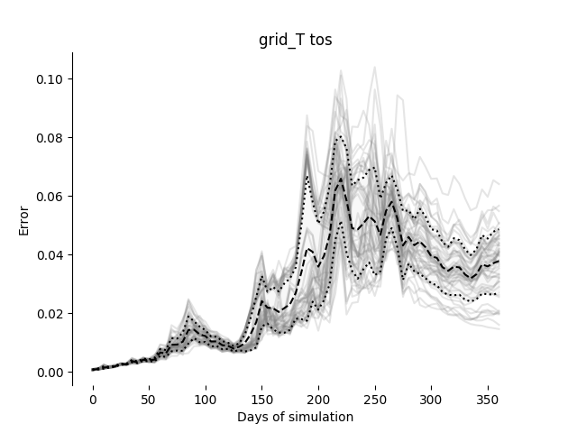
Verifying NEMO
Initial conditions perturbed with white noise in the 3D temperature field.
Evaluating 53 output variables.

Slide 41
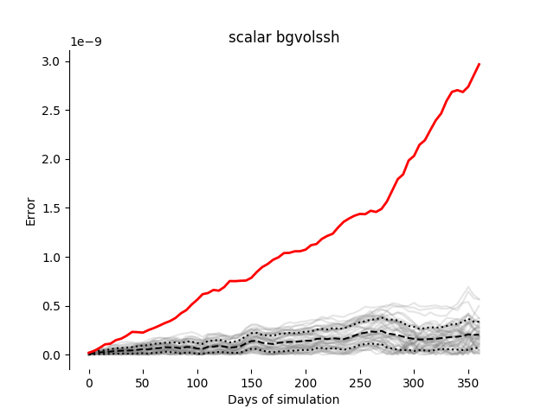
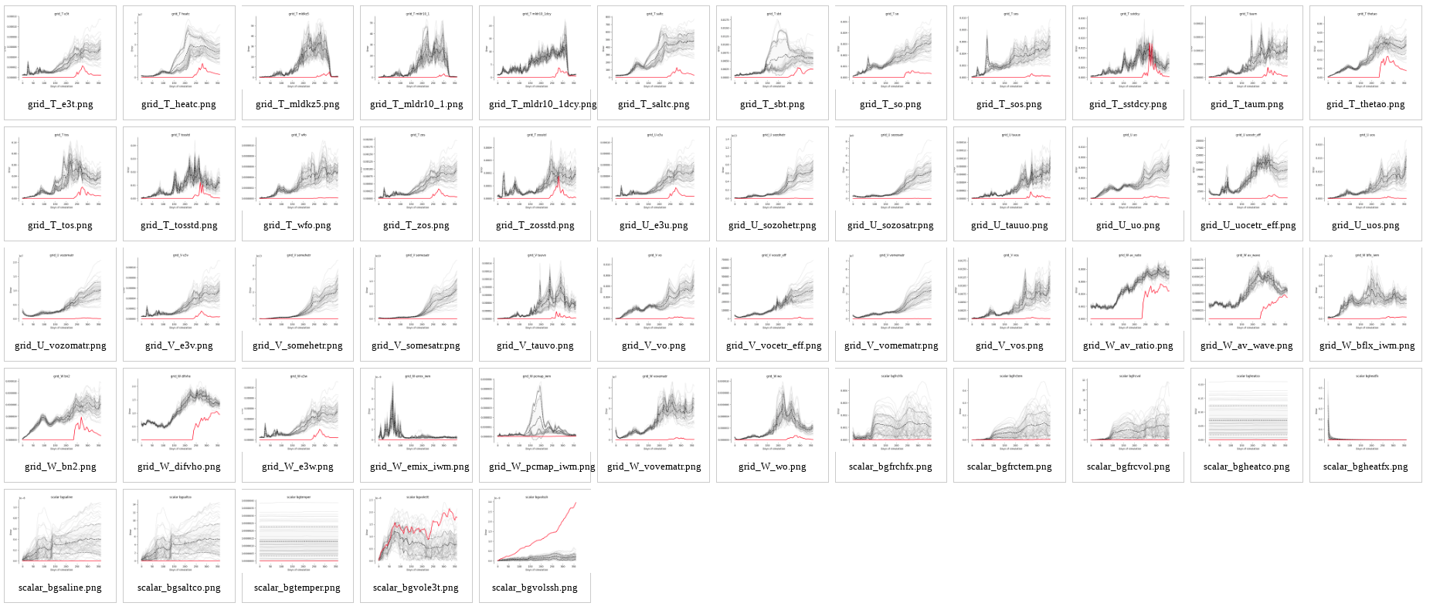
Verifying NEMO
Example: Compiling with -xHost

Slide 42
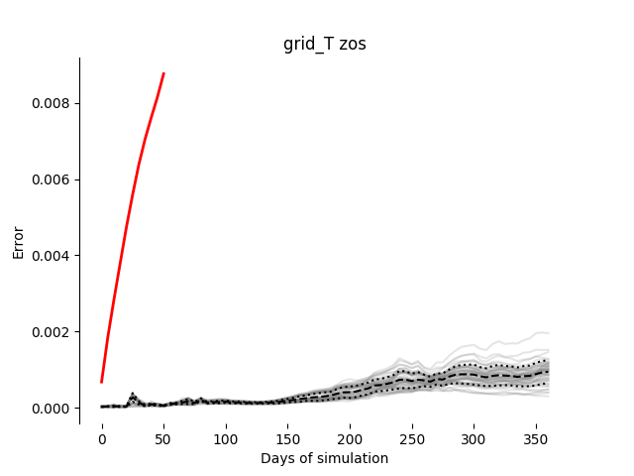
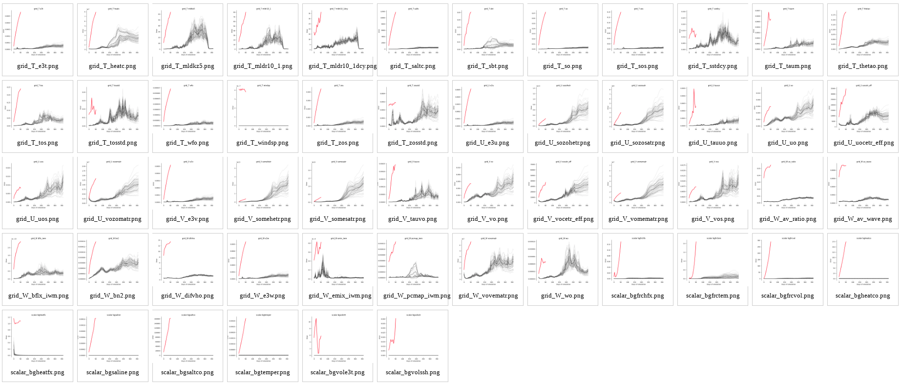
Verifying NEMO
Example: Everything in single precision:

Slide 43
Analysis algorithm:
How is it implemented?
Implementation done in Python:
class Job( variable_set):
Submit job to remote machine.
Check job status.
Evaluate success.
Expand subgroups.
Check subgroups.
[0 1 2 3 4 5 6 7 8 9]
[0 1 2 3 4] [ 5 6 7 8 9]
PENDING
RUNNING
SUSPENDED
SUCCESS
FAIL

Slide 44
Analysis algorithm:
How is it implemented?
Some details:
We use a simulation template which prepares everything required to execute our test case. The only thing that is modified from one simulation to the other is the precision namelist.
The size of the outputs for each individual simulation is about 8GB. To reduce the load to the filesystem the RMSE for all the fields is computed after the simulation and the outputs are deleted. We save a file with a python object which is ~0.5MB.
At the beginning of the analysis we don’t have many changes to exploit trivial parallelism but at lower steps there are many simulations that can be executed in parallel.

Slide 45
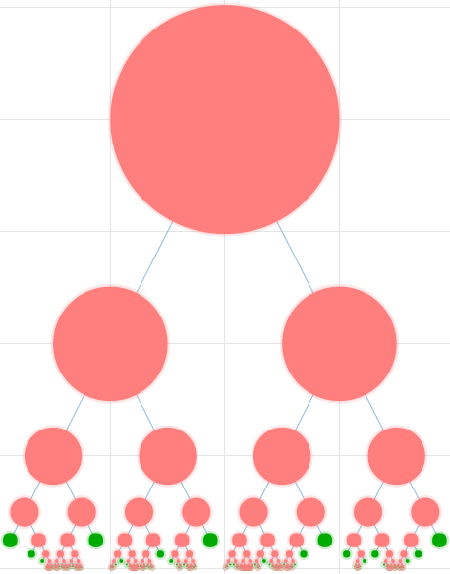
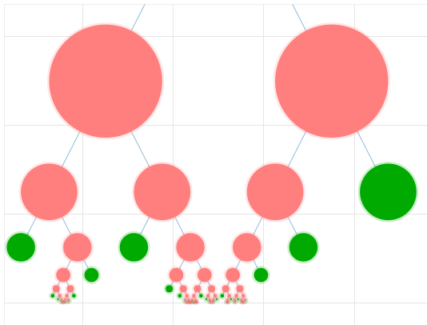
Precision Analysis

Slide 46
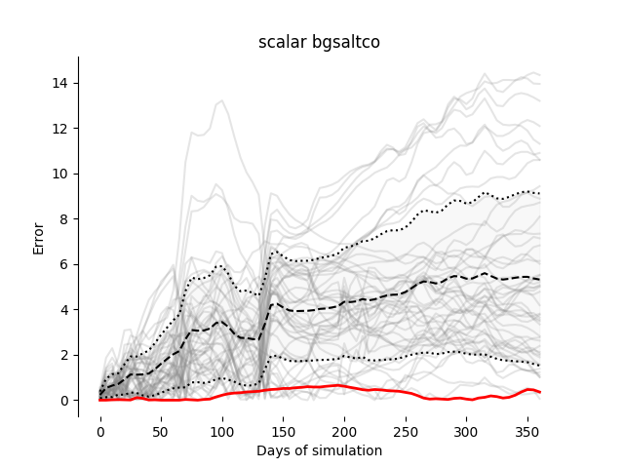
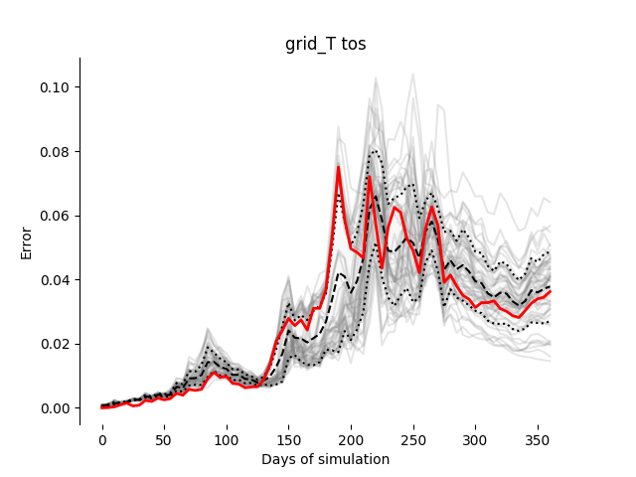
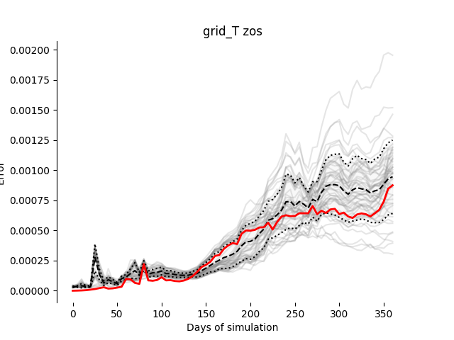
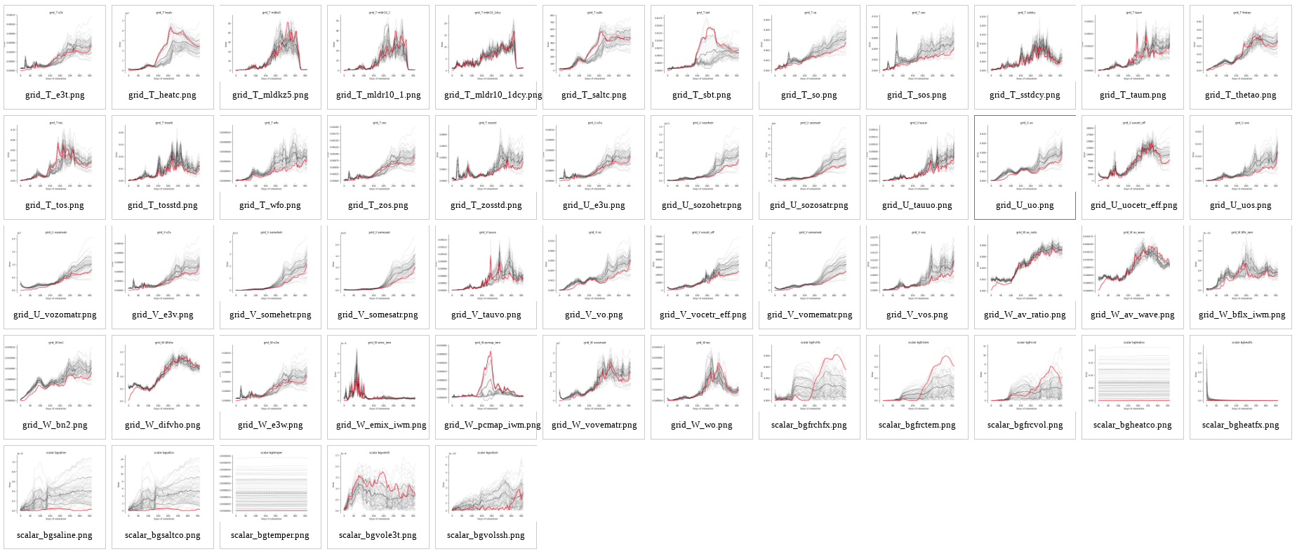
Results (1)
Using this verification test to run the analysis algorithm on a small part of the code:

Slide 47
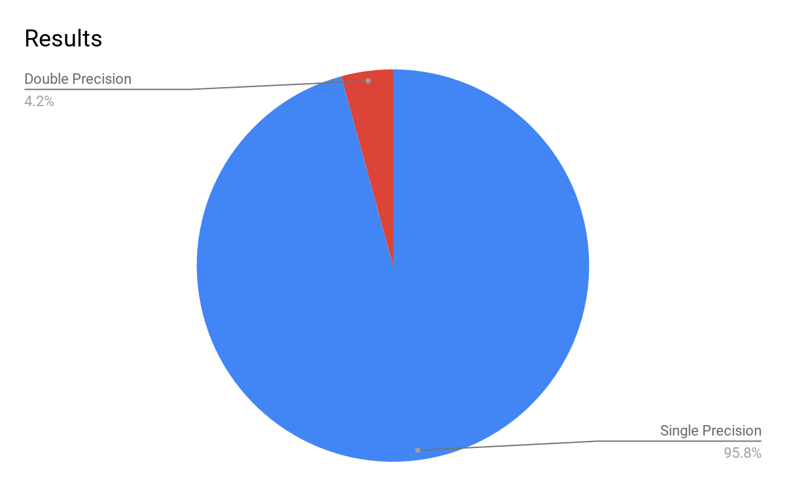
Results(2)
Using the old verification test on the full model:

Slide 48
Conclusions and open questions

Slide 49
Conclusions
We can find which variables require double precision.
There’s a huge room for reducing the precision used in NEMO.

Slide 50
Open Questions
Transferability between different cases?
Other ways of verifying the results?
Reducing even more the precision for future architectures?

Slide 51
Thank you
oriol.tinto@bsc.es

