Slide 1
Evaluation and Quality Control Function for the CDS
Francisco Doblas-Reyes (BSC-CNS and ICREA)
on behalf of the C3S EQC for CDS team
C3S GA, Warsaw, 30 October 2019

Slide 2
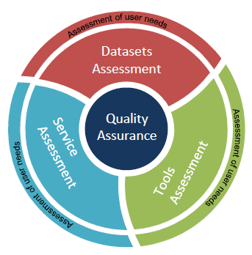
Evaluation and quality control of the CDS
The CDS requires an Evaluation and Quality Control (EQC) function that provides an overarching quality assurance service. It polices all aspects of the CDS and includes:
CDS datasets: provide information about the technical and scientific quality and fitness-for-purpose, along with independent assessment of the datasets
CDS Toolbox: assessment of maturity and fitness for purpose of the software provided to explore the datasets
CDS service: performance assessment of the CDS infrastructure (e.g. speed, responsiveness, system availability)
CDS users: user requirement assessment to measure users’ satisfaction with the CDS. Map evolving user needs into viable user requirements to ensure a user-oriented evolution of the CDS

Slide 3
EQC OF THE CDS DATASETS

Slide 4
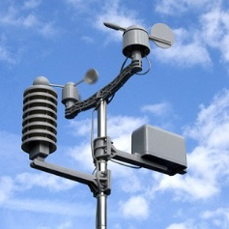
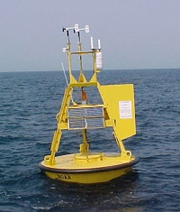
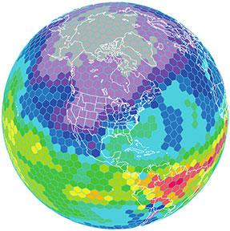
EQC of the CDS datasets
The quality assessment of the CDS datasets is collected in Quality Assurance Reports (QARs). The QAR includes a variety of dataset documentation, according to provider indications, that is independently reviewed by the EQC team, including an independent assessment of the data
QAR available in the CDS
A challenge: the CDS datasets encompass a wide variety of data types:
Satellite observations
In-situ observations
Global and regional reanalyses
Seasonal forecasts
Global and regional climate projections
This poses challenges to provide a seamless and homogeneous EQC information for the whole CDS datasets
To overcome this issue a synthesis table is published in the CDS web portal

Slide 5
EQC of the CDS datasets
The EQC information is made of dataset documentation according to provider indications and reviewed during the EQC process plus an independent assessment conducted by the EQC team
Compliance with a set of minimum requirements
Fast assessment
Documentation: e.g. quantity name, units, format, resolution, provider, version, description of processing, uncertainty characterization
Data checker: e.g. space/time completeness of data and metadata, physical ranges of plausability
Includes expert evaluation and maturity matrix
In-depth assessment
Documentation: e.g. quality flags, product traceability chain, validation report, inter-comparison activities
Independent assessment: e.g. compliance with community standards, maturity matrix (whether best practises have been followed), fitness for purpose (weather the dataset is robust and sufficient for the user’s specific application), performance metrics, data strong and weak points

Slide 6
Synthesis table
Based on information obtained by providers and reviewed by EQC
Based on results from the EQC assessment
INTRODUCTION
Dataset overview
Temporal and spatial coverage and resolution
USER DOCUMENTATION
User guide
Scientific methodology
ACCESS
INDEPENDENT ASSESSMENT
Expert evaluation
Toolbox compatibility
Archiving
Providers
Dataset version
Record update
Uncertainty quantification
Validation
Inter-comparison
Data check
Maturity matrix
Summary of the independent assessment
The synthesis table is a tool to organise and homogenize the EQC information
Its layout is shared by all data types
Each box has a link to display the specific EQC information of interest

Slide 7
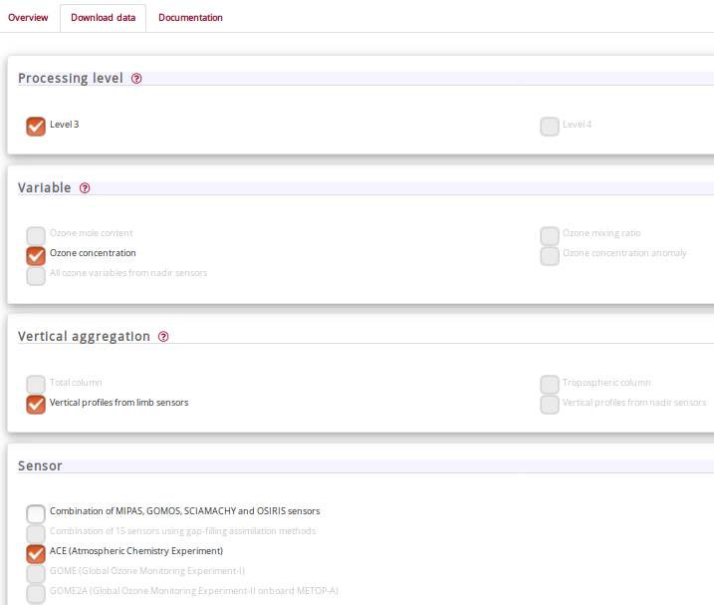
Display of the dataset EQC information
EQC
User selects the dataset and variable of interest
The user is then offered the option to access the related EQC information by clicking on the appropriate link
The information is presented through a web page displaying the synthesis table; the webpage is created dynamically using the most recent information available in a database
Show EQC information

Slide 8
Display of the dataset EQC information
Based on information obtained by providers and reviewed by EQC
Based on results from the EQC assessment
INTRODUCTION
Dataset overview
Temporal and spatial coverage and resolution
USER DOCUMENTATION
User guide
Scientific methodology
ACCESS
INDEPENDENT ASSESSMENT
Expert evaluation
Toolbox compatibility
Archiving
Providers
Dataset version
Record update
Uncertainty quantification
Validation
Inter-comparison
Data check
Maturity matrix
Summary of the independent assessment
The synthesis table is a tool to organise and homogenize the EQC information
Its layout is shared by all data types
Each box has a link to display the specific EQC information of interest

Slide 9
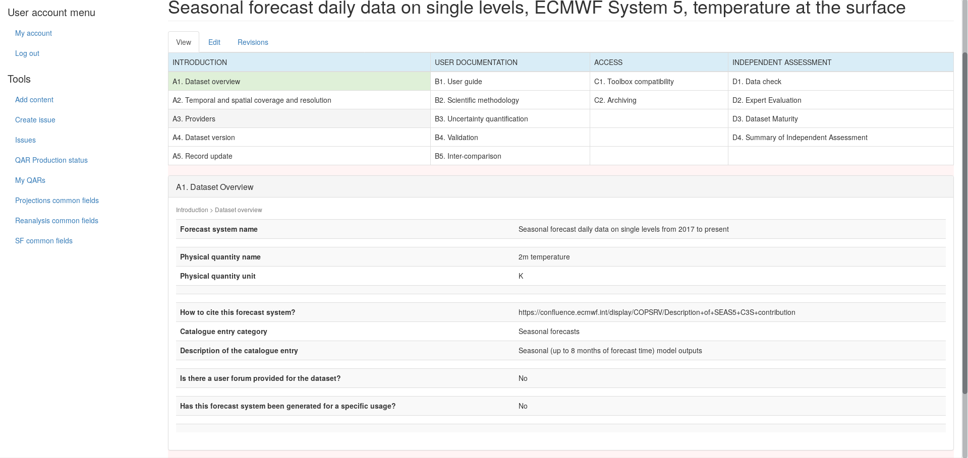
Content management system: Seasonal QAR
2m temperature
The synthesis table web pages are built dynamically, showing the information stored and managed by the EQC Content Management System (CMS)
The user selections form the query to interrogate the database managed by the CMS

Slide 10
Display of the dataset EQC information
Based on information obtained by providers and reviewed by EQC
Based on results from the EQC assessment
INTRODUCTION
Dataset overview
Temporal and spatial coverage and resolution
USER DOCUMENTATION
User guide
Scientific methodology
ACCESS
INDEPENDENT ASSESSMENT
Expert evaluation
Toolbox compatibility
Archiving
Providers
Dataset version
Record update
Uncertainty quantification
Validation
Inter-comparison
Data check
Maturity matrix
Summary of the independent assessment
The synthesis table is a tool to organise and homogenize the EQC information
Its layout is shared by all data types
Each box has a link to display the specific EQC information of interest

Slide 11
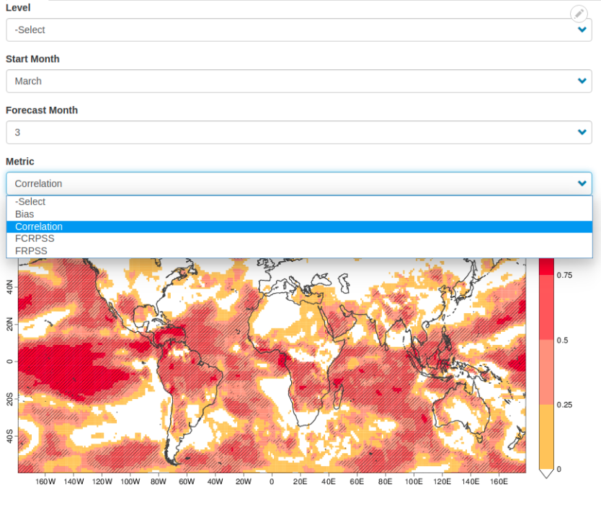
Seasonal QAR: expert evaluation

Slide 12
EQC OF THE CDS TOOLBOX

Slide 13
EQC of the CDS Toolbox
The EQC function assesses the quality of the CDS Toolbox from multiple angles: tools, workflows, Common Data Model (CDM), application editor, provenance tracking system.
Software quality assessment is based on the internationally-recognized standard ISO/IEC 9126 and extensions (e.g. ISO/IEC 25010:2011)
ISO 9126
Maintainability
Efficiency
Portability
Reliability
Functionality
Usability
The EQC framework of the Toolbox aims to:
Assess the maturity of the software tools: robust in terms of code versioning and testing and well documented
Evaluate the fitness-for-purpose of the software through use cases identified together with the users, assessing the applicability of the Toolbox to specific operations

Slide 14
EQC OF THE CDS SERVICE

Slide 15
EQC of the CDS service
The EQC function measures and reports the technical quality of the CDS service (e.g. system availability, response time).
The KPIs have been inspired by the internationally-recognized standard ISO/IEC 25010 and 25011
CDS KPIs
Performance
Reliability
Visibility
Overall quality
Suitability
In particular, monitoring of the CDS infrastructure is based on:
A set of Key Performance Indicators (KPIs)
On-line rating widgets to monitor user satisfaction
A web dashboard hosting the KPIs and widget statistics for information of the operators

Slide 16
USER NEEDS

Slide 17
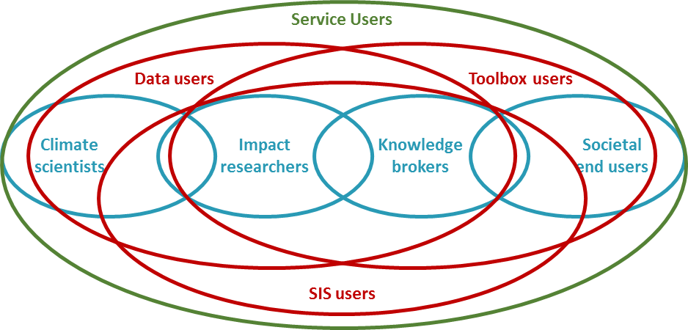
User engagement
As the C3S is a user-driven climate service, user feedback is central to develop recommendations for improvement and expansion of the overall C3S (CDS data, Toolbox and SIS products)
User pool
USER FEEDBACK
Focus group
Workshop
Direct contact
CDS Help & Support
CDS feedback
c3s-eqc@ecmwf.int e-mail
Links with other C3S contracts
Harvesting user requirements in a database
Analysed in a report for further development of the C3S
URDB
URAD

Slide 18
OTHER SERVICES

Slide 19
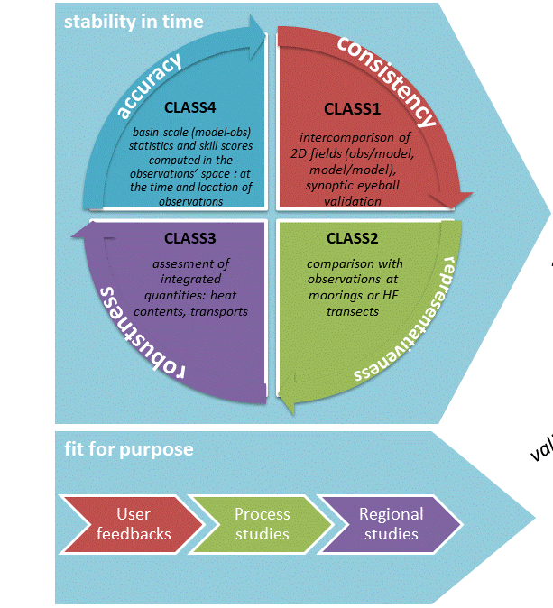
Marine service
CMEMS has a well-developed product quality control system performed mainly by the providers and coordinated by Mercator that focuses on the scientific quality of the datasets
A working group of ~40 people:
Meet each year
Agree on actions
Exchange regularly
evolution of validation/verification standards
evolution of the documentation
evolution of the central website
Need for a cross-service coordination group in EQC activities (principles, vocabularies, methodologies, display)
on topics/actions 1-2-3
on new reference observations
on common scientific issues …
A coordination team of 3+ people (1,5 FTE):
Organization of meetings, animation of working group
Reviewing documentation and reporting
Draft roadmaps for topics 1-2-3
Development and maintenance of central website

Slide 20
Conclusions
The EQC function of the C3S provides an overarching quality assurance service for the whole CDS and SIS components
Users can fully understand the status and purpose of data and products, with all relevant information in one place, with a unified language and look-and-feel, based on the aspects the user deems most important
The homogenization of the EQC information across all datasets allows to directly use several different datasets
The EQC function is run by independent actors and helps data producers to understand which information they need to deliver for their datasets to be usable
Applications (e.g. energy, water) will inherit the EQC information and propagate it to their end-user indicators
There is a plethora of EQC functions across Copernicus services (mainly CAMS, CMEMS and C3S), with different principles, vocabularies and methodologies that would benefit from some level of coordination

