Slide 1
Barcelona, Winter 2018
Seasonal Hurricane Forecasting Website
Review of 2017
Phil Klotzbach (CSU) Louis-Philippe Caron (BSC)

Slide 2
What’s new - 2017
Participation of 3 new groups
University of Colorado
Seoul National University
Climate Forecast Application Network
Quick link to post on Facebook and Twitter
Colorblind friendly scale
Color scheme changed from forecast type to organization type
Graphs now show the trend in the forecasts as the season approaches
Dot on graphs show the average forecast for each metric

Slide 3
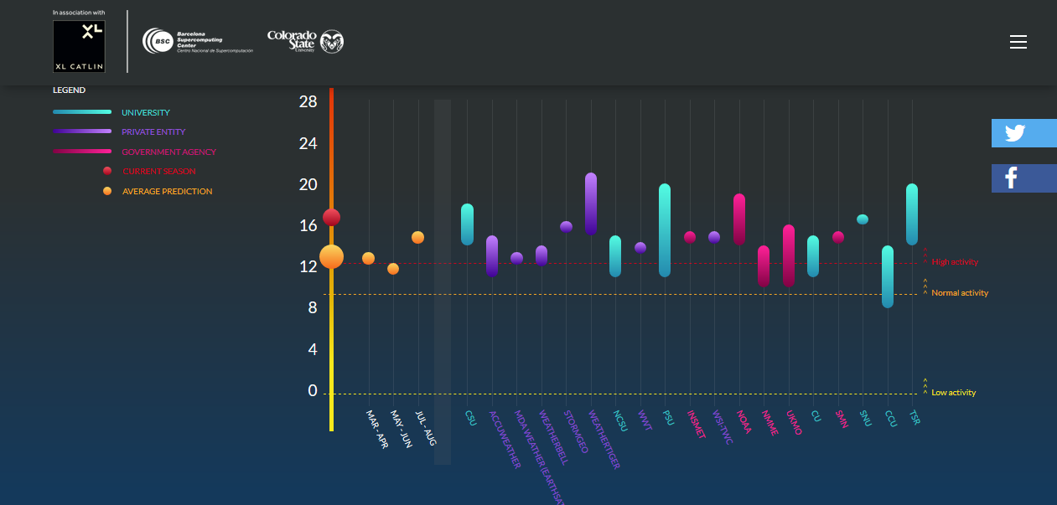

Slide 4
Participation
21 groups participated (+3)
Number of centers issuing
Named storms | 19 (+2)
Hurricanes | 18 (+1)
Major hurricanes | 15 (+1)
ACE | 12 (+1)

Slide 5
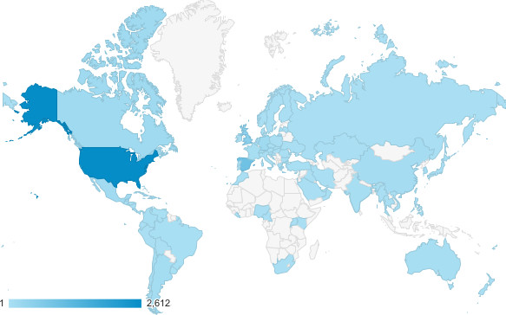
Traffic
Traffic (2016 vs 2017)
Top 5:
U.S. (Houston, New York)
Spain
U.K.
Germany
Canada
8%
44%

Slide 6
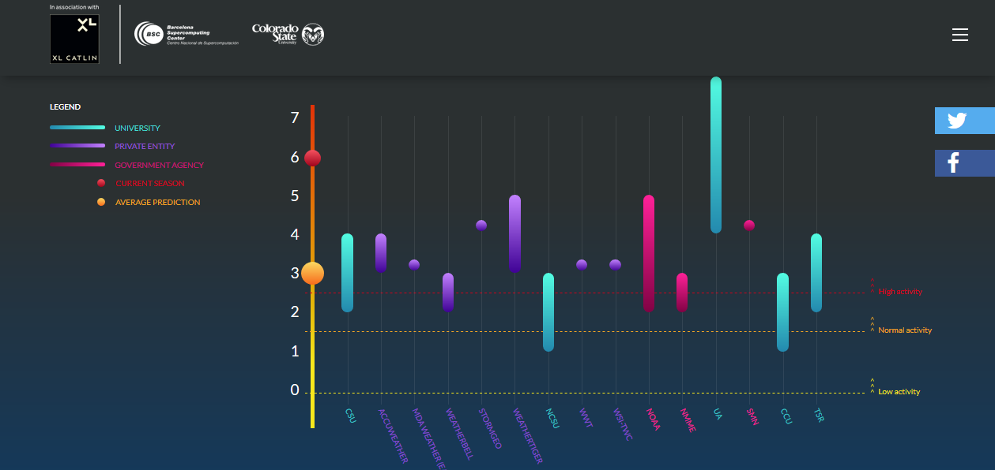
Ensemble Forecast Accuracy
 | Average | Observed | Difference
Named storms | 14.4 | 17 | -2.6
Hurricanes | 7.4 | 10 | -2.6
Major hurricanes | 3.3 | 6 | -2.7
ACE | 127.8 | 226 | -43%

Slide 7
Ensemble Forecast Accuracy

Slide 8
Exposure
World Meteorological Organization Training Workshop at the National Hurricane Center - February 28 - Miami, FL
National Tropical Weather Conference - April 6 - South Padre Island, TX
National Hurricane Conference - April 18 - New Orleans, LA
PCS Catastrophe Conference - May 1 - Denver, CO
Florida Governor's Hurricane Conference - May 19 - West Palm Beach, FL
Advisen Property Conference - June 8 - New York City, NY
Ironshore Hurricane Seminar - August 8 - Houston, TX
6th Summit on Hurricane and Climate Change, June 4-9, Keraklion, Greece,
https://www.scientificamerican.com/article/scientists-at-work-forecasting-the-atlantic-hurricane-season/
http://www.grupoaseguranza.com/noticias-de-seguros/xl-catlin-participa-prediccion-huracanes-para-2017

Slide 9
Looking ahead
WMO endorsement
Include Western North Pacific basin
Include decadal prediction
Workshop on seasonal prediction of tropical cyclones
58 answers – 11 from forecasters
74%/47% could attend if event held in US/Europe
Preferably in spring or summer
Preferred topics:
Reason(s) behind the 2017 forecast underestimate
Review of current methodologies and their skill
Seasonal forecasts for landfalling storms
Application of new technologies (e.g. machine learning)
Applications, in particular to financial market

Slide 10
For further information please contact
Louis-philippe.caron@bsc.es

