Slide 1
Predicción de la Calidad del Aire Multiescala con el modelo MONARCH en el Centro Nacional de Supercomputación
O. Jorba, S. Basart, J. A. Benavides, D. Bowdalo, M. L. Dawson, E. Di Tomaso, M. Gonçalves, M. Guevara, M. Klose, F. Macchia, V. Obiso, M. Olid, M. T. Pay, M. Porquet, K. Serradell, C. Tena, C. Pérez García-Pando
Departamento Ciencias de la Tierra
Centro Nacional de Supercomputación
19/09/2018
VI Simposio Nacional de Predicción - AEMET

Slide 2
Contents
BSC and the Earth Sciences Department
Overview of MONARCH and HERMESv3 models
Multiscale capability of MONARCH model
Data Assimilation work
Conclusions

Slide 3
BSC and the Earth Sciences Department

Slide 4
Barcelona Supercomputing Center Centro Nacional de Supercomputación
BSC-CNS objectives
Supercomputing services
to Spanish and
EU researchers
R&D in Computer,
Life, Earth and
Engineering Sciences
PhD programme,
technology transfer,
public engagement
Spanish Government 60%
Catalonian Government 30%
Univ. Politècnica de Catalunya (UPC) 10%
BSC-CNS is
a consortium
that includes
Notes:
Bsc objectives – consortium – objectius consorci

Slide 5
Earth Science Department
Environmental modelling and forecasting, with a particular focus on weather, climate and air quality
Climate Prediction
Modelling
Atmospheric Composition
Modelling
Computational Earth Sciences
Earth System Services
Director: Francisco Doblas-Reyes
72 people
Leading: H2020 project, COPERNICUS contract, ERC Consolidator Grant and hosts an AXA Chair

Slide 6
Overview of MONARCH and HERMESv3 models for Air Quality Applications

Slide 7
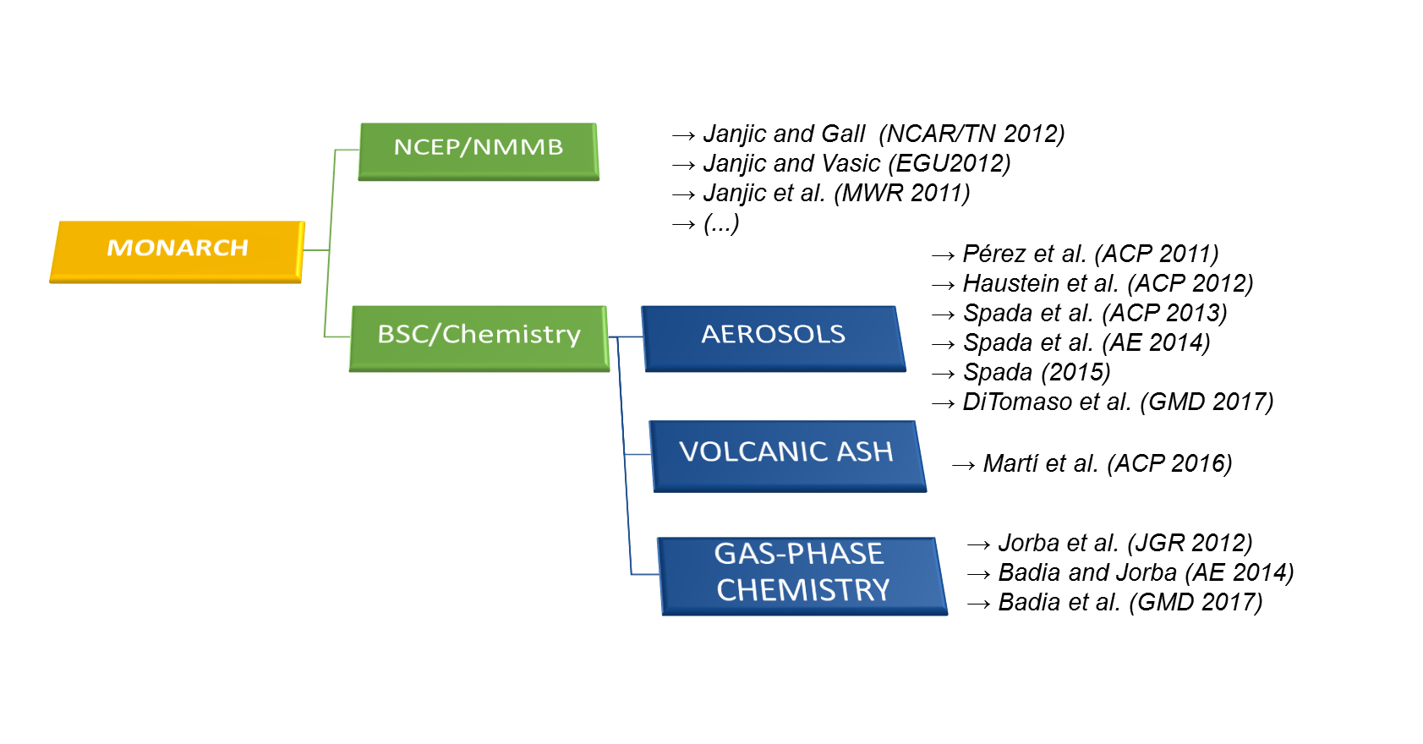
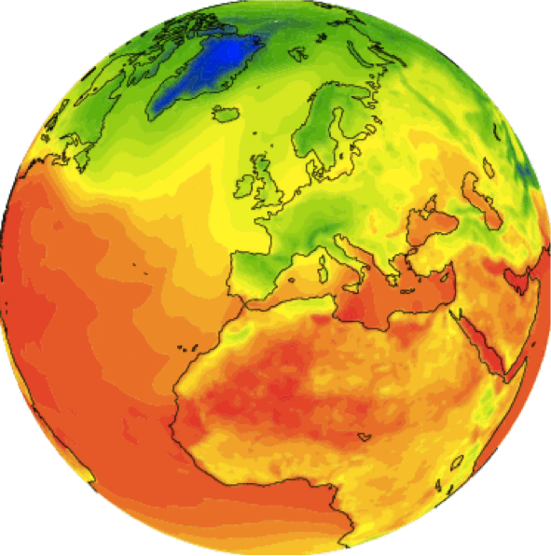
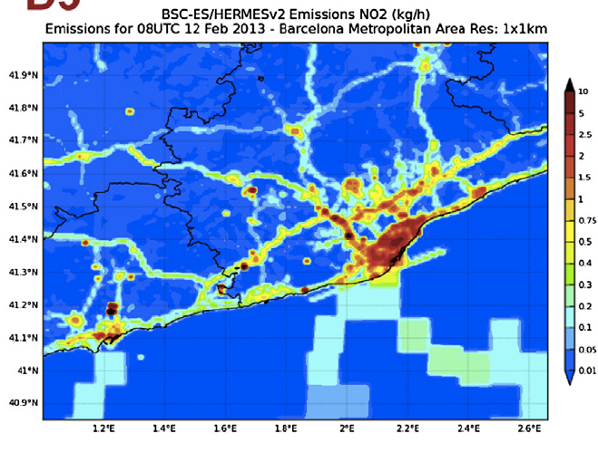
MONARCH: online weather-chemistry model
· Multiscale: global to regional (up to 1km) scales allowed
· Fully on-line coupling: weather-chemistry feedback processes allowed
· Enhancement with a data assimilation system
Multiscale Model from Global to Local Scales
Dust module is known as NMMB/BSC-Dust

Slide 8
MONARCH forecasts
Global
Regional
20100715 at 12UTC
BDFC and SDS-WAS dust forecast
Candidate model CAMS-50
It will be implemented in
MONARCH contributes to the ICAP global forecast aerosol multi-model ensemble http://icap.atmos.und.edu
CALIOPE (www.bsc.es/caliope)
AQ Forecast System for EU and Spain
And more products in: http://www.bsc.es/ess/

Slide 9
HERMESv3: emission model
An open source, parallel and stand-alone multiscale atmospheric emission model that processes and estimates gas and aerosol emissions for use in chemistry transport models
global-regional module
(HERMESv3_GR)
bottom-up module
(HERMESv3_BU)
A highly customizable processing system that calculates emissions through an automatic combination of existing inventories and user defined vertical, temporal, speciation scaling and masking factors
A Spanish emission model to estimate emissions at the source level (e.g. road link, industrial facility, crop type) combining state-of-the-art bottom-up methods with local activity and emission factors

Slide 10
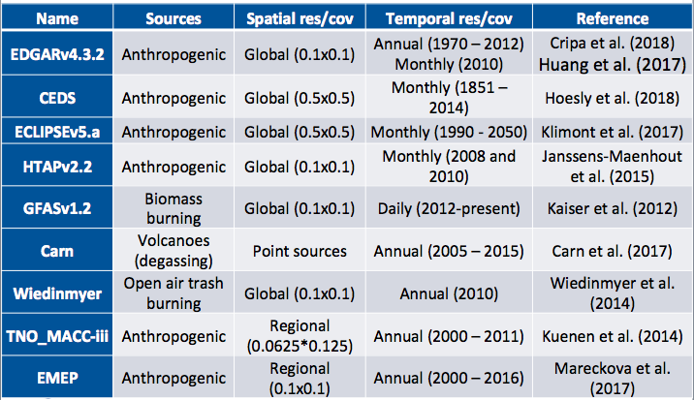
Emission Combination and Spatial regridding
Widely applicable framework for designing and adjusting the emission modelling experiment:
Combination of multiple emission inventories
Country-specific scaling factors
Country-specific masks
Flexibility on chemical speciation
Manufacturing industrial NOx emissions:
North Africa
(HTAPv2.2 0.1x0.1deg)
Portugal
(ECLIPSEv5.a, 0.5x0.5deg),
France
(TNO_MACC-iii, 0.0625x0.125deg)
Spain
(bottom-up inventory, Guevara et al. 2013)

Slide 11
Multiscale capability of MONARCH model

Slide 12
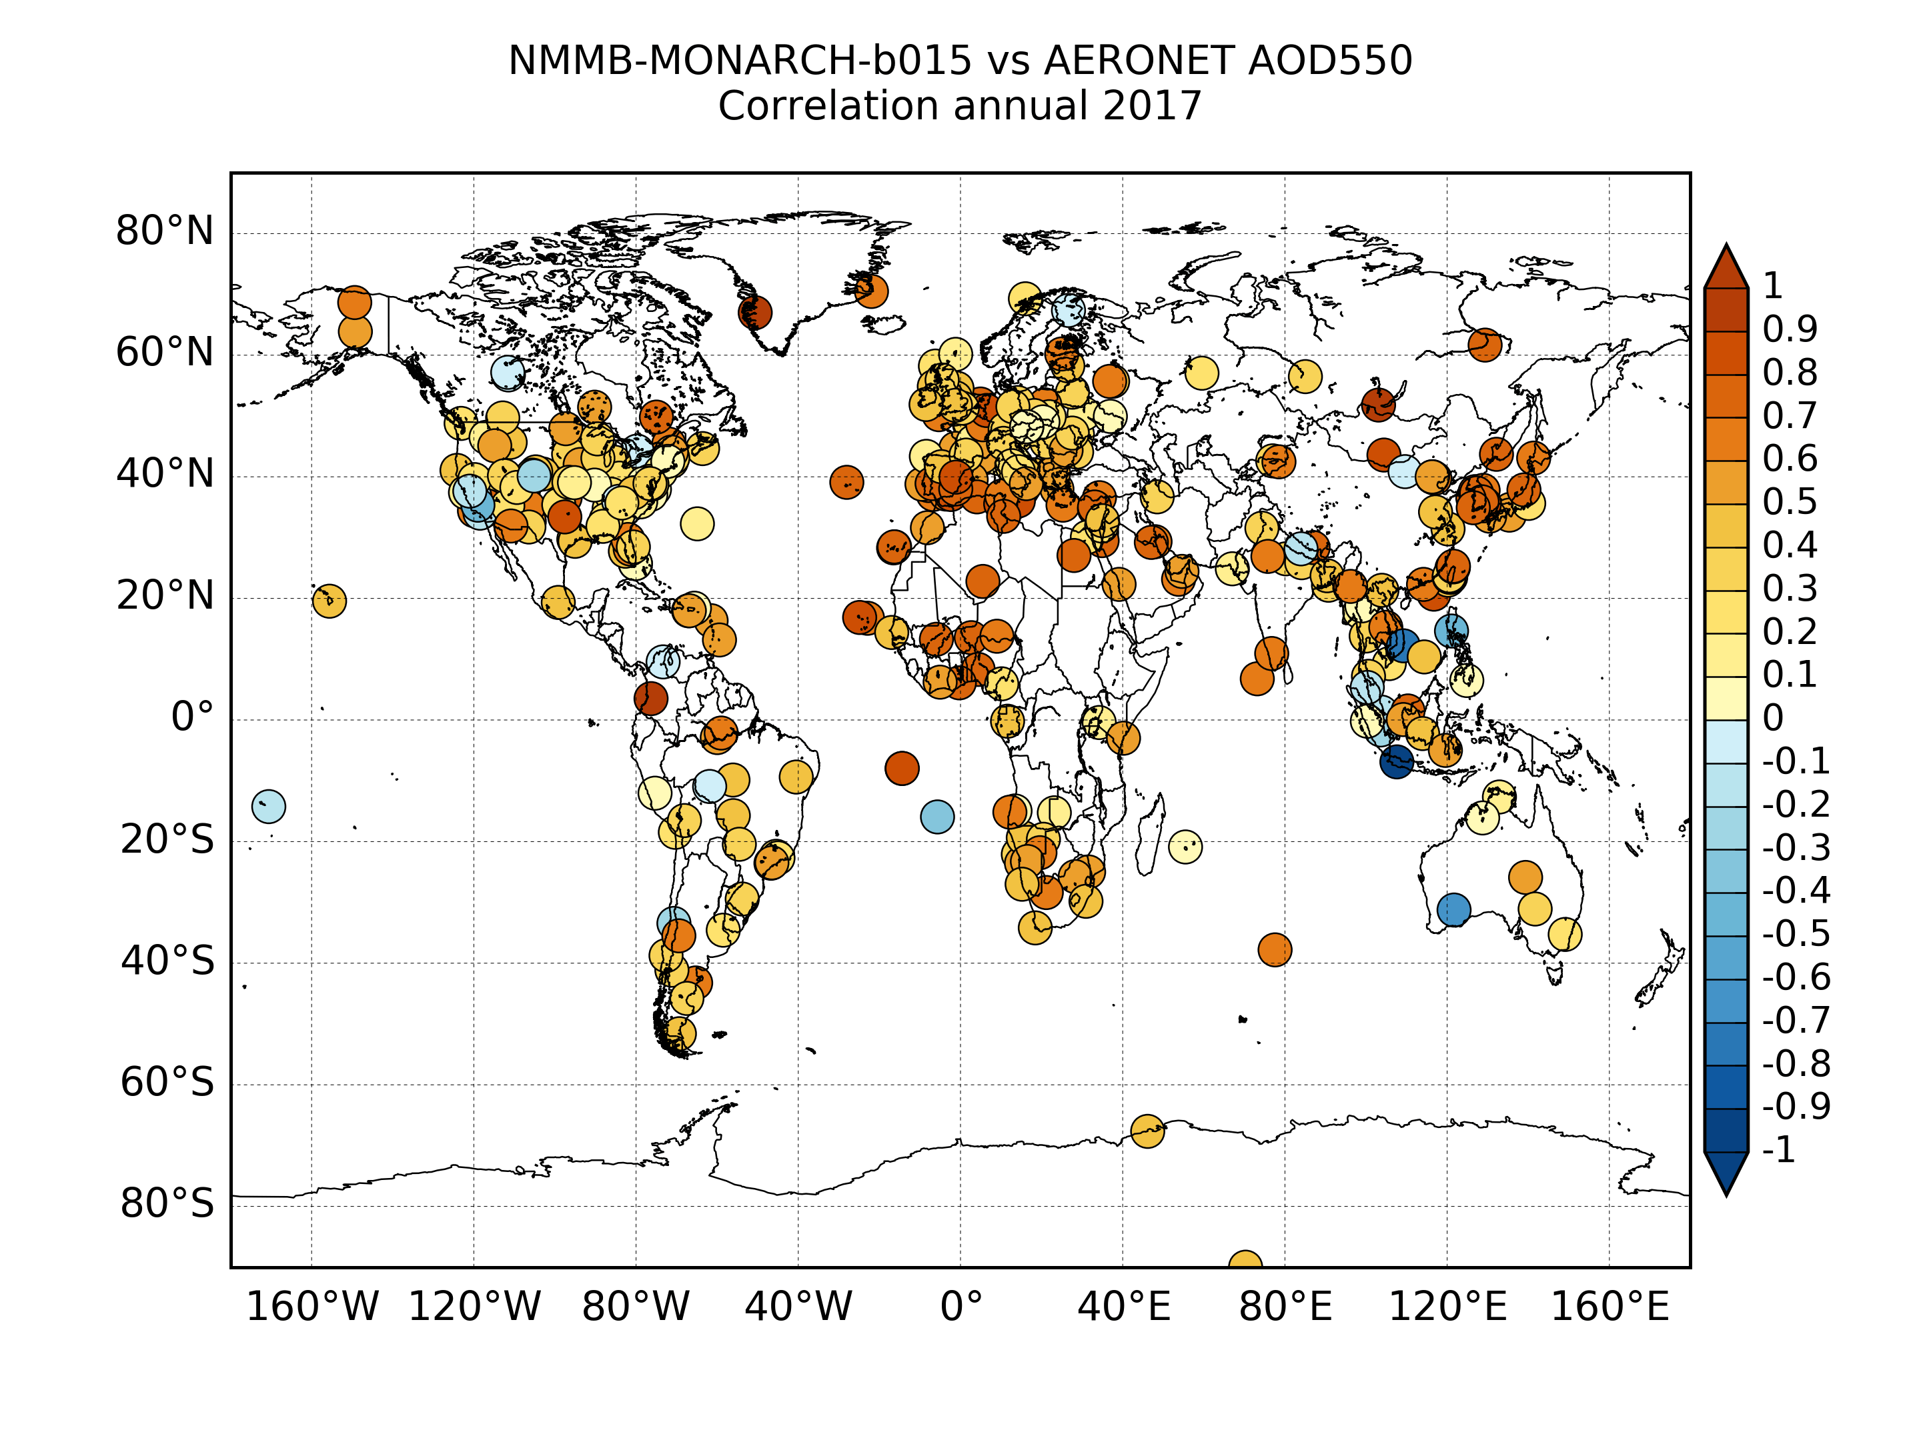
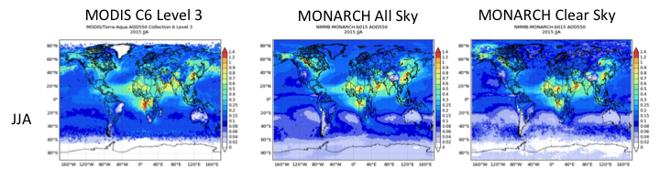
Aerosol forecasting at global scale:
International Cooperative for Aerosol Prediction
AOD MODEL
AOD AERONET
Notes:
Several studies focused on evaluating aerosol optical depth
Not many evaluation of intensive properties: single scattering albedo (Qscat/(Qscat+Qabs)) and asymmetry parameter (forward scattering/all scattering)
Here we present an evaluation of a global aerosol model of omega and g
And will discuss the impact of using updated refractive indexes

Slide 13
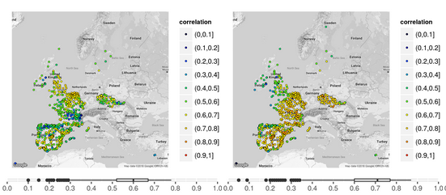
Regional Air Quality
Model results evaluated with EIONET and EBAS gas-phase and aerosol surface concentration measurements
European domain at 12 km
Comparison with current CALIOPE system based on WRF-CMAQ shows good improvements
Ozone correlation
2015 annual run
Hourly resolution
WRF-CMAQ
MONARCH

Slide 14
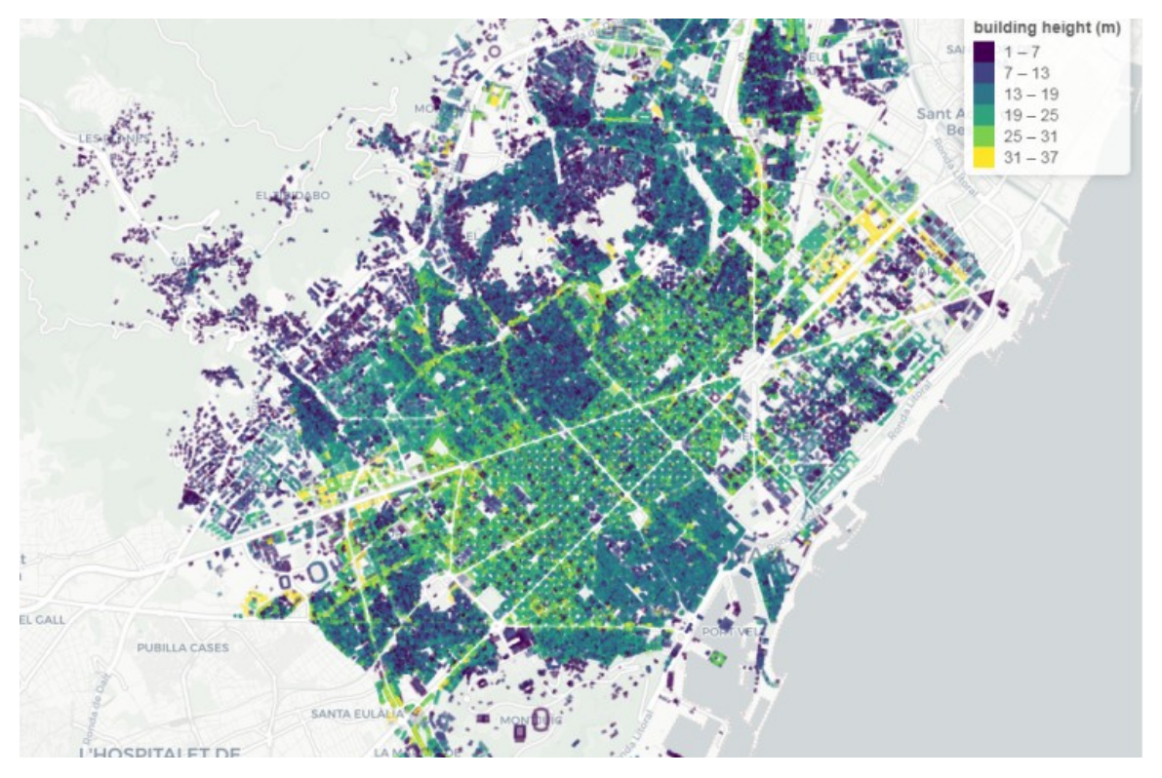
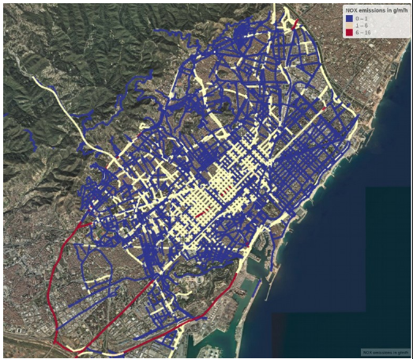
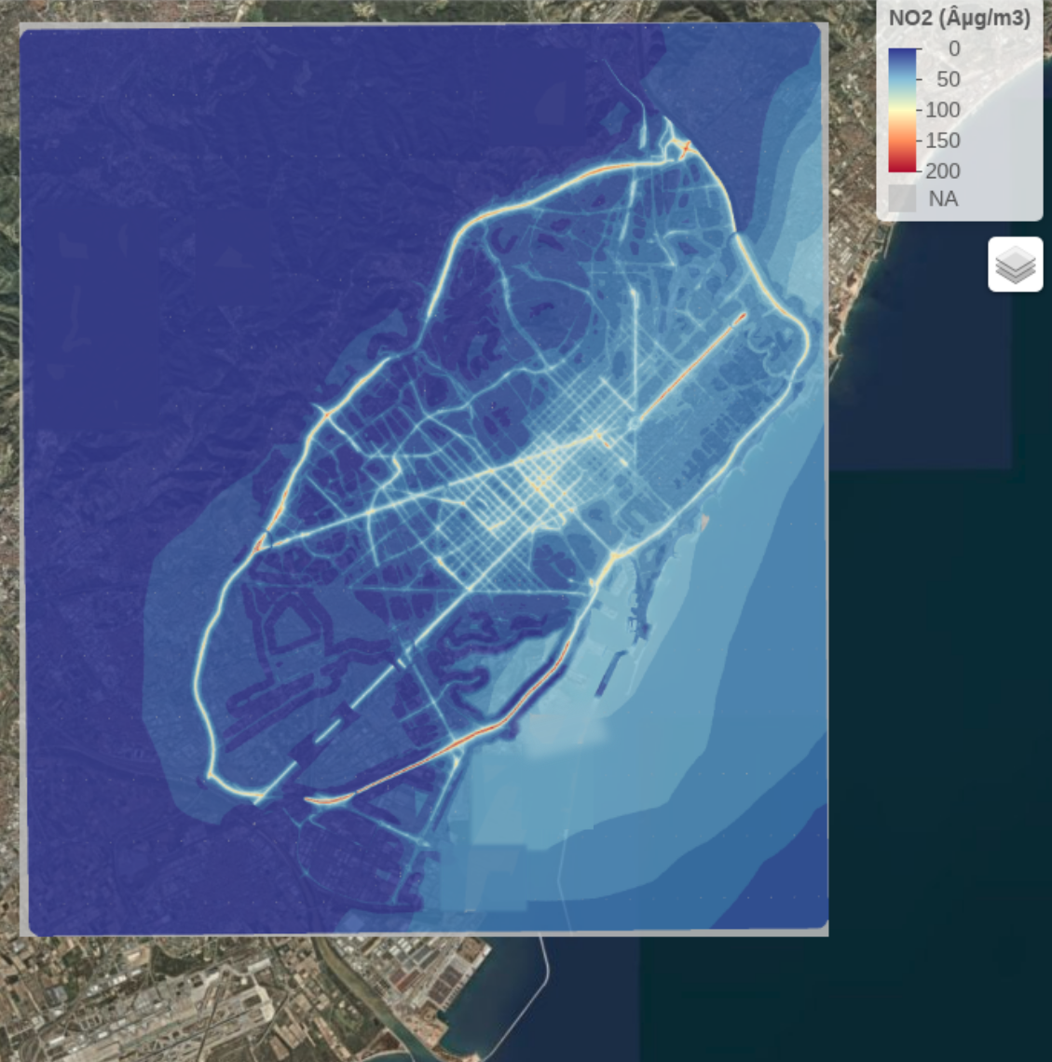
Street Scale NO₂ modelling: Barcelona case
City morphology parameters: building height, street width, building density
Street scale NO_{x} emissions from HERMESv3
Mesoscale – Street Canyon model coupling: NO₂ concentration

Slide 15
Data assimilation work

Slide 16
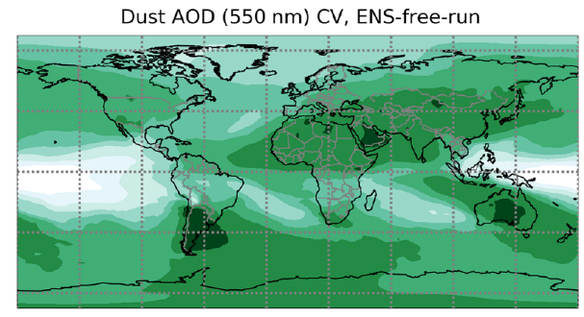
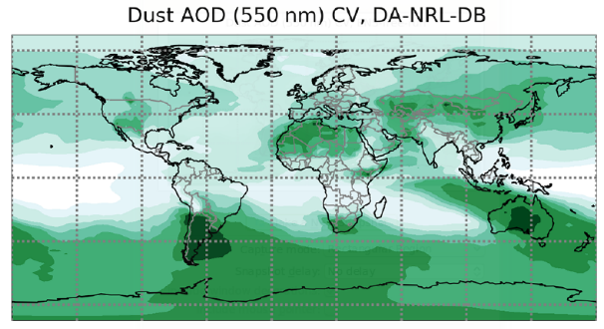
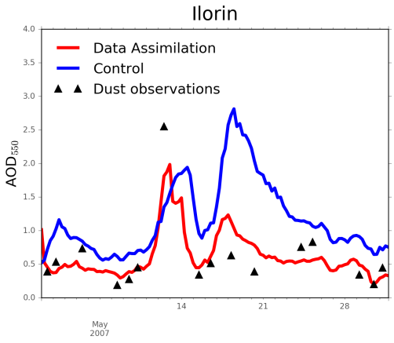
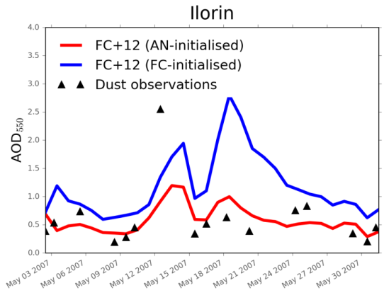
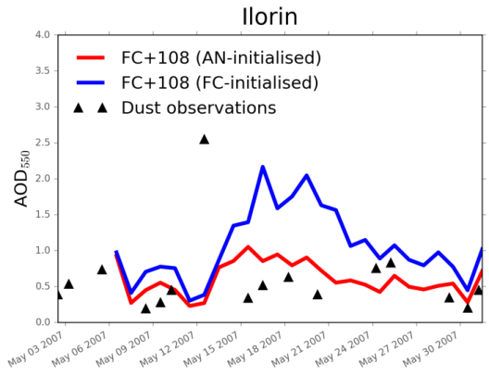
Ensemble-Based Data Assimilation (DA) at BSC
Dust ensemble forecasts are used at BSC to estimate flow-dependent forecast uncertainty, which is used by DA to optimally combine forecast with observations
Ensemble free run
Data assimilation run
The ensemble forecast has been designed considering model uncertainties with respect to:
surface winds
soil humidity
vertical flux distribution at sources
AERONET independent observations
Better description of current and forecast conditions for dust with DA
Notes:
Figures top row: Ensemble spread reduction where observations are present
The coefficient of variation is defined as the ratio of the standard deviation of the ensemble to the ensemble mean. Data assimilation lowers the values of the coefficient of variation in the regions where observations are present, which indicates a reduction of the ensemble spread due to the assimilated observations
Figures bottom row: An analysis-initialized forecast performs better (lower forecast error and higher correlation) than a standard forecast.
Dust optical depth at 550 nm for May 2007 with the assimilation of MODIS Deep Blue and Dark Target (red) and for the control (blue). Comparison between the model simulations, analysis (a) and forecasts (b and c) and AERONET independent observations in Ilorin (Niger). The positive impact of initialization is kept for more than 4 days into the forecast. Simulations are based on the NMMB/BSC-Dust model
Notes:
The DA scheme is the LETKF (Hunt et al. 2007), an ensemble-based technique with the following features:
- usage of a flow-dependent background error covariance,
- performs the analysis locally (this has shown to be particularly suitable for the assimilation of aerosol information since it has been observed that aerosol fields have limited spatial correlations)
Perturbations:
The implementation of the ensemble forecast is based on known uncertainties in the physical parametrizations of the dust scheme (imperfect model scenario assumption)
In dust modelling, the emission source term is a particularly large contributor to model error (Huneeus et al., 2011). Hence each ensemble member is run with a different perturbation of uncertain model parameters in the emission scheme.
The spin-up period for the ensemble ensures that perturbations applied at the sources propagate everywhere in the globe.
(1)
- the threshold friction velocity for dust emission is perturbed extracting a multiplicative random factor from a normal distribution with mean 1 and spread 0.4.
- this considers the uncertainty of the model with respect to both surface winds and soil humidity: at low resolution, model surface winds are typically underestimated
over dust sources. Furthermore, the model uses the scheme of Fécan et al. (1999) to calculate the increase in the threshold friction velocity with soil humidity, which is typically overestimated in arid regions (Haustein et al., 2015)
(2)
- In the case of NMMB-MONARCH one of the components of the uncertainty in the emission term has been identified for example in the vertical flux distribution at sources (Gama et al., 2016).
- NMMB-MONARCH follows a sectional approach for dust, i.e. the size distribution is decomposed into small
size bins
- The perturbations are extracted imposing some physical constraint: correlated noise is used across the bins so that noise correlation decreases with increased difference of the normalized cubic radius among the bins; the noise has mean 1 and standard deviation of 30 % of the unperturbed value in each bin; the final distribution is unimodal

Slide 17
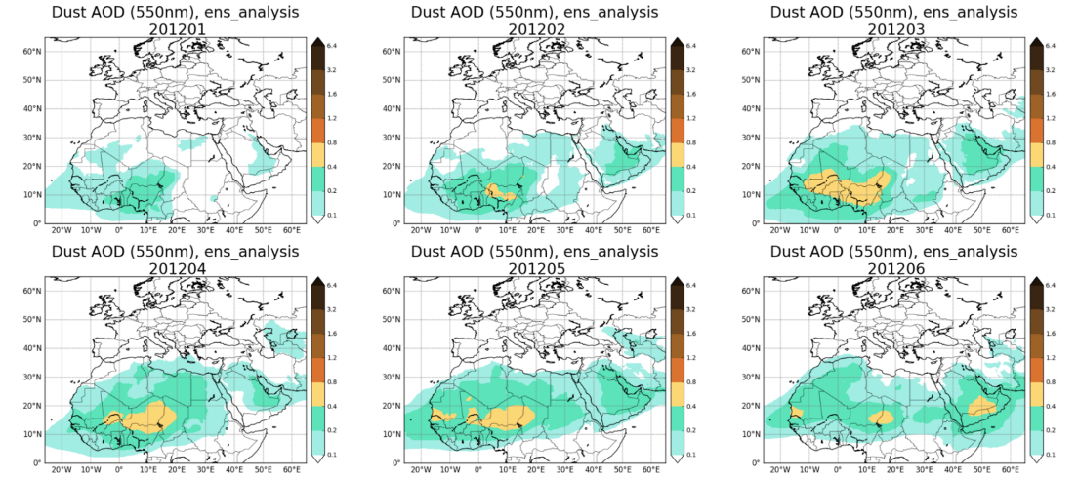
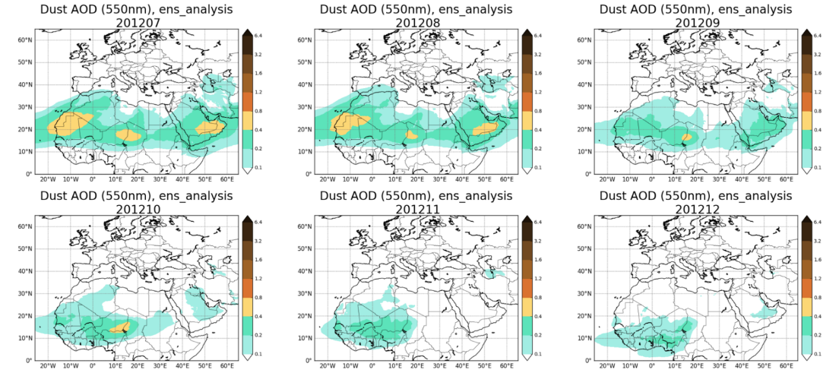
DustClim Project (2017-2020)
Produce a high resolution dust reanalysis for Northern Africa, Middle East and Europe covering the satellite era of quantitative aerosol information, and develop dust-related services tailored to specific socio-economic sectors
Monthly dust analyses for 2012
Notes:
Consortium of different partners
Figures: monthly values of a high resolution reanlysis at 0.1 on the BDFC domain (first test for 2012)

Slide 18
Conclusions

Slide 19
Conclusions
Atmospheric Composition Group of BSC focused on Atmospheric Chemistry model developments
MONARCH – HERMESv3 systems allow wide range of applications
Used in SDS-WAS, ICAP, CALIOPE and in the forthcoming Phase-II CAMS-50
Successful collaboration with AEMET in WMO Dust centers
Potential further collaborations in air quality with AEMET

Slide 20
Gracias!
19/09/2018
VI Simposio Nacional de Predicción - AEMET

