Slide 25
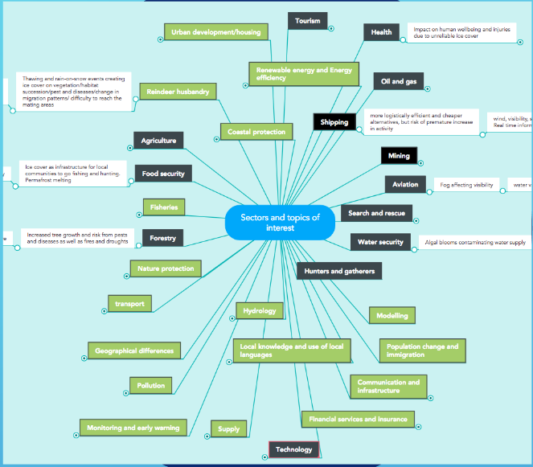
MAPPING EXERCISE

