Slide 1
HARMONIE performance analysis: summary of the 1st phase
Xavier Yepes-Arbós
Mario C. Acosta
7/5/2020
HARMONIE Virtual System Working Week

Slide 2
Who we are

Slide 3
Computational Earth Sciences Group
Performance Team
Provide HPC Services (profiling, code audit, …)
Apply new computational methods
Models and Workflows Team
Development of HPC user-friendly software framework
Support the development of atmospheric research software
Data and Diagnostics Team
Big Data in Earth Sciences
Provision of data services
Visualization

Slide 4
Performance Team
The necessary refactoring of numerical codes is given a lot of attention and is stirring a number of discussions
Computational performance analysis and new optimizations are needed for actual numerical models
Studying new algorithms for the new generation of high performance platforms (path to exascale)
We are collaborating with several institutions on different projects working together in the same direction

Slide 5
Roadmap

Slide 6
BSC-HIRLAM collaboration
The BSC and the HIRLAM consortium signed a contract for a 1 year project to perform a complete code profiling of the HARMONIE-AROME model and the Data Assimilation system
The project consists of two phases:
1st: Basic profiling analysis
2nd: Perform a complete analysis according to the results from the first phase

Slide 7
Scope of the phase 1
Duration: 4 months
Prepare selected configurations to be deployed with Extrae on cca/ccb at ECMWF, a Cray XC40 machine
Perform a basic analysis of the HARMONIE-AROME Forecast model and the Data assimilation execution
Use different computational metrics: IPC, useful duration, MPI overhead, cache misses, etc
Identify the different parts of the trace with regard the code being executed
Deliver a complete document with the results and feedback to decide the main goals for the profiling analysis of the phase 2

Slide 8
Scope of the phase 2
Duration: 8 months after completion of phase 1
Complete profiling analysis according to the results obtained from phase 1
Training:
Prepare basic tutorials based on coarser HARMONIE configurations
Prepare a physical event to perform a training for the users
Prepare complete documentation:
Online follow-up meetings to detect deviations and correct if needed
Write a final document describing all the tasks carried on
Presence in the HIRLAM System group meetings: dissemination and feedback

Slide 9
Code profiling methodology

Slide 10
Profiling methodology overview
Scalability tests: MPI, OpenMP, Tiling
Evaluate deployment efficiency: compilation flags
Affinity tests: find a proper placement for MPI processes
Profile analysis: user functions calls, statistics…
Trace analysis: MPI, hardware counters, communication…
Performance simulation: evaluate the code under machine changes
Validation tests: check code correctness if optimized

Slide 11
BSC performance tools
Since 1991
Based on traces
Open Source: http://www.bsc.es/paraver
Extrae: Package that generates Paraver trace-files for a post-mortem analysis
Paraver: Trace visualization and analysis browser
Includes trace manipulation: Filter, cut traces
Dimemas: Message passing simulator
Trace files
Simulated trace files
Application
DIMEMAS simulator
EXTRAE library
Paraver
Paraver
Trace visualization
DIMEMAS generated trace. Target = ideal machine

Slide 12
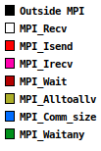
How a trace looks like: basic overview
Computation
Communication
MPI processes
Timeline
MPI call color legend

Slide 13
Model configuration and structure

Slide 14
HARMONIE configuration
Common configuration for the different scenarios:
Branch | release-43h2.beta.5 (with OpenMP bugfix)
Domain | METCOOP25C
Number of points (x) | 900
Number of points (y) | 960
Grid size in meters (x, y) | 2500.0
Time step | 75 seconds
Forecast length | 12 hours
Compile environment | gcc 7.3.0
MPI library | Cray MPICH 7.5.3
NPROMA size | 30
Output | disabled

Slide 15
Structure of HARMONIE
Cut trace containing 12 time steps
Regular time step plus radiation
Regular time steps

Slide 16
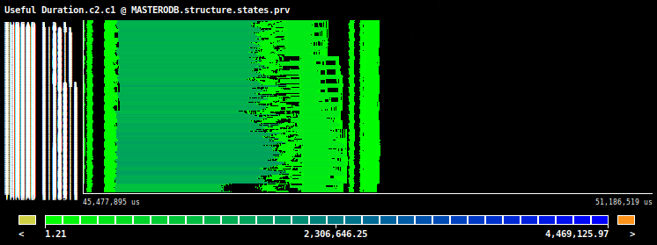
Types of time step
Time steps with radiation are much more expensive due to the extra computation in the grid-point part
Regular time step plus radiation
Regular time step

Slide 17
Structure of a regular time step
A
B
C
D
A - Inverse transformations
B - Grid-point computations
C - Direct transformations
D - Spectral computations

Slide 18
Deployment efficiency evaluation

Slide 19
Potential optimizations for MPI only
Compilation flags:
-ftree-vectorize: It increases the execution time
-march=native: It decreases the execution time
-O3: It increases the execution time
OpenMP:
No OpenMP support: It decreases the execution time
Job geometry:
-ss: the execution time is not affected, but it might be decreased in other circumstances
MPI master in a shared node:
It saves computing resources

Slide 20
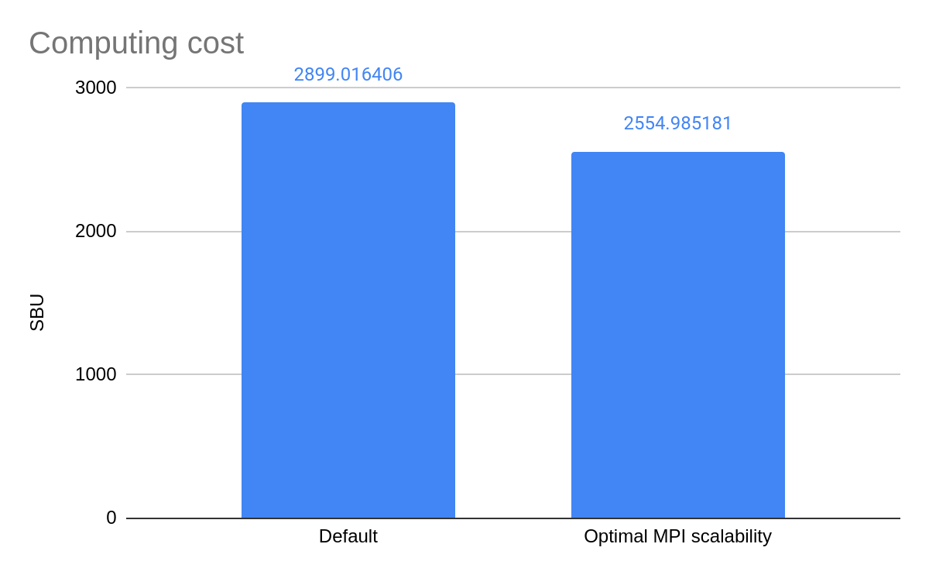
Computing cost of MPI only setups

Slide 21
Potential optimizations for MPI+OpenMP
All previous useful MPI only optimizations, except that OpenMP is enabled
Job geometry:
EC_threads_per_task and -d: It decreases the execution time
-cc depth: It decreases the execution time
Hyperthreading: depending on the needs (time-to-solution vs. cost-to-solution), it might be interesting to enable hyperthreading to decrease the execution time or save computing resources

Slide 22
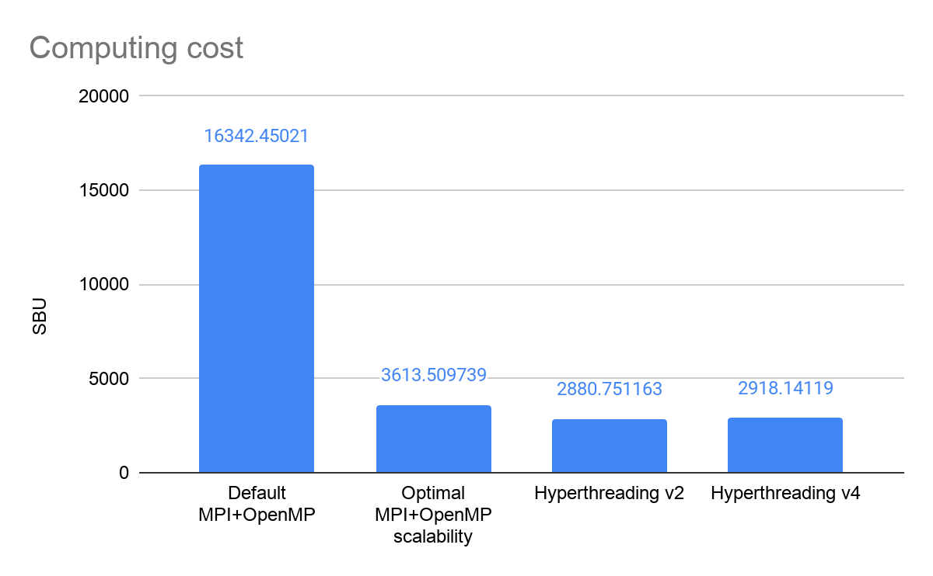
Computing cost of MPI+OpenMP setups

Slide 23
Scalability tests

Slide 24
MPI strong scaling: test cases
MPI processes | nprocx | nprocy | Nodes
285 | 15 | 19 | 8
576 | 18 | 32 | 16
1008 | 28 | 36 | 28
1800 | 25 | 72 | 50

Slide 25
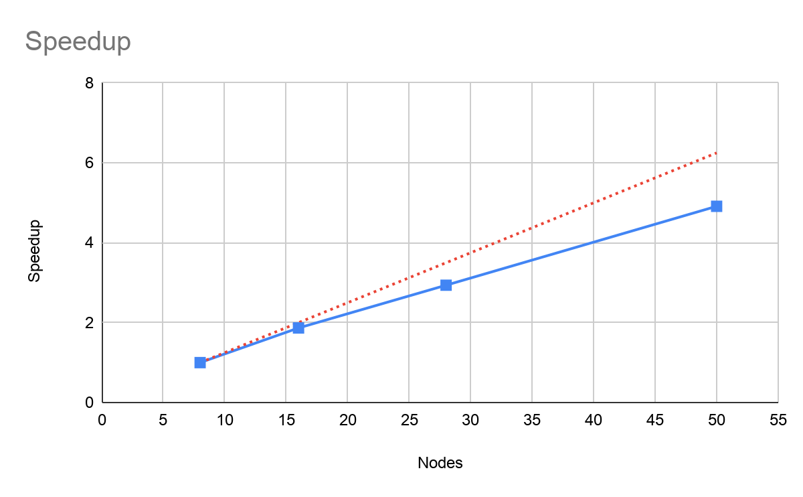
MPI strong scaling: speedup

Slide 26
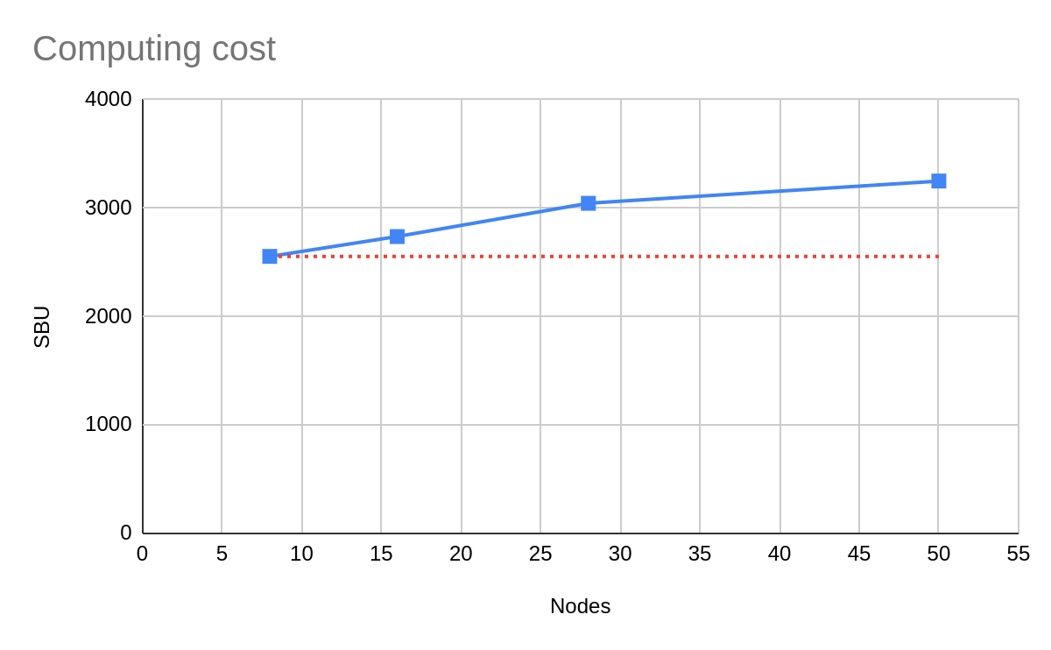
MPI strong scaling: computing cost

Slide 27
MPI strong scaling: trace views
285 MPI (8 nodes)
576 MPI (16 nodes)
1008 MPI (28 nodes)
1800 MPI (50 nodes)

Slide 28
MPI+OpenMP scaling: test cases
OpenMP threads | MPI processes | nprocx | nprocy
1 | 576 | 18 | 32
2 | 288 | 16 | 18
4 | 144 | 9 | 16
6 | 96 | 8 | 12

Slide 29
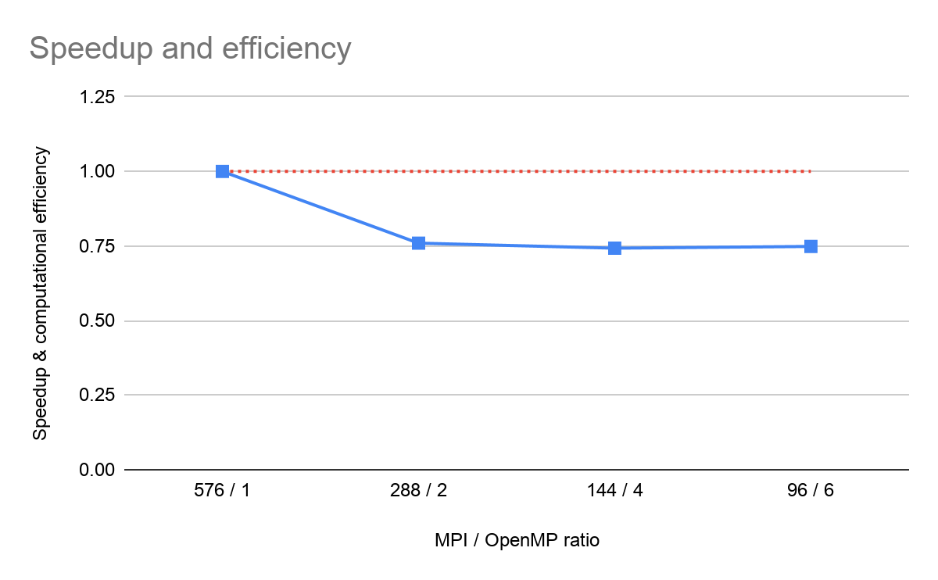
MPI+OpenMP scaling: speedup

Slide 30
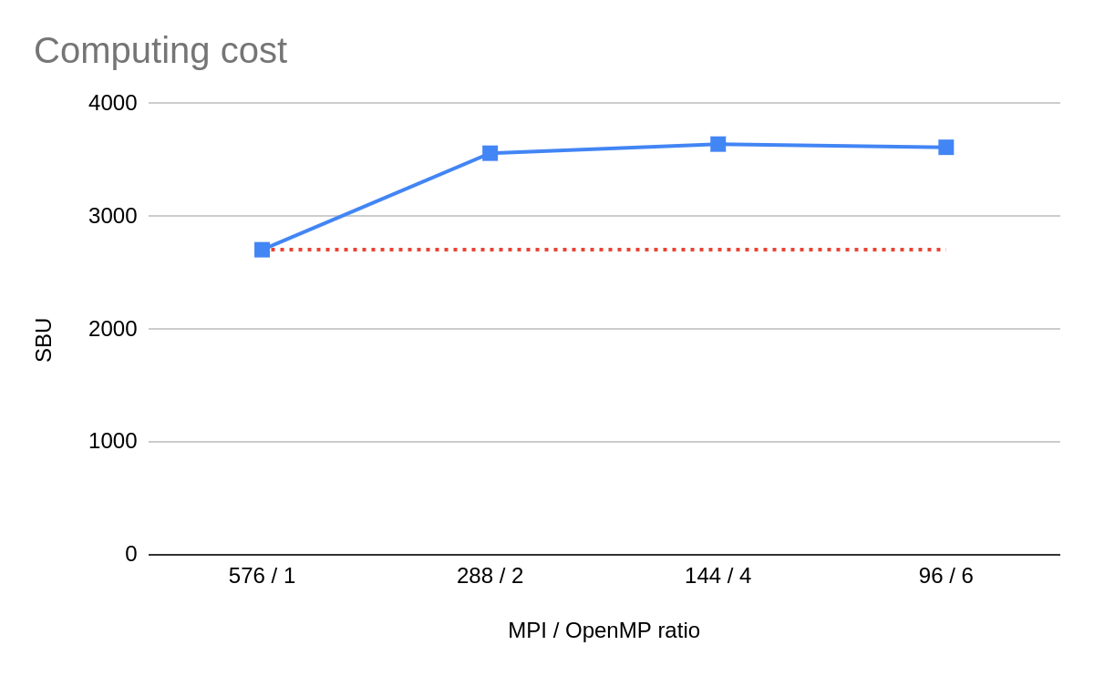
MPI+OpenMP scaling: computing cost

Slide 31
MPI+OpenMP scaling: trace views
576 MPI / 1 OMP
288 MPI / 2 OMP
144 MPI / 4 OMP
96 MPI / 6 OMP

Slide 32
Profiling analysis

Slide 33
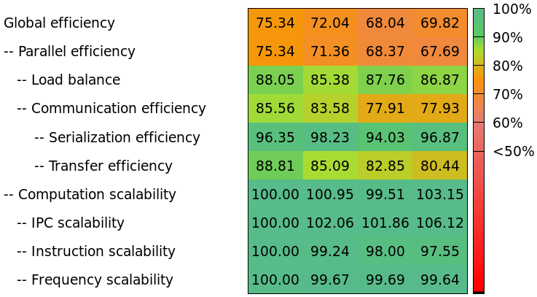
Performance model
Computation and parallel efficiency factors for MPI only:
Good computation scalability and serialization efficiency
Not very good load balance neither transfer efficiency

Slide 34
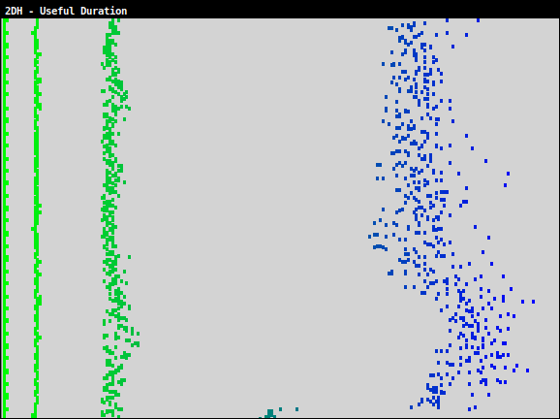
Load balance
All phases are well balanced, except the grid-point computation
A
B
C
D
A
B
C
D

Slide 35
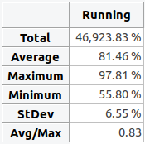
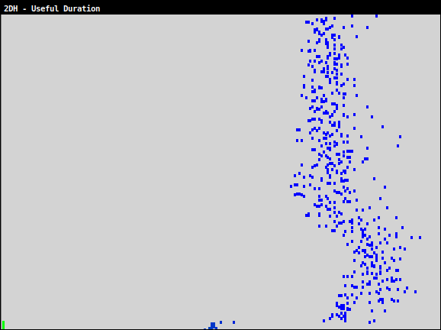
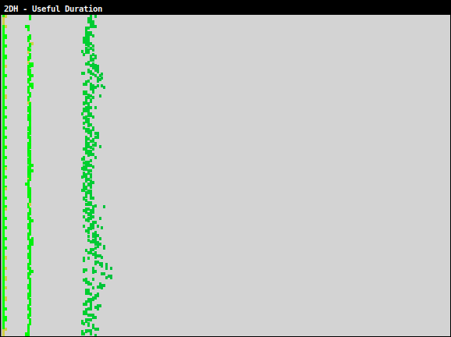
Load balance: grid-point comp. phase
B.1 part: CPG subroutine (cpg.F90) and inner subroutines
B.2 part: Semi-Lagrangian interpolation that belongs to the CALL_SL subroutine (call_sl.F90) and inner subroutines
B
B.1
B.2
B.1
B.2
Imbalanced
Quite well balanced

Slide 36
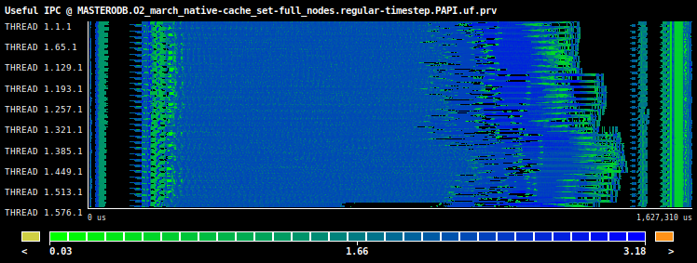
Instructions per Cycle (IPC)
In general, the IPC is above one in the computational parts, except in the spectral one that is quite low.
Useful IPC
Aggregated IPC

Slide 37
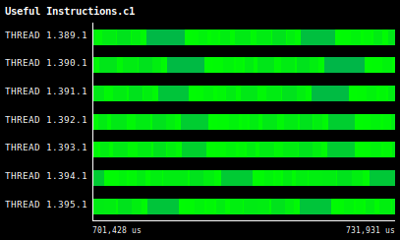
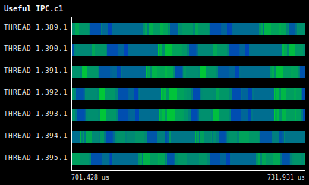
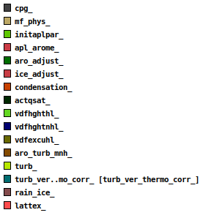
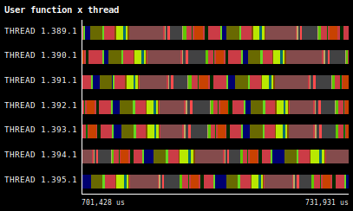
IPC in detail
The IPC varies a lot depending on the piece of code that it is executing
Subset of traced functions

Slide 38
Cache misses
The cache miss ratios in the grid-point part is constant and lower compared to other regions ⟹ high IPC
The cache miss ratios in the spectral part is high ⟹ low IPC
L1
L2
L3

Slide 39
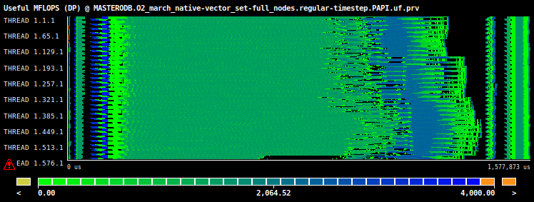
MFLOPS
In general, the MFLOPS do not surpass 1600 and for the grid-point computation phase is about 800
Useful MFLOPS
Aggregated MFLOPS

Slide 40
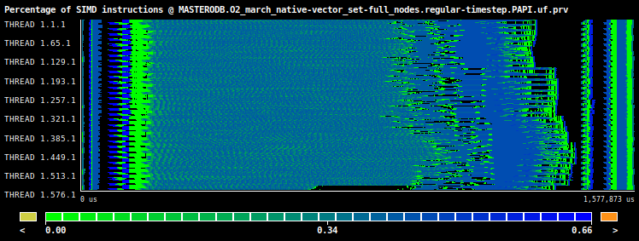
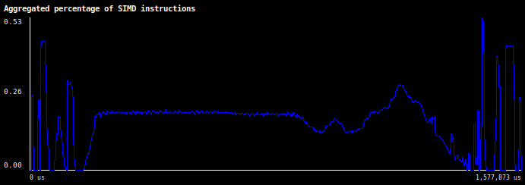
SIMD instructions
Percentage of floating-point operation SIMD instructions of the total instructions: 20% for the grid-point phase and 43% for the spectral phase
This percentage difference is the main reason in their MFLOPS difference
In the grid-point phase there are more instructions than in the spectral phase that are not doing useful computation
Useful percentage
Aggregated percentage

Slide 41
Sources of load imbalance
CPU frequency slowdown: The system may decide to temporarily slow down the frequency because of thermal issues
IPC slowdown: The number of instructions (IPC) achieved is very correlated to the performance of the application. There are many factors that may slow it down:
Increase in the number of cache misses.
Increase in the number of TLB misses.
Increase in the number of mispredicted branches.
Other types of stalls such as ROB, SB, etc.
Different number of instructions: Because of the algorithm used or the parallelization strategy, the amount of instructions (workload) may not be balanced across the processes

Slide 42
CPG load imbalance: CPU frequency?
The aggregated CPU frequency of the CPG part, which is constant along the time, it is not the cause of the load imbalance

Slide 43
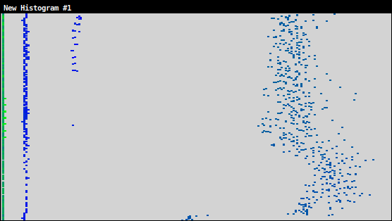
CPG load imbalance: IPC?
The IPC is kept across all processes, as there is no variance in the semantic scale (color) of the CPG part of the histogram, so it is not the cause of the load imbalance
CPG

Slide 44
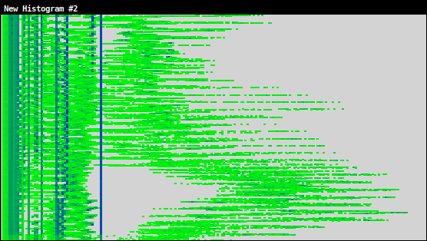
CPG load imbalance: instructions?
The histogram indicates that the amount of work across processes is not the same, so this is the source of the load imbalance
Two different sources: extension zone treatment and unknown

Slide 45
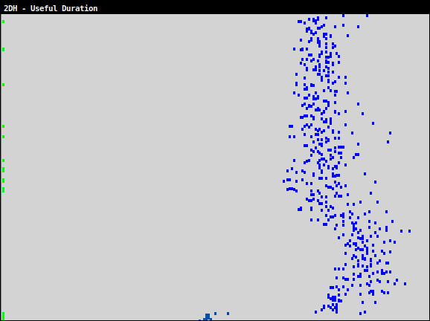
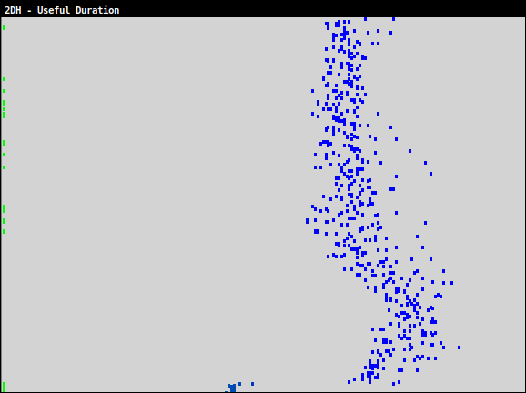
CPG part: compute or memory bound?
Simple L3 cache pressure test: use only half of the cores per socket (18 instead of 36), but doubling the nodes
There is a decrease in the duration of the bursts, which proves that L3 is a bottleneck, so in this context the application is memory bound.
Full socket
Half socket

Slide 46
CPG part: compute or memory bound?
What happens? The L3 cache misses decrease when using half of the cores of the socket
Full socket used
L1
Half socket used
20
L2
15
L3
5.5
4

Slide 47
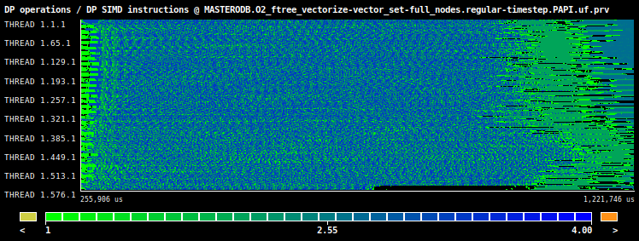
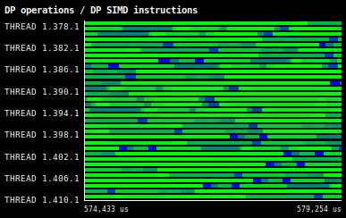
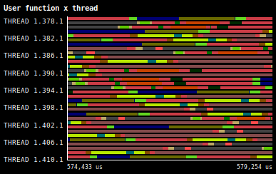
CPG part: gcc auto-vectorization
Useful duration
-O2 -march=native
The vectorization efficiency is around 1.40 for the vectorized code
It really depends on the user function
Difficult to understand why this poor auto-vectorization efficiency of gcc
-O2 -ftree-vectorize
Aggregated MFLOPS
Aggregated vectorization efficiency
Vectorization efficiency
User functions
Subset of traced functions

Slide 48
MPI calls and profile
Not many different types of MPI functions are used
Only the MPI_Alltoallv and MPI_Waitany functions represent a significant amount of time with 14.65% and 9.29% respectively. In part, because of the CPG load imbalance

Slide 49
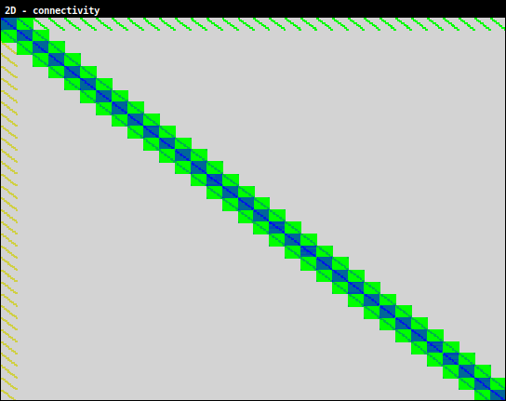
Point-to-point connectivity matrix
It indicates who communicates with whom
Almost all point-to-point communications are locally performed between MPI processes neighbours

Slide 50
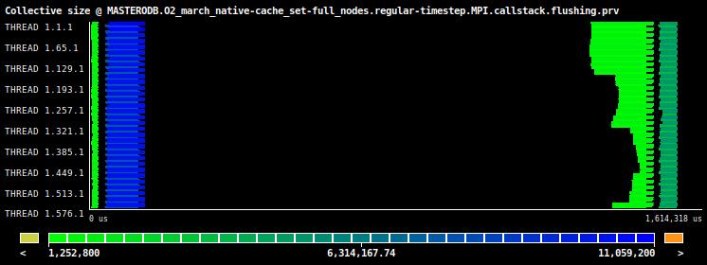
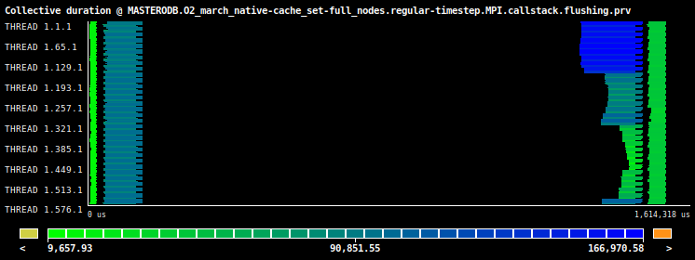
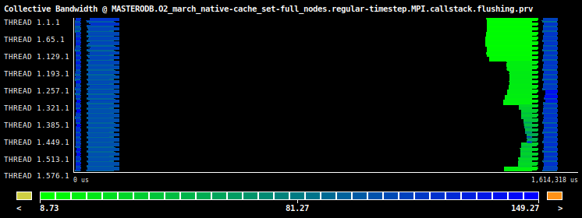
Collective communications
Four calls to MPI_Alltoallv each time step
The most significant in terms of size and duration is the second one
Call
Enumeration
Size
Duration
Bandwidth

Slide 51
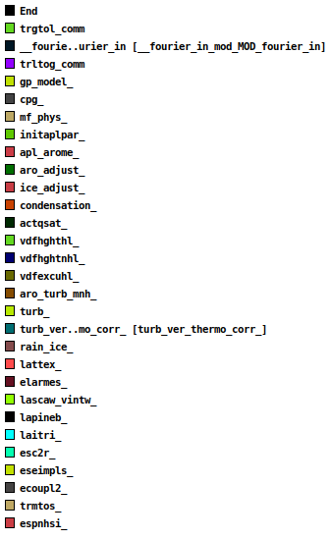
Subset of profiled user functions
The granularity of the calls is very fine
Performance may be decreased because additional control instructions are executed

Slide 52
Recommendations

Slide 53
Recommendations
Building process: have two compilation files for the HARMONIE binary and the other tools
Compilation flags:
Add the -march=native flag to use specific instructions of the target architecture
Remove the -ffast-math flag
Remove some (legacy) flags that might not be useful or necessary, such as -fno-second-underscore or -rdynamic
OpenMP: if HARMONIE is only run with one OpenMP thread per MPI process, it would be useful to disable the OpenMP support

Slide 54
Recommendations (2)
Job geometry for new platforms. On ECMWF cca these parameters should be defined:
-cc
-S
-ss
-d and EC_threads_per_task
-j
The MPI master should run in a shared node to save SBU
Explore alternative compilers that might provide a performance increase such as Intel
Extension zone treatment: it would be interesting to find a workaround to mitigate the load imbalance

Slide 55
What’s next?

Slide 56
Follow-up ideas
Whole time step:
Study in detail the point-to-point communications
Study the low efficiency of the OpenMP parallelization
Grid-point computation phase, especially the CPG part:
The source of the load imbalance
NPROMA blocking scalability
Analyze other sources of CPU stalls
Determine if the fine granularity of user functions affects the performance
Determine performance metrics such as IPC or cache misses at a lower level, this is, per significant user function
Analyze the low auto-vectorization efficiency of gcc

Slide 57
Thank you
xavier.yepes@bsc.es

