Slide 1
Vienna, 13 April 2015
Study of the Mediterranean desert dust outbreaks’ vertical structure based on a synergistic use of satellite and ground retrievals
A. Gkikas¹, S. Basart¹, N. Hatzianastassiou², J. Pey³,
X. Querol⁴, V.Amiridis⁵, O. Jorba¹, S Gassó⁶, J. M. Baldasano^{1,6}
“The MDRAF project has received funding from the European Union’s Seventh Framework Programme for research, technological development and demonstration under grant agreement no 622662”

Slide 2
Introduction
Mediterranean is affected by dust outbreaks throughout the year
Their spatial and temporal characteristics (Moulin et al., 1998, Gkikas et al., 2013) apart from the dust sources are mainly determined by the prevailing atmospheric circulation (Gkikas et al., 2014)
Dust transport over the Mediterranean has a multilayered structure (Hamonou et al., 1999) in contrast to the Atlantic Ocean (SAL, Karyampudi et al., 1999)
Description of the Mediterranean dust outbreaks based on lidar measurements (Papayanis et al., 2008) and therefore geographically limited
European Aerosol Research Lidar Network (EARLINET, Bösenberg et al., 2003)
Limited/Few studies based on satellite retrievals (Amiridis et al., 2009) and modelling techniques (Alpert et al., 2004)
Interaction with the radiation → atmospheric dynamics (Mallet et al., 2009)
Consideration of radiative impacts in numerical simulations improve weather models’ forecasting accuracy (Pérez et al., 2006)
European Geosciences Union | General Assembly 2015 | Vienna | Austria | 12 – 17 April 2015

Slide 3
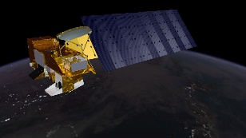
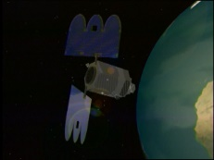
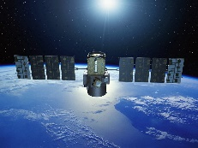
Satellite and ground datasets
Gridded daily satellite retrievals provided at 1ºx1º spatial resolution
MODIS – Terra (2000 – 2013) & MODIS – Aqua (2003 – 2012) – C051, L3
Aerosol Optical Depth at 550nm (AOD550nm)
Ångström exponent (land ➔ 470 – 660nm, sea ➔ 550-865nm)
Fine Fraction
Effective radius (over sea)
Earth Probe TOMS (2000 – 2004)
Aerosol Index (AI)
OMI-Aura (2005 – 2013)
Aerosol Index (AI)
Columnar data
CALIOP - CALIPSO (2006 – 2013) – Versions 3.01 & 3.02
Vertical Feature Mask (Level 2, 5km spatial resolution)
APro files (Level 2, 5km spatial resolution)
CAD score
Total backscatter coefficient at 532nm (β₅₃₂)
Vertical data
Daily AERONET Level 2.0 optical properties over the period 2000 – 2013
Daily PM₁₀ measurements (2001 – 2011) – [18 RB & 4 SUB stations]
European Geosciences Union | General Assembly 2015 | Vienna | Austria | 12 – 17 April 2015

Slide 4
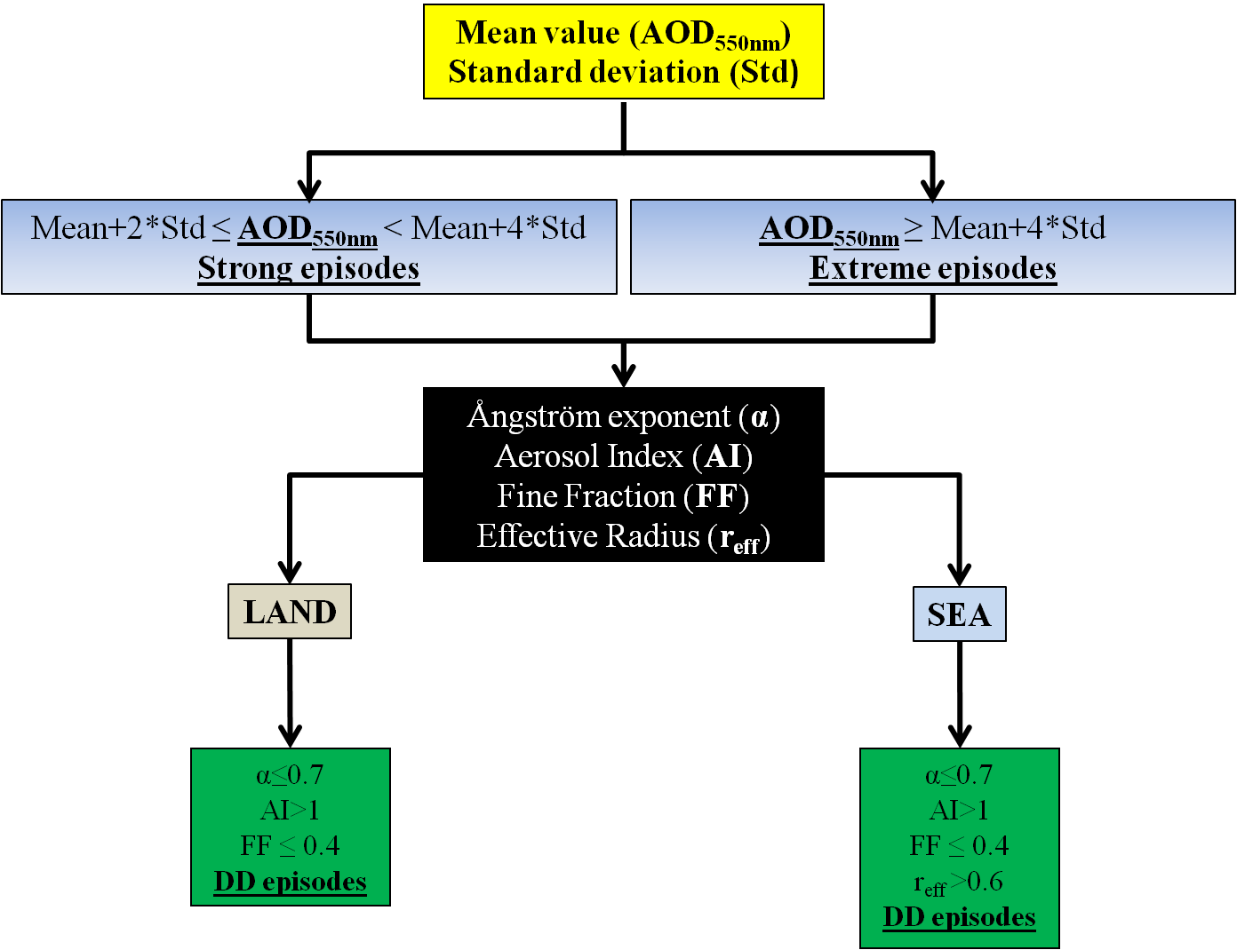
Identification of desert dust (DD) episodes
Gkikas et al. (2009, Ann. Geophys.)
Gkikas et al. (2013, ACP)
Implementation of the algorithm in each grid cell
European Geosciences Union | General Assembly 2015 | Vienna | Austria | 12 – 17 April 2015

Slide 5
The regime of mediterranean desert dust outbreaks
European Geosciences Union
General Assembly 2015
Vienna | Austria | 12 – 17 April 2015

Slide 6
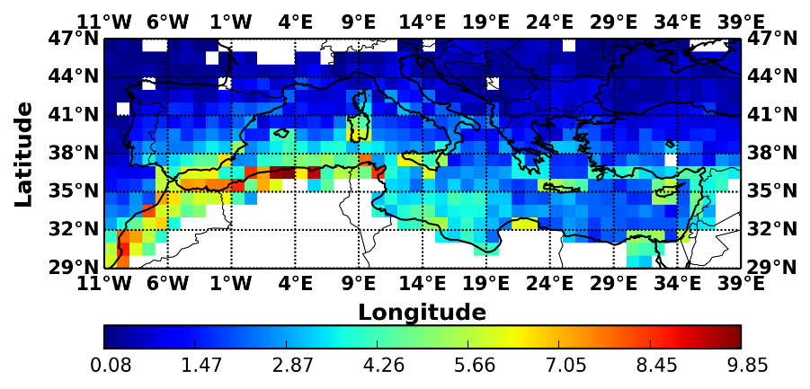
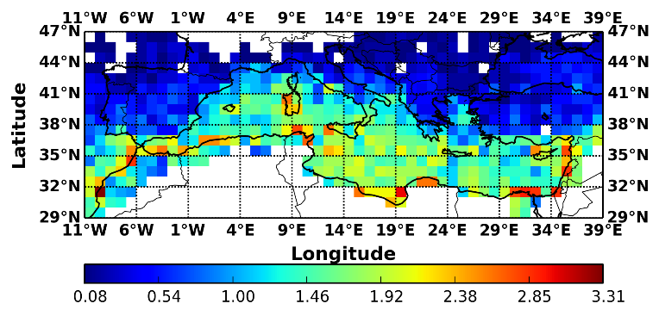
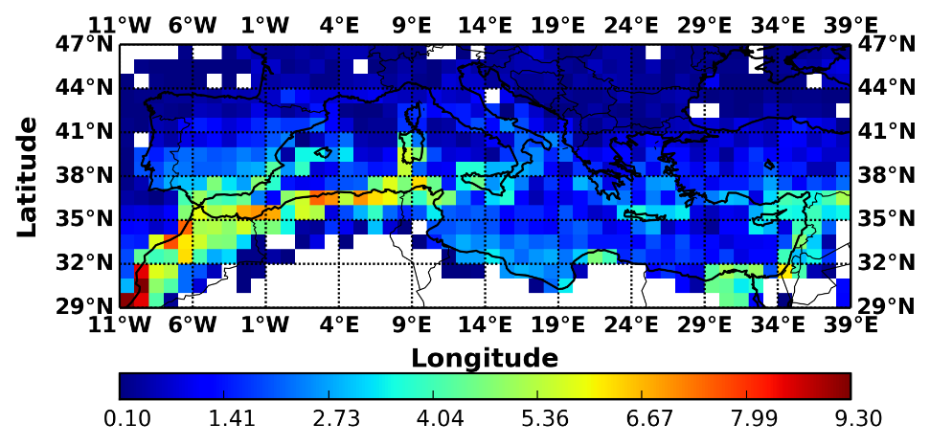
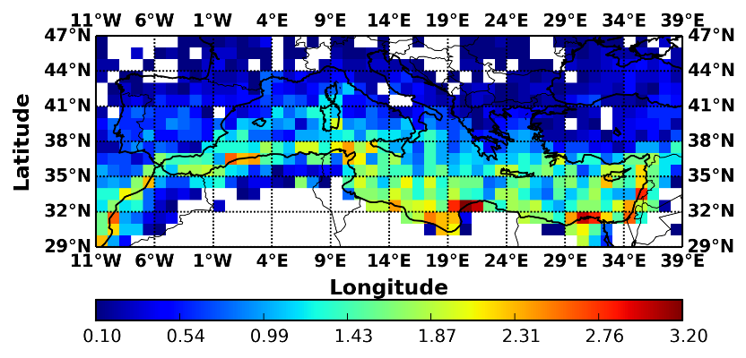
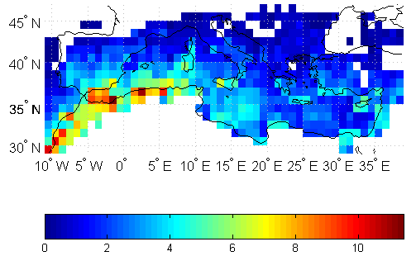
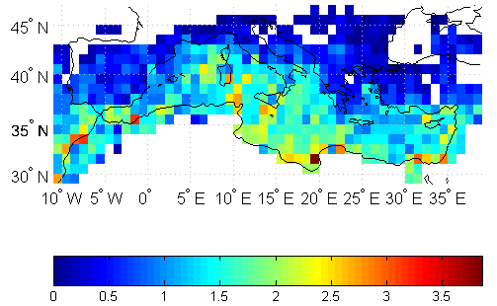
Frequency of occurrence of dust outbreaks (episodes/year)
Strong DD episodes
Extreme DD episodes
9.9
2000 – 2013
MODIS-Terra
3.3
9.3
2003 – 2012
MODIS-Aqua
3.2
2000 – 2007
MODIS-Terra
11.4
3.9
Gkikas et al. (2013, ACP)
Similar spatial patterns among the different study periods
MODIS-Terra: Reduction of the frequencies
European Geosciences Union | General Assembly 2015 | Vienna | Austria | 12 – 17 April 2015

Slide 7
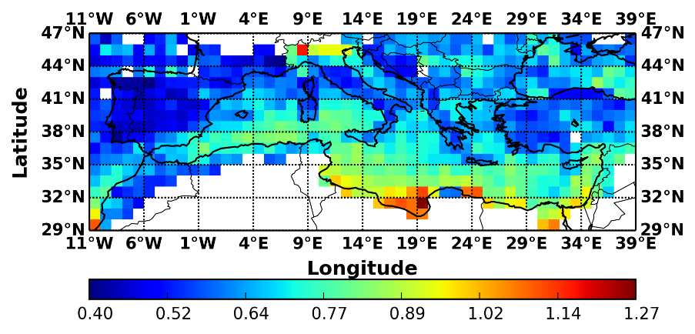
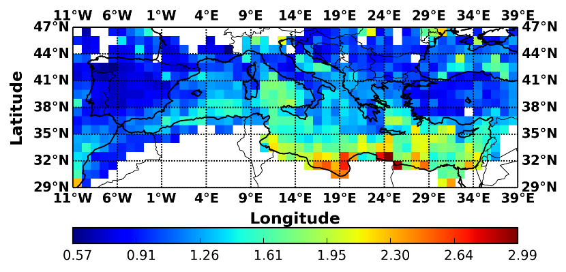
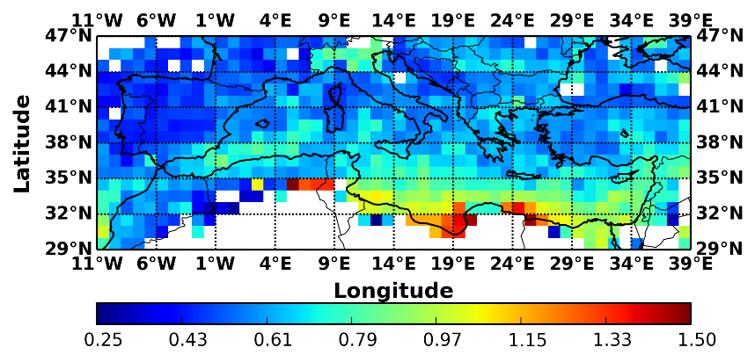
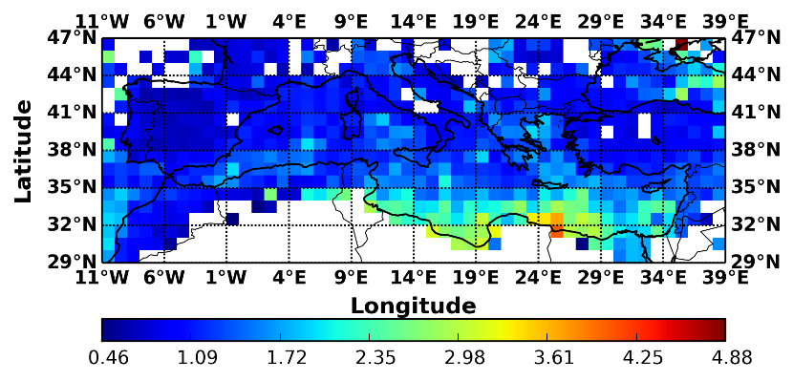
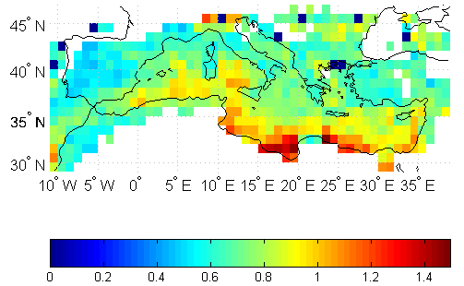
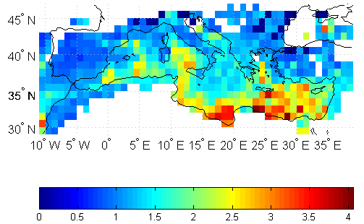
Intensity of dust outbreaks (AOD_{550nm})
Strong DD episodes
Extreme DD episodes
1.3
2000 – 2013
3.0
1.5
2003 – 2012
4.0
1.5
4.1
2000 – 2007
Gkikas et al. (2013, ACP)
Similar spatial patterns among the different study periods
MODIS-Terra: Reduction of the intensities
European Geosciences Union | General Assembly 2015 | Vienna | Austria | 12 – 17 April 2015

Slide 8
Evaluation of the satellite algorithm against surface measurements
European Geosciences Union
General Assembly 2015
Vienna | Austria | 12 – 17 April 2015

Slide 9
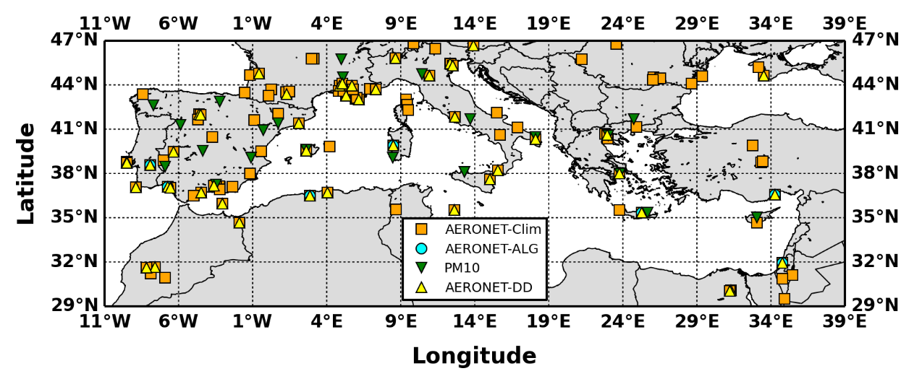
AERONET and PM₁₀ sites
Station | Study period
Blida | 7/11/2003 – 18/2/2012
El Arenosillo | 1/3/2000 – 21/2/2010
Evora | 4/7/2003 – 28/2/2013
FORTH CRETE | 23/1/2003 – 6/8/2011
IMC Oristano | 30/5/2000 – 28/2/2003
IMS METU ERDEMLI | 1/3/2000 – 28/2/2013
Nes Ziona | 1/2/2000 – 28/2/2013
109 Stations
46 Stations
7 Stations
22 Stations
European Geosciences Union | General Assembly 2015 | Vienna | Austria | 12 – 17 April 2015

Slide 10
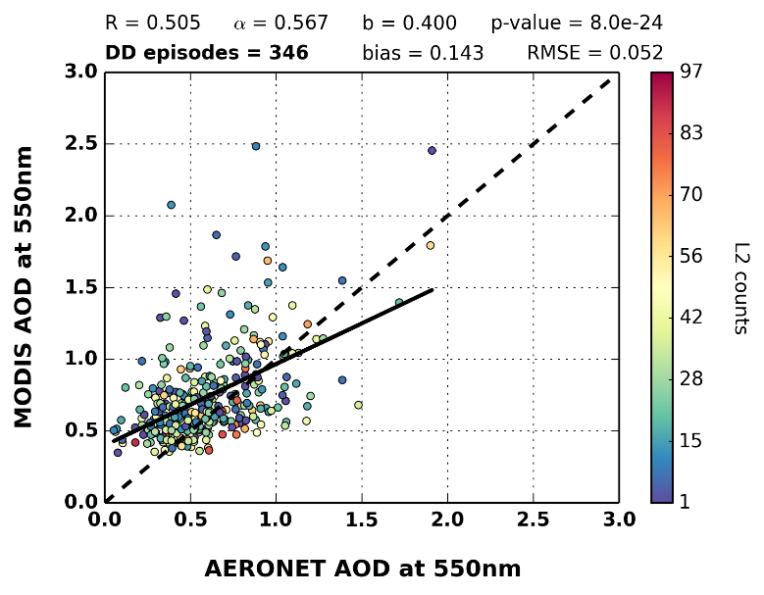
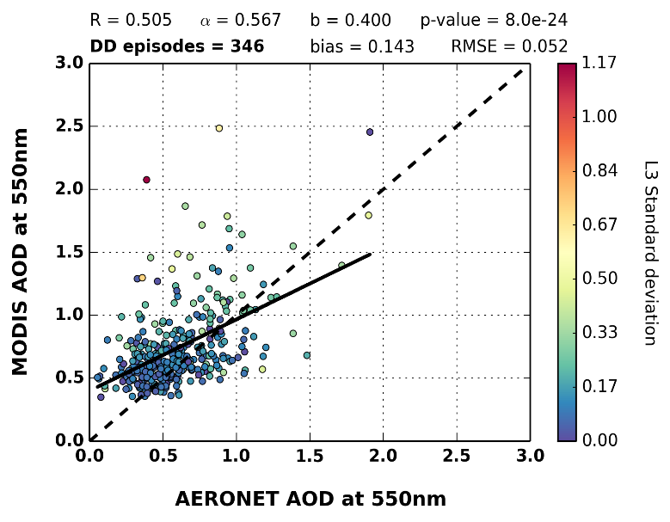
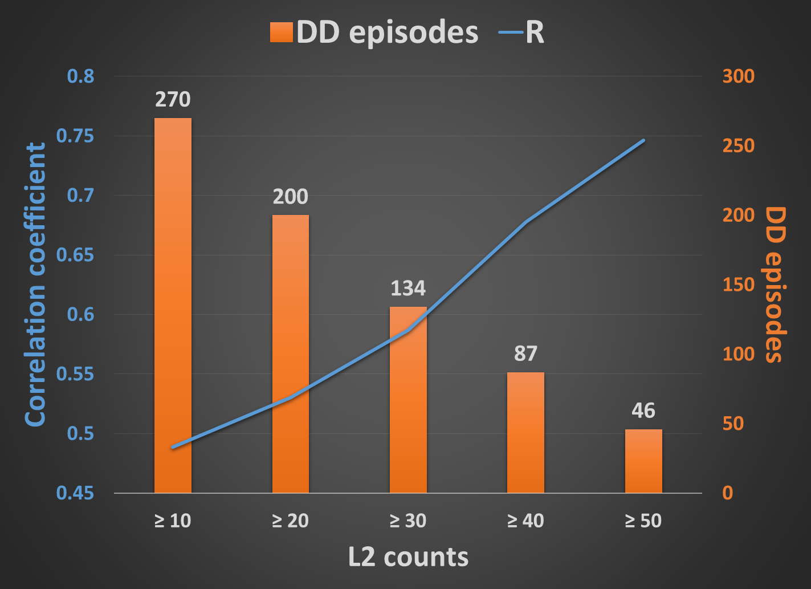
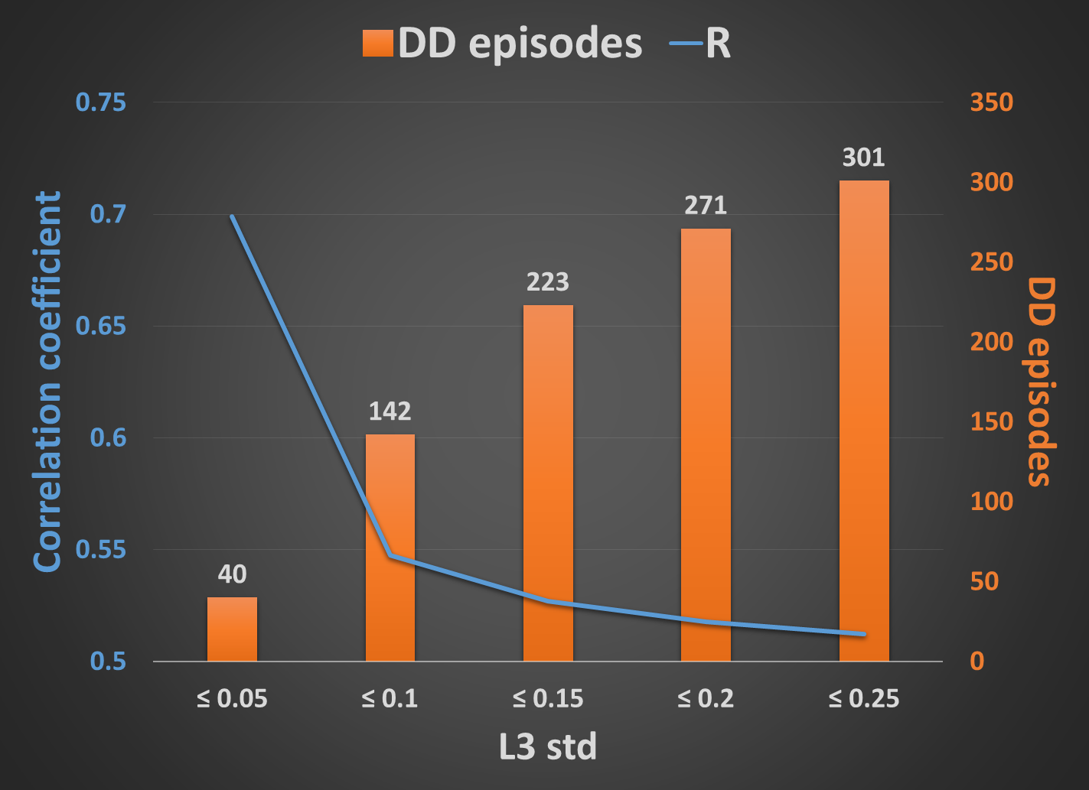
Scatterplot of AERONET and MODIS-Terra AODs
Resolved by Level 2 counts
Resolved by Level 3 std
Better agreement between ground and satellite AODs for L3 retrievals with higher sub-grid spatial representativeness and homogeneity
European Geosciences Union | General Assembly 2015 | Vienna | Austria | 12 – 17 April 2015

Slide 11
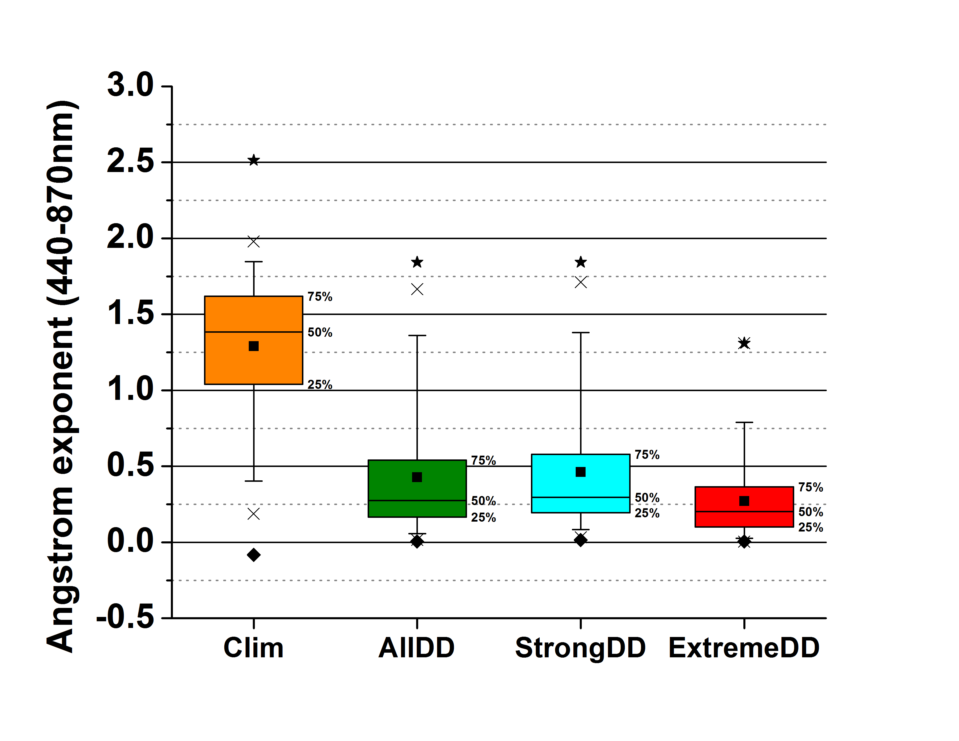
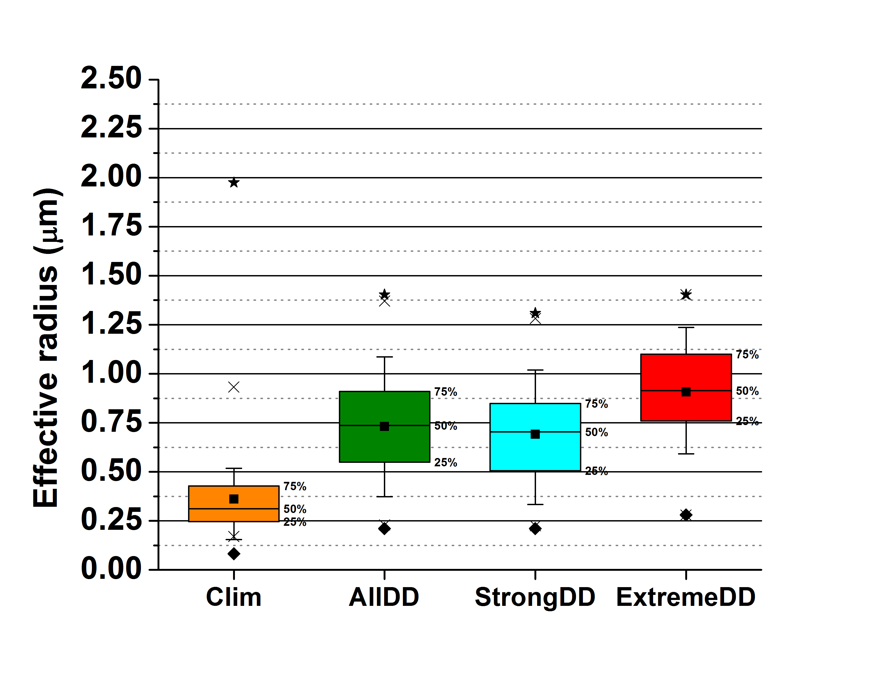
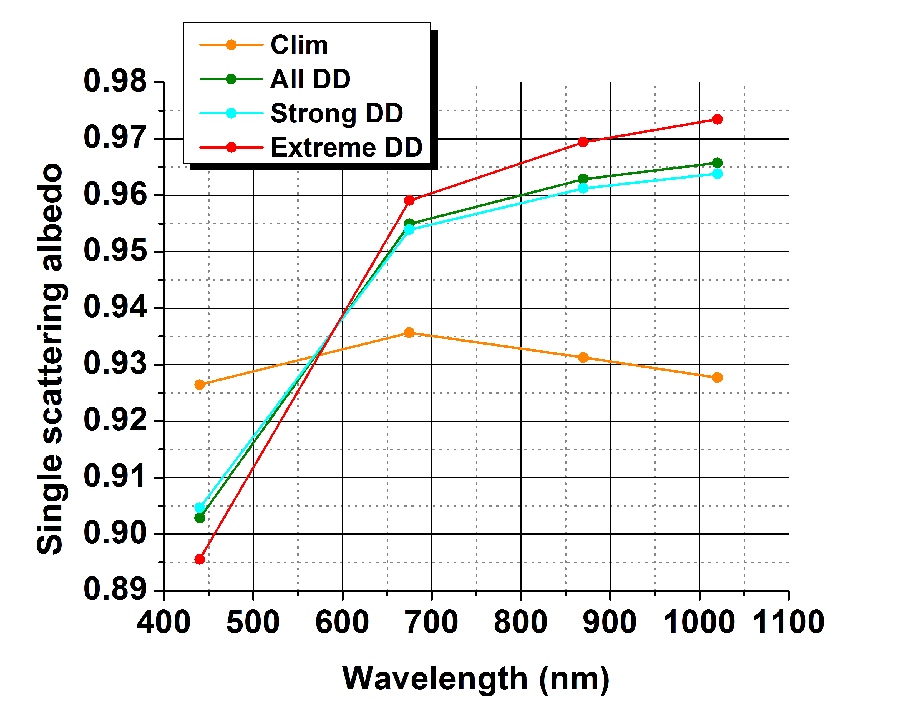
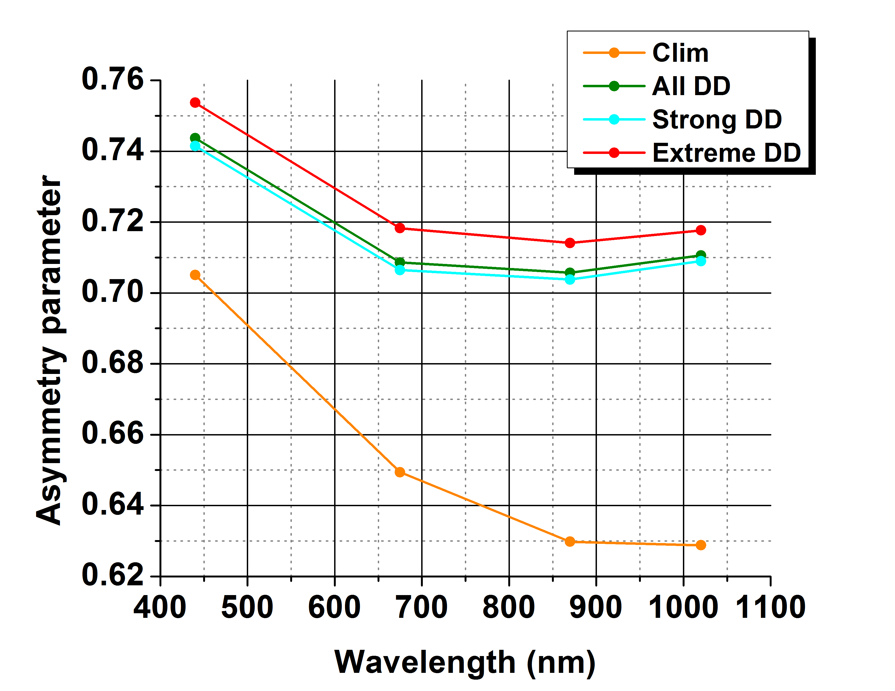
AERONET – Optical properties
MODIS-Terra (2000 – 2013)
Ångström exponent
Effective radius
α_{440-870nm}
r_{eff}
Single scattering albedo
Asymmetry parameter
Typical spectral variation, indicative of dust aerosols, for ω and g values
European Geosciences Union | General Assembly 2015 | Vienna | Austria | 12 – 17 April 2015

Slide 12
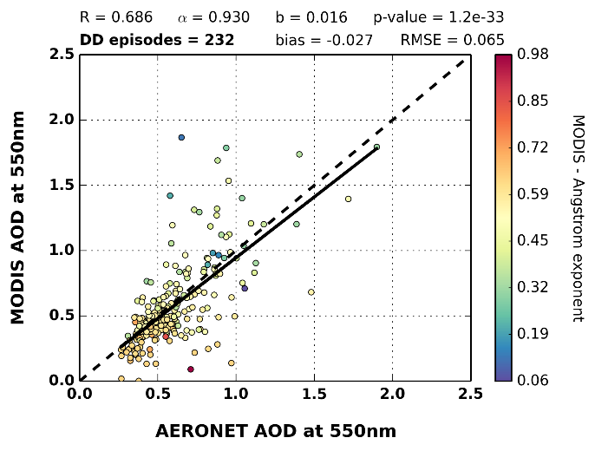
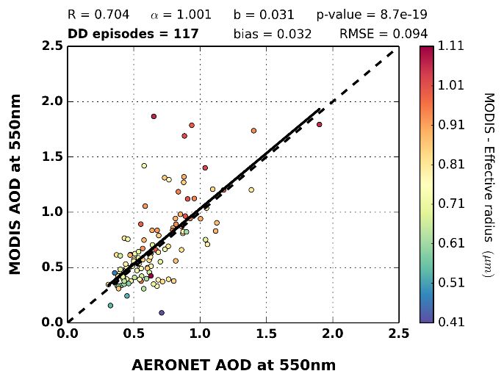
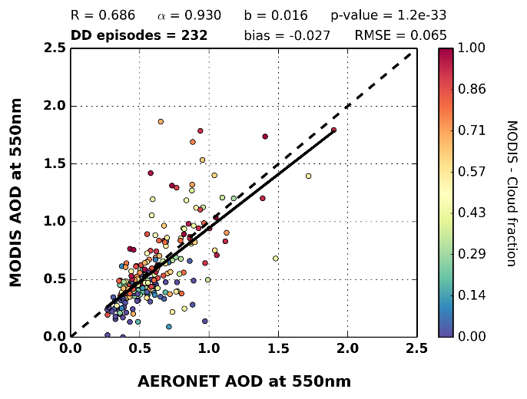
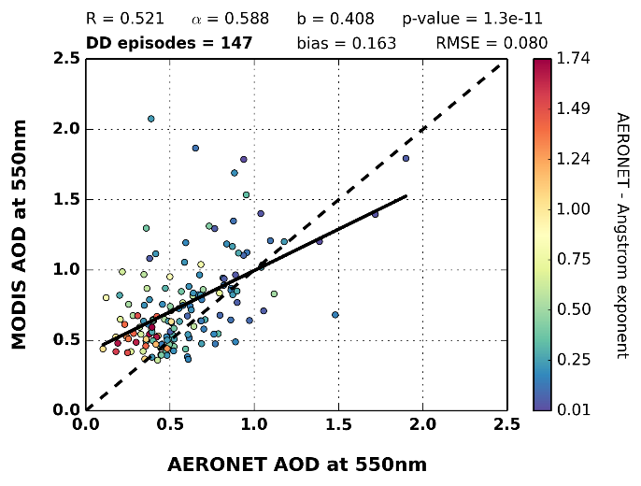
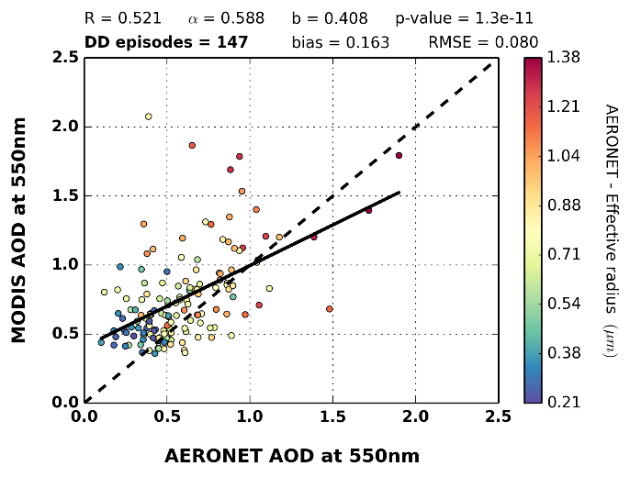
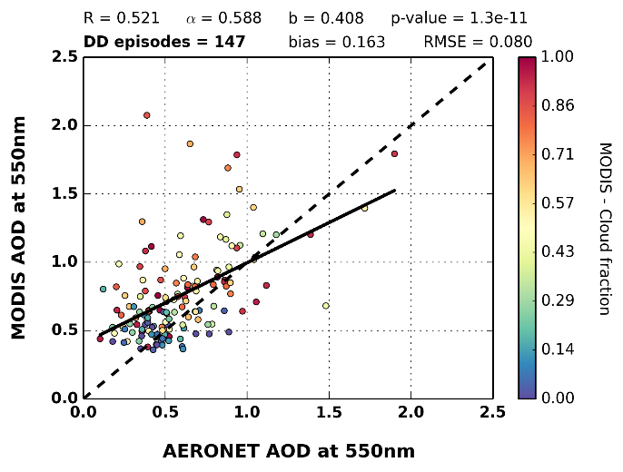
Intercomparison of ground and satellite algorithms
Identification of DD episodes based on AOT₈₇₀, α₄₄₀₋₈₇₀ and r_{eff} AERONET retrievals
AERONET
MODIS-Terra
Better agreement between AERONET and MODIS when ground retrievals are used
About 15% of the pixel level DD episodes is misclassified by the satellite algorithm
Cloud contamination can cause overestimation of the DD episodes’ intensity
European Geosciences Union | General Assembly 2015 | Vienna | Austria | 12 – 17 April 2015

Slide 13
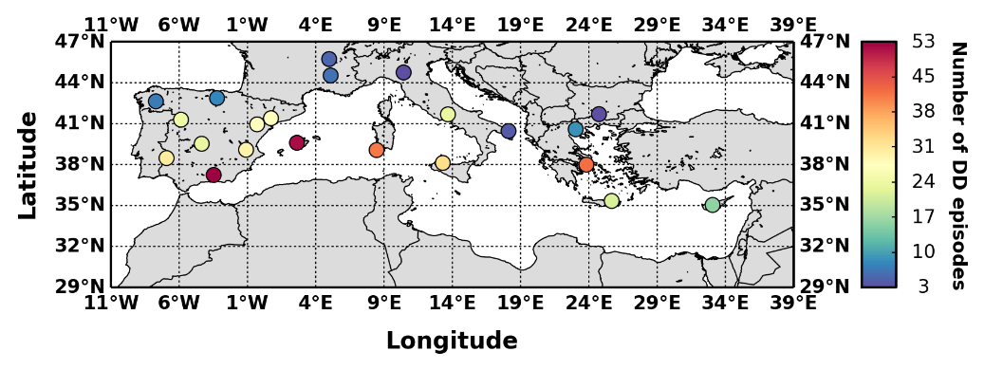
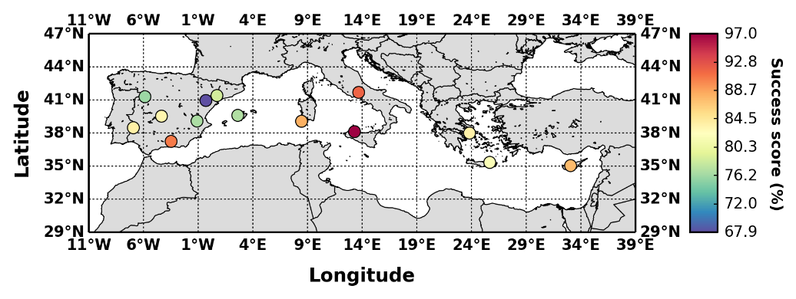
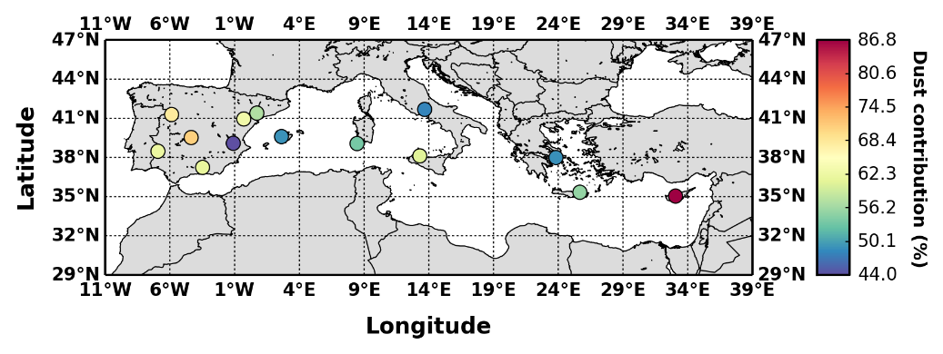
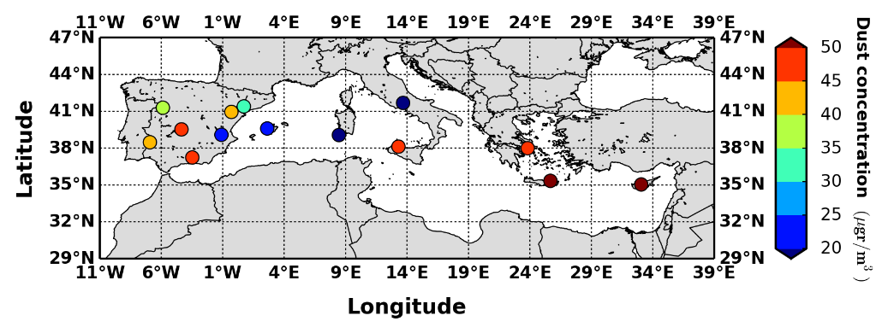
Comparison against PM₁₀ measurements
Number of DD episodes
Success score
Desert dust contribution (%)
Mean desert dust concentration
Total and dust PM₁₀ concentrations (Pey et al., 2013)
Number of DD episodes: 3 – 53
In 14 out of 22 stations more than 10 DD episodes have been identified
Success score: 67.9% - 97%
Desert dust contribution: 44% - 86.8%
Mean desert dust concentration: 20 μgr/m³ – 50 μgr/m³
Min: 17 μgr/m³ (Censt, Sardinia)
Max: 223 μgr/m³ (Ayia Marina, Cyprus)
European Geosciences Union | General Assembly 2015 | Vienna | Austria | 12 – 17 April 2015

Slide 14
3d structure of the mediterranean desert dust outbreaks
European Geosciences Union
General Assembly 2015
Vienna | Austria | 12 – 17 April 2015

Slide 15
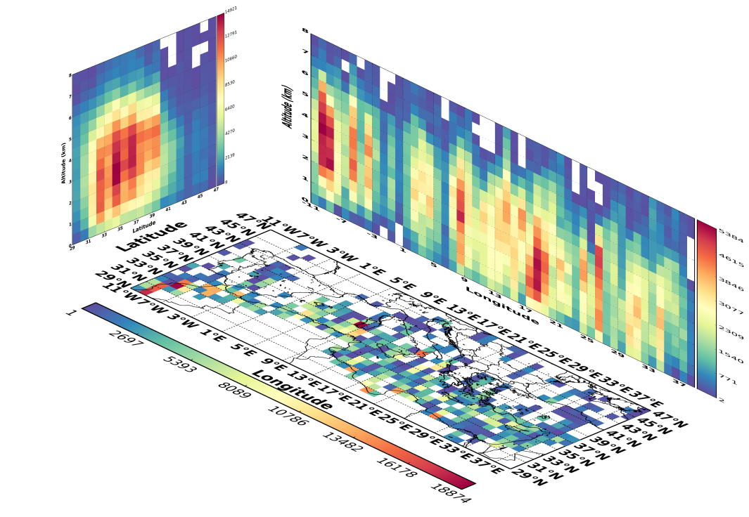
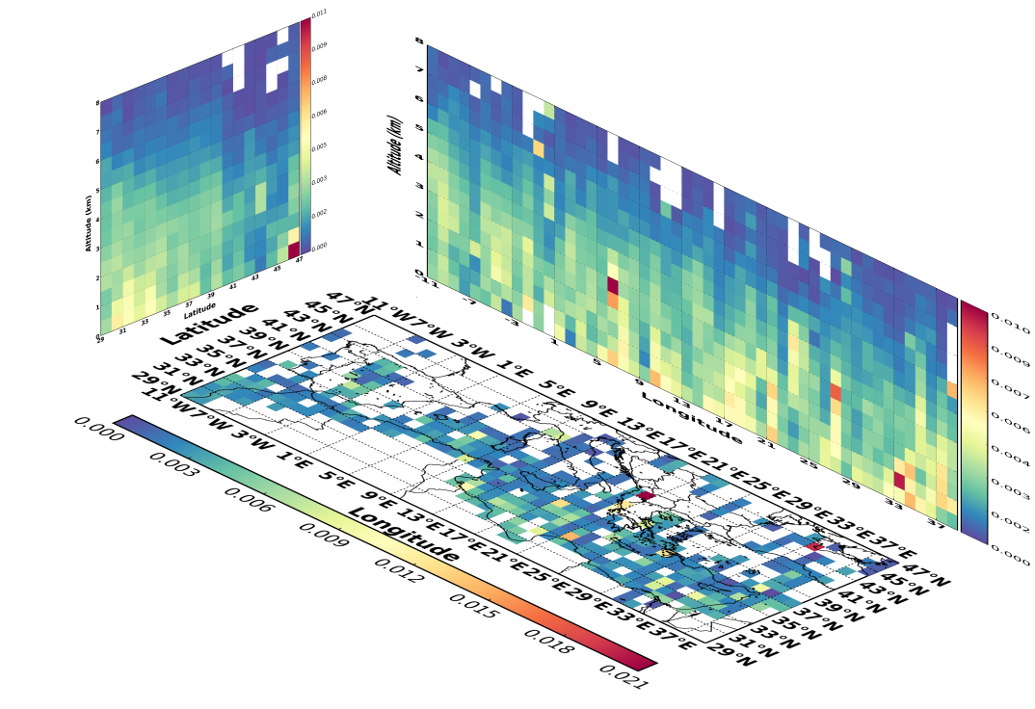
Vertical structure of desert dust outbreaks over the Mediterranean
16 layers up to 8km
Boxes of 1ºx1º spatial resolution (surface area) and 500m height
CALIPSO VFM: Dust & Polluted dust
-100 ≤ CAD ≤ -20 (Winker et al., 2013)
CALIPSO dust observations
Total backscatter coefficient (532nm)
40ºN
2 – 6 km
0.5 – 6 km
0.5 – 6 km
< 2 km
0.006 sr⁻¹ km⁻¹
Increasing height with latitude
< 1.5 km (35ºN - 38ºN)
2 – 4 km (35ºN - 43ºN)
Decreasing base height with longitude
European Geosciences Union | General Assembly 2015 | Vienna | Austria | 12 – 17 April 2015

Slide 16
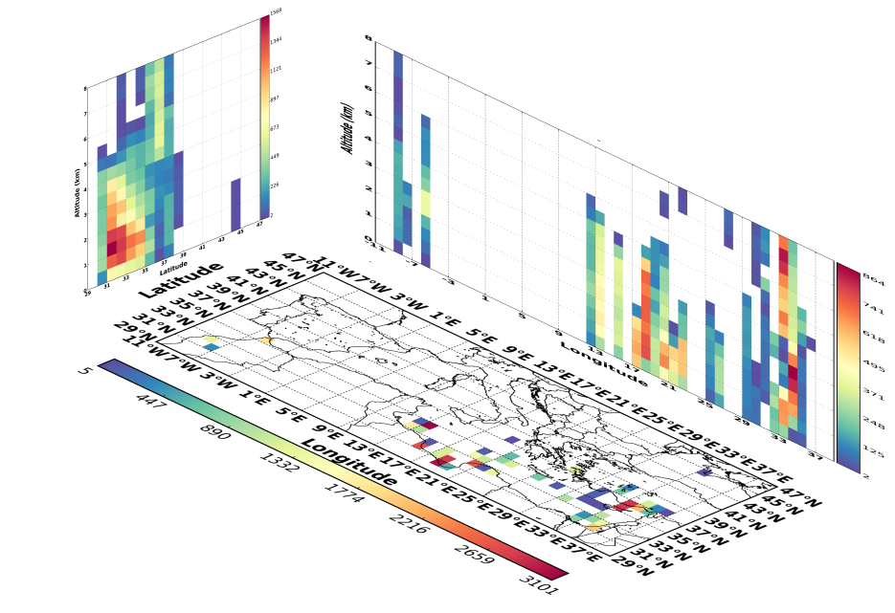
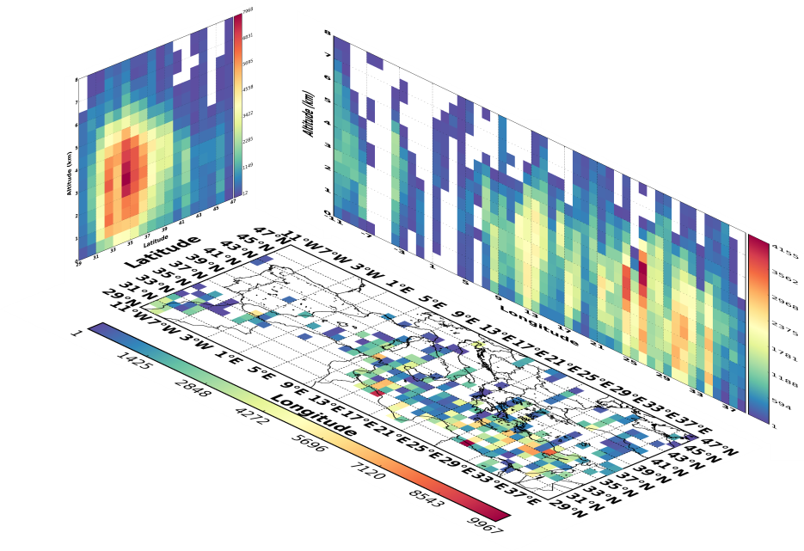
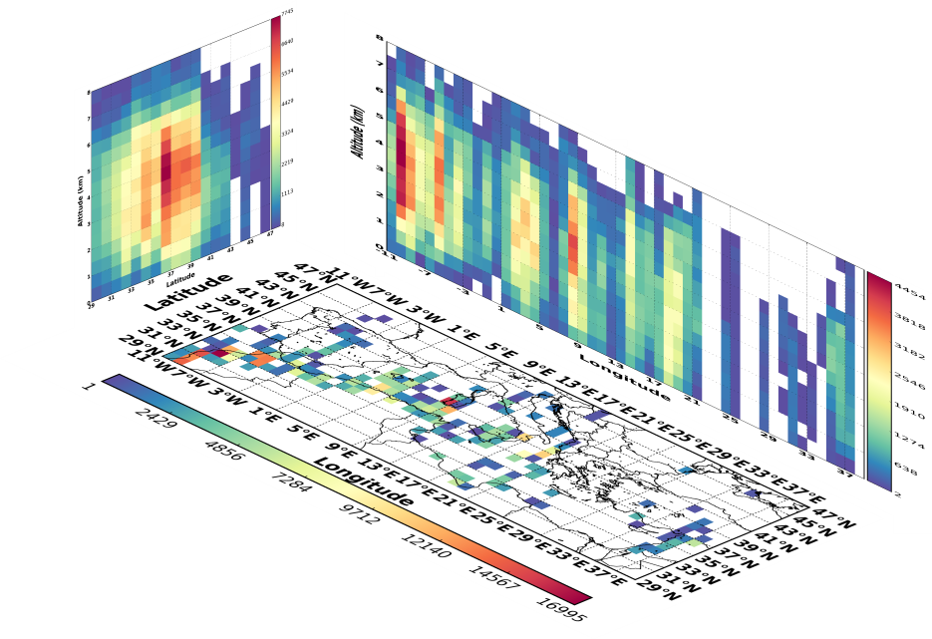
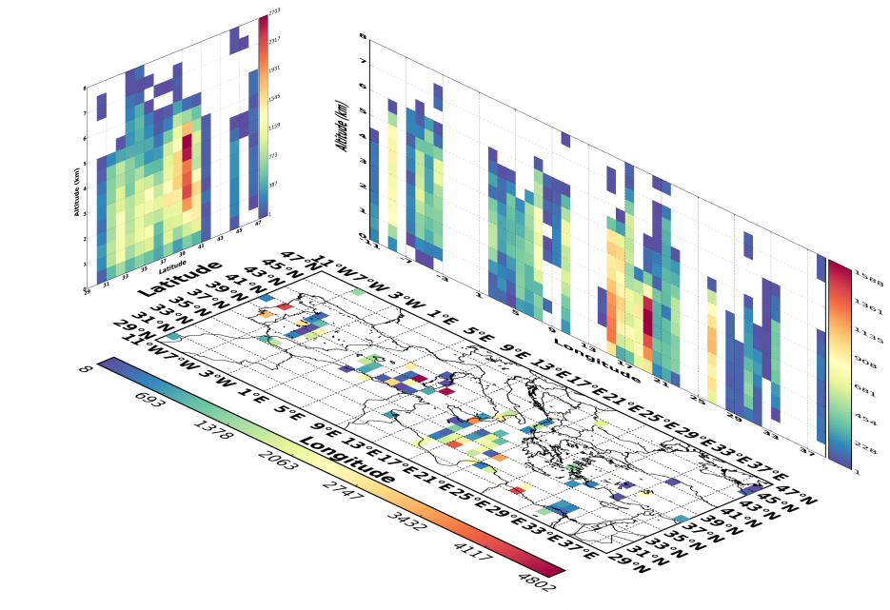
Seasonal variation of dust outbreaks’ vertical structure (dust observations)
0.5 – 4 km
Winter
0.5 – 5.5 km
Spring
0.5 – 4 km
0.5 – 5 km
Summer
Autumn
1 – 6 km
1.5 – 4.5 km
0.5 – 4 km
2 – 6 km
European Geosciences Union | General Assembly 2015 | Vienna | Austria | 12 – 17 April 2015

Slide 17
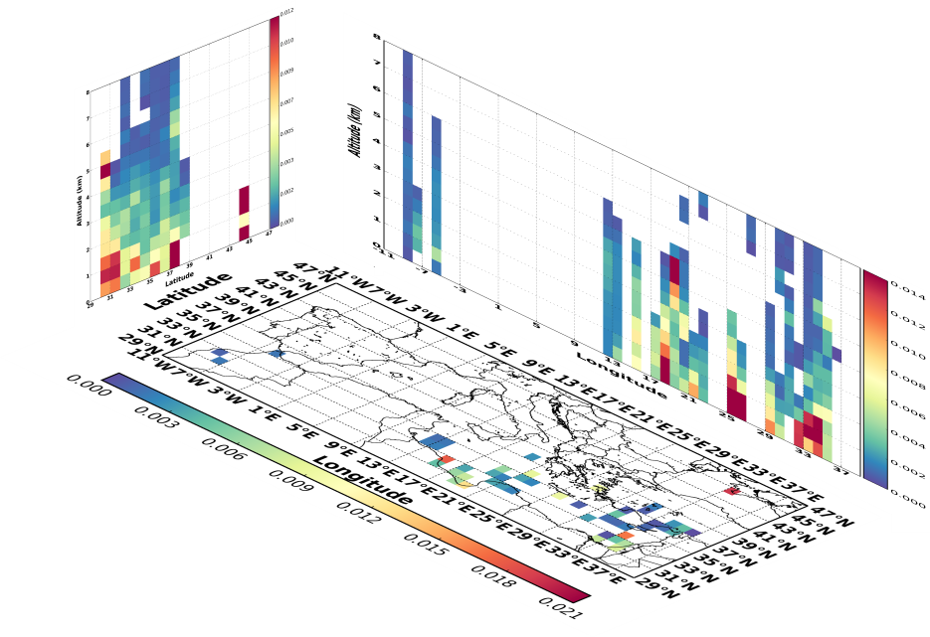
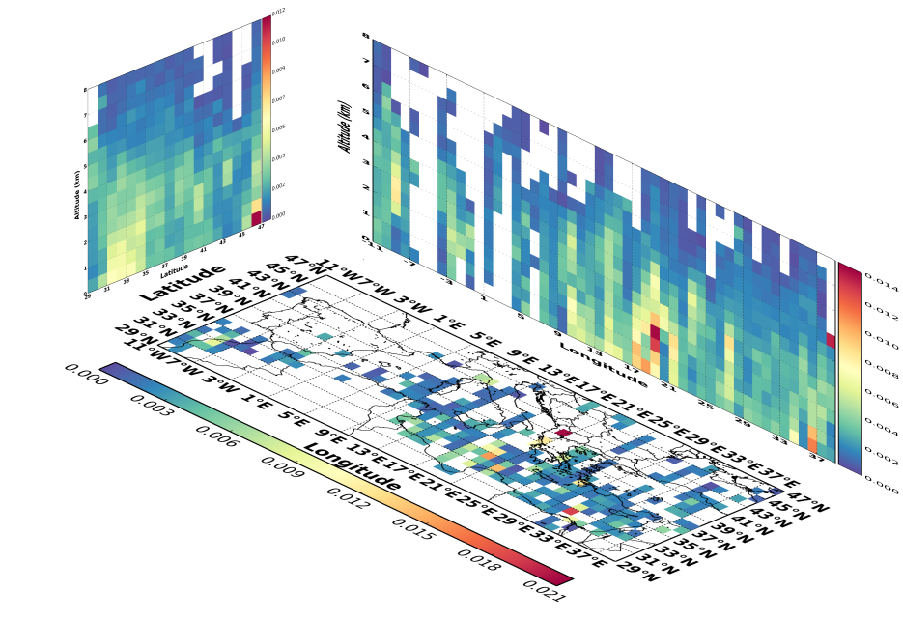
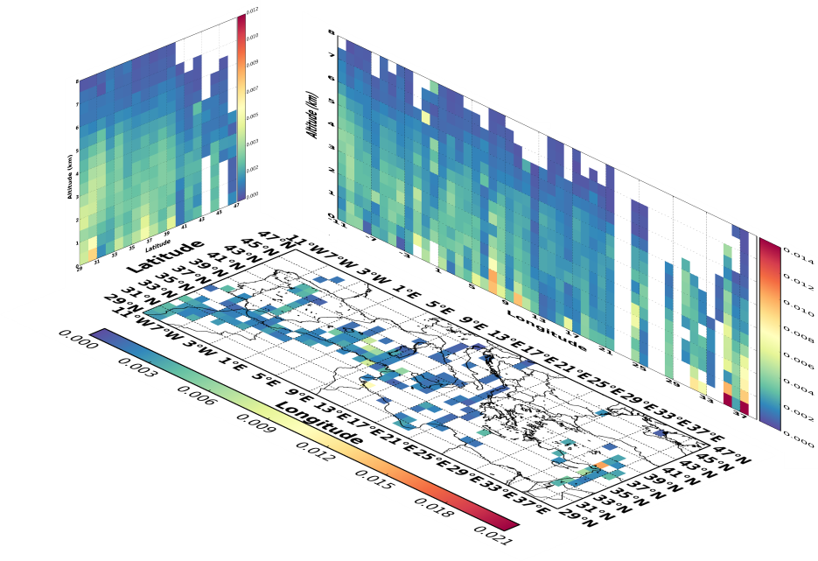
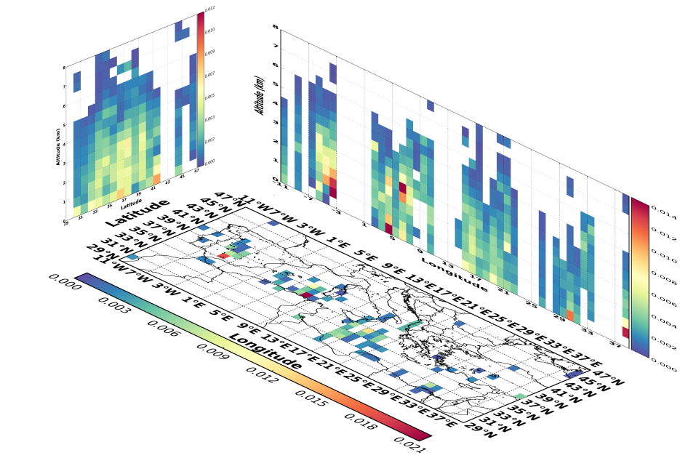
Seasonal variation of dust outbreaks’ vertical structure (β₅₃₂)
Winter
< 4 km
Spring
2-4 km
< 1.5 km
Summer
Autumn
1.5-5 km
< 4 km
< 2.5 km
European Geosciences Union | General Assembly 2015 | Vienna | Austria | 12 – 17 April 2015

Slide 18
Conclusions – Perspectives
Frequency: Strong (10 episodes/year, W. Mediterranean), Extreme (3.3 episodes/year, C. Mediterranean)
More intense (up to 4.0) DD episodes over the eastern parts of the Mediterranean Sea
Good performance of the satellite algorithm based on the evaluation of its outputs against AERONET retrievals and PM₁₀ concentrations
The transported dust particles over the Mediterranean are mainly detected between 0.5 and 6 km (spring, summer)
W. Mediterranean (2-6 km), C. & E. Mediterranean (0.5-6 km)
Maximum β₅₃₂ values below 2 km and near to the dust sources
High β₅₃₂ values: < 2 km (35ºN - 38ºN) and 2 – 4 km (35ºN - 43ºN)
Dust layers with high β₅₃₂ values over the Mediterranean in spring
Selection of 27 desert dust outbreaks in order to estimate their impact on radiation budget and atmospheric dynamics based on NMMB/BSC-Dust model
European Geosciences Union | General Assembly 2015 | Vienna | Austria | 12 – 17 April 2015

Slide 19
Vienna, 13 April 2015
Study of the Mediterranean desert dust outbreaks’ vertical structure based on a synergistic use of satellite and ground retrievals
A. Gkikas¹, S. Basart¹, N. Hatzianastassiou², J. Pey³,
X. Querol⁴, V.Amiridis⁵, O. Jorba¹, S Gassó⁶, J. M. Baldasano^{1,6}
“The MDRAF project has received funding from the European Union’s Seventh Framework Programme for research, technological development and demonstration under grant agreement no 622662”

