Slide 1
Barcelona, 25th October 2016
THE MULTIFACETED ASPECTS OF MODEL PERFORMANCE
IS-ENES2: Crossing the Chasm Workshop
Francisco Doblas-Reyes
Kim Serradell

Slide 2
MODEL
PERFORMANCE
Small and “trivial” modifications
Big Projects and
challenges
“Castells” Contest at Tàrraco Arena Plaça de Tarragona (October 2016)
Notes:
Which is our main goal?
How to acheive it?
Working on challenges but also the TRIVIAL

Slide 3
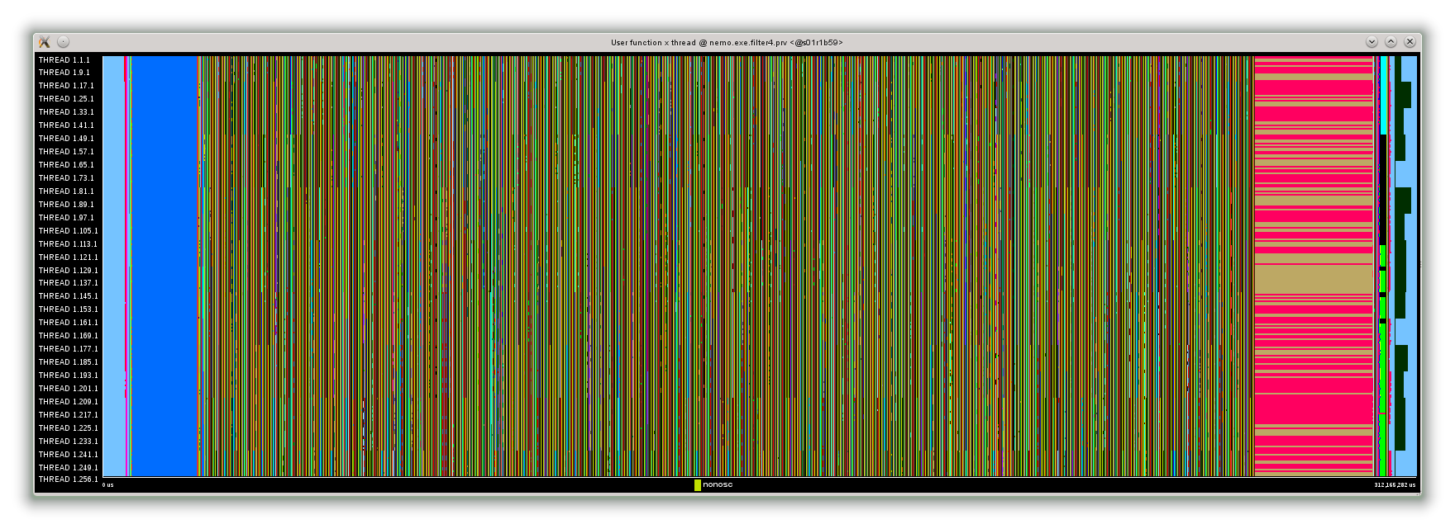
BSC Performance tools
BSC-CNS performance tools:
EXTRAE: Trace generation package.
PARAVER: Trace visualization and analysis tool.
DIMEMAS: Simulation tool for analysis on a configurable target platform.
Application
Trace file
DIMEMAS simulator
Simulated trace file
EXTRAE library
PARAVER
PARAVER
Trace visualization
DIMEMAS generated trace. Target = ideal machine
Blue regions = computation
Yellow lines = comunication

Slide 4
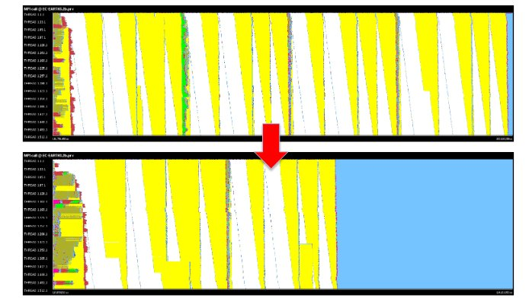
Performance analysis
Optimize coupling strategy between IFS and NEMO
Analysing the coupling strategy between IFS and NEMO Aggregation of message and calculations (by default IFS passes variables to NEMO in several instances)
4 groups of variables
-40%
2 groups of variables
Top: using default namcouple file
Bottom: using an optimized namcouple file (pack variable groups with similar type of coupling together)

Slide 5
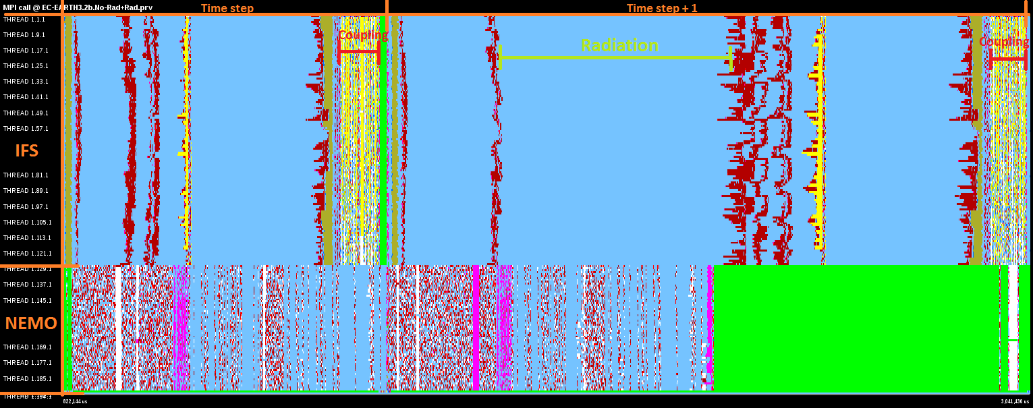
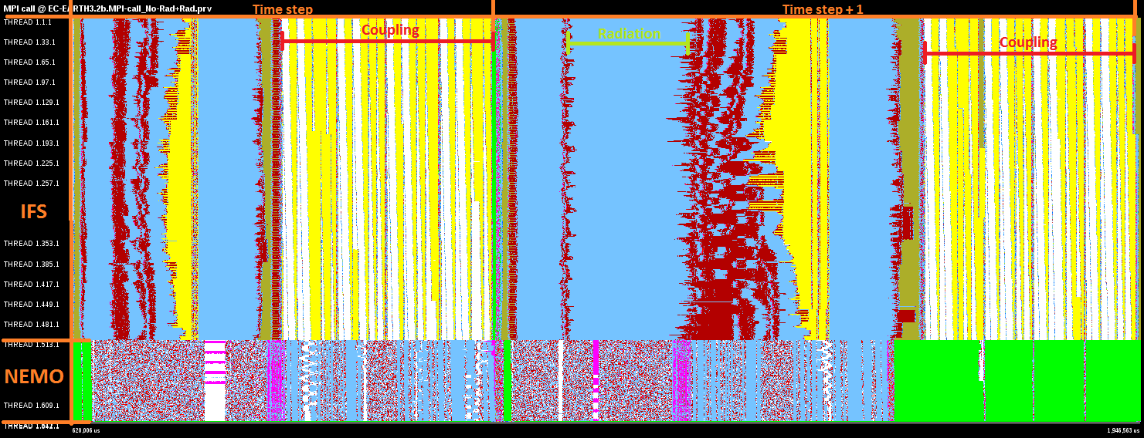
Coupling in high resolution
128 MPI processes for IFS
512 MPI processes for IFS
Different traces to see the impact when scaling the number of cores
We can see with more cores the coupler phase is not scaling and takes longer to complete

Slide 6
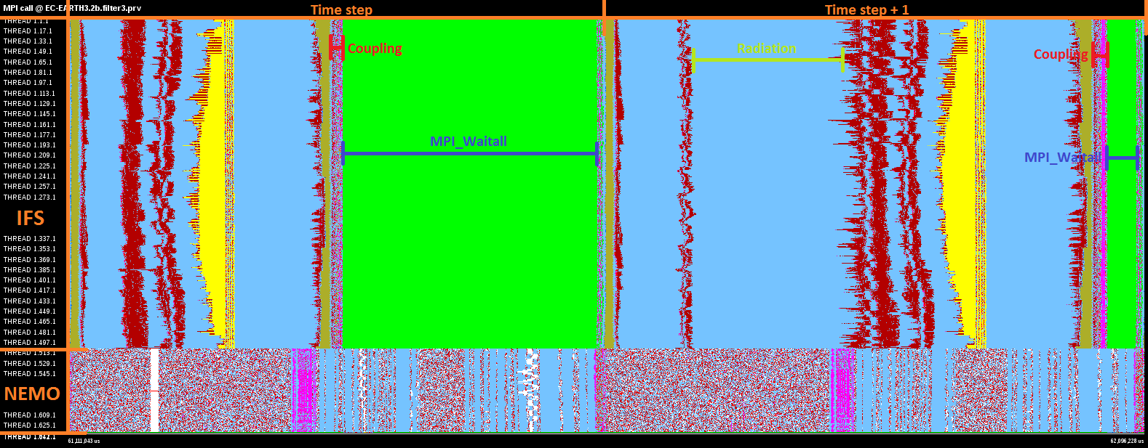
Optimizing coupling in high resolution
Option for CONSERV operation has two implementations
communications all-to-one/one-to-all using MPI_send/MPI_irecv
collective and non-blocking communications MPI_igather/MPI_iscatter

Slide 7
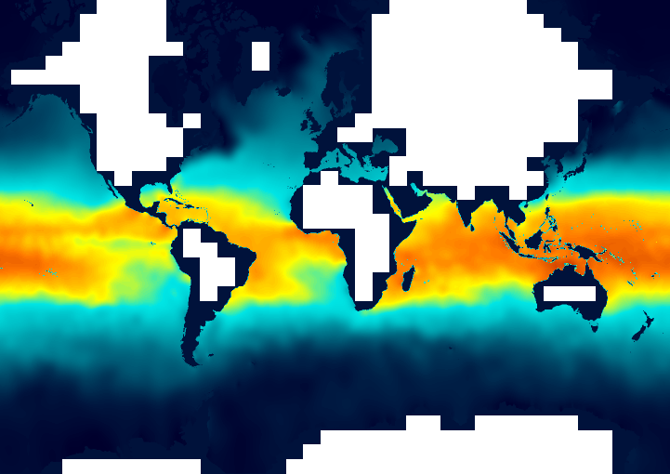
Exclude land-only processes in NEMO
ELPiN: A tool that allows finding adequate namelist parameters to exclude land-only processes in NEMO simulations
NEMO decomposes automatically the domain
Computes and communicates in land-only processes and then discards the result
Currently performing an evaluation of the results produced
ORCA025 domain decomposed in 1287 sub-domains
312 are land-only and therefore removed (24% of the total grid)

Slide 8
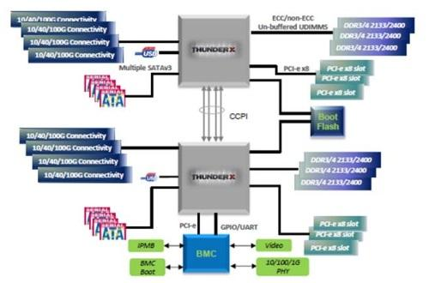
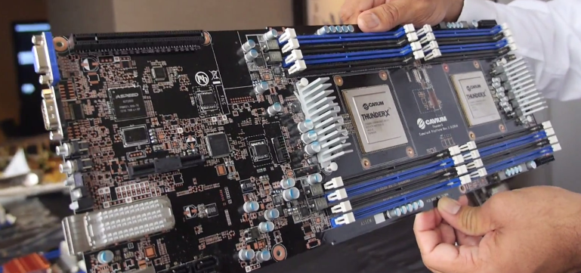
EC-Earth in ThunderX
One of the Mont-Blanc mini-clusters.
Small clusters including ARMv8 (64 bit) platforms.
4 nodes devoted to computation, each equipped with:
2x sockets Cavium ThunderX
48x ARMv8-A cores each (i.e. 96 cores with shared mem each node) @ 1.8 GHz
128 GB memory
2x 10GbE (data network)
1x 40GbE (not connected)
1x 128GB SSD

Slide 9
EC-Earth in ThunderX
EC-Earth 3.2 built with:
GCC 4.8.4, SZIP 2.1, OPENMPI 1.10.2, NETCDF 4.4.0, HDF5 1.8.17, LAPACK 3.6.0
T255L91-ORCA1 configuration
Successful run of one month of simulation (output included)
First execution times needs to be improved
10.508 seconds using 258 cores (128 IFS, 128 NEMO, 1 XIOS, 1 runoff)
923 seconds using the same number of cores in MN3
Work required to improve these numbers

Slide 10
OmpSs programming model
Extend OpenMP with new directives to support asynchronous parallelism and heterogeneity
Overlap communication and computation
Apply Dynamic Load Balancing library
Two stages compilation
Mercurium compiler which introduces OmpSs runtime
Usual compiler (gcc, intel, ibm) to generate the executable
Previous work done
EC-Earth 3.1 compiled and executed with OmpSs
NEMO is not OpenMP ready so not really useful
Moved to OpenIFS 40r1
Bugs with mercurium compiler not yet solved
Some corrections reported to OpenIFS developers to make the code ready for Mercurium

Slide 11
Thank you!
For further information please contact
kim.serradell@bsc.es

