Slide 1
Coupling between traffic and emission models for the evaluation of mobility plans
Daniel Rodriguez Rey¹, Marc Guevara¹, Mari Paz Linares², Juan Salmeron², Josep Casanovas^{1,2}, Jaime Benavides¹, Oriol Jorba¹, Albert Soret¹.
Barcelona Supercomputing Centre – Centro Nacional de Supercomputación (BSC-CNS) Earth Sciences division
inLab FIB, Universitat Politècnica de Catalunya, Facultat d’Informàtica de Barcelona
08/10/2019
Fairmode – Madrid

Slide 2
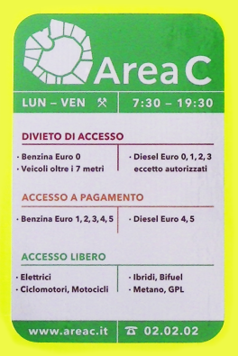
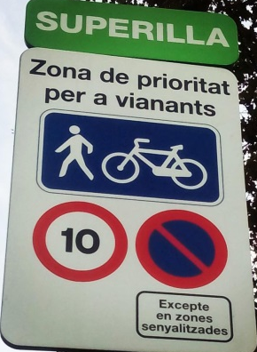
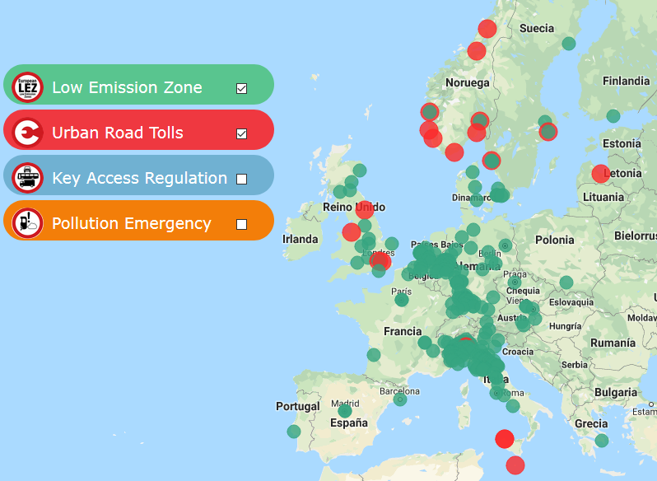
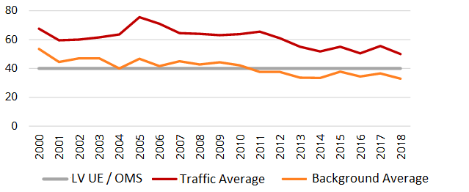
Need to integrate mobility and emission models
Urban air quality problems mostly related to traffic. They can be tackled:
Technological policies: Euro classification program: Inefficient for NOx reduction in Diesel (Carslaw and Rhys-Tyler, 2013).
Reduction of VKT (vehicles kilometres travelled) by mobility plans:
https://urbanaccessregulations.eu/userhome/map
Which tools or methodologies should we use to evaluate urban mobility plans?
Historic NO₂ measured levels in Barcelona (ASPB, 2018)

Slide 3
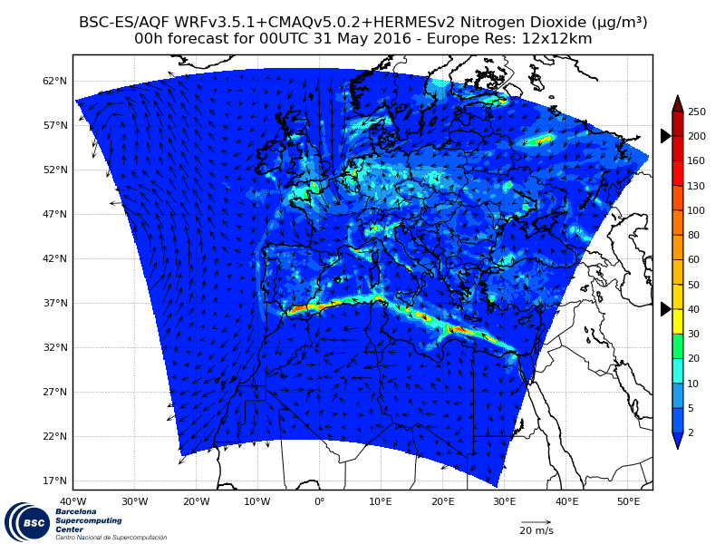
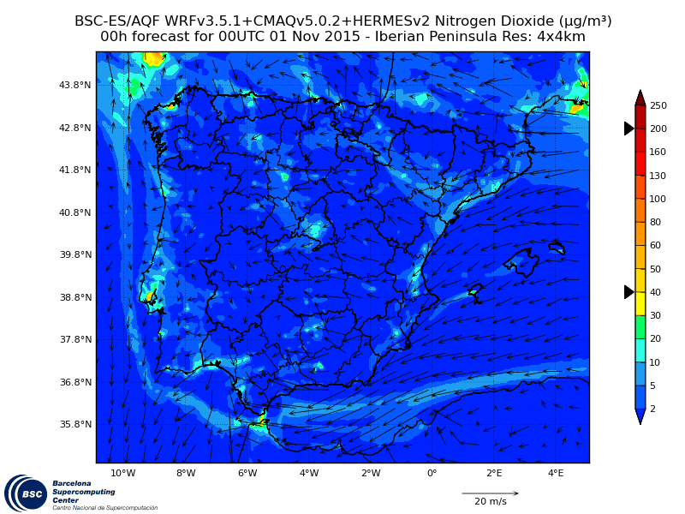
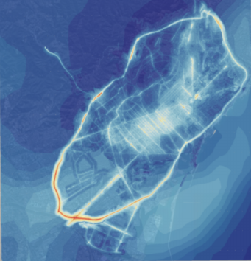
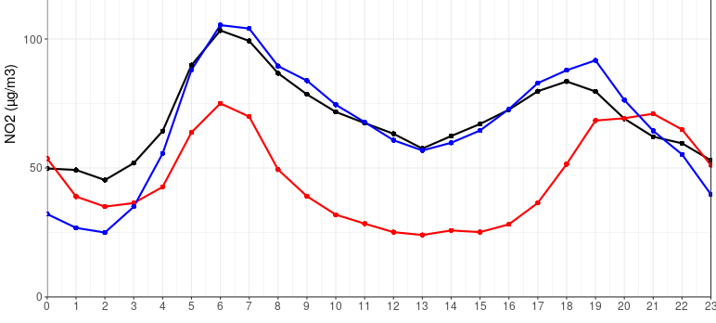
CALIOPE / CALIOPE – Urban workflow
VISUM
Available at: www.bsc.es/caliope
HERMESv3
(emissions)
(Baldasano et al., 2008; Guevara et al., 2013)
WRF-CMAQ
(mesoscale)
CALIOPE
(Baldasano et al., 2008)
R-Line
(urban scale)
CALIOPE - Urban
(Benavides et al. 2019)
445 Valencia St.
(Snyder et al., 2013)
CALIOPE-Urban NO₂ high-resolution (10m × 10m) concentration map. Benavides et al. (2019, Geosci. Model Dev.)
Observed
CALIOPE
CALIOPE-Urban

Slide 4
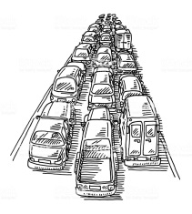
The traffic simulator
Origin Destination matrixes OD
Each path with difference impedance
Zone B
Zone A
Traffic lights
Vehicle flow
Road capacity
Traffic assigment by an iterative process achieving user optimum.
Network construction:
Network: Open Street Map data.
Private Tr. OD matrix data: GPS phone.
Public Tr. OD matrix data: GPS phone + public administration counting.
Calibration: 138 traffic flow data.

Slide 5
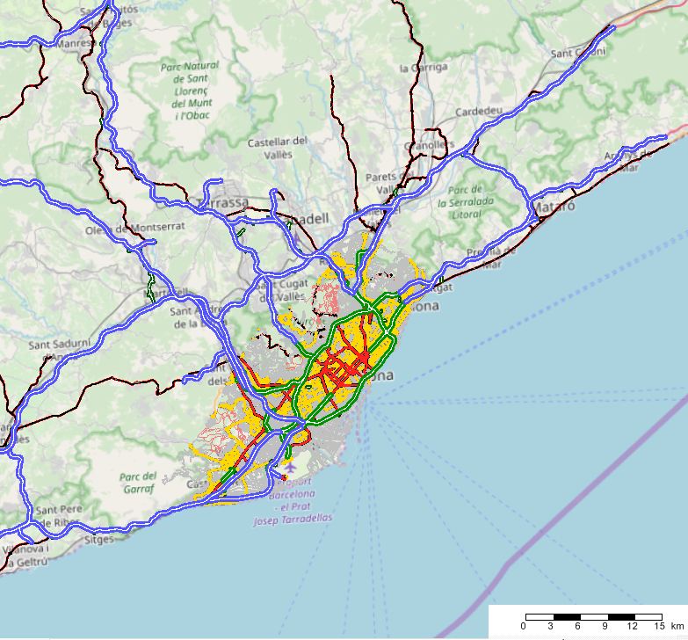
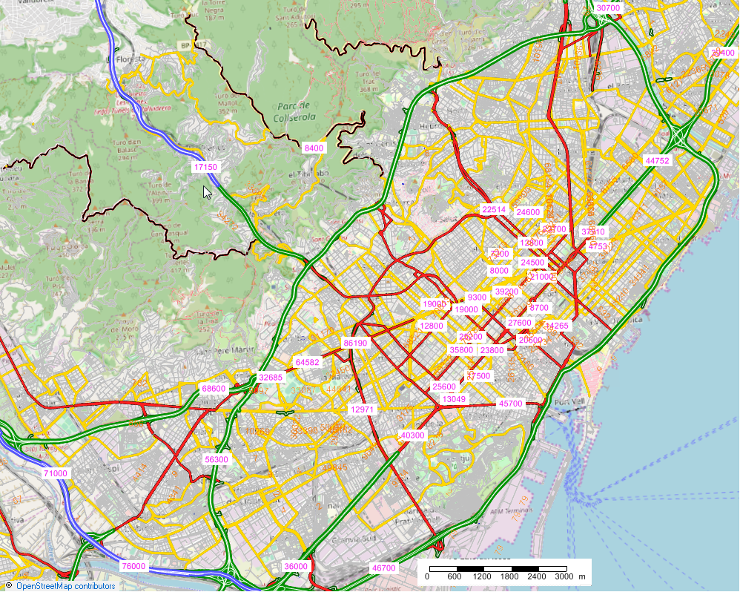
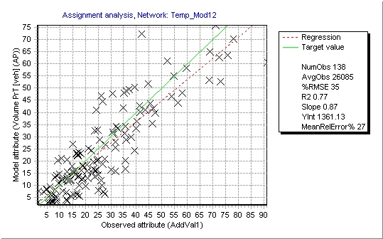
Visum network

Slide 6
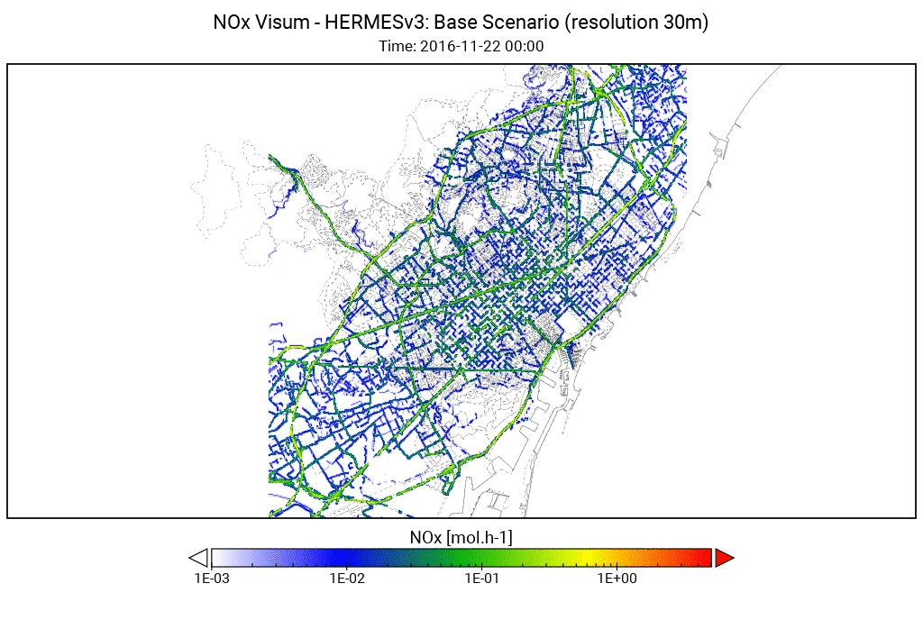
Visum - HERMESv3
High resolution emission modelling system
Emissions estimated at the source level combining state-of-the-art methodologies with local data and meteorology (Energy and manufacturing industries, residential and commercial combustion, agriculture, road transport, other mobile sources)
Road transport emissions
Street-level and vehicle-specific emissions
COPERT 5 + resuspension (Pay et al., 2011)
AADT (Annual Average Daily Traffic) →
Traffic Network →
Volume profile →
Speed profile →
Vehicle fleet
RSD study (RACC-AMB, 2017)
VISUM
VISUM
VISUM
VISUM

Slide 7
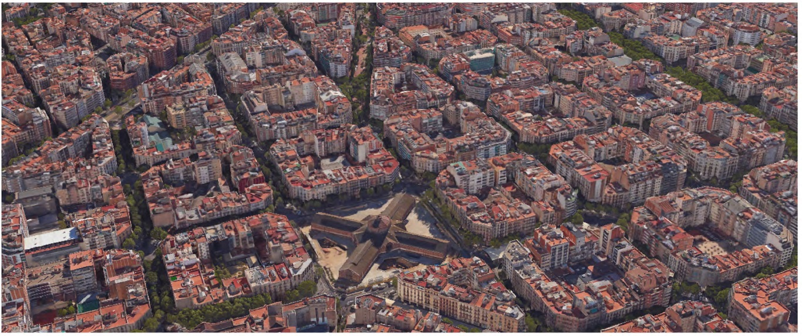
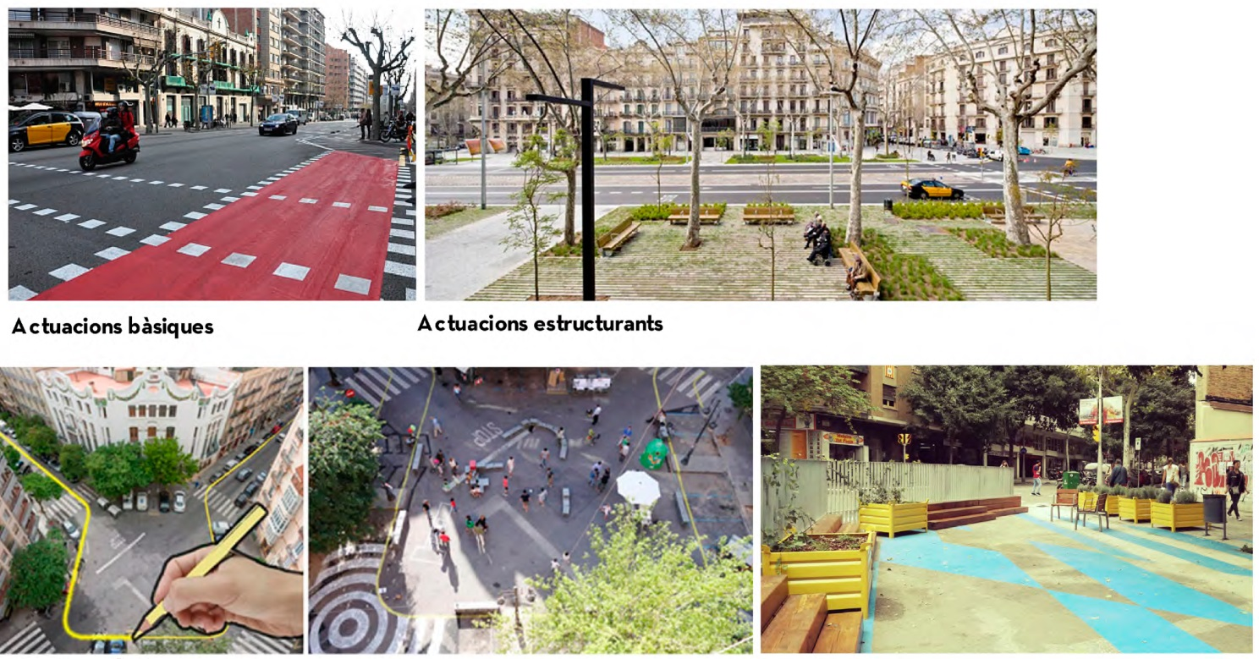
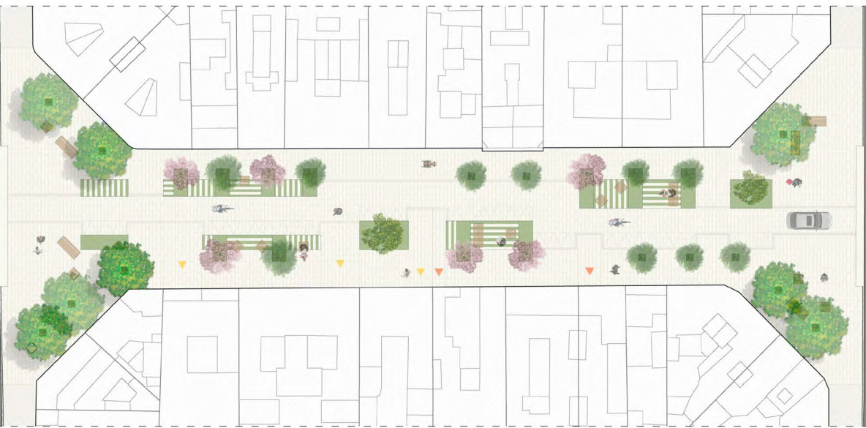
Superblocs idea
Aj. de Barcelona – “Pla d’Acció de l’àmbit de Superilles de St. Antoni.” December 2017
Street type to simulate

Slide 8
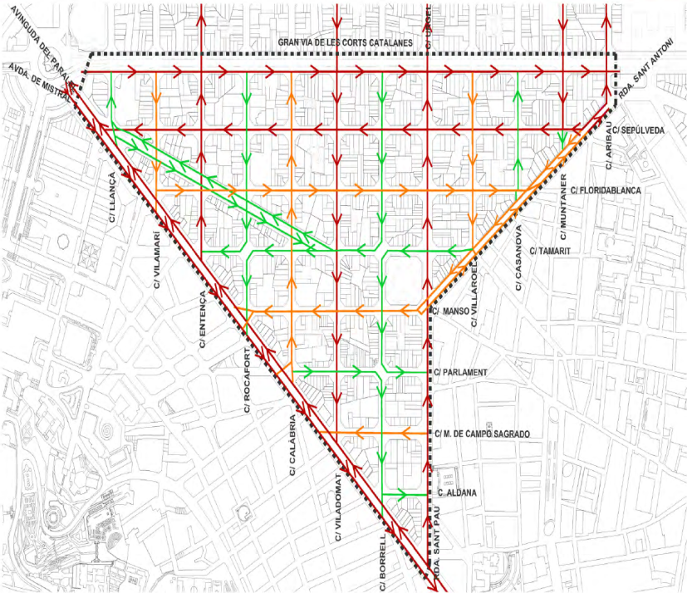
Superblocks scenario
Creation of a new road type: “Superblock”.
Max speed: 20 km/h
Link capacity: 5,250 vehicles/day
Estimated AADT: 3,000 to 8,000 vehicles. (action plan superilles: St. Antoni)
Vehicle demand (nº of trips) kept constant
Modification of the streets according to the reports of the city hall for each Superblock.
Screenshot from Visum network
Aj. de Barcelona – “Pla d’Acció de l’àmbit de Superilles de St. Antoni.” December 2017

Slide 9
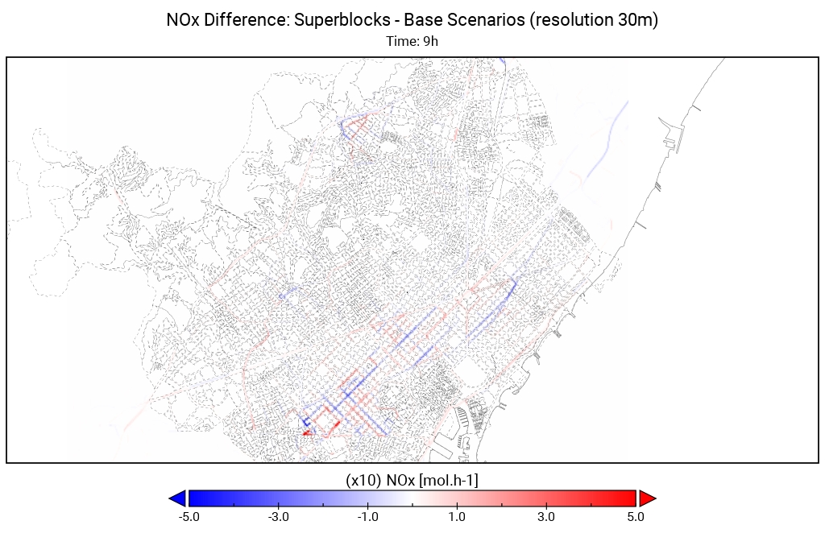
Superblocs scenario results
Superblock

Slide 10
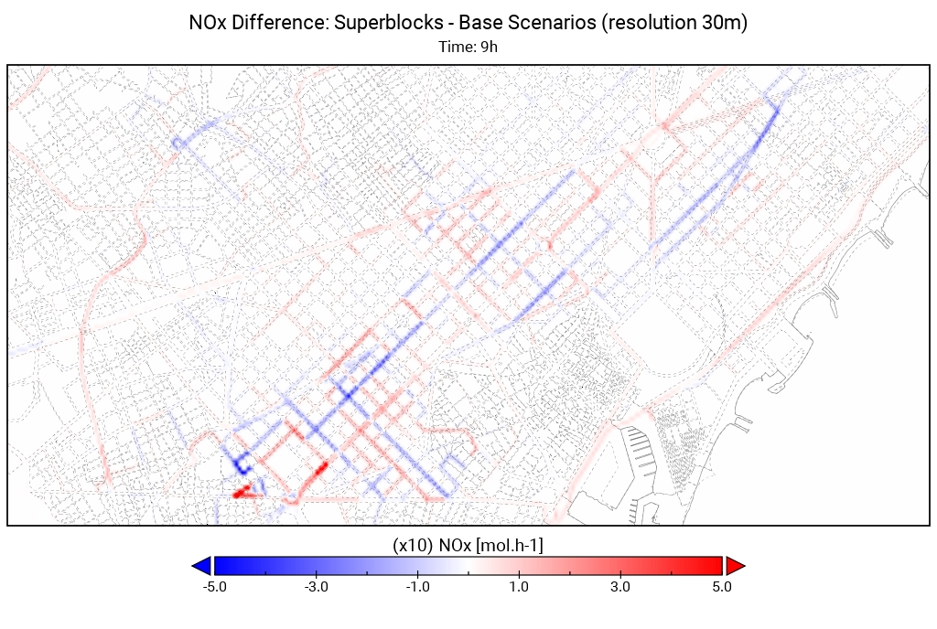
Superblocs scenario results
NOx [mol.h-1]
Total Base (24h) | 22.454 mol Nox
Total Superblocks (24h) | 22.743 mol NOx

Slide 11
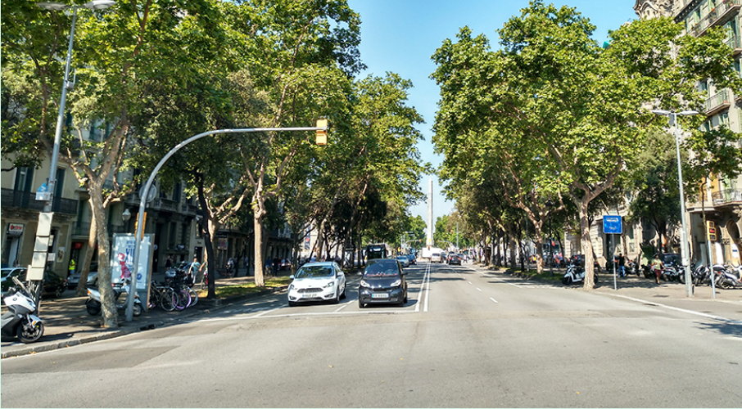
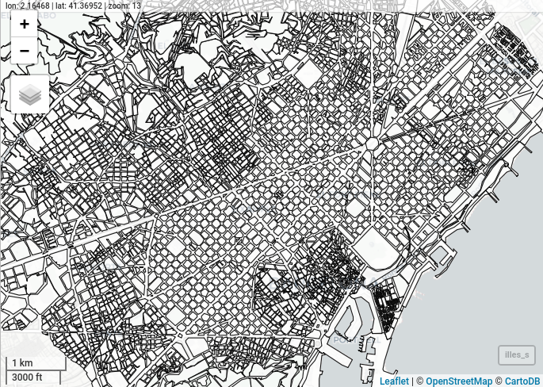
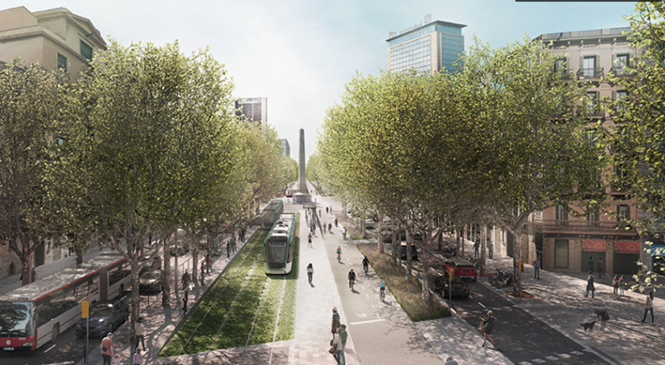
Diagonal Tram plan
Current disposition
New Tram line
Current Tram line
Proposed disposition

Slide 12
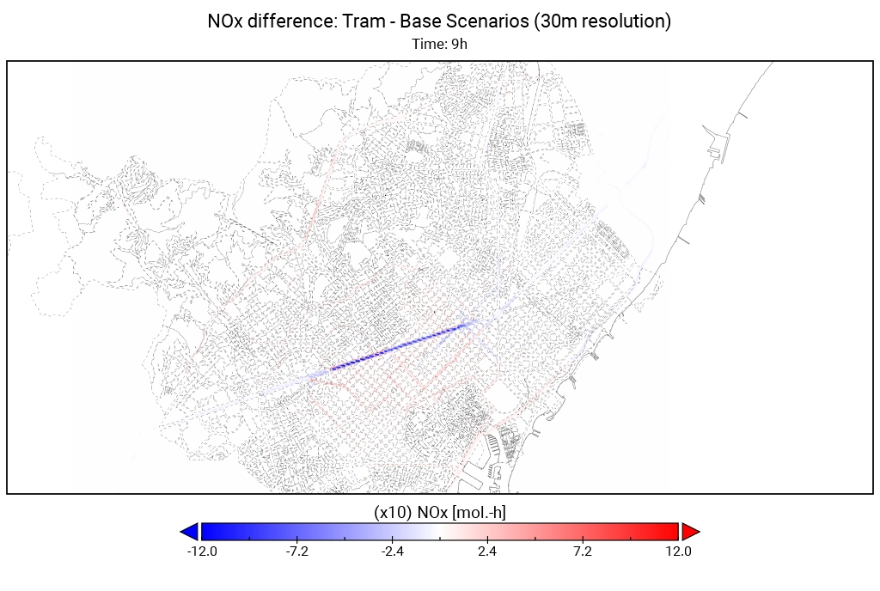
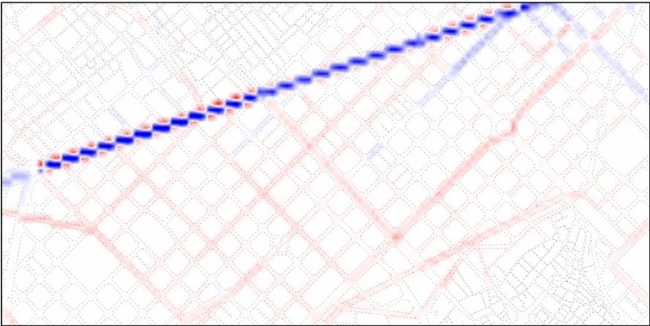
Diagonal Tram scenario results
NOx [mol.h-1]
Total Base (24h) | 11743 mol NOx
Total Tram (24h) | 11180 mol NOx

Slide 13
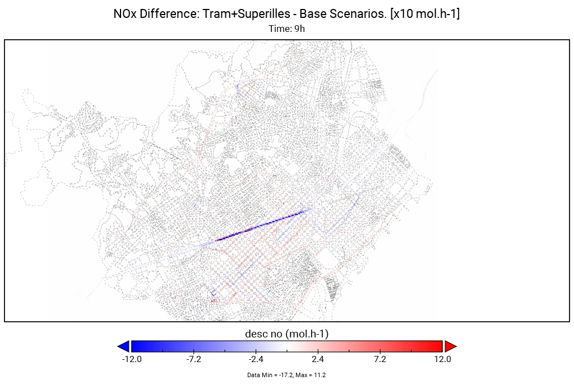
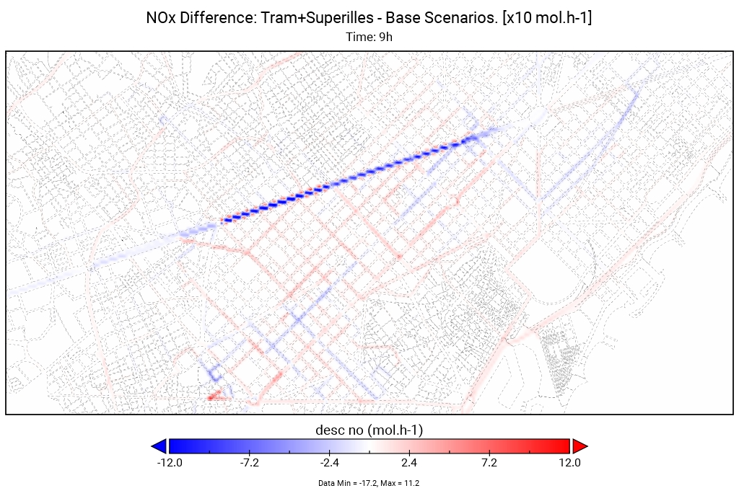
Tram+Superblocks scenario results
NOx [mol.h-1]
Total Base (24h) | 63274 mol NOx
Total Tram+SB (24h) | 64058 mol NOx

Slide 14
Future work
Coupling the public transport network
Design and implementation of other mobility policies (congestion charge)
Air quality evaluation:
Mesoscale CALIOPE
Urban scale (CALIOPE – Urban)
Comparison between mesoscale (COPERT 5) and instantaneous (PHEMLight) emission models for hot spots

Slide 15
Thank you for your attention
Daniel Rodríguez Rey
Barcelona Supercomputing Center
Earth Sciences department
daniel.rodriguez@bsc.es
Acknowledgements:
Daniel R. Rey work is funded with the grant BES-2016-078116 from the FPI program by the Spanish Ministry of Economy and Competitiveness.
Daniel developed part of this work at the inLab-Fib UPC research center and acknowledges the staff in there.
08/10/2019

Slide 16
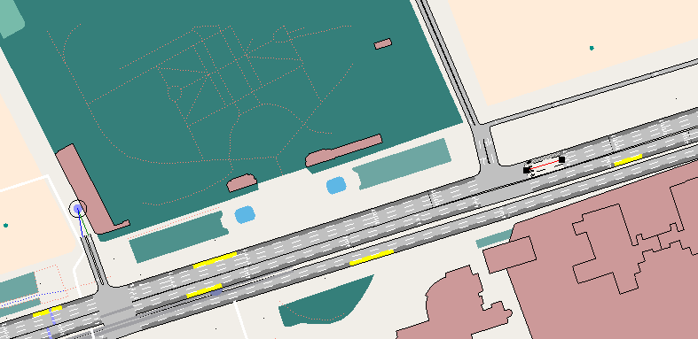
Future work
Instantaneous emission models for hot spots
AIMSUN
PHEMLight
NOx (g/h)

Slide 17
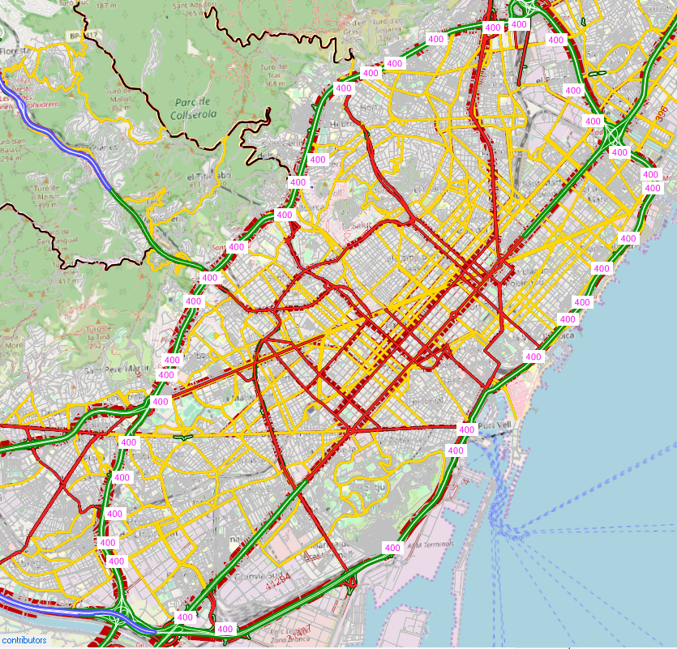
Future work
Congestion charge scenario
$Impedance [s] = Tcur +Toll_Tax$
$Tcur=T_{0}∗(1+a·{sat}^{b})$ ← Total travel time
$Toll_Tax\left[s\right]= {2 €}/{0,005 €/s}$ = 400 seconds
+400 seconds

