Slide 1
BSC-ES Performance team updates from IMMERSE and ESiWACE2 H2020 projects
Miguel Castrillo
BSC-ES Performance Team, Computational Earth Sciences
22/04/2020
NEMO HPC Group

Slide 2
The Performance Team in BSC Earth Sciences

Slide 3
Barcelona Supercomputing Center Centro Nacional de Supercomputación
BSC-CNS objectives
Supercomputing services
to Spanish and EU researchers
R&D in Computer, Life, Earth and
Engineering Sciences
PhD programme, technology transfer, public engagement
Spanish Government 60%
Catalan Government 30%
Univ. Politècnica de Catalunya (UPC) 10%
BSC-CNS is
a consortium
that includes

Slide 4
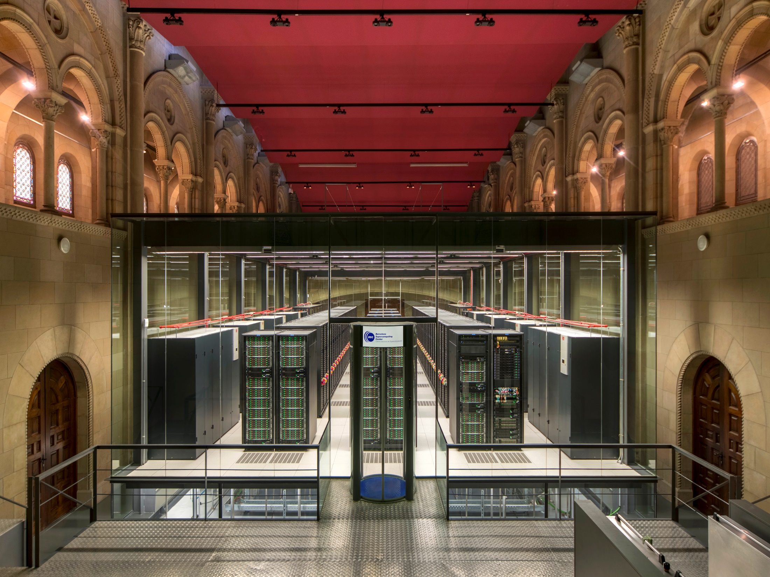
MareNostrum 4
Total peak performance: 13,7 Pflops
General Purpose Cluster: 11.15 Pflops (1.07.2017)
CTE1-P9+Volta: 1.57 Pflops (1.03.2018)
CTE2-AMD: 0.52 Pflops (2020)
CTE3-Arm V8: 0.5 Pflops (2020)
Access: prace-ri.eu/hpc_acces
Access: bsc.es/res-intranet
MareNostrum 1
2004 – 42,3 Tflops
1st Europe / 4th World
New technologies
MareNostrum 2
2006 – 94,2 Tflops
1st Europe / 5th World
New technologies
MareNostrum 3
2012 – 1,1 Pflops
12th Europe / 36th World
MareNostrum 4
2017 – 11,1 Pflops
2nd Europe / 13th World
New technologies

Slide 5
MareNostrum 5. A European pre-exascale supercomputer
Hosting Consortium:
200 Petaflops peak performance (200 x 10¹⁵)
Spain
Portugal
Turkey
Croatia
Experimental platform to create supercomputing technologies “made in Europe”
223 M€ of investiment

Slide 6
ESiWACE2

Slide 7
BSC-ES involvement in ESiWACE2
Task 1.1: Develop infrastructure for production-mode configurations
Introduce XIOS in EC-Earth, NEMO Mixed Precision...
Task 1.2: Develop production-mode configurations
EC-Earth: 16 km (TL1279) atmosphere coupled to a 1/12 degree (~8 km) ocean
Task 1.3: Port models to pre-exascale EuroHPC systems
Port EC-Earth ~10km to MareNostrum5

Slide 8
EC-Earth4
Development of a mixed precision mode for NEMO 4.2. Port EC-Earth3 Ocean configurations.
Set up PISCES for NEMO 4 (plus Age and CFCs). Pending on funding, develop PISCES-lite for HR.
XIOS integration into OpenIFS 43r3. XIOS benchmarking and computational evaluation to improve I/O efficiency.
Scientific and computational evaluation (in collaboration with other institutions) of EC-Earth4 in MP mode (OpenIFS-SP, NEMO-MP).
Profiling studies to ensure that the eventual main bottlenecks of EC-Earth4 are highlighted and their solution studied.

Slide 9
NEMO Mixed Precision implementation
a) BSC developing a prototype based on NEMO 4.0.1; Further testing done at ECMWF with this version.
b) Provide demonstrator for NEMO ST (how? => Scientific Publication, Branch in NEMO rep.) (BSC)
c) Prepare minimal list of changes for merge party that could enter next NEMO version (BSC+ ECMWF together)
d) Prepare tools for automation to make sure that all the workflow that goes from identifying sensitive variables to a final implementation can be reapplied to any version of the code. (BSC, April 2020)
e) Provide a mixed-precision branch at the NEMO SVN starting after the merging party. (BSC, April 2020)
f) Provide scientific evaluation and progress idealised test cases motivated by single precision evaluation and beyond (throughout 2020) (ECMWF); (Discussion on intercomparison test cases at Commodore Workshop, January 2020).
g) By end 2020, ECMWF anticipates to have a working version of NEMO + SI3 in mixed precision for DA, medium-range and extended-range ocean prediction in forced and coupled mode. Potential changes will be included into the Mixed-precision branch. (ECMWF+BSC task).

Slide 10
NEMO Mixed Precision implementation
After the sensitive variables have been identified it is time to think on the actual implementation of the code.
Highlights:
We are using a new key_single:
Activating this key will set the working precision to single.
Compiling without this key will yield a version of the code in double precision, that shall pass all the sette tests.
Oriol Tintó (BSC) & Sam Hatfield (ECMWF)

Slide 11
IMMERSE

Slide 12
BSC-ES involvement in IMMERSE
T4.1:​ Efficient exploitation of memory hierarchies and hardware peak performance
Assessment of the performance impact
T4.3: Efficient IOs and diagnostics for operational systems
Offload NEMO model diagnostics to GPUs
T4.4: Load balancing for AGRIF massive multigrid capability
Efficiency assessment for high-resolution configuration

Slide 13
NEMO timeline in BSC-ES performance
TYPE-C
2019
2020
2021
2022
COPERNICUS CMEMS Final report: ORCA036 profiling
IS-ENES3 M8.4: Definition of the optimization strategy
IMMERSE MS25: First setup of online diagnostics
ESiWACE2 D1.2: Model inter-comparison
IMMERSE MS34: Final setup of online diagnostics
ESiWACE2 D1.1: Production mode configurations
ESiWACE2 D1.3: Scalability for pre-exascale systems
IS-ENES3 D8.5: Update NEMO code
IMMERSE D4.1: Activities during 2019
IS-ENES3 D4.3: CPMIP metrics & performance
IMMERSE D4.3: AGRIF performance
IMMERSE D4.4: Node performance
IMMERSE D4.5: Report online diagnostics
NEMO 4.2 beta
* Bold indicates BSC is the lead

Slide 14
From ORCA2 to ORCA36

Slide 15
Global 1/36° (ORCA36): context
Model configuration for future CMEMS/MOI global forecasting and reanalysis systems
Based on NEMO 4
Projects:
IMMERSE (EU H2020):
demonstrator for developments in NEMO 4 (HPC dvpts)
with CMCC and Ocean-Next
ESIWACE2 (EU H2020):
demonstrator for « production runs at unprecedented resolution on pre-exascale supercomputers »
with CMCC

Slide 16
Global 1/36° (ORCA36): context
Collaborations:
CMEMS contract with BSC:
« 87-GLOBAL-CMEMS-NEMO: EVOLUTION AND OPTIMISATION OF THE NEMO CODE USED FOR THE MFC-GLO IN CMEMS » :
NEMO HPC performances, especially with global 1/36°
CMEMS contract with CNRS/IGE/MEOM team:
« 2-GLO-HR Evolution of CMEMS Global High Resolution MFC »
sensitivity of NEMO solutions to numerical and parametric choices in realistic configurations
an Atlantic (20S-81N) 1/12° configuration with AGRIF zooms (1/12° to 1/48° and 75 to 200 vertical levels)
Definition of metrics to assess resolved fine-scale structures
Small scale vorticity variance, KE wavenumber spectra, regularity of resolved fields at the grid scale,submesoscale vertical buoyancy flux, fine scale horizontal gradient of surface buoyancy

Slide 17
From ORCA2 to ORCA36
ORCA: Curvilinear tripolar grid family without singularity point inside the computational domain. It has two north mesh poles placed on lands.
name | jpiglo | jpjglo | jpk | size (million vertices) | resolution (km)
ORCA2 | 182 | 149 | 31 | 0.84 | 220.19
ORCA1 (SR) | 362 | 292 | 75 | 7.92 | 110.7
ORCA025 (HR) | 1,442 | 1,021 | 75 | 110.42 | 27.79
ORCA12 (VHR) | 4,322 | 3,059 | 75 | 991.57 | 9.27
ORCA36 (VVHR?) | 12,962 | 9,173 | 75 | 8,917.53 | 3.09
x9.4
x14
x10,650
x9
x9
Notes:
‹#›

Slide 18
ORCA36
Configurations
Code | Step | Init T&S | Atmospheric Forcing | ICE | Runoff | Geothermal heating | QSR
O36-I | 90 | F | F | F | F | F | F
O36-II | 90 | F | 512x256 | F | F | F | F
O36_ICE | 90 | F | 512x256 | T | F | F | F
O36_FULL* | 30 | 9,173x12,962 | 512x256 | T | 9,173x12,962 | 360x180 | 9,173x12,962

Slide 19
ORCA36 in MareNostrum4
Resources constraints
Configuration | Minimum resources standard nodes (96GB) | Minimum resources high-mem nodes (384GB)
O36-I | 64 nodes, 6TB memory | 16 nodes, 6TB memory
O36-II | 64 nodes, 6TB memory | 16 nodes, 6TB memory
O36_ICE | 64 nodes, 6TB memory | 16 nodes, 6TB memory
O36_FULL* | - | 16 nodes, 6TB memory

Slide 20
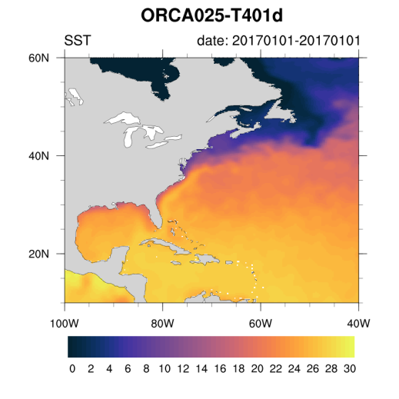
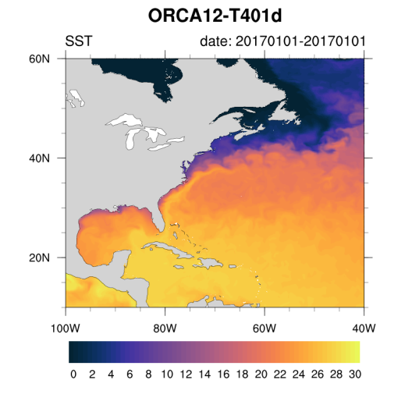
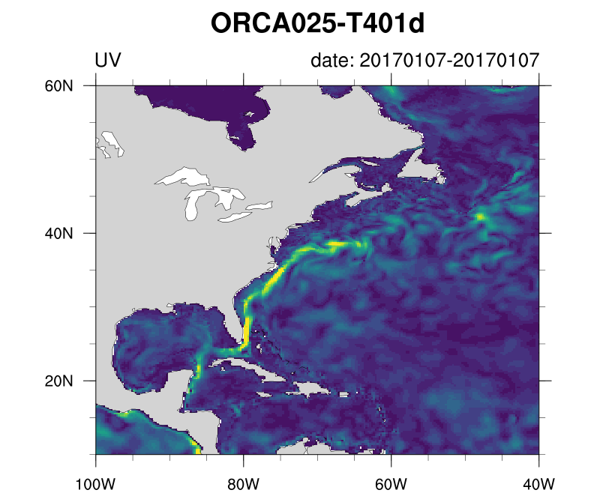
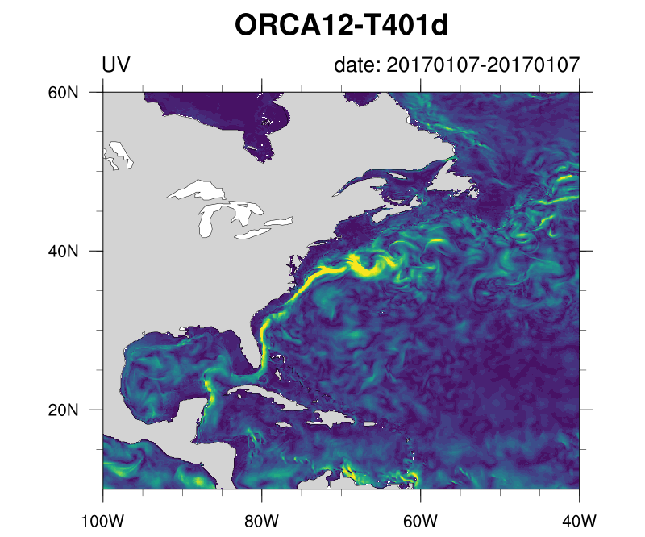
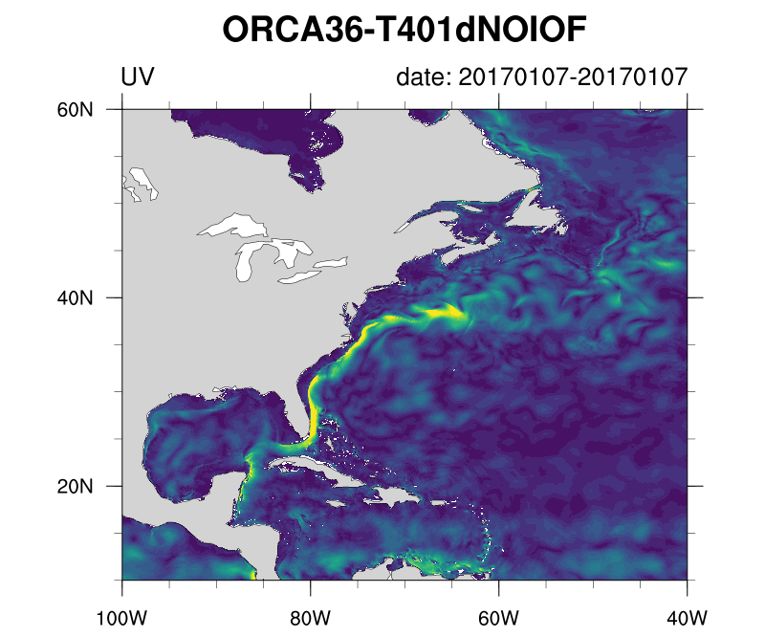
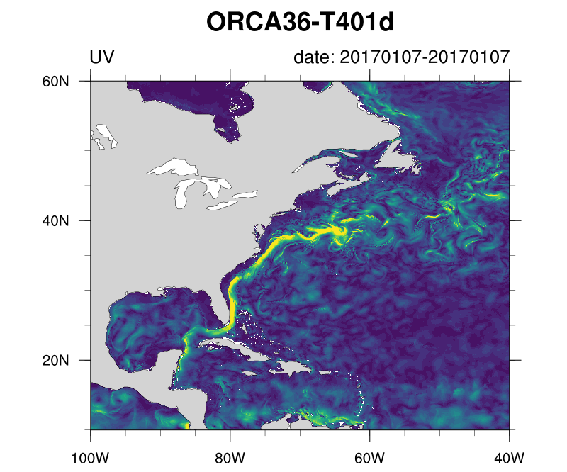
Interpolation from G2V4 to grid model for CI
¼° (ORCA025) 1/12° (ORCA12) 1/36°(ORCA36) 1/36°(ORCA36)
IC smooth IC no smooth
SST after 1hour
MOD(UV) after 7 days (hourly)
Notes:
‹#›

Slide 21
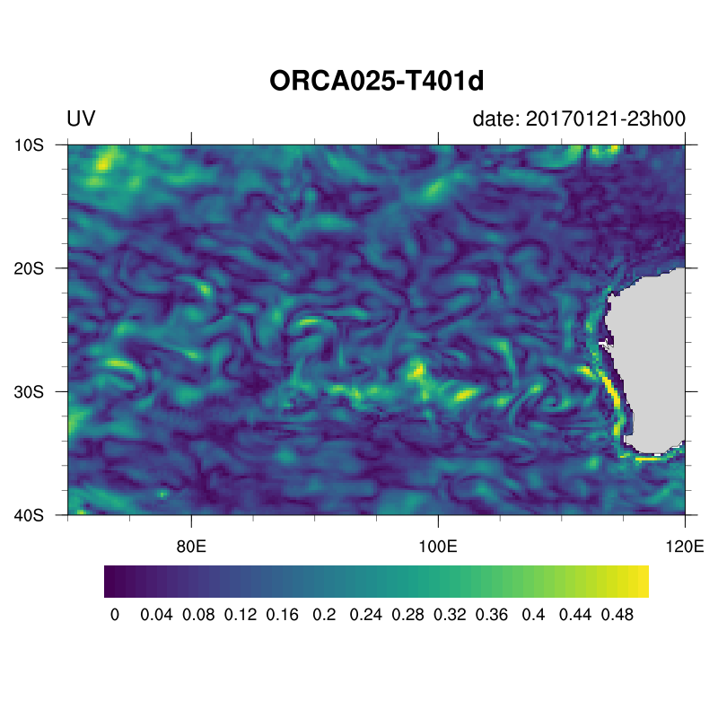
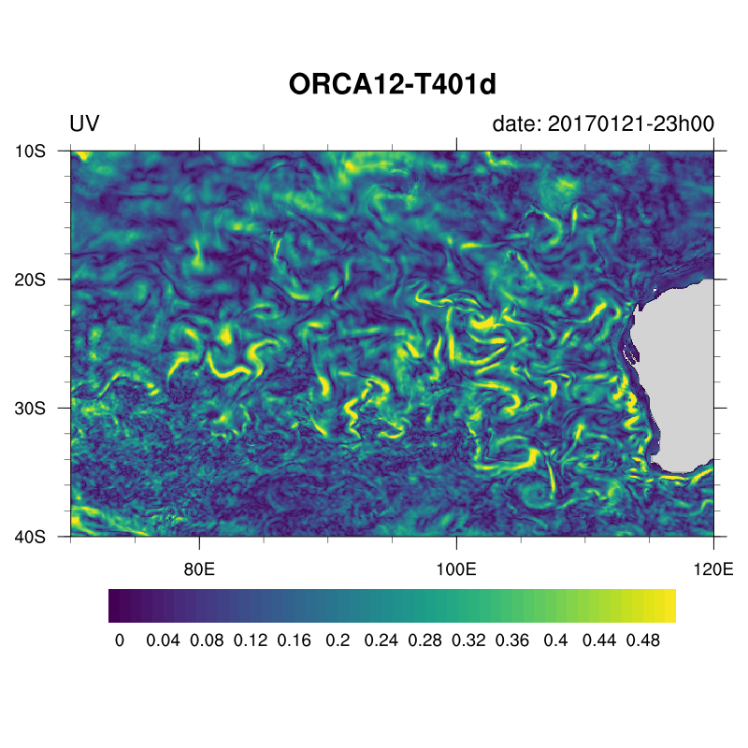
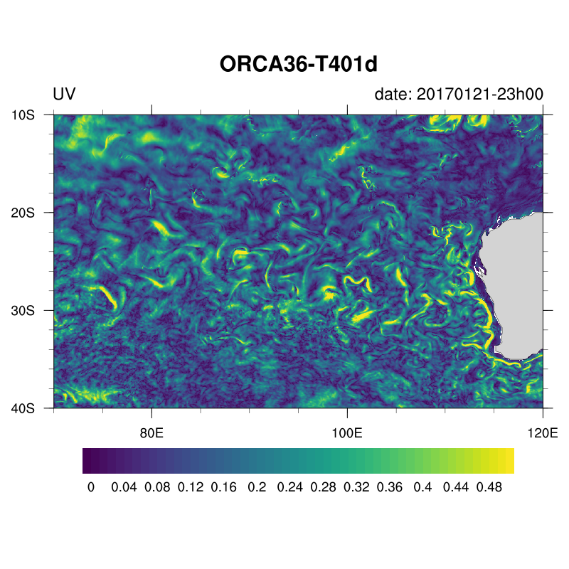
Surface velocities after 3 weeks ( 1 hour outputs)
global ¼°
global 1/12°
global 1/36°
Notes:
‹#›

Slide 22
ORCA36 scaling

Slide 23
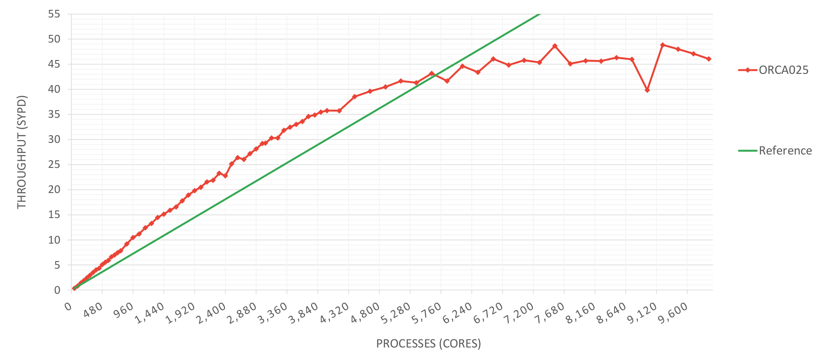
ORCA025 scalability (MN4)
ORCA025 scalability
PROCESSES (CORES)

Slide 24
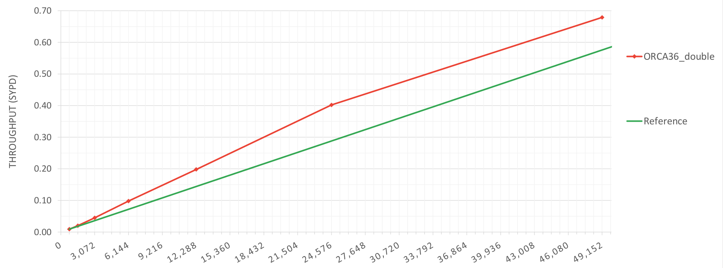
ORCA36 scalability (MN4)
ORCA36 scalability
PROCESSES (CORES)

Slide 25
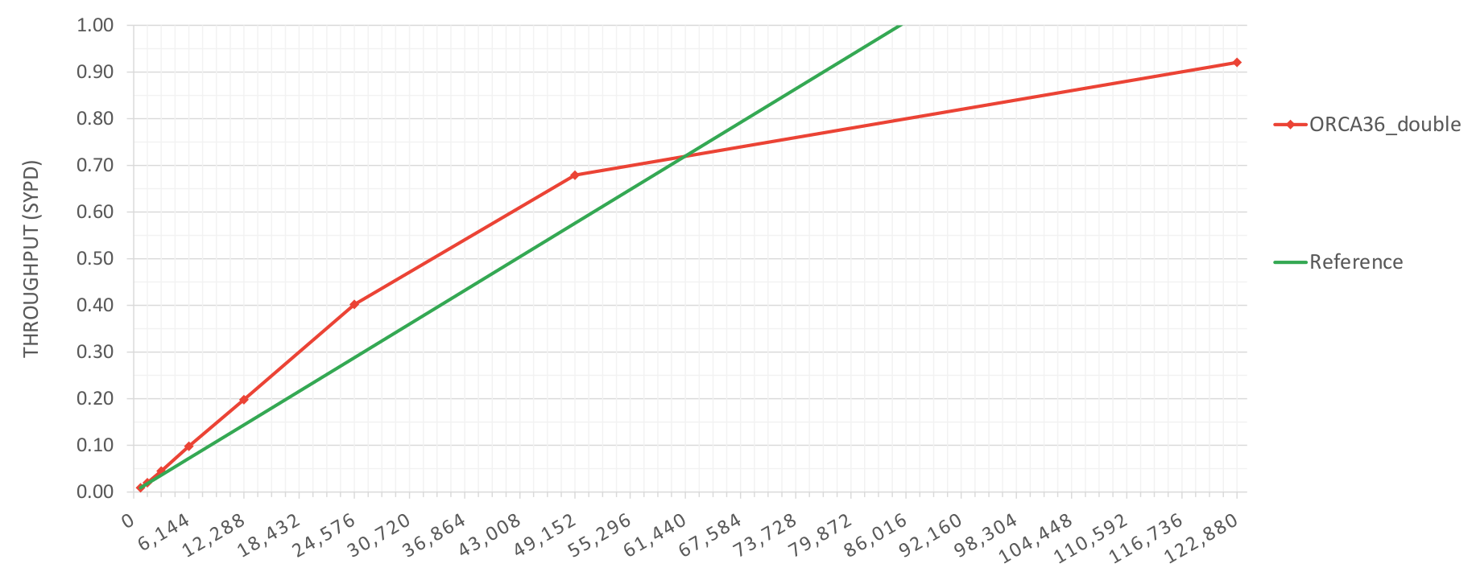
ORCA36 scalability (MN4)
ORCA36 scalability – Grand Challenge
PROCESSES (CORES)

Slide 26
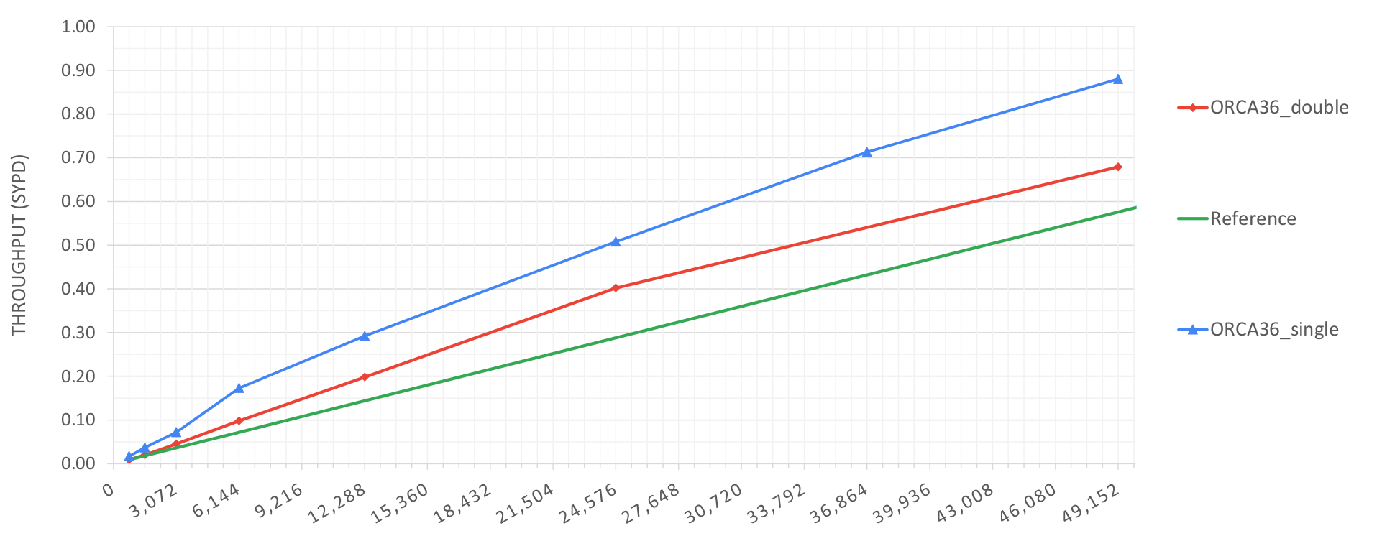
ORCA36 scalability (MN4)
ORCA36 scalability – Double precision vs Single precision
PROCESSES (CORES)

Slide 27
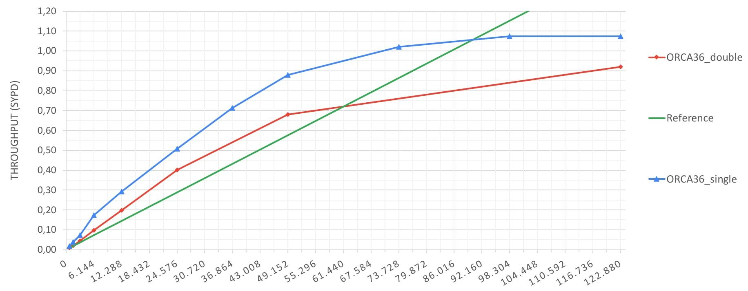
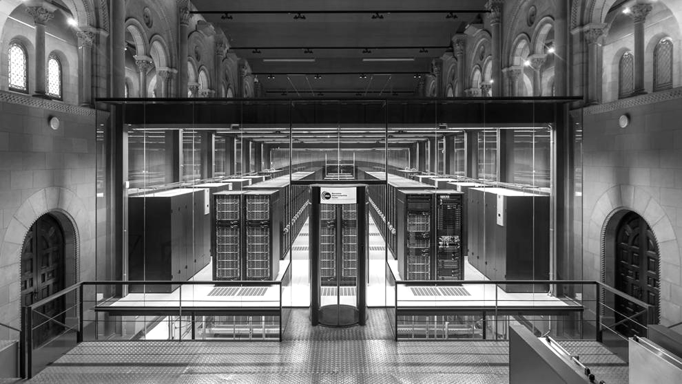
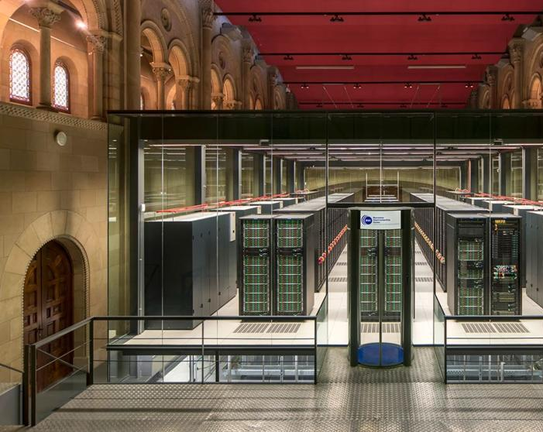
ORCA36 scalability (MN4)
ORCA36 scalability – Double precision vs Single precision – Grand challenge
71% of MN4
PROCESSES (CORES)

Slide 28
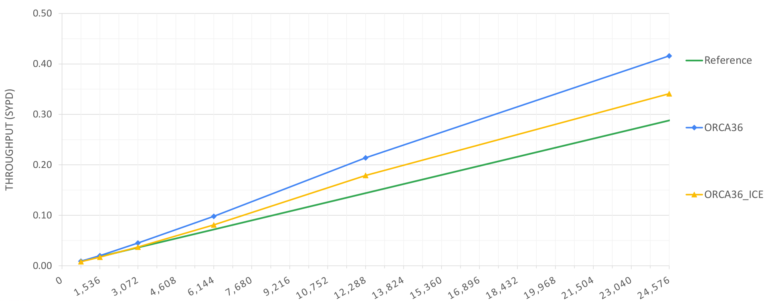
ORCA36 scalability (MN4)
ORCA36 scalability - ICE
PROCESSES (CORES)

Slide 29
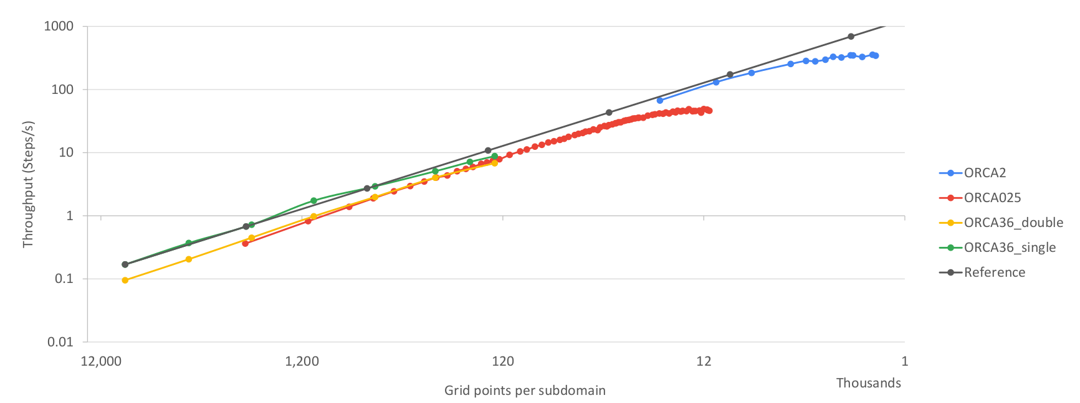
ORCA weak scaling (MN4)
ORCA2, ORCA025 and ORCA36 scalability. Steps per second per subdomain size

Slide 30
ORCA36 Performance analysis

Slide 31
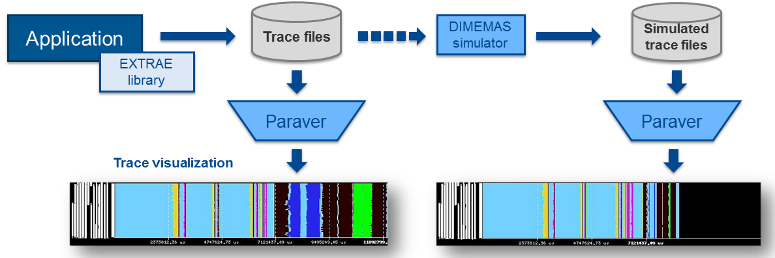
Performance analysis
Since 1991
Based on traces
Open Source: https://tools.bsc.es
Extrae: Package that generates Paraver trace-files for a post-mortem analysis
Paraver: Trace visualization and analysis browser
Dimemas: Message passing simulator

Slide 32
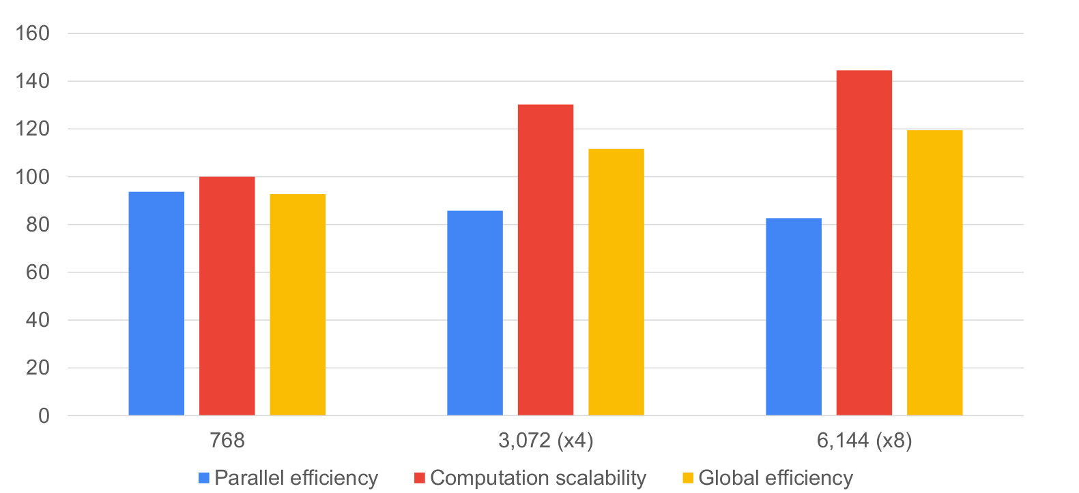
ORCA36 scalability
Model factors explaining scalability on 16, 32 and 64 nodes

Slide 33
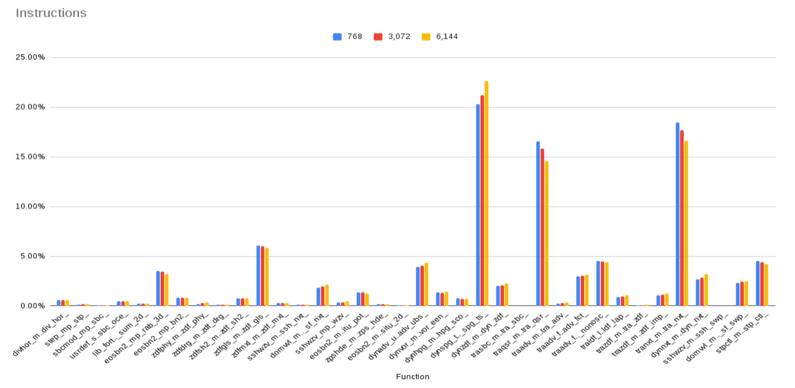
ORCA36 instructions breakdown

Slide 34
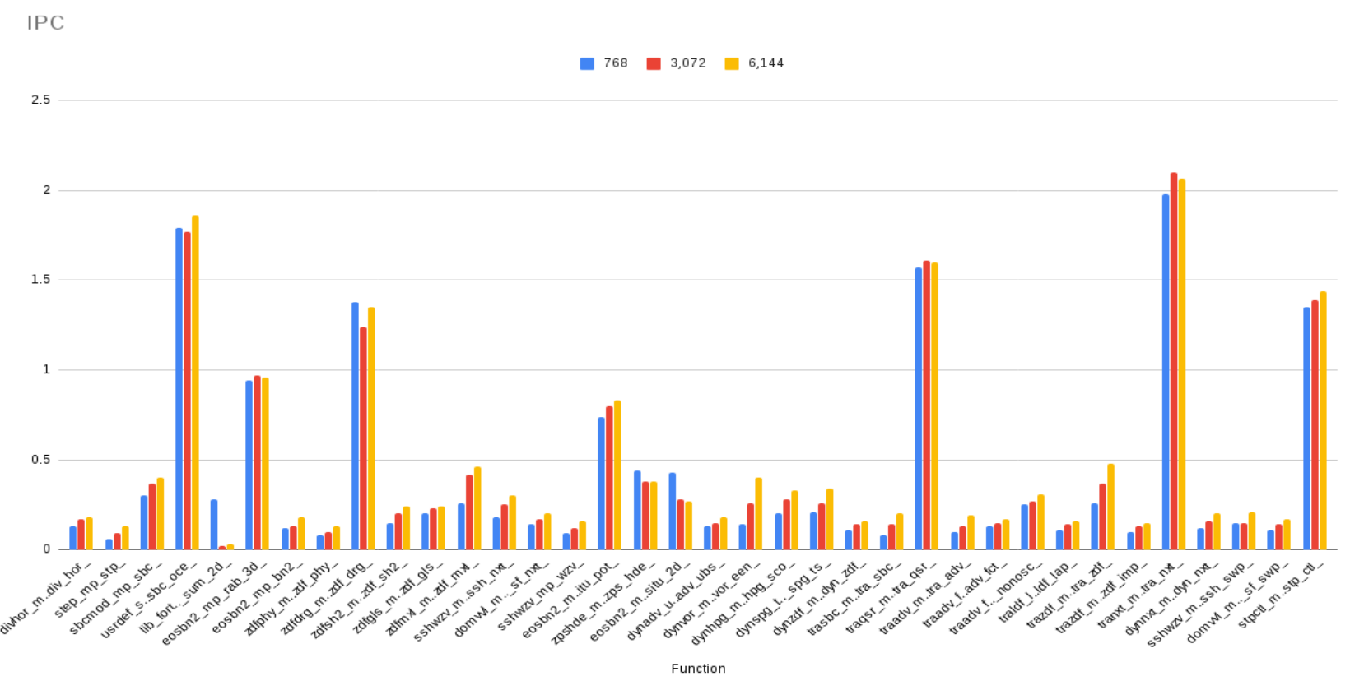
ORCA36 IPC per function

Slide 35
NEMO4 time vs cost

Slide 36
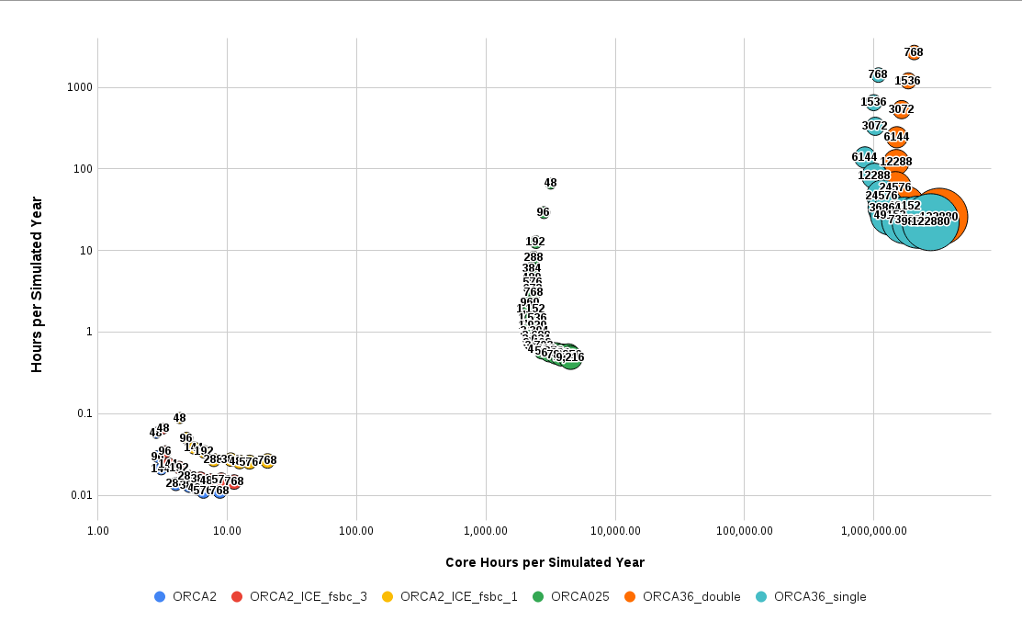
NEMO4 time vs. cost

Slide 37
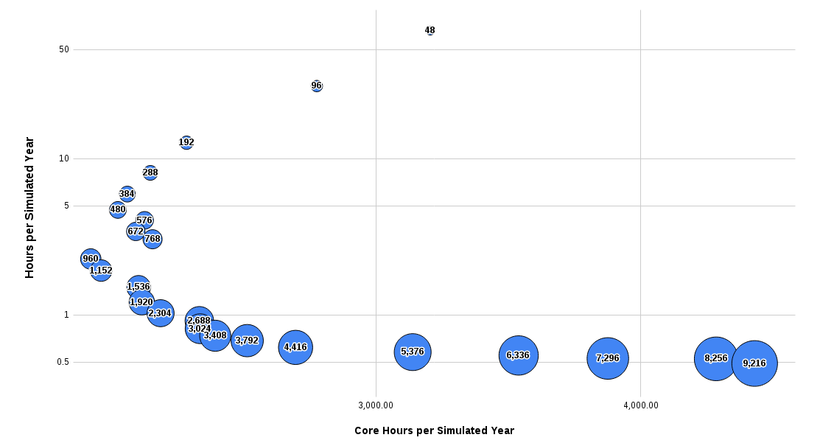
NEMO4 time vs. cost
ORCA 025

Slide 38
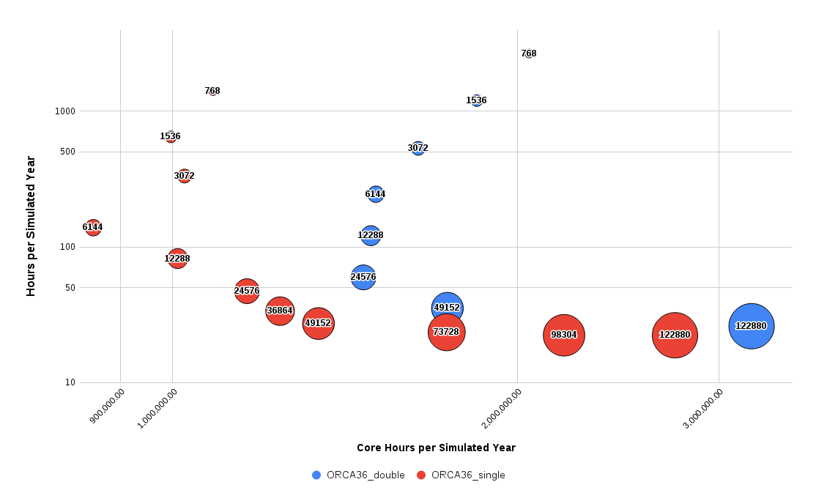
NEMO4 time vs cost
ORCA 36

Slide 39
Conclusions
NEMO scalability is good when maintaining subdomain size over 15x15. Max. throughput achieved at 10x10. With very large configurations (and many more PE’s) this may not be true.
Using mixed precision in NEMO may allow to achieve 1SYPD with 3km global resolution on current architectures. Up to x1.9 speedup on memory bandwidth bound configurations.
NEMO memory usage is not scaling: online interpolations in ORCA36 make impossible to run the model on standard nodes.
Data is an issue: restarts of ~1Tb size.

Slide 40
Porting NEMO diagnostics to GPUs

Slide 41
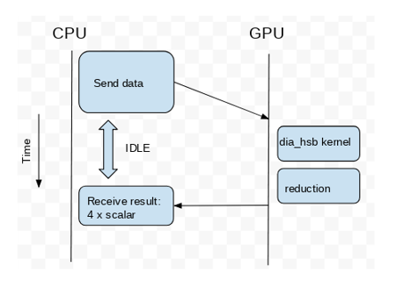
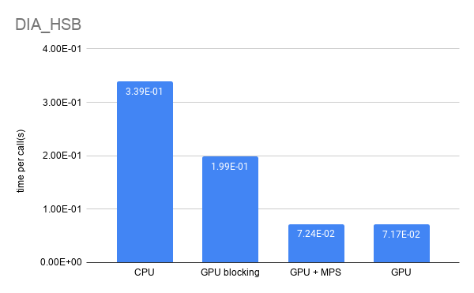
IMMERSE: Porting diagnostics to GPUs
The diagnostics dia_hsb kernel
DIA_HSB diagnostics time, using one Power9 node
Maicon Faria (BSC)

Slide 42
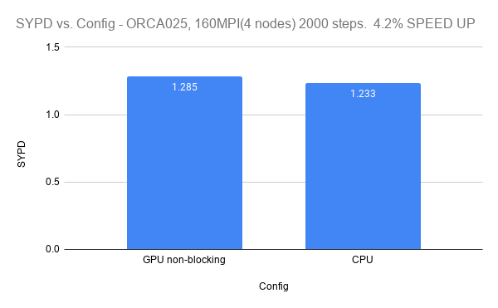
NEMO's GPU Diagnostic Strong Scaling
ORCA 025
Maicon Faria (BSC)
Notes:
Elapsed time for the NEMO’s diagnostic routine for the ORCA025 resolution in a synchronous/blocking implementation (2000 steps). The strong scaling behaviour is represented for one, two, and four CTE-Power nodes, each node equipped with four V100 GPUs.

Slide 43
Thank you
This project has received funding from the European Union’s Horizon 2020 research and innovation programme under grant agreement No 821926.
This project has received funding from the European Union’s Horizon 2020 research and innovation programme under grant agreement No 823988.
miguel.castrillo@bsc.es

