Slide 1
From MAGIC to reality:
Facilitating access to sector-specific
climate projection information
Dragana Bojović,
Alasdair Hunter, Nicolau Manubens, Louis-Philippe Caron (BSC)
and Andreas Sterl (KNMI)
EMS
Budapest, 4 September 2018

Slide 2
Notes:
Scientists are producing a plethora of climate data. Here symbolized by words

Slide 3
Notes:
This data should serve as information about the Earth's past, present and future climate. Helping better informed decision-making So we need to have them organized

Slide 4
Source: Guardian
Notes:
And also catalogued – to facilitate the access to this plethora now of information without requiring a high level of expertise in either climate or computer science

Slide 5
Notes:
Finally if we have a nice interface, that can indeed attract users of this data (this is Redcliff camera that houses part of the Oxford University library)

Slide 6
C3S-MAGIC portal
Notes:
C3S_34a-Lot2

Slide 7
Bringing calculation to the data
The platform implements High Performance Computing
and Big Data techniques
Uses developed ESMVal Tool recipes

Slide 8
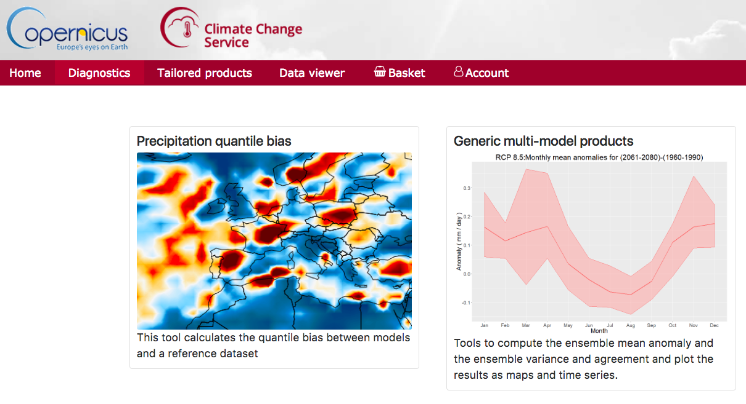
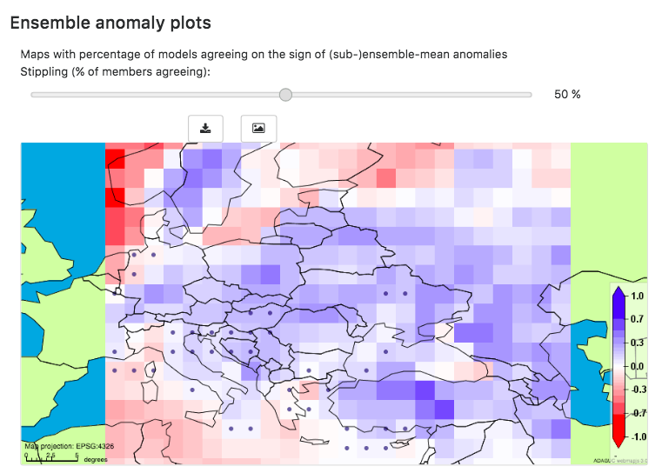
Notes:
To name some: Tools to aggregate and combine multi-model climate information into a single best estimate of future climate information
The module will compute and visualise maps (or time series) of
1) ensemble mean anomalies for any variable with respect to its mean annual cycle computed on a pre-defined period.
2) ensemble mean variance over any preselected period and variable of interest.
User changeable settings:
Period for defining climatology
Period for projections
Ensemble agreement threshold
Selection of models
Temporal averaging (monthly, seasonal, or yearly anomalies)

Slide 9
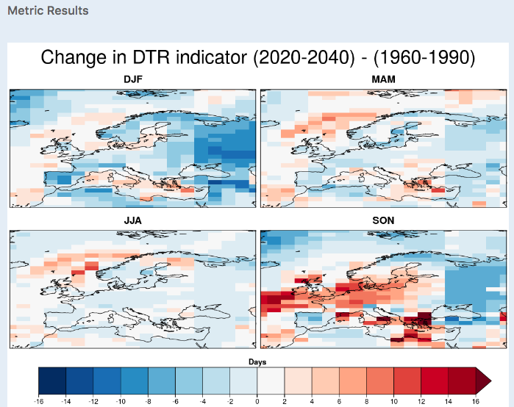
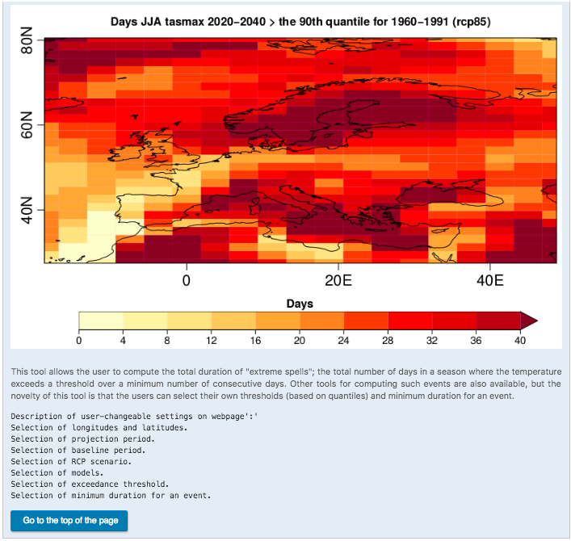
Energy sector: demand and supply
Demand - based on temp. variability
Extreme spells
Diurnal temperature indicator
Supply – wind capacity factor

Slide 10
Costal areas: storm surge estimator
Estimates surge height from anomalies in mean sea level pressure and wind
Simple and fast
Intended to quickly browse large data volumes and identify "interesting" cases

Slide 11
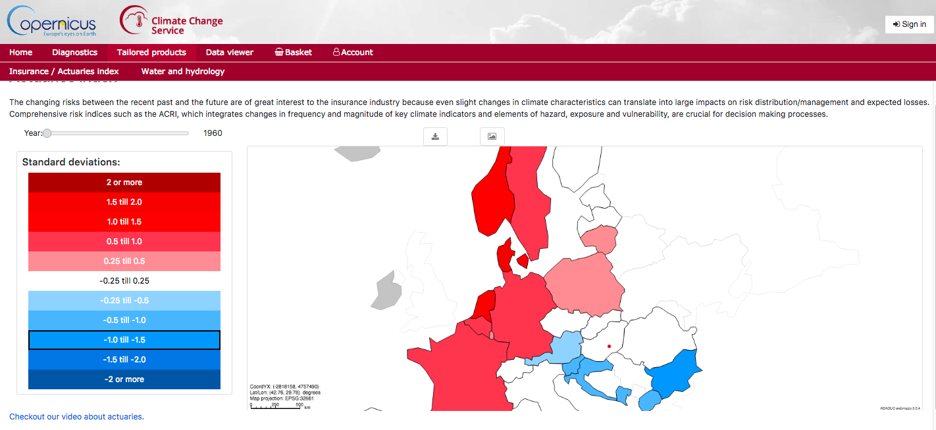

Slide 12
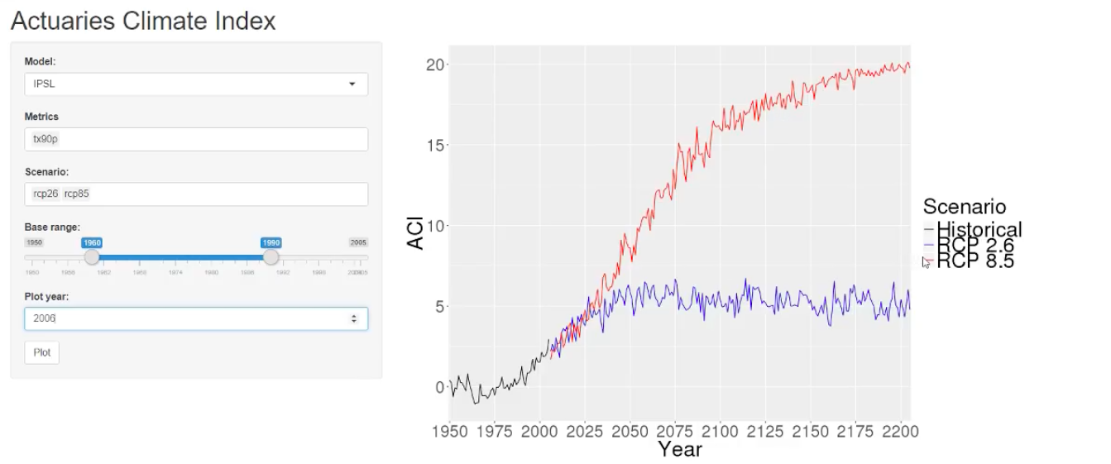
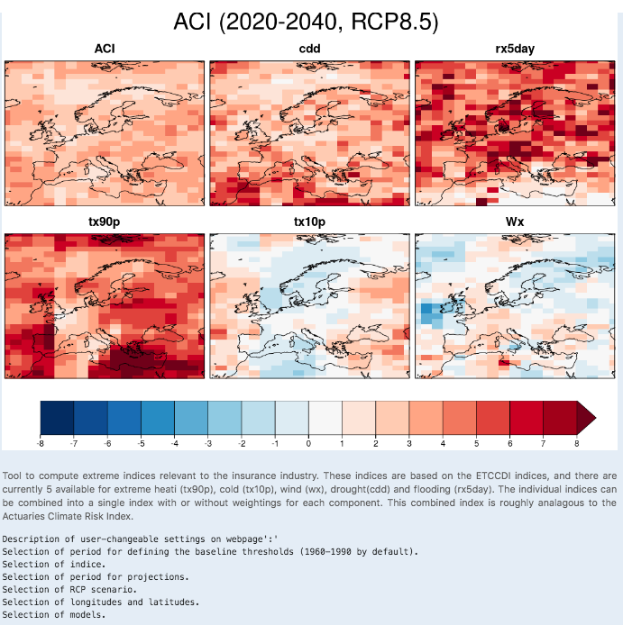
Insurance sector – Actuaries index

Slide 13
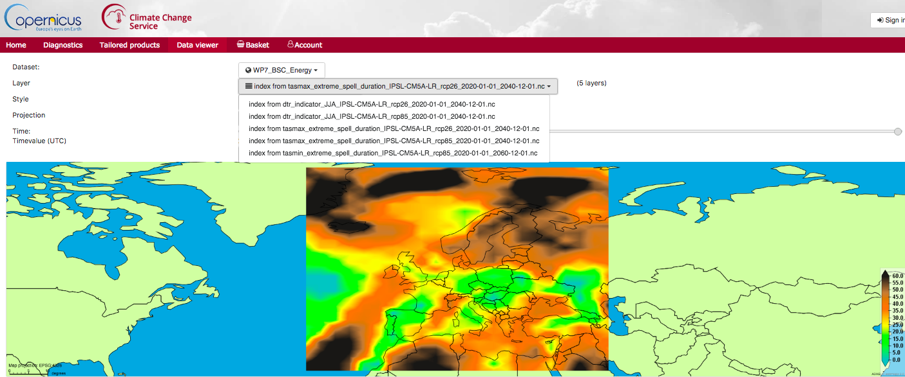
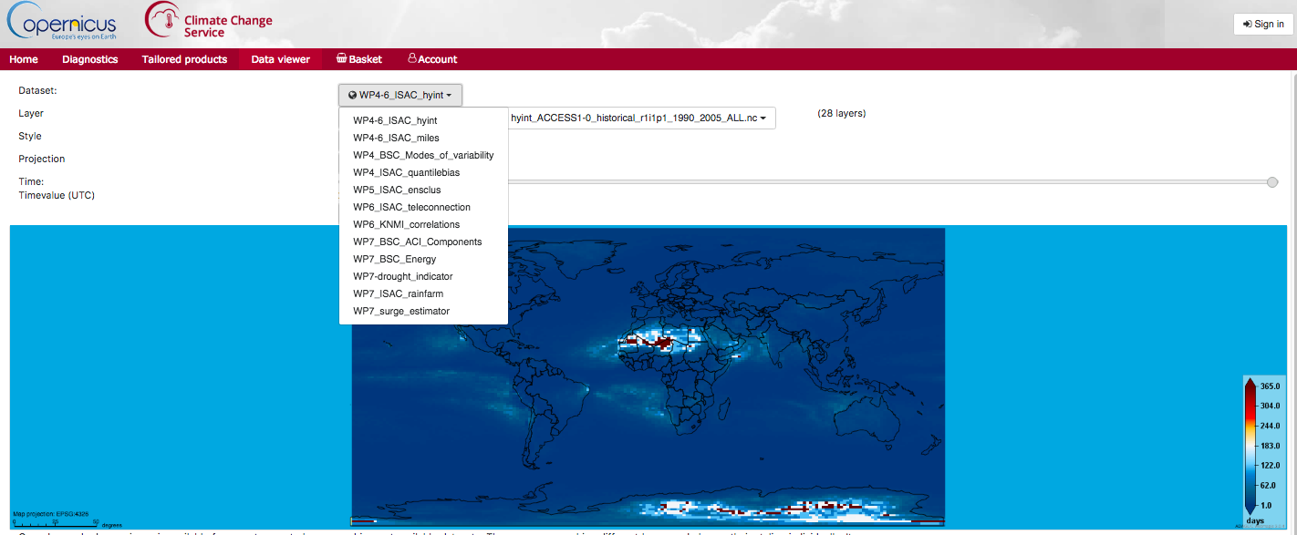
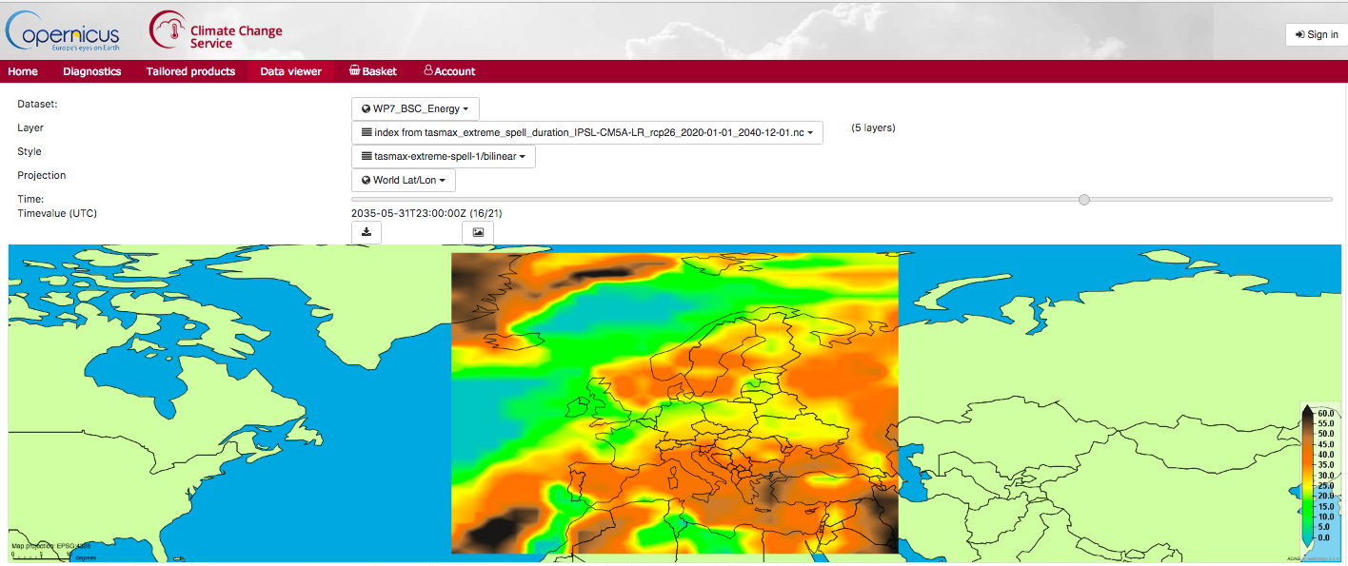
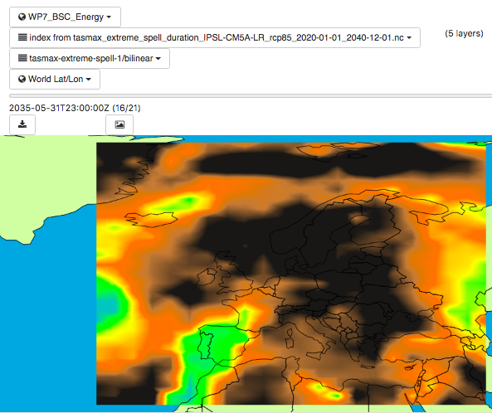

Slide 14
Collaboration with users
Private sector
Water and DRR Consultancy
Insurance sector
Energy sector
Scientists
Water utility
Everyone welcome to evaluate the platform!

Slide 15
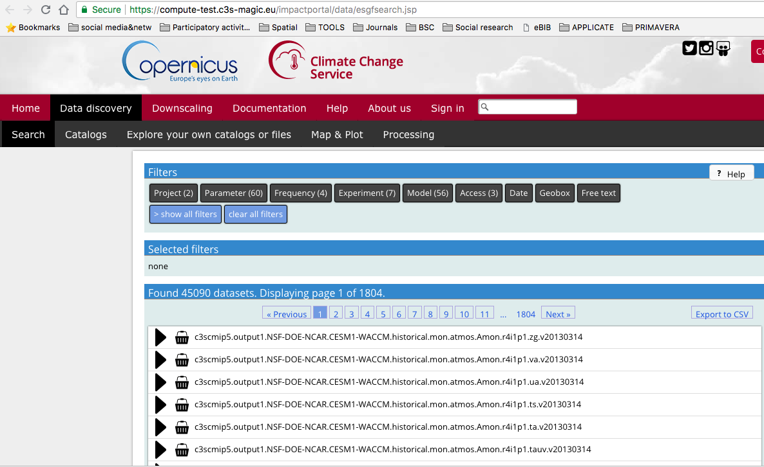
Collaboration with other C3S
Providing metrics for the Quality Assurance templates (QAT) developed by DECM. Collaboration to automatically incorporate them into the QATs
Complementing tools developed within other contracts
Direct data access through CP4CDS database
Notes:
Within C3S-51_Lot 4 (DECM) Quality Assurance Templates (QAT) for climate mode datasets are developed. These templates are intended to present information about product definition, quality and usability in a unified way. MAGIC can provide some of the key metrics to be used in the QATs. We are working together with DECM to automatically incorporate them into the QATs.

Slide 16
portal.c3s-magic.eu
Thank you for your attention!
dragana.bojovic@bsc.es

