Slide 1
Turning climate-related information into added value for traditional MEDiterranean Grape, OLive and Durum wheat food systems
4th European Climate Change Adaptation conference
MED-GOLD consortium
29 May 2019, Lisbon

Slide 2
MED-GOLD
The 4-H2020 EU funded project MED-GOLD will demonstrate the proof-of-concept for climate services in the agriculture sector.
MED-GOLD will co-design prototype pilot services involving both suppliers and users from three Mediterranean food systems.
MED-GOLD will identify key decisions or introduce new actions that can benefit from climate-related information at different timescales.

Slide 3
WORKPLAN
Tools Testing
2020
2018
2019
2021
Tools Development
Exploitation of value chain
(replicability,
Business plan,
market uptake)
Setting the Scene

Slide 4
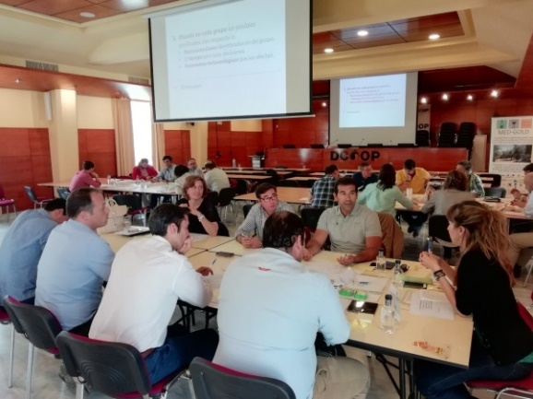
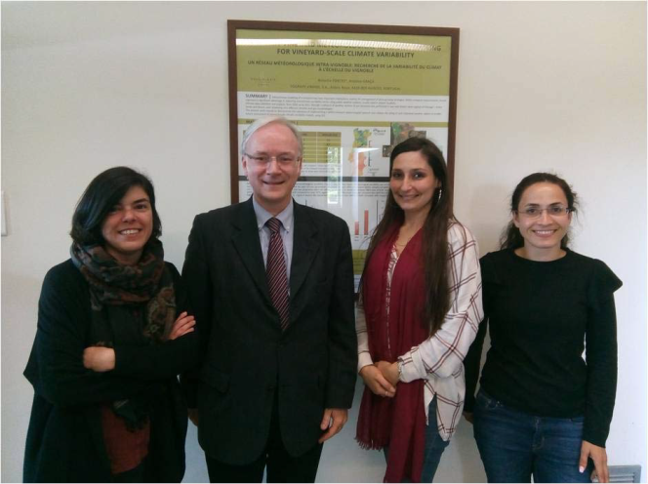
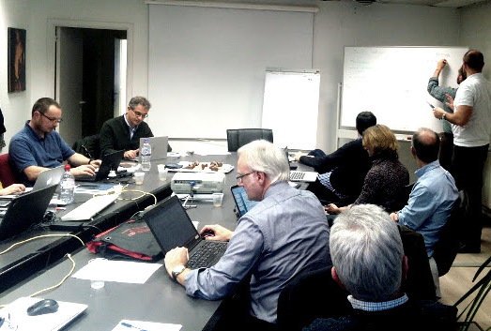
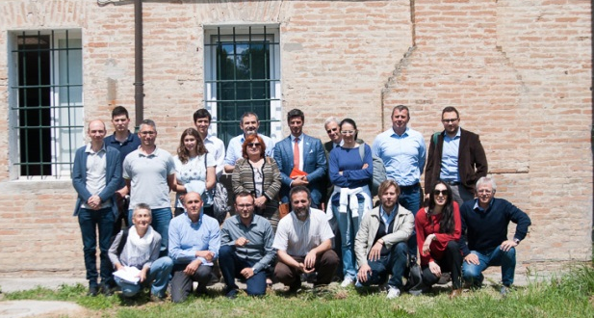
CO-DEVELOPMENT: Setting the scene
Scoping workshops
May 2018
Focus group discussions
April 2018
Workshop user perspective on seasonal forecasts
February 2019
Olive/olive oil: DCOOP, Antequera, Spain
Grape/wine: Sogrape, Porto, Portugal
Brussels, Belgium
Durum wheat/pasta: HORTA, Ravenna, Italy

Slide 5
CO-DEVELOPMENT:
Developing the tools
Dissemination material on the usability of the climate services tools
Three workshops for collecting feedback from potential users
Olive/olive oil: DCOOP, Antequera, Spain, May 2019

Slide 6
JOIN THE MED-GOLD COMMUNITY!
The MED-GOLD community is composed of organisations in Europe operating in the olive-olive oil, grape-wine, durum wheat-pasta sectors.
Join the MED-GOLD community at:
www.med-gold.eu/participate/
(available in English, Italian, Spanish, Portuguese, Greek and French)
Join our forum: http://forum.med-gold.eu/login

Slide 7
med-gold.project@enea.it
www.med-gold.eu
medgold_h2020
Thank you
Eυχαριστίες
Grazie
Gracias
Obrigado
Merci

