Slide 1
BSC-HIRLAM collaboration: HARMONIE code profiling roadmap and current status
Xavier Yepes-Arbós
Mario C. Acosta
Kim Serradell
18/06/2019
HARMONIE System Working Week, ECMWF, UK

Slide 2
Who we are

Slide 3
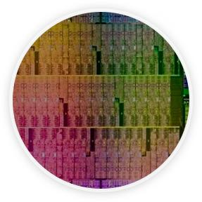
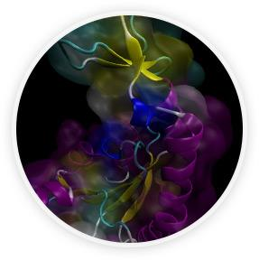
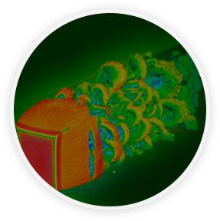
Mission of BSC Scientific Departments
Computer
Sciences
Earth Sciences
To influence the way machines are built, programmed and used: programming models, performance tools, Big Data, computer architecture, energy efficiency
To develop and implement global and regional state-of-the-art models for short-term air quality forecast and long-term climate applications
Life
Sciences
CASE
To understand living organisms by means of theoretical and computational methods (molecular modeling, genomics, proteomics)
To develop scientific and engineering software to efficiently exploit super-computing capabilities (biomedical, geophysics, atmospheric, energy, social and economic simulations)

Slide 4
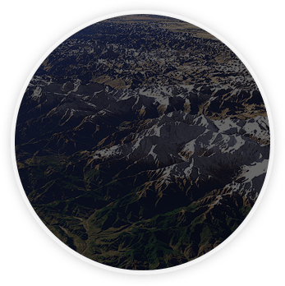
Earth Sciences
Environmental modelling and forecasting, with a particular focus on weather, climate and air quality
Modeling
air quality and
Sand and Dust Storms
Processes from urban to
Global and the impacts
on weather, health
and ecosystems
Climate
predictions
system from
subseasonal-to-decadal
forecasts
Research
and
Forecasts
Service Users Sectors
Infrastructures
Solar
Energy
Urban
development
Transport
Wind
Energy
Agriculture
Insurance

Slide 5
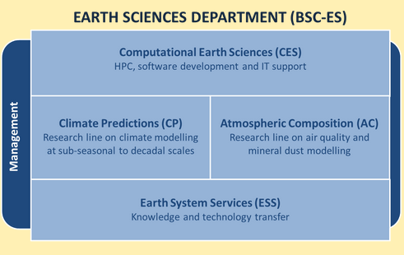
Earth Sciences Groups
Climate Prediction
Modelling
Atmospheric Composition
Modelling
Earth System Services
Computational Earth Sciences

Slide 6
Computational Earth Sciences Group
Performance Team
Provide HPC Services (profiling, code audit, …)
Apply new computational methods
Models and Workflows Team
Development of HPC user-friendly software framework
Support the development of atmospheric research software
Data and Diagnostics Team
Big Data in Earth Sciences
Provision of data services
Visualization

Slide 7
Roadmap

Slide 8
BSC-HIRLAM collaboration
The BSC and the HIRLAM consortium signed a contract for a 1 year project to perform a complete code profiling of the HARMONIE-AROME model and the Data Assimilation system, starting on June 2019
The project consists of two phases:
1st: Basic profiling analysis
2nd: Perform a complete analysis according to the results from the first phase

Slide 9
Scope of the phase 1
Duration: 4 months
Prepare selected configurations to be deployed with Extrae on cca/ccb at ECMWF, a Cray XC40 machine
Perform a basic analysis of the HARMONIE-AROME Forecast model and the Data assimilation execution
Use different computational metrics: IPC, useful duration, MPI overhead, cache misses, etc
Identify the different parts of the trace with regard the code being executed
Deliver a complete document with the results and feedback to decide the main goals for the profiling analysis of the phase 2

Slide 10
Scope of the phase 2
Duration: 8 months after completion of phase 1
Complete profiling analysis according to the results obtained from phase 1
Training:
Prepare basic tutorials based on coarser HARMONIE configurations
Prepare a physical event to perform a training for the users
Prepare complete documentation:
Online follow-up meetings to detect deviations and correct if needed
Write a final document describing all the tasks carried on
Presence in the HIRLAM System group meetings: dissemination and feedback

Slide 11
Code profiling methodology

Slide 12
Profiling methodology overview
Scalability tests: MPI, OpenMP, Tiling
Evaluate deployment efficiency: compilation flags
Affinity tests: find a proper placement for MPI processes
Profile analysis: user functions calls, statistics…
Trace analysis: MPI, hardware counters, communication…
Performance simulation: evaluate the code under machine changes
Validation tests: check code correctness if optimized

Slide 13
BSC performance tools
Since 1991
Based on traces
Open Source: http://www.bsc.es/paraver
Extrae: Package that generates Paraver trace-files for a post-mortem analysis
Paraver: Trace visualization and analysis browser
Includes trace manipulation: Filter, cut traces
Dimemas: Message passing simulator
Trace files
Simulated trace files
Application
DIMEMAS simulator
EXTRAE library
Paraver
Paraver
Trace visualization
DIMEMAS generated trace. Target = ideal machine

Slide 14
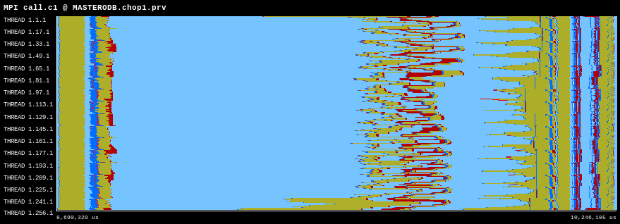
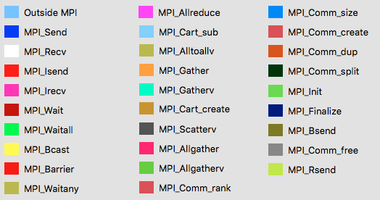
How a trace looks like: basic overview
Computation
Communication
MPI processes
Timeline
MPI call color legend

Slide 15
Current status

Slide 16
Deployment
Git develop branch
The first deployed configuration is the default one
DKCOEXP domain (2.5km and 65 vertical levels)
Run on cca at ECMWF
GNU compiler
Four different scenarios have been tested by combining OpenMP and the I/O server
Only one of them worked with Extrae

Slide 17
1st scenario
Default setup: 256 MPI (16x16) and no OpenMP. 2 IO servers
It only crashes when it is used with Extrae
The I/O server voluntarily aborts the execution
Error:
ABORT! 1 IO_SERV_GET_REQ: SIZE MISMATCH
ABOR1 CALLED
IO_SERV_GET_REQ: SIZE MISMATCH
MPL_ABORT: CALLED FROM PROCESSOR 1 THRD 1
MPL_ABORT: THRD 1 IO_SERV_GET_REQ: SIZE MISMATCH
[myproc#1,tid#1,pid#53203]: 1081 MB (maxheap), 276 MB (maxrss), 0 MB (maxstack), walltime = 1554295600.04s
[myproc#1,tid#1,pid#53203]: IO_SERV_RUN
[myproc#1,tid#1,pid#53203]: IO_SERV_RUN_MF
[myproc#1,tid#1,pid#53203]: IO_SERV_RECV_REQ
[myproc#1,tid#1,pid#53203]: IO_SERV_SYNC_SORT
[myproc#1,tid#1,pid#53203]: IO_SERV_GET_REQ

Slide 18
2nd scenario
256 MPI (16x16) and no OpenMP. No IO servers
It worked with Extrae and a trace was generated

Slide 19
3rd scenario
100 MPI (10x10) and 4 OpenMP = 400. No IO servers. It does not use FLAKE
It is not stable. There were run 3 instances, where 2 of them crashed and 1 properly finished
First error:
Rank 95 [Wed Apr 3 15:42:56 2019] [c2-1c2s9n0] Fatal error in MPI_Recv: Other MPI error, error stack:
MPI_Recv(212)..................: MPI_Recv(buf=0x2aacca7995d0, count=4200, dtype=0x4c000829, src=1, tag=25002, comm=0x84000004, status=0x7fffff78d2d0) failed
MPIDI_CH3I_Progress(537).......:
MPID_nem_mpich_test_recv(989)..:
MPID_nem_gni_poll(1554)........:
MPID_nem_gni_check_recvCQ(1448):
MPID_nem_gni_process_recv(1298): GNI_SmsgGetNextWTag (GNI_RC_INVALID_PARAM)
aborting job:
Fatal error in MPI_Recv: Other MPI error, error stack:
MPI_Recv(212)..................: MPI_Recv(buf=0x2aacca7995d0, count=4200, dtype=0x4c000829, src=1, tag=25002, comm=0x84000004, status=0x7fffff78d2d0) failed
MPIDI_CH3I_Progress(537).......:
MPID_nem_mpich_test_recv(989)..:
MPID_nem_gni_poll(1554)........:
MPID_nem_gni_check_recvCQ(1448):
MPID_nem_gni_process_recv(1298): GNI_SmsgGetNextWTag (GNI_RC_INVALID_PARAM)
[NID 02084] 2019-04-03 15:42:57 Apid 334084920: initiated application termination

Slide 20
3rd scenario (2)
Second error:
***Received signal = 11 and ActivatED SIGALRM=14 and calling alarm(10), time =1553846291.95
[myproc#29,tid#1,pid#65932,signal#11(SIGSEGV)]: Received signal :: 8439MB (heap), 1285MB (rss), 0MB (stack), 0 (paging), nsigs 1, time 1553846291.95
tid#1 starting drhook traceback, time =1553846291.95
[myproc#29,tid#1,pid#65932]: 8439 MB (maxheap), 1285 MB (maxrss), 0 MB (maxstack), walltime = 1553846291.95s
[myproc#29,tid#1,pid#65932]: MASTER
[myproc#29,tid#1,pid#65932]: CNT0
[myproc#29,tid#1,pid#65932]: CNT1
[myproc#29,tid#1,pid#65932]: CNT2
[myproc#29,tid#1,pid#65932]: CNT3
[myproc#29,tid#1,pid#65932]: CNT4
[myproc#29,tid#1,pid#65932]: STEPO
[myproc#29,tid#1,pid#65932]: SCAN2M
[myproc#29,tid#1,pid#65932]: GP_MODEL_STACK
[myproc#29,tid#1,pid#65932]: GP_MODEL
[myproc#29,tid#1,pid#65932]: CALL_SL_STACK
[myproc#29,tid#1,pid#65932]: CALL_SL
[myproc#29,tid#1,pid#65932]: SLCOMM
[myproc#29,tid#1,pid#65932]: SLCOMM:SLCOMM_INT
[gdb__sigdump] : Received signal#11(SIGSEGV), pid=65932 , it=1 : sigcontextptr=0x7fffff78aa00

Slide 21
4th scenario
100 MPI (10x10) and 4 OpenMP = 400. 2 IO servers. It does not use FLAKE
As in the 1st scenario, it only crashes when it is used with Extrae
The I/O server voluntarily aborts the execution
Error:
ABORT! 1 IO_SERV_GET_REQ: SIZE MISMATCH
ABOR1 CALLED
IO_SERV_GET_REQ: SIZE MISMATCH
MPL_ABORT: CALLED FROM PROCESSOR 1 THRD 1
MPL_ABORT: THRD 1 IO_SERV_GET_REQ: SIZE MISMATCH
[myproc#1,tid#1,pid#53203]: 1081 MB (maxheap), 276 MB (maxrss), 0 MB (maxstack), walltime = 1554295600.04s
[myproc#1,tid#1,pid#53203]: IO_SERV_RUN
[myproc#1,tid#1,pid#53203]: IO_SERV_RUN_MF
[myproc#1,tid#1,pid#53203]: IO_SERV_RECV_REQ
[myproc#1,tid#1,pid#53203]: IO_SERV_SYNC_SORT
[myproc#1,tid#1,pid#53203]: IO_SERV_GET_REQ

Slide 22
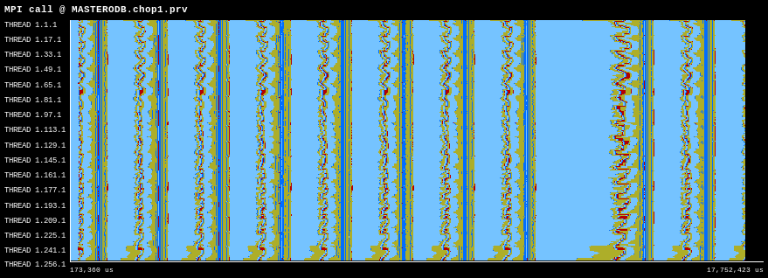
HARMONIE general overview
Trace from the 2nd scenario
Several time steps were traced
Regular time steps
Larger time step (it is probably computing radiation)

Slide 23
HARMONIE MPI calls
1 regular time step
Workload imbalance

Slide 24
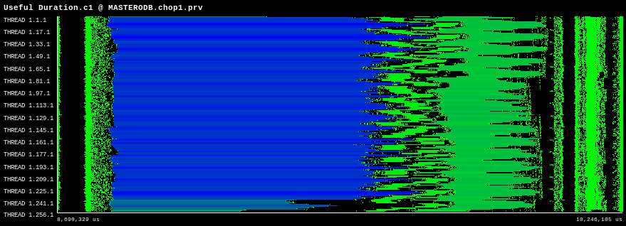
HARMONIE useful duration
Shorter computation burst
Larger computation burst

Slide 25
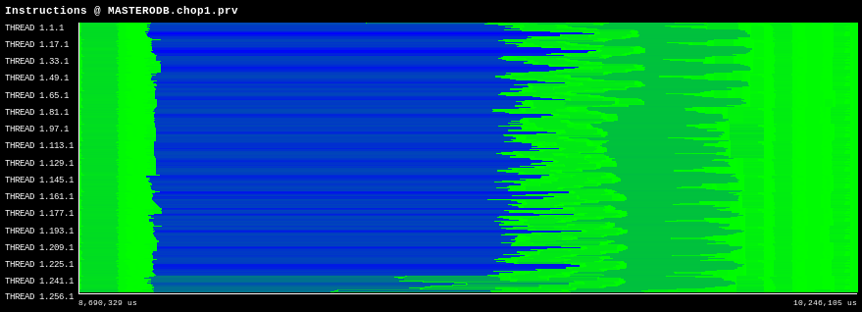
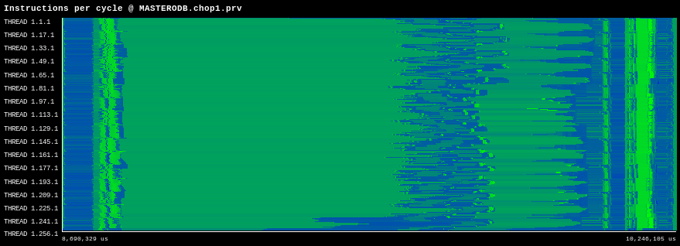
HARMONIE Inst.-IPC histogram
Instructions and IPC correlation histogram
Number of instructions
Instructions per cycle (IPC)

Slide 26
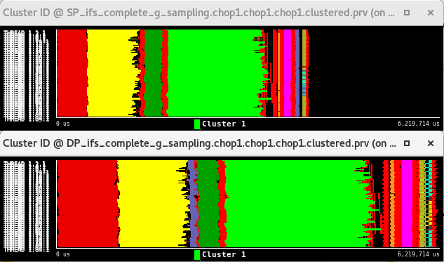
Other BSC tools: Clustering
Single precision vs double precision in IFS
1
2
3
4
5
1
2
3
4
5

Slide 27
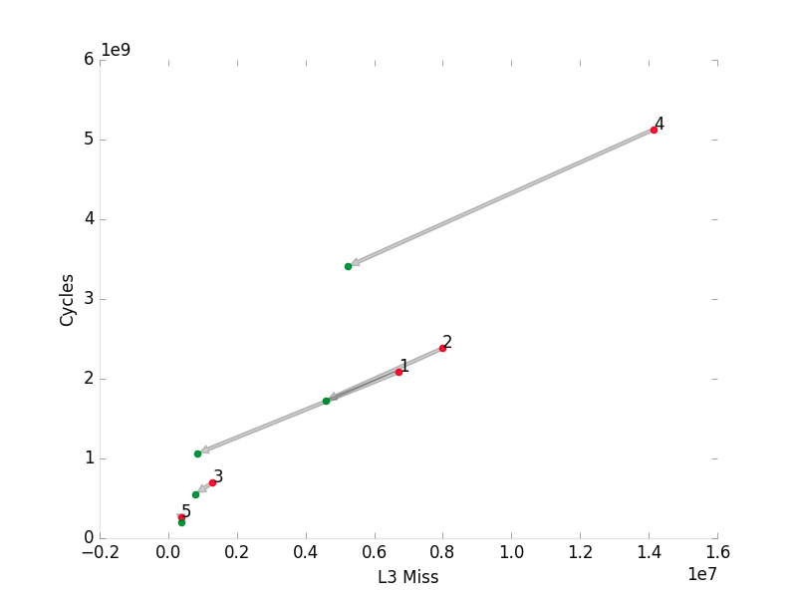
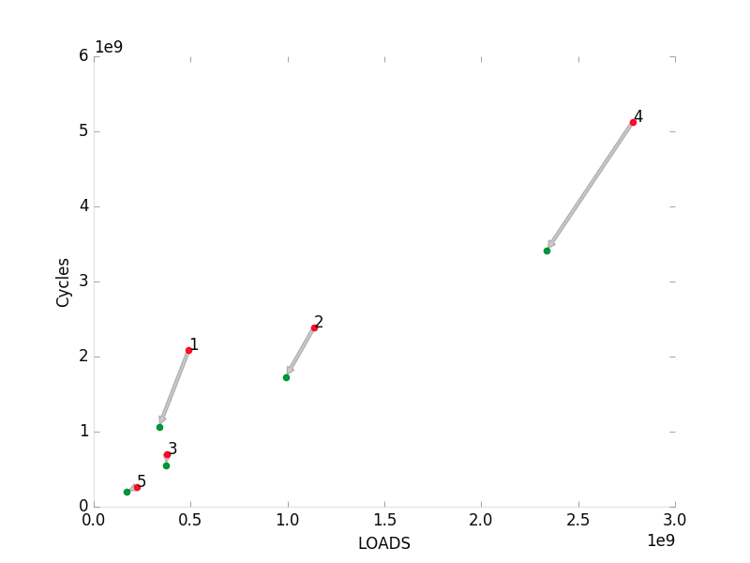
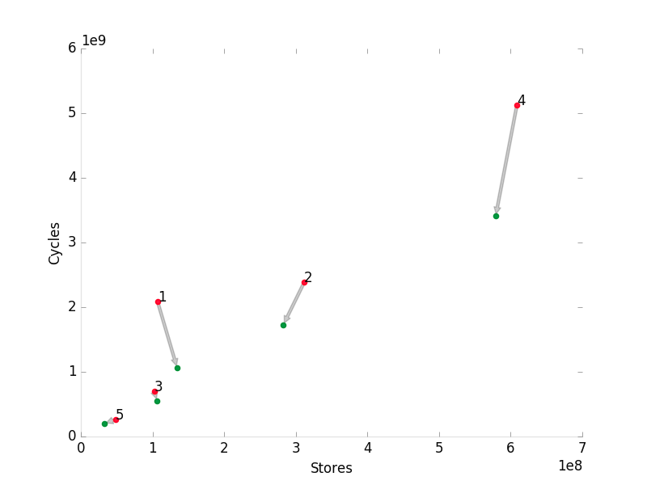
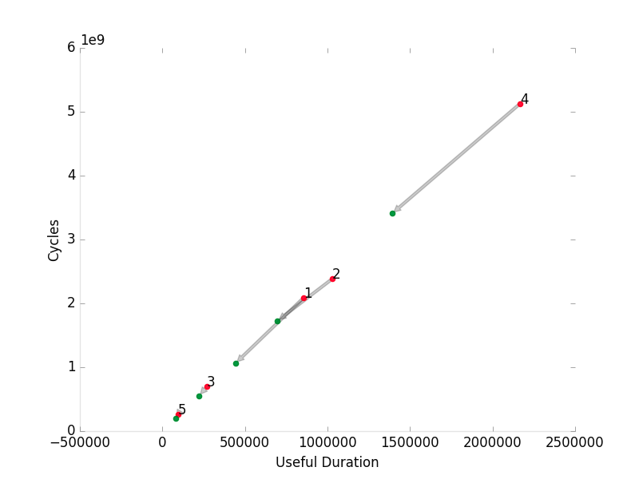
Other BSC tools: Tracking
Single precision vs double precision in IFS

Slide 28
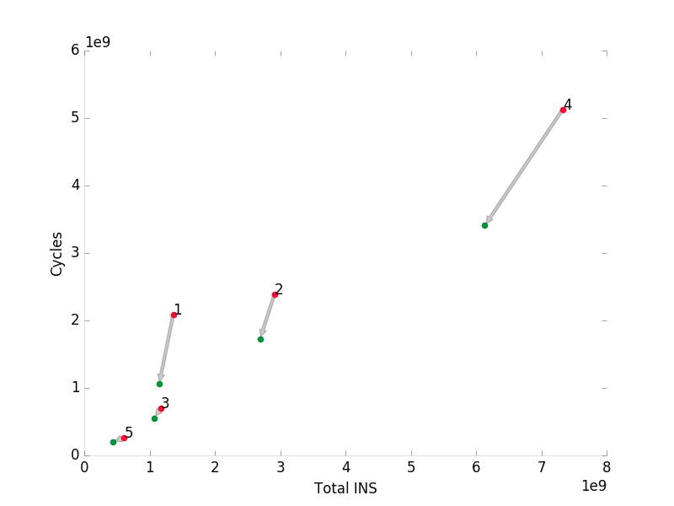
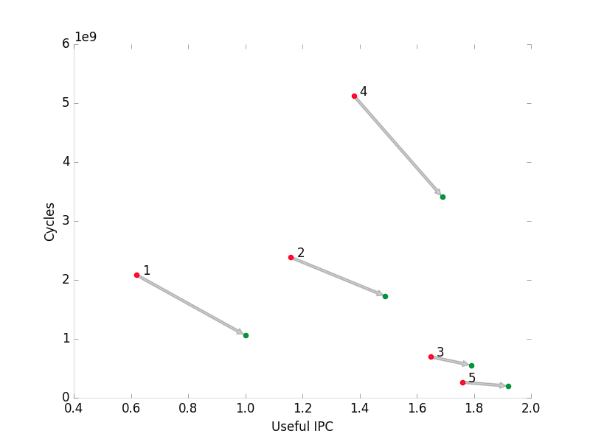
Other BSC tools: Tracking
Single precision vs double precision in IFS

Slide 29
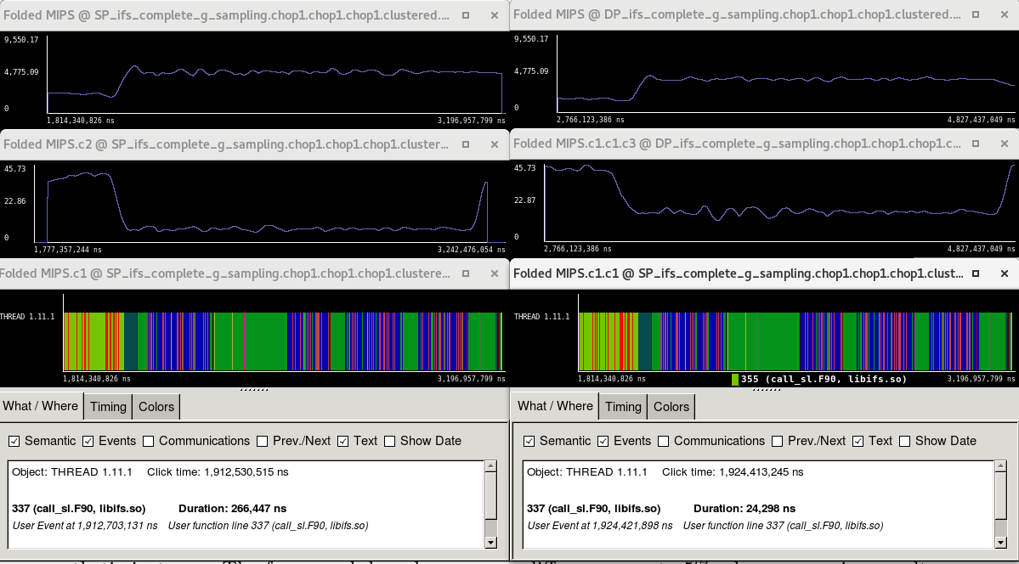
Other BSC tools: Folding
Single precision vs double precision in IFS
Region studied using sampling+folding
TOT_INS
TOT_CACHE_MISSES
Connection to the code
USER_FUNCTION_LINE

Slide 30
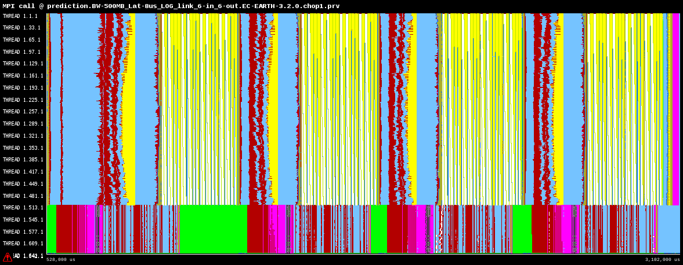
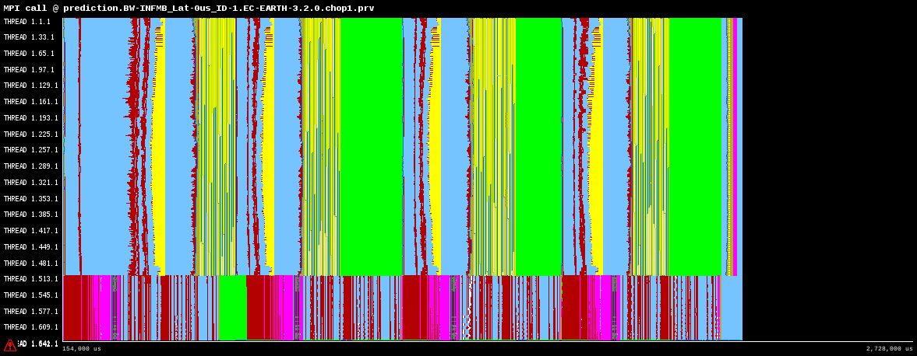
Other BSC tools: Dimemas
Ideal machine test (infinite bandwidth, no latency) in EC-Earth
Base trace
Ideal machine
Intra workload imbalances
Workload imbalances between models
Data dependencies
20.59% is communication

Slide 31
Discussion

Slide 32
List of things to discuss
To summarize, we ran the default configuration (DKCOEXP) with these 4 variants or scenarios:
1st: 256 MPI (16x16) and no OpenMP. 2 IO servers. Crashes w/ Extrae
2nd: 256 MPI (16x16) and no OpenMP. No IO servers. Works
3rd: 100 MPI (10x10) and 4 OpenMP = 400. No IO servers. It does not use FLAKE. Unstable
4th: 100 MPI (10x10) and 4 OpenMP = 400. 2 IO servers. It does not use FLAKE. Crashes w/ Extrae
It is very important to have a working and stable configuration to apply all the techniques of the profiling methodology in order to perform a successful study for both phases 1 and 2
Stable branch to profile?
Configuration to be used -> DKCOEXP, METCOOP25C… ?

Slide 33
List of things to discuss (2)
Compiler to be used -> Intel, gcc?
Generic issues -> systemcore-bsc@hirlam.org mailing list
Specific technical issues -> who?
Best way to keep good communication and feedback between HIRLAM and BSC?
SBUs account
Any other issue?

Slide 34
Thank you
xavier.yepes@bsc.es

