Slide 1
Climateurope2: Climate services, standards, provenance and more
17 October 2023
Francisco Doblas-Reyes (ICREA and BSC)
This project has received funding from the European Union’s Horizon Europe research and innovation programme under grant agreement No 101056933.
The sole responsibility for the content of this document lies with the Climateurope2 project and does not necessarily reﬂect the opinion of the European Union.

Slide 2
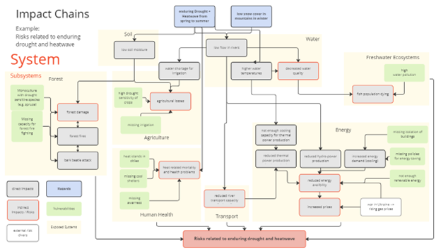
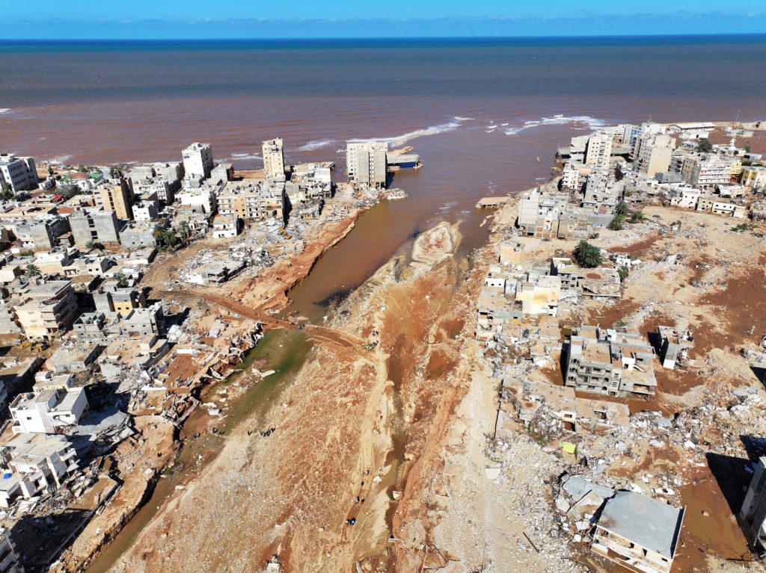
Climate risk and adaptation
Climate risk assessment and climate adaptation require access to reliable climate information. Climate services is the set of procedures that develops such information in context.
Storm Daniel, 11 September 2023
Derna, Libya, more than 400 mm recorded in 24 hours
EUCRA impact chain for heat and drought risk assessment

Slide 3
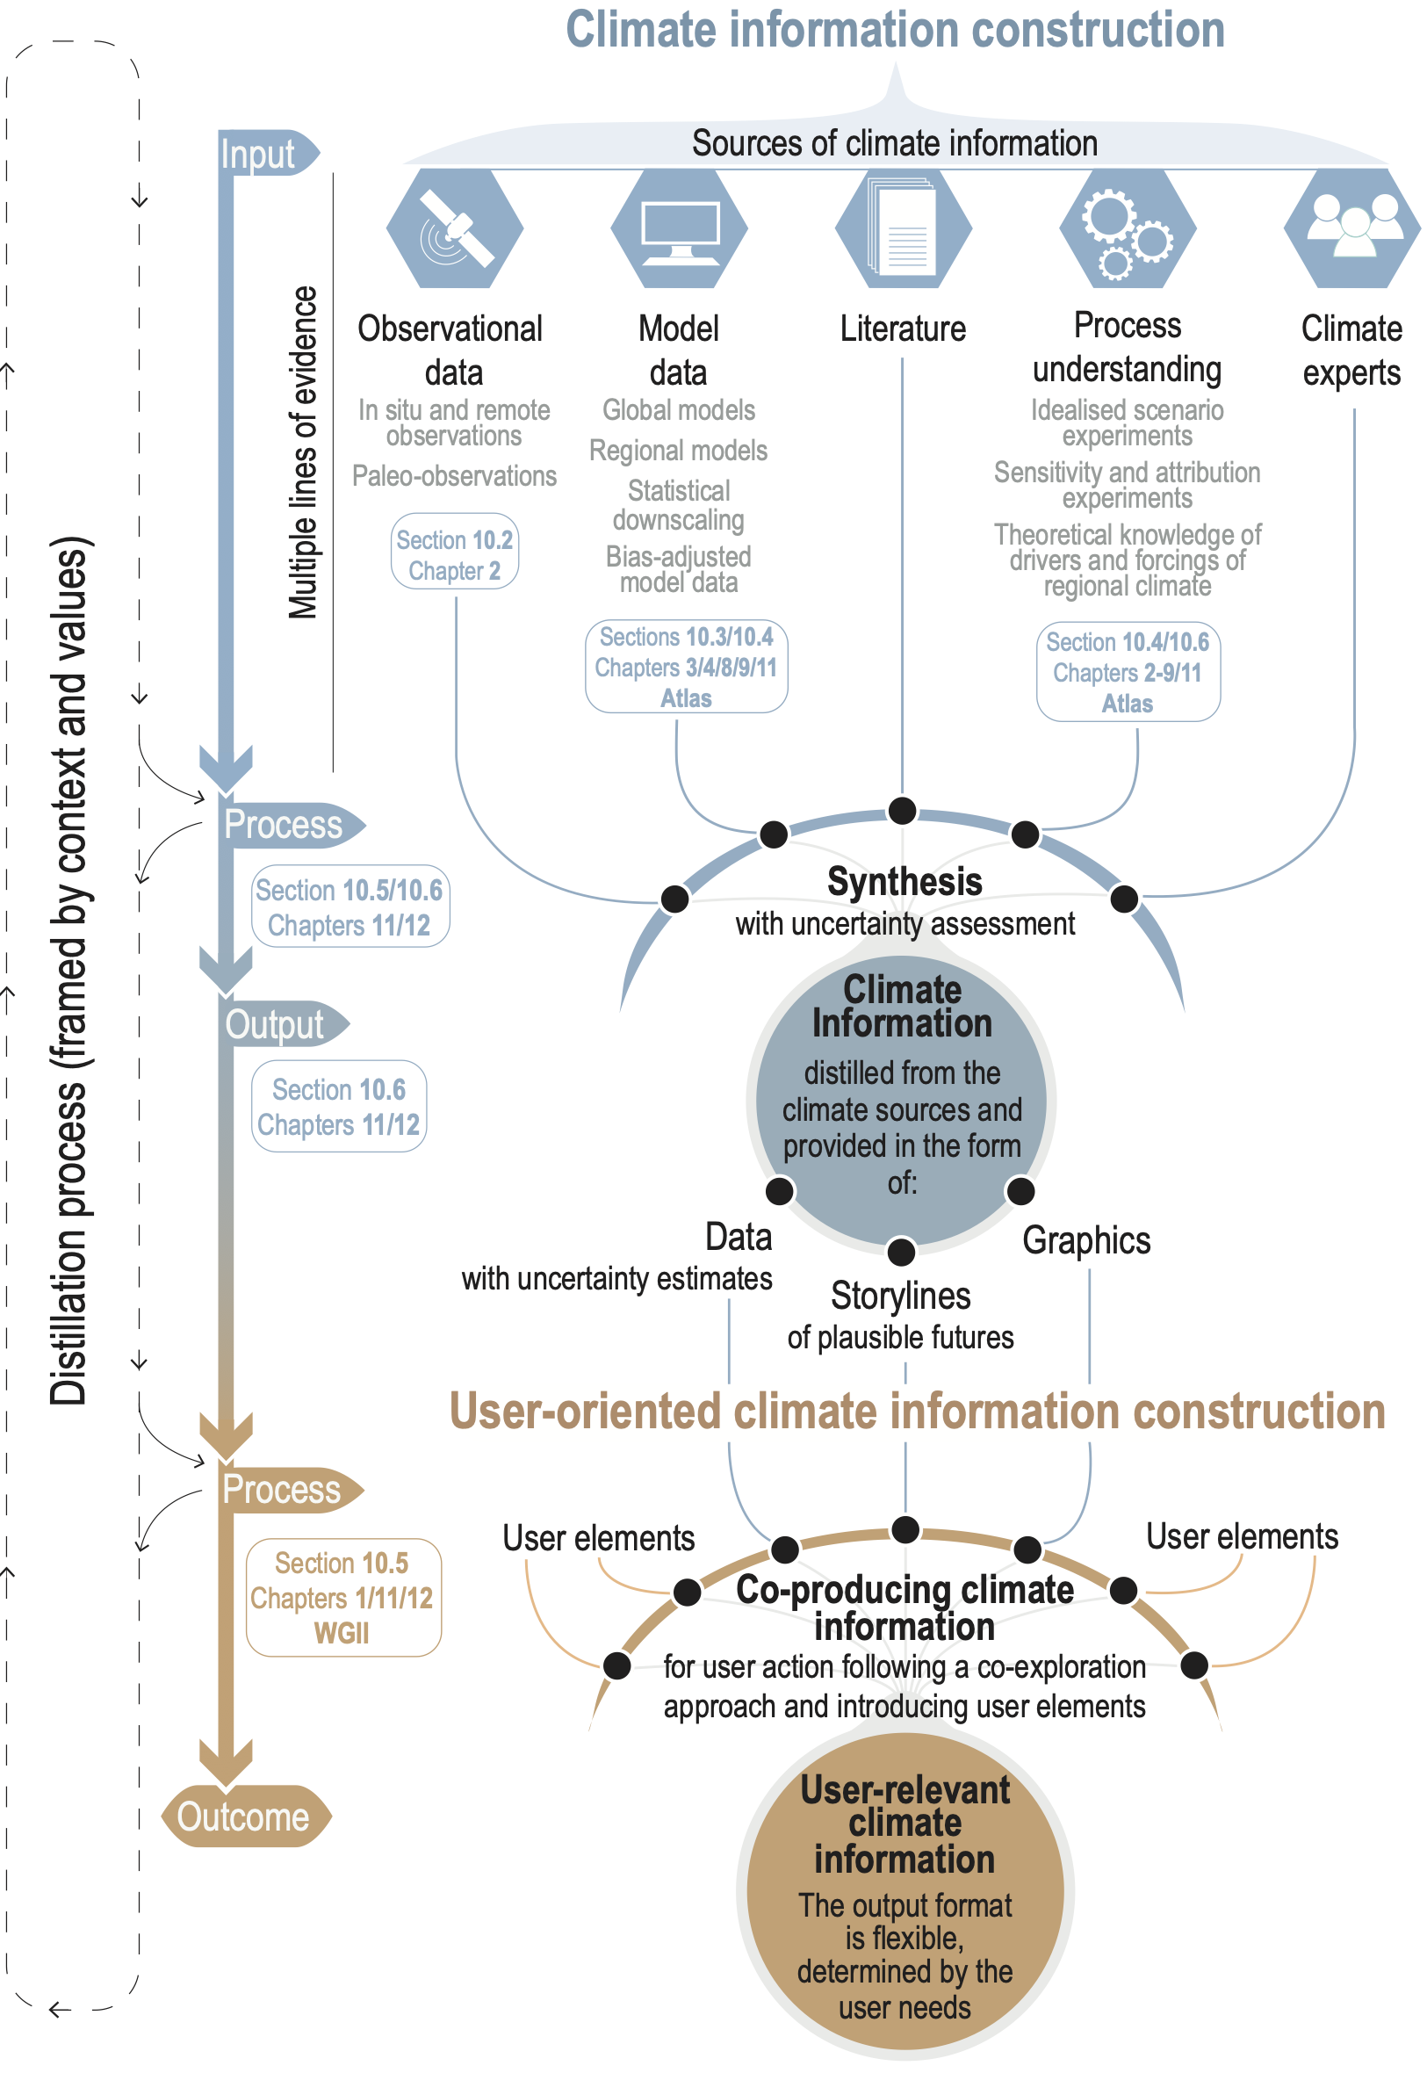
Climate information
and services
Fig. 10.1 (AR6 WGI)

Slide 4
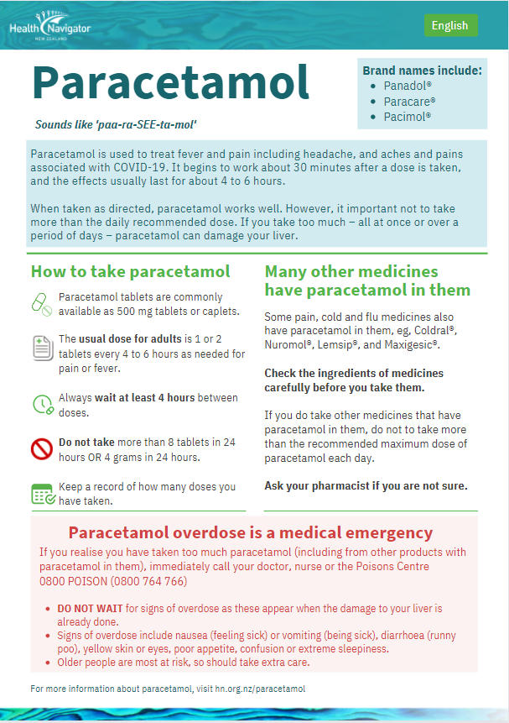
What about quality?

Slide 5
What about quality?
Can we be confident in the service provided?
Poor quality leads to
waste of time and money
poor decisions
frustration
reputation damage
Quality management is central to ensure a reliable service useful to users
with the purpose of
demonstrating that the service is a trusted source
characterising quality dimensions in a clear and traceable way
guiding users with information to make their own decisions
providing a vehicle that will trigger actions to improve the service

Slide 6
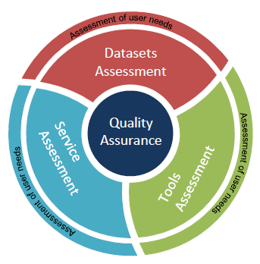
Quality assurance of climate services
Quality assurance assesses the fitness-for-purpose of climate services against standards from multiple angles: tools, workflows, data, applications, provenance, documentation, user engagement, etc.
For instance, software quality assessment should be based on the standard ISO/IEC 9126 and extensions (e.g., ISO/IEC 25010:2011).
ISO 9126
Maintainability
Efficiency
Portability
Reliability
Functionality
Usability

Slide 7
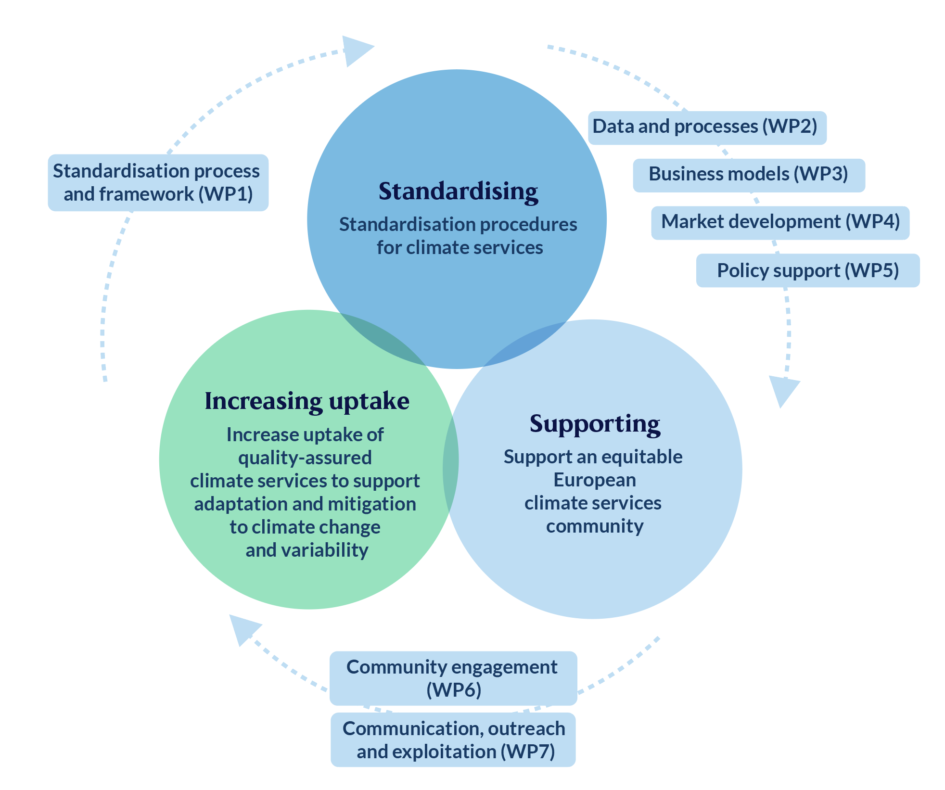
Objectives and structure
Standardising
Development of standardisation procedures for climate services
Supporting
Support of an equitable European climate services community
Increasing uptake
Enhancement of the uptake of quality-assured climate services to support climate adaptation and mitigation
CSA Horizon Europe, Sep 2022-Feb 2027

Slide 8
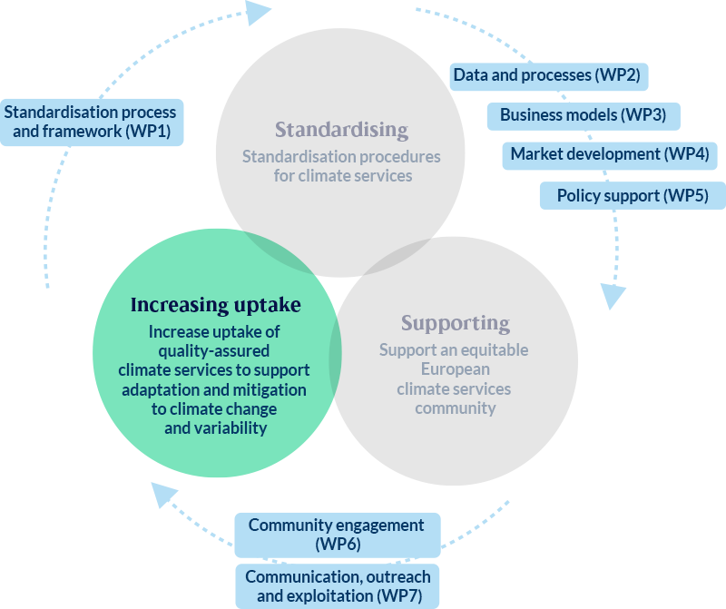
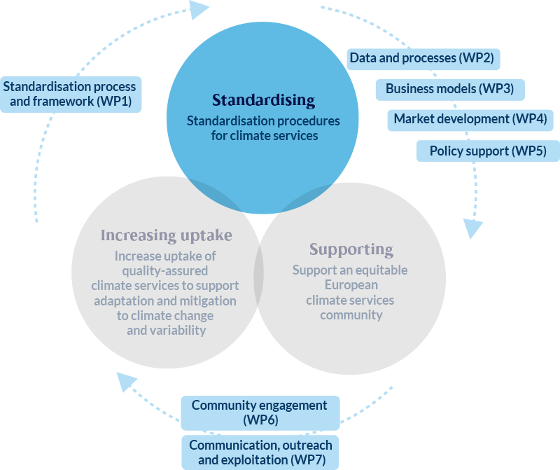
Objectives and structure
Standardising
Development of standardisation procedures for climate services
O1.1 Estimate the maturity of the climate services components
O1.2 Proceed with the standardisation of the components of climate services and the interoperability of the standards
O1.3 Develop a quality management approach for the verification of climate services

Slide 9
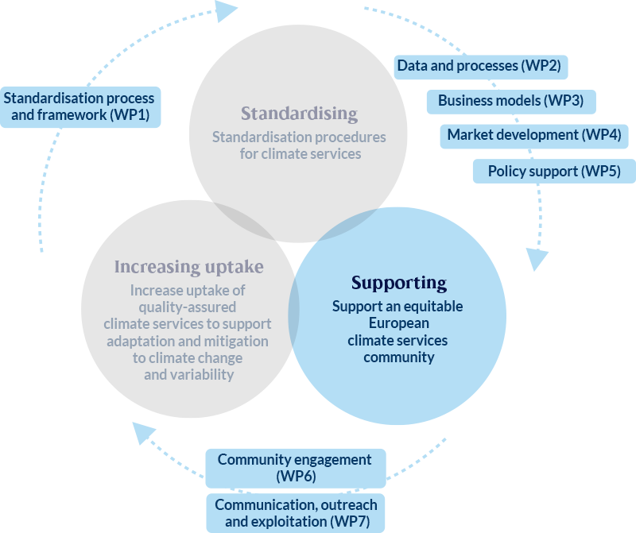
Objectives and structure
Supporting
Support of an equitable European climate services community
O2.1 Sustain a community of European climate services actors, including underrepresented groups
O2.2 Develop an interactive platform and support service
O2.3 Integrate ethical, political, anthropological and sociological perspectives from social sciences and humanities

Slide 10
Objectives and structure
Increasing uptake
Enhancement of the uptake of quality-assured climate services to support climate adaptation and mitigation
O3.1 Develop a strategy for the accreditation of climate services
O3.2 Provide recommendations for improving tools to enhance the salience, credibility and legitimacy of climate services
O3.3 Promote trust between supply and demand
O3.4 Assess current business models and the scalability of market solutions

Slide 11
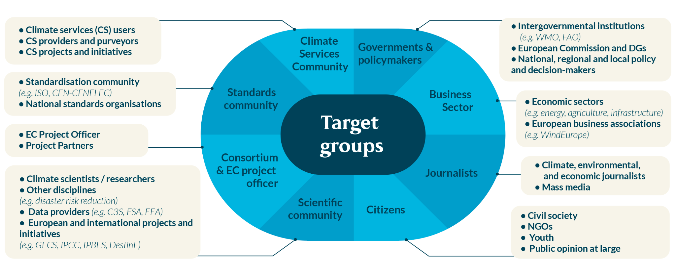
Community and audience

Slide 12
Elements for standard recommendations
Landscape
Glossary
Framework
WP2-5
Clarify the existing landscape of technical, procedure, and performance norms and standards and identify initiatives supporting standardisation of climate services
Create a glossary mapping of sectoral vocabulary
Develop a framework for standardisation of climate services
Synthesis of WPs 2-5 results
Updates: ongoing
v1: ongoing
Standards revelant for CS components: stakeholder engagement + co-creation
More than 13 terms to discuss + consensus scoping
Framework refinement

Slide 13
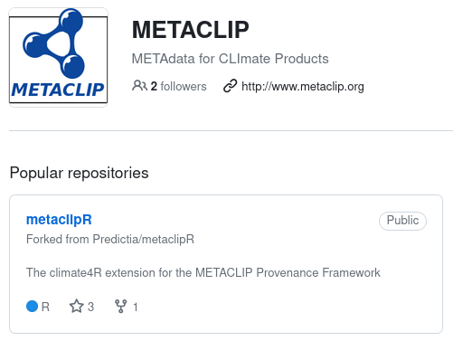
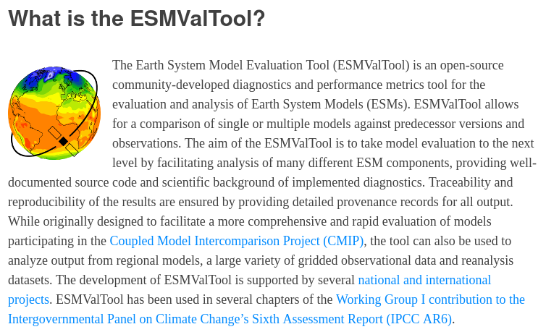
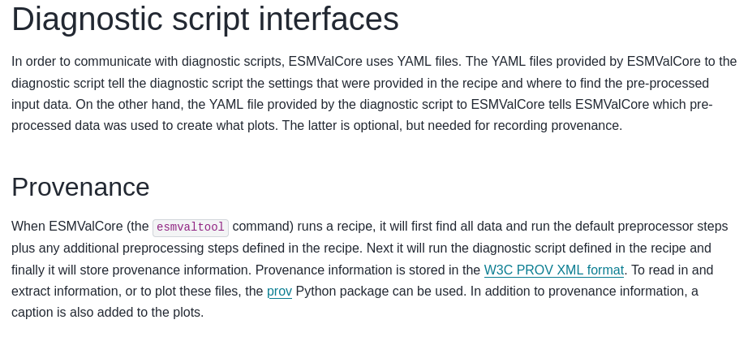
Provenance in climate information
A cacophony of climate information sources is available, and this happens in a growing market with no clearly defined standards. What about the adequacy of the information sources? How is product quality addressed? As open as possible, as restricted as necessary.

Slide 14
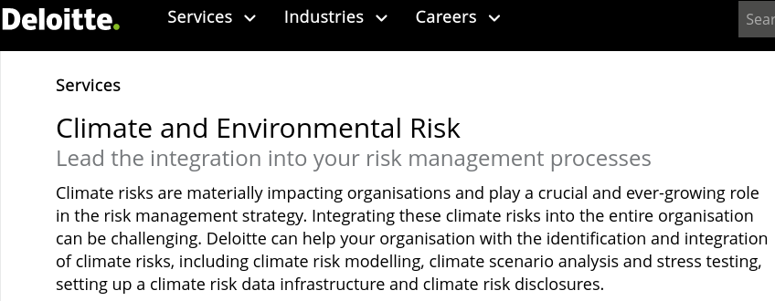
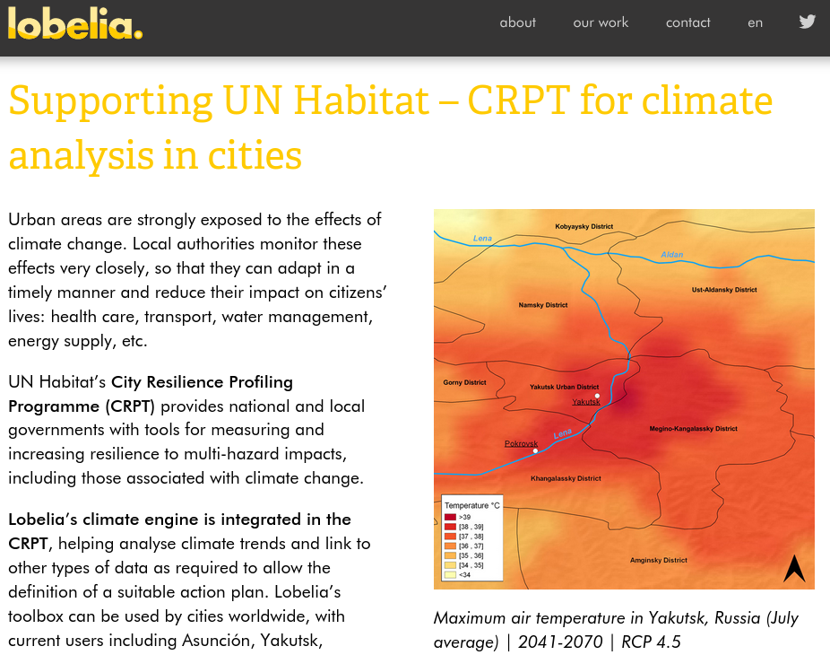
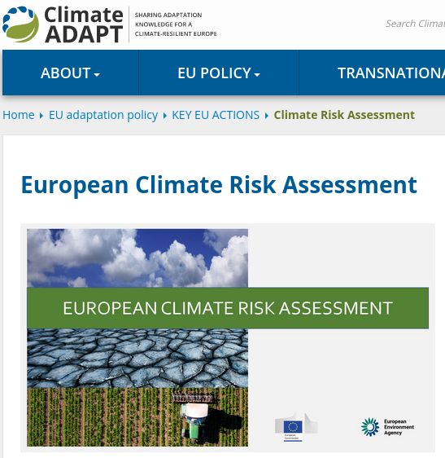
What about provenance in this case?
A cacophony of climate information sources is available, and this happens in a growing market with no clearly defined standards. What about the adequacy of the information sources? How is product quality addressed? As open as possible, as restricted as necessary.

Slide 15
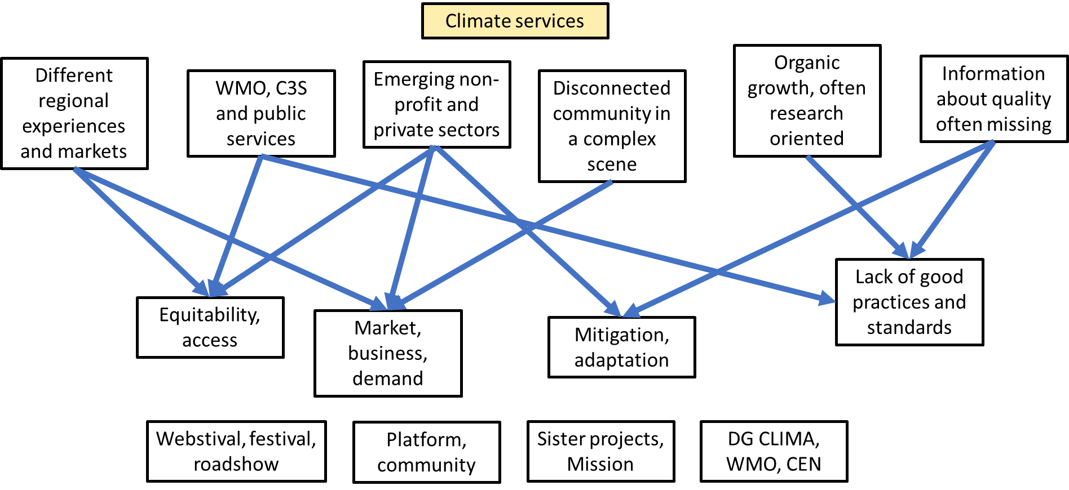
Community and audience

Slide 16
INFORMATION
https://climateurope2.eu/
https://earth.bsc.es/climateurope2
CONNECT
contact@climateurope2.com
climateurope2.eu
@climateurope2
climateurope2
This project has received funding from the European Union’s Horizon Europe research and innovation programme under grant agreement No 101056933.
The sole responsibility for the content of this document lies with the Climateurope2 project and does not necessarily reﬂect the opinion of the European Union.

