Slide 1
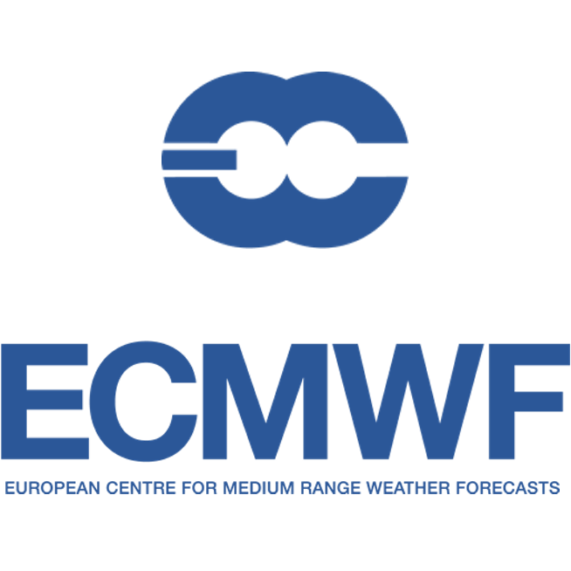
Evaluation and Quality Control for the Copernicus Seasonal Forecast Systems
Nicolau Manubens
Computer Scientist
13 / 12 / 2017
AGU Fall Meeting, New Orleans
Notes:
(25seg)
Hello. I am Nicolau Manubens, from the Barcelona Supercomputing Center.
I am going to talk about the quality control and provenance approaches in a European-funded project, from a producer perspective.
I am a computer scientist and I am not the main author of this work, I will rather present the work done in behalf of the whole team.
Let me start by introducing the Copernicus programme.

Slide 2
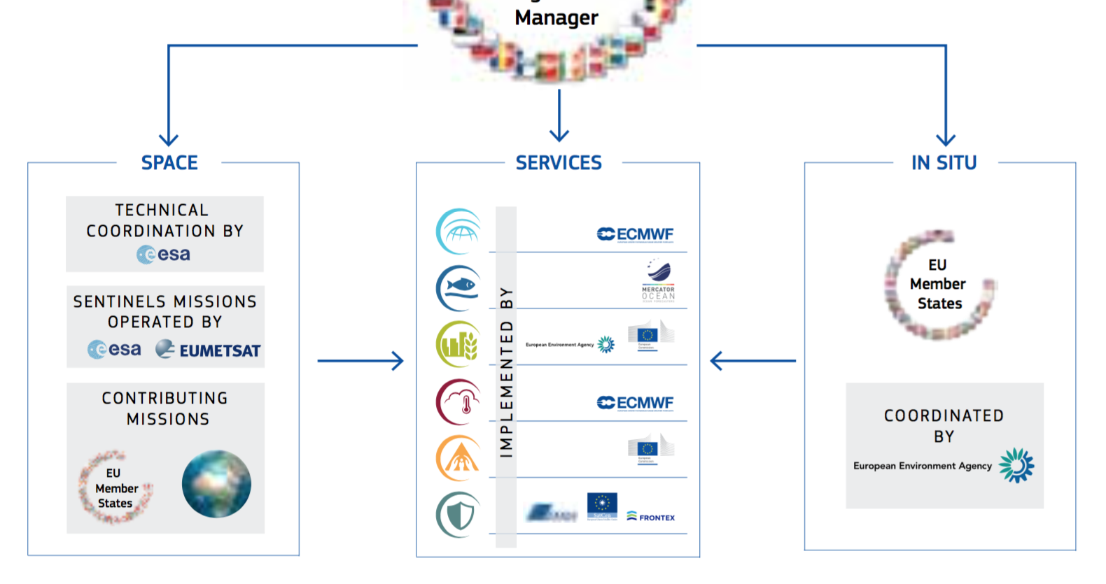
The Copernicus Programme
Establishment of a European capacity for Earth Observation
Notes:
(30seg)
Copernicus is the European flagship Programme for the establishment of a European capacity for Earth Observation.
On top of in situ and satellite observations, a range of services are being developed as part of this programme to monitor and provide information about the atmosphere, seas, land use, and others.
One of these services is the Copernicus Climate Change Service. For short, I will be using C3S.

Slide 3
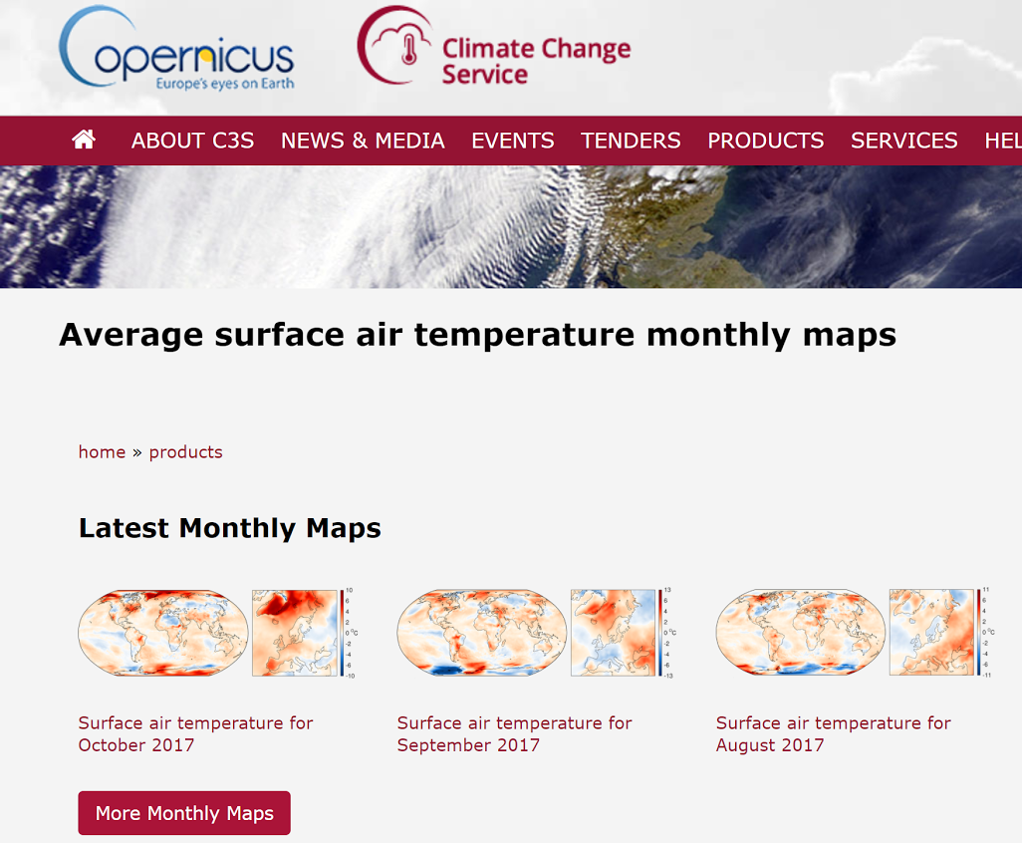
The Copernicus Climate Change Service (C3S)
The C3S will openly provide authoritative information about past, present and future climate
Targetting the private and public sectors, e.g. for decision making in the energy sector
https://climate.copernicus.eu
Notes:
(1min 30seg)
The C3S will provide information about the climate of the past, present and future. This information will be provided at global and regional scales, and will be openly accessible through a web portal and mobile applications. Although it is not fully functional yet, you can access it through the URL on the overhead and take a look.
I have attached here a screenshot of a section of the portal that shows the records for monthly averages, in this case of air temperature at surface level. The C3S will target a wide range of users, including researchers and private stakeholders. Two examples of applications of this service could be policy making in the insurance sector and decision making in the energy sector. These examples are important because they imply that the publication of erroneous products or having a user choose an unsuitable product could lead to third-party losses of huge amounts of money. We will be back to these responsibilities in a minute. Now let me introduce the seasonal forecasting activity in C3S. Although the C3S will cover other aspects of the climate change, in this talk I will focus on the developments devoted to seasonal forecasts.

Slide 4
Quality assurance strategy for seasonal forecasts
RAW CLIMATE FORECASTS FROM GCMs
C3S STORE
EXAMPLE C3S PRODUCT GENERATION WORKFLOW
Notes:
(1min 50seg)
The C3S has contracted a number of institutions who dispose of state-of-the-art seasonal forecast systems, commonly named models, and run them each month to generate ensemble forecasts. The institutions are represented in the diagram on the overhad by the Earth globes,
The forecasts go usually through a preliminary processing stage and are then ingested by the C3S service.
Afterwards, according to the users’ demands, the forecasts go through additional procedures.
This diagram represents the steps followed to generate a selected example product. As you can see, the seasonal forecast data can potentially go through different types of procedures before being sent to the final user.
This is a very complete example, but even when the user only wants the seasonal forecast, usually the forecast data needs to be processed or at least plotted as a visual product.
As I was saying before, a wrong product or a wrong chosen product can have bad consequences, so C3S has to take responsibility and follow a robust quality assurance strategy.
In this direction, the Barcelona Supercomputing Center is leading the development of the quality assurance strategy for the provision of seasonal forecasts and related products.
The partners involved are PREDICTIA, a Spanish private company, MeteoSwiss and other European and UK partners.

Slide 5
Quality assurance strategy for seasonal forecasts
Assessment of user needs
Scientific assessment
User guidance
QA measures
Identification of data sources and conventions
Quality Assurance
Software prototype
Technical assessmet
Provenance
Notes:
(1min 00seg)
The strategy is multi-faceted and comprehensive. I won’t have time to explain all of its aspects but, in short, it builds upon three main pillars: first, providing user guidance for the user to select the correct product; estimates of the quality of the products, or QA measures, for the user to know how trustworthy a product is; and provenance information, which by one side contributes to user guidance and by the other side allows for product inspection and comparison.
These three ingredients are the only way for C3S to minimize issues and build trust in the offered service.
Although all of these aspects are very intersting, I will focus here on the provenance solution we are developing.

Slide 6
C3S data conventions
File content, format, structure and metadata
Based on CF conventions, SPECS, CMIP, and ACDD
NetCDF
File naming and distribution
Attributes (e.g. source, commit)
Spatial and time coordinates and axes: names, valid_min/max, units, bounds
Variables: names, units, dimension names, cell methods
Notes:
(1min 20seg)
It is only possible to think of a metadata propagation and provenance tracking mechanism if some conventions are established for the seasonal forecasts to be stored in a homogeneous way and with all the required information.
A strict convention has been set at the C3S level for the data to be stored, which establishes what should be the content of the data files, which format should be used, how to structure the data and which metadata to store.
The convention results from combining and extending other existing conventions: the CF conventions, SPECS, CMIP and the ACDD conventions.
In short, the resulting convention establishes NetCDF as the standard file format, and provides indications on how to name and distribute the files, which attributes must be defined, how to define the space and time coordinates and axes, and includes also, for each climate varriable, an extensive list of standard names, units, dimension names, cell methods, etcetera.
Two relevant attributes included in the convention are the ‘source’, to document the exact version of the climate model that was used; and ‘commit’, which should point to the exact software used to ‘preprocess’ the forecast data before being ingested by the C3S.

Slide 7
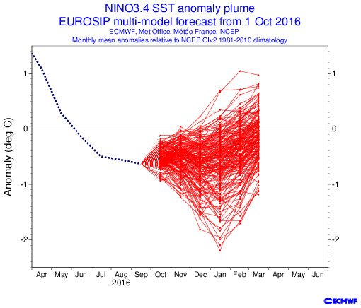
Metadata and provenance model
Metaclip. It allows encoding meta-data and provenance as a graph
The graph can be serialized and attached to products
Metaclip info. of a product can be visually inspected
http://metaclip.predictia.es
JPG file
XML
The metadata and provenance information is delivered within the image
EXIF tags
Notes:
(1min 05seg)
Having these conventions, we have developed a framework, or model, called Metaclip, that allows for encoding and propagating the metadata involved in climate forecasting.
It is encoded in the form of a directed graph. On the overhead, these blue balls are the graph explaining the involved data sources and containing their most essential metadata.
Once this basic set of metadata is encoded, the resulting graph can easily be extended with information on the steps applied to the data. Additional steps are coloured in green on the overhead.
Once all the processing steps are encoded, the graph can easily be serialized as an XML string, which can be attached to NetCDF files or image files.
After, the produced file with metadata can be ingested by a provenance visualization engine, which will interpret and graphically display the provenance and metadata graph.

Slide 8
Metadata and provenance model
Missing DEMO video of use of http://demo.predictia.es/qa4seas/metadata/ , you can ask nicolau.manubens@bsc.es
Notes:
(1min 10seg)
In this demonstration video, you can see the provenance inspection application.
An example product with attached Metaclip information is dragged and dropped into the box, and a visualization of the metadata and provenance graph is displayed.
We can move the components around and double click for more information.
Here we can see that data coming from the System 4 forecast system has been used to generate this product, and we can check the model version for example.
We can also see that this forecast data has been used in combination with observational data and has gone through transformation and verification processes (in purple and yellow. respectively).
Finally, we see that a visual product has been generated. With this, we can tell that the product that has been dragged and dropped is a plot of the AUC verification score for a System 4 seasonal forecast.
We can check all the details of the process, and we can see it in various levels of granularity.

Slide 9
Metadata and provenance model
Based on the W3C Resource Description Framework
Modular and extensible
Abstract
Provides meaningful provenance traces
Notes:
(1min 10seg)
Metaclip is based on RDF, which is a W3C standard widely used for the web semantics. RDF allows to describe relationships between entities or concepts. A set of relationships is called a “vocabulary”. Metaclip is modular and benefits from existing community efforts by importing some already defined vocabularies such as the PROV, the GEO or the SEQ. Thanks to its modularity, it can be extended to other research fields.
Metaclip is an abstract framework. It means it can be implemented in any programming language.
The main advantages of using Metaclip are that it allows to generate clean and meaningful provenance traces, that it helps in generating description digests of products, for example figure titles, which is a big challenge, and that it provides a governance solution for provenance standards, since it uses already established vocabularies.

Slide 10
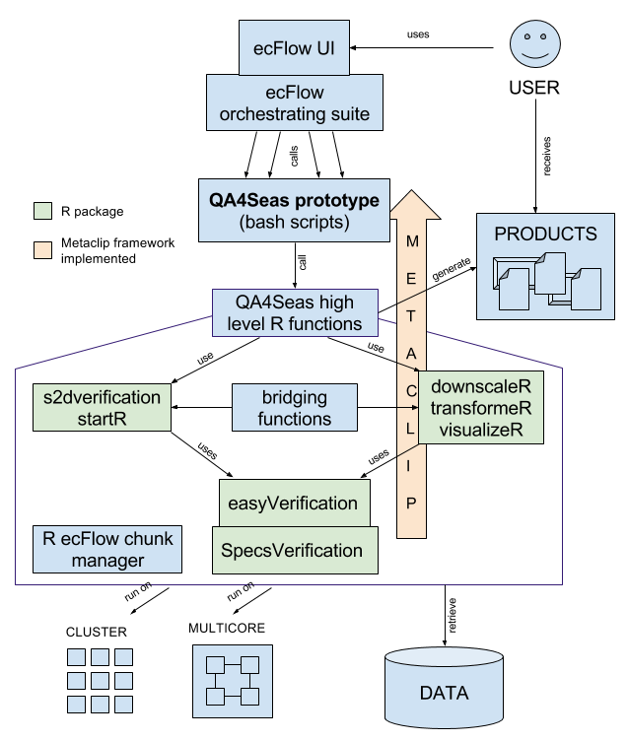
Prototype
Proof-of-concept software
Existing open-source R packages are being evolved
Performance will also be addressed
Notes:
(1min 00seg)
The last piece of the metadata and provenance strategy consists in developing a proof-of-concept software prototype that demonstrates the viability of the designed mechanism.
On the overhead you can see a module diagram of the prototype. It is quite complex. The important thing is that it shows how existing open-source R packages have been considered. They are coloured in green and highlighted with a red box. These packages are being extended with an implementation of Metaclip. Not all of the other surrounding software modules in the diagram will be publicly available, but these will not be required to generate the EQC products with attached provenance. Additionally, the prototype will also try to perform as well as possible by exploiting multicore and cluster resources, using a distributed multidimensional cube approach.

Slide 11
Conclusions
A quality control and provenance strategy for climate seasonal forecasts has been shown from a producer perspective
The solution consists in defining quality measures for the products and in establishing a provenance mechanism
User guidance and data conventions are fundamental
An extensible provenance framework called Metaclip has been shown
Open-source software for the QC of seasonal forecasts is being developed
Notes:
(10seg)
This is all, I will leave here the highlights, please ask if you have questions. Thanks.

Slide 12
Thank you
This project has received funding from the EU Copernicus Programme under Framework Agreement No. 2016/C3S_51_Lot3_BSC
nicolau.manubens@bsc.es

